Slide 1
Topics of Discussion:
CEPA Intro
Defining an Action
The CEPA Process
Assessing Environmental Impact
The Environmental Review Checklist (ERC)
Additional Resources
CEPA and NEPA
Questions
Connecticut Environmental Policy Act (CEPA) Training
Prepared by the Office of Policy and Management (OPM) 04/14/2022

Slide 2
Statutory & Regulatory References
  Connecticut General Statutes (CGS) Sections 22a-1 through 22a-1h, established in 1973 (PA 73-562), and revised in 2002 (PA 02-121):
  Sections 22a-1a-1 through 22a-1a-12 Regulations of Connecticut State Agencies (RCSA), established in 1978, and revised in 2019:
Notes:
New Regulations adopted in 2019.
Regs outline the process and requirements for agencies.

Slide 3
Identify environmental impacts, including social and economic impacts;
Assess alternatives;
Provide opportunity for public review and comment;
Document the agency’s review and decision.
Why undertake a CEPA review?
After establishing a clear purpose and need for why the state action is needed, CEPA is the vehicle for assessing how the action will be implemented.
Notes:
CEPA Regs defines “Environment” to include physical, biological, social, and economic surroundings and conditions which may be affected by an action .............
Purpose and Need establishes “Why”; CEPA evaluates alternatives for “How” to satisfy the purpose and need. Sometimes only build or no-build, sometimes many options.
A primary purpose of CEPA is to provide for transparency and public outreach.
Review and documentation provides support for the agency’s decision – especially for controversial projects.

Slide 4










CEPA applies to any state agency, department, or institution undertaking an action which may affect the environment.
Who must comply with CEPA?
Notes:
Under CEPA the state agency, department, or institution is the “responsible entity”. This cannot be delegated.
Quasi-public agencies are not a “state agency, department, or institution”, unless in partnership with, or funded by, a state agency. Contact OPM.

Slide 5

What is an “Action” under CEPA?
No

Slide 6
What is an action under CEPA?
(Sec. 22a-1a-1 of the RCSA)
Action means:
An activity or a sequence of planned activities initiated or proposed by a state agency; or
An activity funded in whole or in part by the state.
Notes:
Action is a broad term.
“sequence of planned activities” – if any phase of a project qualifies as an “action”, all phases become subject to CEPA. Agency must consider potential impacts from all phases.

Slide 7
other activities for which an agency exercises judgment or discretion as to the propriety of that action;
capital improvements, alterations, or additions;
Property acquisition for capitol improvements;
grants-in-aid or other financial assistance;
Lease or purchase agreements;
What is an action under CEPA?
(Sec. 22a-1a-1 of the RCSA)
Actions include, but are not limited to:
Notes:
Action is a broad term.
Choosing one project/action/activity over another is discretion. Permitting is generally not exercising discretion.
“sequence of planned activities” – if any phase of a project qualifies as an “action”, all phases become subject to CEPA.

Slide 8
Actions which may significantly affect the environment:
What is an action under CEPA?
(Sec. 22a-1a-1 of the RCSA)
An action which could have a major impact on the state's land, water, air, historic structures and landmarks, housing, or other environmental resources;
or could serve short term to the disadvantage of long-term environmental goals.
Do not include (1) emergency measures undertaken in response to an immediate threat to public health or safety; or (2) activities in which state agency participation is ministerial in nature (ie. involving no discretion on the part of the state agency).
Notes:
Actions which may significantly affect the environment is a second threshold. These projects may require scoping.
“Climate change”, specifically flooding, is an example of a long-term environmental goal.

Slide 9
Understanding the CEPA Process
No

Slide 10
Agency initiates an Action
Is this an “Action which may significantly affect the environment”?
Understanding the CEPA Process
No
Notes:
ACTION = An activity or a sequence of planned activities proposed or funded by a state agency.

Slide 11
Agency initiates an Action
Is this an “Action which may significantly affect the environment”?
Understanding the CEPA Process
Is it an “Action which may significantly affect the environment”?
No
Notes:
Is it something that could have an impact on the state's land, water, air, historic structures and landmarks, housing, or other environmental resources (including social and economic);
or could hinder long-term environmental goals?

Slide 12
Agency initiates an Action
Is this an “Action which may significantly affect the environment”?
Understanding the CEPA Process
Is it an “Action which may significantly affect the environment”?
No
In making this determination, the sponsoring agency shall consider:
The Environmental Classification Document (ECD);
The factors in 22a-1a-3 of the RCSA;
Any known public comments/controversy;
Inconclusive or unknown impacts.
Notes:
This does require a judgment call from the sponsoring agency.
We will cover this in detail later in the presentation.

Slide 13
Agency initiates an Action
Is this an “Action which may significantly affect the environment”?
Understanding the CEPA Process
Is it an “Action which may significantly affect the environment”?
No
Yes
No
No
For “Actions which may significantly affect the environment” the agency shall conduct a 30-day public scoping comment period.
The agency shall internally document its decision. This concludes the agency’s CEPA responsibilities.
Up Next: Scoping
Notes:
Yes = Scoping
No = Internally document and conclude CEPA.

Slide 14
Agency initiates an Action
Scoping
The purpose of scoping is to notify the public and provide opportunity for public comment. (Section 22a-1a-6 of the RCSA).
Understanding the CEPA Process
No
No
Notes:
The purpose of scoping is to provide an opportunity for the public to review and comment on the project.

Slide 15
Agency initiates an Action
Scoping
The purpose of scoping is to notify the public and provide opportunity for public comment. (Section 22a-1a-6 of the RCSA).
Understanding the CEPA Process
No
No
The agency publishes the project in the Environmental Monitor and accepts public comments for a minimum of 30-days;
  may hold a public informational meeting or be required to do so;
Projects that undertake scoping MUST culminate with a post-scoping notice
Up Next: Post- Scoping
Notes:
The purpose of scoping is to provide an opportunity for the public to review and comment on the project.

Slide 16
Agency initiates an Action
Scoping
Post-Scoping
In a post-scoping notice, the agency provides public notice summarizing the scoping process, comments received and the agency’s responses, and indicates whether or not the agency will be preparing an Environmental Impact Evaluation (EIE). (Sec. 22a-1a-7 of the RCSA)
Understanding the CEPA Process
No
No
Notes:
Post-scoping notice is a summary of the agency’s evaluation of the project including comments received and the agency’s responses. Ultimately indicates whether or not the agency will be preparing an Environmental Impact Evaluation (EIE).

Slide 17
Agency initiates an Action
Scoping
Post-Scoping
In a post-scoping notice, the agency provides public notice summarizing the scoping process, comments received and the agency’s responses, and indicates whether or not the agency will be preparing an Environmental Impact Evaluation (EIE). (Sec. 22a-1a-7 of the RCSA)
Understanding the CEPA Process
No
No
New requirements from 2019:
The agency shall consult with all state agencies and municipalities that submitted substantive comments;
Project updates must be provided every six (6) months until a post-scoping notice is published.
Notes:
Project update notice is a separate notice required by the regulations.

Slide 18
Agency initiates an Action
Scoping
Post-Scoping
In a post-scoping notice, the agency provides public notice summarizing the scoping process, comments received and the agency’s responses, and indicates whether or not the agency will be preparing an Environmental Impact Evaluation (EIE). (Sec. 22a-1a-7 of the RCSA)
Understanding the CEPA Process
No
Yes
No
No
Will the agency be preparing an Environmental Impact Evaluation (EIE)?
No
If an EIE will be prepared, then the post scoping notice shall indicate as such and agency shall begin preparing the EIE.
If no EIE, then the agency’s notice shall include a completed Environmental Review Checklist (ERC). Publication of the notice concludes the agency’s CEPA responsibilities.
Up Next: EIE
Notes:
Environmental Review Checklist will be covered later in the presentation.

Slide 19
Action
Scoping
Post-Scoping
Environmental Impact Evaluation
An Environmental Impact Evaluation (EIE) is a more detailed evaluation of a proposed action, its potential impacts, and reasonable alternatives. (Sec. 22a-1a-8 and 9 of the RCSA)
Understanding the CEPA Process
No
No

Slide 20
Action
Scoping
Post-Scoping
Environmental Impact Evaluation
An Environmental Impact Evaluation (EIE) is a more detailed evaluation of a proposed action, its potential impacts, and reasonable alternatives. (Sec. 22a-1a-8 and 9 of the RCSA)
Understanding the CEPA Process
No
No
The agency publishes the EIE in the Environmental Monitor and accepts public comments for a minimum of 45 days, and may hold a public informational meeting or be require to do so.
After the comment period, the agency conducts further analysis or amends the EIE, as necessary, before preparing its Record of Decision (ROD).
Up Next: ROD

Slide 21
Action
Scoping
Post-Scoping
Environmental Impact Evaluation
Record of Decision
The Record of Decision (ROD) is the agency’s determination whether or not to proceed with the proposed action. (Section 22a-1a-10 of the RCSA).
Understanding the CEPA Process
No
No

Slide 22
Action
Scoping
Post-Scoping
Environmental Impact Evaluation
Record of Decision
The Record of Decision (ROD) is the agency’s determination whether or not to proceed with the proposed action. (Section 22a-1a-10 of the RCSA).
Understanding the CEPA Process
No
No
The agency’s ROD shall include:
  The decision whether to proceed with the action;
  Any mitigation measures;
  A summary of any consultations or comments/responses with interested parties;
The agency shall submit the EIE and ROD to OPM for a determination of adequacy, and shall also publish the ROD to the Environmental Monitor.
Up Next: OPM’s Determination
Notes:
New requirement: ROD’s must be published in the environmental monitor.
If multiple options are presented, it is good practice for agencies to indicate second, or third alternatives as part of its ROD.

Slide 23
Action
Scoping
Post-Scoping
Environmental Impact Evaluation
Record of Decision
OPM shall review the content of the EIE and ROD, and the associated process, to determine if it satisfies the requirements of CEPA.
OPM shall publish its determination to the Environmental Monitor.
Understanding the CEPA Process
No
No
OPM reviews the EIE and ROD to determine adequacy.

Slide 24
Action
Scoping
Post-Scoping
Environmental Impact Evaluation
Record of Decision
OPM shall review the content of the EIE and ROD, and the associated process, to determine if it satisfies the requirements of CEPA.
OPM shall publish its determination to the Environmental Monitor.
Understanding the CEPA Process
No
No
OPM reviews the EIE and ROD to determine adequacy.
If determined adequate by OPM the agency may proceed with proposed action. This concludes the agency’s CEPA responsibilities.
If determined inadequate, OPM shall specify the areas of inadequacy and the corrective action required. The agency shall revise the EIE and ROD, as appropriate, and resubmit.
Notes:
An agency may cancel the CEPA process at any time.

Slide 25
Action
Scoping
Post-Scoping
Environmental Impact Evaluation
Record of Decision
Understanding the CEPA Process
No
No
OPM Determination of Adequacy
Notes:
An agency may cancel the CEPA process at any time.
When in doubt, scope it!

Slide 26
Assessing the potential for environmental impacts
No

Slide 27
Agency initiates an Action
Is this an “Action which may significantly affect the environment”?
Determining what is an action which may significantly affect the environment
Is it an “Action which may significantly affect the environment”?
No
In making this determination, the sponsoring agency shall consider:
The Environmental Classification Document (ECD);
The factors in 22a-1a-3 of the RCSA;
Any known public comments/controversy;
Inconclusive or unknown impacts.
Notes:
This is the most common question.
It is ultimately the sponsoring agency’s responsibility to make this determination. OPM can only advise.
Internally document the review and decision-making!
Address the last two bullets:
When in doubt = scope.

Slide 28
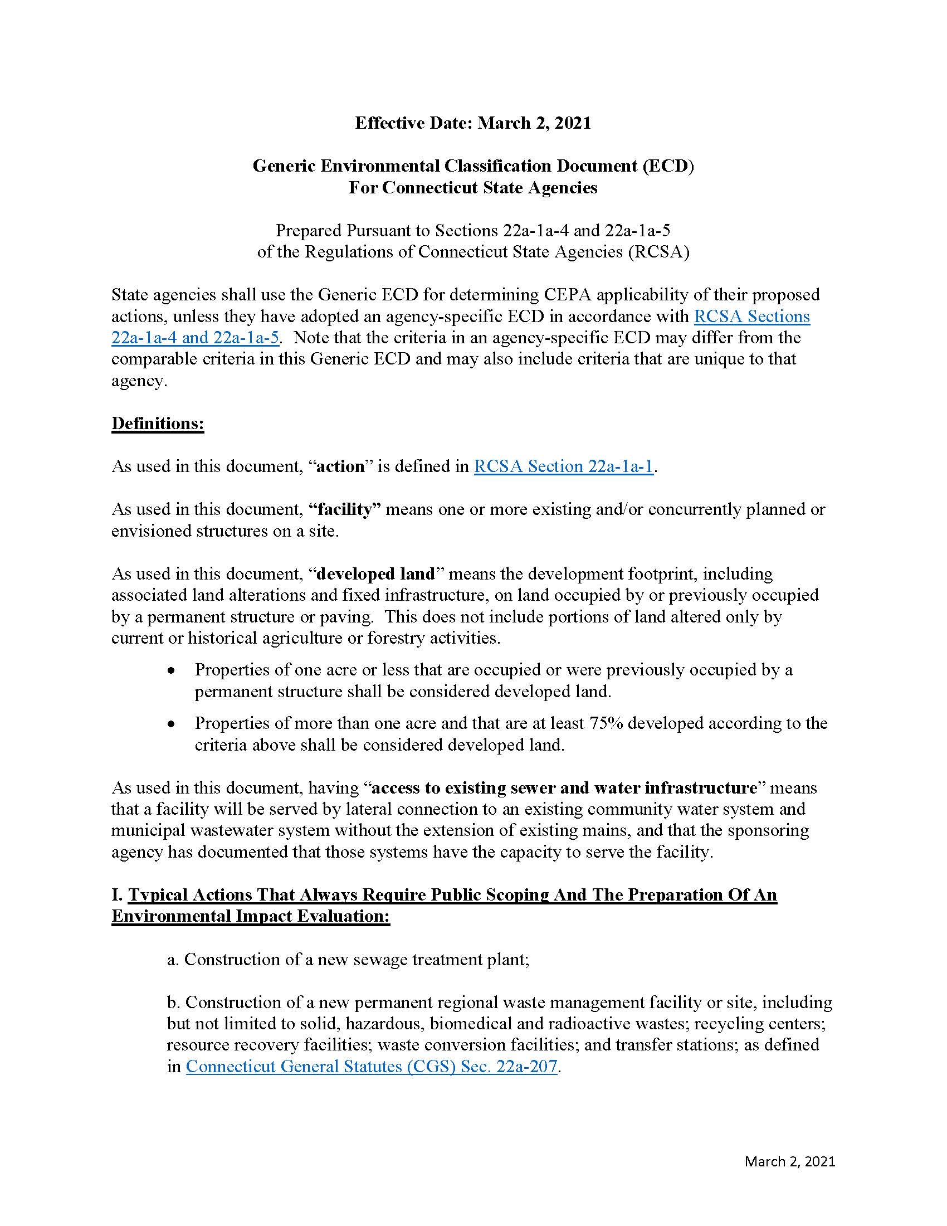
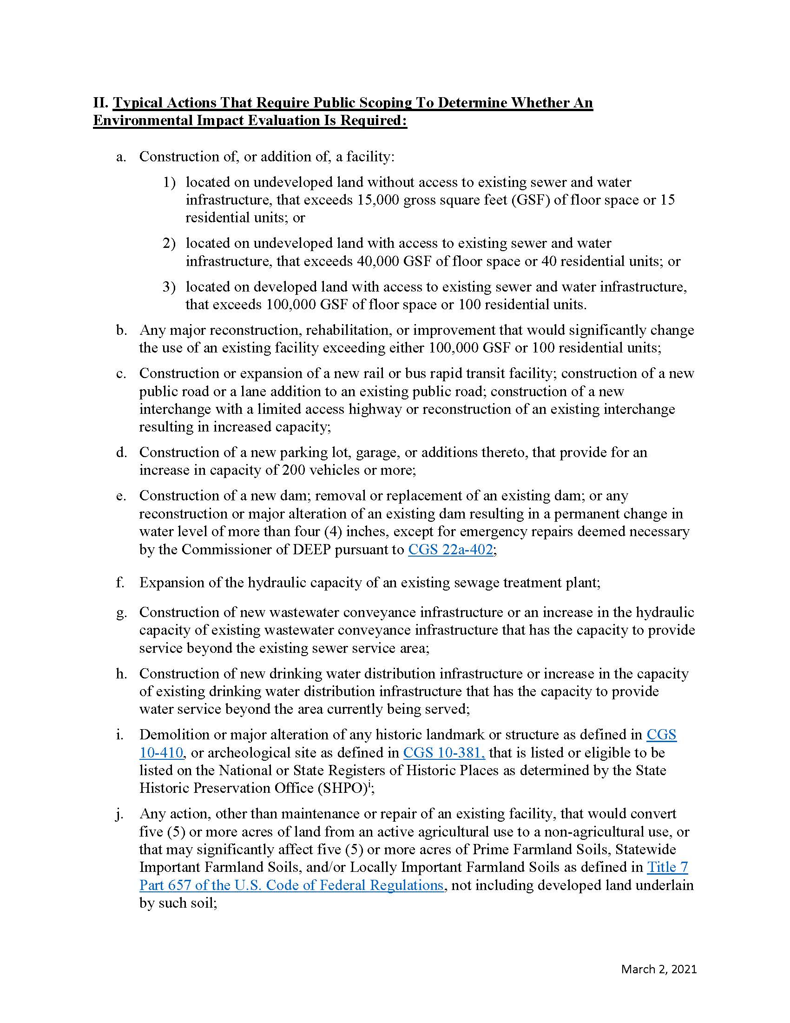
Generic Environmental Classification Document (ECD) https://portal.ct.gov/-/media/OPM/IGP/ORG/CEPA/Revised-Generic-ECD_03022021.pdf
The ECD is a list of typical agency actions that may have significant environmental impacts and is a tool to assist agencies in determining if a proposed action warrants further CEPA evaluation.
It is often the first step in determining an action’s environmental significance.
Notes:
ECD is broken out into four sections, most of which contain thresholds that dictate the level of review required by CEPA.
Only DOT has its own ECD.

Slide 29
Factors identified in 22a-1a-3 of the RCSA
Requires consideration of the direct, indirect, and cumulative effects of the factors listed:
https://eregulations.ct.gov/eRegsPortal/Browse/RCSA/Title_22aSubtitle_22a-1aSection_22a-1a-3/
Direct effects are the primary environmental consequences;
Indirect effects are the secondary consequences ... which could result from additional activities induced or stimulated by the action; and
Cumulative effects are the effects on the environment which result from the incremental impact of the action when considered with past, present or reasonably foreseeable future actions to be undertaken by the sponsoring or participating agencies.
Notes:
21 factors listed in the regulations.
Identifying an impact does not automatically mean the project is an “action which may significantly affect the environment”.
“Good” impacts don’t necessarily mean that an action does not have significant impacts. Perception can play a role.
Cumulative effects are compounded by related past, present, or future actions. Chain reaction of impacts.

Slide 30
What is the Environmental Review Checklist (ERC)?
No

Slide 31
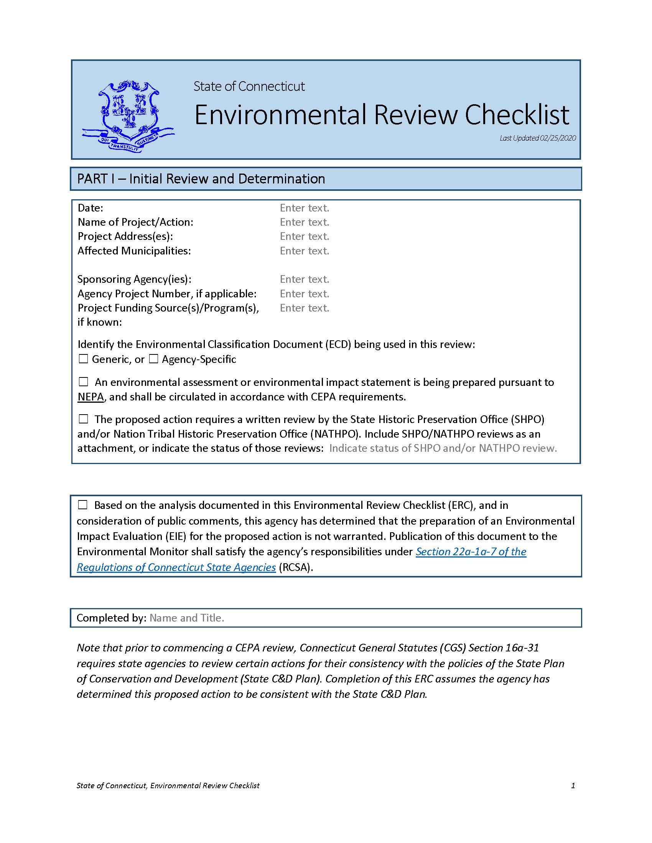
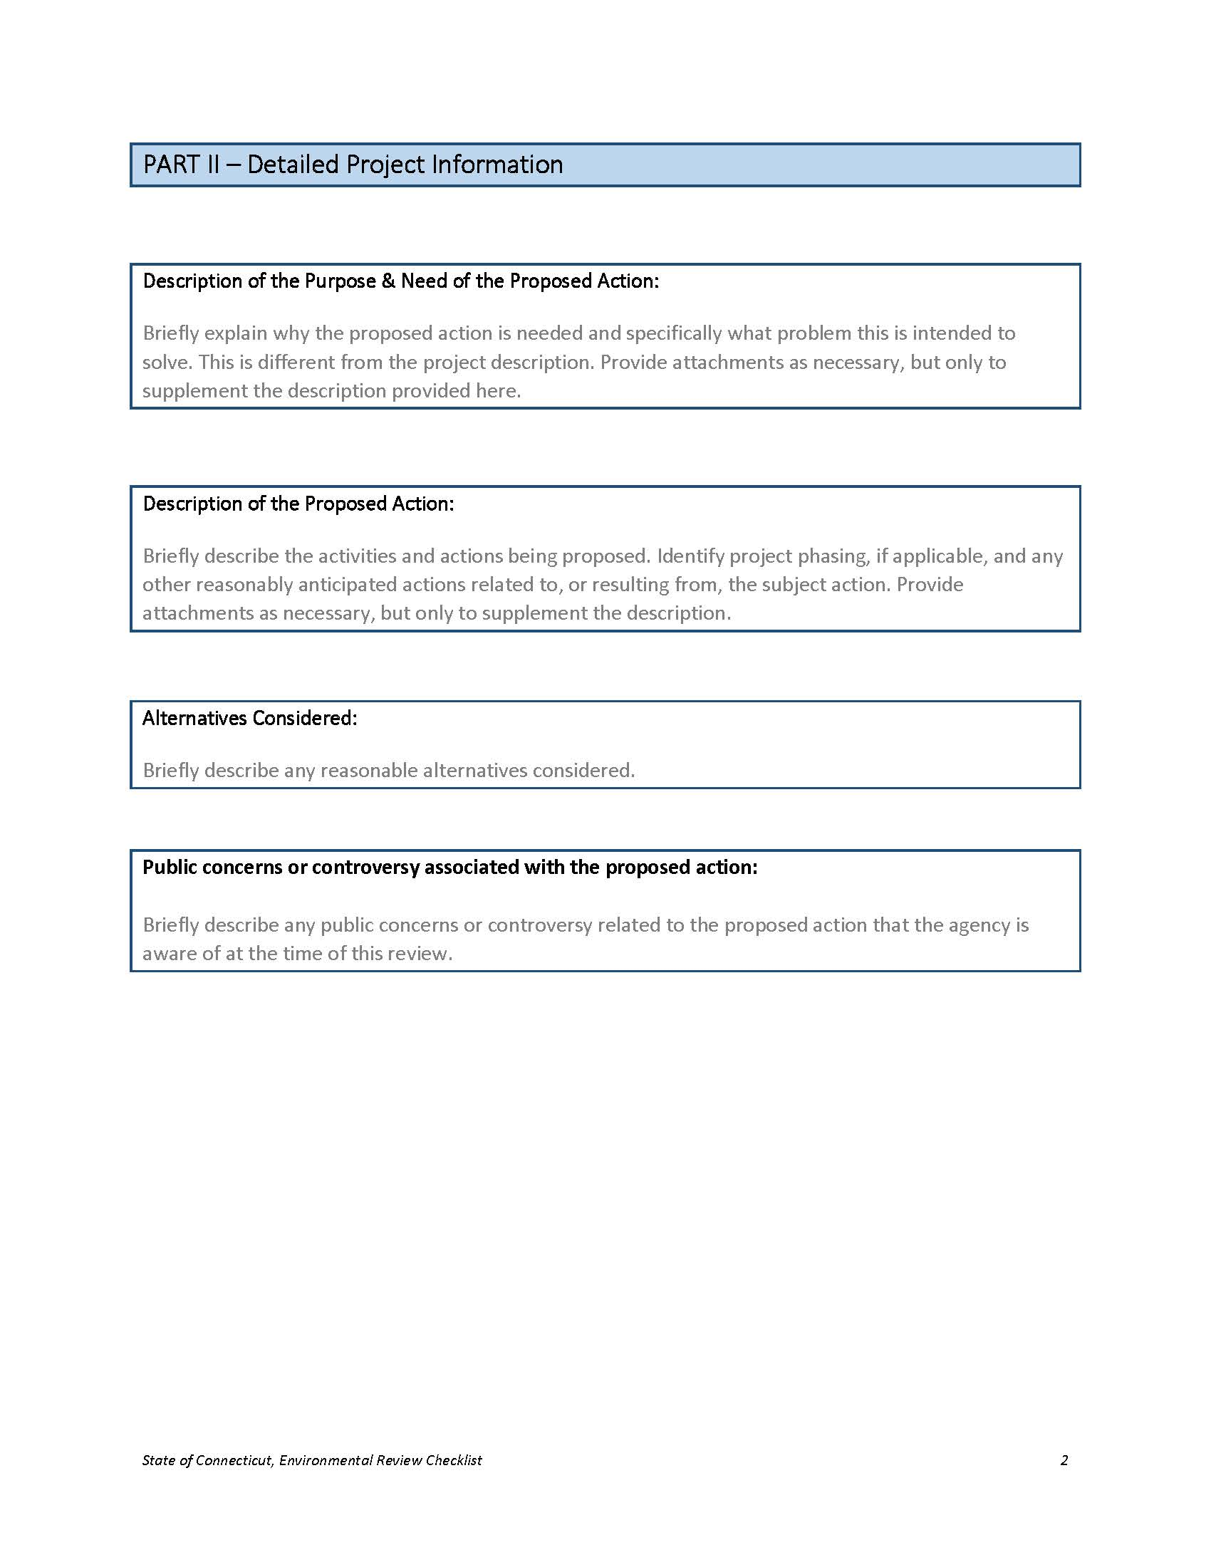
Environmental Review Checklist (ERC) https://portal.ct.gov/-/media/OPM/IGP/ORG/CEPA/Environmental-Review-ChecklistBlank-Fillable02252020.docx
Used to assist agencies in determining whether an action requires Scoping, and to record an agency’s initial assessment of the potential environmental effects of a proposed action.
A sponsoring agency is required to publish its completed ERC whenever it publishes a post-scoping notice indicating that an EIE will not be prepared.
Notes:
An agency may use the ERC to internally document its decision not to scope an action.
An ERC is required as part of post-scoping notice when an EIE is not required.

Slide 32
Additional Resources
No

Slide 33
OPM maintains a webpage with useful information and additional resources, including more in-depth training material:
https://portal.ct.gov/OPM/IGPP-MAIN/Responsible-Growth/CEPA/Overview-of-Connecticut-Environmental-Policy-Act
OPM Inventory of State Agency Actions: ftp://ftp.ct.gov/opm/CEPA/CEPA%20Project%20Inventory.xlsx
Environmental Monitor Templates:
https://portal.ct.gov/-/media/CEQ/Env-Monitor-Notices-in-Word/Sitecore-training-slides-Env-Monitor-Notices-2-6-2020.pdf?la=en&hash=89BEA2886351BDAAC1B45B01C560ED45
Additional Resources

Slide 34
CEPA and NEPA
No

Slide 35
Separate, yet related, requirements;
Satisfying one does not automatically satisfy the other;
CEPA only applies for actions undertaken by a state agency or funded in whole or in part by an agency;
NEPA documents may be used to satisfy CEPA requirements provided that the NEPA documents meet, and are circulated in accordance with, the CEPA document-equivalent requirements and provided that such NEPA analysis, documents, and public processes meet the CEPA equivalent requirements (see Section III of the Generic ECD).
CEPA and NEPA

Slide 36
Office of Policy and Management
Contacts:
Matthew Pafford,
  Matthew.pafford@ct.gov Phone: 860.418.6412
Dan Morley,
  Daniel.Morley@ct.gov Phone: 860.418.6343
Bruce Wittchen,
  Bruce.Wittchen@ct.gov Phone: 860.418.6323
Questions?
No

Slide 37
Topics of Discussion:
State C&D Plan
Application of the Plan
Determining Consistency
Locational Guide Map
Priority Funding Area
Growth Related Projects
State Plan of Conservation and Development
Prepared by the Office of Policy and Management (OPM) 04/14/2022

Slide 38
State Plan of Conservation and Development
The purpose of the State C&D Plan is to provide over-arching policy guidance for executive branch state agencies.
It is organized into six Growth Management Principles.
Notes:
Establishes statewide “purpose and need” goals.

Slide 39
State Plan of Conservation and Development
Growth Management Principles:
  GMP #1: Develop within areas of existing and planned infrastructure
  GMP #2: Expand Housing Opportunities for all Household Types
  GMP #3: Develop Around Transportation Nodes and Corridors
  GMP #4: Conserve and Restore the Natural Environment
  GMP #5: Protect Environmental Assets Critical to Health and Safety
  GMP #6: Integrate Planning Across all Levels of Government
Notes:
Each GMP contains multiple, more specific policies.

Slide 40
Application of the State C&D Plan
CGS Section 16a-31 requires state agencies to be consistent with the State C&D Plan whenever they undertake any of the following actions with state or federal funds:
The acquisition, development, or improvement of real property exceeding two hundred thousand dollars;
The acquisition of public transportation equipment or facilities exceeding two hundred thousand dollars; or
The authorization of each state grant for any of the above.

Slide 41
Determining consistency
Consistency means:
compatibly with the written policies of the plan as a whole – not just a select few policies;
Identifying and evaluating potential conflicts and inconsistencies.
Notes:
Policy conflicts exist.
The goal is to reduce or eliminate inconsistencies, or at least recognize the pitfalls to ensure that the end result is worth it.
May request OPM advice.

Slide 42
Locational Guide Map
No
Notes:
Locational Guide Map is separate from the State CD Plan policies,

Slide 43
The role of the Locational Guide Map (LGM):
Provides state agencies with underlying data for general planning purposes;
Delineates “Priority Funding Areas” (PFAs) for the purpose of CGS Chapter 297a:
  “The Secretary of the Office of Policy and Management, in consultation with the Commissioners of Economic and Community Development, Housing, Energy and Environmental Protection, Administrative Services, Agriculture and Transportation, the regional councils of governments in the state and any other persons or entities the secretary deems necessary, shall develop recommendations for delineation of the boundaries of priority funding areas in the state and for revisions thereafter.
Locational Guide Map

Slide 44
What are Priority Funding Areas (PFAs)?
Priority Funding Areas
Priority Funding Areas are classified by Census Blocks that include:
Designation as an Urban Area or Urban Cluster in the 2010 Census;
Boundaries that intersect a ½ mile buffer surrounding existing or planned mass-transit stations;
Existing or planned sewer service from an adopted Wastewater Facility Plan;
Existing or planned water service from an adopted Public Drinking Water Supply Plan;
Local bus service provided 7 days a week.
Notes:
PFAs have one or more of these criteria

Slide 45
What are Priority Funding Areas (PFAs)?
Priority Funding Areas

Slide 46
Why are Priority Funding Areas (PFAs) important?
Priority Funding Areas
CGS Section 16a-35d states that no state agency, department or institution shall provide funding for a growth-related project unless such project is located in a priority funding area.
Statute does allow OPM to make exception based on limiting factors established in the statute.
Notes:
PFAs have one or more of these criteria

Slide 47
What are Growth-Related Projects?
CGS Sec. 16a-35c defines Growth-Related Projects as any of the following when costs are in excess of $200,000 (CGS 16a-35c(a)(2)):
(A) the acquisition of real property, except the acquisition of open space for the purposes of conservation or preservation;
(B) the development or improvement of real property;
(C) the acquisition of public transportation equipment or facilities;
(D) the authorization of each state grant for the acquisition or development or improvement of real property or for the acquisition of public transportation equipment or facilities, with exceptions.....
It is the sponsoring agency’s responsibility to determine if a project is growth-related.
Growth Related Projects

Slide 48
What are Growth-Related Projects?
CGS Sec. 16a-35c defines Growth-Related Projects as any of the following when costs are in excess of $200,000 (CGS 16a-35c(a)(2)):
(A) the acquisition of real property, except the acquisition of open space for the purposes of conservation or preservation;
(B) the development or improvement of real property;
(C) the acquisition of public transportation equipment or facilities;
(D) the authorization of each state grant for the acquisition or development or improvement of real property or for the acquisition of public transportation equipment or facilities, with exceptions.....
It is the sponsoring agency’s responsibility to determine if a project is growth-related.
Growth Related Projects

Slide 49
Growth Related Projects
What are Growth-Related Projects?
Growth related projects that are within a PFA may proceed.
Those that are not within a PFA must receive an exception from OPM.

