Slide 1
Medicaid Long Term Services & Supports Rebalancing Updates
Department of Social Services (DSS) Community Options
Money Follows the Person
Strategy Group

Slide 2
Presenters
Dawn Lambert
Colleen Hudson
Angelique Pearson
Michael Peccerilli
Kathryn Barnard
Gregory Bennett
Hye-Yeon Ryu Kim
Lauren Carabetta
Karri Filek
Jose-Michael Gonzalez
Tamara Lopez

Slide 3
Topics
Money Follows the Person (MFP)
Assistive Technology
My Care Options (MCO)
Community First Choice (CFC)
Racial Health Equity
CT Housing Engagement and Support Services (CHESS)
Innovative Services and Support Models
Universal Assessment
Supports at Home Option (SHO)
Presumptive Eligibility
Health Information Exchange
Value Based Payment

Slide 4
Money Follows the Person
(MFP)

Slide 5
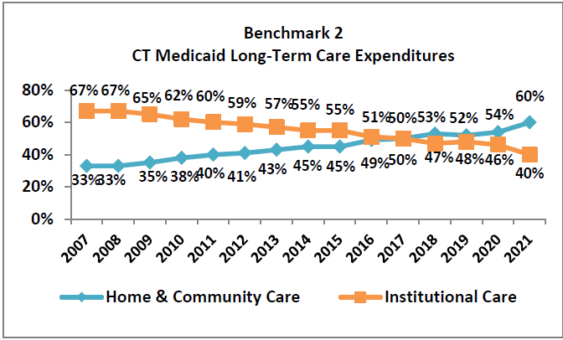
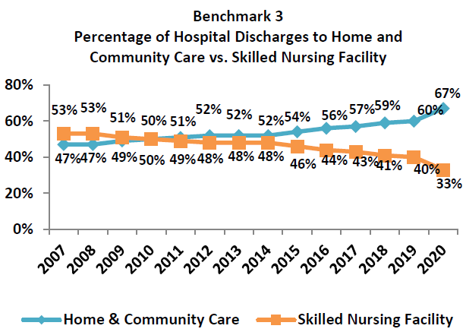
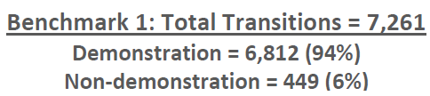
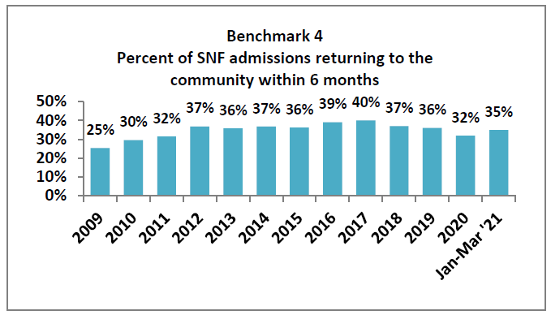
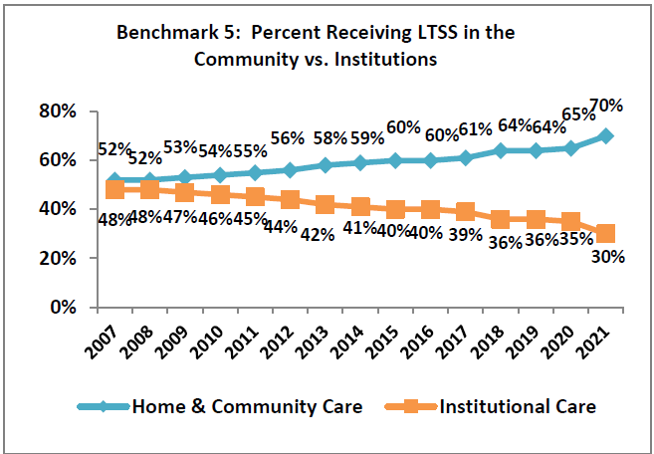
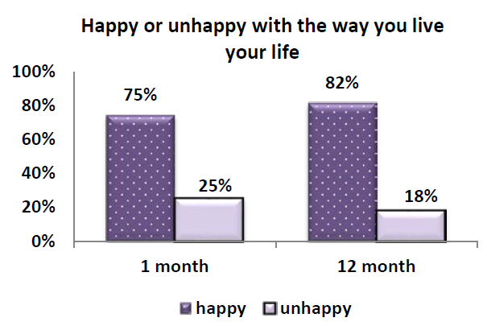
Money Follows the Person Benchmarks
UConn Health, Center on Aging Operating Agency: CT Department of Social Services Funder: Centers for Medicare and Medicaid Services
CT Money Follows the Person Report Quarter 2: April 1-June 30, 2022 (Based on latest data available at the end of the quarter)
Notes:
Transition 5200 people from qualified institutions to the community
Increase dollars to home and community-based services
Increase hospital discharges to the community rather than to institutions
Increase probability of returning to the community during the six months following nursing home admission
Increase the percentage of long-term care participants living in the community compared to an institution

Slide 6
My Care Options
(MCO)

Slide 7
My Care Options
Provide home and community-based services (HCBS) information to people at risk for a long-term institutional stay
  Including people who are not yet Medicaid eligible
Facilitate transition
  Outcome: An additional 600 people returning to the community
    Individuals on the Medicare Savings Program (MSP)
  10 full time Care Coordinator staff
Status update:
  Began training on June 1, 2022
  Launched in the field on June 24, 2022

Slide 8
Presumptive Eligibility

Slide 9
Presumptive Eligibility
“….enroll individuals who appear likely eligible for coverage while the state processes the full application and makes a final eligibility determination. Presumptive eligibility (PE) can facilitate access to coverage and services when individuals in need of critical services also may need extra time to collect documents needed to complete a full eligibility determination…”-Kaiser Family Foundation

Slide 10
Presumptive Eligibility
ARP 9817 initiative Supports at Home Option (SHO): establishing a mechanism to test and potentially pilot presumptive eligibility for Home and Community Based Services (HCBS)
Target population: SHO Medicare Savings Program (MSP) members
We plan to look at:
  Team coordination
  PE Screening and Reliability of predictions
  Timing of application to determination of HCBS
Resources:
  Financial tools (MyPlaceCT)
  Medicaid informational videos
  Specially trained case managers
  Coordination between CMs and financial eligibility staff
Notes:
People on MSP are more likely to remain in nursing homes and reduce assets to SNF Medicaid coverage rather than reduce assets in the community to Medicaid HCBS waivers.

Slide 11
Supports at Home Option
(SHO)

Slide 12
SHO (Supports at Home Option)
ARPA funded benefits expansion for Medicare Savings Program participants
  Aiming to reduce unnecessary reliance on Medicaid and paid supports, to reduce signs of depression, and to increase quality of life.
  Providing caregiver assessment, dementia supports, care coordination, respite services, and training to the unpaid caregivers.
SHO Requirements
  Active on Medicare Savings Program (MSP)
  At risk of short-term nursing home placement requiring assistance with 1 or 2 critical needs
SHO services
1. Case management
2. Informal caregiver supports
(COPE/ Care4Caregivers)
3. Respite care
4. CAPABLE
5. Environmental Adaptation
6. Assistive Technology

Slide 13
Community First Choice
(CFC)

Slide 14
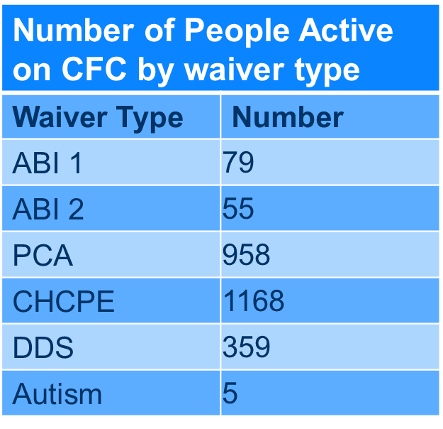
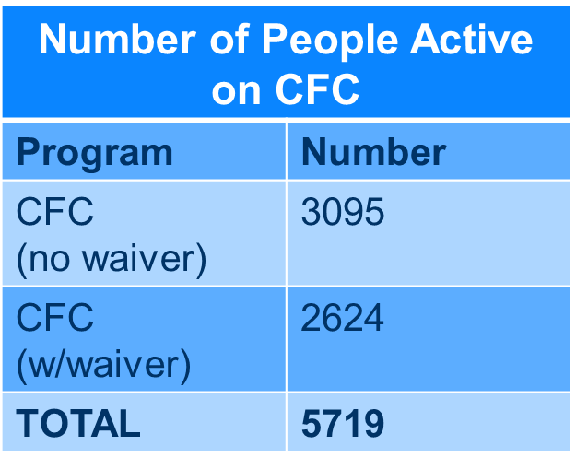
CFC Workforce
CFC Enrollment
Employer Toolkit
Reviewing for member goals and outstanding employer needs for Home Modifications and Assisted Technology Adaptations.
New PCA Rates Updated July 2022.
ABI: Acquired Brain Injury PCA: Personal Care Assistant CHCPE: CT Home Care Program for Elders DDS: Department of Developmental Services

Slide 15
CFC Workforce
New PCA Employment Network Website (admin partnership with the Department of Developmental Services).
Based heavily on principles of Person-Centeredness and Equity focused on matching Employer needs with relevant local Employees.
Biweekly Planning Group Design and Planning Meetings.
Identified 10 Outcomes (Universal Design, Marketing, Recruitment, Stakeholder Collaboration, Training Curriculum, Customer Service, Quality Assurance, Information Platform (with equity resources), Emergency Pool, Employer-specific Supports) with Individual Measures and Timelines for Implementation.
Request for Proposal process underway with tentative contract launch: 10/1/22.
Website to be fully functional and accessible tentatively 3/1/23.

Slide 16
CFC Workforce
Support & Planning (S&P) Coaches Registry Pool
Support to employers with Self-Directedness (exercise of employer choices, autonomy, and dignity through: Goal Setting, Person Centered Planning and Coaching) on Electronic Visit Verification (EVV), Environmental Modifications, Assistive Technology, and overall CFC.
Newly Registered S&Ps: Personal Centered Planning Training held 8/24/22 (24 attendees receiving Certificates of Completion).
Recruitment Strategy (Mass Approach-Allied to Homemaker Companion Agencies; Direct Approach-Outreach to agencies)
Recruitment and enrollment targeting Agencies and current PCAs (document to be sent to workforce).
O'Donnell Marketing Firm targeting providers to enroll them as a support and planning coach providers (to obtain status having gone through process).

Slide 17
Racial Health Equity
Trauma Informed Care Racial Equity Lens Initiative (PCA & Employer Support Strategies)
Targeted Learning Collaborative Racial Justice Champions Trainings (first wave by 10/22).
Targeted Training Modules (partnership with DSS Organizational and Skill Development).
Monthly Diversity Equity Inclusion Newsletter (currently to Unit staff, to be included on DSS MyPlaceCT and Employment Network Websites).
Resource Library
Future Employer Support Strategy Development

Slide 18
Health Information Exchange and Value Based Payments

Slide 19
Health Information Exchange and Value Based Payments
To improve Medicaid client health outcomes the Connecticut Home and Community-Based Services (HCBS) American Rescue Plan Act (ARPA) Program aims to create and sustain a value-based fee-for-service delivery model by providing whole-person care through incentive payments to HCBS providers based on clearly defined outcomes.
The providers will be expected to reach certain benchmarks that include two primary components: entering into data sharing agreements with the Health Information Exchange (CONNIE) and participating in DSS provided Racial Equity trainings.
CONNIE’s purpose is to create a platform to support health care delivery, quality, safety, and value for Connecticut healthcare organizations, providers, and residents.
With successful completion of the quarterly benchmarks, HCBS providers will receive a 1% supplemental payment.
Home and Community Based Services (ct.gov)

Slide 20
CHESS
(Connecticut Housing Engagement and Supports Services)

Slide 21
CHESS
New Home and Community Based Services Medicaid entitlement
CHESS combines Medicaid services, supportive housing benefits, and non-Medicaid housing subsidies
Aims to achieve housing stability, improved health, and community integration and life satisfaction
Celebrated 1-year 08/2022!
Over 2300 applicants
49 people in housing

Slide 22
CHESS Program Information
Requirements
Services
Active HUSKY A, C, and D
Be 18 years or older
Have a Behavioral Health Diagnosis
Meet the needs-based criteria*:
  Homeless, or at risk of homelessness*
  Have a Modified Charlson Comorbidity Index score of 4 or more
  Have at least 2 critical needs
Care plan development and monitoring
Pre-tenancy Supports
Tenancy-Sustaining Supports
Non-medical transportation
Notes:
At risk without the receipt of CHESS services
CCI: This score looks at your diagnoses and tells us how sick a person might be in the future
Critical needs means needing help with ADLS (bathing, dressing, eating, toileting, transferring) and IADLs, meal preparation, shopping, medication management, transportation, healthcare coordination,, maintain housing stability, or behavioral health management

Slide 23
Assistive Technology

Slide 24
Assistive Technology in Subsidized Housing
Integration of Smart Home Technology into Subsidized Housing
Target Population for the grants eligible HUD 202 recipients or other federally or state subsidized community-based buildings prioritized for people with disabilities or older adults.
A Request for Application (RFA) is in the process of being finalized and will generate a pool of prospective Smart Home Technology planning and development projects.
Smart Home Technology Examples
Technology that controls or automates appliances, HVAC and thermostat control, lights, etc.
Home security and home monitoring. This includes remote monitoring which is included in the Innovative Support Services plan for alternative back up supports.
Use of smart phones, tablets, and computers. Universal remote control/single button setups. Network and wireless internet systems. Audio and video command and control.
Goal of Introducing Smart Home Technology into Homes
To increase the quality of life for members in their home
To increase the ability of members to remain independent and age in place.
To offset the need for human assistance in the home.

Slide 25
Innovative Services and Support Models

Slide 26
Innovative Services and Support Models Our mission is to enhance back-up supports and to better address social determinates of health such as housing and food in-security
Remote Services - Remote Services will provide technological options to consumers with the primary goal of increased independence while reducing the need for staff without compromising the consumer’s safety. Core supports will include dedicated, community based (Hubs) staff responsible for implementation of the remote support plan, 24 hours. It includes motion detection, live video/audio, web-based monitoring and other 2-way communication systems. There will be a connection to an on-call nurse (Husky Health Line) as needed. In addition, the remote service provider will be able to dispatch in person supports as needed. This will be a service option to all our Medicaid Waiver, SHO and Community First Choice participants who meet functional eligibility requirements as a new option for support.
White House Conference on Health and Nutrition – 9/28/22 - The goal of the conference is to release a strategic plan to “End hunger and increase healthy eating and physical activity by 2030, so that fewer Americans experience diet-related diseases like diabetes, obesity, and hypertension.” White House Conference on Hunger, Nutrition, and Health | health.gov
The Task Force on Hunger, Nutrition and Health (comprised of more than 240 subject matter experts and multi sector leaders, have released their comprehensive report which includes 30 key recommendations, including “medically tailored meals which are one of the least expensive and most effective ways to improve our healthcare system in an equitable way”. Home | Informing the White House Conference (informingwhc.org) https://informingwhc.org/
Explore implementation of PACE Program - All-Inclusive Care for the Elderly (PACE) for consumers 55 years of age and older and who are at nursing home level of care and want to live in the community as independently as possible.

Slide 27
Universal Assessment
(UA)

Slide 28
Universal Assessment (UA)
Expansion of Universal Assessment:
  Department of Developmental Services (DDS)
    Test cases are currently in the Quality Control phase
    To ensure accuracy with the DDS algorithm
  Improvements: (Quality Control)
    Held focus groups with contracted partners (Access Agencies, UCONN, Internal DSS staff)
    Reviewed the UA and identified areas for improvements to increase efficiency and accuracy throughout the Universal Assessment
  Next Steps:
    Finish Quality Control review
    Submit APD (Advanced Planning Document) to CMS by end of year (2022)

Slide 29
Questions?

Slide 30
Additional Information

Slide 31
CHESS Information
Governor Lamont Announces Public-Private Initiative to Address Homelessness and Chronic Health Problems (ct.gov)
A Major Shift Toward Home-Based Care is Underway in Connecticut’s Long-Term Services and Supports Program | Milbank Memorial Fund
Online applications:
www.CTCHESSDSS.com.
Application information is also available by calling 1-888-992-8637 or 2-1-1.

Slide 32
Presumptive Eligibility Information
Financial Tools | MyPlaceCT
Medicaid Informational Videos | MyPlaceCT
Medicare Savings Program (ct.gov)

