Slide 1
Developing a Multisector Plan for Aging and Disability
Long-term Care Committee
December 12, 2023

Slide 2
Overview:
Connecticut Age Well Collaborative
Notes:
What is the Age Well Collaborative (suggest you include the history you shared with me as many of the members of this group may remember the Livable Community Initiative)
Who is on steering committee for the Collaborative?
What are the purpose and goals of the Collaborative?
What are the Collaborative’s major initiatives?
What is the Collaborative’s potential intersection with state agencies?

Slide 3
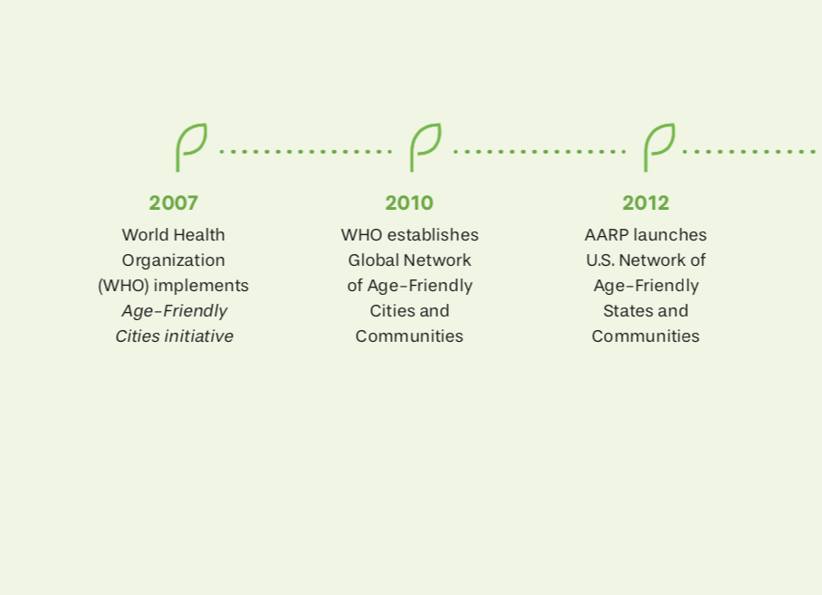
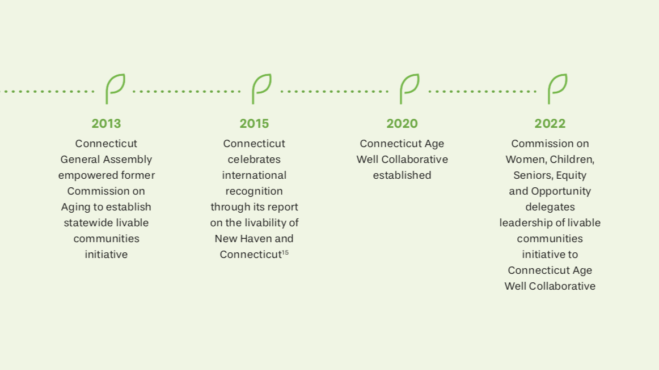
Our Story

Slide 4

Core Collective Impact Partners
Partner and supporter
Sec. 17b-420a. “Livable Communities” initiative. Internet portal. Report. Community recognition. (a) For purposes of this section, (1) “livable community” means a community with affordable and appropriate housing, infrastructure, community services and transportation options for residents of all ages, and (2) “age in place” means the ability of residents to stay in their own homes or community settings of their choice regardless of age or disability.
(b) The Commission on Women, Children, Seniors, Equity and Opportunity shall establish a “Livable Communities” initiative to serve as a forum for best practices and a clearinghouse for resources to help municipal and state leaders to design livable communities to allow residents of this state to age in place…
The Commission on Women, Children, Seniors, Equity and Opportunity delegates its statutory charge (CGS Section 17b-420a) to lead a statewide livable communities initiative to the Connecticut Age Well Collaborative.
Notes:
30 collective impact partners total

Slide 5


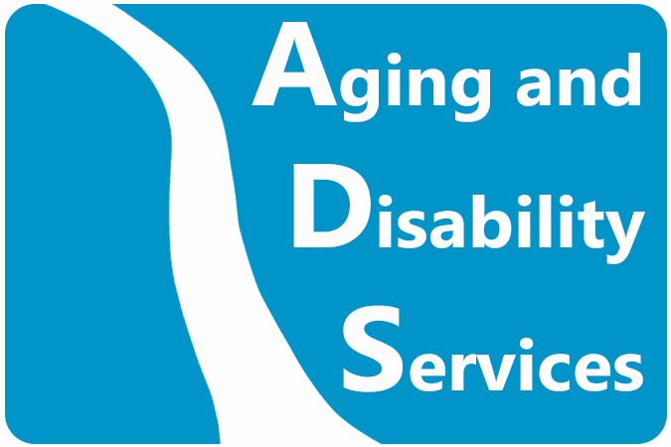
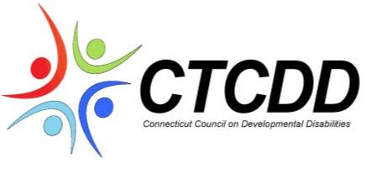
Core Collective Impact Partners: Funders
Founder and Initiative home
Philanthropic funder AND convener
STATE Funder and collaborator
NEW Funder

Slide 6
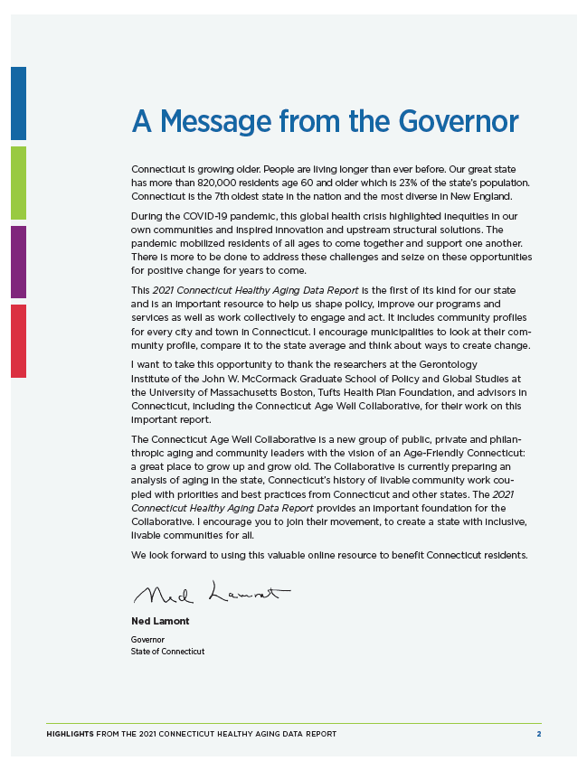
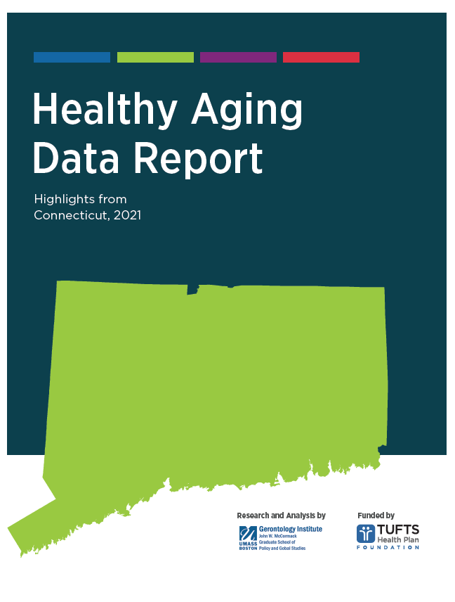
Connecticut is one of only four states to have such extensive data on healthy aging, with nearly 200 indicators for each of the state’s 169 cities and towns, plus 12 neighborhoods in Bridgeport, Hartford, New Haven, and Stamford.
Notes:
The Connecticut Healthy Aging Data Report helps residents, agencies, lawmakers and community leaders understand the older people who live in their cities and towns. It provides data and recommendations to help advance healthy aging to aid in building vibrant, healthy communities that work for all ages. Connecticut is one of only four states in the nation to have such extensive data available for healthy aging.
Within this report, you will find interactive maps, in-depth charts, and comprehensive profiles that include nearly 200 indicators of healthy aging for each of the state’s 169 cities and towns, plus 12 neighborhoods in Bridgeport, Hartford, New Haven, and Stamford.

Slide 7
Summer 2022 Steering Committee Assessment
Strengths
Philanthropy
Opportunities for Growth
Municipal government
Councils of government
Nonprofits (beyond aging)
Community centers of power and grassroots leaders
State government
Nonprofits (focused on aging policy and services)
Goal: Build on strengths and embody equity through a composition more reflective of Connecticut’s demographics
Notes:
Steering Committee

Slide 8
2022-2023 Organizations Represented
Local and Regional Government
Capitol Regional Council of Governments
City of Manchester – Social Services
City of New Haven – Disability Services
State Government
Connecticut Department of Aging and Disability Services
Commission on Women, Children, Seniors, Equity and Opportunity
Philanthropy
Community Foundation of Eastern CT
Connecticut Health Foundation
Nonprofit and Academic
AARP Connecticut
Alzheimer’s Association
Center for Housing Opportunity
Central Connecticut State University
Connecticut Community Care
CT Aging
Leading Age Connecticut
National Council on Aging
Community Centers of Power/Grassroots Leaders
Community Members (recently retired professionals)
Cultivation through Community Leaders Fellowship

Slide 9
2023 Steering Committee Analysis
Strengths
Local and regional government (could further grow)
State government (aging-focused)
Opportunities for Growth
Disability representation
State government (beyond aging)
Community centers of power, grassroots leaders, and lived experience
Nonprofits (broadly based)
Philanthropy
Community members (recently retired professionals)
Goal: Further build on strengths and embody equity through a composition more reflective of historically disempowered demographics

Slide 10
2023 Representation in Nomination Slate
Local and Regional Government
City of Manchester – Social Services
City of New Haven – Disability Services
Town of Newington – Parks and Recreation
Town of Woodbury – Senior Services
Northwest Hills Council of Governments
State Government
Connecticut Department of Aging and Disability Services
Commission on Women, Children, Seniors, Equity and Opportunity
Connecticut Office of Policy and Management, Intergovernmental Policy and Planning Division
Nonprofit, Academic and Philanthropy
AARP Connecticut
Aging CT
Alzheimer’s Association of Connecticut
Centers for Housing Opportunity
Connecticut Health Foundation
Connecticut State Independent Living Council
Health Equity Solutions
UCONN Center on Aging
Community Centers of Power/Grassroots Leaders
Recently retired aging services professionals
Community Leaders Fellowship alumni (2-3)
New representation on proposed nomination slate

Slide 11
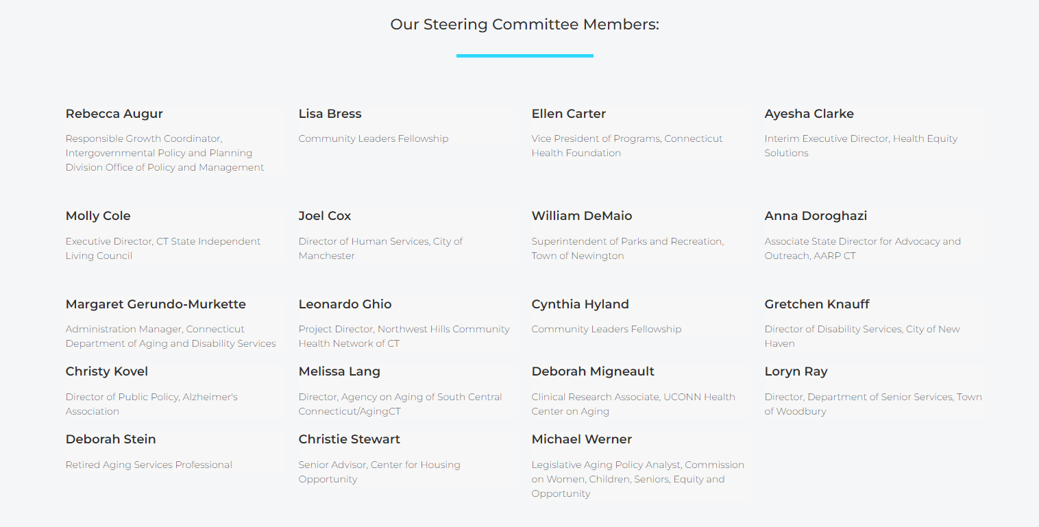

Slide 12
Vision:
Connecticut communities where we all thrive as we grow up and grow older.
Mission:
The Connecticut Age Well Collaborative is a statewide, cross-sector initiative, implementing the state’s statutory livable communities initiative to foster aging, dementia and disability-inclusive communities.
Notes:
Purpose and Goals

Slide 13
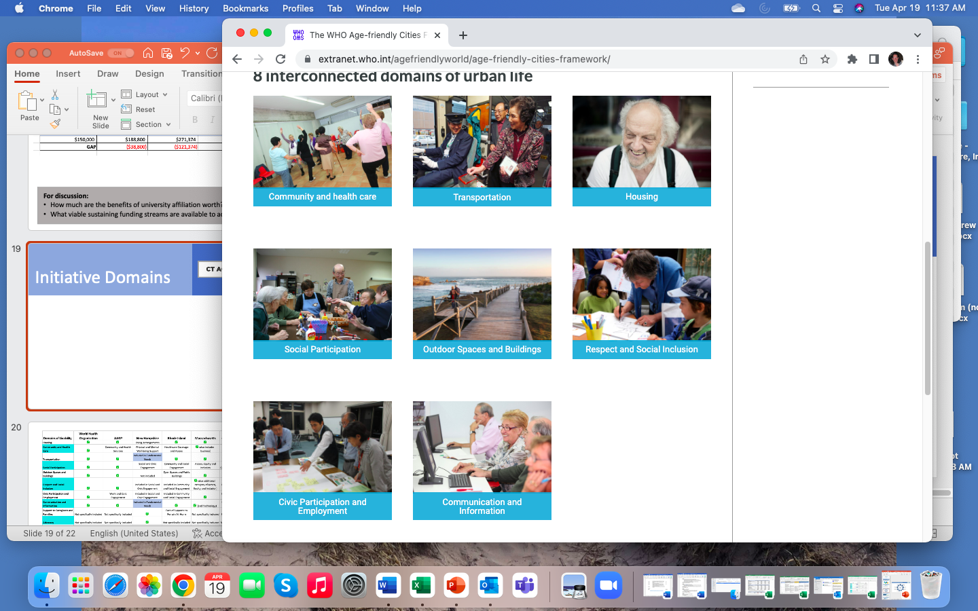
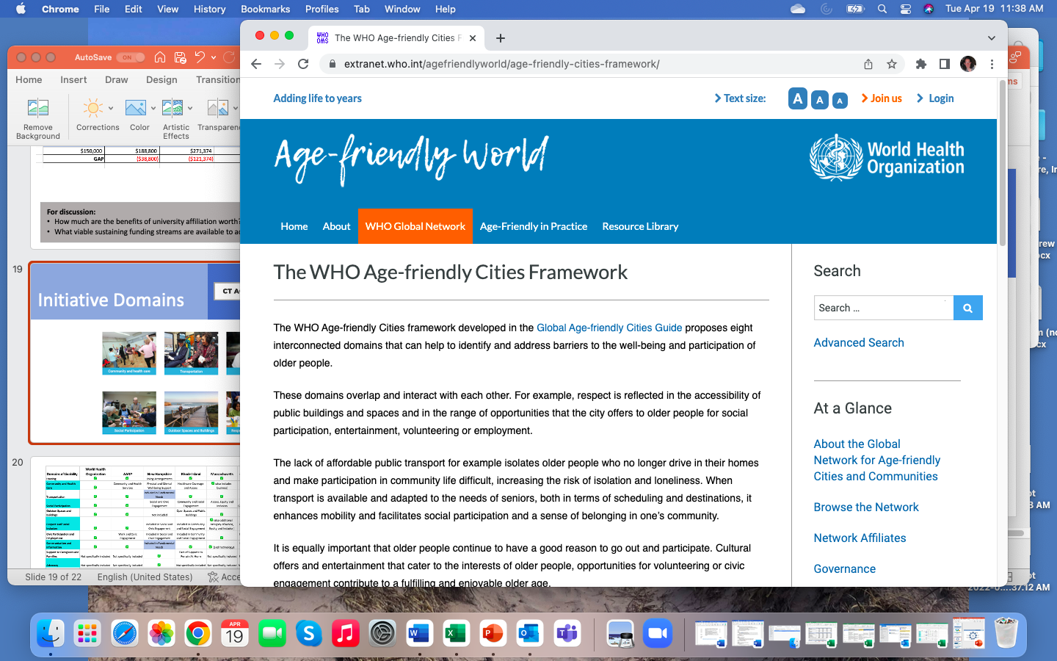
World Health Organization Framework

Slide 14
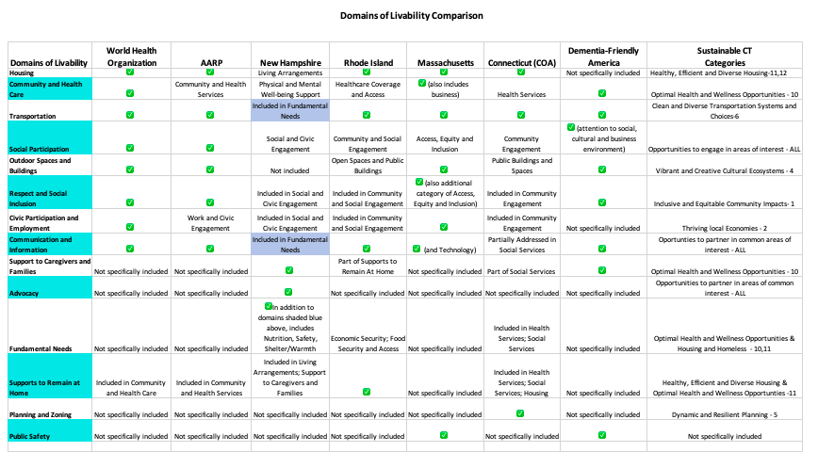

Slide 15

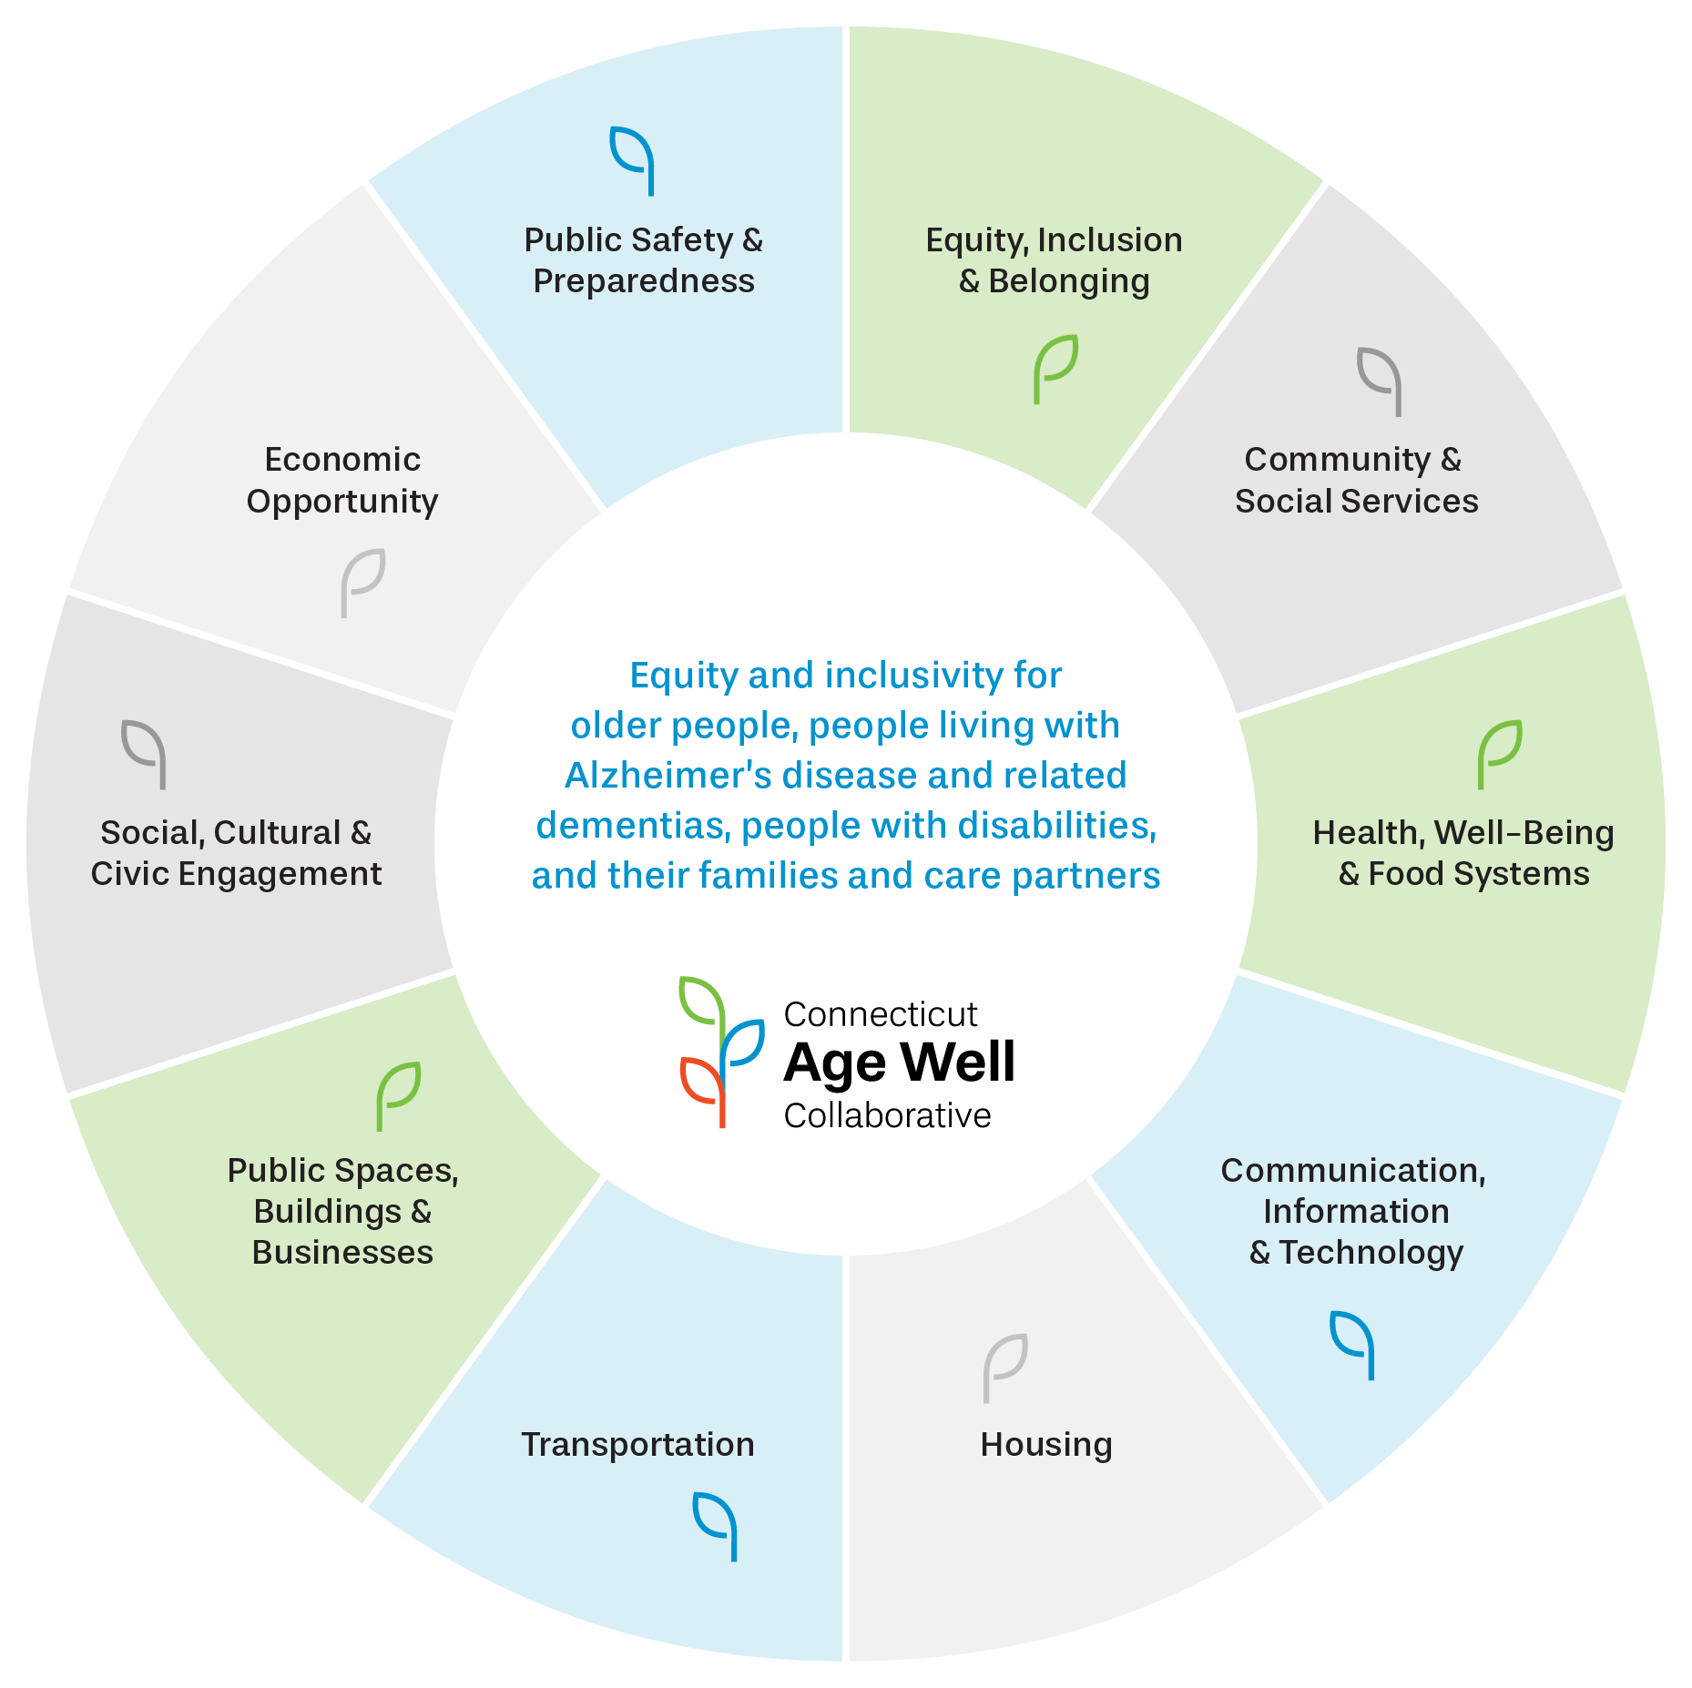
Notes:
Creates an explicit category on equity inclusion and belonging
Goes beyond health care to include health, well-being and food systems
Emphasizes technology as a critical component of communication and information
Goes beyond outdoor spaces to include all public spaces (including downtowns) and businesses
Looks at employment as part of a larger category of economic opportunity
Expands social participation to also include cultural engagement
Adds a new category to consider public safety and preparedness
Recognizes the importance of families and care partners of affected individuals

Slide 16
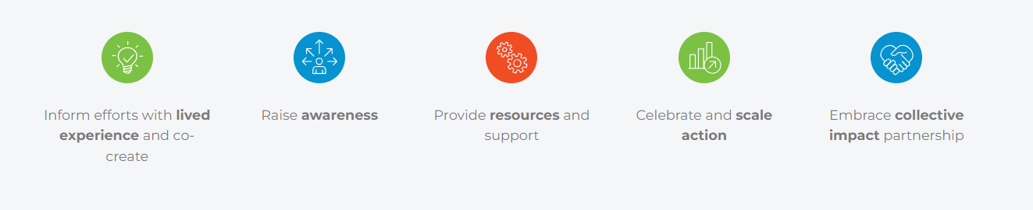
What We Do

Slide 17
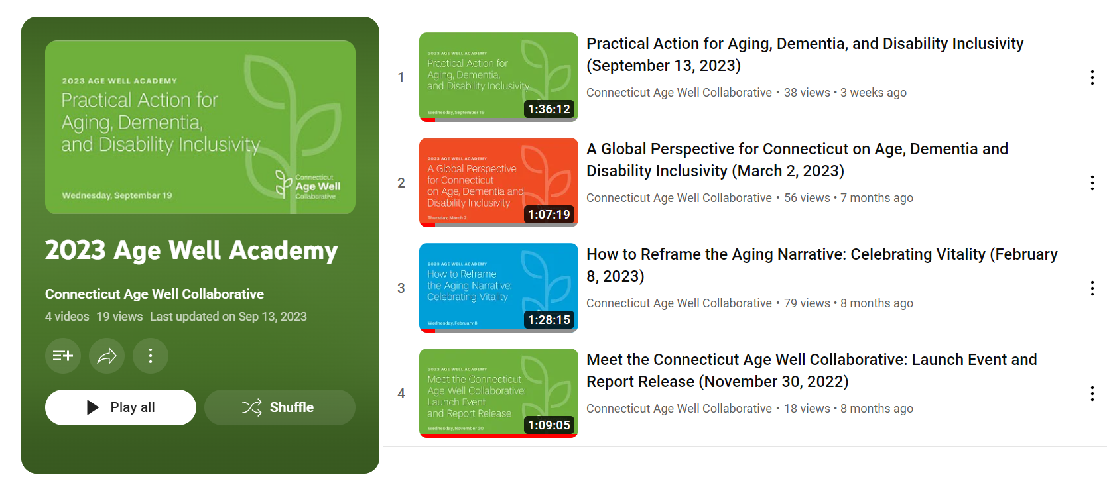
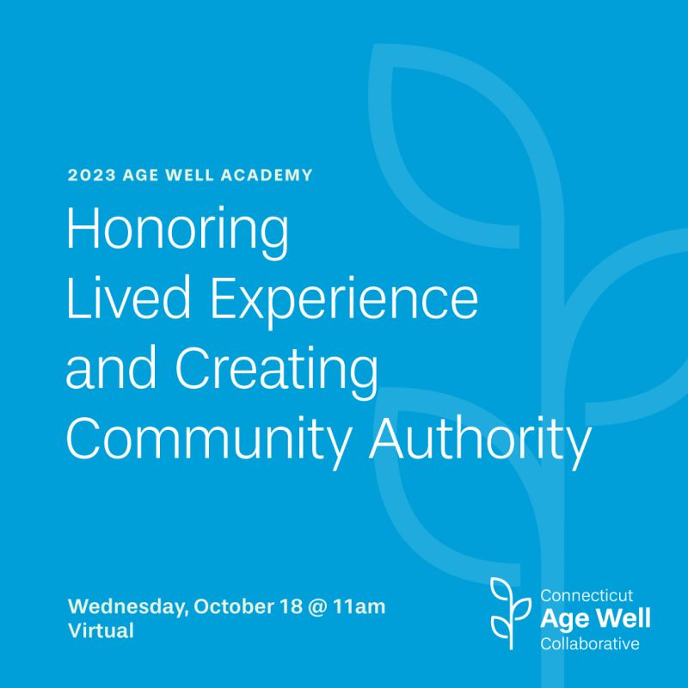
2023 Age Well Academy
Notes:
6 presentations, 40 presenters, 322 total webinar attendees, plus over 300 additional views on YouTube; with CCM

Slide 18
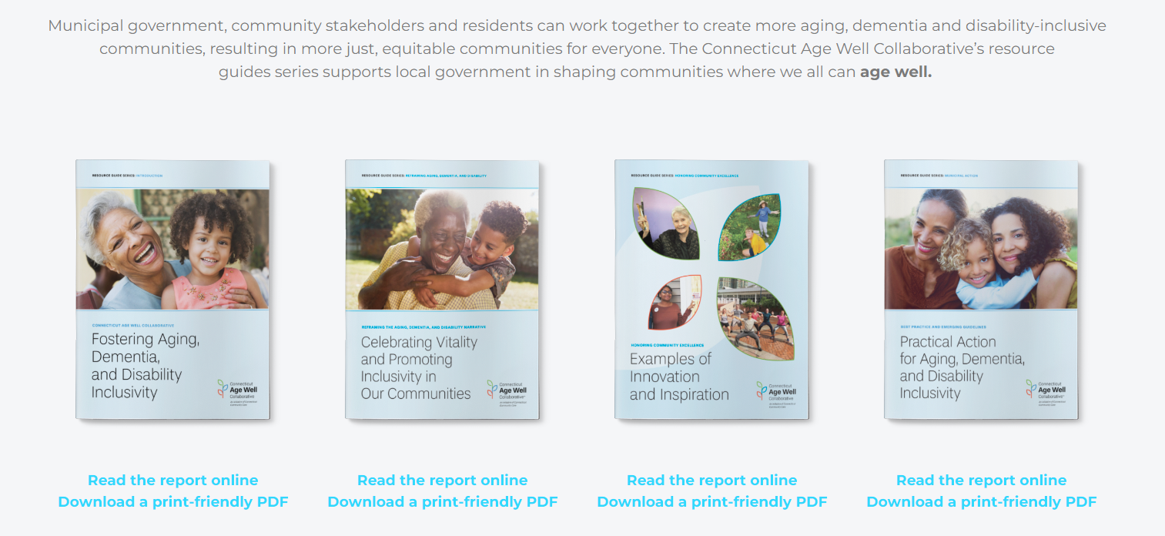
Municipal Resource Guides
Notes:
6 presentations, 40 presenters, 322 total webinar attendees, plus over 300 additional views on YouTube; with CCM

Slide 19
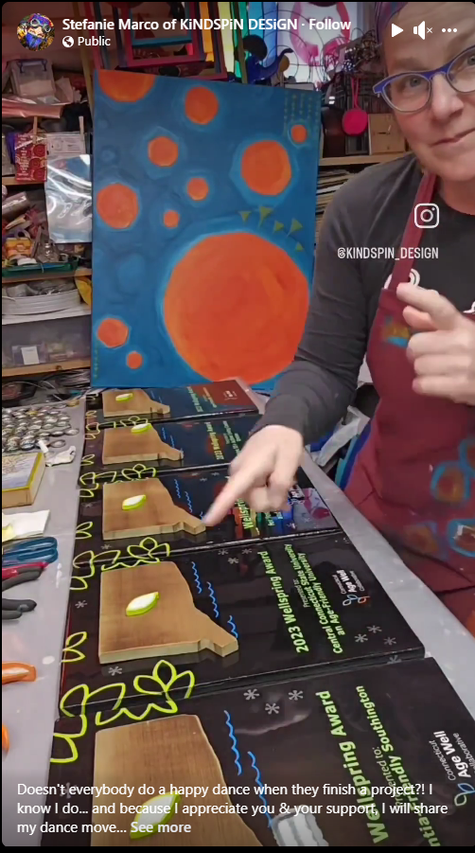
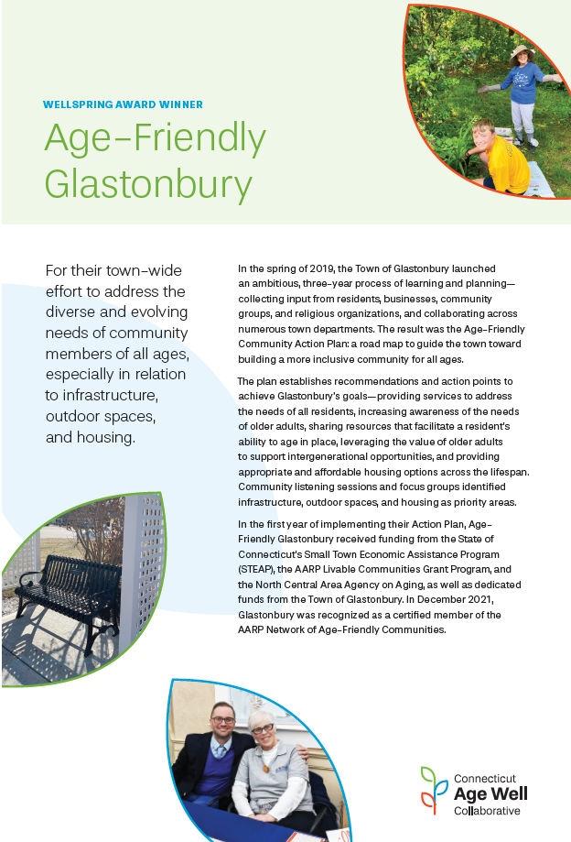
2023 Wellspring Awards
Age-Friendly Glastonbury
Thrive 55+ Active Living Center, Groton
Dementia-Friendly Southington
Connecticut Central State University
Notes:
Age-Friendly Glastonbury: A community-wide effort to address the diverse and evolving needs of community members of all ages, especially in relation to infrastructure, outdoor spaces, and other domains of livability.
Thrive 55+ Active Living Center, Groton: For its work toward adopting a new branding identity and for its inclusion efforts for individuals with dementia or socialization issues.
Dementia-Friendly Southington: A comprehensive effort to support people experiencing cognitive change, especially through training of municipal staff and community partners.
Connecticut Central State University: The first Connecticut university to join the Age-Friendly University Global Network, promoting lifelong learning, intergenerational connection and disrupting ageism.

Slide 20
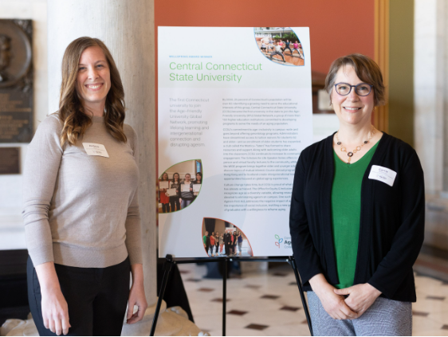
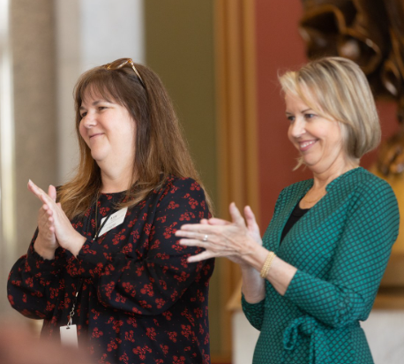
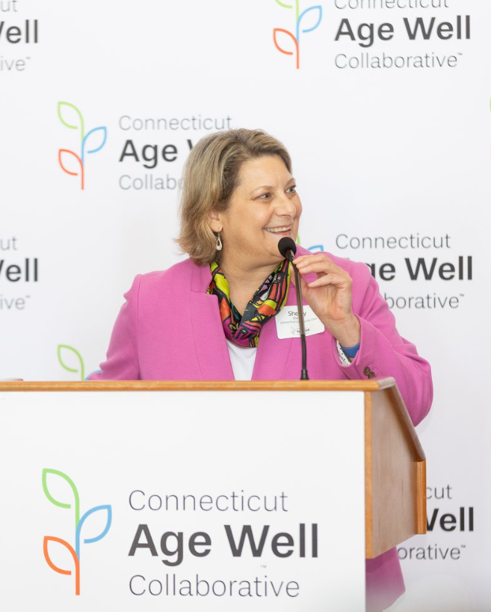
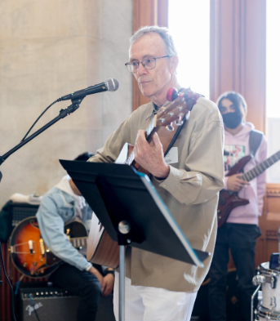
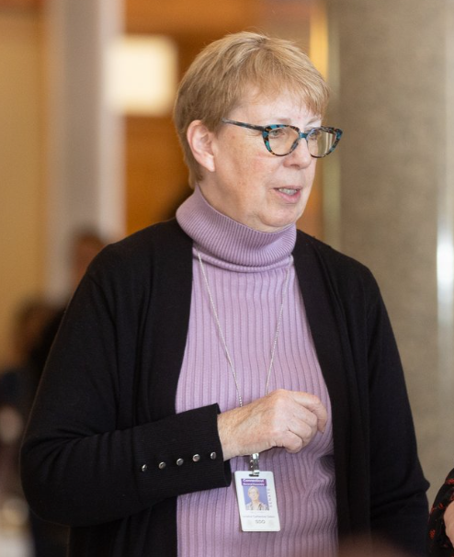
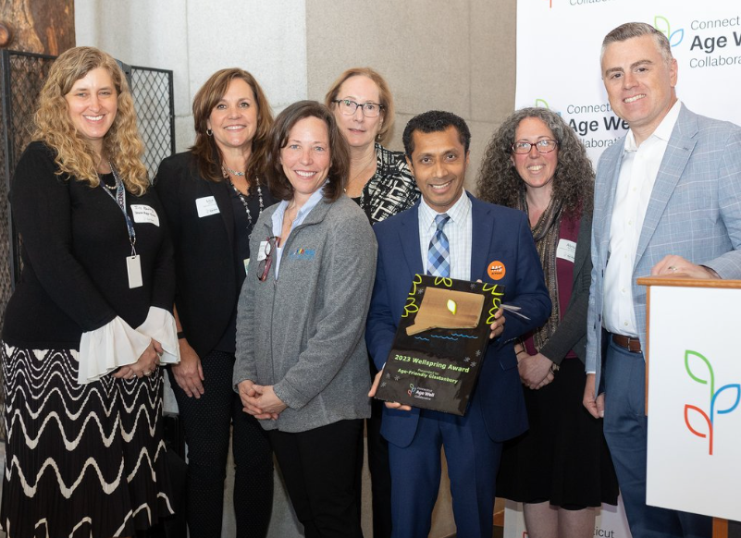
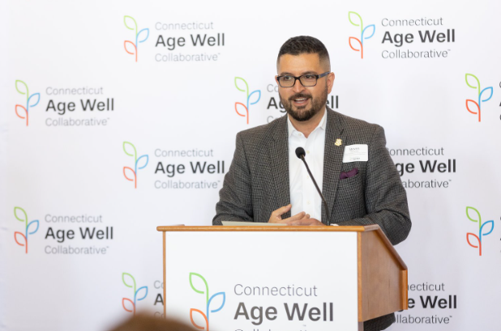
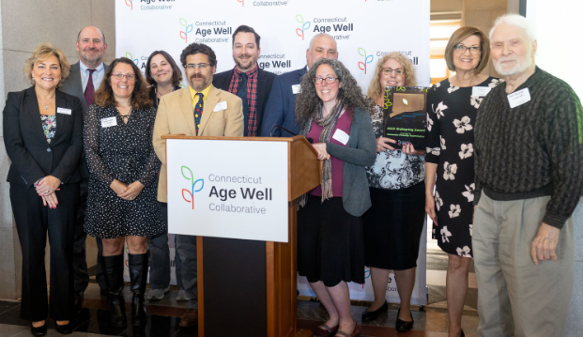
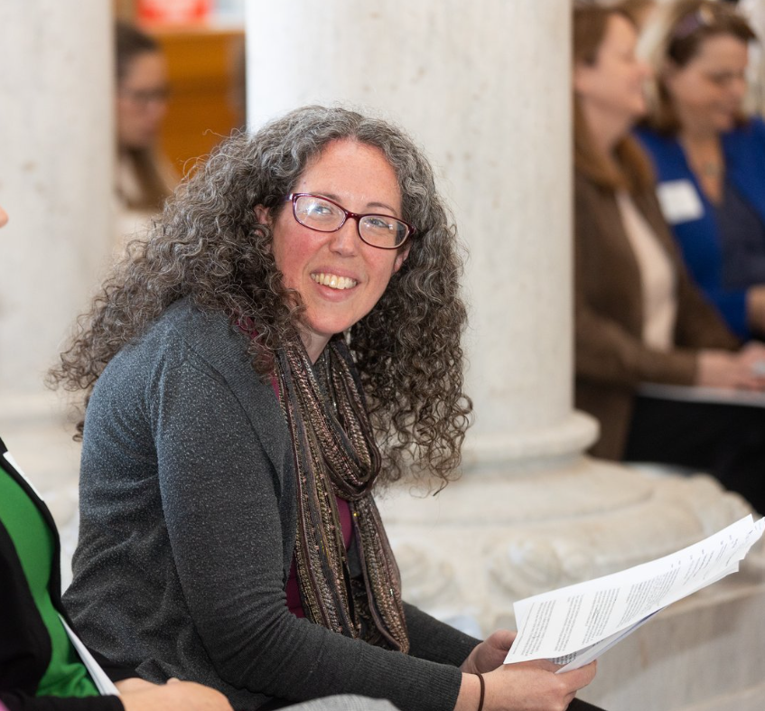
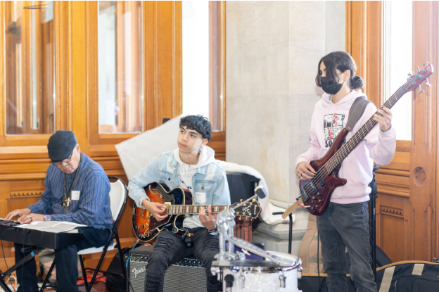
Notes:
At least 88 Summit attendees

Slide 21
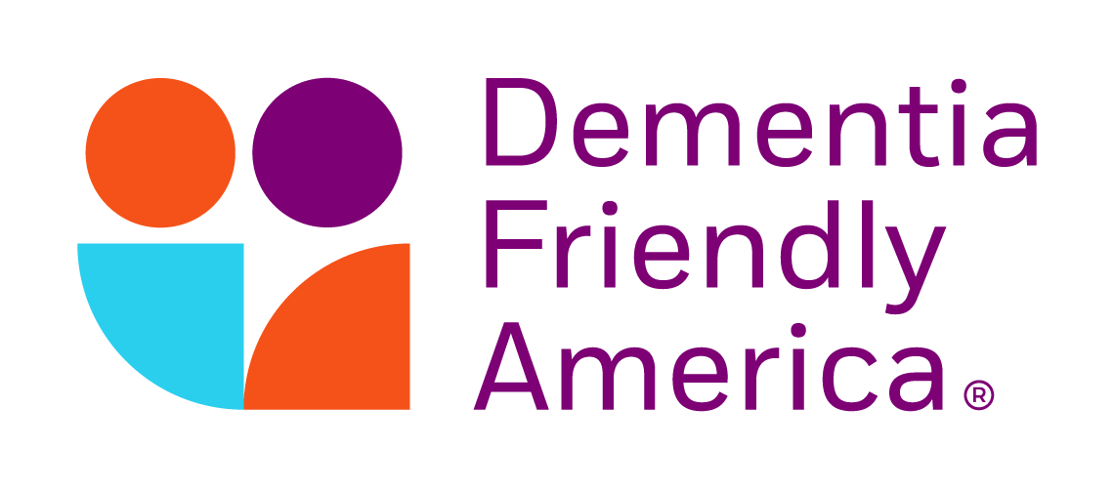
Collaborative Selected as State Lead
Received by e-mail August 29, 2023:
“It was lovely to read your state lead application, it is evident that you have spent significant time building the infrastructure to develop and support thriving dementia friendly efforts throughout Connecticut. We are so thrilled welcome you to the DFA network as state lead!”
What is Dementia Friendly America (DFA)? DFA is a national network of communities, organizations and individuals seeking to ensure that communities across the U.S. are equipped to support people living with dementia and their caregivers. Dementia friendly communities foster the ability of people living with dementia to remain in community and engage and thrive in day to day living.
Notes:
Alyssa to transition to Karen

Slide 22
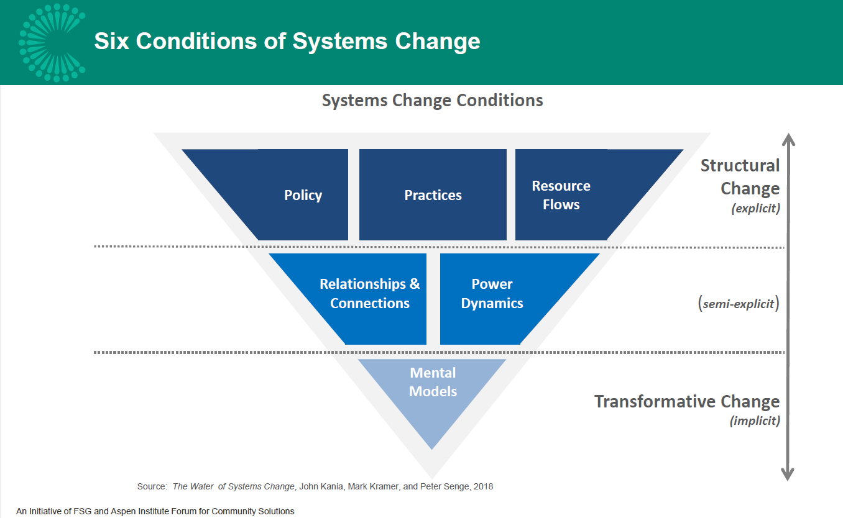
Notes:
Christina

Slide 23
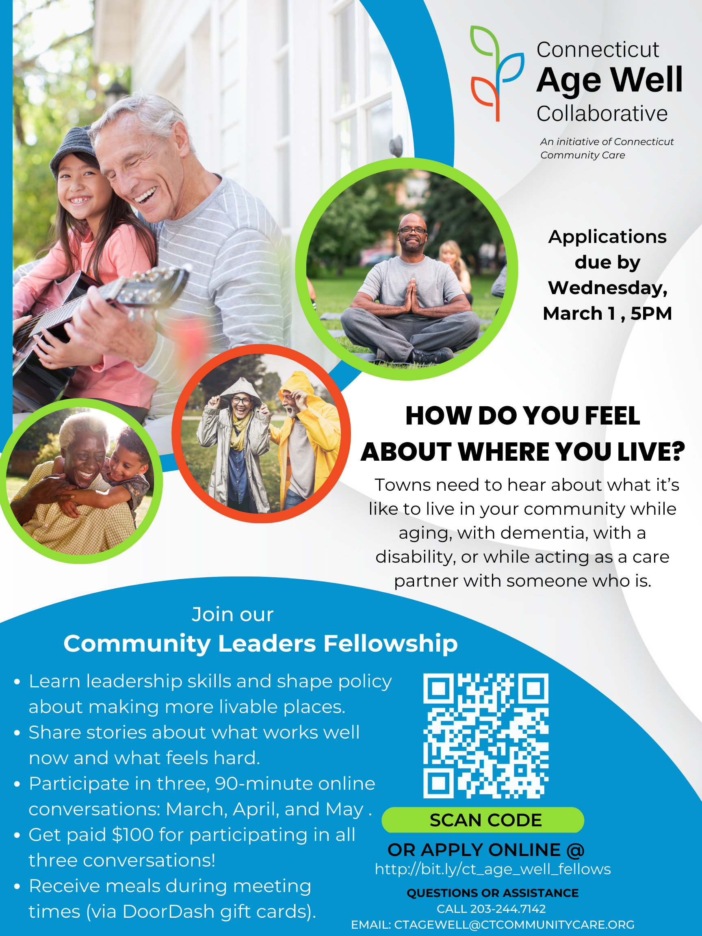
Moving from community-informed to community-involved, and ultimately, to community-driven
Community Leaders Fellowship, implemented locally
Notes:
Facilitating a culture of intentional inclusion. Shifting paradigms/broadening options in terms of how we community members engage with government. Culture change of valuing “lived experience experts.” Started by modeling it ourselves… this year’s Fellowship as statewide pilot for our org, with goals two-fold: (1) co-create this org… who are we and what do we do, and (2) to provide pathway to leadership on our Steering Committee. 21 Fellows. 3 in this room.

Slide 24
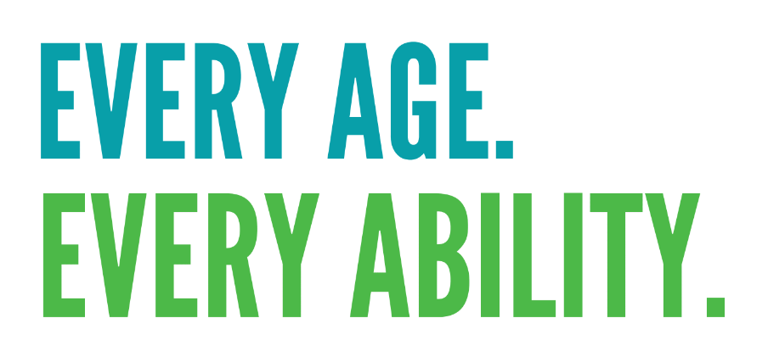
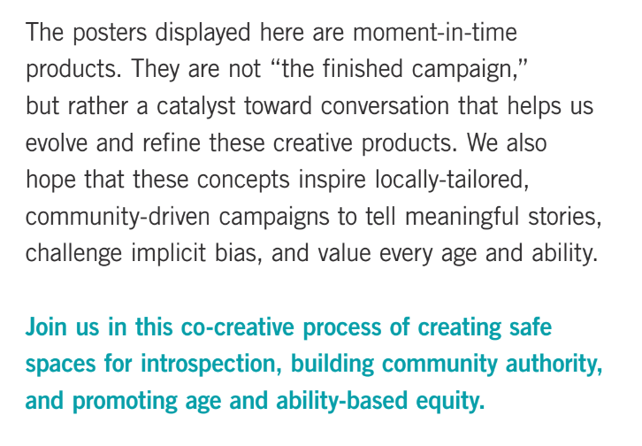
Disrupting Ageism and Ableism Campaign
Ageism and Ableism
Stereotypes, discrimination and prejudice directed toward people based on age or ability.
Notes:
Alyssa. Leveraged pro bono support of Yale Social Impact Consulting Club and AIGA CT.

Slide 25
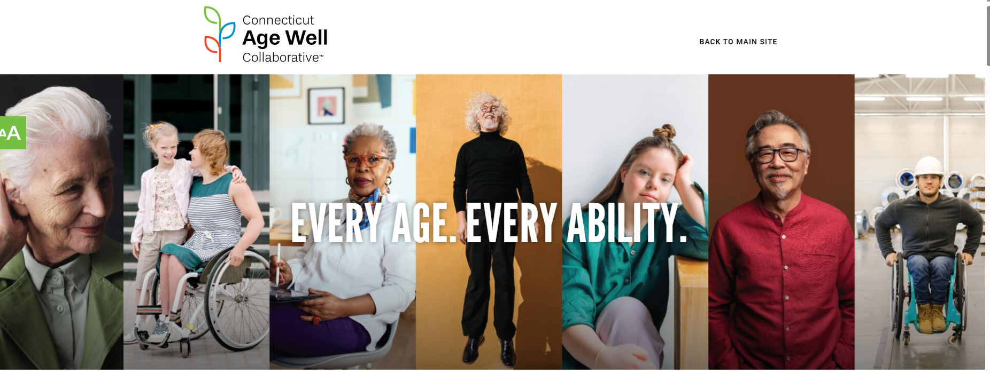

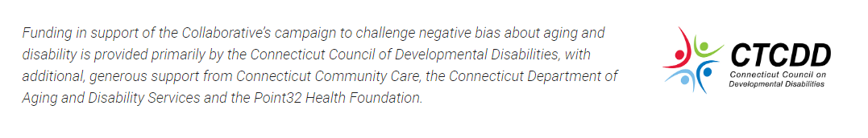
Notes:
Lesley

Slide 26
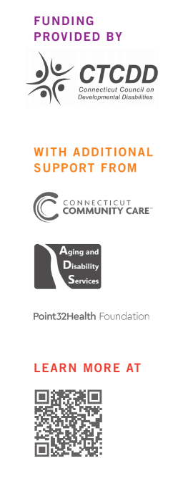


Notes:
Lesley

Slide 27
Notes:
Lesley

Slide 28
Multisector Plans on Aging and Disability
Notes:
Intersection with state agencies

Slide 29
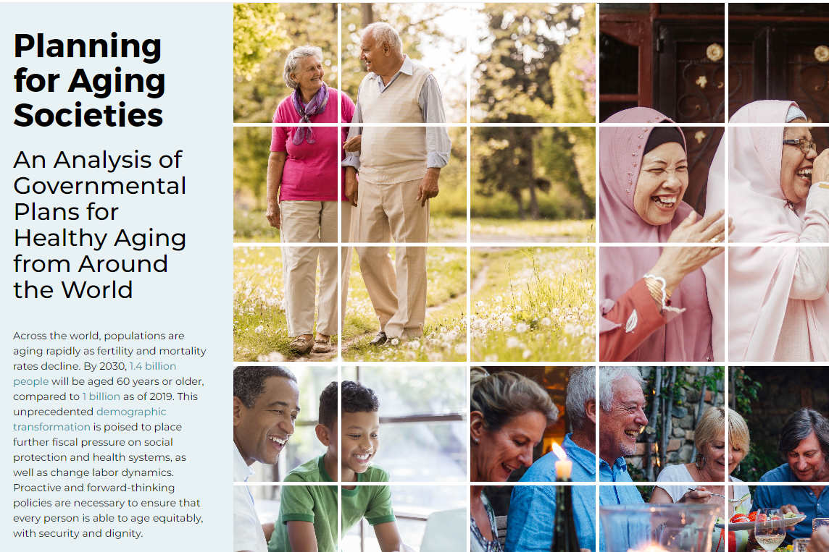
Multi-Sector Plans for Aging
A multi-sector plan for aging and disability creates a roadmap that helps states transform policy, infrastructure and service coordination for rapidly aging populations and people with disabilities.
https://www.aarpinternational.org/resources/healthy-aging/national-plans

Slide 30
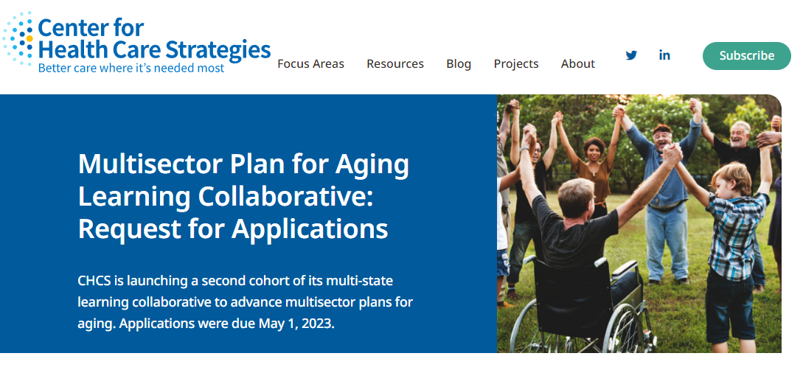
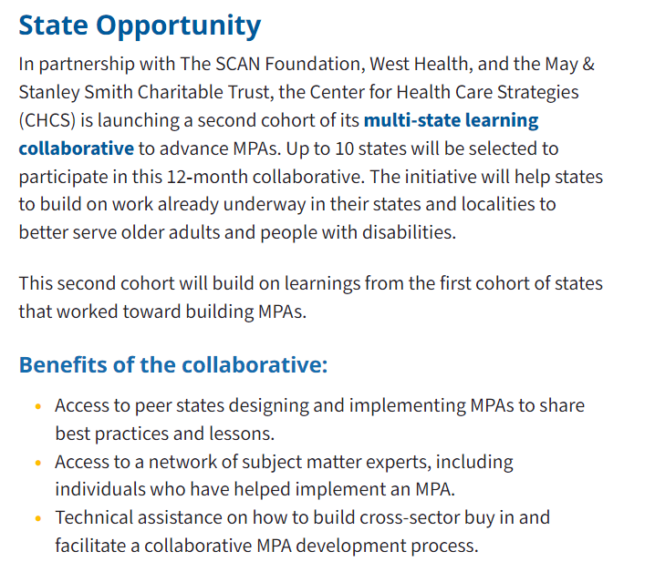
Multi-State Learning Collaborative
Team named in Connecticut state application:
Margaret Gerundo-Murkette, Department of Aging and Disability Services
Alyssa Norwood, Connecticut Age Well Collaborative
Rebecca Auger, Office and Policy and Management, Intergovernmental Policy and Planning Division
Walter Glomb, Connecticut Council of Developmental Disabilities
Michael Werner, Legislative Commission on Women, Children, Seniors, Equity and Opportunity
Karri Filek, Department of Social Services

Slide 31
Initial National Landscape Analysis
States with existing multisector plans
California
Massachusetts
States with plans in development
At least 15 states, including
Maryland
Timeframe
Dependent upon pre-work before an Executive Order, but initially 1-3 years
Colorado
Pennsylvania
Vermont
State participating in current multi-state learning collaborative
Connecticut, Iowa, Maryland, Massachusetts, Missouri, New Hampshire, Nevada, Pennsylvania, Utah and Washington
Dependent upon funding
Plan typically spans 5-10 years; ongoing development, monitoring and implementation
Intersects with other state planning processes and across levels of government
New Hampshire
Washington
6 States with Executive Orders/legislation, including
Utah
Minnesota
Texas

Slide 32
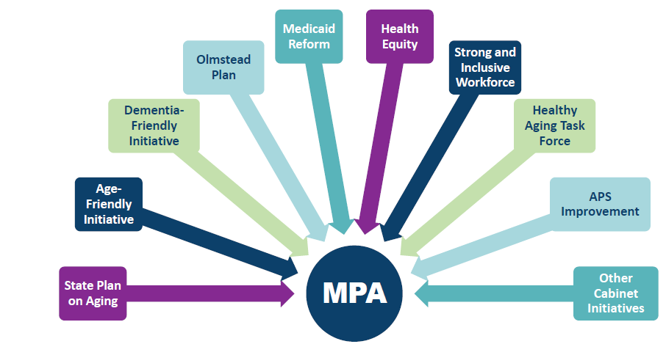
Broad Goals
Strengthens rather than replaces!
Elevates common goals
Reduces duplication
Streamlines efforts
Provide framework to plan for 10 years
Build community authority and value lived experience
Transform infrastructure
Improve service coordination
Connect planning efforts across state agencies with aging and disability lens
Ensure ongoing accountability and evaluation
Sample graphic from North Carolina MPA

Slide 33
Connecticut Approach
Leverage Connecticut Age Well Collaborative as key asset (cross-sector governance and framework, equity focus, municipal and community connections), high ROI
Continue researching best practices from other states and conduct cost-savings analysis (based on Pennsylvania modeling)
Collaborate with state agencies and other stakeholders to explore interest, long-term partnership and fiscal investment to sustain policy excellence and cost-savings
Hold statewide summit on multi-sector plans for aging and disability
Formalize MPA initiative through Executive Order (or other mechanism) and sustained investment

Slide 34
Questions?

