Slide 1
Medicaid Long Term Services & Supports Rebalancing Updates
DSS Community Options
Money Follows the Person
Strategy Group

Slide 2
Topics
Rebalancing Updates
  American Rescue Plan Act (ARPA)
  Capacity Building
  MFP Benchmarks
  Universal Assessment
  Community First Choice (CFC)
  CT Housing Engagement and Support Services (CHESS)
  My Place CT
Appendices
  ARPA
  COVID Nursing Home Analysis

Slide 3
Presenters
Dawn Lambert, DSS
Karri Filek, DSS
Lauren Carabetta, DSS

Slide 4
ARPA (American Rescue Plan Act)

Slide 5
ARPA Highlights – Department of Social Services
Expand benefits for Medicare Savings Program participants
Workforce Initiatives
  Provider increases and funds for recruitment/retention
  Informal Caregivers
Assistive Technology
  Modernize subsidized housing with Smart Home Technology
  Increase access, use and training of assistive technology
Model Design
Quality Initiatives

Slide 6
Capacity Building

Slide 7
Capacity Building Objectives
Increase the use of home and community-based, rather than institutional long-term care services
Increase availability of self-directed services and supports beyond MFP participants
Connecticut’s Money Follows the Person Capacity Building Proposal June 30, 2021

Slide 8
Capacity Building Project 1: HCBS Services
Provide home and community-based services (HCBS) information to people at risk for staying in nursing homes for more than 100 days
  Including people who are not yet Medicaid eligible
  Staff co-located in nursing homes
Facilitate transition
  Outcome: An additional 600 people returning to the community
Connecticut’s Money Follows the Person Capacity Building Proposal June 30, 2021

Slide 9
Capacity Building Project 2: Self-Direction Supports
Increase the number of support and planning coaches
Increase self-direction tools and training options
Connecticut’s Money Follows the Person Capacity Building Proposal June 30, 2021

Slide 10
MFP Benchmarks

Slide 11
MFP Benchmarks
Transition 5200 people from qualified institutions to the community
Increase dollars to home and community-based services
Increase hospital discharges to the community rather than to institutions
Increase probability of returning to the community during the six months following nursing home admission
Increase the percentage of long-term care participants living in the community compared to an institution
UConn Health, Center on Aging
CT Money Follows the Person Report Quarter 2: April 1-June 30, 2021 (Based on latest data available at the end of the quarter)
Operating Agency: CT Department of Social Services Funder: Centers for Medicare and Medicaid Services

Slide 12
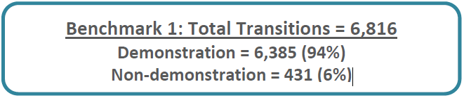
Benchmark 1:
Transition 5200 people from qualified institutions to the community
UConn Health, Center on Aging
CT Money Follows the Person Report Quarter 2: April 1-June 30, 2021 (Based on latest data available at the end of the quarter)
Operating Agency: CT Department of Social Services Funder: Centers for Medicare and Medicaid Services
Notes:
Last year 6,270, Increase of 546

Slide 13
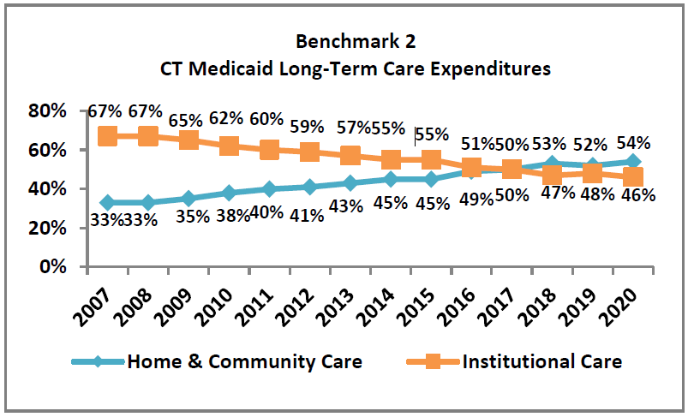
Benchmark 2:
Increase dollars to home and community-based services
UConn Health, Center on Aging
CT Money Follows the Person Report Quarter 2: April 1-June 30, 2021 (Based on latest data available at the end of the quarter)
Operating Agency: CT Department of Social Services Funder: Centers for Medicare and Medicaid Services

Slide 14
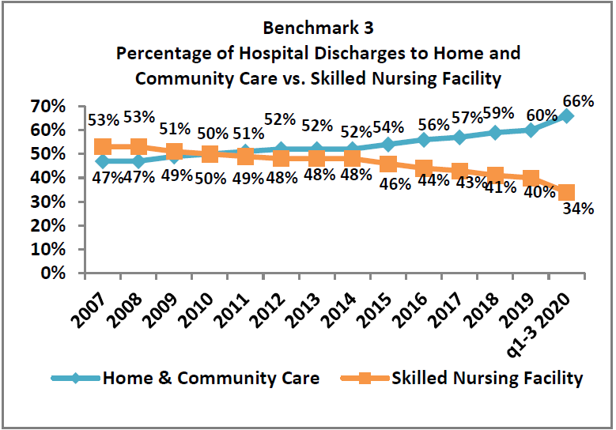
Benchmark 3:
Increase hospital discharges to the community rather than to institutions
UConn Health, Center on Aging
CT Money Follows the Person Report Quarter 2: April 1-June 30, 2021 (Based on latest data available at the end of the quarter)
Operating Agency: CT Department of Social Services Funder: Centers for Medicare and Medicaid Services

Slide 15
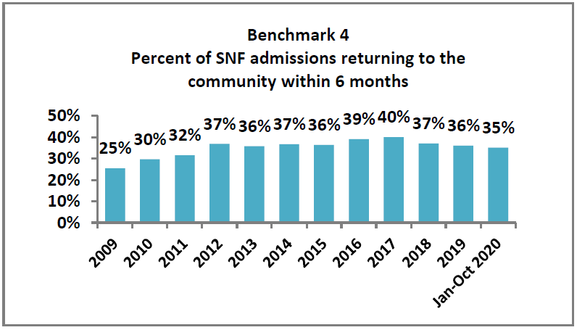
Benchmark 4:
Increase probability of returning to the community during the six months following nursing home admission
UConn Health, Center on Aging
CT Money Follows the Person Report Quarter 2: April 1-June 30, 2021 (Based on latest data available at the end of the quarter)
Operating Agency: CT Department of Social Services Funder: Centers for Medicare and Medicaid Services

Slide 16
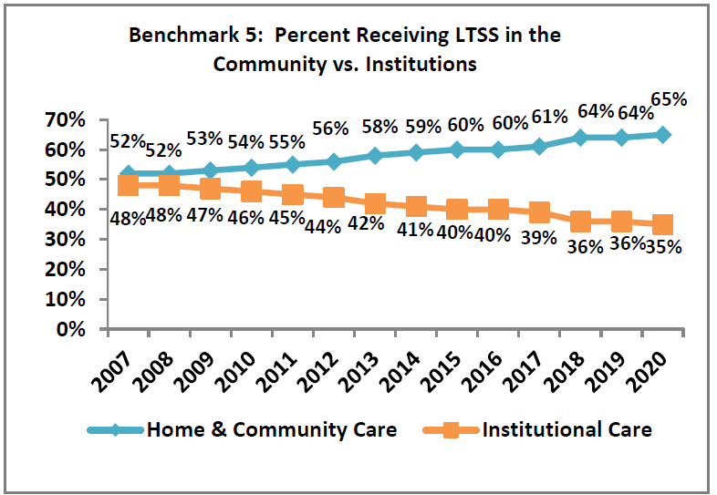
Benchmark 5:
Increase the percentage of long-term care participants living in the community compared to an institution
UConn Health, Center on Aging
CT Money Follows the Person Report Quarter 2: April 1-June 30, 2021 (Based on latest data available at the end of the quarter)
Operating Agency: CT Department of Social Services Funder: Centers for Medicare and Medicaid Services

Slide 17
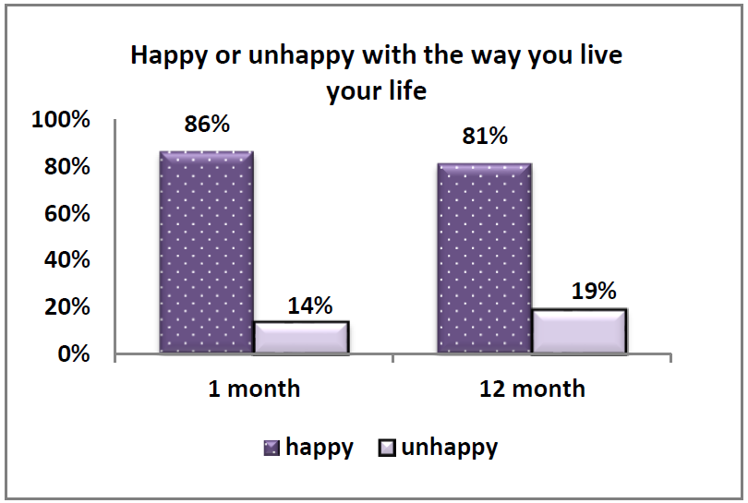
Happy or Unhappy
UConn Health, Center on Aging
CT Money Follows the Person Report Quarter 2: April 1-June 30, 2021 (Based on latest data available at the end of the quarter)
Operating Agency: CT Department of Social Services Funder: Centers for Medicare and Medicaid Services

Slide 18
Universal Assessment

Slide 19
Universal Assessment (UA)
Expansion
  Utilization with participants receiving services from:
    DDS
    Department of Mental Health and Addiction Services
Improvement
  Conduct a review of the UA
    Identify improvement opportunities
  Algorithm
    Establish need groupings associated with care plan budget allocations
      Ensure cost neutrality
State of Connecticut Spending Plan for Implementation of the American Rescue Plan Act of 2021, Section 9817, Pg 12

Slide 20
Community first Choice (CFC)

Slide 21
CFC
Number of People Active on CFC
Program | Number
CFC (no waiver) | 2465
CFC (w/waiver) | 2518
TOTAL | 4983
Number of People Active on CFC by waiver type
Waiver Type | Number
ABI 1 | 90
ABI 2 | 48
PCA | 1041
CHCPE | 1008
DDS | 327
Autism | 4

Slide 22
CFC Applications
Month | Number
January 2021 | 181
February 2021 | 189
March 2021 | 202
April 2021 | 196
May 2021 | 182
June 2021 | 256
MONTHLY AVERAGE | 201

Slide 23
COVID-19 Emergency Response for CFC
Expedited onboarding process of new CFC participants/EOR & PCAs
Emergency Hiring of PCA staff for existing CFC participants
Overtime hours for existing PCA staff
Temporary budget increases for existing CFC cases
Temporary suspension of CFC budget reductions

Slide 24
COVID-19 Emergency Response for CFC
Shifted authority to Access Agencies to authorize immediate services
No additional approval by DSS during the emergency
Extensions reviewed in accordance with the Governor’s State of Emergency Declaration

Slide 25
CHESS
(Connecticut Housing Engagement and Supports Services)

Slide 26
CHESS
New Home and Community Based Services Medicaid entitlement
CHESS combines Medicaid services, supportive housing benefits, and non-Medicaid housing subsidies
Aims to achieve housing stability, improved health, and community integration and life satisfaction
Built upon the combined work history of:
  DOH: CANS and housing subsidies
  DMHAS: supportive housing program
  DSS MFP: Medicaid services and housing supports

Slide 27
CHESS Requirements
Active HUSKY A, C, and D
Be 18 years or older
Have a Behavioral Health Diagnosis
Meet the needs-based criteria*:
  Homeless, or at risk of homelessness*
  Have a Modified Charlson Comorbidity Index score of 4 or more
  Have at least 2 critical needs
Notes:
At risk without the receipt of CHESS services
CCI: This score looks at your diagnoses and tells us how sick a person might be in the future
Critical needs means needing help with ADLS (bathing, dressing, eating, toileting, transferring) and IADLs, meal preparation, shopping, medication management, transportation, healthcare coordination,, maintain housing stability, or behavioral health management

Slide 28
CHESS Services
Care plan development and monitoring
Pre-tenancy Supports
Tenancy-Sustaining Supports
Non-medical transportation

Slide 29
CHESS Team
Department of Social Services
Determines CHESS eligibility
Completes CHESS financial eligibility processing
Enters CHESS start and stop dates
Behavioral Health Administrative Service Organization (BH-ASO)
Completes Universal Assessment
Reviews and approves Person Centered Recovery Plan and Revised Plan
Supportive Housing Providers (SHPs)
Completes Housing Assessment (aka, Acuity Index)
Direct service delivery
Contracts with BH-ASO
Completes data review process for CHESS applications
Completes annual reassessments
Approves Prior authorizations
Develops Person-Centered Recovery Plan
Submits Prior authorizations
Locates and secures housing
Completes Revised Plan

Slide 30
CHESS
Approved by CMS on August 16, 2021
Governor Lamont Announces Public-Private Initiative to Address Homelessness and Chronic Health Problems (ct.gov)
A Major Shift Toward Home-Based Care is Underway in Connecticut’s Long-Term Services and Supports Program | Milbank Memorial Fund

Slide 31
CHESS Contact information
Online applications www.CTCHESSDSS.com.
Application information is also available by calling 1-888-992-8637 or 2-1-1.

Slide 32
My Place ct Transition

Slide 33
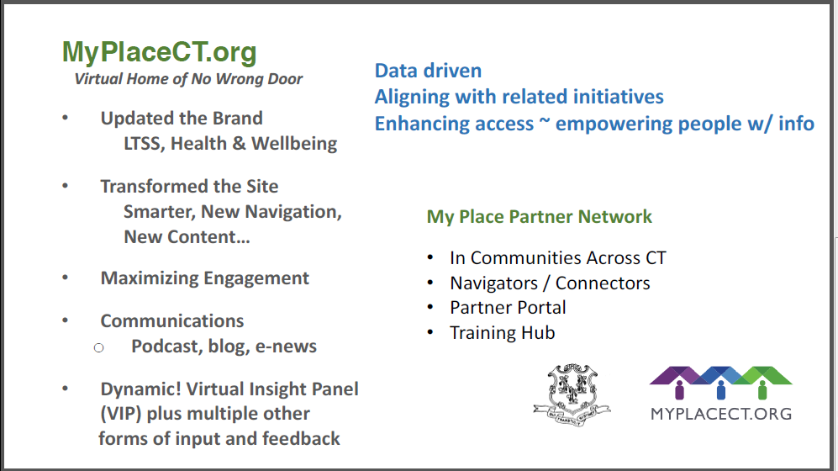
My Place CT Transition
Notes:
We have been working with O’Donnell Marketing firm since 09/2020.

Slide 34
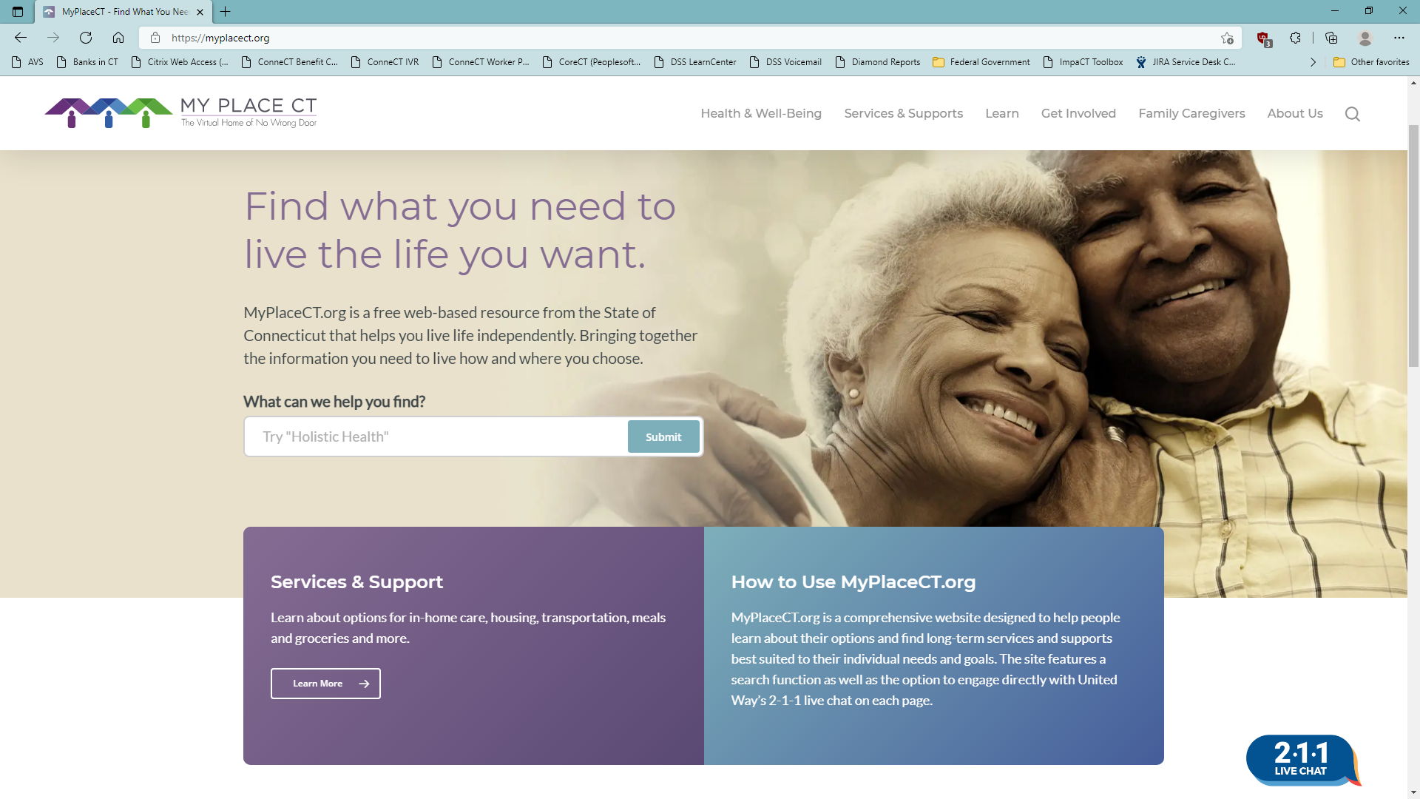
My Place CT Transition

Slide 35
My Place CT
Medicaid Information Videos Series
Medicaid Informational Videos | MyPlaceCT
Medicaid Financial Tools:
Financial Tools | MyPlaceCT

Slide 36
Questions?

Slide 37
Appendix A
American Rescue Plan Act
Home and Community Based Services
Overview

Slide 38
Connecticut's experience with COVID-19 challenges rebalancing assumptions and forecasts. While the current status of long-term services and supports (LTSS) clearly reflects a sharp drop in nursing facility (NF) census and concomitant increase in demand for home and community-based services (HCBS), continued demand projections for HCBS are dependent upon two essential factors: adequate supply of workforce and continued quality of care.
The sudden growth in demand for HCBS in addition to the previously forecasted demand challenges the stability of the system and drives costs. The state must consider not only growing and enhancing value of the HCBS paid workforce through the adjustment of rates aligned with performance but also implementing innovative workforce and community solutions to quickly address the growth in demand.

Slide 39

Enhance HCBS Workforce
Provider Rate Increases
(Rate Adequacy)
Invest in Capacity Building and Training
1) Temporary Workforce and Provider Stabilization
Supports for Family Caregivers
Provide tools and resources for families caring for older adults and close relatives with a disability. Support will include respite care, caregiver needs assessments, training, and care coordination
Investment: $10.8 million
Level the playing field with comparable investments to other providers with a focus on improving consumer access. A 31.7% increase for pediatric complex care services and an increase of up to 4.5% (3.5% base increase plus value-based payment increase of up to 1%) for home health, and waiver providers
Investment: $80.7 million
Establish a statewide train-the-trainer program for all HCBS providers to integrate a racial equity lens in care delivery. Training resources and content will include implicit bias, health literacy and self-management, racial microaggressions, and cultural humility. Build capacity to expand Medication Assisted Treatment (MAT) for substance abuse
Investment: $2.2 million
Develop an incentive-based program to help with recruitment and retention of provider staff and fund one-time support to offset COVID- related impacts that destabilized the provider network
Investment: $95.5 million
Temporary stabilization funds for HCBS providers that were hit hard by COVID-19 and rate increases will help ensure providers can meet growing consumer demand and retain a quality workforce
Enhanced family caregiver supports will reduce caregiver “burn-out,” improve quality of life, supplement the need for paid caregivers, and help reduce unnecessary or premature reliance on Medicaid

Slide 40
Expand and Integrate Use of Assistive Technology
Expand Access and Use of Assistive Technology
1) Integrate Smart Home Technology into Subsidized Housing
Establish a Medicaid assistive technology initiative to oversee integration of technology into care plans, in coordination with existing HCBS care planning team, and provide in-home training on proper use of technology
Examples:
Automatic medication dispensers and reminders, talking microwaves and voice-activated devices
Investment: $24.3 million
Update affordable housing stock to promote independence
Examples:
Set up apartments to monitor a senior’s patterns and identify when their pattern changes
Installing a system to enhance hearing devices in group areas of housing
Smart lighting to improve visibility and avoid falls
Investment: $40 million
Facilitates communication with health care providers, supplements the demand for informal and formal caregivers, and promotes social connectedness, ultimately leading to greater independence in the community

Slide 41
Expand Environmental (Home) Adaptations
1) Implement CAPABLE Model in Medicaid HCBS
Adopt Johns Hopkins’ evidence-based CAPABLE model for HCBS waiver participants and those at risk of nursing home placement to ensure their home surroundings promote function and independence. The approach teams nurses, occupational therapists and handy workers to address the home environment and complement the strengths of older adults to improve safety and function
Home modifications / equipment could include:
Stair chairs
Ramps
Hand railings
Raised toilet seats
Basic safety repairs
Investment: $15 million
Improves function through environmental modifications that enable older individuals and those with disabilities to remain at home

Slide 42
Enhance Self-Direction
Support Electronic Visit Verification (EVV) Call Center
Expanded Self-Direction Support Available through the Fiscal Intermediary
1) Create and Implement Employment Network
Employment network will help connect direct care workers seeking employment with individuals trying to find staff and will help individuals and families quickly locate backup staff
Investment: $4.4 million
A consumer call center will provide centralized resources for consumer-employers and PCAs to ask questions related to EVV and provide technical support to correct time entries electronically into the system. This resource will also help with adoption of federally mandated EVV system for PCAs
Investment: $2.1 million
Through added supports for fiscal intermediaries, consumers will be able to review and manage their individual care budgets in real time. System improvements will help ensure that PCAs working for consumer-employers are paid on time for their services
Investment: $6 million
Addresses barriers for over 7,000 consumers who prefer to hire and manage their own staff. Self-directed programs like Community First Choice offer the greatest degree of autonomy, personal control and customization, but administrative burdens and barriers make it difficult for consumer-employers. Investments will help consumers identify emergency back-up support, adopt EVV and process PCA timesheets, making it easier for those consumers

Slide 43
Incentives to Expand HCBS Options
1) RFP to Support Community Partnerships for Local Respite, Housing and Workforce Development
(Create and Implement Innovative Service and Support Model for Older Adults and People with Disabilities )
Technical Assistance for Innovative Models
Consultants for Medicaid technical assistance to ensure that innovative models are designed to be sustainable within Medicaid
Investment: $1 million
Seek applications from providers who work in partnership with local communities to address local needs for 24-hour backup, local respite, local housing development and local workforce needs
Investment: $9.2 million
Expands service array and consumer options for more integrated and efficient care settings

Slide 44
Enhance Provider Infrastructure
1) Stability and Infrastructure Improvements through Technology
Streamline and modernize antiquated processes to increase efficiency and support consumers as active participants in their own care
More appropriate service planning and improved service delivery
Improved billing accuracy to minimize negative auditing outcomes
Electronic health records
Billing system enhancements
Quality reporting
Improve public reporting
Investment: $66 million
Enhanced technology infrastructure promotes active participation in individual care plans

Slide 45
Strengthen Quality
1) Innovative Quality Improvement Fund
Quality Management Tool Kit for HCBS Participants
Improve and Expand Universal Assessment System
Seek innovative ideas from stakeholders to improve quality. Proposals will be assessed based on immediate impact, ability to replicate statewide and sustainability
Investment: $20 million
Develop web-based tools and printed materials to empower consumers with a strong awareness of the expectations for community service providers, who to contact when those expectations are not met, and a safe way to report concerns
Investment: $5 million
Expand the use of universal assessment tool to participants who receive services through DDS and DMHAS, resulting in more consistent needs assessments across the system
Investment: $7 million
Empower consumers with self-advocacy tools

Slide 46
Strengthen Quality (Continued)
4) Value-Based Payment Initiative
Create a value-based model that provides incentive payments to HCBS providers that achieve clearly defined outcomes
Investment: $21.2 million
Quality measures align financial incentives to higher quality performance

Slide 47
Sustain Change
1) Partner with UCONN Health, Center on Aging for evaluation
2) Establish diverse workgroup structure for design, development and implementation
3) Create effective integrated value-based payment that leads change

Slide 48
Workgroups
Assistive Technology/Environmental Adaptations
Smart Home Technology in HUD housing
Assistive technology integrated into care plans with ‘on site assistance’
CAPABLE Model – Handyperson, Occupational Therapist, nurse

Slide 49
Workgroups
Quality
Solicitation for ideas related to quality improvement
Implementation of new initiatives
Self-advocate quality initiative
Pay for performance – Value based payments

Slide 50
Workgroups
Informal Caregivers
Care management
Dementia supports
Respite
Caregiver Assessment
Training for caregivers – medical tasks

Slide 51
Workgroups
Model Design
Community based
Back-up systems
Continuum

Slide 52
Workgroups
Evaluation
UCONN

Slide 53
Appendix B
COVID-19 & Nursing home analysis

Slide 54
