Slide 1
Medicaid Long Term Services & Supports Rebalancing Updates
DSS Community Options
Money Follows the Person
Strategy Group

Slide 2
Topics
MFP Benchmarks
CFC
Universal Assessment
My Place CT
My Care Options
Smart Home Technology
Notes:
Guest Speaker

Slide 3
Presenters
Dawn Lambert, DSS
Julia Evans Starr, Consultant
Karri Filek, DSS
Tamara Lopez, DSS

Slide 4
MFP Benchmarks

Slide 5
MFP Benchmarks
Transition 5200 people from qualified institutions to the community
Increase dollars to home and community based services
Increase hospital discharges to the community rather than to institutions
Increase probability of returning to the community during the six months following nursing home admission
Increase the percentage of long term care participants living in the community compared to an institution
(Based on latest data available at the end of the quarter)

Slide 6
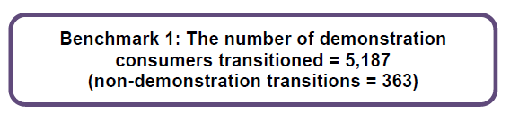
MFP Benchmark 1

Slide 7
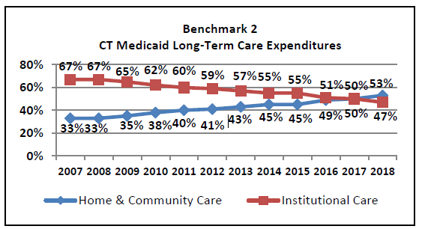
Benchmark 2

Slide 8
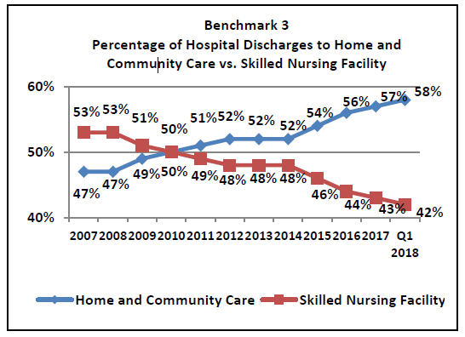
Benchmark 3

Slide 9
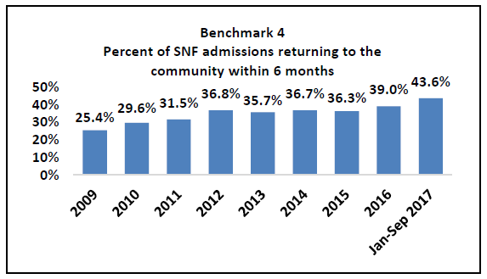
Benchmark 4

Slide 10
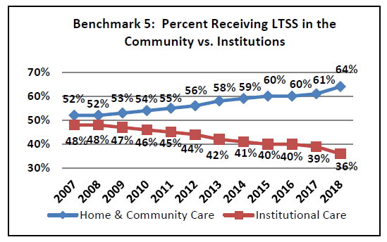
Benchmark 5

Slide 11
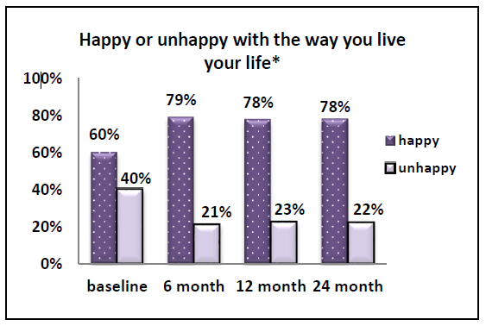
Happy or Unhappy

Slide 12
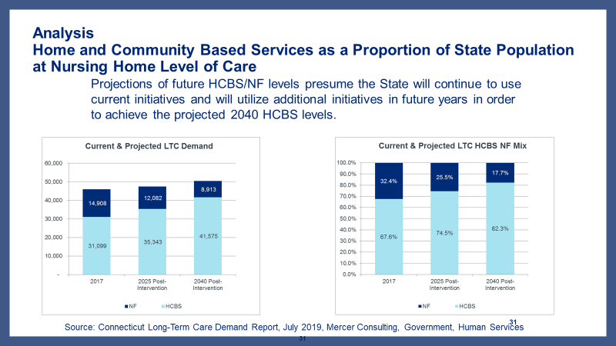

Slide 13
Community First Choice

Slide 14
Community First Choice
8626 unique applications since inception
2349 assigned to be assessed
2785 active CFC participants
(this includes participants using CFC with various waivers)
5291 cases recommended for closure/closed
883 pending assignment to field
Notes:
Active participants based off of paid claims data from March 2019

Slide 15
Community First Choice
Connecticut continues to see demand for CFC
We continue to see changes to the workforce. Each additional participant accessing services, grows the workforce by a 2:1 ratio

Slide 16
Universal Assessment

Slide 17
Universal Assessment (UA)
Currently the UA is used across multiple Medicaid programs to inform a participants Level of Care and Level of Need when assessing for access to Long Term Services and Supports
In coordination with UConn Center on Aging a Quality Management (QM) Plan has been developed and is in the early stages of implementation
  QM Goals include
    Training & Continued Education
    Data Reliability and Accuracy
  New Level of Care Screening Tool will launch in October 2019. This will be a shorter tool with Core items selected to evaluate Level of Care

Slide 18
My Place CT

Slide 19
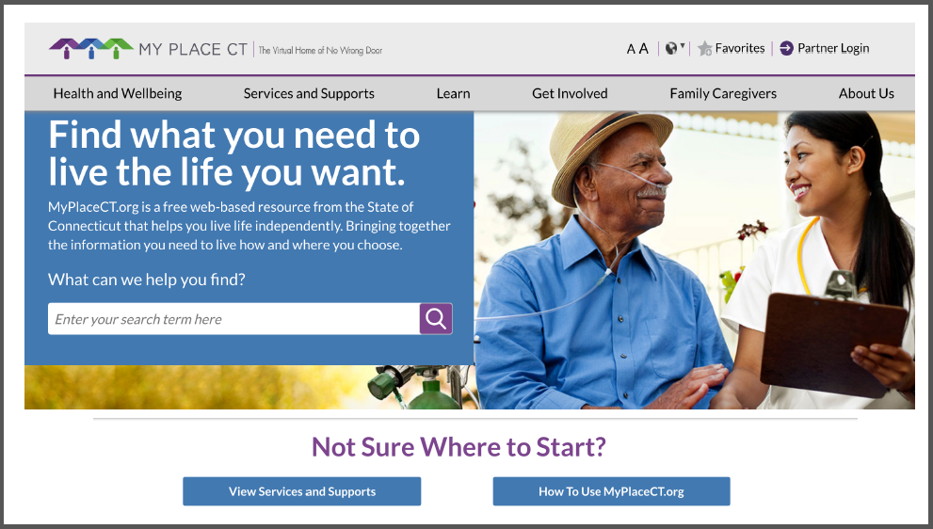
My Place CT

Slide 20
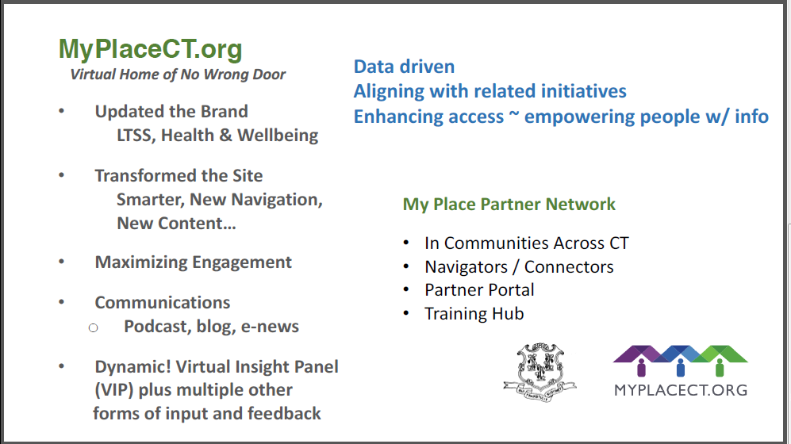
My Place CT

Slide 21
My Care Options
My Care Options

Slide 22
My Care Options
A new LTSS strategy that uses predictive methodology to support discharge of people from nursing homes to community.
Governor’s Initiative: Medicaid-Long-Term-Care-Demand-Projections NEWS-RELEASE

Slide 23
My Care Options: Goals
Provide information on all LTSS options under Medicaid to allow a person to make an informed choice of how and where to receive services
Create a support path to Medicaid while accessing Home and Community Based Services

Slide 24
My Care Options: Population
Short Term Plan
Individuals active on DSS’ Medicare Savings Program (MSP) that also have recently paid nursing facility claims
    Paid Claims under the MSP benefit
Future Plan
Access to MDS data and “Indicators to predict a potential for a long-term stay in a nursing home”

Slide 25
My Care Options: Predictors
ADL Dependence
Age
Gender
Martial Status (unmarried)
Incontinence
Moderate to sever cognitive impairment
Diabetes diagnosis
Heart failure diagnosis
Alzheimer’s Disease or dementia diagnosis
End state disease
Cancer diagnosis
Severe mental illness diagnosis
Hip fracture
Falls
Prior nursing facility stay or prior formal care
Daily behavior problems
Living alone
Lack of family support
Housing challenges

Slide 26
My Care Options: Benefits
Specialized staff providing LTSS information
Connection to information and/or services that might best serve a person
Private/Public Partnership
Access to dedicated LTSS Eligibility staff
Automated tools to allow a person to understand the Medicaid reduction of assets process

Slide 27
My Care Options: Next Steps
Next Steps
Anticipated Start Date: October/November 2019
Short term plan while waiting for MDS data
Finalizing details of the process

Slide 28
Smart Home Technology

Slide 29
The Vision
Health Care Professionals
Technology Experts
People living with the Disease
Will collaborate around solving barriers that are the major causes of people living with Dementia becoming or remaining institutionalized.

Slide 30
Partners
UCONN
North Eastern University
Oak Hill ( Neat Market Place)
Live Well
Alzheimer's Resource Center
CT Innovations (under review)
AARP
ARC of CT (mid-state)
East Conn
Hartford Health Care
MIT (under review)

Slide 31


Slide 32
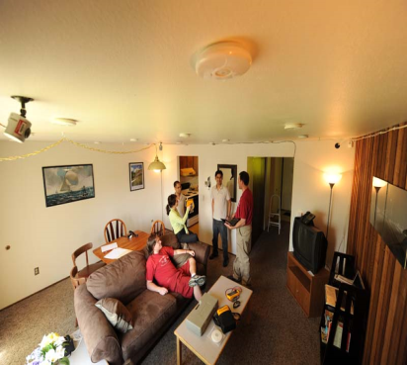

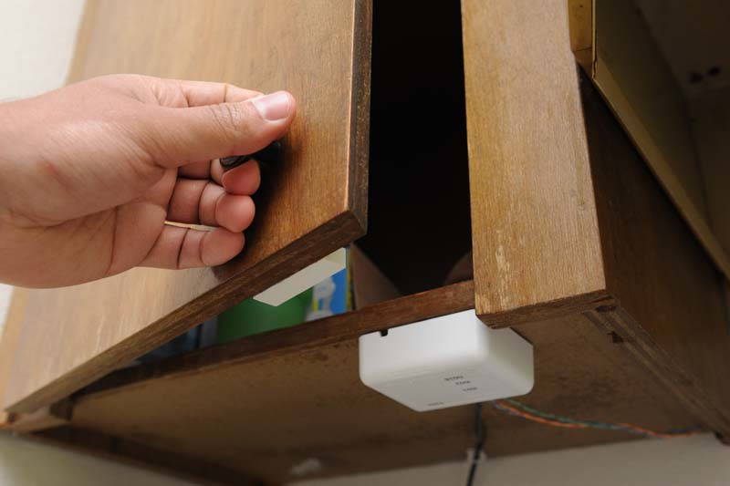

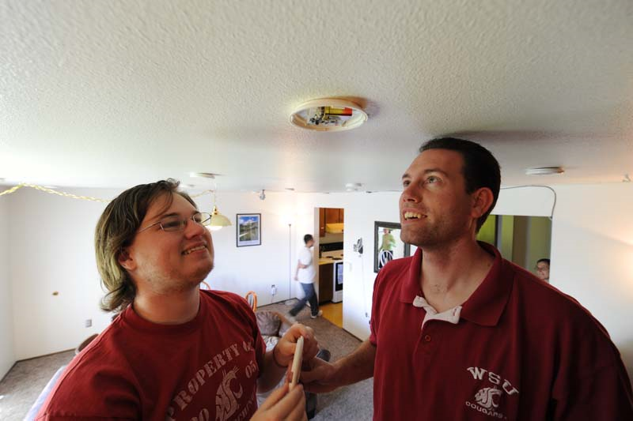


Sense
Identify
Assess
Intervene
Cook

Slide 33
Questions

