Slide 1
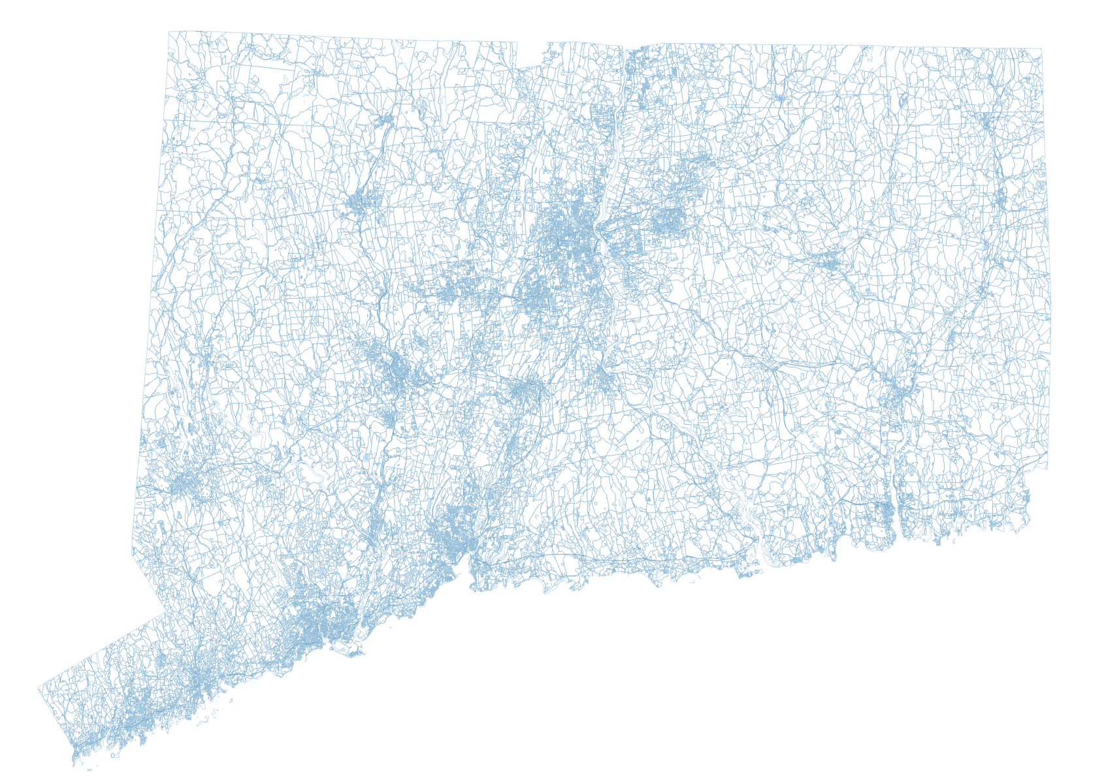

CT GIS Advisory Council Meeting
March 31, 2022

Slide 2
Agenda
Introductions
Introductory Remarks
Public Comment
Discuss and Create Bylaws
Develop GISO Priority Topics
Roundtable Discussion
Adjourn

Slide 3
Introductions

Slide 4
Advisory Council Membership
Appointing Authority | Appointee
OPM | Alfredo Herrera
OPM | Scott Gaul
DEEP | Stuart DeLand
ConnDOT | Greg Ciparelli
DESPP | Dan Czaja
DPH | Gary Archambault
CTCOG | Erik Snowden
CTCOG | Mark Hoover
CCM | Thad J. Dymkowski
CCM | John Guszkowski
Uconn | Emily Wilson
PURA | Peter Sampiere
GA | Meghan McGaffin
GA | Vacant

Slide 5
Introductory Remarks

Slide 6
Legislative Basis for the Council
The Geographic Information Systems (GIS) Advisory Council was established pursuant to Section 79 of Public Act 21-2 of the June 2021 Special Session. The GIS Advisory Council consults with the Geographic Information Officer (GIO) to establish goals on matters relating to:
  the coordination, procurement, processing, storage and distribution of free and public GIS data; and
  the powers and duties of the GIO and the GIS Office as described in CGS Sec. 4d-90.
The GIS Advisory Council also develops priorities for the GIS Office, develops annually a five-year plan for the performance of such office, and makes recommendations to the GIO concerning such priorities and plan.

Slide 7
GIS Office & GIO
OPM's Geographic Information Systems (GIS) Office was established in 2022 following passage of Public Act 21-2 during the 2021 June Special Session. It is directed by a Geographic Information Officer (GIO) and resides within the Data and Policy Analytics Unit of OPM.
The GIS Office is responsible for:
  coordinating the collection, compilation and dissemination of GIS data across the state, including from and to state agencies, regional councils of governments, municipalities and other constituencies;
  managing a publicly accessible geospatial data clearinghouse;
  using GIS to support economic development efforts in the state;
  provide training and outreach on the use of GIS;
  administering a statewide orthoimagery and lidar program;
  adopting geospatial data standards, guidelines, and procedures;
  performing technical data processing to aggregate and organize existing datasets and create new datasets; and
  develop broadband data and mapping in accordance with Public Act 21-159.

Slide 8
Important Milestone
First meeting of the GIS Advisory Council
Special thanks to everyone involved in the legislative process that made this possible.

Slide 9
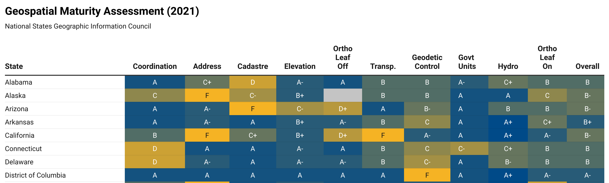
NSGIC Maturity Assessment
The NSGIC Geospatial Maturity Assessment (GMA) provides NSGIC members, sponsors, and other partners with a summary of geospatial initiatives, capabilities, and issues within and across state governments.
How we did:
Special thanks to Eric Lindquist for assisting in the completion of this first assessment last year.

Slide 10
Public Comment

Slide 11
Creation and Discussion of Bylaws

Slide 12
Creation of Bylaws
Voting Structure
Meeting Frequency
Working groups
  Composition
  Mechanism for discussion and adoption of working group recommendations.

Slide 13
GIS Office Priority Topics

Slide 14
Topics List
Aerial Imagery Data Acquisition
Geospatial Open Data Clearinghouse
Statewide Addressing and Geocoding
Broadband Mapping
CAMA Working Group
Parcel Drafting Standards

Slide 15
Aerial Imagery Data Acquisition
Create working group to begin the process of procuring the Spring 2023 Flight.
  Write white paper on requirements and concerns regarding data products, quality, and other considerations.

Slide 16
Geospatial Open Data Clearinghouse
Create a working group to do a needs assessment of GIS community and other audiences for the GIS Clearinghouse.
  Make recommendation on suggested topology for federation with other clearinghouses.

Slide 17
Statewide Addressing and Geocoding
Discuss challenges with statewide addressing.
  Dan Czaja to speak about creating a framework to provide more timely updates to DESPP for inclusion in the statewide address point layer.
Discuss GISO Proposal to create a statewide public geocoder.
  Coordination between DESPP, DOT, and OPM.

Slide 18
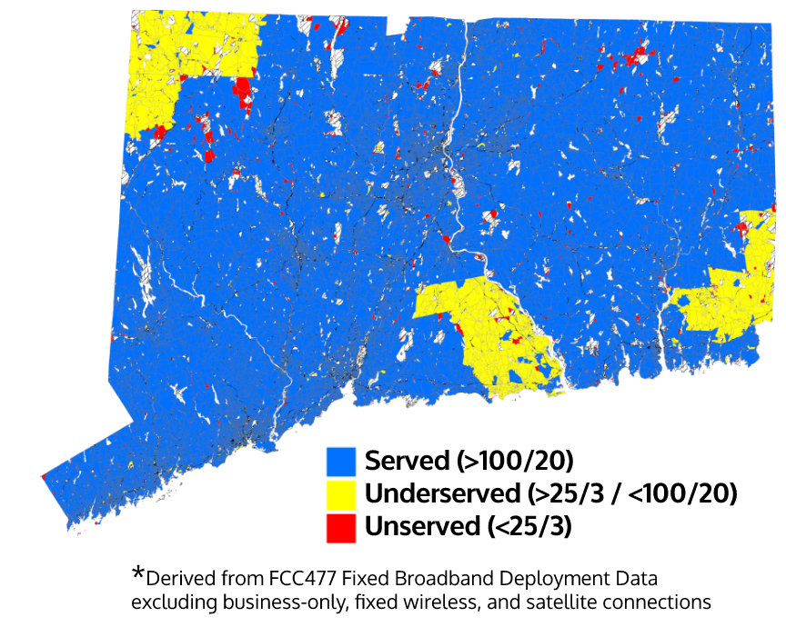
Broadband Mapping
FCC Remap and Data Request (2/1~4/1)
ISP data collection (4/1 ~ 5/31)
Secondary data collection (3/1 ~)
  CCM survey support and cooperation
  Local data collection with NRZs
  Targeted data collection with municipalities
Broadband Mapping Hub (Coming soon)
Broadband Map
(by 12/1/2022)

Slide 19
CAMA Working Group
Update of the activities of the CAMA working group.
  Coordination with COGs and Municipalities
  Plan for Statewide Parcel Layer/Viewer

Slide 20
Parcel Drafting Standards
Discuss the creation of guidelines for varying parcel drafting scenarios and how to resolve them.

Slide 21
Roundtable Discussion

Slide 22
Final Thoughts/Adjourn

