Slide 1
DSS IT Capital Investment Briefing
September 11, 2013

Slide 2
Contents
    ConneCT (Modernization of Client Service Delivery)
    and
    Health Insurance Marketplace/Integrated Eligibility Project
    (Access Health CT/IEP) – Tiers 1, 2, 3, and 4

Slide 3
ConneCT Project
Project Overview
Purpose: The DSS ConneCT project will modernize the agency’s existing infrastructure with the implementation of a Modernization of Client Service Delivery (MCSD) solution utilizing three (3) specific technologies: Internet-based Client Access and Web Services, Document Scanning and Work Flow Management, and Interactive Voice Response (IVR) and Call Center Services. These technologies will be integrated with our existing eligibility legacy system known as EMS. These functionalities will increase the efficiency and effectiveness in how DSS serves its customers.
Status of Project: As of December 31, 2012, two of the project's seven releases have been built and fully tested. These two releases feature Client Accounts and Pre-Screening functionality. In addition to Client Accounts and Pre-Screening, the state has completed the installation and configuration of approximately 95% of the new ConneCT Solution Platform.
Project Timeline: 07/01/11 - 10/01/13

Slide 4


Achieving Incremental “Wins” for DSS and Connecticut
Reach & Impact:
Enables cross-agency collaboration and the ability to serve the “whole client”.
Integrated Eligibility
(Cross-Agency)
Tier 4
Reach & Impact:
Increased automation to improve service delivery to all DSS clients.
Reach & Impact:
New population of clients who purchase/receive medical insurance.
New quasi-public agency.
Integrated Eligibility
(DSS)
Tiers 2 and 3
Reach and Impact
Reach & Impact:
New channels for DSS clients to get information.
New technology tools for DSS workers.
Tier 1
Time
These projects build on each successful milestone to increase reach and impact.

Slide 5
Objectives - ConneCT
  Improve Client Access
    Anywhere/anytime access via web services.
  Achieve Better Quality Outcomes
    Makes processes faster and more efficient by reducing “back and forth” and generation of paper.
  Enhance Customer Service
    Empowers workers with tools to help clients.
    Increases the number of workers who can help a client.
  Reduce Costs
    Reduces the need for paper (and associated storage costs).
    More efficient retrieval of documents.
  Provide a Technological Framework for the Future
    Integrated technologies support the business and allow for expansion.
Through ConneCT we are using technology to generate positive business impact.

Slide 6
Building a Technological Framework for Future - ConneCT
 | Technical Milestone | Benefit to DSS and Connecticut
✓ | Built and deployed new server infrastructure at BEST Data Center. | Allows to BEST to host a modern web-based system for DSS.
✓ | Installed new telephone system at BEST and at three DSS offices. | Single, centralized telephony platform enables a state-wide workforce and provides redundancy.
✓ | Installed new optical fiber network. | Enables high-speed connectivity between the BEST data center and DSS benefit center offices to support voice and data.
✓ | Installed 700 new telephone lines at the BEST Data Center. | Allows DSS customers to reach DSS via a central location and access telephony services.
✓ | Deployed new web-based software platform. | Provides modern, web-based systems for DSS clients and DSS workers to use.
✓ | Installed leading COTS products including Rules Engine and Document Generation Software | Provides modern, web-based systems for DSS clients and DSS workers to use.
Extensible technical products support DSS now and in the future.

Slide 7







Release Update and Timelines- ConneCT
 | Functional Overview | Status / Target Date
Client Accounts | Provides secure, anytime access to generic and case-specific information to clients via the Internet. | Currently Live (http://connect.ct.gov)
Pre-Screening | Allows clients to independently check for potential eligibility online without having to visit or call DSS. | Currently Live (http://connect.ct.gov)
Interactive Voice Response (IVR) | Provides secure, anytime access to generic and case-specific information to clients by phone. | Currently Live
Document Management and Workflow | Reduces the need for paper-based processing and provides centralized access to documents and visibility into document status. | Currently Live
Benefit Center | Provides a centralized, consistent enterprise system for receiving and servicing incoming calls. | Currently Live
Online Application | Allows clients to apply online and provides a dynamic verification checklist to clearly explain what verification is required. | September 2013 (beta)
Change Reporting and Online Redeterminations | Allows clients to report changes and conduct redeterminations online. | October 2013

Slide 8



ConneCT Telephony – Benefit Center Model
Benefit Center Office 1
Key Features:
Web Services Make Legacy Data Available for Self Service
Benefit Centers are Redundant
Licenses Float Between Offices
Remote Agent Capability.
Service Group
Benefit
Group
Processing
Group
Benefit Center Office 2
State-Wide IVR
One Phone #:
1-855-6-CONNECT
Service Group
Benefit
Group
Processing
Group
Automated Self-Service
Benefit Center Office 3
EMS
Legacy
System
Service Group
Benefit
Group
Processing
Group

Slide 9
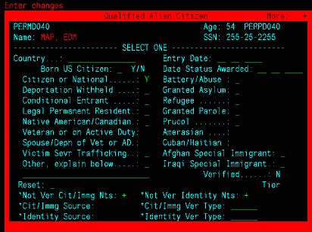

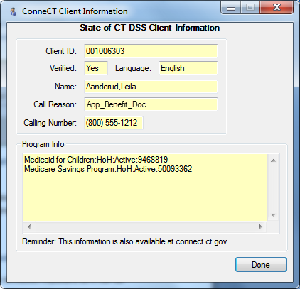
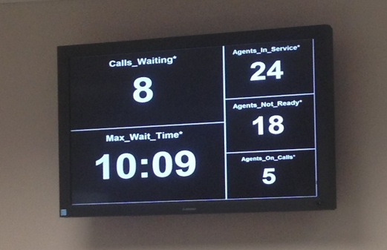
A Closer Look…
CT Benefit Center
Worker Portal
EMS Legacy System
Benefit Center
Worker
and Supervisors
Benefit Center
Console (Avaya)
ConneCT Screen Pop
Benefit Center Phone (VoIP)
Benefit Center Screen Pop
Tells the Worker Who is Calling and Why
Office Wall Boards
Display Agent Status and Max Call Wait Time (Configurable)

Slide 10










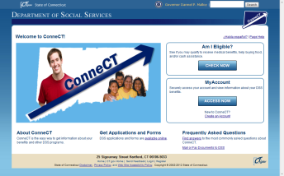
A Closer Look…
CT Document Management and Workflow
Daily Pick-up
Central PO
Box Mail
Post Office Manchester, CT
Expedited Fax: 2hr SLA
Transmission Every 2hrs.
All Other Docs: 24hr SLA
Transmission Every 2hrs.
Scan Optics
BEST
Prep
Scan
Form ID
Client ID
4AM – 6AM
12PM – 1PM
5PM – 8PM
Batch
Process
Fax
Expedited
Fax
DSS Office
Mail-Room
Workers
Mail
UPS - 1 Business Day
ConneCT WP
Work Items Created
or Appended
Walk-in
*NEW*
Online Applications, Changes and Redes
ConneCT CP

Slide 11
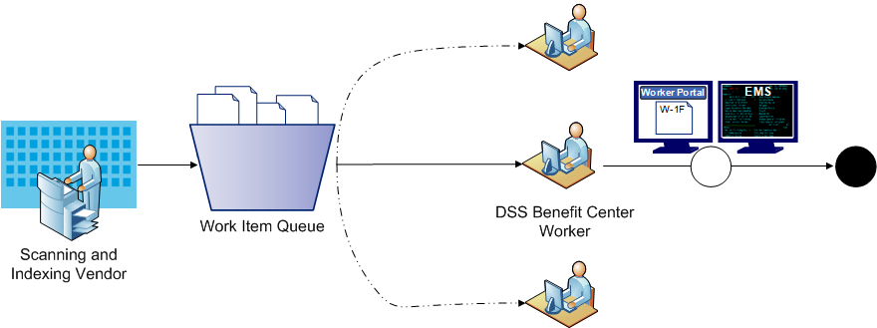

A Closer Look…
CT Document Management and Workflow

Slide 12

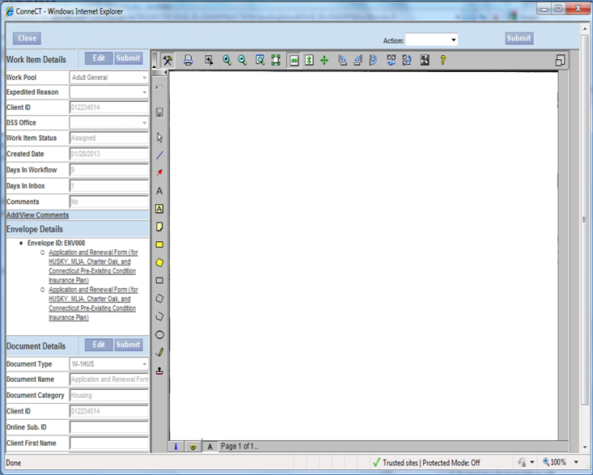

A Closer Look…
CT Document Management and Workflow
ConneCT Worker Portal
EMS Eligibility System
DSS
Processing
Workers
Client Accounts

Slide 13
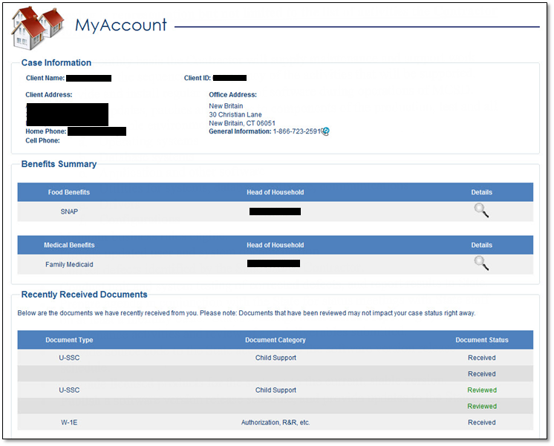
ConneCT Document Management and Workflow –
Enabling Real-Time Document Tracking

Slide 14
ConneCT Modification Releases (Draft Plan)

Slide 15
ConneCT – Current Risks and Issues
Risks:
  State resource competition for upcoming releases and other projects.
Issues:
  Challenges with scanning/indexing at the current full production volume.
  Analysis and refinement of business processes has been challenging with aggressive rollout approach.
  Intermittent production issues have impacted production up-time.

Slide 16
ConneCT – Results and Impacts
While recently implemented (fully operational July 8, 2013), ConneCT has already started to make a significant impact:
  30,015 Online Accounts Created
  50,000+ IVR Accounts Created
  127,308 Calls Answered by the Benefit Center
    29,302 Interviews Conducted via Phone
  ~1M Legacy and New Documents Committed into FileNet (Doc Mgmt)
“This series of technological improvements will gradually change the service landscape at DSS for the benefit of Connecticut residents, the agency’s dedicated staff, and taxpayers in general. We are literally taking an agency from obsolescence in terms of overwhelmed phones and laborious paper processing into the modern age of business systems.”
-Governor Dannel Malloy

Slide 17
Financial Estimates (SFY 13 – SFY 14) - ConneCT
Estimated Total Development Cost | Estimated total Capital Funding Request | Estimated Annual Operating Cost | One Time Financial Benefit | Recurring Annual Financial Benefit
$21,401,663 | $8,550,041 | $4,652,061 | $10,478,858 | $2,279,510
Explanation of Estimates
The total development costs indicated above are reimbursed by the Federal Government at a 49% FFP rate. The “One Time Financial Benefit” of $10,478,858 shown above reflects $2,279,714 of FFP against the Capital Equipment Purchase Fund expenditures of $4,652,478, in addition to the FFP of $8,199,144 for the federal share of this initiative.
Funding requested for the ConneCT project through this submission reflects the final allocation of funds for SFY 2014 consistent with the funding amounts approved in our original submission to the Committee.

Slide 18
Actual & Projected Expenditures – ConneCT
Actual and Projected Development Expenditures
Actual Expenditures:
SFY 2009 | 859,840
SFY 2010 | 441,458
SFY 2011 | 894,014
SFY 2012 | 4,793,671
SFY 2013 | 13,636,831
Total Actual Expenditures Through SFY 2013 | 20,625,814
Projected Expenditures:
SFY 2014 | 7,764,832
Grand Total All Expenditures | 28,390,646
$20.6 m expended in prior years
$ 7.8 m for 2014 costs
$28.4 m total project cost

Slide 19
Actual & Projected Expenditures (SFY 13 – SFY 14) - ConneCT
*Does not include Maintenance & Operation expenditures (SFY14 - $4.5m, SFY15 - $4.7m).

Slide 20
Achieving Incremental “Wins” for DSS and Connecticut
Reach & Impact:
Enables cross-agency collaboration and the ability to serve the “whole client”.
Integrated Eligibility
(Cross-Agency)
Tier 4
Reach & Impact:
Increased automation to improve service delivery to all DSS clients.
Reach & Impact:
New population of clients who purchase/receive medical insurance.
New quasi-public agency.
Integrated Eligibility
(DSS)
Tiers 2 and 3
Reach and Impact
Reach & Impact:
New channels for DSS clients to get information.
New technology tools for DSS workers.
Tier 1
Time
These projects build on each successful milestone to increase reach and impact.

Slide 21
Health Insurance Exchange & Integrated Eligibility System Project (HIX / IEP) – Tiers 1, 2, 3, and 4
Project Overview
Purpose: The Department of Social Services Integrated Eligibility System project will replace the Department’s existing 24 year old Eligibility Management System (EMS). The integrated eligibility platform, once designed, developed and implemented, will provide a seamless eligibility and enrollment process for Medicaid, CHIP and the CTHIX, and will ultimately be used to determine eligibility for other social service programs (e.g., SNAP, TFA). Specifically, the planned integrated eligibility function will initially address federal requirements for eligibility determinations for advance premium tax credits and reduced cost sharing through the Exchange, MAGI-based eligibility for Medicaid, complete individual responsibility exemption determinations, and coordinate enrollment.
Anticipated Project Timeline: 02/1/12 - 12/31/15

Slide 22
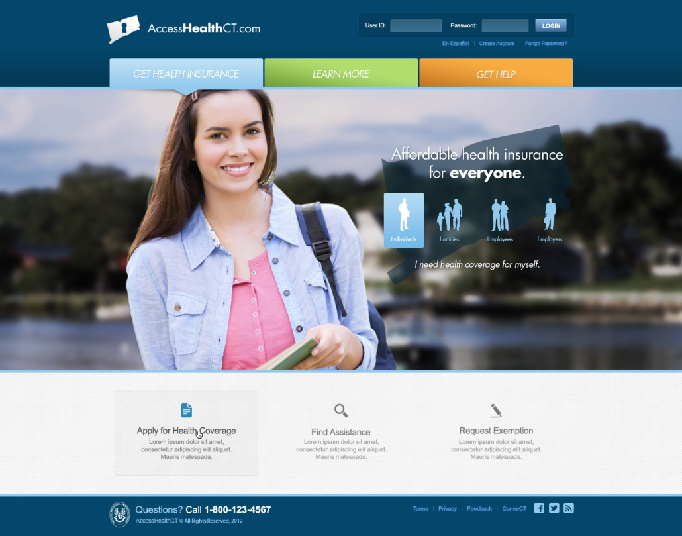
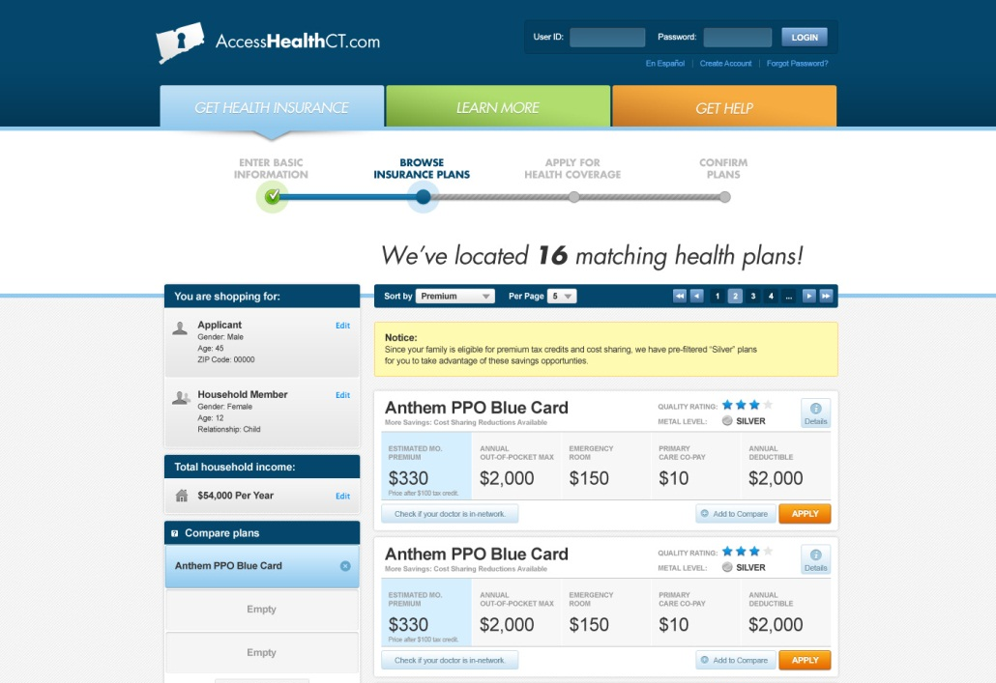
Tier 1 Update and Timeline – Access Health CT
June 2013: Enables the Loading of Plan Data (Currently Live)
 | O | N | D | J | F | M | A | M | J | J | A | S | O
R1: Plan Management
R2: Core Functionality
R3/R4: Deferred Functionality
October 2013: Allows Clients to Browse, Apply, Shop and Enroll
Provides Additional Functionality to Enhance the Marketplace

Slide 23
Access Health IE PMO IT Program Plan Completion
(per the IE PMO work plan)
IEPMO Program Plan Completion as of 8-30-13
Phase | IT/OPS | Current Completion | Weight | IT Total | Start Date | Finish Date | Previous
Planning | R0 IT | 100% | 0.5 | 100% | 05/14/2012 | 11/15/2013 | 100%
 | R1 IT | 100% | 0.5
 | R2 IT | 100% | 0
Design | R1 IT | 99% | 0.93 | 99% | 07/10/2012 | 09/16/2013 | 98%
 | R2 IT | 93% | 0.07
Development | R1 IT | 99% | 0.31 | 95% | 08/16/2012 | 09/30/2013 | 93%
 | R2 IT | 93% | 0.69
Implementation | R1 IT | 99% | 0.14 | 71% | 10/19/2012 | 10/03/2013 | 62%
 | R2 IT | 67% | 0.86
Operations | R1 IT | 21% | 0.05 | 1% | 06/04/2013 | 12/31/2014 | 0%
 | R2 IT | 0% | 0.95

Slide 24
Access Health CT / Integrated Eligibility PMO IT Dashboard 08/30/2013 08/30/13
Summary – milestones
 | FEB | MAR | APR | MAY | JUN | JUL | AUG | SEP
Reqs/ Planning
Infrastructure
Design
Development
Testing
Implementation
Today
1l
1d
1g
1h
1j
1k
1a
1e
1i
7r
7p
7z
7u
7n
7g
7b
7l
7t
7d
7i
7m
7y
7c
7h
7s
7o
7w
7x
3b
3i
3n
10n
10p
10o
12a
3j
2n
12b
12c
12e
12g
12i
2q
12j
12k
3l
12d
12f
3k
12h
12n
12l
2h
10l
10t
2i
2s
2o
10m
10y
Requirements and Planning
(1a) *Preliminary IRS ACA Safeguard Procedures
Report & System Security Plan due
(Apr 1)
(1d) *Privacy Impact Assessment Complete
(May 15)
(1e) *Preliminary Interconnection Security
Agreement must be provided (May 17)
(1g) *Final State Determination (Jul 1)
(1h) *Computer Matching Agreement (Aug 15)
(1i) *Submit Final ACA Safeguard
Procedures Report & Final System Security
Plan to IRS (Jul 1)
(1j) *Final Interconnection Security Agreement
due (Sep 1)
(1k)*Business Partner Agreements must be
complete (Sep 30)
(1l) Submit Establishment Design Review & IT
consultation/presentation to CMS
(March 27-28)
Infrastructure
UAT
(7g) R2 SIM/SAM Configuration (Jun 17 – 21)
(7h) R2 Informatica Configuration (Jun 24 – Jul 5)
(7i) R2 UAT Deployment (Aug 21)
(7w) R2 UAT Shakedown (Jul 2 – Aug 21)
(7b) R2 SMS Module Install Complete (Jul 1)
(7c) R2 Filenet Configuration (May 31 – Jun 28)
Staging
(7n) R2 SIM/SAM Install (May 14 – Jun 14)
(7o) R2 Staging SIM/SAM Config. (Jul 29 – Aug 9)
(7p) R2 Staging Deployment (Aug 19)
(7d) R2 Software Base Configuration (Jun 6 – Aug 14)
(7l) R2 SMS Module Install Complete (Jul 12)
Production
(7t) R2 Vanilla Software Install (Jun 5 – Jul 19)
(7x) R2 SIM/SAM Install (Jul 15 – was Aug 28, now Sep 4)
(7y) R2 Informatica Configuration (Jun 10 – 20)
(7m) R2 Filenet Configuration (Jun 17 – was Aug 16, now Sep 6)
(7r) R2 SIM/SAM Configuration (Jul 29 – Aug 1)
(7s) R2 SMS Module Install Complete (Jul 29)
(7z) R2 Deployment (was Aug 28, now Sep 6)
(7u) BEST MOU in AHCT legal review (Feb 8)
Design
(3b) Technical Design (Due Feb 1)
(3i) R2 Design Complete (Mar 15)
Telephony – Design
(10n) IVR & Outbound Dialer (Aug 12)
(10o) Telephone System & Call Recording (Jul 25)
(10p) WFM System (Aug 21)
Development
(3j) R2 Development Complete (Aug 2)
(3n) System changes for new SSA
Testing
(12b) Finalize UAT Scenarios (Jun 28)
(12c) Create UAT Training Schedule (Jul 5)
(12d) Select and Prepare Training Rooms (Jul 5)
(12e) Week 1 Training Overview (Jul 16 – 18)
(12f) Complete UAT Env. and Testing Checklist (Jul 24)
(12g) Week 2 Training (Jul 22 – 26)
(3k) R2 SIT (Aug 15)
(12h) Prepare test scripts for UAT (Aug 30)
(2q) Start R2 UAT (Aug)
(12i) UAT Execution Kickoff (Jul 31)
(12j) Final UAT Schedule – Cycle 2 (Aug 16)
(3l) R2 UAT/ Go No-Go (Sep 13)
(12k) Final UAT Schedule – Cycle 3 (Aug 30)
(12l) R2 UAT Exit Review Meeting (Sep 17)
(12n) Final UAT Schedule – Cycle 4 (Sep 6)
Implementation
ConneCT
(2h) Xsfr Case-base to Task-base (Jul 8)
(2i) Online App&Redets [R6&R7] (Aug 13)
EMS/ConneXions/MMIS
(2o) ConneXions MPI load file developed (Jun 26)
(2s) Go live open enrollment (Oct 1)
MAXIMUS Data & Voice Circuits
(10l) Voice Circuits (Jul 22)
(10m) ACD (Jul 16)
MAXIMUS CRM/KMS
(10t) Env Set-up (was Jul 24, now Aug 14)
(10y) KMS Set-up (Aug 11)
*Indicates CMS Critical Activities and Important for Conditionally Approved SBEs
legend

Slide 25

Tier 1 – DSS Workstream Dashboard – 08/30/2013
Summary – milestones
Today
 |  | 2013
 | JUNE | JUL | AUG | SEPT | OCT | NOV | DEC | JAN
DSS
2r
2i
2q
2k
2v
2x
2t
2w
2s
Tier 1
(2k) Approval of Tech Design (June TBD)
(2q) Start R2 UAT (Aug 2013)
(2r) Commence Training DSS staff (Aug 2013)
(2s) Go live open enrollment (Oct 1)
(2t) Go live (Jan 2014)
(2v) Submit SPA to legislative committee (Week of 8/5)
(2w) SPA Tribal Consultation (8/5)
(2x) SPA submission to CMS (8/31)
ConneCT
(2i) Online App & Redets (pilot rollout) [R6&R7] (Sep 9)
EMS/ConneXions/MMIS
(2p) All new SPEC Aus in EMS production (Nov 29)
(2n) EMS webservice lookup (Mid May)
DSS |  | Schedule Risks | Resource Risks | Quality Risks | Deliverables Risks | Issues
ID | Risk (s) |  | Overall Risk Level | Mitigation |  | Current Status
2t | Timing and scope of the R3 & R4 unknown. Resulting impact is lack of Integration Plan across AHCT & ConneCT. (DSS expecting integration in December release) (Risk 107) |  | Medium | Need an integrated work plan with release scope and timing. |  | Meeting scheduled for August 7 at DSS to discuss.
2s | Assumed staffing for processing verifications – scope of Xerox workers in making discretionary action. (Risk 115). |  | Medium | Consider work around for 1) staffing, or 2) forms of verification (including possible ‘self attestation’). |  | Work around currently being explored.
2s | Appeals process and scope of Xerox .There is a risk DSS will not be able to support the increase in fair hearings impacting DSS staffing. |  | Low | Discussions are currently underway between AHCT and DSS on how Fair Hearings would be handled (roles and responsibilities of various parties incl Xerox). |  | Meetings have commenced to document this and are being supported by KPMG.
2s | There are currently 17 DSS Change Requests pending analysis which impact either the R2 October Release, or the January Release[refer to IPEMO CR Log]. |  | Low | Need a CCB meeting ASAP to address each of these CRs and other CRs that may arise. |  | Awaiting CCB meeting to be scheduled.
Key planned activities for current week
1. Decision on verification – potential self attestation
2. Identify reporting requirements
3. Develop hearings processes.
4. Develop functionality required for future releases
5. Follow up on IPA

Slide 26
Access Health CT – Release 2 – Risk by Category
Quality | Medium
 | 107 | Timing and scope of future releases
 | 111 | Requirements have not been traced to Design, Development, and Test scripts
 | 115 | Verification process (IT)
 | 120 | Poor Quality Deliverables causing rework and schedule delays
 | 144 | Training evironment is unstable and the work portal is not working
 | 146 | System Integrator Testing Defect Reslution Late
Schedule | Medium
 | 83 | MOU between BEST and Exchange polished on 1/24 pending AHCT legal sign-off
 | 85 | The Federal Data Services Hub (FDSH) will not be available in time for Deloitte development timeline.
 | 123 | UAT and Performance Testing Availability
 | 126 | ICDs missing/late bSwift, ScanOptics, sir speedy, Xerox impacting testing
 | 132 | Limited time to get approval for Power User, Plan Variation and SSA changes design to meet coding deadlines.
 | 135 | Data format inconsistencies between Federal data templates and AHCT are hindering QHP data uploads.
 | 138 | Staging Environment will not be ready for shakeout until 8/7
 | 142 | Domain and DNS changes
 | 147 | Significate Scope Changes may be made for R3 and R4 whih have created schedule risk for requested scope.
Scope | Medium
 | 124 | Operational and systems integration with DSS not finalized (e.g. - appeals, notifications, and call center operations, etc.)

Slide 27
Achieving Incremental “Wins” for DSS and Connecticut
Reach & Impact:
Enables cross-agency collaboration and the ability to serve the “whole client”.
Integrated Eligibility
(Cross-Agency)
Tier 4
Reach & Impact:
Increased automation to improve service delivery to all DSS clients.
Reach & Impact:
New population of clients who purchase/receive medical insurance.
New quasi-public agency.
Integrated Eligibility
(DSS)
Tiers 2 and 3
Reach and Impact
Reach & Impact:
New channels for DSS clients to get information.
New technology tools for DSS workers.
Tier 1
Time
These projects build on each successful milestone to increase reach and impact.

Slide 28
IEP – Tiers 2 and 3 – High Level Description
The implementation of Tiers 2 and 3 effectively provides CT DSS the ability to sunset its legacy eligibility system known as EMS

Slide 29
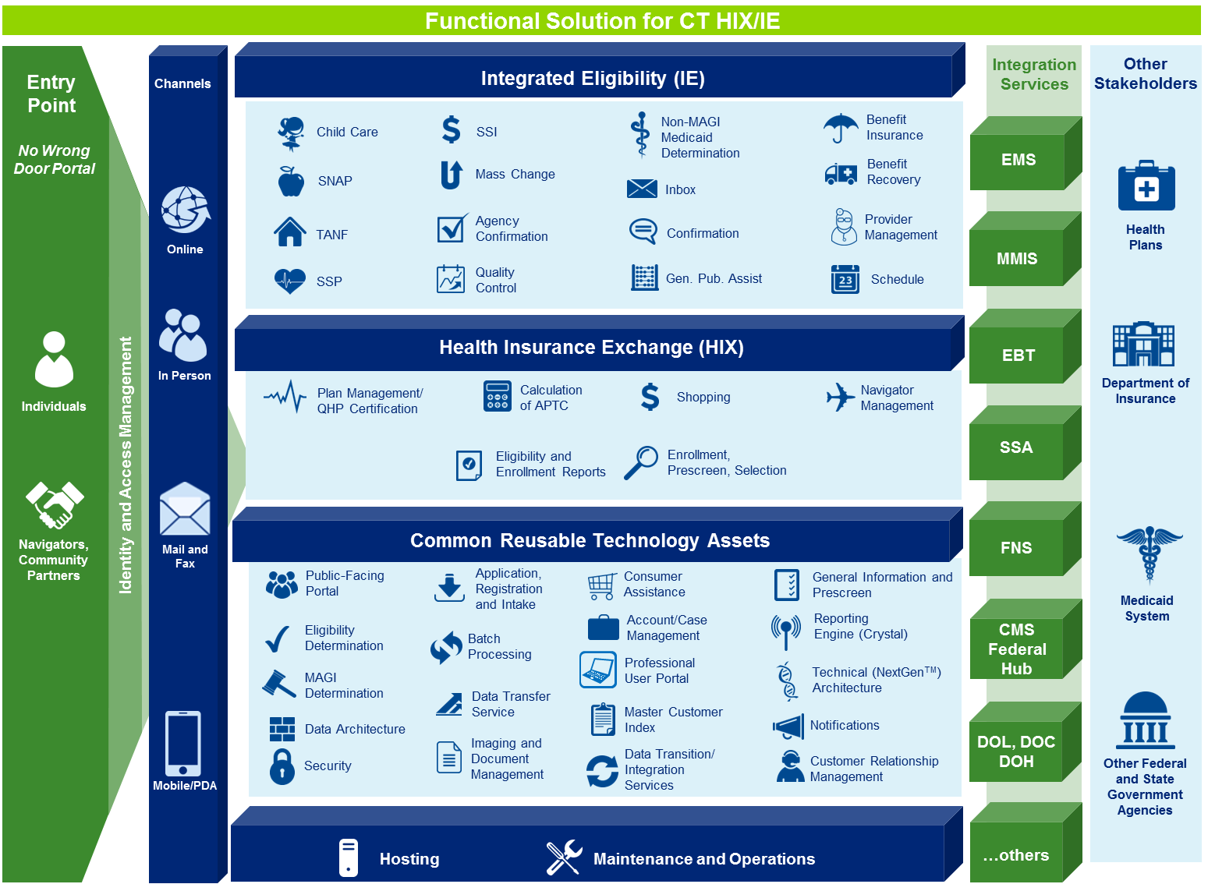
IEP - Platform Capabilities for Tiers 2, 3 and 4

Slide 30
IEP - Future Vision for Tiers 2 and 3 (proposed)

Slide 31
IEP – Tiers 2 and 3 – High Level Project Timeline (proposed)

Slide 32
IEP – Tiers 2 and 3 – Key Dates (proposed)

Slide 33
IEP – Current Status of Planning Phase
Implementation Advanced Planning Document (IAPD) was approved by the Centers for Medicare and Medicaid Services (CMCS) and by the Food and Nutrition Services (FNS) on April 5, 2013.
IEP Statement of Work (SOW) approved by CMCS and FNS on June 25, 2013 and submitted to Deloitte Consulting.
Final DSS Negotiated Deloitte SOW Response submitted to CMCS and FNS on August 8, 2013
CMCS and FNS are currently reviewing Deloitte SOW Response and have indicated that review will be completed within approximately thirty (30) days.
CT DSS anticipates official IEP kick-off to happen on October 1, 2013.

Slide 34
Achieving Incremental “Wins” for DSS and Connecticut
Reach & Impact:
Enables cross-agency collaboration and the ability to serve the “whole client”.
Integrated Eligibility
(Cross-Agency)
Tier 4
Reach & Impact:
Increased automation to improve service delivery to all DSS clients.
Reach & Impact:
New population of clients who purchase/receive medical insurance.
New quasi-public agency.
Integrated Eligibility
(DSS)
Tiers 2 and 3
Reach and Impact
Reach & Impact:
New channels for DSS clients to get information.
New technology tools for DSS workers.
Tier 1
Time
These projects build on each successful milestone to increase reach and impact.

Slide 35
IEP – Tier 4 – Across the CT HHS Enterprise
This tier contemplates an enterprise build enabling cross-agency collaboration and the ability to serve the “whole client”.
This tier is being led by CT Chief Information Officer, Mark Raymond
Involves CT HHS agencies such as Department of Public Health, Department of Children and Families, Department of Disability Services
Planning work is still ongoing

Slide 36
Updated Financial Estimates (SFY 13 – SFY 16) – CT HIX/IEP
Estimated Total Development Cost | Estimated total Capital Funding Request | Estimated Annual Operating Cost | One Time Financial Benefit | Recurring Annual Financial Benefit
$108,104,791 | $13,699,707 | $13,782,851 | $94,375,483 | $10,337,138
Explanation of Estimates
The total development cost is reimbursed by the Federal Government at an 87.3% FFP rate. The estimated annual operating cost is calculated based on the SFY15 amount of $13,782,851. The recurring annual financial benefit is calculated by multiplying the estimated annual operating cost by 75%, as operating costs will be reimbursed at a 75% FFP rate. In the development of the cost estimates above, the majority of the cost is allocated to information technology systems and related support. These costs are highly dependent upon future activities, such as the structure of procurements, vendor solicitations, and the actual reusability of technology components. The costs also reflect assumptions on the approach to implementation including training, user acceptance test, pilot, conversion and the number of releases. The operational cost budget accounts for two (2) years of operations and maintenance, starting in January 1, 2014 and running through December 31, 2015. Assuming a full implementation of software around December 31, 2014, the estimate includes one full year of post implementation stabilization support. Please note that these costs are very preliminary estimates and subject to change as additional information becomes available. Furthermore, there is an anticipated future APD for Tier 4 Development Costs, which are not included in this submission.

Slide 37
Reasons for Expenditure Updates (SFY 13 – SFY 16) – CT HIX/IEP
An adjustment is made to include additional project costs of $4.3 million associated with the HIX Tier 1 development. This includes the following:
  IV&V – First Data $0.7 m
  In Person Assistors $1.3 m
  Hardware/Software $2.3 m
Further detail on project timelines has allowed us to better estimate project needs across the multi-year period. As a result, total project funding of $23.6 million is shifted from SFY 2014 to SFY 2015.
The IT Capital Fund request is also altered to reflect a revision to the anticipated federal reimbursement level. The original request utilized an overall federal share of approximately 85%; this request updates the federal share to approximately 87%.

Slide 38
Projected Expenditures (SFY 13 – SFY 16) – CT HIX/IEP
*Does not include Maintenance & Operation expenditures (SFY14 - $2.8m, SFY15 - $13.8m, SFY16 - $3.9m). *Does not include anticipated future APD for Tier 4 Development Costs, which are undetermined at this time.

