Slide 1
Lean and information technology in Connecticut State Government
November 2014
Notes:
6 MINUTES - Alison
Introductions of presenters and guests
Does anyone know about Lean?
Do you know about the state’s process improvement initiative? What have you heard?
Has anyone served on a Lean team? Government? Private sector?
Has anyone visited a Lean team? What were your thoughts?

Slide 2


Vision
Serving the individuals, families, businesses and communities of Connecticut in the most efficient and responsive way.
Notes:
2 MINUTES - Alison
Overlap between Lean and IT -- Both Lean and IT have a similar overall goal – to make things better/to improve services to our customers (fast, efficient, transparent and accessible). Lean enables the process owners to streamline their process and remove wasteful activity. This is important for IT staff, because, why would we want to automate waste? That would not make things better long term.

Slide 3

We need to have this conversation
IT plays a significant role in the efficiency and effectiveness of state government
Coordination must be clear and intentional
Provides the opportunity to speak the same language
Notes:
5 MINUTES - Alison
“By applying Lean principals to application maintenance and development we have helped clients to improve productivity by 15–25 percent, and time-to-market has fallen by up to 25 percent.” - McKinsey & Co
Business process improvement efforts cannot be sustained without your input, commitment and support. Many Lean projects will have IT implications (solutions, changes, new requests, etc.), and likewise, when folks are requesting new systems or additional functions, we can try to encourage them to “Lean” the process first. We want to do everything we can not to automate a bad process that is full of waste. Because of this, our coordination with one another must be clear and intentional.
Often times, there is a disconnect between IT and program staff. Requirements for both functions are not always clearly understood by one another. Lean process mapping, implementation plans, and associated goals/metrics provide a framework by which IT staff can learn what it is that program staff need. The two can speak the same language to understand requirements, timelines and project deliverables. Through improved communication, we can reduce waste, not only within a given process, but also in the way we do business overall (administrative, time, resources, etc.)

Slide 4
Statewide Continuous Improvement Timeline
State of CT Jobs Bill passes
Statewide Process Improvement Steering Committee
- Increased activity
- Accountability
- Continued investment
- Governor’s Directive
- LeanCT Program
Limited Statewide Lean Activity
Before 2011
2011
2012
2013
2014 +
Notes:
Alison – 2 MINUTES
Before 2011:
Between 2000 and 2010, the CT Department of Labor (DOL) begins its Lean journey, serving as the statewide champion of continuous improvement in CT state government
DOL provides training and support to agency staff across the state in Lean tools and critical thinking and introduces other state agencies to the Lean process (CT Departments of Energy and Environmental Protection (DEEP), Transportation (DOT), Motor Vehicles (DMV) and Social Services (DSS))
2011: Jobs Bill passes – section 10 requires the use of Lean in areas such as permitting, licensing, and enforcement (CGS 4-68z)
2012: Statewide Steering Committee forms to oversee implementation of Lean statute and annual statewide reporting on the use of Lean begins
2013: Governor Malloy directs state agencies to utilize Lean tools and LeanCT program is developed with a full-time position at OPM to spearhead and coordinate effort
2014: Statewide Steering Committee expands to include all functions of government, CT holds its first Statewide Process Improvement Showcase at the State Capitol and CT joins National Community of Practice of states who have a statewide “Lean” effort. Remainder of 2014 and Beyond: Continued investment in our commitment to Lean practices & continuous improvement

Slide 5
An Overview of Connecticut’s Lean Journey
The Jobs Bill has sparked State Government to embrace Lean process improvement techniques, with customer service as its focus
Assignment of Agency Lean Coordinators
Training of state employees and non-profit providers
Process improvement activities using Lean tools
Focus is on ALL areas of government
Collaboration across agency lines
Notes:
Alison - 3 MINUTES
Over 40 state agency heads (the 14 on the Steering Committee and another 30) have assigned “Lean Coordinators” to coordinate process improvement efforts and promote a new way of thinking
Over 2,000 state employees (and over 100 non-profit provider staff members) have been trained to use Lean tools and principles
Hundreds of processes have been improved using Lean tools, generating savings and improving service to CT residents, including project that cross agency functions and operations.
Agencies that have participated in Lean events or project implementation span all functions of government, including regulation and protection, health and human services, corrections, conservation and development, education, enforcement and compliance, housing, transportation, and general oversight. These events have improved business processes by eliminating waste, removing redundant steps and adding automation across programmatic, functional and agency lines.

Slide 6
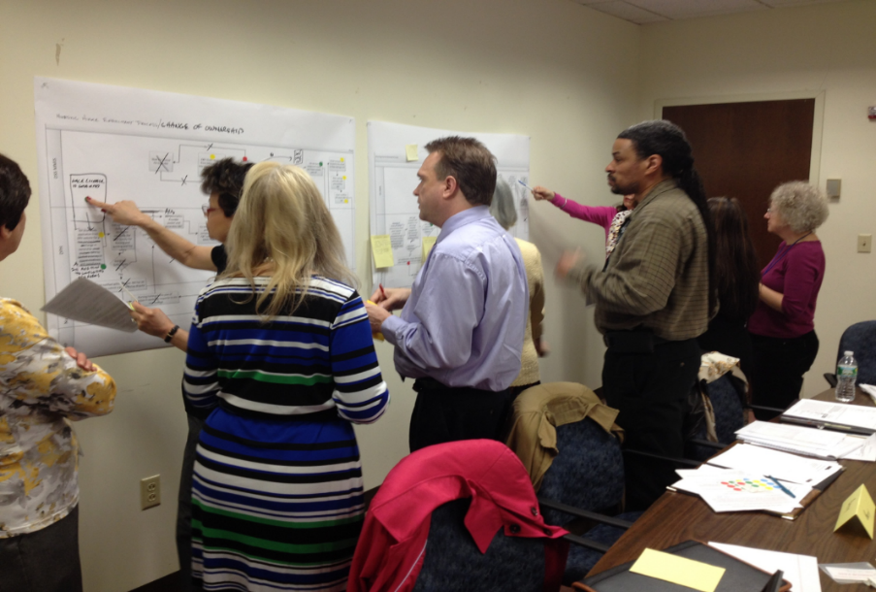
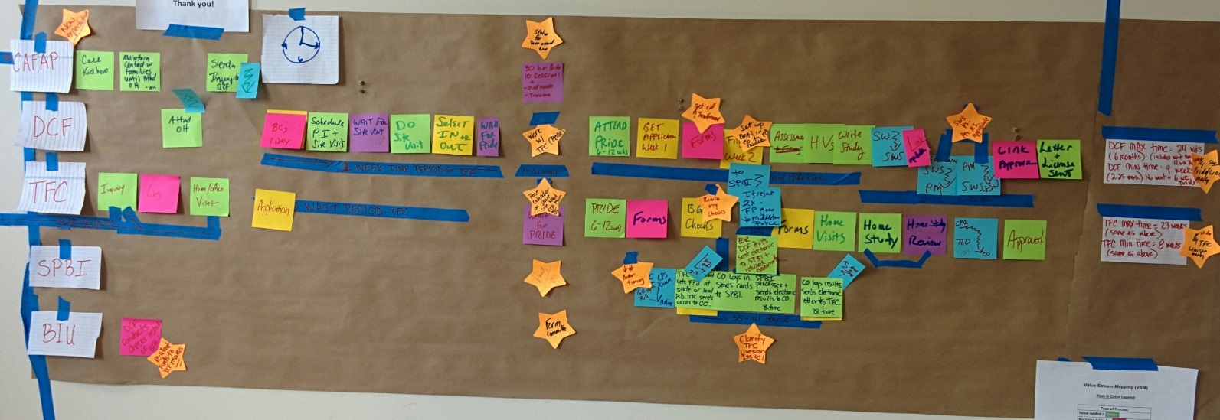
“Lean” in Connecticut State Government is:
A set of tools and templates
A term for the improvements we make
A philosophy
Notes:
Alison - 3 MINUTES
A set of tools and templates used to make a particular process more efficient -- process mapping allow us to communicate about business rules and requirements (current vs. future state). We can reduce waste, not only within a given process, but also in the way we do business overall (administrative, time, resources, etc.)
Tools: The most common tool we use is value stream mapping. This is mapping out a process that you do – this helps with really seeing what is involved and where, specifically, improvements can be made. It also helps with documenting and standardizing and succession planning. Again, process mapping is a tool that everyone can use to communicate needs and intentions more effectively. IT and program staff can work together, along with management and other process stakeholders, to design what the future could look like after removing waste and automating as much as possible. Simply put, Lean provides the structure for a collaborative approach to problem solving that is not typically used today.
Templates: The most common template we use is the project implementation plan. This enables a team, or an individual, to set goals, identify tasks and keep track. It’s very similar to project management and can be done using Excel, Project or a piece of paper, if that’s what you like to use.
A term for the improvements that state employees make every day
A philosophy/ way of thinking that promotes creativity, collaboration, and improved customer service with a specific focus on the customer – what do they value?

Slide 7

Lean and IT:
A Partnership for Sustainable Success
Notes:
5 MINUTES
Goals:
Work together more effectively by “speaking the same language”
Use data to make informed decisions – impact is bidirectional
Learn more about the datasets/reporting that is available, what we need to collect and what we don’t need
Clearly identify what is needed at the program level and what is possible from an IT resource perspective
Look at Lean processes within your agency holistically. Try to see the trends and overlaps that occur. Remember that Lean can be helpful at any stage if development.
Create buy-in from agency staff regarding changes that are being developed by IT staff. This will make your job easier in the long-run.
Gain a better understanding of external stakeholders and other partners – who they are and what they need

Slide 8
How it Works
  IT Capital Investment Program
  OPM – Budget
  Statewide Process Improvement Steering Committee
  Agency Lean Coordinators
  Solutions and/or large scale changes
  Smaller requests for databases/workarounds
Notes:
5 MINUTES - John
IT Capital Investment Program – Lean is required for most projects that request funding.
OPM – Budget – Staff may have knowledge of requests for IT projects that may result in a Lean event.
Statewide Process Improvement Steering Committee – made up of 15 state agencies spanning all functional areas of government. This group may receive information regarding a Lean project that could have IT implications.
Make sure you are connected with your agency’s Lean Coordinator to get all of the necessary information. We have encouraged them to seek you out as well.
Solutions and/or large scale changes to how your agency delivers service – try to encourage folks to use Lean tools to map out and plan future activity and next steps – use meetings like this to discuss overlapping/widespread solutions that involved processes that need to be Lean’d.
Smaller requests for databases/work-arounds – can we be doing this differently, overall? – Consider how best to achieve the result that the customer seeks using the least amount of resources (time, people, $) possible

Slide 9

Expectations
  Include others
  Communicate your concerns
  Encourage agency staff to “Lean” the process
  Coordinate IT efforts within your agency
  Experimentation, within reason, is ok
Notes:
5 MINUTES - Len
Include agency’s Lean Coordinator, Budget/Fiscal, HR and program staff as necessary
Communicate your concerns about a potential solution as early as you can
Encourage agency staff to “Lean” the process when they approach you with a request
Coordinate IT efforts within your agency as much as possible
Experimentation, within reason, is ok. We may not get everything 100% right on the first try and we have to be ready for that. But, Lean can get us closer.

Slide 10
How else might Lean be helpful to you?
  Eliminate waste to increase capacity for innovation
  Deliver more value to the end user
  Project management and tracking performance
  Improve communication with technical and non-technical colleagues
Notes:
3 MINUTES - John

Slide 11

Notes:
20 MINUTES – Guided discussion
What are your issues and frustrations with supporting Lean teams?
How can we change the process to make things easier for you?
What can we do to support you?

Slide 12
For more information on
Continuous Improvement in
Connecticut State Government please visit: www.ct.gov/LeanCT
Thank You!
Notes:
Alison – 1 MINUTE
Additional information including tools, helpful hints, event information, and our contact information can be found on the LeanCT website.

