Slide 1
RREC – The Public Policy Perspective
Mike Lawlor, Undersecretary
Criminal Justice Policy & Planning Division
Office of Policy and Management

Slide 2
Connecticut’s prison population
since February 2008

Slide 3
Average sentenced admits per month

Slide 4
Monthly Criminal Arrests in CT

Slide 5
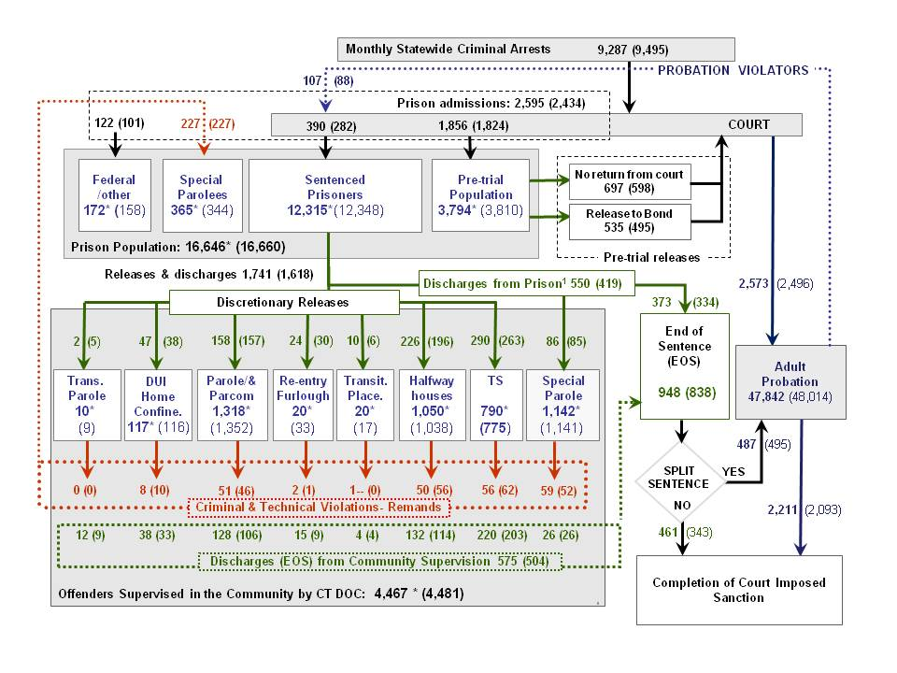
System Chart – Monthly Indicators Report, September 2012

Slide 6
Releases and discharges – Monthly Indicators Report, Sept. 2012

Slide 7
Average releases and discharges per month

Slide 10
Risk Reduction Earned Credits (RREC):
a preliminary review of implementation and performance issues
Karl Lewis – Director of Offender Classification and Population Management , The Connecticut Department of Correction
&
Ivan Kuzyk, Director, Statistical Analysis Center
The Office of Policy & Management

Slide 11
Purpose of this analysis by OPM
OPM has been tracking RREC discharges since they were implemented last year.
This is the first opportunity OPM has had to summarize the impact of RREC on recidivism among offenders discharging from prison
Purpose of this analysis is both to:
  clarify the operations with respect to RREC,
  and to report preliminary findings with respect to offender recidivism

Slide 12
Discretionary Release Mechanisms at DOC
  Discretionary releases are a time-tested, widely used tool in correction systems in every U.S. state.
  In October 2010, one year before the RREC began, 1,604 offenders were released or discharged from state prisons.
    747 of these offenders (43%) left prison through some discretionary release mechanism.
  In October 2010, the DOC released prisoners through 6 discretionary release programs.
  By September 2012, the DOC has expanded the number of discretionary release programs to 7
    DUI Home confinement was introduced in March 2012
  In October 2011, 1,722 offenders were released or discharged from DOC facilities

Slide 13
Discretionary Release Mechanisms at DOC (2)
Discretionary release mechanisms:
  Parole
  Transitional Supervision
  Transfer Parole
  Transfer Placement
  DUI Home Confinement
  Re-entry Furlough
  Halfway Houses
Each mechanism provides an alternative pathway to completing a prison sentences in lieu of incarceration.

Slide 14
Discharges
Between October 5, 2011 and September 5,2012,
  8,941 offenders were eligible to earn RREC
  only 8,700 were awarded at least one day of RREC.

Slide 15
RREC receivers
The average offender who was granted RREC earned 60.4 days.
The median offender earned 32 days of RREC
79% earned under 3 months
Median RREC awarded: 32.0 days
Average RREC awarded: 60.4 days

Slide 16
RREC and discretionary releases
In April 2012, 84% of offenders who discharged from prison, discharged with less than 90 days of RREC
In August 2012:
– the average offender discharged from prison earned 49.3 days of RREC
– the average offender discharged in the community earned 89.5 days.

Slide 17
Measuring recidivism (2)
Between October 5, 2011 and September 5, 2012,
8,941 offenders discharged from prison having earned RREC
of these, 8,700 were awarded RREC
By September 5, 2012, there were 1,403 readmits to DOC facilities by these 8,941 men.
These 1,403 admits were made by 1,202 offenders
So, can we compute the recidivism rate
of these offenders from this data?

Slide 18
Measuring recidivism (1)
Recidivist: a convicted criminal who reoffends
By extension, recidivism rates explain how and how long it takes for groups of criminals to reoffend
There are two main concerns:
  What events constitute recidivism, and
  How long should you wait before calculating rates.

Slide 19
Measuring recidivism (3)
To compute recidivism rates you require
a fixed time component
and a meaningful cohort
Six months
Six months
Six months

Slide 20
Measuring recidivism (2)
OPM had been publishing annual recidivism studies of state prisoners for almost a decade.
OPM uses:
  Data from the Dept. of Correction, the State Police and the Judicial Branch (CSSD)
  We apply a consistent methodology to our studies based on US DOJ practice
We track four measures
  New arrests
  New convictions
  Reincarceration events, and
  Returns to prison with a new sentence

Slide 21
Measuring recidivism (3)
In recent years OPM has published recidivism studies based on 2-year, 3-year and 5-year outcome data.
We have tracked recidivism among sex offenders, high risk offenders, career criminals and gun felons.
Our reports are available on the OPM website.
OPM has developed excellent benchmark recidivism data for cohorts of offenders who were released in 2004, 2005 and 2008.

Slide 22
Measuring recidivism – Typical analysis

Slide 23
Measuring recidivism – Data Required + Time
Judicial, State Police data
DOC Data
Time to gather data

Slide 24
Measuring recidivism – 4 measures over time
67.5%
53.6%
53.7%
36.6%
Predictive and stable

Slide 25
Recidivism – Return to prison w/in 6 months
3,279 offenders who had earned RREC were released or discharged between October 1, 2011 and January 31, 2012 .
  3,178 were awarded at least one day of RREC
During the 6-month period following their discharge dates, 420 offenders were returned to prison (12.8%)
By September 9, 2012 – 628 offenders in the group of 3,279 had returned to prison 769 times.

Slide 26
Recidivism – Return to prison w/in 6 months
In 2008, 16,286 offenders were discharged or released from prison.
In the 6 months follow there releases, 21% were returned to prison
Offenders receiving RREC during October through January returned to prison at considerably lower rates than offenders in 2008.

Slide 27
Recidivism – Return to prison w/in 6 months
16,241 offenders were discharged or released from prison during 2005. These offenders returned to prison at rates similar to the rate for offenders in 2005.
Offenders receiving RREC during October 2011 through January 2012 returned to prison at considerably lower rates than offenders in 2005 or 2008.

Slide 28
RREC – The Numbers (3)

Slide 31
6-month rate: 13% vs. 21%
Comparing the recidivism rates for 2005 and RREC receivers, OPM tested what would happen if technical violations were not counted in the 2005 rate.

Slide 32
2005 recidivism w/o technical violations
When technical violation were not added in, the 2005, 6-month recidivism rate for returns to prison dropped from 20.7% to 14.3%.
  Criminal violations in 2005 were still counted.

Slide 33
Nine month rates – 18% vs. 28%
Nine months
Nine months

Slide 34
Summary of the analysis
6-month recidivism rates for offenders discharged with RREC were significantly lower than the rates for offenders discharged during 2005 and 2008.
The difference in rates appears to be largely accounted for by the drop in the number of returns-to-prison for technical violations.
When technical violations were removed – the recidivism rates for both 2005 and 2008 cohorts declined to the near the level of RREC offenders.

Slide 35
Sentence Credits: The Historical Perspective
Connecticut’s sentencing structure has evolved greatly over the past three decades.
Currently, sentencing credits are more restrictive than at any time that these credits have been available.

Slide 36
Connecticut’s prison population 1973-2012
10/1976 – 7/1981
10 days per month for first 5 years. 15 days for sixth and subsequent years
7/1983 – 10/1994
10 days per month for first 5 years. 12 days for sixth and subsequent years.
Prior to 10/1976
60 days for first 5 years.
90 days for sixth and subsequent
7/2011
5 days
per month
7/1981 – 7/1983
10 days per month for first 5 years. 12 days for sixth and subsequent years
Indeterminate sentencing,
to 10/1976
Definite,
Indefinite & Indeterminate sentencing
Determinate sentencing,
from 7/1981
Between 10/1975 and 10/1994, offenders also earned good time credit for pre-trial incarceration.

Slide 37
Connecticut’s prison population 1973-2012
10/1976 – 7/1981
10 days per month for first 5 years. 15 days for sixth and subsequent years
7/1983 – 10/1994
10 days per month for first 5 years. 12 days for sixth and subsequent years.
Prior to 10/1976
60 days for first 5 years.
90 days for sixth and subsequent
7/2011
5 days
per month
7/1981 – 7/1983
10 days per month for first 5 years. 12 days for sixth and subsequent years
Indeterminate sentencing,
to 10/1976
Definite,
Indefinite & Indeterminate sentencing
Determinate sentencing,
from 7/1981
Between 10/1975 and 10/1994, offenders also earned good time credit for pre-trial incarceration.

Slide 38
Incentives and disincentives
Inmate-on-inmate assaults declined by 11% from FY 10-11 to FY11-12.
Disciplinary reports declined by 6% during the same period.
Anecdotal evidence indicates that program participation is up significantly and programs waiting lists have been reduced.

Slide 39
RREC – The Details (1)
The Risk Reduction Earned Credit (RREC) was implemented in accordance with Public Act 11-51.
Purpose: to provide an incentive for sentenced offenders to
  act in accordance with Department rules, and
  participate in programming that will reduce the likelihood of re-offense.
The Commissioner of Correction is authorized to award up to five days per month credit for good behavior combined with adherence to rehabilitative programming recommendations.

Slide 40
RREC – The Details (2)
Only inmates sentenced to a crime committed on or after October 1, 1994 are eligible to earn RREC. Accused prisoners may not earn RREC regardless of whether they accrue Jail Credit.
An inmate shall not earn credit, and may forfeit any or all credit earned (or credit that might be earned in the future), for:
  institutional misconduct
  refusing needed programming
  refusing to provide DNA
  being on escape or absconder status,
  or placement on a restrictive status.

Slide 41
RREC – The Details (3)
The maximum amount of days earned per month is five. Thus, the maximum number of days that can be earned for a year is 52.
Inmates convicted of the following crimes are not eligible to receive RREC:
  53a-54a – Murder
  53a-54b – Capital Felony
  53a-54c – Felony Murder
  53a-54d – Arson Murder
  53a-70a – Sexual Assault, First Degree with a Firearm
  53a-100aa – Home Invasion

Slide 42
RREC – The Details (4)
RREC shall not reduce the mandatory portion of a sentence. There are more than 60 criminal statutes that carry mandatory minimums of this type in Connecticut.
Inmates earn credit on each separate sentence; however, an aggregate sentence will be reduced by no more than five days per month.

Slide 43
RREC – The Details (5)
Retroactive credit at the rate of 5 days per month may have been applied if an inmate was serving a continuous sentence from April 1, 2006 or later through October 1, 2011 and met the conduct and programmatic criteria outlined above. By statute, the Department of Correction had until June 30, 2012 to complete the implementation of retroactive credit.
Credits that are forfeited due to a disciplinary finding may be restored after a prolonged period of good behavior and program participation.

Slide 44
RREC – Implementation (1)
The Department implemented the RREC program in October, 2011 and had until June 30, 2012 to complete implementation, including application of retroactive credits as authorized by the Public Act.
Application of retroactive credit within the implementation period was prioritized, with the lowest level offenders evaluated first and the highest level offenders last.

Slide 45
RREC – Implementation (2)
Approximately 4000 manual reviews for application of retroactive credit were completed.
Implementation presented considerable logistical challenges which were compounded by an antiquated information system and the fact that our central inmate records remain paper- based.
For example, because the Department’s computer system cannot docket full statute numbers, DOC staff had to manually review about 9,500 files to determine which sentences met mandatory-sentence criteria.

Slide 46
RREC – Implementation (3)
To accomplish the implementation in the given time frame, the Department diverted resources at the Correctional Counselor and Records ID Specialist levels and utilized overtime.
In order to increase the number of class sessions available and reduce inmate waitlists for recommended programs, the Department utilized overtime, generally on second shift, and redeployed resources from two correctional facilities that closed. This practice has reduced waitlists substantially.

Slide 47
RREC – Implementation (4)
The Department is establishing a Discharge Review Board that will:
  Review all inmates discharging from facilities two weeks before discharge.
  Ensure all credit has been applied correctly.
  Ensure all programs have been accurately credited.
  Ensure all non-compliance and disciplinary action has resulted in appropriate penalties
  Review relevant victim impact information and suspend or reduce credit as appropriate.

Slide 48
RREC – Implementation (5)
The Department is establishing a Discharge Review Board that will:
  Ensure that dangerous offenders who are not in compliance with an Offender Accountability Plan, or who present a continued threat to public safety, receive negative RREC adjustments.
  Integrate the new state-of the-art risk assessment tools (SCORES) into the discharge review process.

