Slide 1

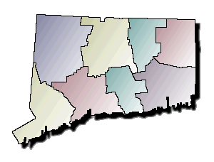
CJIS Governing Board
April 19, 2012
Quarterly Meeting
Partner with Stakeholders to
Drive Innovation and Smart Growth

Slide 2
Agenda
CJIS Goals and Objectives
CISS Project Plan
CISS Requirements
CJIS Program Management
CIDRIS Status
OBTS Status
Information Any Way You Want It

Slide 3
CJIS Goals and Objectives
Provide each agency the IT autonomy to achieve their business goals
Optimize existing IT investments and infrastructure within CJIS agencies
Develop a universal adaptor (dial tone) type service so that CJIS agencies can connect to Information Sharing (IS) system easily
Create a security model that meets State and federal standards
Provide services that are boringly predictable
Use the “Forced Multiplier” to help leverage existing resources to “do more with a lot less”

Slide 4
CISS So Far . . .
Security Design Approved
Search Design Proceeding
  Analysis of Agency Data Sources and Connections
Overall System Architecture Review Drafted
Development of Proofs of Concepts Begun
Information Exchange Design Progressing
  Middleware Design and Training Materials
Notes:
4
4

Slide 5
CISS Will Look Like This . . .
CPCA
DESPP
CSSD
DPDS
DCJ
BOPP
Connecticut’s Information Sharing System
(CISS)
Courts
OVA
DOC
DMV
OBTS
LEAs
RMS
PRAWN
ETC…
RMS
OBIS
SOR
RMS
CRMVS
CIB

Slide 6
CISS Delivery Sequence
Establish Framework
& Infrastructure
Proofs of Concepts
July 2012
Initial “Portal”
OBTS Search
September 2012
Uniform Arrest Report
December 2012
Infractions
March 2013
Judicial Common
Exchanges
Post Arrest
Disposition
Post Judgment
Misdemeanors
Arraignment, 1st
Appearance

Slide 7
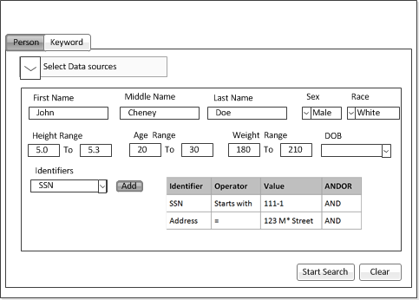
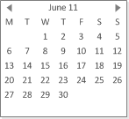
Executing Search Query
Simple keyword search
Natural language
(John Does’ with blue eyes)
Wildcard search
Advanced Search
(Refine results based on selected parameters)

Slide 8
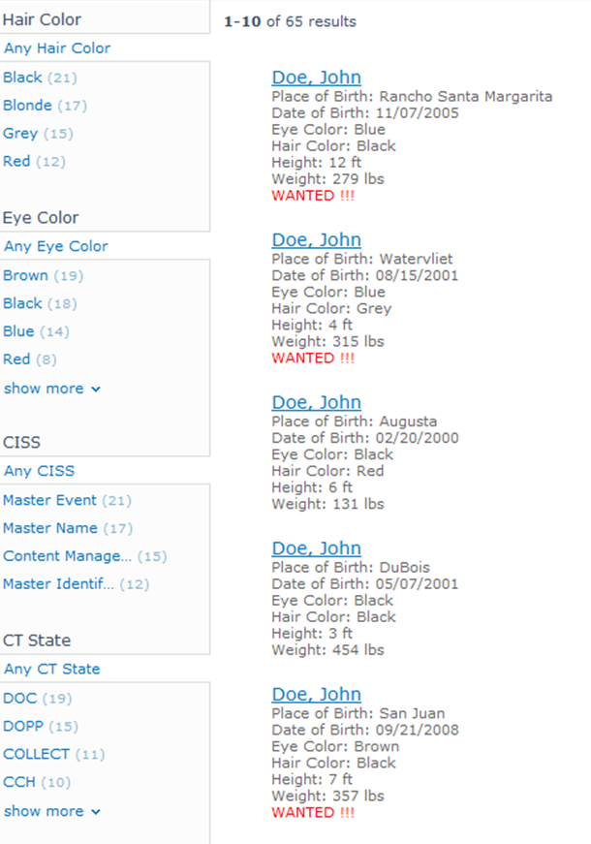

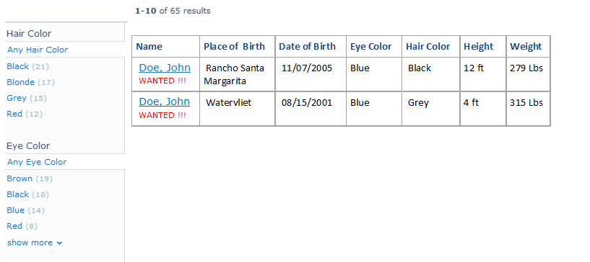
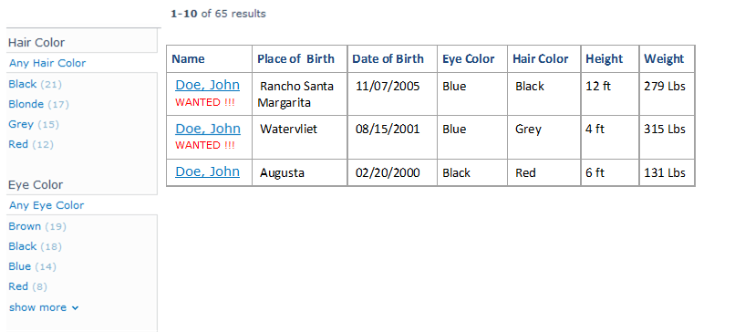
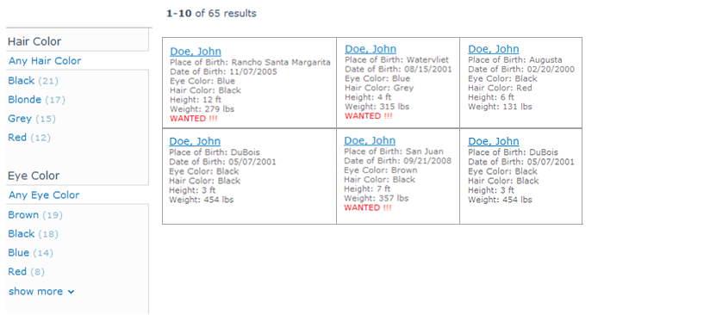

Search Results
Sorting Options
Custom Refiners
-----------------------------------
-----------------------------------
Results with blue eyes
-----------------------------------
Refine Results (blue eyes)
Table Layout
Internet Search Layout
Grid Layout
Pagination

Slide 9
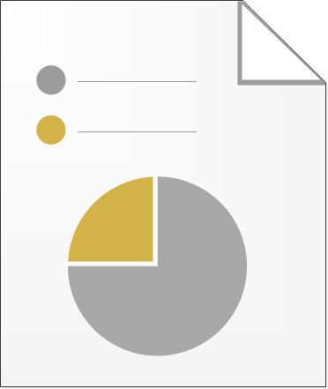
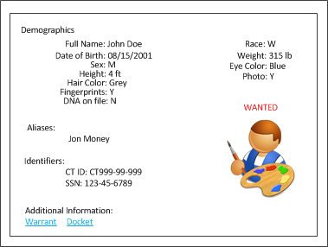
Result Details
Warrant

Slide 10
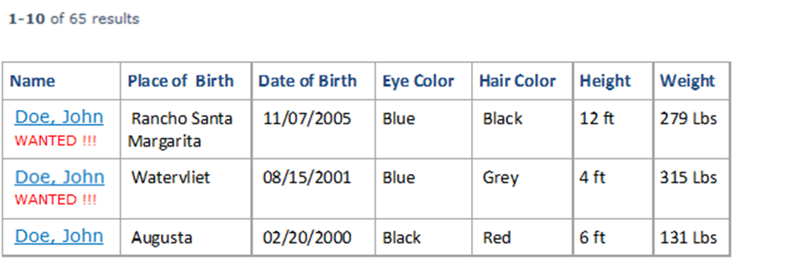
Federated Search Results
Table Layout
Pagination

Slide 11
CISS Development Milestones
Phase | JFM | A | M | J | J | A | S | O | N | D | J | F
Infrastructure
Requirements - Wave 1
Proof of Concepts Design
Requirements - Wave 2
POC Development
Design OBTS Search and Portal
Develop OBTS Search and Portal
Design Uniform Arrest Workflow
Acceptance OBTS Search/Portal
Develop UAR Workflow
Deploy OBTS Search/Portal
Acceptance UAR Workflow
Deploy UAR Pilot
Deploy UAR Full
Design Infractions Workflow
Develop Infractions Workflow
Acceptance Infractions Workflow
Primarily ACS Team
Primarily State
Team
(There is Only One Team)

Slide 12
CISS – The Next Three Months
Design Process is Underway
  Security Design: April Completion
  Middleware Design: April Completion
  Search Design: May Completion
  Initial Portal Design: May Completion
Workflows, Searches and Information Exchanges
  Requirements and Design in Waves
  Detailed Design Follows Requirements Approval
Project Plan
  Published at Least Quarterly
  Always Looking Out 9-12 Months
Notes:
12
12

Slide 13
CISS Requirements
Requirements Validation
  Workflow requirements
    8 Workflow diagrams approved
  Reports and Forms Validation
    5/31/2012
Agency Source System Technical Documentation
  Document agency source systems by 4/30/2012
  Validate CT RMS installations by 4/25/2012
Field Observations to Document Agency Business Processes
  Planning is underway; tentatively May and June

Slide 14
CISS Business Milestones
CISS Tasks | April |  |  |  | May |  |  |  | June
 | 9 | 16 | 23 | 30 | 7 | 14 | 21 | 28 | 4 | 11 | 18 | 25
Technical Discovery:
Judicial Branch
Department of Corrections
Board of Pardons & Paroles
Department of Criminal Justice
Department of Emergency Services & Public Protection
Division of Public Defender Services
Department of Motor Vehicles
CT Police Chiefs Association
CISS Reports & Forms
Statewide RMS
Agency Field Observations

Slide 15
CJIS Program Management
Governor’s Vision for
Technology
CJIS Business Objectives /
Goals
CJIS Governing Board
Strategic Plan
Identify
Implementation
Team
Gather and
Report Lessons
Learned
Program
Management Plan
Develop Program
Integration
Standards and
Processes
Develop
Training
Plan
Establish
Program Office,
Define
Governance
Develop
Implementation
Schedule
Develop
Testing
Plan
Develop
Change
Management
Plan
Develop
Communications
Plan
Develop
CJIS Security
Solution

Slide 16
CJIS Project Management Office
Milestones
PMO Setup | JFM | A | M | J | J | A | S | O | N | D | J | F
Establish Program Office - Define Governance
Budget
Identify Implementation Team
Develop Communications Plan
3rd Quarter Implementation Schedule
Develop Change Mgmt. Plan
Risk/Issue Mgmt. Plan
Develop Quality Mgmt. Plan
Implement Project Management in Jazz
Update CJIS Security Plan
Master Project Plan & Sub Plans: CISS, OBTS, CIDRIS
CISS Success Metrics
Service Level Agreement with DAS-BEST
CJIS GB Strategic Plan
Completed
Target Completion Date

Slide 17
CJIS Communication Plan
Updated CJIS Monthly Newsletter
First Issue in May as an Electronic Publication to all CJIS Stakeholders
Governing Board
Executive Summary, Progress, User Feedback, Plain Talk and Tech Talk
CJIS Community Surveys
OBTS, CISS, CIDRIS
Quarterly Report
Quarterly Presentation
Identify Areas for Improvement

Slide 18
Watch for the debut of CJIS Roadmap coming to an inbox near you

Slide 19
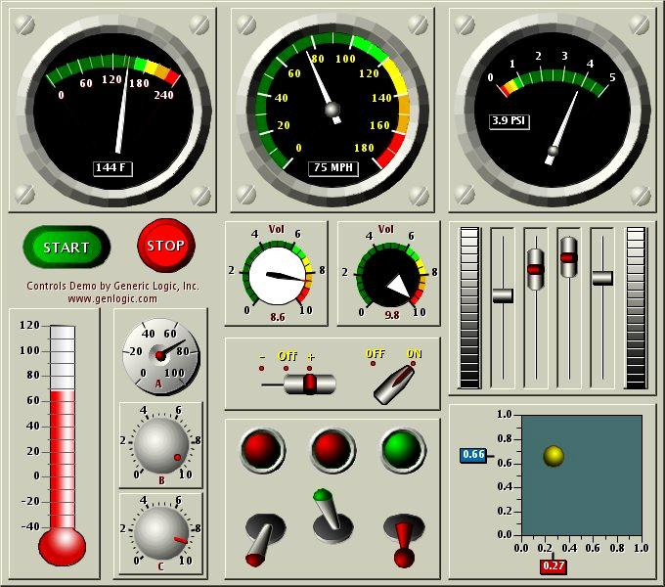
Performance Metrics
11 Strategic Metrics
21 Operational Metrics
9 Tactical Metrics
Roll-up to Executive Dashboard

Slide 20
CIDRIS - Accomplishments
Deployment
Deployed Troop B, Troop L, with Troop A next
UAR for OUI arrests w/criminal charges
Deploy the rest of the Troops over the next few months based on the new draft DESPP schedule
Added companion UAR for OUI arrests that also have criminal charges
Testing with DESPP, DMV, and Judicial
Validation Programming and Improved Training
DESPP and NexGen have added additional validation programming to reduce errors sent to CIDRIS
DESPP is improving their training

Slide 21
CIDRIS – The Next Three Months
Deployment
Work with Judicial, DESPP, and DMV to accelerate deployment schedule for remaining troops
Paperless OUIs
Judicial, DESPP, and DMV
Transition to permanent application maintenance and support to the CJIS Operations Team
Application Maintenance & Support
Develop needed Technology
Develop needed Business Processes

Slide 22

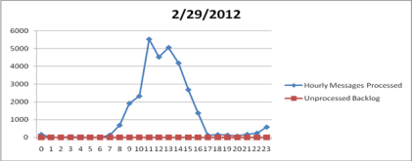
OBTS Accomplishments
7.1 QUARTERLY RELEASE
The Offender Based Tracking System (OBTS) team completed and implemented the February OBTS 7.1 quarterly release on schedule
SYSTEM PERFORMANCE
Event Processing Improvements – Rate of 6,800 messages per hour exceeded with no backlogs
Data Integrity Enhancements
Inquiry Processing Improvements – 65% Average increase in response time
Notes:
User Group Meeting
Introductions
OBTS/CDIRIS/CISS Overview
Provides Open Forum for Feedback and Information Sharing

Slide 23
Exact Name Search
Seconds
Smart Name Search
Seconds

Slide 24
Full Docket Search
Seconds
Partial Docket Search
Seconds

Slide 25


Accomplishments
OBTS/CIDRIS/AFIS User Group
USER GROUP MEETINGS
The first User Group Meeting was held on February 21st at the Department of Emergency Services and Public Protection in Middletown. The User Group members included participants from the CJIS Team, CPCA, DESPP, DMV, DOC, local Law Enforcement Agencies (LEAs), and Judicial.
CONTINUOUS IMPROVEMENTS
The first OBTS “Help Us Help You” Survey has been distributed to the User Group for feedback in the areas of system usage, performance, data quality, and training.
Notes:
User Group Meeting
Introductions
OBTS/CDIRIS/CISS Overview
Provides Open Forum for Feedback and Information Sharing

Slide 26
Where We Are Now
OBTS 7.2 – May Quarterly Release
Enhancements
Judicial
    New Verdict Finding
  System Performance
    Scheduler Optimization
    Code Fix for Quicker Indexing
    Improve Inquiry Response Times
Notes:
The May 7.2 Release is under construction and we expect to include Enhancements and Mitigation Issues.
For Enhancements – Judicial is implementing anew Verdict Finding, NI – for Not Guilty by Reason of Insanity. This new verdict finding will assist the courts to better identify cases and charges with this finding. The Operational team will be making changes to OBTS to support the new verdict.
The Operational team is continuing their efforts in System Performance and identified three areas for improvements in this release. The Scheduler Optimization …………………………..
Proper Indexing …………………………
And continuing effort to optimize each of the underliny infrastructure components that support OBTS.

Slide 27
Where We Are Now
OBTS 7.2 – May Quarterly Release
Enhancements
Judicial
    New Verdict Finding
  System Performance
    Scheduler Optimization
    Code Fix for Quicker Indexing
    Improve Inquiry Response Times
Issues Mitigation
  Improve System Memory Resource Usage
  Message Console Stop and Start Correction
Notes:
The May 7.2 Release is under construction and we expect to include Enhancements and Mitigation Issues.
For Enhancements – Judicial is implementing anew Verdict Finding, NI – for Not Guilty by Reason of Insanity. This new verdict finding will assist the courts to better identify cases and charges with this finding. The Operational team will be making changes to OBTS to support the new verdict.
The Operational team is continuing their efforts in System Performance and identified three areas for improvements in this release. The Scheduler Optimization …………………………..
Proper Indexing …………………………
And continuing effort to optimize each of the underlying infrastructure components that support OBTS.

Slide 28
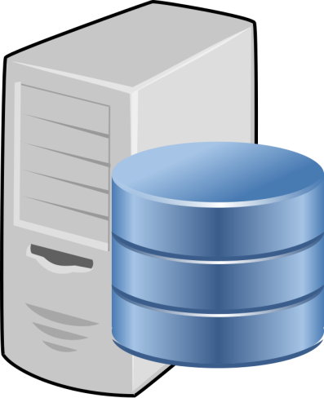
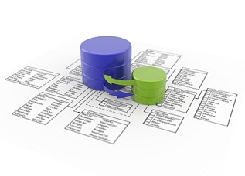
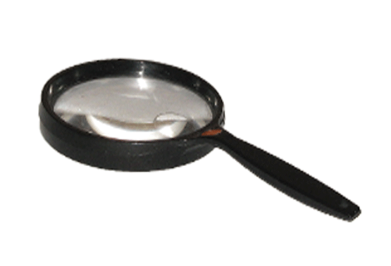
Where We Are Going
Data Purity Initiative
OBTS
Judicial
CRVMS
Corrections Dept.
OBIS
State Police
MNI/CCH
CIB
PRAWN
POR

Slide 29








Information Any Way You Want It
Sources-Information
Delivery-Device Independence
CISS
CIDRIS
OBTS
Office PC/Laptop
Tablets-iPad, Android, Google’s Ice Cream Sandwich
Mobile Phone-Any
Smart Phone
CISS
CIDRIS
OBTS

Slide 30
Information Any Way You Want It
Benefits
Ability to Make Good Decisions
Timely Information Available 24X7
Delivery to Your Preferred Device

Slide 31
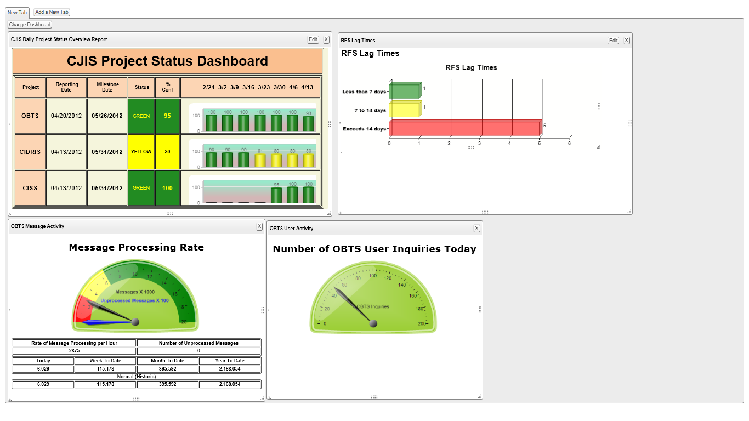
CJIS Project Status Dashboard

Slide 32
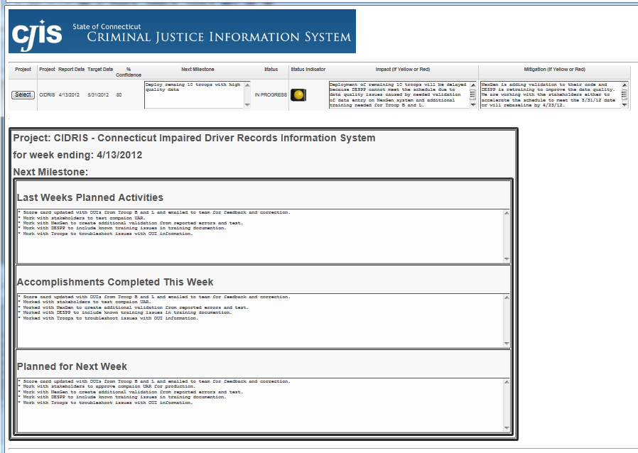

Slide 33
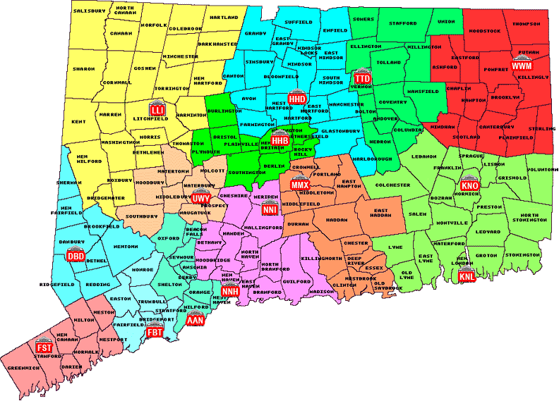
Building Connecticut’s
Information Sharing System

