Slide 1


State of Connecticut
Criminal Justice Information System
July 19, 2012
Quarterly Governing Board Meeting
Partnerships to Drive Innovation and Smart Growth

Slide 2
Agenda
Governor’s Vision for Technology
CJIS Goals and Objectives
OBTS Status
CIDRIS Status
CISS Project Plan
CISS Requirements
CJIS Program Management
CISS Initial Capabilities Demonstration
July 19, 2012
2 of 37

Slide 3
Governor’s Vision
The Governor’s vision for technology provides the foundation upon which CJIS is working. This vision is predicated on:
Implementation of efficient, modern business processes that result in cost-effective delivery of services
Open & transparent engagement with State citizens
Accurate and timely data for policy making, service delivery & results evaluation
A secure and cost effective IT infrastructure, including greater use of shared services and applications wherever possible
Easily accessible services for all constituents
July 19, 2012
3 of 37

Slide 4
CJIS Goals & Objectives
Provide each agency the IT autonomy to achieve their business goals
Optimize existing IT investments & infrastructure within CJIS partner agencies
Develop a universal adaptor-type (dial tone) service so that CJIS agencies can connect to Information Sharing system easily
Create a security model that meets State and federal standards
Provide services that are “boringly predictable”
Use the “Forced Multiplier” to help leverage existing resources to “Do a lot more with a lot less”
Responsive to stakeholders: “Information any way you want it”
July 19, 2012
4 of 37

Slide 5
OBTS Accomplishments
  7.2 Quarterly Release
    The Offender Based Tracking System (OBTS) team completed and implemented the May OBTS 7.2 quarterly release on schedule.
    Improved Performance Tuning (for Speed) and Data Quality Improvements
    Made enhancements to Smart Name Search
  System Performance
    Nastel performance tool installed
    CJIS and DAS/BEST technical teams attended Nastel Training Class
    Nastel tool will perform end-to-end monitoring to identify & correct problems
  User Group Meetings
    The second OBTS/CIDIS/AFIS User Group Meeting – May 23 at CPCA. OBTS, CIDRIS, and CISS updates provided by the CJIS Operational Team, was followed by an open forum discussion.
July 19, 2012
5 of 37

Slide 6
OBTS — Where We Are Now
  OBTS 7.3 – August Quarterly Release
  Enhancements
    Case Activity – Events 18 & 31
    Statistical Reports Key Table
    Interface to Monitor OBTS Health Status
  System Performance
    Improve SMART Name and EXACT Name Inquiry Response Times Tuning
July 19, 2012
6 of 37

Slide 7
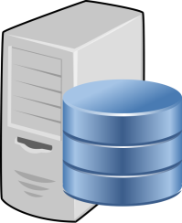
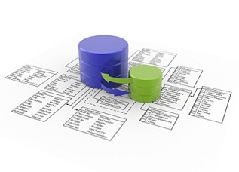

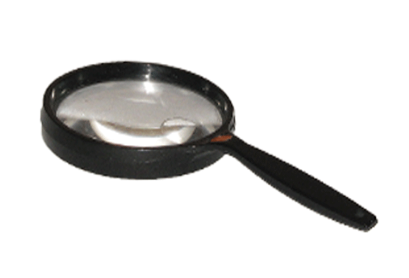
Where We are Now: Data Purity Framework
Data Environments & Access Methods
Data Mappings
Data Validation and Analysis
Identify Data Discrepancies and Data Correction Techniques
Data Purity Assessment Report
OBTS
Quarterly Release Candidate(s)
Judicial:
In Progress
DOC
DESPP
7 of 37

Slide 8
OBTS — Where We Are Going
  The Next 90 Days
  Begin constructing deliverables for Release 7.4
  Continue gathering & analyzing requirements for Release 7.5
  Continue data mappings of the Judicial branch’s source systems
  CJIS to begin comparing OBTS data to Judicial’s source system data – process includes:
        Creating data dictionary
        Writing code for the comparison
        Documenting data required to update
  OBTS certification classes — August 2 and September 12 at Judicial’s training center
July 19, 2012
8 of 37

Slide 9
CIDRIS – Where We Are Now
Implementation
The CIDRIS team — including DMV, DESPP and Judicial — has begun CIDRIS redeployment exercises.
Five Troops — B, L, A, I, and F — have been deployed
The remaining six Troops — G, H,D,C,K and E — are expected to be complete in September.
Current Activities
The implementation team meets each week to monitor current implementation activities and issues.
The team is working to identify and correct the primary sources of data entry problems.
The DESPP is expanding training coverage to enhance and streamline trooper and administrative work processes.
Current Issues
Data quality improvement process continues
Working to resolve issues with delivery of electronic OUI to Judicial and DMV
July 19, 2012
9 of 37

Slide 10
CIDRIS – Where We Are Going
Our Work Continues
Complete roll-out of the six remaining Troops by mid-September.
Work with stakeholders to increase quality of OUI data to 100%.
Benefits to CJIS Community
Stakeholders have the opportunity to use OUI information electronically after implementation is complete.
July 19, 2012
10 of 37

Slide 11
Quarterly IV&V Report for 2nd Quarter 2012
July 19, 2012
11 of 37

Slide 12
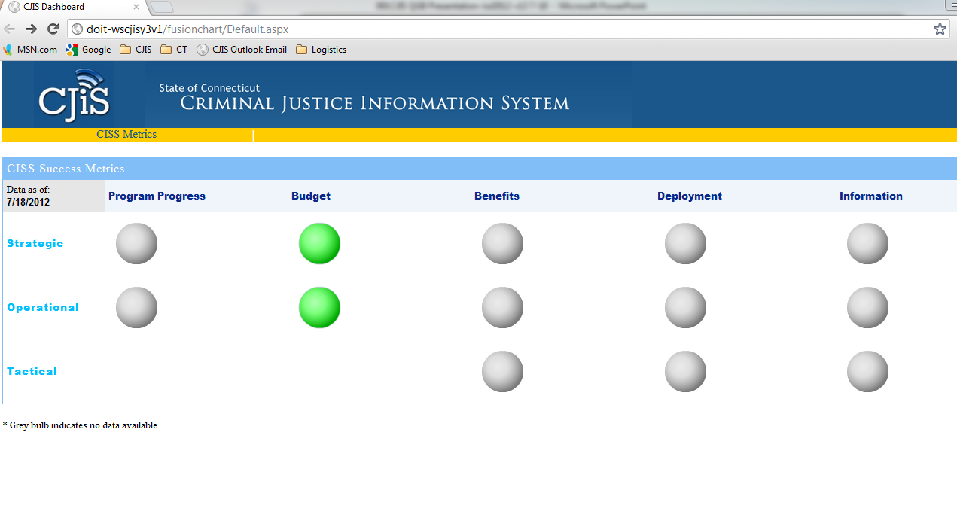
CISS Success Metrics – Phase 1
July 19, 2012
12 of 37

Slide 13
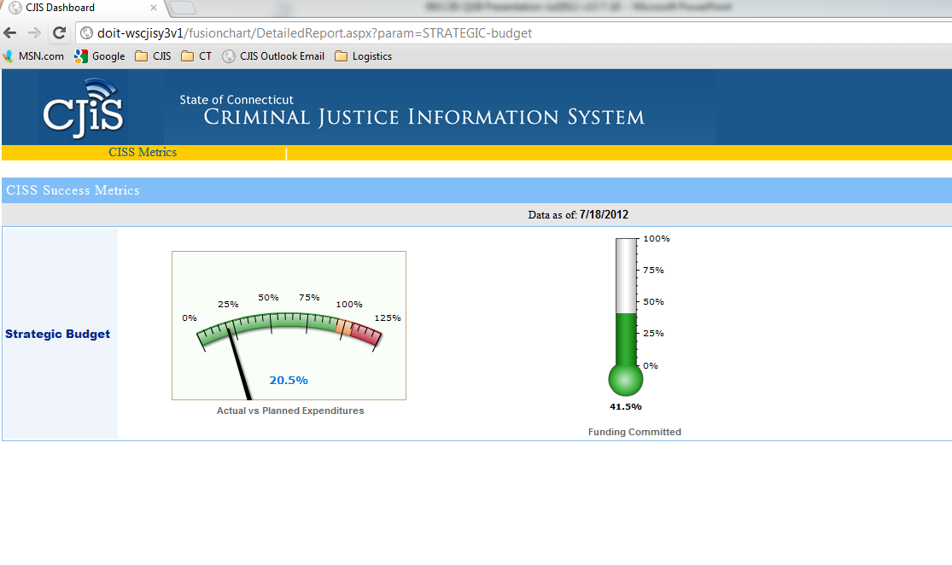


CISS Success Metrics – Phase 1
$3,977,569 $÷$19,370,000
Funding Committed vs Total Program Cost
$1$\text{5,700,000 }\text{÷}$ 37,810,000
July 19, 2012
13 of 37

Slide 14
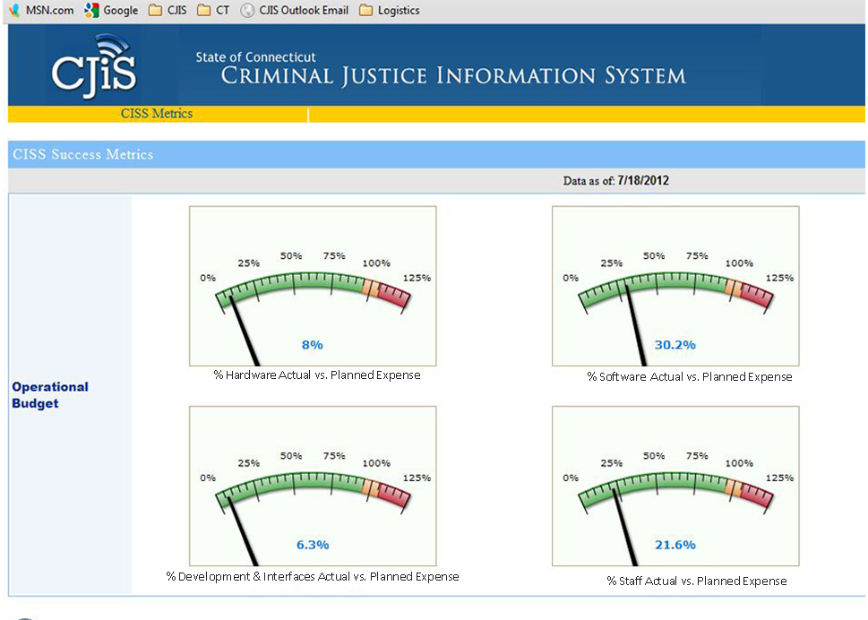




CISS Success Metrics – Phase 1
$1$\text{82,967 }\text{÷}$ 2,300,000
$2$\text{,748,088}÷\text{9}$,110,000
$162,$\text{507 }\text{÷}$ 2,580,000
$$\text{884,006 }\text{÷}$4,085,000
July 19, 2012
14 of 37

Slide 15
CJIS Program Management
Governor’s Vision for Technology
CJIS Business Goals & Objectives
CJIS Governing Board Strategic Plan
Identify
Implementation
Team
Gather and
Report Lessons
Learned
Program Management Plan
Develop Program
Integration
Standards and
Processes
Develop
Training
Plan
Establish
Program Office,
Define
Governance
Develop
CJIS Security
Solution
Develop
Implementation
Schedule
Develop
Testing
Plan
Develop
Communications
Plan
Develop
Change
Management
Plan
July 19, 2012
15 of 37

Slide 16
CJIS PMO Milestones
PMO Setup | JFM | A | M | J | J | A | S | O | N | D | J | F
3rd and 4th Quarter Implementation Schedule
Develop Quality Management Plan
Implement Project Management in Jazz
Update CJIS Security Plan
Master Project Plan & Sub Plans: CISS, OBTS, CIDRIS
Service Level Agreement with DAS-BEST
CJIS GB Strategic Plan
Risk/Issue Management Plan
Target Completion Date
July 19, 2012
16 of 37

Slide 17

CJIS Communications
Monthly Newsletter Updated
  Plans for links to additional content on website; FAQs
  Links to “white papers” for in-depth information
  Articles from the perspective of CJIS stakeholders
Reporting
  Governing Board: Quarterly Reports & Presentations
  Bi-Annual Reports to the Legislature
  Periodic Presentations to other groups (e.g., CRCOG)
  Monthly Project Status Meeting for CISS Stakeholders
  Monthly Meetings on Project Status
  Hands-on Workshops of CISS in Development
  Meetings with Stakeholders
  CISS team has met with stakeholders as requested
July 19, 2012
17 of 37

Slide 18
CISS Business Management
Reports and Forms Validation
  Reviewed with all agencies – 5/23/2012
  Business Team completed forms mapping – 5/31/2012
  Reviewed by DCJ – 6/21/2012
  Follow Up Meeting to Finalize – 7/11/2012
Field Observations to Learn Agency Business Processes
RMS Vendors
  Validated CT RMS & CAD installations – 4/25/2012 to 6/19/2012
  RMS Vendor Meeting to kickoff CISS – 7/10/2012
Define & Validate Security Restrictions
  Define based on GFIPM model
  Guided workshop sessions to validate with Administrative Committee
July 19, 2012
18 of 37

Slide 19
CISS Business Milestones
CISS Tasks | May |  |  |  | June |  |  |  | July
 | 7 | 14 | 21 | 28 | 4 | 11 | 18 | 25 | 2 | 9 | 16 | 23 | 30
CISS Reports & Forms
RMS Vendors
Agency Field Observations:
Local Law Enforcement Bookings
Local Law Enforcement Ride-Alongs
State Police Ride-Alongs
Court Visits
Test Strategy & Approach
Security Restrictions
July 19, 2012
19 of 37

Slide 20
CISS Technology Management
Defining processes to streamline Agency integration with CISS for Service-Oriented Architecture (SOA) based messaging
Ordered equipment to support the initial production Establishing architectures to support a scalable platform
Configuring the demonstration
Designing architectures to support the initial development waves and production environments
Defining the methodologies to integrate agency data with CISS (Static Replication, Dynamic Replication, and Federated Search)
Develop hands-on workshops for Agency stakeholders
July 19, 2012
20 of 37

Slide 21
CISS Technology Milestones
Phase | MJ | J | A | S | O | N | D | J
Develop logical design
Order hardware/software
Staffing technical group
Develop application life cycle mgmt. methodology
Develop software development life cycle
Develop Service Level Agreement (SLA)
Design and develop CISS success metrics
Develop IEPD templates
Gather IEPD data elements from agencies
Design production architecture
Define storage requirements
Define network/security requirements
Procure storage and network equipment
Define certificate authority model
Configure production environment
Develop workshops for Agency stakeholders
Primarily Xerox
Team
Primarily State
Team
July 19, 2012
21 of 37

Slide 22
Internal Agency Communication
Share information with your staff/organization
We also encourage you to invite your staff to attend meetings
July 19, 2012
22 of 37

Slide 23
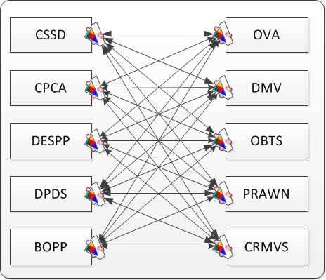
The As-Is View
Communication Spaghetti
July 19, 2012
23 of 37
Notes:
Emphasize that many ad-hoc exchange arrangements between many systems can quickly become unmanageable, both organizationally and technically. Adding a new system requires development of new MOUs, message formats, endpoints, etc.

Slide 24
CISS Will Look Like This
CSSD
CPCA
DESPP
DCJ
DPDS
SCO
BOPP
DOC
OVA
Connecticut
Information
Sharing System
(CISS)
DMV
OBTS
OBIS
CIDRIS
RMS
PRAWN
NMI/CCH
CRMVS
POR
CIB
SOR
July 19, 2012
24 of 37

Slide 25
The Big Picture
User Log In
Single Sign-on
CISS Portal
Structured Search
View Detail Information
Agency Sites
Simple Search
Alerts & Notifications
Data “within” the Solution
Indexes
Data Mart
ESB
Web Services
Business Rules
Workflows
Logging
Auditing
Record Details
Information Exchanges
Agency
Data Sources
July 19, 2012
25 of 37

Slide 26
The Last Three Months
User Log In
Single Sign-on
CISS Portal
Structured Search
View Detail Information
Agency Sites
Simple Search
Alerts & Notifications
Data “within” the Solution
Indexes
Data Mart
ESB
Web Services
Business Rules
Workflows
Logging
Auditing
Record Details
Information Exchanges
Agency
Data Sources
OBTS
July 19, 2012
26 of 37
Notes:
Items highlighted in green are those that were implemented (either partially or entirely) for the POC. Note that plumbing/mechanics for structured search, simple search, and view details is in-place but currently only OBTS and MultiVue are connected. MultiVue has created a people index using OBTS data – this will be expanded to include other indexes (locations, vehicles, property, etc.) and additional data sources.

Slide 27
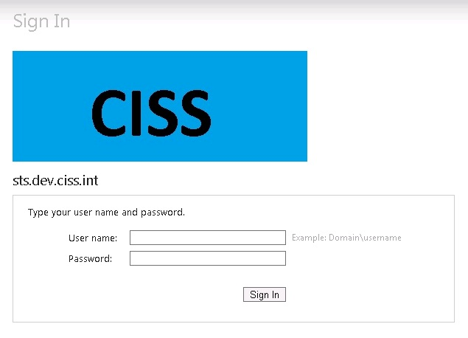
User Log In
Single Sign-on
CISS Portal
Structured Search
View Detail Information
Agency Sites
Simple Search
Alerts & Notifications
Data “within” the Solution
Indexes
Data Mart
ESB
Web Services
Business Rules
Workflows
Logging
Auditing
Record Details
Information Exchanges
OBTS
Agency
Data Sources
July 19, 2012
27 of 37
Notes:
Items highlighted in green are those that were implemented (either partially or entirely) for the POC. Note that plumbing/mechanics for structured search, simple search, and view details is in-place but currently only OBTS and MultiVue are connected. MultiVue has created a people index using OBTS data – this will be expanded to include other indexes (locations, vehicles, property, etc.) and additional data sources.

Slide 28
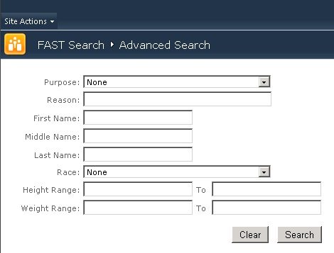
User Log In
Single Sign-on
CISS Portal
Structured Search
View Detail Information
Agency Sites
Simple Search
Alerts & Notifications
Data “within” the Solution
Indexes
Data Mart
ESB
Web Services
Business Rules
Workflows
Logging
Auditing
Record Details
Information Exchanges
OBTS
Agency
Data Sources
July 19, 2012
28 of 37
Notes:
Items highlighted in green are those that were implemented (either partially or entirely) for the POC. Note that plumbing/mechanics for structured search, simple search, and view details is in-place but currently only OBTS and MultiVue are connected. MultiVue has created a people index using OBTS data – this will be expanded to include other indexes (locations, vehicles, property, etc.) and additional data sources.

Slide 29
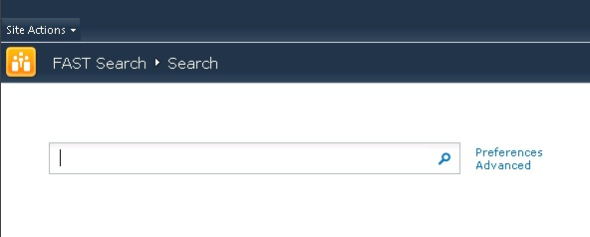
User Log In
Single Sign-on
CISS Portal
Structured Search
View Detail Information
Agency Sites
Simple Search
Alerts & Notifications
Data “within” the Solution
Indexes
Data Mart
ESB
Web Services
Business Rules
Workflows
Logging
Auditing
Record Details
Information Exchanges
OBTS
Agency
Data Sources
July 19, 2012
29 of 37
Notes:
Items highlighted in green are those that were implemented (either partially or entirely) for the POC. Note that plumbing/mechanics for structured search, simple search, and view details is in-place but currently only OBTS and MultiVue are connected. MultiVue has created a people index using OBTS data – this will be expanded to include other indexes (locations, vehicles, property, etc.) and additional data sources.

Slide 30
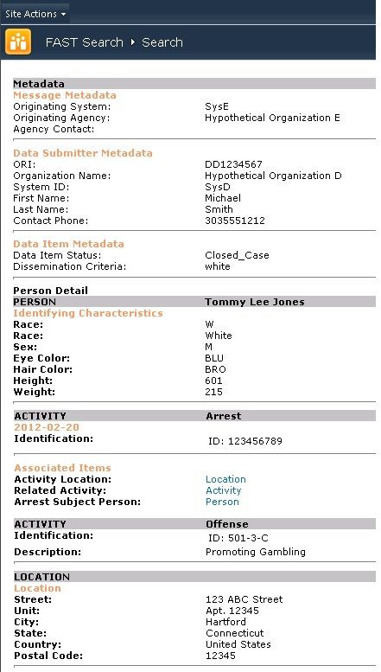
User Log In
Single Sign-on
CISS Portal
Structured Search
View Detail Information
Agency Sites
Simple Search
Alerts & Notifications
Data “within” the Solution
Indexes
Data Mart
ESB
Web Services
Business Rules
Workflows
Logging
Auditing
Record Details
Information Exchanges
OBTS
Agency
Data Sources
July 19, 2012
Notes:
Items highlighted in green are those that were implemented (either partially or entirely) for the POC. Note that plumbing/mechanics for structured search, simple search, and view details is in-place but currently only OBTS and MultiVue are connected. MultiVue has created a people index using OBTS data – this will be expanded to include other indexes (locations, vehicles, property, etc.) and additional data sources.

Slide 31
CISS – The Next Three Months
Design Process Continues
      Initial Team Site Design: September Completion
Development
      Initial Search Development: September Completion
Workflows, Searches and Information Exchanges
      Facilitating Agency Technical Discussions on Security
      Supporting State Technical Team Knowledge Transfer
      Supporting State Technical Team Development
Project Plan
      Continue to Refine State – Xerox Handoffs
July 19, 2012
31 of 37
Notes:
31
31

Slide 32
CISS Delivery Sequence
Establish Framework
& Infrastructure
Proofs of Concept
July 2012
Initial Search
November 2012
Uniform Arrest Report
March 2013
Infractions
June 2013
Judicial Common
Exchanges
June 2013
Post Arrest
August 2013
Disposition
October 2013
Post Judgment
December 2013
Misdemeanors
February 2014
Arraignment,
1st Appearance
March 2014
July 19, 2012
32 of 37

Slide 33
CISS Development Milestones
Phase | JFM | A | M | J | J | A | S | O | N | D | J | F
Infrastructure
Requirements - Wave 1
Proof of Concepts Design
Requirements - Wave 2
POC Development
Design OBTS Search
Develop OBTS Search
Design Uniform Arrest Workflow
Acceptance OBTS Search
Develop UAR Workflow
Deploy OBTS Search/Portal
Acceptance UAR Workflow
Deploy UAR Pilot
Deploy UAR Full
Design Infractions Workflow
Develop Infractions Workflow
Acceptance Infractions Workflow
Primarily Xerox Team
Primarily State
Team
July 19, 2012
33 of 37

Slide 34
CISS – The Longer Term View
Functionality to Improve Citizen Safety
Information Sharing
Alerting
Functionality to Improve Officer Safety
Information Sharing
Access to Better Information
Tools to Save Time and Money
Less Redundant Work
Tools To Benefit the State In Addition to CISS
  Enterprise Service Bus
July 19, 2012
34 of 37
Notes:
34
34

Slide 35
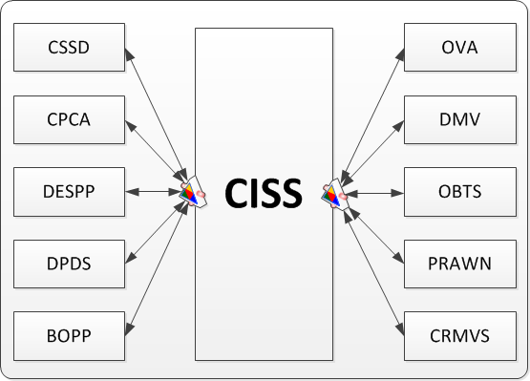
The CISS View
Streamlined Information Access
July 19, 2012
35 of 37
Notes:
The ESB provides an intermediate “hub” to facilitate communication between many systems. A new system can be easily added without affecting other systems. Also, since all communication runs through a central point, business rules, logging, auditing, monitoring, troubleshooting, etc. all happen in a single place. This ensures that the system behaves as desired in every case and allows developers to make changes that affect all exchanges uniformly.

Slide 36
What Does This Mean To You?
Requirements Process Continues
Design Process Continues
        Ongoing
Development
        Power User Feedback
Workflows, Searches and Information
        Exchanges
July 19, 2012
36 of 37
Notes:
36
36

Slide 37
Feedback
We need your feedback —
please send us your comments, questions & suggestions.
This presentation will be posted on www.ct.gov/cjis
Sean Thakkar — Sean.Thakkar@ct.gov
Mark Tezaris — Mark.Tezaris@ct.gov
Rick Ladendecker — Rick.Ladendecker@ct.gov
Nance McCauley — Nance.McCauley@ct.gov
Thank you.
July 19, 2012
37 of 37

Slide 38
Appendix: Acronyms
AFIS = Automated Fingerprint Identification system
AST = Application Support System
BEST = Bureau of Enterprise Systems and Technology
BICE = Bureau of Immigration and Customs Enforcement
BOPP= Board of Pardons and Paroles
CAD = Computer Aided Dispatch
CCH= Computerized Criminal History
CIB = Centralized Infraction Bureau (Judicial)
CIB = Centralized Infractions Bureau
CIDRIS = Conn. Impaired Driver Records Information System
CIVLS = CT Integrated Vehicle & Licensing System
CJPPD = Criminal Justice Policy Development and Planning Division\
CMIS = (Judicial’s) Case Management Information System
COLLECT = Connecticut On-Line Law Enforcement
Communications Teleprocessing network
CPCA= Conn. Police Chiefs Association
CRMVS = Criminal and Motor Vehicle System (Judicial)
CSSD =Court Support Services Division
DCJ = Division of Criminal Justice
DAS = Dept. of Administrative Services
DESPP= Department of Emergency Services & Public Protection
DEMHS = Dept of Emergency Management & Homeland Security
DMV= Dept. of Motor Vehicles
DOC= Department of Corrections
DOIT = Dept. of Information Technology
DPDS= Div. of Public Defender Services
IST = Infrastructure Support Team
JMI = Jail Management System
JUD = Judicial Branch
LEA = Law Enforcement Agency
LAW = Local Law Enforcement (e.g., DPS, CPCA)
LIMS = State Crime Laboratory Database
MNI = Master Name Index (State Police)
OBIS = Offender Based Information System (Corrections)
OBTS = Offender Based Tracking System
OVA= Office of Victim Advocacy
OVS = Office of Victim Services
RMS = Records Management System (Police Agency RMS
manages & stores info on arrests, incidents)
OSET = Office of Statewide Emergency Telecommunications
POR = Protective Order Registry (Judicial)
PRAWN = Paperless Re-Arrest Warrant Network (Judicial)
PSDN = Public Safety Data Network
SCO= Superior court operations
SOR = Sex Offender Registry (Judicial)
Technology Related
COTS = Computer Off The Shelf (e.g., software)
IEPD = Information Exchange Package Delivery
POC = Proof of Concept
SDLC = Software Development Life Cycle
SOA = Service Oriented Architecture
July 19, 2012 – CJIS Governing Board

