Slide 1

Higher Education in Connecticut
Higher Education Coordinating Council
2015 Accountability Report

Slide 2
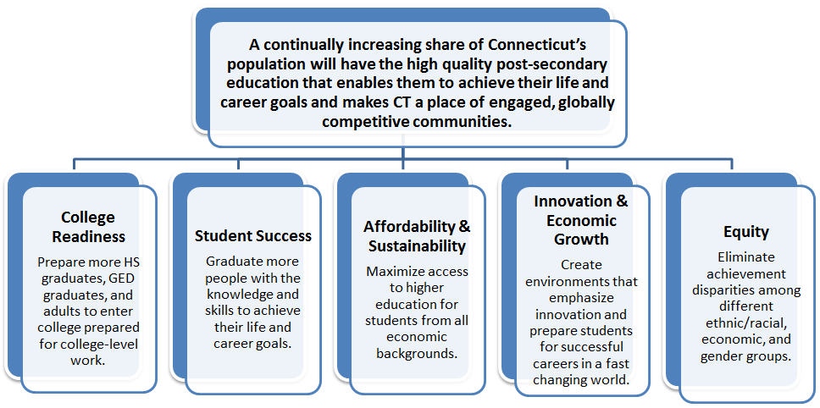
Framework
The framework for this report was approved by the Higher Education Coordinating Council on November 29, 2012. The Connecticut Board of Regents for Higher Education is statutorily bound to produce this report pursuant to Section 10a-6b of the Connecticut General Statutes.
Members of the Higher Education Coordinating Council are:
· Susan Weisselberg – Deputy Secretary of the Office of Policy and Management
· Gregory W. Gray, Sr. - President of the Board of Regents for Higher Education (BOR)
· Susan Herbst - President of University of Connecticut
· Mon Choi – Provost and Chief Academic Officer University of Connecticut
· David Levinson – BOR Vice President for Community Colleges
· Elsa Nunez – BOR Vice President for Connecticut State University Systems
· Nicholas Donofrio - Chair of the Board of Regents for Higher Education
· Lawrence McHugh - Chair of the Board of Trustees for the University of Connecticut
· Dianna R. Wentzell - Commissioner of State Department of Education
Data are provided for each institution of public higher education, each sector and for the state where applicable. Data are disaggregated by race, ethnicity, gender, undergraduate and graduate degree types where available and applicable, and the data provided are for the most recent year(s) available.

Slide 3
Overview
Preface
This report is intended to articulate Connecticut’s statewide vision and goals for attaining higher levels of educational attainment of our state’s residents.
Achieving this vision will require partnerships with other state and local agencies and organizations.
Connecticut Public Policy Framework for Higher Education
Vision
A continually increasing share of Connecticut’s population will have the high quality post-secondary education that enables them to achieve their life and career goals and makes Connecticut a place of engaged, globally competitive communities.
Goal 1 - College Readiness: Prepare more high school graduates, GED graduates, and adults to enter college prepared for college-level work.
Goal 2 - Student Success: Graduate more people with the knowledge and skills to achieve their life and career goals.
Goal 3 - Affordability & Sustainability: Maximize access to higher education for students from all economic backgrounds
Goal 4 - Innovation & Economic Growth: Create environments that emphasize innovation and prepare students for successful careers in a fast changing world.
Goal 5 – Equity: Eliminate achievement disparities among different ethnic/racial, economic, and gender groups. Disaggregated data are provided within the other 4 goal areas where available.
Indicators
Each goal has a set of indicators which attempt to provide balance for understanding higher education in Connecticut across sectors; however, each indicator is a proxy of truth and can only approximate the progress being made within institutions , across sectors, and for individuals.
Pg. 6
Pg. 12
Pg. 27
Pg. 45
Pg. 55
Pg. 67

Slide 4
Table of Contents
Vision 6
Connecticut adults, 25-44 holding associate degrees and above 7
Median household income 8
Voter participation 9
State Domestic Product per capita 10
Enrollment per Connecticut Residents ages 18-44 11
College Readiness 12
Percent of high school graduates identified as “college-ready” 13
College-going rates of public high school graduates 15
Percent completing college-level English and math courses within 2 years 18
Percent on track to completing on-time: 22
Student Success 27
Completions per 100 Full Time Equivalents (FTE) 28
Graduation rate of full-time, first-time students in 150% of normal time; 29
Employment and earnings after graduation 32
Time and credits to degree/certificate 41
Transfers from 2-year to 4-year institutions per 100 FTE 43
Affordability and Sustainability 45
Tuition and fees as % of median household income 46
Percent of undergraduates receiving federal loan aid 47
State and local appropriations per 100 FTE and per completion 50
Education and related expenses per FTE enrollment and per completion 52
Instructional expenditures as a percent of education & related spending 54
Innovation and Economic Growth 55
Completions in fields with high workforce demand: STEM, health, education 56
External research funding per full-time faculty 63
Patents per 100K workers 64
Percent of students enrolled in distance education courses exclusively
  or some but not all 65
Equity 67
Disaggregated enrollment and completion data 68
Peer Institutions_ 85

Slide 5
Limitations
Indicators selected by the Higher Education Coordinating Council should be used collectively to provide a high level understanding of Connecticut’s progress on the goals. No single measure or group of measures can tell the full story for individuals, specific institutions of higher education or sectors of higher education; rather the information in this report should be used to facilitate further questions and dialogue.
The time required to develop the metrics in this report and staffing constraints within the office of Policy, Research and Strategic Planning at the Connecticut Board of Regents for Higher Education since the origination of the Board of Regents have made it impossible to produce this report until now. Even today, this report has been developed with less time than is sufficient to address every aspect of the framework according to the original specifications.
Some calculations of indicators differ from the original technical specifications. Use the notes on each page to identify instances where the calculations were done differently.

Slide 6
Vision
A continually increasing share of Connecticut’s population will have the high quality post-secondary education that enables them to achieve their life and career goals and makes Connecticut a place of engaged, globally competitive communities.
Indicators:
Connecticut adults, 25-44 holding associate degrees and above
Median household income
Voter participation
State Domestic Product per capita
Enrollment per capita

Slide 7
Vision - Indicator 1:
Connecticut adults, 25 or older holding associate degrees and above
Connecticut’s Planning Commission for Higher Education established a goal that at least 70% of the working age population in Connecticut will have a postsecondary credential by 2025. This goal was selected to ensure that Connecticut has a workforce with the skills needed by a competitive workforce and to provide citizens with the tools needed to participate in an increasingly complex society. Currently, approximately 44% of Connecticut’s residents ages 25 and older have a postsecondary credential of some level. (e.g. certificates through doctorates)
State | State Population Age 25 & older | Associate or Higher | % Associate or Higher
MA | 2,135,638 | 982,393 | 46.0%
CT | 2,443,761 | 1,070,367 | 43.8%
MD | 922,827 | 397,738 | 43.1%
NJ | 6,007,746 | 2,523,253 | 42.0%
NY | 13,211,060 | 5,495,801 | 41.6%
PA | 8,712,262 | 3,066,716 | 35.2%
Source: U.S. Census Bureau, 2009-2013 American Community Survey 5-Year Estimates (Table B15001: EDUCATIONAL ATTAINMENT) as of March 1, 2015.
Calculation: The numerator is the sum of individuals in the state, ages 25 and older, whose highest education level is an associate degree, a bachelor’s degree, and a graduate degree; the denominator is the total population in the state, ages 25 and older.

Slide 8
Vision - Indicator 2: Median Household Income
A high average household income is indicative of a vibrant state economy. This metric is used as an indicator of the success of Connecticut’s higher education system based on the economic principle¹ that a more educated workforce will contribute to higher household incomes.
Median Household Income of CT and Comparison States²
State | Median Household Income | Margin of Error
PA | $52,548 | $165
NY | $58,003 | $204
MA | $66,866 | $318
CT | $69,461 | $411
NJ | $71,629 | $303
MD | $73,538 | $404
Source:
¹Berger, Noah. Fisher, Peter. “A Well-Educated Workforce Is Key to State Prosperity.” Economic Policy Institute, 22 August 2013. Web. Article accessed 29 March 2015. http://www.epi.org/publication/states-education-productivity-growth-foundations/
²U.S. Census Bureau, 2009-2013 American Community Survey 5-Year Estimates ;Table S1903: Median household income (in 2013 Inflation Adjusted Dollars) as of March 1, 2015.
Calculation: Medians are calculated in Table.S1903.

Slide 9
Vision - Indicator 3: Voter Participation
Research¹ has shown that individuals who have some post-secondary education are more likely to vote. This metric is used as a proxy for understanding the impact of higher education in Connecticut and peer states.
Percent of Citizens who Voted in Presidential General Elections
Voter data as of 2012 Presidential Election for individuals 18 years or older
 | Total Population (millions) | Total Citizens (millions) | % Total Population Citizens | Total Registered (millions) | % Total Population Registered | % Total Citizens Registered | Total Voted (millions) | % Total Population Voted | % Total Citizens Voted | % Total Registered Voted
Connecticut | 2,726 | 2,499 | 91.7% | 1,760 | 64.6% | 70.4% | 1,568 | 57.5% | 62.7% | 89.1%
Maryland | 5,170 | 4,774 | 92.3% | 3,759 | 72.7% | 78.7% | 3,382 | 65.4% | 70.8% | 90.0%
Massachusetts | 7,496 | 7,228 | 96.4% | 5,620 | 75.0% | 77.8% | 4,832 | 64.5% | 66.9% | 86.0%
New Jersey | 6,730 | 5,929 | 88.1% | 4,326 | 64.3% | 73.0% | 3,670 | 54.5% | 61.9% | 84.8%
New York | 15,066 | 13,082 | 86.8% | 8,887 | 59.0% | 67.9% | 7,675 | 50.9% | 58.7% | 86.4%
Pennsylvania | 9,847 | 9,452 | 96.0% | 6,795 | 69.0% | 71.9% | 5,824 | 59.1% | 61.6% | 85.7%
Source:
Reported Voting and Registration of the Citizen Voting-Age Population, for States: November 2000, 2004, 2008, and 2012. U.S. Census Bureau, Percentages are calculated in Table are calculated in Table 4c (2000), Table 4a (2004), Table 4a (2008), and Table 4a (2012).
¹ College Board, Education Pays 2013, The Benefits of Higher Education for Individuals and Society, https://trends.collegeboard.org/sites/default/files/education-pays-2013-full-report.pdf
Calculation: Percentages are calculated in Tables 4a and 4c. of the U.S. Census Bureau data.

Slide 10
Vision - Indicator 4: State Domestic Product per million residents
State Domestic Product (SDP), the state income, is the total value of goods and services produced during any financial year within the geographic boundaries of a state. This metric is used as a proxy for understanding the quality of Connecticut’s education system because it is anticipated that a more highly educated workforce will contribute to a higher state level of productivity.
State Domestic Product per million residents
 | 2010 | 2011 | 2012 | 2013
Connecticut | $64,717 | $63,922 | $64,492 | $65,011
Maryland | $54,079 | $54,458 | $54,684 | $54,260
Massachusetts | $60,347 | $61,239 | $62,223 | $62,715
New Jersey | $56,024 | $55,487 | $56,726 | $57,125
New York | $60,969 | $61,336 | $62,095 | $62,279
Pennsylvania | $45,977 | $46,503 | $46,948 | $47,247
Source: U.S. Bureau of Economic Analysis, Real GDP by state (millions of chained 2009 dollars)
U.S. Census Bureau Annual Estimates of the Population for the United States, Regions, States, and Puerto Rico: April 1, 2-1-- July 1, 2014 (NST-EST2014-01).
Calculation: The numerator is the real GDP of state in chained 2009 dollars. The denominator is the July 1 population estimate represented in millions.

Slide 11
Vision - Indicator 5: Enrollment Per Connecticut Residents ages 18-44
Enrollment per capita shows the rate of individuals enrolled compared to the population of Connecticut residents who are of similar age. This metric reflects the volume of students enrolled by higher education sector within Connecticut.
Enrollment per count of Connecticut residents ages 18-44
 | 2010 | 2011 | 2012 | 2013
Connecticut Population18-44 Years Old | 1,214,129 | 1,233,508 | 1,230,943 | 1,231,082
Fall Enrollmemnt
Charter Oak State College | 2,278 | 2,241 | 1,644 | 1,580
Connecticut Community Colleges | 58,253 | 57,674 | 58,228 | 56,976
Connecticut State Universities | 36,629 | 36,047 | 34,824 | 34,062
University of Connecticut* | 30,034 | 30,525 | 30,256 | 30,474
Connecticut Public Total | 127,194 | 126,487 | 124,952 | 123,066
* Includes Health Center and Law School, Medicine and Dental Medicine
Source: U.S. Dept. of Education, IPEDS Fall Enrollment Survey (EF)
U.S. Census Bureau, July 1 intercensal estimates by age (Table series NST-EST2011-01)
Calculation: The numerator is fall headcount enrollment within the public Sector. The denominator is the July 1 population estimate of persons aged 18-44 years

Slide 12
College Readiness
Prepare more high school graduates, GED graduates, and adults to enter college prepared for college-level work.
Indicators:
Percent of high school graduates identified as “college-ready”
College-going rates of public high school graduates
Percent completing college-level English and math courses within 2 years
Percent on track to completing on-time:
    FT student completing 24 credits in 1st academic year,
    PT student completing 12 credits in 1st academic year

Slide 13
Goal 1 - College Readiness
Indicator 1 - Percent of high school graduates identified as “college-ready”
2010 public high school graduates
What does this mean?
Students Enrolling Anywhere: An enrollment at an institution of higher education indicates a level of interest and preparatory readiness for obtaining postsecondary education. Students likely have a mindset of success, have taken entrance or placement exams and have completed financial aid paperwork.
Students without Remediation: Students who did not take a remedial math or English course within 24 months of enrollment, may have placed directly into college level courses indicating college readiness. As a caution, some individuals place into remedial courses, but opt out of taking them or defer enrollment in remedial classes until later.
Data about student enrollment in remedial courses at institutions outside of CSCU are not available.
 |  | Connecticut State Universities (CSU) & Community Colleges (CC)³
Subgroup¹ | Enrolled Anywhere in 16 months² | Enrolled in CSU or CC in 16 months | Students without Remediation⁴
Female | 81% | 38% | 51%
Male | 74% | 34% | 53%
American Indian | 75% | 43% | 40%
Asian | 85% | 29% | 59%
Black, not Hispanic Origin | 70% | 43% | 33%
Hispanic/Latino | 63% | 43% | 31%
White, not Hispanic Origin | 81% | 34% | 60%
English Language Learners | 54% | 42% | 23%
Students with Disabilities | 56% | 38% | 26%
Free Meals Eligible | 61% | 42% | 29%
Not eligible for Free or Reduced Price Meals | 81% | 35% | 58%
Reduced price meals eligible | 66% | 45% | 36%
State Total | 77% | 36% | 52%
Notes & Sources
¹ Subgroup is a legal term defined in the Elementary and Secondary Education Act (ESEA) for required reporting
² Source: National Student Clearinghouse, report run 01/10/2014. Indicates students enrolled in post-secondary education anywhere
³ Source: P20WIN: data from Board of Regents (BOR) and CT Dept. of Education (CSDE) linked through P20 WIN
⁴ Did not enroll in a remediation course either at a CC and/or a CSU institution within 16 months of admission. Remedial courses include any course identified by the individual campus as remedial. Credits from remedial courses do not apply to ward a degree.
Notes:
Waiting: SDE may be able to produce the SAT data – message to Chuck
Context
Smarter Balanced Assessments are not available
SAT scores are proxy’s for College Readiness only for those individuals who take the SAT
Predominantly those who are pursing post-secondary education at 4 year instead of 2-year institutions.
This is all that we have that is related to the topic.
UCONN doesn’t officially offer remediation courses
Data about student enrollment in remediation courses at institutions outside of CSCU are not available.
What we have:
Graduates from public high schools
Students enrolling anywhere: indicates a readiness for pursuing further education, mindset of success, likely time to take entrance exams and complete financial aid paperwork
Proportion of students who did not take a remedial course in English or Math within 16 months of their enrollment. Students may have been placed into or recommended for remedial courses, but may not have yet enrolled in the class or they may have opted out of this recommendation.

Slide 14
Goal 1 - College Readiness
Indicator 1 - Percent of high school graduates identified as “college-ready”
2010 CT public high school graduates
enrolled at a CSCU institution¹
within 16 months of graduation
What does this mean?
Students without remediation are able to enter college level math and English courses in their first semester of enrollment. Being able to do so signifies that the students were ready for college level classes.
Community colleges which have open enrollment typically serve a population of students who have a lower overall level of college readiness. This is reflected in the lower rate of students without remediation.
Approximately half of the students graduating from Connecticut public high schools and enrolling in a CSCU institution are ready for college level coursework in both English and math.
 | Number of students | Students without remediation²
All CT Community Colleges | 5,991 | 45.7%
Asnuntuck CC | 253 | 59.2%
Capital CC | 296 | 40.8%
Gateway CC | 632 | 38.1%
Housatonic CC | 548 | 39.9%
Manchester CC | 1,152 | 57.0%
Middlesex CC | 428 | 57.0%
Naugatuck Valley CC | 633 | 39.4%
Northwestern CT CC | 166 | 44.9%
Norwalk CC | 625 | 47.0%
Quinebaug CC | 203 | 41.5%
Three Rivers CC | 476 | 43.5%
Tunxis CC | 579 | 45.3%
All CT State Universities | 4,325 | 80.7%
Central CSU | 1,422 | 81.0%
Eastern CSU | 930 | 92.6%
Southern CSU | 1,079 | 73.9%
Western CSU | 894 | 78.6%
All CSCU Institutions | 8,441³ | 51.2%
Who is counted? Students are counted if they were a part of the Graduation Cohort of 2010. This cohort includes those students who were first-time 9th graders in 2006-07 and graduated with a regular high school diploma in four years or less. Data from BOR included students in all categories of post-secondary enrollment including part-time, full-time, degree-seeking and non-degree seeking who enrolled after high school graduation. Individuals who may have been enrolled in a dual enrollment program to obtain college credit while in high school were not included unless they also enrolled after graduation.
Notes & Sources
Source: P20 WIN, data from Board of Regents (BOR) and CT Dept. of Education (CSDE), P20 WIN
¹ CSCU institutions include all CT Community Colleges and State Universities. UCONN and Charter Oak State College (COSC) are not included. COSC typically serves a population of students that are no longer high school graduates.
² Did not enroll in a remediation course either at a CC and/or a CSU institution within 16 months of admission. Remedial courses include any course identified by the individual campus as remedial. Credits from these courses do not apply toward a degree.
³ This is a unique unduplicated count of students. Some students attend more than one institution.
Notes:
Waiting: SDE may be able to produce the SAT data – message to Chuck
Context
Smarter Balanced Assessments are not available
SAT scores are proxy’s for College Readiness only for those individuals who take the SAT
Predominantly those who are pursing post-secondary education at 4 year instead of 2-year institutions.
This is all that we have that is related to the topic.
UCONN doesn’t officially offer remediation courses
Data about student enrollment in remediation courses at institutions outside of CSCU are not available.
What we have:
Graduates from public high schools
Students enrolling anywhere: indicates a readiness for pursuing further education, mindset of success, likely time to take entrance exams and complete financial aid paperwork
Proportion of students who did not take a remedial course in English or Math within 16 months of their enrollment. Students may have been placed into or recommended for remedial courses, but may not have yet enrolled in the class or they may have opted out of this recommendation.

Slide 15
Goal 1 - College Readiness
Indicator 2 – College-going rates of public high school graduates
College-going rates¹ of public high school graduates from 2007 through 2013
 | 2007 | 2008 | 2009 | 2010 | 2011 | 2012 | 2013
Female | 74.5% | 76.5% | 77.3% | 77.1% | 78.1% | 77.6% | 78.9%
Male | 64.9% | 66.7% | 67.9% | 68.3% | 67.1% | 67.0% | 67.8%
Economically Disadvantaged³ | 47.5% | 51.9% | 53.2% | 53.7% | 56.2% | 55.5% | 56.3%
Not Economically Disadvantaged | 75.1% | 77.3% | 78.8% | 79.6% | 79.0% | 79.4% | 80.8%
Disabled | 39.2% | 42.0% | 42.6% | 42.1% | 41.7% | 40.7% | 41.0%
Not Disabled | 72.4% | 73.9% | 74.8% | 74.9% | 74.8% | 74.9% | 75.8%
English Language Learner | 40.1% | 45.9% | 47.5% | 48.2% | 48.1% | 48.8% | 50.0%
Not English Language Learner | 70.7% | 72.6% | 73.6% | 73.7% | 73.5% | 73.3% | 74.3%
American Indian or Native Alaskan | 61.0% | 58.7% | 57.9% | 70.7% | 64.3% | 68.4% | 58.5%
Asian | 76.2% | 81.0% | 80.0% | 81.8% | 81.3% | 82.3% | 83.2%
Black or African American | 58.5% | 61.7% | 62.3% | 62.4% | 65.5% | 63.4% | 63.9%
Hispanic/Latino | 47.0% | 53.3% | 53.7% | 55.3% | 58.2% | 57.8% | 59.2%
Two or more races | * | * | * | * | 72.0% | 66.1% | 69.6%
Native Hawaiian or Pacific Islander | * | * | * | * | 58.8% | 52.4% | 70.8%
White | 74.7% | 75.9% | 77.1% | 77.3% | 76.3% | 76.6% | 77.7%
State of Connecticut | 70% | 72% | 73% | 73% | 73% | 72% | 73%
What does this mean?
College going rates are going up in all but one demographic category – American Indian or Native Alaskan students. However, the data in this chart reflect unfortunate familiar patterns. Individuals who are economically disadvantaged, disabled, Hispanic/Latino, African American, or those who use English as a second language all pursue post-secondary education at lower rates than those who are not a part of these groups. Progress is being made within these areas. For example, there has been 10% improvement for English Language Learners and 12% improvement for Hispanic/Latino children, but less than 2% improvement for those who are disabled and only 5.4% increase for blacks over 7 years. Connecticut must continue to strive to lower achievement gaps for all subgroups.
Notes & Sources
¹ Enrollments are counted if the student enrolled at any time during the first year after high school graduation.
² Source: State Department of Education’s report of National Student Clearinghouse data., as of November 26th, 2014 ³ Eligibility for Free or reduced price lunch is a proxy for Economic Disadvantage.
* Data not available due to re-structuring of demographic categories effective 2011.
Notes:
Waiting: Message to Chuck for copies of NSC statewide reports for last couple years. Looking for state level figure
Source: SDE
http://www.sde.ct.gov/sde/lib/sde/pdf/evalresearch/college_enrollment_persistence_graduation_statewide_results.pdf
Context copied from SDE’s report
These reports provide the most complete data about college going, persistence, and graduation that currently exist for Connecticut’s public high schools. They were created for the Connecticut State Department of Education by the National Student Clearinghouse. They provide information about students who graduated from Connecticut Public High Schools in 2006-07 through 2011-12 and subsequently enrolled in postsecondary institutions nationally at any point between June 2007 and November 14, 2014. (source, the website: http://www.sde.ct.gov/sde/cwp/view.asp?a=2758&q=335288)
Of the approximately 28,000 students from the class of 2012 who enrolled in college in the first year after graduation:
64 percent chose a public higher education institution;
73 percent chose a 4-year institution; and
58 percent remained in the state.
These figures have remained relatively stable over the last six graduating classes.

Slide 16
Goal 1 - College Readiness
Indicator 2 – College-going rates of public high school graduates
Percent of Connecticut public high school graduates enrolled in college anywhere and at any time during the 1st year after high school
What does this mean?
The majority of Connecticut public high school students who pursue post-secondary education do so at public institutions and in-state institutions. Connecticut has a significant opportunity and responsibility to improve education programs to benefit these individuals and the shape the economic vitality of Connecticut for the future.
Notes & Source
¹ Enrollments are counted if the student enrolled at any time during the first year after high school graduation.
Source: State Department of Education’s report of National Student Clearinghouse data., as of November 26th, 2014
Notes:
Waiting: Message to Chuck for copies of NSC statewide reports for last couple years. Looking for state level figure
Source: SDE
http://www.sde.ct.gov/sde/lib/sde/pdf/evalresearch/college_enrollment_persistence_graduation_statewide_results.pdf
Context copied from SDE’s report
These reports provide the most complete data about college going, persistence, and graduation that currently exist for Connecticut’s public high schools. They were created for the Connecticut State Department of Education by the National Student Clearinghouse. They provide information about students who graduated from Connecticut Public High Schools in 2006-07 through 2011-12 and subsequently enrolled in postsecondary institutions nationally at any point between June 2007 and November 14, 2014. (source, the website: http://www.sde.ct.gov/sde/cwp/view.asp?a=2758&q=335288)
Of the approximately 28,000 students from the class of 2012 who enrolled in college in the first year after graduation:
64 percent chose a public higher education institution;
73 percent chose a 4-year institution; and
58 percent remained in the state.
These figures have remained relatively stable over the last six graduating classes.

Slide 17
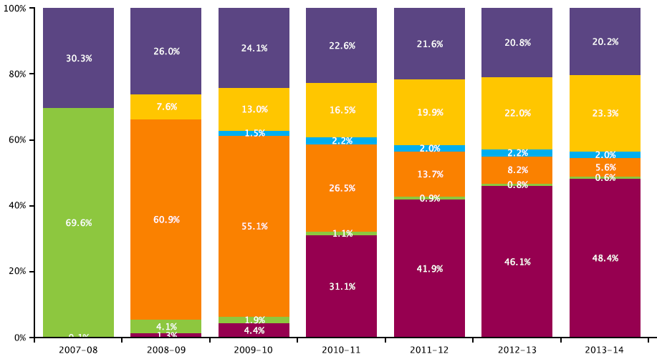
Goal 1 - College Readiness
Indicator 2 – College-going rates of public high school graduates
ENROLLMENT AND PROGRESS OF THE CLASS OF 2007
The most complete picture of the pathways of progress in college can be obtained by following the class of 2007, through six years of National Student Clearinghouse data (see Chart below). The chart follows the class of 2007 from the fall of 2007 through the spring of 2014. Important highlights of the results include:
70 percent of this class enrolled in the first year, while an additional 4 percent enrolled in the second year, 2 percent more in the third year, and approximately 1 percent enrolled in each remaining year.
20 percent of students never enrolled in college, according to NSC.
23 percent of the class enrolled but left college without earning a degree.
8 percent of the class were still enrolled after six years, and 5.6 percent after seven years.
About 2 percent of the class returned each year after a gap in their postsecondary enrollment.
After six years, 48 percent of the high school class had earned a college degree.
CLASS OF 2007 Post secondary Enrollment and Progress
Source
State Department of Education, National Student Clearinghouse Student Tracker Report for High Schools. Report Run Date: 03/04/2015.
Notes:
Waiting: Message to Chuck for copies of NSC statewide reports for last couple years. Looking for state level figure
Source: SDE
http://www.sde.ct.gov/sde/lib/sde/pdf/evalresearch/college_enrollment_persistence_graduation_statewide_results.pdf
Context copied from SDE’s report
These reports provide the most complete data about college going, persistence, and graduation that currently exist for Connecticut’s public high schools. They were created for the Connecticut State Department of Education by the National Student Clearinghouse. They provide information about students who graduated from Connecticut Public High Schools in 2006-07 through 2011-12 and subsequently enrolled in postsecondary institutions nationally at any point between June 2007 and November 14, 2014. (source, the website: http://www.sde.ct.gov/sde/cwp/view.asp?a=2758&q=335288)
Of the approximately 28,000 students from the class of 2012 who enrolled in college in the first year after graduation:
64 percent chose a public higher education institution;
73 percent chose a 4-year institution; and
58 percent remained in the state.
These figures have remained relatively stable over the last six graduating classes.

Slide 18
Goal 1 - College Readiness
Indicator 3 – Percent completing college-level English and math courses within 2 years
Connecticut Community Colleges –
  Completion of College-level English within 2 years
Completion of College-level math within 2 years
Source: Board of Regents Community College Institutional Research Database (IRDB)
Calculation: Numerator: Among the First-time, Degree or Certificate Seeking Students in a given fall semester, the number successfully completing a college level English course (ENG* >100) or college level Math course (MAT* >099) within the first two consecutive academic years of initial enrollment. Denominator: New, First-time, Degree or Certificate Seeking Students in a given fall semester. Successful completion means a grade of C or better. Data for each year is for those who were registered in the fall of each given year.
Notes:
Waiting: Message to Chuck for copies of NSC statewide reports for last couple years. Looking for state level figure
Source: SDE
http://www.sde.ct.gov/sde/lib/sde/pdf/evalresearch/college_enrollment_persistence_graduation_statewide_results.pdf
Context copied from SDE’s report
These reports provide the most complete data about college going, persistence, and graduation that currently exist for Connecticut’s public high schools. They were created for the Connecticut State Department of Education by the National Student Clearinghouse. They provide information about students who graduated from Connecticut Public High Schools in 2006-07 through 2011-12 and subsequently enrolled in postsecondary institutions nationally at any point between June 2007 and November 14, 2014. (source, the website: http://www.sde.ct.gov/sde/cwp/view.asp?a=2758&q=335288)
Of the approximately 28,000 students from the class of 2012 who enrolled in college in the first year after graduation:
64 percent chose a public higher education institution;
73 percent chose a 4-year institution; and
58 percent remained in the state.
These figures have remained relatively stable over the last six graduating classes.

Slide 19
Goal 1 - College Readiness
Indicator 3 – Percent completing college-level English and math courses within 2 years
Community College - English
 | Fall 2008 |  | Fall 2009 |  | Fall 2010 |  | Fall 2011 |  | Fall 2012
 | N | % | N | % | N | % | N | % | N | %
Asnuntuck | 118 | 42.8% | 116 | 35.4% | 124 | 41.8% | 129 | 41.2% | 127 | 42.8%
Capital | 269 | 37.9% | 268 | 38.0% | 289 | 36.8% | 243 | 33.0% | 224 | 35.8%
Gateway | 496 | 39.8% | 542 | 37.9% | 563 | 40.5% | 575 | 41.8% | 680 | 43.5%
Housatonic | 570 | 48.4% | 623 | 50.9% | 614 | 46.8% | 575 | 47.4% | 565 | 49.2%
Manchester | 643 | 40.4% | 758 | 43.5% | 740 | 46.0% | 718 | 47.6% | 757 | 44.9%
Middlesex | 196 | 36.1% | 247 | 40.9% | 234 | 38.6% | 257 | 45.3% | 268 | 46.3%
Norwalk | 434 | 49.7% | 481 | 51.7% | 421 | 49.4% | 505 | 51.4% | 555 | 52.2%
Naugatuck Valley | 533 | 43.8% | 631 | 47.1% | 691 | 46.9% | 729 | 47.2% | 670 | 44.4%
Northwestern CT | 142 | 44.9% | 149 | 47.8% | 154 | 51.3% | 128 | 52.9% | 113 | 47.9%
Quinebaug Valley | 165 | 38.5% | 174 | 35.3% | 201 | 36.8% | 155 | 36.6% | 155 | 35.2%
Three Rivers | 355 | 37.4% | 389 | 38.2% | 399 | 36.2% | 340 | 33.2% | 404 | 42.3%
Tunxis | 282 | 34.2% | 329 | 38.9% | 296 | 34.7% | 305 | 37.9% | 333 | 40.6%
CCC Total | 4203 | 41.4% | 4707 | 42.9% | 4726 | 42.5% | 4659 | 43.4% | 4851 | 44.4%
Community College - math
 | Fall 2008 |  | Fall 2009 |  | Fall 2010 |  | Fall 2011 |  | Fall 2012
 | N | % | N | % | N | % | N | % | N | %
Asnuntuck | 81 | 29.3% | 82 | 25.0% | 82 | 27.6% | 86 | 27.5% | 88 | 29.6%
Capital | 181 | 25.5% | 148 | 21.0% | 155 | 19.7% | 142 | 19.3% | 133 | 21.3%
Gateway | 333 | 26.7% | 330 | 23.1% | 353 | 25.4% | 345 | 25.1% | 414 | 26.5%
Housatonic | 369 | 31.3% | 297 | 24.2% | 337 | 25.7% | 345 | 28.4% | 326 | 28.4%
Manchester | 533 | 33.5% | 551 | 31.6% | 561 | 34.8% | 576 | 38.2% | 617 | 36.6%
Middlesex | 168 | 30.9% | 186 | 30.8% | 191 | 31.5% | 181 | 31.9% | 187 | 32.3%
Norwalk | 282 | 32.3% | 255 | 27.4% | 248 | 29.1% | 293 | 29.8% | 284 | 26.7%
Naugatuck Valley | 484 | 39.7% | 440 | 32.9% | 476 | 32.3% | 512 | 33.1% | 456 | 30.2%
Northwestern CT | 108 | 34.2% | 96 | 30.8% | 98 | 32.7% | 64 | 26.4% | 71 | 30.1%
Quinebaug Valley | 144 | 33.6% | 153 | 31.0% | 158 | 28.9% | 132 | 31.2% | 131 | 29.8%
Three Rivers | 307 | 32.4% | 281 | 27.6% | 286 | 26.0% | 245 | 23.9% | 305 | 32.0%
Tunxis | 191 | 23.2% | 222 | 26.2% | 188 | 22.0% | 208 | 25.8% | 261 | 31.8%
CCC Total | 3181 | 31.3% | 3041 | 27.7% | 3133 | 28.2% | 3129 | 29.1% | 3273 | 30.0%
Source: Board of Regents Community College Institutional Research Database (IRDB)
Calculation: Numerator: Among the first-time, degree or certificate seeking students in a given fall semester, the number successfully completing a college level English course (ENG* >100) or college level Math course (MAT* >099) within the first two consecutive academic years of initial enrollment. Denominator: New, first-time, degree or certificate seeking students in a given fall semester. Successful completion means a grade of C or better. Data for each year is for those who were registered in the fall of each given year.
Notes:
Waiting: Message to Chuck for copies of NSC statewide reports for last couple years. Looking for state level figure
Source: SDE
http://www.sde.ct.gov/sde/lib/sde/pdf/evalresearch/college_enrollment_persistence_graduation_statewide_results.pdf
Context copied from SDE’s report
These reports provide the most complete data about college going, persistence, and graduation that currently exist for Connecticut’s public high schools. They were created for the Connecticut State Department of Education by the National Student Clearinghouse. They provide information about students who graduated from Connecticut Public High Schools in 2006-07 through 2011-12 and subsequently enrolled in postsecondary institutions nationally at any point between June 2007 and November 14, 2014. (source, the website: http://www.sde.ct.gov/sde/cwp/view.asp?a=2758&q=335288)
Of the approximately 28,000 students from the class of 2012 who enrolled in college in the first year after graduation:
64 percent chose a public higher education institution;
73 percent chose a 4-year institution; and
58 percent remained in the state.
These figures have remained relatively stable over the last six graduating classes.

Slide 20
Goal 1 - College Readiness
Indicator 3 – Percent completing college-level English and math courses within 2 years
Connecticut State Universities –
  Completion of College-level English within 2 years
 | Fall 2008 |  | Fall 2009 |  | Fall 2010 |  | Fall 2011 |  | Fall 2012
 | N | % | N | % | N | % | N | % | N | %
Central | 994 | 75.8% | 1041 | 80.8% | 1087 | 80.1% | 1116 | 80.5% | 1060 | 78.4%
Eastern | 835 | 82.1% | 831 | 84.7% | 782 | 84.0% | 789 | 83.0% | 881 | 86.8%
Southern | 1170 | 90.3% | 1122 | 90.2% | 1103 | 88.0% | 1065 | 79.8% | 1126 | 81.5%
Western | 747 | 79.1% | 859 | 84.3% | 767 | 77.8% | 720 | 81.2% | 654 | 78.2%
CCSU Total | 3746 | 82.0% | 3853 | 85.0% | 3739 | 82.6% | 3690 | 80.9% | 3721 | 81.2%
  Completion of College-level math within 2 years
 | Fall 2008 |  | Fall 2009 |  | Fall 2010 |  | Fall 2011 |  | Fall 2012
 | N | % | N | % | N | % | N | % | N | %
Central | 932 | 71.1% | 898 | 69.7% | 923 | 68.0% | 914 | 65.9% | 859 | 63.5%
Eastern | 686 | 67.5% | 717 | 73.1% | 691 | 74.2% | 653 | 68.7% | 770 | 75.9%
Southern | 851 | 65.7% | 794 | 63.8% | 785 | 62.6% | 843 | 63.2% | 935 | 67.7%
Western | 564 | 59.7% | 674 | 66.1% | 652 | 66.1% | 513 | 57.8% | 515 | 61.6%
CCSU Total | 3033 | 66.4% | 3083 | 68.0% | 3051 | 67.4% | 2923 | 64.1% | 3079 | 67.2%
Source: Connecticut State Universities Departments of Institutional Research
Calculation: Numerator: Among the First-time, Degree or Certificate Seeking Students in a given fall semester, the number successfully completing a college level English course within the first two consecutive academic years of initial enrollment. Denominator: IPEDS data for: New, First-time, Degree or Certificate Seeking Students in a given fall semester. Successful completion means a grade of C or Better. Data for each year is for those who were registered in the fall of that year.
Notes:
Waiting: Message to Chuck for copies of NSC statewide reports for last couple years. Looking for state level figure
Source: SDE
http://www.sde.ct.gov/sde/lib/sde/pdf/evalresearch/college_enrollment_persistence_graduation_statewide_results.pdf
Context copied from SDE’s report
These reports provide the most complete data about college going, persistence, and graduation that currently exist for Connecticut’s public high schools. They were created for the Connecticut State Department of Education by the National Student Clearinghouse. They provide information about students who graduated from Connecticut Public High Schools in 2006-07 through 2011-12 and subsequently enrolled in postsecondary institutions nationally at any point between June 2007 and November 14, 2014. (source, the website: http://www.sde.ct.gov/sde/cwp/view.asp?a=2758&q=335288)
Of the approximately 28,000 students from the class of 2012 who enrolled in college in the first year after graduation:
64 percent chose a public higher education institution;
73 percent chose a 4-year institution; and
58 percent remained in the state.
These figures have remained relatively stable over the last six graduating classes.

Slide 21
Goal 1 - College Readiness
Indicator 3 – Percent completing college-level English and math courses within 2 years
University of Connecticut - all campuses
  Completion of College level English & math within 2 years of entry
 | Total | Math but not English¹ |  | English but not Math² |  | Math and English
Term | Students | N | % | N | % | N | %
Fall 2007 | 4,326 | 75 | 1.73% | 401 | 9.27% | 3,792 | 87.66%
Fall 2008 | 4,858 | * | * | * | * | 3,778 | 77.77%
Fall 2009 | 4,362 | 82 | 1.88% | 534 | 12.24% | 3,695 | 84.71%
Fall 2010 | 4,580 | 153 | 3.34% | 989 | 21.59% | 3,358 | 73.32%
Source: University of Connecticut, Office of Institutional Research and Effectiveness
* Data not available at this time.
Calculation:
¹ Students Completing at Least One Entry, College-Level Math Course but not a College-Level English Course within Two Academic Years of Entry (of First-time Entry Students)
² Students Completing at Least One Entry, College-Level English Course but not a College-Level Math Course within Two Academic Years of Entry (of First-time Entry Students)
Notes:
Waiting: Message to Chuck for copies of NSC statewide reports for last couple years. Looking for state level figure
Source: SDE
http://www.sde.ct.gov/sde/lib/sde/pdf/evalresearch/college_enrollment_persistence_graduation_statewide_results.pdf
Context copied from SDE’s report
These reports provide the most complete data about college going, persistence, and graduation that currently exist for Connecticut’s public high schools. They were created for the Connecticut State Department of Education by the National Student Clearinghouse. They provide information about students who graduated from Connecticut Public High Schools in 2006-07 through 2011-12 and subsequently enrolled in postsecondary institutions nationally at any point between June 2007 and November 14, 2014. (source, the website: http://www.sde.ct.gov/sde/cwp/view.asp?a=2758&q=335288)
Of the approximately 28,000 students from the class of 2012 who enrolled in college in the first year after graduation:
64 percent chose a public higher education institution;
73 percent chose a 4-year institution; and
58 percent remained in the state.
These figures have remained relatively stable over the last six graduating classes.

Slide 22
Goal 1 - College Readiness
Indicator 4 – Percent on track to completing on-time
Community Colleges
- Full-time students completing 24 credits in 1st academic year
Table 1.4a: Full-time Students
 | 2008 | 2009 | 2010 | 2011 | 2012 | 2013 | 5 year % change
Asnuntuck | 40.9% | 44.8% | 32.1% | 27.8% | 46.1% | 46.5% | 5.6%
Capital | 10.8% | 9.3% | 10.8% | 7.1% | 10.7% | 11.9% | 1.1%
Gateway | 10.1% | 11.6% | 12.2% | 11.9% | 15.4% | 21.2% | 11.1%
Housatonic | 9.9% | 12.1% | 13.3% | 14.8% | 18.2% | 15.2% | 5.2%
Manchester | 20.3% | 24.8% | 27.4% | 27.6% | 27.6% | 30.1% | 9.7%
Middlesex | 14.1% | 16.5% | 20.1% | 16.5% | 24.4% | 23.1% | 9.0%
Norwalk | 38.1% | 36.1% | 37.8% | 36.9% | 30.9% | 42.1% | 4.0%
Naugatuck Valley | 10.4% | 14.8% | 17.1% | 18.2% | 18.9% | 20.3% | 9.9%
Northwestern CT | 17.2% | 18.1% | 19.7% | 17.4% | 16.4% | 20.3% | 3.1%
Quinebaug Valley | 46.0% | 45.2% | 40.9% | 45.8% | 44.8% | 49.5% | 3.5%
Three Rivers | 22.1% | 20.7% | 20.6% | 18.8% | 27.8% | 26.7% | 4.7%
Tunxis | 29.2% | 36.7% | 32.0% | 35.8% | 39.9% | 39.5% | 10.4%
CCC Total - FT | 19.9% | 22.2% | 22.2% | 22.2% | 25.3% | 27.7% | 7.8%
Source: Board of Regents Community College Institutional Research Database (IRDB)
Calculation:
Full-time: Percent of first-time, full-time undergraduate or degree seeking students in a fall IPEDS Graduation Rate Survey cohort who completed 24 or more credit hours before the following fall.
Part-time: Percent of first-time, part-time, undergraduate, degree seeking students in a fall GRS cohort who completed 12 or more credit hours that count towards a degree before the following fall.
Notes:
Waiting: Message to Chuck for copies of NSC statewide reports for last couple years. Looking for state level figure
Source: SDE
http://www.sde.ct.gov/sde/lib/sde/pdf/evalresearch/college_enrollment_persistence_graduation_statewide_results.pdf
Context copied from SDE’s report
These reports provide the most complete data about college going, persistence, and graduation that currently exist for Connecticut’s public high schools. They were created for the Connecticut State Department of Education by the National Student Clearinghouse. They provide information about students who graduated from Connecticut Public High Schools in 2006-07 through 2011-12 and subsequently enrolled in postsecondary institutions nationally at any point between June 2007 and November 14, 2014. (source, the website: http://www.sde.ct.gov/sde/cwp/view.asp?a=2758&q=335288)
Of the approximately 28,000 students from the class of 2012 who enrolled in college in the first year after graduation:
64 percent chose a public higher education institution;
73 percent chose a 4-year institution; and
58 percent remained in the state.
These figures have remained relatively stable over the last six graduating classes.

Slide 23
Goal 1 - College Readiness
Indicator 4 – Percent on track to completing on-time
Community Colleges
- Part-Time student completing 12 credits in 1st academic year
Table 1.4b: Part-time Students
 | 2008 | 2009 | 2010 | 2011 | 2012 | 2013 | 5 year % change
Asnuntuck | 39.7% | 41.7% | 24.7% | 27.8% | 31.3% | 31.4% | -8.3%
Capital | 22.8% | 24.9% | 29.4% | 25.3% | 17.5% | 27.3% | 4.5%
Gateway | 24.1% | 21.4% | 25.0% | 22.5% | 25.6% | 27.1% | 2.9%
Housatonic | 15.7% | 21.7% | 20.0% | 24.1% | 25.1% | 22.4% | 6.6%
Manchester | 28.9% | 30.6% | 32.7% | 33.3% | 31.4% | 33.7% | 4.8%
Middlesex | 17.0% | 20.1% | 15.9% | 19.5% | 24.2% | 21.8% | 4.8%
Norwalk | 44.0% | 49.5% | 47.6% | 52.9% | 50.8% | 52.5% | 8.5%
Naugatuck Valley | 20.5% | 23.7% | 22.8% | 28.0% | 24.8% | 21.6% | 1.1%
Northwestern CT | 16.8% | 22.7% | 15.0% | 26.6% | 27.3% | 23.5% | 6.7%
Quinebaug Valley | 49.0% | 50.0% | 50.4% | 49.2% | 53.2% | 54.5% | 5.5%
Three Rivers | 15.3% | 22.5% | 20.6% | 20.6% | 24.0% | 25.3% | 10.0%
Tunxis | 40.6% | 50.6% | 44.4% | 45.5% | 47.9% | 47.3% | 6.7%
CCC Total - PT | 25.7% | 29.4% | 28.6% | 30.2% | 30.3% | 31.1% | 5.4%
Source: Board of Regents Community College Institutional Research Database (IRDB)
Calculation:
Full-time: Percent of first-time, full-time undergraduate or degree seeking students in a fall IPEDS Graduation Rate Survey cohort who completed 24 or more credit hours before the following fall.
Part-time: Percent of first-time, part-time, undergraduate, degree seeking students in a fall GRS cohort who completed 12 or more credit hours that count towards a degree before the following fall.
Notes:
Waiting: Message to Chuck for copies of NSC statewide reports for last couple years. Looking for state level figure
Source: SDE
http://www.sde.ct.gov/sde/lib/sde/pdf/evalresearch/college_enrollment_persistence_graduation_statewide_results.pdf
Context copied from SDE’s report
These reports provide the most complete data about college going, persistence, and graduation that currently exist for Connecticut’s public high schools. They were created for the Connecticut State Department of Education by the National Student Clearinghouse. They provide information about students who graduated from Connecticut Public High Schools in 2006-07 through 2011-12 and subsequently enrolled in postsecondary institutions nationally at any point between June 2007 and November 14, 2014. (source, the website: http://www.sde.ct.gov/sde/cwp/view.asp?a=2758&q=335288)
Of the approximately 28,000 students from the class of 2012 who enrolled in college in the first year after graduation:
64 percent chose a public higher education institution;
73 percent chose a 4-year institution; and
58 percent remained in the state.
These figures have remained relatively stable over the last six graduating classes.

Slide 24
Goal 1 - College Readiness
Indicator 4 – Percent on track to completing on-time
Connecticut State Universities
- Full-Time student completing 24 credits in 1st academic year
Table 1.4c: Full-time Students
 | 2008 | 2009 | 2010 | 2011 | 2012 | 2013 | 5 year % change
Central | 69.1% | 73.3% | 73.6% | 69.0% | 68.6% | 74.4% | 5.3%
Eastern | 77.3% | 78.7% | 78.9% | 77.5% | 81.6% | 84.4% | 7.1%
Southern | 73.1% | 72.5% | 71.0% | 68.6% | 75.3% | 70.1% | -3.0%
Western | 62.9% | 70.9% | 71.6% | 73.9% | 78.2% | 79.7% | 16.8%
CSU Total | 70.7% | 73.7% | 73.5% | 71.6% | 75.2% | 76.2% | 5.5%
- Part-Time student completing 12 credits in 1st academic year
Table 1.4d: Part-time Students
 | Fall 2008 |  | Fall 2009 |  | Fall 2010 |  | Fall 2011 |  | Fall 2012 |  | Fall 2013
College | >=12 Hrs | % | >=12 Hrs | % | >=12 Hrs | % | >=12 Hrs | % | >=12 Hrs | % | >=12 Hrs | %
Central | 3 | 42.9% | 4 | 57.1% | 5 | 71.4% | 6 | 46.2% | 10 | 83.3% | 8 | 53.3%
Eastern | 46 | 69.7% | 27 | 73.0% | 10 | 62.5% | 18 | 75.0% | 32 | 88.9% | 20 | 90.9%
Southern | 5 | 62.5% | 1 | 14.3% | 2 | 40.0% | 5 | 33.3% | 7 | 31.8% | 4 | 21.1%
Western | 4 | 28.6% | 2 | 18.2% | 4 | 36.4% | 12 | 70.6% | 5 | 33.3% | 6 | 46.2%
CSU Total | 58 | 61.1% | 34 | 54.8% | 21 | 53.8% | 41 | 59.4% | 54 | 63.5% | 38 | 55.1%
Sources:
Numerator: Connecticut State Universities
Denominator: Integrated Postsecondary Education Data System (IPEDS)
Calculation:
Full-time: Percent of first-time, full-time undergraduate or degree seeking students in a fall Graduation Rate Survey cohort who completed 24 or more credit hours before the following fall.
Part-time: Percent of first-time, part-time, undergraduate, degree seeking students in a fall GRS cohort who completed 12 or more credit hours that count towards a degree before the following fall.
Notes:
Waiting: Message to Chuck for copies of NSC statewide reports for last couple years. Looking for state level figure
Source: SDE
http://www.sde.ct.gov/sde/lib/sde/pdf/evalresearch/college_enrollment_persistence_graduation_statewide_results.pdf
Context copied from SDE’s report
These reports provide the most complete data about college going, persistence, and graduation that currently exist for Connecticut’s public high schools. They were created for the Connecticut State Department of Education by the National Student Clearinghouse. They provide information about students who graduated from Connecticut Public High Schools in 2006-07 through 2011-12 and subsequently enrolled in postsecondary institutions nationally at any point between June 2007 and November 14, 2014. (source, the website: http://www.sde.ct.gov/sde/cwp/view.asp?a=2758&q=335288)
Of the approximately 28,000 students from the class of 2012 who enrolled in college in the first year after graduation:
64 percent chose a public higher education institution;
73 percent chose a 4-year institution; and
58 percent remained in the state.
These figures have remained relatively stable over the last six graduating classes.

Slide 25
Goal 1 - College Readiness
Indicator 4 – Percent on track to completing on-time
University of Connecticut (All Campuses)
- Full-Time student completing 24 credits in 1st academic year
Table 1.4e: Full-time Students
Students Completing 24 Credit Hours in 1st year
Term | Total | N | %
2007 | 4,326 | 3,469 | 80.2%
2008 | 4,858 | 3,938 | 81.1%
2009 | 4,362 | 3,582 | 82.1%
2010 | 3,030 | 2,597 | 85.7%
Source:
University of Connecticut, Office of Institutional Research and Effectiveness
Calculation:
Of first-time freshmen entry class at all campuses, the number and percent of students completing 24 credit hours within their first academic year.
Notes:
Waiting: Message to Chuck for copies of NSC statewide reports for last couple years. Looking for state level figure
Source: SDE
http://www.sde.ct.gov/sde/lib/sde/pdf/evalresearch/college_enrollment_persistence_graduation_statewide_results.pdf
Context copied from SDE’s report
These reports provide the most complete data about college going, persistence, and graduation that currently exist for Connecticut’s public high schools. They were created for the Connecticut State Department of Education by the National Student Clearinghouse. They provide information about students who graduated from Connecticut Public High Schools in 2006-07 through 2011-12 and subsequently enrolled in postsecondary institutions nationally at any point between June 2007 and November 14, 2014. (source, the website: http://www.sde.ct.gov/sde/cwp/view.asp?a=2758&q=335288)
Of the approximately 28,000 students from the class of 2012 who enrolled in college in the first year after graduation:
64 percent chose a public higher education institution;
73 percent chose a 4-year institution; and
58 percent remained in the state.
These figures have remained relatively stable over the last six graduating classes.

Slide 26
Goal 1 - College Readiness
Indicator 4 – Percent on track to completing on-time
What does this mean?
Students are identified as full-time students if they are enrolled in 12 or more credits per term. This is the amount of credit hours students need to take in order to be eligible for financial aid. At this rate, a full-time student will be able to complete 24 credits in a year, while a part-time student can accumulate 12. This metric was developed to identify the volume of students who are on track to completing on-time; however, at this pace, students pursuing a Bachelor’s degree, which typically requires a minimum of 120 credit hours, will graduate in 6 years instead of 4 years – the popular expectation. Similarly, students pursuing an associate degree, which typically requires a minimum of 60 credit hours, will complete their degree in 3 years instead of 2.
This pace is 150% of normal program completion time, and although it may be a longer period of time than is expected by the general public, the vast majority of students pursuing post-secondary credentials in public institutions are spending additional years in school. Graduation rates are now commonly reported in terms of 150% and 200% of normal time.¹
Tables 1.4a and 1.4b show that for both full-time and part-time community college students, the proportion of students maintaining academic momentum in their first year has risen consistently across campuses and the sector over the past five years. This improvement is important because students who complete their degrees earlier accumulate less debt and can enter the workforce or pursue additional schooling earlier which bolsters their future earning potential.
Rates for State University students are higher because these institutions are more likely to attract students who are interested in pursuing post-secondary education on a full-time basis. These students frequently live on campus furthering the opportunity for them to focus their time on academic pursuits. A majority of students attending a CT State University do so on a full-time basis; therefore, the rates of on-track part-time students need to be reviewed along with the actual count of those students. In many cases, the cohort of individuals attending part-time was less than 10 individuals. Rates based upon a cohort this small need to be used with caution.
There are no data for Charter Oak State College for this metric because Charter Oak does not enroll individuals who are first-time students.
Source:
¹ U.S. Department of Education, Tracking Students to 200 Percent of Normal Time: Effect on Institutional Graduation Rates, December 2010 NCES 2011-221, http://nces.ed.gov/pubs2011/2011221.pdf
Notes:
Waiting: Message to Chuck for copies of NSC statewide reports for last couple years. Looking for state level figure
Source: SDE
http://www.sde.ct.gov/sde/lib/sde/pdf/evalresearch/college_enrollment_persistence_graduation_statewide_results.pdf
Context copied from SDE’s report
These reports provide the most complete data about college going, persistence, and graduation that currently exist for Connecticut’s public high schools. They were created for the Connecticut State Department of Education by the National Student Clearinghouse. They provide information about students who graduated from Connecticut Public High Schools in 2006-07 through 2011-12 and subsequently enrolled in postsecondary institutions nationally at any point between June 2007 and November 14, 2014. (source, the website: http://www.sde.ct.gov/sde/cwp/view.asp?a=2758&q=335288)
Of the approximately 28,000 students from the class of 2012 who enrolled in college in the first year after graduation:
64 percent chose a public higher education institution;
73 percent chose a 4-year institution; and
58 percent remained in the state.
These figures have remained relatively stable over the last six graduating classes.

Slide 27
Student Success
Graduate more people with the knowledge and skills to achieve their life and career goals.
Indicators:
Completions per 100 FTE student by level
Graduation rate of full-time, first-time students in 150% of normal time; community colleges only will include transfers out to another institution
Employment and earnings after graduation
Time and credits to degree/certificate
Transfers from 2-year to 4-year institutions per 100 FTE

Slide 28
Goal 2 - Student Success
Indicator 1 – Completions per 100 Full-time Equivalent (FTE) Students
 | 2011-12 |  | 2012-13 |  | 2013-14
 | UG | GR | UG | GR | UG | GR
Asnuntuck | 43.1 | - | 56.9 | - | 47.0 | -
Capital | 20.6 | - | 20.1 | - | 24.3 | -
Gateway | 18.6 | - | 17.6 | - | 17.9 | -
Housatonic | 15.6 | - | 18.4 | - | 20.7 | -
Manchester | 21.4 | - | 20.6 | - | 20.6 | -
Middlesex | 19.6 | - | 18.3 | - | 20.1 | -
Naugatuck Valley | 23.0 | - | 27.8 | - | 30.9 | -
Northwestern CT | 22.3 | - | 25.7 | - | 27.7 | -
Norwalk | 18.5 | - | 17.6 | - | 20.9 | -
Quinebaug Valley | 20.6 | - | 30.4 | - | 36.3 | -
Three Rivers | 18.5 | - | 23.7 | - | 23.0 | -
Tunxis | 20.7 | - | 22.2 | - | 22.5 | -
Community College Total | 20.5 | - | 22.3 | - | 23.7 | -
Charter Oak | 75.1 | - | 65.4 | - | 81.2 | -
Central | 21.6 | 60.2 | 22.0 | 63.0 | 22.5 | 66.5
Eastern | 24.0 | 102.9 | 24.9 | 74.0 | 23.2 | 58.1
Southern | 21.3 | 57.2 | 22.1 | 60.1 | 22.6 | 49.7
Western | 18.5 | 58.7 | 20.7 | 63.3 | 23.1 | 63.4
State University Total | 21.3 | 60.0 | 22.4 | 61.9 | 22.8 | 57.5
University of Connecticut | 24.7 | 41.4 | 24.8 | 39.5 | 24.8 | 41.4
What does this mean?
The concept of Full-Time Equivalent (FTE) is used to account for the fact that many students attend college on a part-time basis. For example, a single full-time student at one college may be compared to two part-time students at another by using calculations with FTE’s. This metric shows the rate of total completions at a campus during a given academic year compared to the number of FTE’s. For example, if a 4-year institution only had full-time students, ideally one quarter of their student body would graduate every year; the number for that campus would be 25.
Connecticut Community Colleges and State Universities
Sources : Completions: BOR Office of Planning and Research. Community College completions were obtained from the Institutional Research Data Base. Connecticut State University Data was extracted from the Institutional Research Repository and Charter Oak State College (COSC) Data was prepared by COSC.
Full Time Equivalent (FTE) Counts from: http://www.ct.edu/opr/statistical_abstract. See definition in IPEDS glossary entry for "Calculation of FTE students at nces.ed.gov/ipeds/glossary/?charindex=C. FTE's prepared by Office of Planning and Research, November 20, 2014. This FTE is based on fall enrollment only; it is not an annualized calculation.
Calculation: Completions divided by FTE as calculated per IPEDS definition.
¹ Due to data availability, FTE’s for Charter Oak were calculated differently. Data for 2011-12 and 2012-13 are annualized FTE’s available from IPEDS. Data for 2013-2014 is calculated for fall 2013 by a different but standard method where 15 undergraduate credit hours = 1 FTE. The 2013-14 figure is for fall 2013 and not an annualized figure. Data may be lower than official FTE reports based on credit hours, which include a full 12 months of instructional activity as well as FTE reports based on the NCES fall headcount conversion formula.
University of Connecticut:
Source: IPEDS Completions and Fall Enrollment Survey
* Graduate enrollment/FTE includes Graduate Certificates and Sixth-Year Diploma in Education.

Slide 29
Goal 2 - Student Success
Indicator 2 – Graduation rate and transfer rate of full-time, first-time students in 150% of normal time
Connecticut Community Colleges – 3 Year Success Rates*
First-time, Full-time Cohorts by Year of Entrance
 | 2003 | 2004 | 2005 | 2006 | 2007 | 2008 | 2009 | 2010 | 5 year change
Asnuntuck | 49.2% | 42.0% | 40.0% | 45.9% | 50.0% | 46.2% | 56.3% | 48.2% | 2.3%
Capital | 30.6% | 30.1% | 28.4% | 29.2% | 30.5% | 33.9% | 29.7% | 31.8% | 2.5%
Gateway | 9.1% | 31.0% | 32.8% | 26.1% | 28.9% | 28.7% | 26.7% | 29.1% | 3.0%
Housatonic | 29.0% | 28.3% | 28.1% | 9.7% | 28.6% | 15.4% | 17.1% | 28.0% | 18.3%
Manchester | 38.8% | 35.8% | 37.6% | 34.7% | 36.5% | 41.7% | 40.2% | 39.4% | 4.8%
Middlesex | 39.1% | 38.0% | 41.0% | 33.1% | 33.6% | 34.9% | 40.7% | 39.3% | 6.2%
Naugatuck Valley | 31.4% | 28.2% | 28.4% | 33.7% | 31.4% | 25.3% | 31.3% | 31.0% | -2.7%
Northwestern CT | 35.6% | 37.2% | 42.3% | 34.6% | 35.0% | 33.0% | 31.6% | 31.6% | -3.0%
Norwalk | 32.7% | 33.5% | 30.0% | 32.7% | 29.3% | 35.3% | 31.6% | 28.1% | -4.7%
Quinebaug Valley | 34.6% | 35.6% | 34.7% | 42.7% | 35.8% | 40.4% | 33.1% | 33.8% | -8.9%
Three Rivers | 37.4% | 32.2% | 37.6% | 31.9% | 30.0% | 30.1% | 33.2% | 29.3% | -2.6%
Tunxis | 33.0% | 30.4% | 32.7% | 33.7% | 24.6% | 25.9% | 34.6% | 32.3% | -1.4%
CCC Overall Success Rate | 31.3% | 32.4% | 33.5% | 31.1% | 31.8% | 31.4% | 32.7% | 32.5% | 1.4%
What does this mean?
Completion rates for students attending a community college have historically been low. Individuals pursuing education through a community college may have additional interests or they may face challenges in life which are reflected in a longer path toward completion. Students may arrive at college lacking basic skills, they may be working simultaneously or balancing school with family life. Transportation and childcare issues may also hinder continuous progress.
Community colleges also enable students to pursue additional education at institutions that provide bachelor degrees. If students don’t complete a degree at a community college but transfer to another institution, those transfers are considered successes for the institution which helped prepare the students, and it is success for the students who are continuing to further their education. For these reasons, the Community College Success Rate includes both degree completers and a count of students who transfer out.
Source: Integrated Postsecondary Education Data system (IPEDS)
*Calculation: Connecticut Community Colleges: The numerator is the number of students from the adjusted cohort of first-time full-time degree or certificate seeking students who completed their program or who transferred out without an award within 150% of normal time; the denominator is the adjusted cohort. The resulting metric is the 150% completion rate reported to IPEDS.

Slide 30
Goal 2 - Student Success
Indicator 2 – Graduation rate of full-time, first-time students in 150% of normal time
Connecticut State Universities – 6 Year Graduation Rates
First-time, Full-time Cohorts by Year of Entrance
 | 2001 | 2002 | 2003 | 2004 | 2005 | 2006 | 2007 | 2008 | 5 year change
Central | 44.3% | 46.1% | 48.9% | 47.6% | 47.3% | 52.0% | 51.9% | 52.4% | 4.8%
Eastern | 48.3% | 45.9% | 50.8% | 52.4% | 48.8% | 52.8% | 50.8% | 56.2% | 3.8%
Southern | 37.6% | 37.9% | 42.3% | 42.0% | 43.8% | 43.7% | 49.4% | 52.9% | 10.8%
Western | 37.9% | 40.5% | 42.5% | 44.7% | 40.2% | 42.3% | 44.5% | 42.2% | -2.5%
CSU Total | 41.7% | 42.6% | 45.9% | 46.2% | 45.3% | 47.6% | 49.5% | 51.2% | 5.0%
What does this mean?
Completion rates for students across all Connecticut State Universities has risen by 6% when the cohort of 2005 is compared to the cohort of 2008. These graduation rates are calculated for cohorts of students entering college for the first time and on a full-time basis, and they exclude individuals who may have passed away or taken a break from their education experience due to illness . Graduation rates for part-time or transfer students may be different.
Note that data about graduation and success rates are not comparable across sectors.
The last cohort of data available for this metric is 2008 because six years need to elapse in order to identify those who have completed a credential within the appropriate timeframe.
Source: Integrated Postsecondary Education Data system (IPEDS), May 20, 2015.
Calculation: Connecticut State Universities: The numerator is the number of students from the adjusted cohort of first-time full-time degree or certificate seeking students who completed their program within 150% of normal time; the denominator is the adjusted cohort.

Slide 31
Goal 2 - Student Success
Indicator 2 – Graduation rate of full-time, first-time students in 150% of normal time
University of Connecticut – Storrs - 6 Year Graduation Rates
Storrs
 | White | Black | Hispanic | Asian American | Native American | Total Minority | Unknown¹ | NRA² | Total
2005 | 85% | 65% | 72% | 83% | 89% | 74% | 84% | 80% | 83%
2006 | 83% | 71% | 76% | 83% | 63% | 77% | 85% | 75% | 82%
2007 | 84% | 72% | 80% | 90% | 91% | 82% | 84% | 87% | 83%
2008 | 82% | 67% | 77% | 84% | 100% | 78% | 84% | 63% | 81%
Regional Campuses
 | White | Black | Hispanic | Asian American | Native American | Total Minority | Unknown¹ | NRA² | Total
2005 | 53% | 40% | 42% | 61% | 100% | 49% | 49% | 75% | 51%
2006 | 48% | 40% | 48% | 70% | 33% | 52% | 59% | 74% | 51%
2007 | 52% | 45% | 41% | 68% | 33% | 51% | 51% | 65% | 52%
2008 | 50% | 44% | 51% | 56% | 100% | 51% | 57% | 78% | 52%
Source: University of Connecticut, Office of Institutional Research and Effectiveness
Calculation:
¹Unknown Race/Ethnicity. Students did not identify their race or ethnicity
² Non-Resident Alien

Slide 32
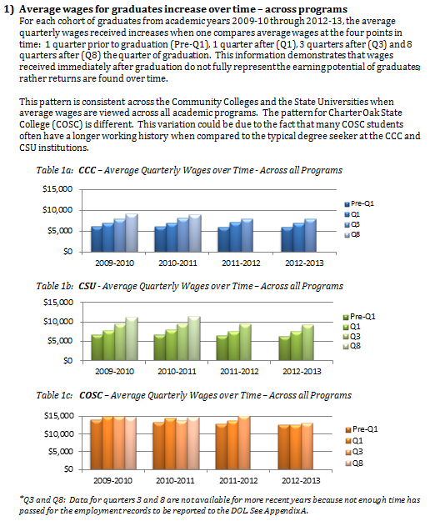
Goal 2 - Student Success
Indicator 3 – Employment and earnings after graduation
There are five primary findings about the employment and wage trends for graduates from Connecticut Community Colleges (CCC), Connecticut State Universities (CSU) and Charter Oak State College (CSOSC). Data are not available at this time from the University of Connecticut.

Slide 33
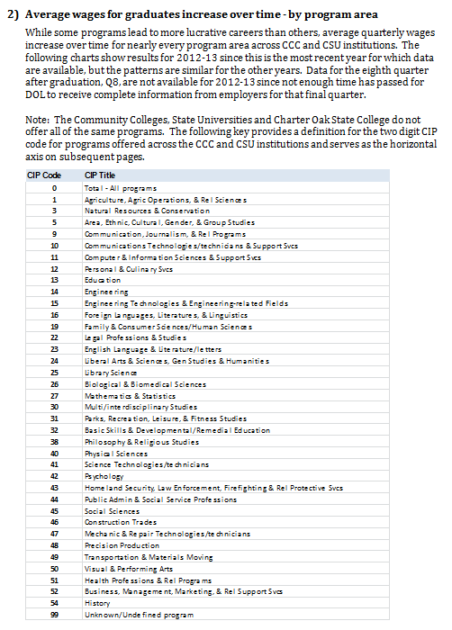
Goal 2 - Student Success
Indicator 3 – Employment and earnings after graduation - continued

Slide 34
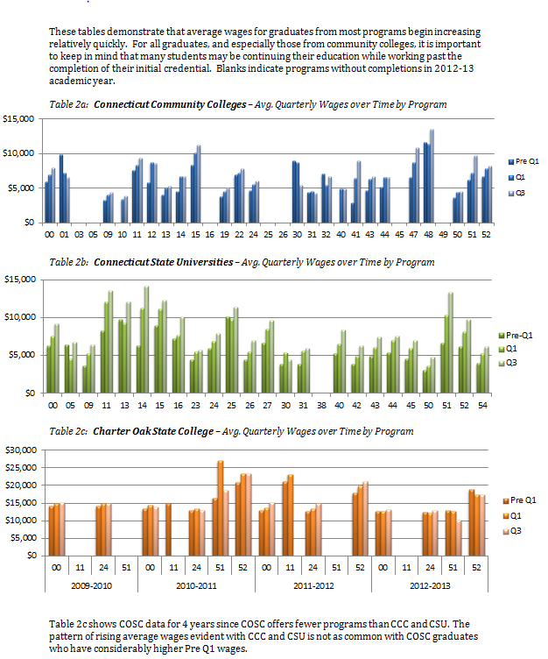
Goal 2 - Student Success
Indicator 3 – Employment and earnings after graduation - continued

Slide 35
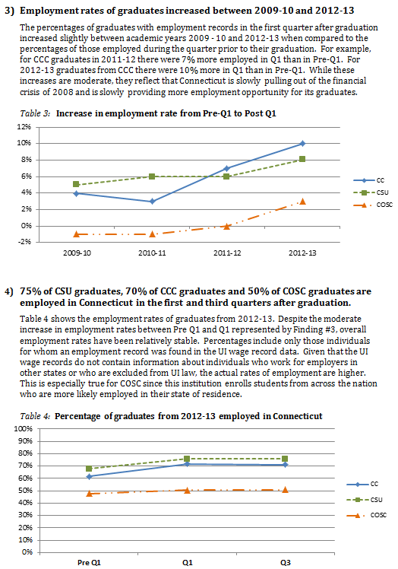
Goal 2 - Student Success
Indicator 3 – Employment and earnings after graduation - continued

Slide 36
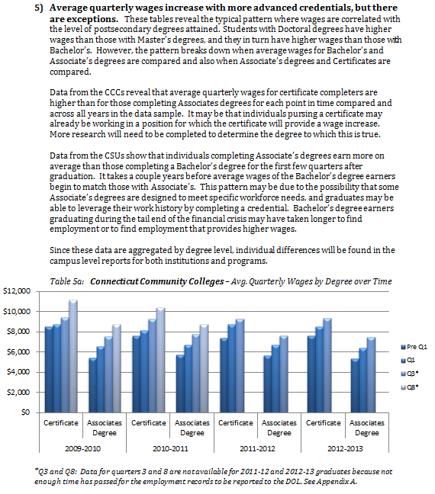
Goal 2 - Student Success
Indicator 3 – Employment and earnings after graduation - continued

Slide 37
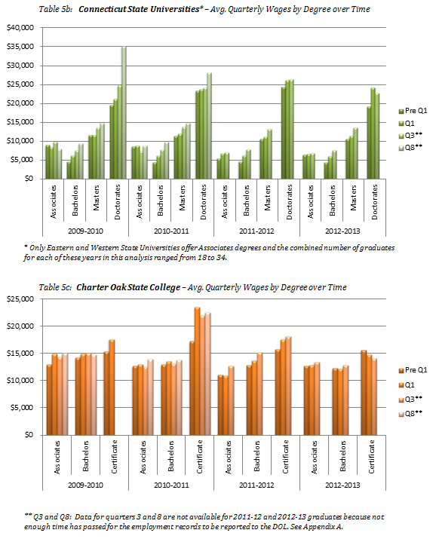
Goal 2 - Student Success
Indicator 3 – Employment and earnings after graduation - continued

Slide 38
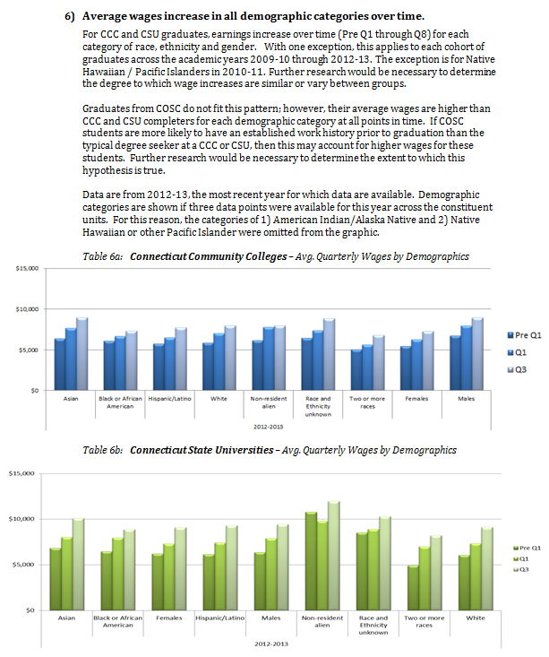
Goal 2 - Student Success
Indicator 3 – Employment and earnings after graduation - continued

Slide 39
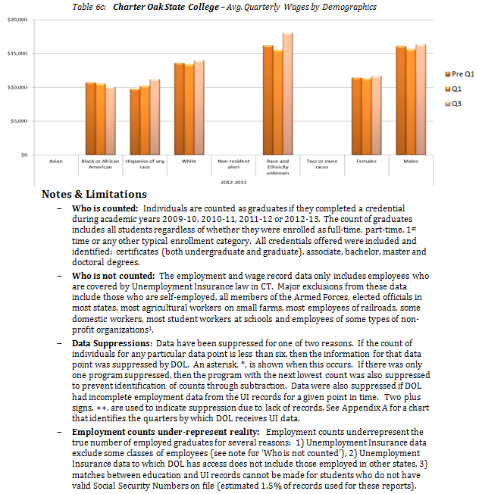
Goal 2 - Student Success
Indicator 3 – Employment and earnings after graduation - continued

Slide 40
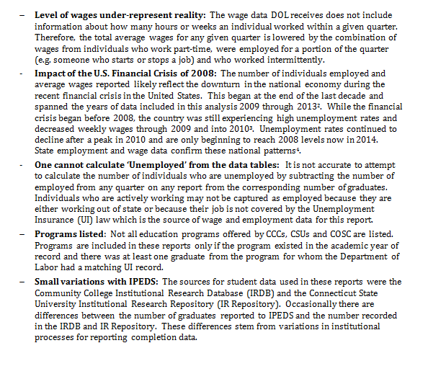

Goal 2 - Student Success
Indicator 3 – Employment and earnings after graduation - continued

Slide 41
Goal 2 - Student Success
Indicator 4 – Time in years and credits to degree / certificate
 | Average Time to Award¹ |  |  |  |  | Average Academic Credits to Award¹
 | 2010 | 2011 | 2012 | 2013 | 2014 | 2010 | 2011 | 2012 | 2013 | 2014
Asnuntuck | 2.5 | 2.4 | 2.6 | 2.3 | 1.9 | 63.9 | 67.5 | 65.2 | 56.8 | 57.9
Capital | 2.6 | 2.2 | 2.2 | 2.1 | 2.1 | 76.1 | 76.8 | 77.0 | 77.7 | 77.4
Gateway | 1.8 | 1.7 | 1.9 | 2.1 | 2.0 | 76.3 | 75.5 | 76.2 | 75.9 | 75.8
Housatonic | 2.7 | 2.9 | 3.1 | 3.0 | 2.9 | 77.2 | 76.5 | 76.4 | 76.3 | 74.9
Manchester | 2.2 | 2.1 | 2.3 | 2.4 | 2.4 | 75.4 | 73.9 | 74.1 | 73.4 | 73.5
Middlesex | 2.6 | 2.7 | 2.7 | 2.7 | 2.7 | 71.4 | 72.0 | 71.3 | 71.5 | 71.1
Norwalk | 1.7 | 1.4 | 1.6 | 1.7 | 1.7 | 80.6 | 81.5 | 81.1 | 81.6 | 80.0
Naugatuck Valley | 2.1 | 2.1 | 2.3 | 2.8 | 2.5 | 77.9 | 77.8 | 77.0 | 75.9 | 76.5
Northwestern CT | 2.9 | 2.6 | 2.6 | 2.3 | 2.1 | 71.3 | 74.9 | 77.2 | 76.5 | 76.8
Quinebaug Valley | 2.2 | 2.4 | 2.1 | 1.8 | 1.7 | 69.9 | 72.4 | 69.6 | 65.0 | 62.7
Three Rivers | 2.2 | 2.2 | 2.3 | 2.2 | 2.3 | 83.0 | 83.2 | 85.9 | 83.1 | 83.8
Tunxis | 2.0 | 1.8 | 1.7 | 1.8 | 2.0 | 73.7 | 75.3 | 77.2 | 75.9 | 78.0
 | Average Time to Award² |  |  |  |  | Average Academic Credits to Award²
 | 2010 | 2011 | 2012 | 2013 | 2014 | 2010 | 2011 | 2012 | 2013 | 2014
Central | 4.6 | 4.5 | 4.5 | 4.5 | 4.8 | 133.7 | 133.6 | 135.6 | 133.5 | 134.5
Eastern | 4.4 | 4.5 | 4.6 | 4.7 | 5.1 | 130.2 | 129.9 | 131.2 | 129.8 | 130.6
Southern | 4.5 | 4.7 | 4.7 | 4.6 | 4.6 | 135.4 | 137.3 | 135.9 | 136.6 | 138.7
Western | 5.0 | 4.6 | 5.0 | 4.8 | 5.1 | 132.6 | 131.9 | 132.6 | 131.2 | 132.7
What does this mean?
Students who complete degrees with the minimum number of credits in the shortest period of time take the most efficient pathway through post-secondary education, pay less for the post-secondary education and utilize fewer state resources in the process. Connecticut State University students on average are taking more than four years to complete a Bachelor’s degree. In addition, the number of credits at the time of graduation exceed 120.
Source: BOR Office of Policy, Research and Strategic Planning
Calculation:
Cohorts are defined by the academic year in which they completed their most recent credential (e.g. 2009-2010 graduates are grouped under 2010).
¹For Community Colleges the term of graduation is the end of the time period assessed. The term in which individuals in this cohort declared the majors (catalog_semester) under which they completed their most recent credential was the starting point for the period assessed. Students may have been enrolled in post-secondary education or even completed additional credentials prior to this point.
² For State Universities, the time to award begins with the term of the first class and continues to the term of graduation.

Slide 42
Goal 2 - Student Success
Indicator 4 – Time and credits to degree / certificate
University of Connecticut
Year | Associate Degree-Seeking |  | Bachelor's Degree-Seeking
 | Full-Time Students | Transfer | Full-Time Students | Transfer In 30 or Fewer Credits | Transfer In 31 to 59 Credits | Transfer in 60 or More Credits
Average Length of Time to Degree (Years, rounded to the nearest 2 decimal points)
2008-09 | 1.9 | 1.7 | 4.31 | 3.5 | 3.02 | 2.83
2009-10 | * | * | * | * | * | *
2010-11 | 2.12 | 1.97 | 4.21 | 3.44 | 3.05 | 3.17
2011-12 | 1.94 | 1.8 | 4.18 | 3.31 | 3.02 | 2.94
Average Credits to Degree
2008-09 | 62.64 | 44 | 123.86 | 99.61 | 82.62 | 55.78
2009-10 | * | * | * | * | * | *
2010-11 | 66.62 | 44 | 125.25 | 100.66 | 82.62 | 55.17
2011-12 | 65.04 | 56 | 125.79 | 97.74 | 83.46 | 54.78
Source:
University of Connecticut, Office of Institutional Research and Effectiveness
* Data not available

Slide 43
Goal 2 - Student Success
Indicator 5 – Transfers from 2-year to 4-year institutions per 100 FTE
 | Total Transfers without a degree to a 4-year institution - anywhere
 |  | Fall 2011 |  |  | Fall 2012 |  |  | Fall 2013 |  |  | Fall 2014
Institution | N | % | per 100 FTE | N | % | per 100 FTE | N | % | per 100 FTE | N | % | per 100 FTE
Asnuntuck | 363 | 13.6% | 37.8 | 338 | 13.3% | 34.2 | 263 | 10.0% | 25.4 | 263 | 10.4% | 26.6
Capital | 482 | 7.5% | 19.5 | 633 | 9.6% | 26.4 | 549 | 8.4% | 24.2 | 539 | 8.8% | 24.4
Gateway | 925 | 8.7% | 22.3 | 1,198 | 11.2% | 26.4 | 858 | 7.7% | 18.3 | 1,080 | 9.2% | 22.9
Housatonic | 951 | 10.6% | 27.4 | 858 | 9.7% | 24.8 | 655 | 7.4% | 20.2 | 768 | 9.4% | 25.7
Manchester | 1,044 | 9.9% | 23.4 | 1,258 | 12.0% | 28.0 | 1,125 | 10.4% | 25.3 | 1,089 | 10.3% | 25.6
Middlesex | 492 | 11.1% | 29.5 | 636 | 14.3% | 37.5 | 479 | 10.7% | 28.0 | 464 | 10.4% | 25.8
Naugatuck Valley | 871 | 8.9% | 19.7 | 747 | 7.6% | 16.8 | 683 | 6.9% | 15.6 | 803 | 8.2% | 19.1
Northwestern CT | 232 | 10.2% | 27.8 | 195 | 9.5% | 24.8 | 157 | 7.2% | 19.2 | 160 | 7.5% | 19.6
Norwalk | 916 | 10.0% | 23.2 | 1,122 | 12.3% | 28.3 | 811 | 8.7% | 21.0 | 780 | 8.6% | 20.6
Qinebaug Valley | 249 | 7.8% | 21.8 | 300 | 9.8% | 26.1 | 232 | 7.8% | 21.2 | 167 | 6.5% | 15.6
Three Rivers | 434 | 6.4% | 14.7 | 542 | 8.0% | 19.1 | 432 | 6.5% | 15.7 | 469 | 7.4% | 17.8
Tunxis | 906 | 13.7% | 33.3 | 1,014 | 14.8% | 38.0 | 748 | 10.9% | 29.0 | 769 | 11.7% | 31.8
Sector Total | 7,865 | 9.6% | 23.7 | 8,841 | 10.9% | 26.5 | 6,992 | 8.5% | 21.3 | 7,351 | 9.2% | 23.1
What does this mean?
The description of the path through community college is as complex as the students themselves. Some students transfer from a 2 year college to a 4 year institution in a direct and timely manner. However, many community college students take a more circuitous route to a credential. Balancing work with family commitments or other life events can cause students to take a break from their education before returning at a later point. Students will also take courses at both 2 and 4 year institutions simultaneously. Of the 80,000 students enrolled at one of the Connecticut Community Colleges in 2013-2014, the following transitions between that academic year and the fall of 2014 occurred.
3,467 (4.3%) graduated from a 2 year college and did not enroll elsewhere in the fall.
1,718 (2.1%) graduated from a 2 year college and then enrolled at a 4 year institution .
754 (.9%) graduated from a 2 year college and then enrolled at a 2 year institution again.
66 (.1%) graduated from a 2 year college and then enrolled at both a 2 and 4 year institution.
6,958 (8.7%) did not graduate, but enrolled at a 4 year institution in the fall.
393 (.5%) did not graduate, and enrolled at both a 2 and 4 year institution in the fall.
31, 109 (38.9%) did not graduate and enrolled at a 2 year institution again.
35,558 (44.4%) did not graduate or enroll anywhere the following fall.
Source & Calculation
Transfers: BOR Office of Planning and Research utilizing data from the National Student Clearinghouse to obtain enrollment outside of the Connecticut State University and College system. Based on an unduplicated annualized count of students enrolled in a Connecticut Community College at any time during each academic year. For example, the section labeled ‘Fall 2014’ shows the number of unduplicated students from the 2013-2014 academic year who transferred in Fall 2014.
Full Time Equivalent (FTE) Counts from: http://www.ct.edu/opr/statistical_abstract. See definition in IPEDS glossary entry for "Calculation of FTE students at nces.ed.gov/ipeds/glossary/?charindex=C. FTE's prepared by Office of Planning and Research, November 20, 2014. This FTE is based on fall enrollment only; it is not an annualized calculation.

Slide 44
Goal 2 - Student Success
Indicator 5 – Transfers from 2-year to 4-year institutions per 100 FTE
Transfers to UCONN, All Campuses, from Connecticut Community Colleges
From | Fall 2011 | Fall 2012 | Fall 2013
Asnuntuck | 6 | 9 | 13
Capital | 11 | 13 | 12
Gateway | 22 | 15 | 21
Housatonic | 18 | 20 | 25
Manchester | 93 | 102 | 81
Middlesex | 9 | 15 | 9
Naugatuck Valley | 25 | 25 | 36
Northwestern CT | 11 | 10 | 9
Norwalk | 68 | 81 | 70
Quinebaug Valley | 5 | 20 | 13
Three Rivers | 24 | 34 | 35
Tunxis | 22 | 23 | 19
Total Count of Transfers | 314 | 367 | 343
Transfers per 100 undergraduate FTE | 1.5 | 1.8 | 1.6
Source: University of Connecticut, Office of Institutional Research and Effectiveness
Calculation: This is an actual count of individuals who transferred from a Connecticut Community College to a UCONN Campus. It is not a figure per 100 FTE.

Slide 45
Affordability & Sustainability
Maximize access to higher education for students from all economic backgrounds
Indicators:
Tuition and fees as % of median household income
Percent of undergraduates receiving federal loan aid
State and local appropriations per completion and per 100 FTE
Education and related expenses per completion and per FTE enrollment
Instructional expenditures as a percent of Education & Related spending

Slide 46
Goal 3 – Affordability & Sustainability
Indicator 1 – Tuition and fees as % of median household income
Institution Name | 2010-2011 % of HH $ | 2011-2012 % of HH $ | 2012-2013 % of HH $
Asnuntuck Community College | 5.3% | 5.3% | 5.3%
Capital Community College | 5.3% | 5.3% | 5.3%
Gateway Community College | 5.3% | 5.3% | 5.3%
Housatonic Community College | 5.3% | 5.3% | 5.3%
Manchester Community College | 5.3% | 5.3% | 5.3%
Middlesex Community College | 5.3% | 5.3% | 5.3%
Naugatuck Valley Community College | 5.3% | 5.3% | 5.4%
Northwestern CT Community College | 5.3% | 5.3% | 5.3%
Norwalk Community College | 5.3% | 5.3% | 5.3%
Quinebaug Valley Community College | 5.3% | 5.3% | 5.3%
Three Rivers Community College | 5.3% | 5.3% | 5.3%
Tunxis Community College | 5.3% | 5.3% | 5.3%
Sector: Connecticut Community Colleges | 5.3% | 5.3% | 5.3%
Sector/ Institution Name | 2010-2011 % of HH $ | 2011-2012 % of HH $ | 2012-2013 % of HH $
Charter Oak State College | NA | NA | NA
Institution Name | 2010-2011 % of HH $ | 2011-2012 % of HH $ | 2012-2013 % of HH $
Central Connecticut State University | 12.3% | 12.3% | 12.4%
Eastern Connecticut State University | 13.0% | 13.0% | 13.2%
Southern Connecticut State University | 12.6% | 12.5% | 12.7%
Western Connecticut State University | 12.4% | 12.3% | 12.5%
Sector: Connecticut State Universites | 12.6% | 12.5% | 12.7%
Institution Name | 2010-2011 % of HH $ | 2011-2012 % of HH $ | 2012-2013 % of HH $
University of Connecticut-Storrs | 16.3% | 16.2% | 16.7%
University of Connecticut-Avery Point | 13.5% | 13.5% | 13.9%
University of Connecticut-Stamford | 13.5% | 13.5% | 13.9%
University of Connecticut-Tri-Campus | 13.5% | 13.5% | 13.9%
Sector: University of Connecticut | 14.2% | 14.2% | 14.6%
Note:
Sector averages are un-weighted to campus enrollment and have limited interpretive value.
Sources
American Community Survey 1-Year Estimates (Household Income); Downloaded 3/30/2015, http://www.census.gov/acs/www/data_documentation/2013_release/
IPEDS ; Tuition & Fees, Downloaded 3/30/2015, http://nces.ed.gov/ipeds/datacenter/Data.aspx

Slide 47
Goal 3 – Affordability & Sustainability
Indicator 2 – Percent of undergraduates receiving federal loan aid
Connecticut Community College Students
 | 2010-2011 | 2011-2012 | 2012-2013
Asnuntuck | 4.2% | 6.0% | 7.2%
Capital | 4.0% | 5.0% | 6.1%
Gateway | 5.1% | 4.6% | 4.1%
Housatonic | 2.9% | 3.7% | 4.2%
Manchester | 1.8% | 2.2% | 1.9%
Middlesex | 5.7% | 5.5% | 5.4%
Naugatuck Valley | 6.2% | 5.8% | 6.3%
Northwestern CT | 0.4% | 1.3% | 1.8%
Norwalk | 0.3% | 0.5% | 0.4%
Quinebaug Valley | 0.0% | 0.0% | 0.0%
Three Rivers | 3.7% | 4.9% | 6.9%
Tunxis | 6.1% | 5.0% | 4.6%
All Community Colleges | 3.5% | 3.8% | 4.1%
What does this mean?
A relatively small percentage of students enrolling in Connecticut Community Colleges obtain a federal loan, when compared to students at other institutions. Community college students appear to be less reliant on loans than their counterparts at four year institutions. However, the proportion of community college students needing additional support financing their education has been increasing.
Source:
Integrated Postsecondary Education Data System (IPEDS) Student Financial Aid Survey, March 6th, 2015

Slide 48
Goal 3 – Affordability & Sustainability
Indicator 2 – Percent of undergraduates receiving federal loans
Connecticut State University Students
 | 2010-2011 | 2011-2012 | 2012-2013
Central CSU | 55.4% | 57.8% | 59.2%
Eastern CSU | 58.9% | 60.4% | 61.0%
Southern CSU | 59.5% | 61.9% | 61.7%
Western CSU | 52.6% | 55.9% | 56.7%
All Connecticut State Universities | 56.6% | 59.1% | 59.8%
Charter Oak State College
What does this mean?
The proportion of students attending Connecticut State Universities or Charter Oak State college who obtain federal loans to assist with paying for their education is increasing at each institution. As with community college students, this likely reflects the increase in student tuition and overall impact of the higher cost of obtaining post-secondary education.
Charter Oak State College students have no residential expenses and are more likely to be presently employed which may explain a lower need for federal loans to cover costs.
Source
Integrated Postsecondary Education Data System (IPEDS), March 6th 2015

Slide 49
Goal 3 – Affordability & Sustainability
Indicator 2 – Percent of undergraduates receiving federal loans
The University of Connecticut
 | 2010-2011 | 2011-2012 | 2012-2013
University of Connecticut | 52.3% | 51.6% | 50.1%
Avery Point | 46.5% | 47.3% | 47.7%
Stamford | 35.3% | 36.1% | 36.5%
Tri-Campus | 44.4% | 48.4% | 47.1%
UCONN - all campuses | 50.2% | 50.2% | 48.8%
What does this mean?
The total proportion of students receiving a federal loan at a University of Connecticut (UCONN) campus is 11% less than at the Connecticut State Universities. While tuition is higher at UCONN, students enrolled at a UCONN campus are apparently able to draw upon other resources to help cover the cost of their education.
Across all campuses, the proportion of students receiving a federal loan has remained relatively stable over the past three years.
Source
Integrated Postsecondary Education Data System (IPEDS), March 6th 2015

Slide 50
Goal 3 – Affordability & Sustainability
Indicator 3 – State and local appropriations per FTE
 | Appropriations per FTE
Institution | 2010-11 | 2011-12 | 2012-13
Asnuntuck Community College | $8,923 | $8,827 | $8,820
Capital Community College | $6,784 | $5,999 | $6,296
Gateway Community College | $5,511 | $4,842 | $5,278
Housatonic Community College | $4,888 | $4,541 | $4,646
Manchester Community College | $6,238 | $5,829 | $5,763
Middlesex Community College | $6,824 | $6,003 | $6,015
Naugatuck Valley Community College | $6,555 | $5,877 | $5,935
Northwestern Connecticut Community College | $11,581 | $11,410 | $11,732
Norwalk Community College | $5,977 | $5,454 | $5,482
Quinebaug Valley Community College | $7,548 | $7,450 | $7,491
Three Rivers Community College | $6,517 | $5,715 | $5,997
Tunxis Community College | $6,449 | $5,762 | $6,160
Sector: Connecticut Community Colleges | $6,389 | $5,817 | $5,968
Sector/ Institution Name | 2010-11 | 2011-12 | 2012-13
Charter Oak State College | $1,887 | $2,965 | $2,697
Institution | 2010-11 | 2011-12 | 2012-13
Central Connecticut State University | $7,157 | $6,155 | $6,734
Eastern Connecticut State University | $8,775 | $7,488 | $8,139
Southern Connecticut State University | $7,656 | $6,619 | $7,561
Western Connecticut State University | $8,196 | $6,855 | $7,571
Sector: Connecticut State Universities | $7,770 | $6,653 | $7,378
Institution | 2010-11 | 2011-12 | 2012-13
University of Connecticut* | $12,325 | $10,366 | $10,673
Sources
Integrated Postsecondary Education Data System (IPEDS). Data for FY 09 and later from the University of Connecticut were separately reported to the Board of Regents; FY12 data are from the General Purpose Financial Statement at http://accountingoffice.uconn.edu/accounting/PDF/2012FS.pdf, p. 10. Prepared by the CT Board of Regents Office of Policy and Research, July 22, 2013
* Branch data for the University of Connecticut are not available.
Calculation: These data represent state appropriations to Connecticut public institutions, including fringe benefits paid by the State Comptrollers Office from FY 2005-06 to FY 2011-12 as a function of full-time equivalent (FTE) enrollment. Appropriations attributable to CSU and CC System Offices are included, but excludes $1.26 million in appropriations for the BOR in FY 2012, which equates to an additional $19 per FTE for ConnSCU institutions. FTE enrollment is calculated based on 12-month instructional activity July 1 - June 30, calculated as 30 undergraduate credits = 1 FTE and 24 graduate credits = 1 FTE; this estimate of FTE differs from the fall headcount estimate used in the state accountability report, but the difference between these two estimates is negligible. Data for the University of Connecticut exclude appropriations to the Health Center and corresponding enrollments; enrollments at the regional
campuses are included (financial data for regional campuses cannot readily be isolated).

Slide 51
Goal 3 – Affordability & Sustainability
Indicator 3 – State and local appropriations per completion
 | Appropriations per Completion
Institution | 2010-11 | 2011-12 | 2012-13
Asnuntuck Community College | $23,105 | $22,110 | $16,419
Capital Community College | $36,321 | $32,123 | $34,077
Gateway Community College | $33,783 | $27,960 | $30,864
Housatonic Community College | $33,910 | $31,477 | $26,989
Manchester Community College | $30,868 | $28,092 | $29,046
Middlesex Community College | $40,717 | $32,641 | $35,178
Naugatuck Valley Community College | $33,375 | $26,322 | $22,009
Northwestern Connecticut Community College | $62,169 | $53,492 | $48,614
Norwalk Community College | $43,293 | $31,751 | $33,277
Quinebaug Valley Community College | $46,913 | $40,766 | $25,213
Three Rivers Community College | $41,067 | $31,493 | $25,891
Tunxis Community College | $35,643 | $29,098 | $29,099
Sector: Connecticut Community Colleges | $35,885 | $30,089 | $27,996
Sector / Institution Name | 2010-11 | 2011-12 | 2012-13
Charter Oak State College | $3,427 | $3,950 | $4,122
Institution | 2010-11 | 2011-12 | 2012-13
Central Connecticut State University | $30,518 | $24,480 | $26,408
Eastern Connecticut State University | $37,897 | $30,755 | $32,668
Southern Connecticut State University | $29,348 | $24,007 | $25,800
Western Connecticut State University | $40,216 | $35,310 | $34,811
Sector: Connecticut State Universities | $32,840 | $26,957 | $28,547
Institution | 2010-11 | 2011-12 | 2012-13
University of Connecticut | $45,885 | $36,345 | $37,850
University of Connecticut-Avery Point | * | * | *
University of Connecticut-Stamford | * | * | *
University of Connecticut-Tri-Campus | * | * | *
Sector: University of Connecticut | $45,885 | $36,345 | $37,850
Sources
Integrated Postsecondary Education Data System (IPEDS). Data for FY 09 and later from the University of Connecticut were separately reported to the Board of Regents; FY12 data are from the General Purpose Financial Statement at http://accountingoffice.uconn.edu/accounting/PDF/2012FS.pdf, p. 10. Prepared by the CT Board of Regents Office of Policy and Research, July 22, 2013
University of Connecticut branch data are not available .
Calculation; Notes about the calculation of appropriations is the same as for the prior metric “State and Local appropriations per FTE”.

Slide 52
Goal 3 – Affordability & Sustainability
Indicator 4 – Education & related expenses per FTE
 | Education & Related Expenses per FTE
Institution Name | 2010-11 | 2011-12 | 2012-13
Asnuntuck Community College | $15,070 | $14,831 | $15,467
Capital Community College | $13,182 | $12,806 | $13,246
Gateway Community College | $10,290 | $11,686 | $13,299
Housatonic Community College | $9,832 | $9,946 | $9,926
Manchester Community College | $10,860 | $10,959 | $10,931
Middlesex Community College | $11,757 | $11,262 | $11,806
Naugatuck Valley Community College | $11,862 | $11,379 | $12,005
Northwestern Connecticut Community College | $17,577 | $18,300 | $18,566
Norwalk Community College | $11,167 | $11,706 | $11,640
Quinebaug Valley Community College | $13,197 | $13,255 | $13,780
Three Rivers Community College | $11,751 | $11,276 | $12,119
Tunxis Community College | $11,644 | $11,414 | $11,822
Sector: Community College | $11,588 | $11,685 | $12,172
Sector/ Institution Name | 2010-11 | 2011-12 | 2012-13
Charter Oak State College | $8,867 | $12,538 | $12,327
Institution Name | 2010-11 | 2011-12 | 2012-13
Central Connecticut State University | $15,253 | $14,888 | $15,910
Eastern Connecticut State University | $17,686 | $16,928 | $17,397
Southern Connecticut State University | $15,999 | $16,084 | $18,068
Western Connecticut State University | $17,069 | $16,758 | $17,687
Sector: Connecticut State Universities | $16,220 | $15,949 | $17,141
Institution Name | 2010-11 | 2011-12 | 2012-13
University of Connecticut* | $32,662 | $31,196 | $33,473
Sources
U.S. Department of Education Integrated Postsecondary Education Data System (IPEDS). Finance Survey and Fall Enrollment Survey. Prepared by the CT Board of Regents Office of Policy and Research, April 17, 2015.
[1] http://www.deltacostproject.org/resources/pdf/issuebrief_02.pdf
* Data about University of Connecticut branch locations are not available .
Calculation: The calculation for the numerator uses the methodology established by the Delta Cost Project:
  Education & related expenses = instruction + student services + (education_share*(academic support + institution support + operation/maintenance)) Where:: Education_share = (instruction + student services) / (instruction + student services + research + public service)[1] The FTE enrollment denominator is calculated using the National Center for Education Statistics fall headcount formula for all students for the same fiscal year. In future sector averages will be weighted for enrollment

Slide 53
Goal 3 – Affordability & Sustainability
Indicator 4 – Education & related expenses per completion
 | Education & Related Expenses/Completion
Institution Name | 2010-11 | 2011-12 | 2012-13
Asnuntuck Community College | $39,021 | $37,150 | $28,790
Capital Community College | $70,576 | $68,575 | $71,699
Gateway Community College | $63,080 | $67,477 | $77,766
Housatonic Community College | $68,205 | $68,942 | $57,656
Manchester Community College | $53,735 | $52,811 | $55,094
Middlesex Community College | $70,152 | $61,234 | $69,046
Naugatuck Valley Community College | $60,394 | $50,966 | $44,522
Northwestern Connecticut Community College | $94,360 | $85,794 | $76,931
Norwalk Community College | $80,885 | $68,141 | $70,652
Quinebaug Valley Community College | $82,030 | $72,533 | $46,381
Three Rivers Community College | $74,054 | $62,143 | $52,322
Tunxis Community College | $64,356 | $57,636 | $55,842
Sector: Community College | $65,086 | $60,441 | $57,100
Sector/ Institution Name | 2010-11 | 2011-12 | 2012-13
Charter Oak State College | $16,100 | $16,705 | $18,839
Institution Name | 2010-11 | 2011-12 | 2012-13
Central Connecticut State University | $65,039 | $59,217 | $62,399
Eastern Connecticut State University | $76,385 | $69,522 | $69,828
Southern Connecticut State University | $61,327 | $58,335 | $61,651
Western Connecticut State University | $83,757 | $86,317 | $81,326
Sector: Connecticut State Universities | $68,556 | $64,620 | $66,325
Institution Name | 2010-11 | 2011-12 | 2012-13
University of Connecticut* | $107,049 | $95,985 | $103,292
Sources
U.S. Department of Education Integrated Postsecondary Education Data System (IPEDS). Finance Survey and Fall Enrollment Survey. Prepared by the CT Board of Regents Office of Policy and Research, April 17, 2015.
[1] http://www.deltacostproject.org/resources/pdf/issuebrief_02.pdf
* Branch data are not available for the University of Connecticut
Calculation: The calculation for the numerator uses the methodology established by the Delta Cost Project:
  Education & related expenses = instruction + student services + (education_share*(academic support + institution support + operation/maintenance)) Where:: Education_share = (instruction + student services) / (instruction + student services + research + public service). The completions denominator is the sum of all degree and certificate completions for the same fiscal year. (A future iteration of this calculation might weight certificate completions). Sector averages will be weighted for enrollment

Slide 54
Goal 3 – Affordability & Sustainability
Indicator 5 – Instructional expenditures as a percent of education and related spending
 | Instructional Expenditures as a percent of Education & Related Spending
Institution Name | 2010-11 | 2011-12 | 2012-13
Asnuntuck Community College | 39.7% | 40.7% | 40.3%
Capital Community College | 44.5% | 44.6% | 45.1%
Gateway Community College | 51.3% | 47.3% | 42.0%
Housatonic Community College | 39.5% | 39.2% | 41.3%
Manchester Community College | 42.1% | 43.7% | 43.3%
Middlesex Community College | 40.9% | 37.3% | 40.0%
Naugatuck Valley Community College | 44.2% | 44.4% | 43.6%
Northwestern Connecticut Community College | 34.6% | 36.1% | 36.0%
Norwalk Community College | 46.6% | 45.2% | 45.8%
Quinebaug Valley Community College | 37.1% | 40.2% | 42.3%
Three Rivers Community College | 43.2% | 42.9% | 43.8%
Tunxis Community College | 42.7% | 43.5% | 43.2%
Sector: Community College | 43.4% | 43.1% | 42.9%
Sector/Institution Name | 2010-11 | 2011-12 | 2012-13
Charter Oak State College | 31.0% | 37.0% | 40.9%
Institution Name | 2010-11 | 2011-12 | 2012-13
Central Connecticut State University | 40.3% | 42.3% | 44.1%
Eastern Connecticut State University | 35.9% | 35.2% | 36.4%
Southern Connecticut State University | 46.9% | 47.2% | 47.3%
Western Connecticut State University | 41.4% | 39.3% | 42.2%
Sector: Connecticut State Universities | 41.7% | 41.9% | 43.4%
Institution Name | 2010-11 | 2011-12 | 2012-13
University of Connecticut | 54.9% | 56.8% | 56.3%
University of Connecticut-Avery Point | * | * | *
University of Connecticut-Stamford | * | * | *
University of Connecticut-Tri-Campus | * | * | *
University of Connecticut | 54.9% | 56.8% | 56.3%
Sources
U.S. Department of Education Integrated Postsecondary Education Data System (IPEDS) Finance Survey. Prepared by the CT Board of Regents Office of Policy and Research, April 29, 2015.
[1] http://www.deltacostproject.org/resources/pdf/issuebrief_02.pdf
* Branch data are not available for the University of Connecticut
Calculation:
The numerator is the reported amount of expenditure on instruction (less depreciation, interest, operations and maintenance). The calculation for the numerator uses the methodology established by the Delta Cost Project:
  Education & related expenses = instruction + student services + (education_share*(academic support + institution support + operation/maintenance)) Where:
  Education_share = (instruction + student services) / (instruction + student services + research + public service)[1]

Slide 55
Innovation and Economic Growth
Create environments that emphasize innovation and prepare students for successful careers in a fast changing world.
Indicators:
Completions in fields with high workforce demand: STEM, health, education
External research funding per full-time faculty
Patents per 100K workers
Percent of students enrolled in distance education courses exclusively/some but not all.

Slide 56
Goal 4 – Innovation and Economic Growth
Indicator 1 – Completions in fields with high workforce demand: STEM, health, education
Connecticut Community Colleges
 | 2011-2012 |  |  | 2012-2013 |  |  | 2013-2014
Sector: Connecticut Community Colleges | Cert.¹ | Assoc.² | Total | Cert.¹ | Assoc.² | Total | Cert.¹ | Assoc.² | Total
Education | 3 | 16 | 19 | 34 | 214 | 248 | 104 | 216 | 320
Health Professions and Related Programs | 296 | 921 | 1217 | 304 | 1035 | 1339 | 350 | 1027 | 1377
Science, Technology, Engineering & Math (STEM) | 271 | 293 | 564 | 431 | 359 | 790 | 809 | 366 | 1175
Other | 784 | 3698 | 4482 | 651 | 3704 | 4355 | 723 | 3815 | 4538
Total | 1354 | 4928 | 6282 | 1420 | 5312 | 6732 | 1986 | 5424 | 7410
Total count of high demand | 570 | 1230 | 1800 | 769 | 1608 | 2377 | 1263 | 1609 | 2872
Percent in high demand | 42.1% | 25.0% | 28.7% | 54.2% | 30.3% | 35.3% | 63.6% | 29.7% | 38.8%
What does this mean?
These data and the data tables 4.1a and 4.1b show that both individually and collectively community colleges are producing increasing numbers of undergraduate certificates and associate degrees in programs that are considered to be high workforce demand areas. There was a 21% increase in the number of high demand undergraduate certificates and a 5% increase in the number of high demand associate degrees produced over the past three academic years. Some of this change has been due to the implementation of the advance manufacturing centers at several community colleges.
Sources
Integrated Postsecondary Education Data System (IPEDS) Completions Data as of 05-05-15. Data entered into IPEDS by the Office of Higher Education may have been modified for one or more of these report years and may account for some minor discrepancies.
¹ Cert. includes certificates below the baccalaureate level.
² Assoc. stands for associate degrees

Slide 57
Goal 4 – Innovation and Economic Growth
Indicator 1 – Completions in fields with high workforce demand: STEM, health, education
Table 4.1a
 |  | 2011-2012 |  |  | 2012-2013 |  |  | 2013-2014
Community College | Education Area | Cert.¹ | Assoc.² | Total | Cert.¹ | Assoc.² | Total | Cert.¹ | Assoc.² | Total
Asnuntuck | Education |  |  |  | 1 | 8 | 9 | 5 | 5 | 10
 | Health | 10 | 10 | 20 | 4 | 5 | 9 | 5 | 15 | 20
 | STEM | 126 | 2 | 128 | 202 | 5 | 207 | 346 | 0 | 346
 | Other | 109 | 157 | 266 | 44 | 145 | 189 | 40 | 147 | 187
 | Total Credentials | 245 | 169 | 414 | 251 | 163 | 414 | 396 | 167 | 563
 | % in high workforce demand | 55.5% | 7.1% | 35.7% | 82.5% | 11.0% | 54.3% | 89.9% | 12.0% | 66.8%
Capital | Education |  |  |  | 4 | 29 | 33 | 4 | 31 | 35
 | Health | 46 | 155 | 201 | 47 | 152 | 199 | 36 | 148 | 184
 | STEM | 1 | 4 | 5 | 1 | 23 | 24 | 3 | 20 | 23
 | Other | 22 | 272 | 294 | 2 | 249 | 251 | 17 | 223 | 240
 | Total Credentials | 69 | 431 | 500 | 54 | 453 | 507 | 60 | 422 | 482
 | % in high workforce demand | 68.1% | 36.9% | 41.2% | 96.3% | 45.0% | 50.5% | 71.7% | 47.2% | 50.2%
Gateway | Education | 0 | 0 | 0 | 2 | 31 | 33 | 3 | 40 | 43
 | Health | 94 | 151 | 245 | 51 | 174 | 225 | 58 | 169 | 227
 | STEM | 22 | 51 | 73 | 67 | 55 | 122 | 61 | 66 | 127
 | Other | 42 | 363 | 405 | 50 | 341 | 391 | 55 | 347 | 402
 | Total Credentials | 158 | 565 | 723 | 170 | 601 | 771 | 177 | 622 | 799
 | % in high workforce demand | 73.4% | 35.8% | 44.0% | 70.6% | 43.3% | 49.3% | 68.9% | 44.2% | 49.7%
Housatonic | Education |  | 2 | 2 | 0 | 28 | 28 | 50 | 35 | 85
 | Health | 15 | 44 | 59 | 5 | 63 | 68 | 13 | 83 | 96
 | STEM | 0 | 3 | 3 | 0 | 4 | 4 | 56 | 7 | 63
 | Other | 50 | 442 | 492 | 51 | 390 | 441 | 11 | 378 | 389
 | Total Credentials | 65 | 491 | 556 | 56 | 485 | 541 | 130 | 503 | 633
 | % in high workforce demand | 23.1% | 10.0% | 11.5% | 8.9% | 19.6% | 18.5% | 91.5% | 24.9% | 38.5%
Manchester | Education | 0 | 0 | 0 |  | 19 | 19 |  | 24 | 24
 | Health | 17 | 91 | 108 | 37 | 69 | 106 | 39 | 78 | 117
 | STEM | 24 | 43 | 67 | 26 | 73 | 99 | 15 | 59 | 74
 | Other | 111 | 678 | 789 | 80 | 652 | 732 | 58 | 653 | 711
 | Total | 152 | 812 | 964 | 143 | 813 | 956 | 112 | 814 | 926
 | % in high workforce demand | 27.0% | 16.5% | 18.2% | 44.1% | 19.8% | 23.4% | 48.2% | 19.8% | 23.2%
Middlesex | Education | 2 | 10 | 12 | 3 | 12 | 15 | 3 | 5 | 8
 | Health | 6 | 41 | 47 | 6 | 54 | 60 | 18 | 40 | 58
 | STEM | 1 | 5 | 6 | 3 | 3 | 6 | 5 | 9 | 14
 | Other | 4 | 232 | 236 | 5 | 241 | 246 | 7 | 223 | 230
 | Total Credentials | 13 | 288 | 301 | 17 | 310 | 327 | 33 | 277 | 310
 | % in high workforce demand | 69.2% | 19.4% | 21.6% | 70.6% | 22.3% | 24.8% | 78.8% | 19.5% | 25.8%
Sources
Integrated Postsecondary Education Data System (IPEDS) Completions Data as of 05-05-15. Data entered into IPEDS by the Office of Higher Education may have been modified for one or more of these report years and may account for some minor discrepancies.
¹ Certificates below the baccalaureate level; ² Associate degrees.
³ Science, Technology, Engineering and Math (STEM)

Slide 58
Goal 4 – Innovation and Economic Growth
Indicator 1 – Completions in fields with high workforce demand: STEM, health, education
Table 4.1b
 |  | 2011-2012 |  |  | 2012-2013 |  |  | 2013-2014
Community College | Education Area | Cert.¹ | Assoc.² | Total | Cert.¹ | Assoc.² | Total | Cert.¹ | Assoc.² | Total
Naugatuck | Education | 1 |  | 1 | 6 | 19 | 25 | 5 | 17 | 22
Valley | Health | 25 | 163 | 188 | 27 | 168 | 195 | 35 | 187 | 222
 | STEM | 59 | 73 | 132 | 73 | 70 | 143 | 198 | 69 | 267
 | Other | 159 | 406 | 565 | 165 | 478 | 643 | 210 | 490 | 700
 | Total Credentials | 244 | 642 | 886 | 271 | 735 | 1006 | 448 | 763 | 1211
 | % in high workforce demand | 34.8% | 36.8% | 36.2% | 39.1% | 35.0% | 36.1% | 53.1% | 35.8% | 42.2%
Northwestern | Education |  |  |  |  | 5 | 5 |  | 10 | 10
Connecticut | Health | 17 | 33 | 50 | 22 | 62 | 84 | 24 | 62 | 86
 | STEM | 4 | 9 | 13 | 0 | 3 | 3 | 0 | 7 | 7
 | Other | 23 | 85 | 108 | 9 | 85 | 94 | 20 | 79 | 99
 | Total Credentials | 44 | 127 | 171 | 31 | 155 | 186 | 44 | 158 | 202
 | % in high workforce demand | 47.7% | 33.1% | 36.8% | 71.0% | 45.2% | 49.5% | 54.5% | 50.0% | 51.0%
Norwalk | Education |  |  |  | 18 | 39 | 57 | 33 | 29 | 62
 | Health | 21 | 85 | 106 | 32 | 103 | 135 | 42 | 101 | 143
 | STEM | 1 | 27 | 28 | 16 | 28 | 44 | 9 | 38 | 47
 | Other | 68 | 366 | 434 | 54 | 409 | 463 | 45 | 376 | 421
 | Total Credentials | 90 | 478 | 568 | 120 | 579 | 699 | 129 | 544 | 673
 | % in high workforce demand | 24.4% | 23.4% | 23.6% | 55.0% | 29.4% | 33.8% | 65.1% | 30.9% | 37.4%
Quinebaug | Education |  | 0 | 0 | 0 | 8 | 8 | 1 | 15 | 16
Valley | Health | 21 | 27 | 48 | 29 | 26 | 55 | 36 | 12 | 48
 | STEM | 3 | 16 | 19 | 1 | 20 | 21 | 76 | 21 | 97
 | Other | 11 | 126 | 137 | 14 | 118 | 132 | 32 | 157 | 189
 | Total Credentials | 35 | 169 | 204 | 44 | 172 | 216 | 145 | 205 | 350
 | % in high workforce demand | 68.6% | 25.4% | 32.8% | 68.2% | 31.4% | 38.9% | 77.9% | 23.4% | 46.0%
Three Rivers | Education |  | 1 | 1 |  | 2 | 2 |  | 0 | 0
 | Health | 0 | 83 | 83 | 3 | 104 | 107 | 9 | 90 | 99
 | STEM | 30 | 56 | 86 | 33 | 69 | 102 | 34 | 61 | 95
 | Other | 32 | 275 | 307 | 46 | 289 | 335 | 80 | 397 | 477
 | Total Credentials | 62 | 415 | 477 | 82 | 464 | 546 | 123 | 548 | 671
 | % in high workforce demand | 48.4% | 33.7% | 35.6% | 43.9% | 37.7% | 38.6% | 35.0% | 27.6% | 28.9%
Tunxis | Education |  | 3 | 3 |  | 14 | 14 |  | 5 | 5
 | Health | 24 | 38 | 62 | 41 | 55 | 96 | 35 | 42 | 77
 | STEM | 0 | 4 | 4 | 9 | 6 | 15 | 6 | 9 | 15
 | Other | 153 | 296 | 449 | 131 | 307 | 438 | 148 | 345 | 493
 | Total Credentials | 177 | 341 | 518 | 181 | 382 | 563 | 189 | 401 | 590
 | % in high workforce demand | 13.6% | 13.2% | 13.3% | 27.6% | 19.6% | 22.2% | 21.7% | 14.0% | 16.4%
Sources
Integrated Postsecondary Education Data System (IPEDS) Completions Data as of 05-05-15. Data entered into IPEDS by the Office of Higher Education may have been modified for one or more of these report years and may account for some minor discrepancies.
¹ Certificates below the baccalaureate level; ² Associate degrees.
³ Science, Technology, Engineering and Math (STEM)

Slide 59
Goal 4 – Innovation and Economic Growth
Indicator 1 – Completions in fields with high workforce demand: STEM, health, education
Connecticut State Universities
 | 2011-2012 |  |  |  |  |  | 2012-2013 |  |  |  |  |  | 2013-2014
Sector: Connecticut State Universities | AS.¹ | BA² | Post-BA Cert.³ | MA⁴ | Prof. Dr.⁵ | Total | AS | BA | Post-BA Cert. | MA | PhD⁶ | Total | AS | BA | Post-BA Cert. | MA | Prof. Dr.⁵ | PhD⁶ | Total
Education |  | 479 | 242 | 814 | 10 | 1545 |  | 491 | 209 | 814 | 28 | 1542 |  | 476 | 207 | 739 | 7 | 19 | 1448
Health |  | 274 | 4 | 146 |  | 424 |  | 390 | 4 | 172 |  | 566 |  | 438 | 9 | 179 |  |  | 626
STEM |  | 528 | 7 | 108 |  | 643 |  | 584 | 7 | 98 |  | 689 |  | 607 | 6 | 107 |  |  | 720
Other | 25 | 4085 | 18 | 510 |  | 4638 | 34 | 4143 | 23 | 566 |  | 4766 | 31 | 4266 | 27 | 494 |  |  | 4818
Total | 25 | 5366 | 271 | 1578 | 10 | 7250 | 34 | 5608 | 243 | 1650 | 28 | 7563 | 31 | 5787 | 249 | 1519 | 7 | 19 | 7612
Count of high demand | 0 | 1281 | 253 | 1068 | 10 | 2612 | 0 | 1465 | 220 | 1084 | 28 | 2797 | 0 | 1521 | 222 | 1025 | 7 | 19 | 2794
% in high demand | 0% | 24% | 93% | 68% | 100% | 36% | 0% | 26% | 91% | 66% | 100% | 37% | 0% | 26% | 89% | 67% | 100% | 100% | 37%
What does this mean?
These data and the data table 4.1c show that the proportion of Bachelor and Masters degrees conferred by Connecticut State Universities that are in programs identified as high demand areas have remained relatively stable over the past three years.
Programs offered by four year institutions are typically of a traditional nature and less likely to be adjusted quickly to fluctuating market demand. Liberal arts programs common at four year institutions may not be identified as high demand programs; however, they are vital to institutions missions and the formation and sustainability of an educated citizenry.
Sources
Integrated Postsecondary Education Data System (IPEDS) Completions Data as of 05-05-15. Data entered into IPEDS by the Office of Higher Education may have been modified for one or more of these report years and may account for some minor discrepancies.
¹ Associate degrees; ² Bachelor’s degree; ³ Post-baccalaureate certificate; ⁴ Master’s degree,
⁵ Doctor's degree - professional practice, ⁵ Doctor's degree - research/scholarship

Slide 60
Goal 4 – Innovation and Economic Growth
Indicator 1 – Completions in fields with high workforce demand: STEM, health, education
Table 4.1c
 | 2011-2012 |  |  |  |  |  | 2012-2013 |  |  |  |  |  | 2013-2014
Connecticut State University | AS.¹ | BA² | Post-BA Cert.³ | MA⁴ | Prof. Dr.⁵ | Total | AS | BA | Post-BA Cert. | MA | PhD⁶ | Total | AS | BA | Post-BA Cert. | MA | Prof. Dr.⁵ | PhD⁶ | Total
Central
Education |  | 169 | 78 | 335 | 6 | 588 |  | 176 | 108 | 359 | 7 | 650 |  | 151 | 77 | 307 |  | 14 | 549
Health |  | 28 | 4 | 60 |  | 92 |  | 69 | 4 | 63 |  | 136 |  | 81 | 9 | 76 |  |  | 166
STEM |  | 261 | 7 | 79 |  | 347 |  | 306 | 7 | 68 |  | 381 |  | 310 | 6 | 80 |  |  | 396
Other |  | 1319 | 1 | 103 |  | 1423 |  | 1327 | 12 | 115 |  | 1454 |  | 1362 | 15 | 112 |  |  | 1489
Total |  | 1777 | 90 | 577 | 6 | 2450 |  | 1878 | 131 | 605 | 7 | 2621 |  | 1904 | 107 | 575 |  | 14 | 2600
% in high demand | 0% | 26% | 99% | 82% | 100% | 42% | 0% | 29% | 91% | 81% | 100% | 45% | 0% | 28% | 86% | 81% | 0% | 100% | 43%
Eastern
Education |  | 75 |  | 77 |  | 152 |  | 75 |  | 92 |  | 167 |  | 79 |  | 56 |  |  | 135
Health
STEM |  | 122 |  |  |  | 122 |  | 139 |  |  |  | 139 |  | 138 |  |  |  |  | 138
Other | 13 | 893 |  | 10 |  | 916 | 12 | 944 |  | 19 |  | 975 | 8 | 1001 |  | 6 |  |  | 1015
Total | 13 | 1090 |  | 87 |  | 1190 | 12 | 1158 |  | 111 |  | 1281 | 8 | 1218 |  | 62 |  |  | 1288
% in high demand | 0% | 18% |  | 89% |  | 23% | 0% | 18% | 0% | 83% | 0% | 24% | 0% | 18% | 0% | 90% | 0% | 0% | 21%
Southern
Education |  | 165 | 164 | 291 | 3 | 623 |  | 151 | 101 | 289 | 9 | 550 |  | 167 | 130 | 301 |  | 5 | 603
Health |  | 194 |  | 75 |  | 269 |  | 218 |  | 97 |  | 315 |  | 255 |  | 81 |  |  | 336
STEM |  | 88 |  | 21 |  | 109 |  | 92 |  | 19 |  | 111 |  | 110 |  | 17 |  |  | 127
Other |  | 1134 | 17 | 318 |  | 1469 |  | 1199 | 11 | 374 |  | 1584 |  | 1158 | 12 | 316 |  |  | 1486
Total |  | 1581 | 181 | 705 | 3 | 2470 |  | 1660 | 112 | 779 | 9 | 2560 |  | 1690 | 142 | 715 |  | 5 | 2552
% in high demand | 0% | 28% | 91% | 55% | 100% | 41% | 0% | 28% | 90% | 52% | 100% | 38% | 0% | 31% | 92% | 56% | 0% | 100% | 42%
Western
Education |  | 70 |  | 111 | 1 | 182 |  | 89 |  | 74 | 12 | 175 |  | 79 |  | 75 | 7 |  | 161
Health |  | 52 |  | 11 |  | 63 |  | 103 |  | 12 |  | 115 |  | 102 |  | 22 |  |  | 124
STEM |  | 57 |  | 8 |  | 65 |  | 47 |  | 11 |  | 58 |  | 49 |  | 10 |  |  | 59
Other | 12 | 739 |  | 79 |  | 830 | 22 | 673 |  | 58 |  | 753 | 23 | 745 |  | 60 |  |  | 828
Total | 12 | 918 |  | 209 | 1 | 1140 | 22 | 912 |  | 155 | 12 | 1101 | 23 | 975 |  | 167 | 7 |  | 1172
% in high demand | 0% | 19% | 0% | 62% | 100% | 27% | 0% | 26% | 0% | 63% | 100% | 32% | 0% | 24% | 0% | 64% | 100% | 0% | 29%
Sources
Integrated Postsecondary Education Data System (IPEDS) Completions Data as of 05-05-15. Data entered into IPEDS by the Office of Higher Education may have been modified for one or more of these report years and may account for some minor discrepancies.
¹ Associate degrees; ² Bachelor’s degree; ³ Post-baccalaureate certificate; ⁴ Master’s degree,
⁵ Doctor's degree - professional practice, ⁵ Doctor's degree - research/scholarship

Slide 61
Goal 4 – Innovation and Economic Growth
Indicator 1 – Completions in fields with high workforce demand: STEM, health, education
Charter Oak State College
Charter Oak | 2011-2012 |  |  |  | 2012-2013 |  |  |  | 2013-2014
State College | Cert.¹ | Assoc.² | BA³ | Total | Cert. | Assoc. | BA | Total | Cert. | Assoc. | BA | Total
Education |  |  |  | 0 | 1 |  |  | 1 | 1 |  |  | 1
Health | 34 |  |  | 34 | 23 |  |  | 23 | 28 |  |  | 28
STEM | 12 |  |  | 12 | 8 |  |  | 8 | 10 |  |  | 10
Other | 39 | 78 | 472 | 589 | 105 | 49 | 476 | 630 | 66 | 66 | 429 | 561
Total | 85 | 78 | 472 | 635 | 137 | 49 | 476 | 662 | 105 | 66 | 429 | 600
Count in High Demand | 46 | 0 | 0 | 46 | 32 | 0 | 0 | 32 | 39 | 0 | 0 | 39
Percent in High Demand | 54.1% | 0.0% | 0.0% | 7.2% | 23.4% | 0.0% | 0.0% | 4.8% | 37.1% | 0.0% | 0.0% | 6.5%
What does this mean?
Each campus has a unique institutional mission which is reflected in the proportion of degrees that are offered in different academic areas. In addition, credentials that are in high demand in one region of Connecticut may not be as relevant in another where the employer base is different.
The Classification of Instructional Program Codes by which these completions have been categorized include a variety of academic programs that could align to a wide variety of occupations. For example, Category 11 is Computer and Information Sciences and Support Services. Individuals obtaining credentials in a program classified by this code might work in any industry including healthcare, business, manufacturing, retail, hospitality, the public sector or other area. In addition, workforce demand in these different industry areas vary.
Completions fro Connecticut Community Colleges and State Universities have been aggregated according to the following 2-digit Classification of Instructional Program (CIP) codes:
Science, Technology, Engineering & Math (STEM)
01 Agriculture, Agriculture Operations, and Related Sciences
03 Natural Resources and Conservation
04 Architecture and Related Services
11 Computer and Information Sciences and Support Services
14 Engineering
15 Engineering Technologies and Engineering-Related Fields
26 Biological and Biomedical Sciences
27 Mathematics and Statistics
28 Military Science, Leadership and Operational Art
29 Military Technologies and Applied Sciences
40 Physical Sciences
41 Science Technologies / Technicians
48 Precision Production
Health
51 Health Professions and Related Programs
Education
13 Education
Sources
Integrated Postsecondary Education Data System (IPEDS) Completions Data as of 05-05-15. Data entered into IPEDS by the Office of Higher Education may have been modified for one or more of these report years and may account for some minor discrepancies.
¹ Certificate below the Associate level; ² Associate degree; ³ Bachelor’s degree

Slide 62
Goal 4 – Innovation and Economic Growth
Indicator 1 – Completions in fields with high workforce demand: STEM, health, education
University of Connecticut (All Campuses) – Awards at all levels
 | All degree Levels including Doctoral degrees
University of Connecticut - All campuses | 2010-2011 | 2011-2012 | 2012-2013 | 2013-2014
Education | 395 | 478 | 429 | 402
Health professions and Related Programs | 795 | 924 | 985 | 1,015
Science, Technology, Engineering, and Math (STEM) | 1491 | 1758 | 1766 | 1846
Other | 4488 | 4610 | 4441 | 4608
Sum of high workforce demand completions | 2,681 | 3,160 | 3,180 | 3,263
Percent of degrees in high workforce demand | 37.4% | 40.7% | 41.7% | 41.5%
Grand Total of UCONN completions - all degree types | 7169 | 7770 | 7621 | 7871
Completions from the University of Connecticut have been aggregated according to the following 2-digit Classification of Instructional Program (CIP) codes:
Science, Technology, Engineering & Math (STEM) Health
01 Agriculture, Agriculture Operations, and Related Sciences 51 Health Professions and Related Programs
03 Natural Resources and Conservation
04 Architecture and Related Services Education
11 Computer and Information Sciences and Support Services 13 Education
14 Engineering
15 Engineering Technologies and Engineering-Related Fields
26 Biological and Biomedical Sciences
27 Mathematics and Statistics
40 Physical Sciences
Source
University of Connecticut, Office of Institutional Research and Effectiveness

Slide 63
Goal 4 – Innovation and Economic Growth
Indicator 2 – External research funding per full-time faculty
Total Research & Development Funding per full-time faculty
 | 2009 | 2010 | 2011 | 2012 | 2013
UCONN | $133 | $133 | $137 | $143 | $128
CCSU | $0.70 | $1.79 | $3.30 | $3.42 | $3.57
SCSU | $9 | $9 | $10 | $8 | $5
Total CSUs* | $3 | $4 | $4 | $4 | $3
Total CT | $78 | $80 | $83 | $85 | $77
What does this mean?
This metric is used to inform the degree to which institutions contribute to an affordable and sustainable education system because institutions that receive a significant amount of funding from external sources may be able to offset some costs that otherwise would need to be covered by funding from the state or tuition. The receipt of external research funding is also a sign that entities outside the institution find value in the research being conducted on campus which may contribute to an institution’s sustainability in that it may receive additional funding and support in the future.
Sources:
Research funding: National Science Foundation, (NSF) Higher Education Research and Development Survey Fiscal Year 2013, (Table 17: Ranked by FY 2013 R&D expenditures: FYs 2004-13) http://ncsesdata.nsf.gov/herd/2013/ as of March 17, 2015.
Full-time faculty: IPEDS Human Resources Survey
* Neither Eastern or Western Connecticut State Universities reported this funding to the NSF.
Calculation: The numerator is R&D expenditures (all fields) as reported on the NSF Survey of Research and Development Expenditures at Universities and Colleges. The denominator is the total number of full-time faculty at the institutions as reported on the IPEDS HR survey for the same fiscal year.

Slide 64
Goal 4 – Innovation and Economic Growth
Indicator 3 – Patents per 100K workers
Patents issued in Connecticut per 100,000 workers in Connecticut
 | Patents per 100K CT Workers | Total Patents
2010 | 242.9 | 4222
2011 | 242.5 | 4242
2012 | 266.7 | 4594
2013 | 277.0 | 4751
What does this mean?
College and university faculty and businesses members who are engaging in research and product development will file for patents when new ideas are generated; therefore the number of patents issued within a state is an indicator of the vitality of a state’s intellectual and economic capabilities.
Sources:
1. U.S. Patent and Trademark Office, Patent Technology Monitoring Team (PTMT) , Extracted 3/27/15, http://www.uspto.gov/web/offices/ac/ido/oeip/taf/reports.htm#by_geog
2. Connecticut Department of Labor Annual Average Employed, Extracted 3/27/15, http://www1.ctdol.state.ct.us/lmi/laus/lauslma.asp

Slide 65
Goal 4 – Innovation and Economic Growth
Indicator 4 – Percent of students enrolled in distance education courses exclusively / some but not all
Connecticut State Colleges and Universities
What does this mean?
Distance education courses enable students to access courses that they might otherwise not be able to take due to lack of availability at another campus. When institutions offer courses exclusively on-line they help to maintain program affordability by leveraging resources to reach additional students without filling up classroom space. Courses which include some component of distance education may offer students expanded access to learning materials and collaboration with peers and faculty.
Source
Integrated Postsecondary Education Data System (IPEDS), Fall Enrollment Survey.
Data only available for fall 2012 and fall 2013.

Slide 66
Goal 4 – Innovation and Economic Growth
Indicator 4 – Percent of students enrolled in distance education courses exclusively / some but not all
University of Connecticut – All Campuses
 | Exclusively Distance Education | Some Distance Education | Total Distance Education | Total Headcount | Percent in Distance Education
2012 | 505 | 1962 | 2467 | 30256 | 8.2%
2013 | 284 | 1851 | 2135 | 30474 | 7.0%
2014 | 572 | 1559 | 2131 | 31119 | 6.8%
University of Connecticut – All Campuses – by degree level
 | Fall 2012 |  |  | Fall 2013 |  |  | Fall 2014
 | Undergraduate Students |  | Graduate Students | Undergraduate Students |  | Graduate Students | Undergraduate Students |  | Graduate Students
 | Degree/ Certificate Seeking | Non-Degree/ Certificate Seeking |  | Degree/ Certificate Seeking | Non-Degree/ Certificate Seeking |  | Degree/ Certificate Seeking | Non-Degree/ Certificate Seeking
Exclusively Distance Education | 96 | 14 | 395 | 58 | 12 | 214 | 70 | 19 | 483
Some Distance Education | 1,670 | 20 | 272 | 1,479 | 31 | 341 | 1,180 | 7 | 372
Not enrolled in Distance Education | 19,859 | 642 | 7,288 | 20,398 | 617 | 7,324 | 21,044 | 653 | 7,291
Total number of students | 21,625 | 676 | 7,955 | 21,935 | 660 | 7,879 | 22,294 | 679 | 8,146
Percent in Distance Education | 8.2% | 5.0% | 8.4% | 7.0% | 6.5% | 7.0% | 5.6% | 3.8% | 10.5%
Sources
University of Connecticut, Office of Institutional Research and Effectiveness
Integrated Postsecondary Education Data System (IPEDS), Fall Enrollment Survey. First Fall reported to IPEDS is Fall 2012.

Slide 67
Equity
Eliminate achievement disparities among different ethnic/racial, economic, and gender groups. Disaggregated data are provided within the other four goal areas where available. There are no specific metrics for this goal.

Slide 68
Equity
Enrollments by race/ethnicity and gender
Connecticut Community Colleges
Connecticut Community Colleges | 2011 |  | 2012 |  | 2013
- Enrollments | N | % | N | % | N | %
Total Men | 23,360 | 40.5% | 23,703 | 40.7% | 23,577 | 41.4%
Total Women | 34,314 | 59.5% | 34,525 | 59.3% | 33,400 | 58.6%
American Indian or Alaska Native | 143 | 0.2% | 136 | 0.2% | 137 | 0.2%
Asian | 1,773 | 3.1% | 1,960 | 3.4% | 1,969 | 3.5%
Black or African American | 8,648 | 15.0% | 9,343 | 16.0% | 9,400 | 16.5%
Hispanic or Latino | 10,542 | 18.3% | 11,477 | 19.7% | 11,832 | 20.8%
Native Hawaiian or Other Pacific Islander | 83 | 0.1% | 81 | 0.1% | 86 | 0.2%
White | 30,753 | 53.3% | 30,523 | 52.4% | 29,524 | 51.8%
Two or more races | 1,059 | 1.8% | 904 | 1.6% | 1,015 | 1.8%
Race/ethnicity unknown | 4,324 | 7.5% | 3,504 | 6.0% | 2,748 | 4.8%
Non-resident alien | 349 | 0.6% | 300 | 0.5% | 266 | 0.5%
Minority¹ | 22,248 | 38.6% | 23,901 | 41.0% | 24,439 | 42.9%
Grand Total | 57,674 | 100% | 58,228 | 100% | 56,977 | 100%
Source
Integrated Postsecondary Education Data System (IPEDS), Fall Census data, April 14, 2015
Notes:
‘AI or AN’ means American Indian or Alaska Native; The full title for ‘Black’ is Black or African American; ‘NH or OPI’ stands for Native Hawaiian or Other Pacific Islander; ‘Unknown’ means Race / Ethnicity are unknown; ‘NRA’ stands for Non-resident Alien.
¹Minority includes all race / ethnicity categories except White, Race/ethnicity unknown and Non-resident Alien.

Slide 69
Equity
Enrollments by race/ethnicity and gender
Connecticut State Universities
Connecticut State Universities | 2011 |  | 2012 |  | 2013
- Enrollments | N | % | N | % | N | %
Total men | 15,709 | 43.6% | 15,151 | 43.5% | 14,911 | 43.8%
Total Women | 20,338 | 56.4% | 19,673 | 56.5% | 19,151 | 56.2%
American Indian or Alaska Native (AI or AN) | 98 | 0.3% | 102 | 0.3% | 70 | 0.2%
Asian | 955 | 2.6% | 933 | 2.7% | 988 | 2.9%
Black or African American | 3,439 | 9.5% | 3,553 | 10.2% | 3,619 | 10.6%
Hispanic or Latino | 3,203 | 8.9% | 3,387 | 9.7% | 3,584 | 10.5%
Native Hawaiian or Other Pacific Islander | 31 | 0.1% | 59 | 0.2% | 36 | 0.1%
White | 26,151 | 72.5% | 24,290 | 69.8% | 23,064 | 67.7%
Two or more races | 664 | 1.8% | 705 | 2.0% | 657 | 1.9%
Race/ethnicity unknown | 1,246 | 3.5% | 1,524 | 4.4% | 1,754 | 5.1%
Nonresident alien | 260 | 0.7% | 271 | 0.8% | 290 | 0.9%
Minority¹ | 8,390 | 23.3% | 8,739 | 25.1% | 8,954 | 26.3%
Grand Total | 36,047 | 100% | 34,824 | 100% | 34,062 | 100%
Source
Integrated Postsecondary Education Data System (IPEDS), Fall Census data, April 14, 2015
Notes:
‘AI or AN’ means American Indian or Alaska Native; The full title for ‘Black’ is Black or African American; ‘NH or OPI’ stands for Native Hawaiian or Other Pacific Islander; ‘Unknown’ means Race / Ethnicity are unknown; ‘NRA’ stands for Non-resident Alien.
¹Minority includes all race / ethnicity categories except white, Race/ethnicity unknown and Non-resident alien.

Slide 70
Equity
Enrollments by race/ethnicity and gender
Charter Oak State College
Charter Oak State College | 2011 |  | 2012 |  | 2013
- Enrollments | N | % | N | % | N | %
Total men | 795 | 35.5% | 539 | 32.8% | 542 | 34.3%
Total Women | 1,446 | 64.5% | 1,105 | 67.2% | 1,038 | 65.7%
American Indian or Alaska Native | 6 | 0.3% | 1 | 0.1% | 5 | 0.3%
Asian | 47 | 2.1% | 30 | 1.8% | 26 | 1.6%
Black or African American | 323 | 14.4% | 263 | 16.0% | 254 | 16.1%
Hispanic or Latino | 188 | 8.4% | 171 | 10.4% | 166 | 10.5%
Native Hawaiian or Other Pacific Islander | 6 | 0.3% | 2 | 0.1% | 3 | 0.2%
White | 1,351 | 60.3% | 966 | 58.8% | 955 | 60.4%
Two or more races | 33 | 1.5% | 22 | 1.3% | 22 | 1.4%
Race/ethnicity unknown | 287 | 12.8% | 182 | 11.1% | 138 | 8.7%
Nonresident alien | 0 | 0.0% | 7 | 0.4% | 11 | 0.7%
Minority¹ | 603 | 26.9% | 489 | 29.7% | 476 | 30.1%
Grand Total | 2,241 | 100% | 1,644 | 100% | 1,580 | 100%
Source
Integrated Postsecondary Education Data System (IPEDS), Fall Census data, April 14, 2015
Notes:
‘AI or AN’ means American Indian or Alaska Native; The full title for ‘Black’ is Black or African American; ‘NH or OPI’ stands for Native Hawaiian or Other Pacific Islander; ‘Unknown’ means Race / Ethnicity are unknown; ‘NRA’ stands for Non-resident Alien.
¹Minority includes all race / ethnicity categories except white, Race/ethnicity unknown and Non-resident alien.

Slide 71
Equity
Enrollments by race/ethnicity and gender
University of Connecticut
UCONN¹ - All campuses | Fall 2011 |  | Fall 2012 |  | Fall 2013
 | N | % | N | % | N | %
Total Men | 14,946 | 49.8% | 14,830 | 49.9% | 14,842 | 49.6%
Total Women | 15,048 | 50.2% | 14,898 | 50.1% | 15,090 | 50.4%
American Indian or Alaska Native | 68 | 0.2% | 56 | 0.2% | 54 | 0.2%
Asian | 2,267 | 7.6% | 2,300 | 7.7% | 2,402 | 8.0%
Black or African American | 1,763 | 5.9% | 1,740 | 5.9% | 1,703 | 5.7%
Hispanic or Latino | 2,155 | 7.2% | 2,265 | 7.6% | 2,447 | 8.2%
Native Hawaiian or Other Pacific Islander | 28 | 0.1% | 29 | 0.1% | 24 | 0.1%
White | 18,249 | 60.8% | 17,946 | 60.4% | 17,740 | 59.3%
Two or More Races | 367 | 1.2% | 538 | 1.8% | 639 | 2.1%
Unknown Race/Ethnicity | 3,187 | 10.6% | 2,679 | 9.0% | 2,545 | 8.5%
Non-Resident Alien | 1,910 | 6.4% | 2,175 | 7.3% | 2,378 | 7.9%
Minority¹ | 6,648 | 22.2% | 6,928 | 23.3% | 7,269 | 24.3%
Grand Total | 29,994 | 100% | 29,728 | 100% | 29,932 | 100%
Sources
University of Connecticut, Office of Institutional Research and Effectiveness
Integrated Postsecondary Education Data System (IPEDS), Fall Census data
¹Includes degree and non-degree seeking headcount, but does not include the medical or dental schools
Notes:
‘AI or AN’ means American Indian or Alaska Native; The full title for ‘Black’ is Black or African American; ‘NH or OPI’ stands for Native Hawaiian or Other Pacific Islander; ‘Unknown’ means Race / Ethnicity are unknown; ‘NRA’ stands for Non-resident Alien.
¹Minority includes all race / ethnicity categories except white, Race/ethnicity unknown and Non-resident alien.

Slide 72
Equity
Enrollment headcount by race/ethnicity and gender
Connecticut Community Colleges
Source
Integrated Postsecondary Education Data System (IPEDS), Fall Census data, April 14, 2015
*Minority includes all demographic categories except White, Race/ethnicity unknown and nonresident alien.

Slide 73
Equity
Enrollment headcount by race/ethnicity and gender
Connecticut Community Colleges - continued
Source
Integrated Postsecondary Education Data System (IPEDS), Fall Census data, April 14, 2015
*Minority includes all demographic categories except White, Race/ethnicity unknown and nonresident alien.

Slide 74
Equity
Enrollment headcount by race/ethnicity and gender
Connecticut Community Colleges - continued
Source
Integrated Postsecondary Education Data System (IPEDS), Fall Census data, April 14, 2015
*Minority includes all demographic categories except White, Race/ethnicity unknown and nonresident alien.

Slide 75
Equity
Enrollment headcount by race/ethnicity and gender
Connecticut State Universities
Source
Integrated Postsecondary Education Data System (IPEDS), Fall Census data, April 14, 2015
*Minority includes all demographic categories except White, Race/ethnicity unknown and nonresident alien.

Slide 76
Equity
Enrollment headcount by race/ethnicity and gender
Charter Oak State College
Sector Totals
Source
Integrated Postsecondary Education Data System (IPEDS), Fall Census data, April 14, 2015
*Minority includes all demographic categories except White, Race/ethnicity unknown and nonresident alien.

Slide 77
Equity
Enrollment headcount by race/ethnicity and gender
University of Connecticut
UCONN¹ - All campuses | Fall 2011 |  | Fall 2012 |  | Fall 2013 |  | Fall 2014
 | Male | Female | Male | Female | Male | Female | Male | Female
American Indian / Alaska Native | 0.2% | 0.3% | 0.2% | 0.2% | 0.2% | 0.2% | 0.1% | 0.2%
Asian | 7.8% | 7.4% | 8.1% | 7.4% | 8.2% | 7.9% | 8.7% | 8.6%
Black or African American | 5.1% | 6.7% | 4.9% | 6.8% | 4.9% | 6.5% | 5.0% | 6.5%
Hispanic | 6.7% | 7.6% | 7.1% | 8.1% | 7.6% | 8.7% | 8.2% | 9.0%
Native Hawaiian / Pacific Islander | 0.1% | 0.1% | 0.1% | 0.1% | 0.1% | 0.1% | 0.1% | 0.1%
White | 61.4% | 60.3% | 61.0% | 59.8% | 60.0% | 58.5% | 58.4% | 57.2%
Two or more races | 1.1% | 1.3% | 1.6% | 2.0% | 1.7% | 2.5% | 2.0% | 2.6%
Race/ethnicity unknown | 10.9% | 10.4% | 9.3% | 8.8% | 8.6% | 8.4% | 7.3% | 7.5%
Non-resident alien | 6.8% | 5.9% | 7.8% | 6.8% | 8.8% | 7.1% | 10.2% | 8.2%
Percent Minority* | 21.0% | 23.4% | 21.9% | 24.7% | 22.6% | 25.9% | 24.1% | 27.0%
Headcount | 14,946 | 15,048 | 14,830 | 14,898 | 14,842 | 15,090 | 15,081 | 15,483
UCONN - Medical school & Dental School | Fall 2011 |  | Fall 2012 |  | Fall 2013 |  | Fall 2014
 | Male | Female | Male | Female | Male | Female | Male | Female
American Indian / Alaska Native | 1.7% | 0.3% | 1.2% | 0.0% | 0.4% | 0.0% | 0.4% | 0.0%
Asian | 17.9% | 13.7% | 19.6% | 15.8% | 19.0% | 17.2% | 16.5% | 18.1%
Black or African American | 5.0% | 12.0% | 5.2% | 12.9% | 4.1% | 11.3% | 5.6% | 11.8%
Hispanic | 6.3% | 5.5% | 6.0% | 5.8% | 3.7% | 5.8% | 4.9% | 5.9%
Native Hawaiian / Pacific Islander | 0.0% | 0.0% | 0.0% | 0.4% | 0.0% | 0.0% | 0.0% | 0.0%
White | 65.0% | 61.5% | 64.8% | 60.4% | 67.2% | 62.8% | 67.8% | 60.1%
Two or more races | 1.3% | 0.7% | 1.2% | 0.7% | 1.9% | 1.1% | 2.6% | 2.4%
Race/ethnicity unknown | 1.7% | 3.1% | 0.8% | 2.2% | 2.6% | 1.8% | 1.5% | 1.4%
Non-resident alien | 1.3% | 3.1% | 1.2% | 1.8% | 1.1% | 0.0% | 0.7% | 0.3%
Percent Minority* | 32.1% | 32.3% | 33.2% | 35.6% | 29.1% | 35.4% | 30.0% | 38.2%
Headcount | 240 | 291 | 250 | 278 | 268 | 274 | 267 | 288
Sources
University of Connecticut, Office of Institutional Research and Effectiveness
Integrated Postsecondary Education Data System (IPEDS), Fall Census data
¹Includes degree and non-degree seeking headcount, but doe s not include the medical or dental schools
* Minority includes all demographic categories except White, Race/ethnicity unknown and nonresident alien.

Slide 78
Equity
Completions by race/ethnicity and gender*
Connecticut Community Colleges
 | 2010-2011 |  | 2011-2012 |  | 2012-2013
Connecticut Community Colleges | N | % | N | % | N | %
Total Men | 2,429 | 38.7% | 2,447 | 38.2% | 2,726 | 39.2%
Total Women | 3,853 | 61.3% | 3,963 | 61.8% | 4,236 | 60.8%
American Indian or Alaska Native | 11 | 0.2% | 22 | 0.3% | 11 | 0.2%
Asian | 174 | 2.8% | 209 | 3.3% | 251 | 3.6%
Black or African American | 618 | 9.8% | 793 | 12.4% | 735 | 10.6%
Hispanic or Latino | 849 | 13.5% | 944 | 14.7% | 1,033 | 14.8%
Native Hawaiian or Other Pacific Islander | 9 | 0.1% | 9 | 0.1% | 9 | 0.1%
White | 3,380 | 53.8% | 3,995 | 62.3% | 4,250 | 61.0%
Two or more races | 173 | 2.8% | 83 | 1.3% | 93 | 1.3%
Race/ethnicity unknown | 952 | 15.2% | 268 | 4.2% | 513 | 7.4%
Nonresident alien | 116 | 1.8% | 87 | 1.4% | 67 | 1.0%
Minority¹ | 1,834 | 29.2% | 2,060 | 32.1% | 2,132 | 30.6%
Grand Total | 6,282 | 100% | 6,410 | 100% | 6,962 | 100%
Source
Integrated Postsecondary Education Data System (IPEDS), Number of Completions/Awards/degrees conferred. This is not an unduplicated count of students; rather, individuals who received more than one credential are counted for each degree earned.
Notes:
‘AI or AN’ means American Indian or Alaska Native; The full title for ‘Black’ is Black or African American; ‘NH or OPI’ stands for Native Hawaiian or Other Pacific Islander; ‘Unknown’ means Race / Ethnicity are unknown; ‘NRA’ stands for Non-resident Alien.
¹Minority includes all race / ethnicity categories except white, Race/ethnicity unknown and Non-resident alien.
*Data entered into IPEDS by the Office of Higher Education may have been modified for one or more of these report years and may account for some minor discrepancies.

Slide 79
Equity
Completions by race/ethnicity and gender*
Connecticut State Universities
 | 2010-2011 |  | 2011-2012 |  | 2012-2013
Connecticut State Universities | N | % | N | % | N | %
Total Men | 2,731 | 37.7% | 2,798 | 37.6% | 2,824 | 38.1%
Total Women | 4,519 | 62.3% | 4,641 | 62.4% | 4,588 | 61.9%
American Indian or Alaska Native | 27 | 0.4% | 23 | 0.3% | 22 | 0.3%
Asian | 204 | 2.8% | 196 | 2.6% | 211 | 2.8%
Black or African American | 536 | 7.4% | 562 | 7.6% | 589 | 7.9%
Hispanic or Latino | 468 | 6.5% | 488 | 6.6% | 553 | 7.5%
Native Hawaiian or Other Pacific Islander | 2 | 0.0% | 5 | 0.1% | 11 | 0.1%
White | 5,606 | 77.3% | 5,775 | 77.6% | 5,630 | 76.0%
Two or more races | 76 | 1.0% | 99 | 1.3% | 137 | 1.8%
Race/ethnicity unknown | 213 | 2.9% | 180 | 2.4% | 191 | 2.6%
Nonresident alien | 118 | 1.6% | 111 | 1.5% | 68 | 0.9%
Minority¹ | 1,313 | 18.1% | 1,373 | 18.5% | 1,523 | 20.5%
Grand Total | 7,250 | 100% | 7,439 | 100% | 7,412 | 100%
Source
Integrated Postsecondary Education Data System (IPEDS), Number of Completions/Awards/degrees conferred. This is not an unduplicated count of students; rather, individuals who received more than one credential are counted for each degree earned.
Notes:
‘AI or AN’ means American Indian or Alaska Native; The full title for ‘Black’ is Black or African American; ‘NH or OPI’ stands for Native Hawaiian or Other Pacific Islander; ‘Unknown’ means Race / Ethnicity are unknown; ‘NRA’ stands for Non-resident Alien.
¹Minority includes all race / ethnicity categories except white, Race/ethnicity unknown and Non-resident alien.
*Data entered into IPEDS by the Office of Higher Education may have been modified for one or more of these report years and may account for some minor discrepancies

Slide 80
Equity
Completions by race/ethnicity and gender*
Charter Oak State College
 | 2010-2011 |  | 2011-2012 |  | 2012-2013
Charter Oak State College | N | % | N | % | N | %
Total Men | 245 | 38.6% | 196 | 29.7% | 186 | 31.2%
Total Women | 390 | 61.4% | 463 | 70.3% | 410 | 68.8%
American Indian or Alaska Native | 5 | 0.8% | 1 | 0.2% | 4 | 0.7%
Asian | 14 | 2.2% | 11 | 1.7% | 14 | 2.3%
Black or African American | 98 | 15.4% | 89 | 13.5% | 85 | 14.3%
Hispanic or Latino | 48 | 7.6% | 46 | 7.0% | 55 | 9.2%
Native Hawaiian or Other Pacific Islander | 0 | 0.0% | 1 | 0.2% | 0 | 0.0%
White | 420 | 66.1% | 368 | 55.8% | 355 | 59.6%
Two or more races | 0 | 0.0% | 9 | 1.4% | 7 | 1.2%
Race/ethnicity unknown | 49 | 7.7% | 132 | 20.0% | 74 | 12.4%
Nonresident alien | 1 | 0.2% | 2 | 0.3% | 2 | 0.3%
Minority¹ | 165 | 26.0% | 157 | 23.8% | 165 | 27.7%
Grand Total | 635 | 100% | 659 | 100% | 596 | 100%
Source
Integrated Postsecondary Education Data System (IPEDS), Number of Completions/Awards/degrees conferred. This is not an unduplicated count of students; rather, individuals who received more than one credential are counted for each degree earned.
Notes:
‘AI or AN’ means American Indian or Alaska Native; The full title for ‘Black’ is Black or African American; ‘NH or OPI’ stands for Native Hawaiian or Other Pacific Islander; ‘Unknown’ means Race / Ethnicity are unknown; ‘NRA’ stands for Non-resident Alien.
¹Minority includes all race / ethnicity categories except white, Race/ethnicity unknown and Non-resident alien.
*Data entered into IPEDS by the Office of Higher Education may have been modified for one or more of these report years and may account for some minor discrepancies.

Slide 81
Equity
Completions by race/ethnicity and gender*
University of Connecticut – all branches
 | 2010-2011 |  | 2011-2012 |  | 2012-2013
University of Connecticut | N | % | N | % | N | %
Total Men | 3,466 | 46.4% | 3,502 | 46.8% | 3,423 | 46.7%
Total Women | 4,004 | 53.6% | 3,980 | 53.2% | 3,899 | 53.3%
American Indian or Alaska Native | 18 | 0.2% | 16 | 0.2% | 20 | 0.3%
Asian | 516 | 6.9% | 554 | 7.4% | 529 | 7.2%
Black or African American | 392 | 5.2% | 411 | 5.5% | 377 | 5.1%
Hispanic or Latino | 400 | 5.4% | 426 | 5.7% | 417 | 5.7%
Native Hawaiian or Other Pacific Islander | 1 | 0.0% | 1 | 0.0% | 10 | 0.1%
White | 4,739 | 63.4% | 4,699 | 62.8% | 4,686 | 64.0%
Two or more races | 14 | 0.2% | 18 | 0.2% | 51 | 0.7%
Race/ethnicity unknown | 988 | 13.2% | 925 | 12.4% | 774 | 10.6%
Nonresident alien | 402 | 5.4% | 432 | 5.8% | 458 | 6.3%
Minority¹ | 1,341 | 18.0% | 1,426 | 19.1% | 1,404 | 19.2%
Grand total | 7,470 | 100.0% | 7,482 | 100.0% | 7,322 | 100.0%
Source
Integrated Postsecondary Education Data System (IPEDS), Number of Completions/Awards/degrees conferred. This is not an unduplicated count of students; rather, individuals who received more than one credential are counted for each degree earned.
Notes:
‘AI or AN’ means American Indian or Alaska Native; The full title for ‘Black’ is Black or African American; ‘NH or OPI’ stands for Native Hawaiian or Other Pacific Islander; ‘Unknown’ means Race / Ethnicity are unknown; ‘NRA’ stands for Non-resident Alien.
¹Minority includes all race / ethnicity categories except white, Race/ethnicity unknown and Non-resident alien.
*Data entered into IPEDS by the Office of Higher Education may have been modified for one or more of these report years and may account for some minor discrepancies.

Slide 82
Equity
Completions by race/ethnicity, gender and award type: 2012-2013*
Connecticut Community Colleges
Source
Integrated Postsecondary Education Data System (IPEDS), Number of Completions/Awards/degrees conferred. This is not an unduplicated count of students; rather, individuals who received more than one credential are counted for each degree earned.
Notes:
‘Certificate’ includes ‘Awards of less than 1 academic year’ and ‘Awards of at least 1 but less than 4 academic years’. ‘Graduate Certificate’ includes Post-baccalaureate or Post-master's certificates.
*Data entered into IPEDS by the Office of Higher Education may have been modified for one or more of these report years and may account for some minor discrepancies.

Slide 83
Equity
Completions by race/ethnicity and gender: 2012-2013*
Charter Oak State College (COSC)
Connecticut State Universities
Source
Integrated Postsecondary Education Data System (IPEDS), Number of Completions/Awards/degrees conferred. This is not an unduplicated count of students; rather, individuals who received more than one credential are counted for each degree earned.
Notes:
‘Certificate’ includes ‘Awards of less than 1 academic year’ and ‘Awards of at least 1 but less than 4 academic years’. ‘Graduate Certificate’ includes Post-baccalaureate or Post-master's certificates.
*Data entered into IPEDS by the Office of Higher Education may have been modified for one or more of these report years and may account for some minor discrepancies.

Slide 84
Equity
Completions by race/ethnicity and gender: 2012-2013*
University of Connecticut
Source
Integrated Postsecondary Education Data System (IPEDS), Number of Completions/Awards/degrees conferred. This is not an unduplicated count of students; rather, individuals who received more than one credential are counted for each degree earned.
Notes:
‘Certificate’ includes ‘Awards of less than 1 academic year’ and ‘Awards of at least 1 but less than 4 academic years’. ‘Graduate Certificate’ includes Post-baccalaureate or Post-master's certificates.
*Data entered into IPEDS by the Office of Higher Education may have been modified for one or more of these report years and may account for some minor discrepancies.

Slide 85
Peer Institution Data
Information about peer institutions can be found in the Integrated Postsecondary Education Data System (IPEDS) Feedback Reports that are available for each institution.
Links to these reports for the Connecticut Community Colleges and State Universities can be found at the Board of Regents website at: http://www.ct.edu/opr/ipeds. Links to each institutions 2013 report are also provided here and a sample report is available on the following pages. Additional information can be obtained from the IPEDS Data Center: http://nces.ed.gov/ipeds/datacenter/Default.aspx
Asnuntuck: http://www.ct.edu/files/opr/AsnuntuckCC-IPEDSDFR2014_128577.pdf
Capital: http://www.ct.edu/files/opr/Capital-CC-IPEDSDFR2014_129367.pdf
Gateway: http://www.ct.edu/files/opr/Gateway-CC-IPEDSDFR2014_130396.pdf
Housatonic: http://www.ct.edu/files/opr/Housatonic-CC-IPEDSDFR2014_129543.pdf
Manchester: http://www.ct.edu/files/opr/Manchester-CC-IPEDSDFR2014_129695.pdf
Middlesex: http://www.ct.edu/files/opr/Middlesex-CC-IPEDSDFR2014_129756.pdf
Naugatuck Valley: http://www.ct.edu/files/opr/Naugatuck-Valley-CC-IPEDSDFR2014_129729.pdf
Northwestern CT: http://www.ct.edu/files/opr/Northwestern-CT-CC-IPEDSDFR2014_130040.pdf
Norwalk: http://www.ct.edu/files/opr/Norwalk-CC-IPEDSDFR2014_130004.pdf
Quinebaug Valley: http://www.ct.edu/files/opr/Quinebaug-Valley-CC-IPEDSDFR2014_130217.pdf
Three Rivers: http://www.ct.edu/files/opr/Three-Rivers-CC-IPEDSDFR2014_129808.pdf
Tunxis: http://www.ct.edu/files/opr/Tunxis-CC-IPEDSDFR2014_130606.pdf
Charter Oak State College: http://www.ct.edu/files/opr/Charter-Oak-IPEDSDFR2014_128780.pdf
Central Connecticut State University: http://www.ct.edu/files/opr/CCSU-IPEDSDFR2014_128771.pdf
Eastern Connecticut State University: http://www.ct.edu/files/opr/ECSU-IPEDSDFR2014_129215.pdf
Southern Connecticut State University: http://www.ct.edu/files/opr/SCSU-IPEDSDFR2014_130493.pdf
Western Connecticut State University: http://www.ct.edu/files/opr/WCSU-IPEDSDFR2014_130776.pdf
University of Connecticut: http://nces.ed.gov/ipeds/DataCenter/DfrFiles/IPEDSDFR2014_129020.pdf

Slide 86
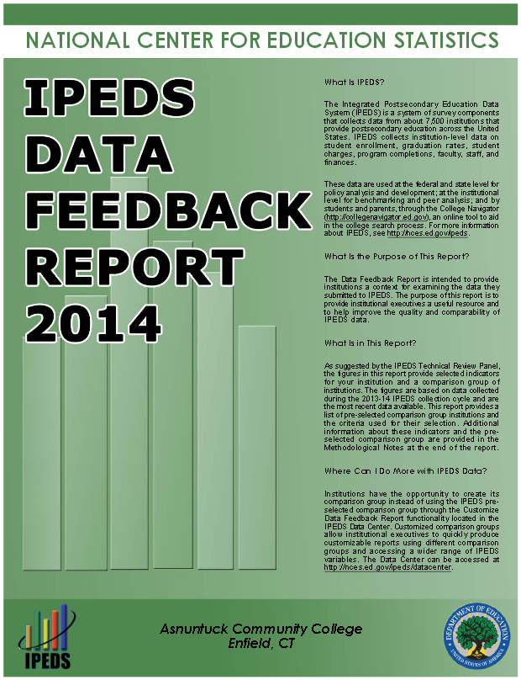
Peer Institution Data – an example

Slide 87

Peer Institution Data – an example

Slide 88
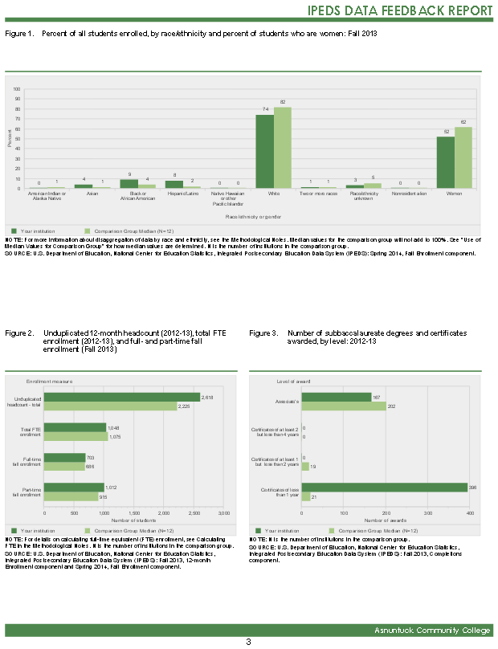
Peer Institution Data – an example

Slide 89
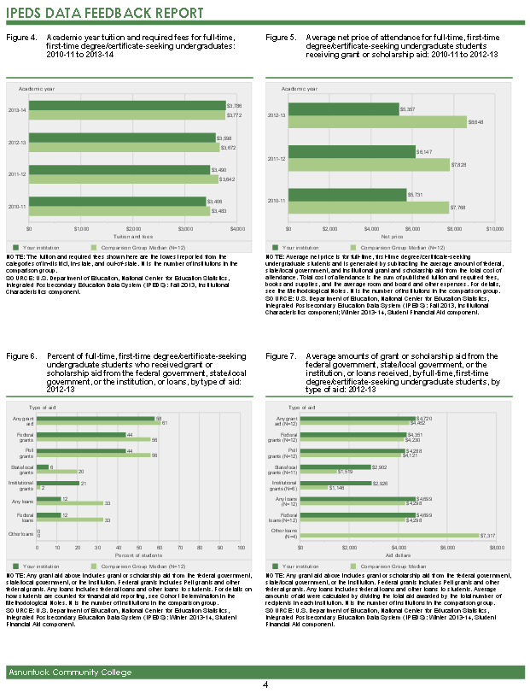
Peer Institution Data – an example

Slide 90
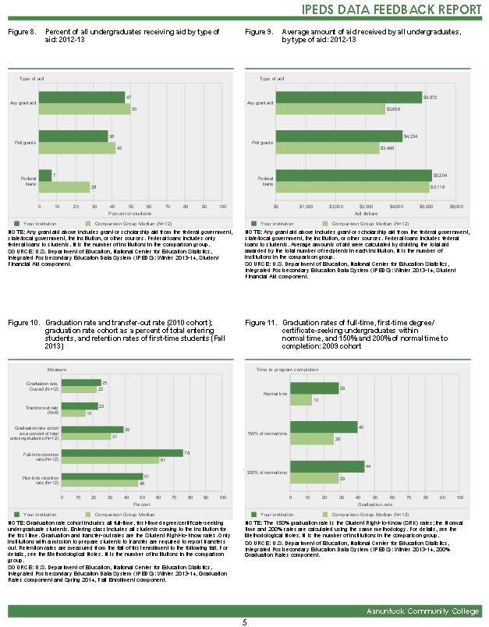
Peer Institution Data – an example

Slide 91
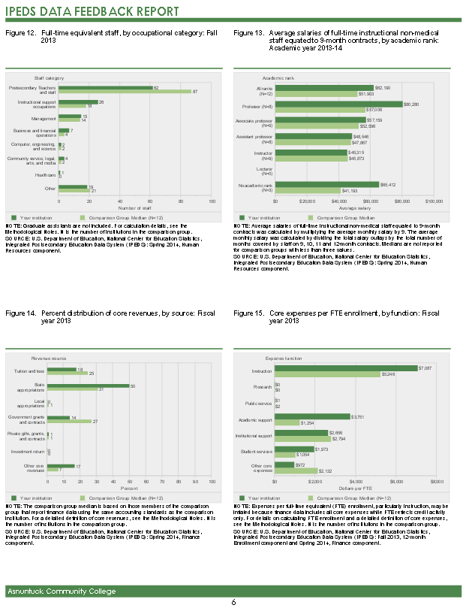
Peer Institution Data – an example

Slide 92
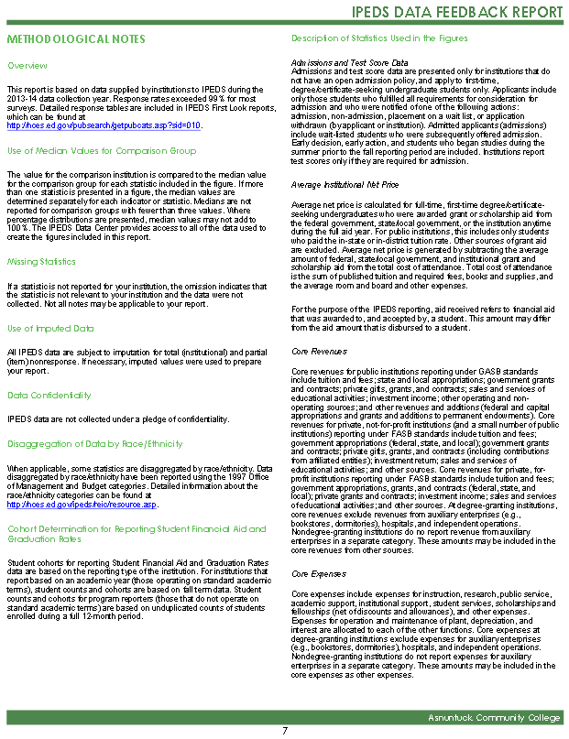
Peer Institution Data – an example

Slide 93
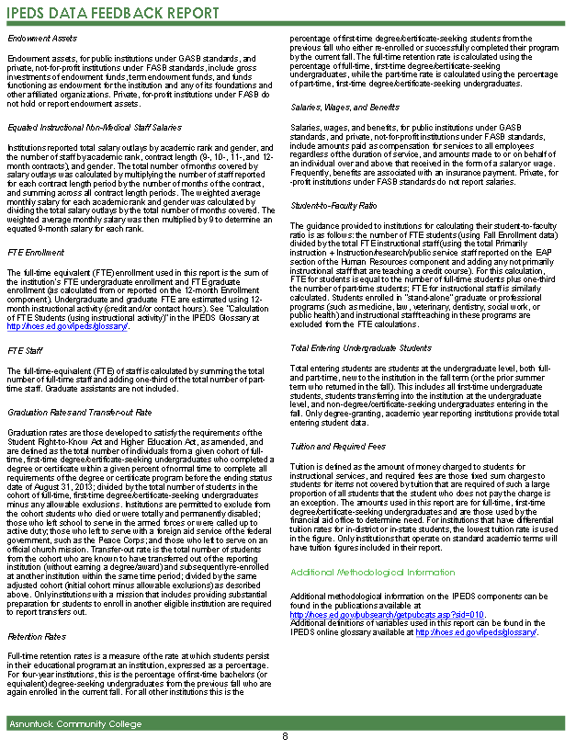
Peer Institution Data – an example

Slide 94
This report was compiled by staff at the Board of Regents for Higher Education in the Office of Research & System Effectiveness with the much appreciated support of Institutional Researchers from the Connecticut State Colleges and Universities and the University of Connecticut. If you have questions about the material, please contact:
William J. Gammell, Ph.D. | Director
Office of Research & System Effectiveness
Connecticut State Colleges and Universities
Board of Regents for Higher Education
39 Woodland Street | Hartford, CT 06105
860-723-0054 | gammellw@ct.edu

