Slide 1

CONNECTICUT
FY 2016 - FY 2017 BIENNIUM
GOVERNOR’S BUDGET
DANNEL P. MALLOY, GOVERNOR
February 26, 2015

Slide 2

Introduction
The Governor’s budget proposal for the biennium is balanced, responsible, and provides tax relief.
It builds on the priorities of the last four years.
    Jobs and the economy
    Education
    Continued support for municipalities
    Smart investments in the state’s infrastructure
    Transparency and accountability through Generally Accepted Accounting Principles (GAAP)

Slide 3
Budget Overview

Slide 4
Governor Malloy’s Recommended Budget

Slide 5
Summary of Expenditure Growth
(in millions)

Slide 6
Closing the Current Services Budget Gap
Even though recommended General Fund spending in FY 2016 is 3.0% higher than FY 2015 estimated levels, it represents a $590 million reduction over FY 2016 current services projections
(in millions)

Slide 7
General Fund Current Services
Cost Drivers – FY 2016

Slide 8
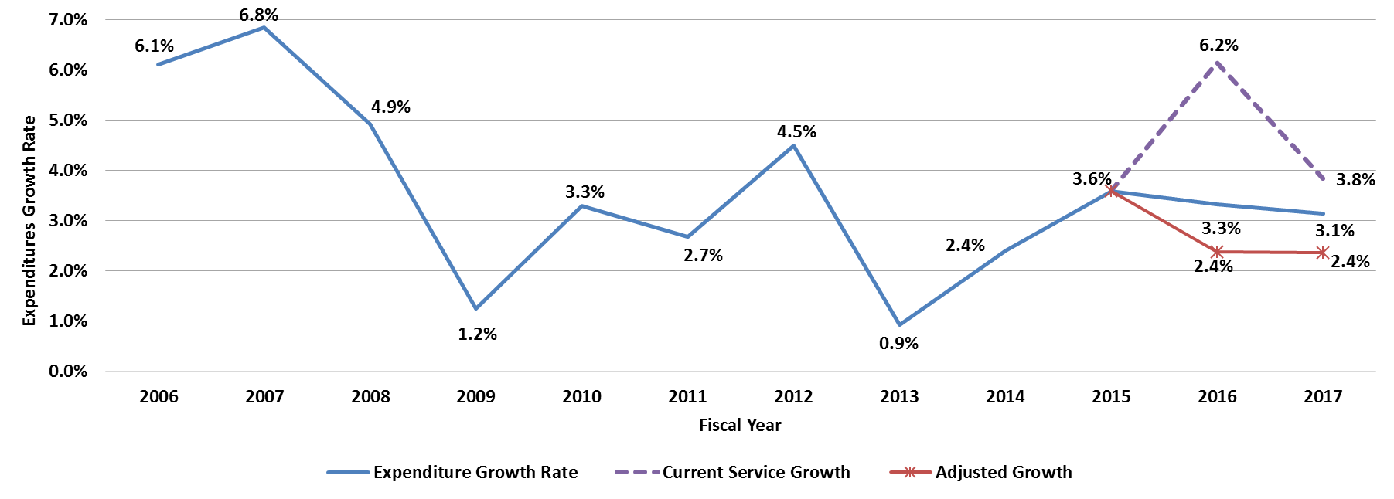
Budget Growth Rate
Budget Growth Rate - All Funds
The adjusted growth rate line excludes debt service and payments toward pensions

Slide 9
Addressing the FY 2015 Deficit
(in millions)

Slide 10
Revenue

Slide 11
Revenue Proposals
(in millions)

Slide 12
General Fund Revenue Proposals
(in millions)

Slide 13
Use of One-Time Revenues
One-time revenues comprise a small fraction of the proposed budget at 2.4% of General Fund revenues in FY 2016 and 1.3% of General Fund revenues in FY 2017

Slide 14
General Fund Revenue
Economic Growth Rates
(underlying growth prior to tax changes/transfers)
FY 2015 – FY 2018 forecast based on January 2015 consensus revenue estimate

Slide 15

Investing in Transportation

Slide 16
Governor’s Transportation Initiative
Long-term strategy to update and improve Connecticut’s transportation system
  Creating a more comprehensive intermodal system
  Reducing congestion on roadways
  Enhancing quality of life with more livable, walkable, bikeable communities
  Partnering with communities to advance mixed use Transit-Oriented Development (TOD)
  Fostering economic growth by enabling people and products to move more freely throughout the state

Slide 17
Capital Funding

Slide 18
Major Projects
Highway design and engineering
  I-84 Viaduct
  I-95 Stamford to Bridgeport expansion
  Waterbury Mixmaster
  I-91 Ramp to the Charter Oak Bridge
Rail
  New Haven/Hartford/Springfield completion
  New train cars
  Repairs and re-construction of bridges – New Haven Line
  Station expansion
  Parking facilities construction
Bus Service re-configuration and expansion

Slide 19
Special Transportation Fund
Motor Fuels Tax Economic Growth Rate
FY 2015 – FY 2018 forecast based on January 2015 consensus revenue estimate

Slide 20
Special Transportation Fund Current Program
Maintaining Current Transportation Funding
(in millions)
* Assumes current levels of borrowing are maintained

Slide 21
Special Transportation Fund Current Program
(in millions)

Slide 22
Governor’s Proposal
Transportation Ramp-Up Projections
(in millions)
* Includes additional debt service needs to meet cash flow requirements for all projects

Slide 23
Capital Budget

Slide 24
Capital Investments
Governor Malloy’s capital budget focuses on funding projects and programs that address critical infrastructure needs
New general obligation bond authorizations
    $1.759 billion in FY 2016
    $1.800 billion in FY 2017
New transportation bond authorizations (including Let’s Go CT!)
    $946.3 million in FY 2016
    $1.214 billion in FY 2017

Slide 25
Capital Investments
Significant capital investments over the biennium include
$1.1 billion for the school construction program
$378 million for Clean Water Fund grants and subsidized low interest loans
$377 million for economic development programs
$405 million for housing projects and programs, including the Zero:2016 Initiative
$186.4 million for Board of Regents projects
$180 million for Local Capital Improvement Program and Municipal Projects
$100 million for Alliance District school improvements
$140 million for Urban Act and Small Town Economic Assistance Programs
$140 million for Town Aid Road and Local Bridge Programs
$148 million for Local Transportation Capital Program

Slide 26
Debt Service Expenditures
General Fund
Note: FY 2014-17 adjusted for net budgeting of Medicaid for comparison to prior years

Slide 27
Debt Service
Interest Rate Comparison – General Obligation Bonds
(in millions)
Actual
Projected

Slide 28
Debt Service
Biennial Budget Request versus Actual – General Fund
(in millions)
FY 2014 and FY 2015 requested numbers have been adjusted to reflect debt service reductions due to the restructuring of the Economic Recovery Note repayments
The average difference between the requested and actual over the last 8 years has been $133.4 million

Slide 29
Debt Service
Governor’s Budget Proposal Comparison – General Fund
(in millions)
September 2014 based on Treasurer’s General Fund request
December 2014 based on Treasurer's December 8, 2014 revised debt service estimates

Slide 30
How Bond Premium Works
Level Principal over 20 Years
(in millions)

