Slide 1

Fiscal Accountability Report
Fiscal Years 2020 – 2024
Melissa McCaw, Secretary
Office of Policy and Management
December 5, 2019

Slide 2
Presentation Overview
Budget Reserve Fund status
Summary of OPM projections of fixed cost growth vs. revenue growth
Economic factors and revenue trends
Long-term obligations and other topics

Slide 3
Presentation Overview
Reduced revenues in FY 2022 relative to FY 2021, driven by enacted revenue policies, will be the primary driver of out-year budgetary imbalance
Fixed cost growth, including increases related to long-term liabilities and entitlement spending, will continue to affect state budgetary decisions beyond FY 2021
Revenue growth has downshifted since the end of the financial crisis
The potential for a national recession demands a cautious approach to budgetary policy and preservation of the Rainy Day Fund

Slide 4
Budget Growth Rates

Slide 5
Budget Reserve Fund History and Forecast
15% threshold attained

Slide 6
Budget Reserve Fund Forecast
Under current law (CGS Sec. 4-30a), unappropriated surpluses and volatile revenues above a certain threshold are committed to the Budget Reserve Fund until reaching the maximum 15% authorized by law. Once the 15% maximum is reached, surplus funds are directed toward:
  Reducing the unfunded liability of the State Employees Retirement Fund
  Reducing the unfunded liability of the Teachers’ Retirement Fund
  Reducing bonded indebtedness

Slide 7
Overdue for a Recession
Average: 60.5 months
(1949 - 2001)
The current economic expansion is the longest since the end of World War II.

Slide 8
Consequences of an Insufficient Budget Reserve Fund – 2008 Recession
In aggregate, it took approximately $9.7 billion in revenue measures, including federal ARRA assistance and deficit financing, to help address budgetary imbalance. This sum does not include significant spending cuts that were implemented!
Federal ARRA assistance included $1.6 billion in enhanced Medicaid and Title IV-E matching funds and $540.0 million in education support (“State Fiscal Stabilization Fund”)

Slide 9
Consequences of an Insufficient Budget Reserve Fund – 2008 Recession
Spending cuts – frequent and significant
  $314.5 million in reduced contributions to SERS, exacerbating the already low funded status of the pension fund ($50 million in FY 2009, $164.5 million in FY 2010, and $100 million in FY 2011)
  2009 Retirement Incentive Plan - $147.5 million in near-term savings, but further strained the pension fund
  Employee concessions in 2009, 2011 and 2017
  Multiple deficit mitigation plans enacted (table at right)
  Reductions to all aspects of the budget, including:
    municipal aid
    human services
    private providers
    arts and tourism
  Substantial and repeated reductions to discretionary spending via rescissions (table below)
Session Year | Deficit Mitigation Legislation | Spending Cuts* ($M)
2008 | PA 08-1, Nov. SS | $25.6
2009 | PA 09-1 | $44.2
2009 | PA 09-1, Dec. SS | $12.4
2010 | PA 10-3 | $89.6
2010 | PA 10-2, June SS | Net zero
2012 | PA 12-1, Dec. SS | $221.5
2015 | PA 15-1, Dec. SS | $214.3
2016 | PA 16-1 | $150.8
2017 | PA 17-51 | $2.3
Rescissions | FY09 | FY10 | FY12 | FY13 | FY15 | FY16 | FY17
# of Occasions | 5 | 2 | 1 | 1 | 3 | 2 | 1
Total ($M) | $201.6 | $51.1 | $78.7 | $170.4 | $99.9 | $181.5 | $77.2
* Source: OFA fiscal notes

Slide 10
Reasons to Preserve the Budget Reserve Fund
Moody’s Analytics - October 2019 report regarding state preparedness to withstand fiscal stress
Recession Scenario | Required Reserves | CT’s Preparedness
Moderate | 10.1% | Relatively well-positioned (ranked 18th of the 50 states)
Severe | 14.8% | Insufficient resources without having to raise taxes or cut spending (ranked 21st of the 50 states)
“How policymakers prepare for downturns matters a great deal in the pace of economic recovery. Unpreparedness can lead to disruptive decisions to drastically cut spending or raise revenues just at the time the economy can least afford it. Preparedness, on the other hand, can lend stability to a struggling economy and help conditions recover more quickly.” (p. 9)

Slide 11
Reasons to Preserve the Budget Reserve Fund
The Moody’s analysis attempts to adjust for state variances, but Connecticut has reasons for a conservative approach to recession-readiness:
Highly progressive (and therefore more volatile) personal income tax structure
Heavy reliance on personal income tax as a proportion of all state revenues (approx. 50% of General Fund), and therefore on the economic fortunes of extremely high-wealth taxpayers
Relatively high “fixed” costs (debt, pension, OPEB)

Slide 12
Reasons to Preserve the Budget Reserve Fund
At least $1.3 billion of the $2.5 billion BRF balance is due to one-time, non-repeatable factors:
$750 million from repatriation of overseas hedge fund deferred profits
  IRS Code 457A required repatriation of overseas hedge fund profits by December 31, 2017 for activity that had occurred prior to 2008 when the federal government disallowed sheltering of such income
  One time revenue for economic activity that occurred a decade or more ago
$570 million from the initial proceeds of the new Pass-through Entity Tax (PET)
  CT passed the PET in response to federal capping of the SALT deduction
  FY 2019 was the first year of collections and initial estimates were based on conservative budgeting and also did not fully account for 18 months of payment – estimated payments for 2 income years, and final payment for 1 income year
Additionally, some (inestimable) revenue related to repatriation of overseas deferred profits under the Tax Cuts and Jobs Act of 2017
  TCJA required individuals and businesses to pay a transition tax on untaxed foreign earnings as if those earnings had been repatriated to the U.S., generally affecting income year 2017 (SFY 2018)

Slide 13
Difficult Choices for Aligning General Fund
Revenue and Expenditure Growth
Health and Human Services Programs
28.0%
Active and Retired State Employee Wages and Benefits 31.7%
Municipal Aid (Incl. Teachers’ Retirement Costs) 21.7%
* Distribution by category estimated based on historical patterns

Slide 14
Summary of OPM Projections of Fixed Cost Growth vs. Revenue Growth

Slide 15
Projected FY 2020 Operating Results

Slide 16
FY 2020 – Projected Deficiencies
General Fund
Agency | Amount
Dept. of Emergency Services and Public Protection | $5,000,000
Dept. of Social Services | $19,200,000
Office of Early Childhood | $1,800,000
Dept. of Correction | $13,000,000
Comptroller – Fringe Benefits | $12,000,000
DAS – Workers’ Compensation Claims | $500,000
Total – General Fund | $51,500,000
Special Transportation Fund
Agency | Amount
Dept. of Transportation | $5,000,000
Comptroller – Fringe Benefits | $2,000,000
Total – Special Transportation Fund | $7,000,000

Slide 17
FY 2021 – FY 2024 Financial Summary
Year-Over-Year Revenue Growth vs. Fixed Cost Growth
(in millions)
“Fixed” costs are rising faster than revenue growth in FY 2022 and FY 2023, but revenue growth is expected to overtake the growth in “fixed” costs in FY 2024.

Slide 18
Revenue Growth vs. Fixed Cost Growth
Revenue = economic growth rate

Slide 19
Explaining the Change in General Fund Revenue from
FY 2021 to FY 2022

Slide 20
FY 2021 – FY 2024 Financial Summary
Year-Over-Year Revenue Growth vs. Fixed Cost Growth
(in millions)

Slide 21
Special Transportation Fund Long Term Outlook

Slide 22
Special Transportation Fund Long Term Outlook
Strong near-term health due to various revenue diversions from the General Fund enacted over the last several years, including:
  0.5% of the current sales tax rate,
  Sales tax from motor vehicle sales, and
  Full diversion of the oil companies tax
The cumulative STF fund balance will grow from an estimated $347.0 million in FY 2020 to $663.5 million in FY 2024
Revenue growth, however, is not keeping pace with expenditure growth over the next 10 years
  Revenues anticipated to grow an average 2.7% annually
  Expenditures projected to grow nearly 4.3% per year
Beginning in 2025 the STF fund balance will rapidly begin to erode:
  FY 2025 estimated operating shortfall of $59.4 million growing to $348.4 million by FY 2030
  Based on current projections, the cumulative fund balance will go negative by FY 2030
New revenue sources are required to support project costs and maintenance, ensure the long-term health of the fund and meet the on-going transportation needs of our state and economy

Slide 23
Economy

Slide 24
Economic Growth Rates of General Fund Revenues
Inflation*:
2.2%
2.4%
2.4%
2.3%
CAGR = Compound Annual Growth Rate
*Inflation = Consumer Price Index for all Urban Consumers (CPI-U); Source: IHS Connect as of 9/30/19

Slide 25
Personal Income Tax Economic Growth Rates

Slide 26
Personal Income Tax Economic Growth Rates

Slide 27
Sales and Use Tax Economic Growth Rates

Slide 28
Motor Fuels Tax Economic Growth Rates

Slide 29
Long Term Obligations, “Fixed” Cost Drivers,
and Other Topics

Slide 30
Spending Cap Growth Rates
Given the state’s low growth in personal income over the past few years, the core consumer price index was the limiting spending cap growth factor in FY 2018 and FY 2019.
Personal income is the limiting factor in FY 2020 and beyond.
The enacted budget is below the cap by $0.2 million in FY 2020 and $5.0 million in FY 2021.
For FY 2021, a growth rate of 3.52% would allow capped expenditures to grow by approximately $518 million over FY 2020 levels.

Slide 31
Recently-Enacted Caps – Impact on FY 2021–FY 2024
Revenue Cap
Caps the amount of revenue that can be appropriated.
Volatility Cap
Threshold above which collections from Estimates and Finals portion of Personal Income Tax plus Pass-Through Entity Tax are transferred to the Budget Reserve Fund.

Slide 32
Long-Term Liabilities
Total = $84.8 billion

Slide 33
Retirement System Liabilities
State Employees Retirement System
$34.2 billion total liability
$21.2 billion unfunded liability
72.5% of the liability is related to inactive or already-retired employees
85.4% of the FY 2020 actuarially determined employer contribution is for the unfunded actuarial accrued liability
Teachers’ Retirement System
$34.7 billion total liability
$16.7 billion unfunded liability
60.6% of the liability is related to inactive or already-retired employees
75.8% of the FY 2020 actuarially determined employer contribution is for the unfunded actuarial accrued liability

Slide 34
Outlook for SERS and TRS
Changes from the 2019 legislative session create a much steadier stream of projected contribution requirements. As a result, SERS is now projected to be fully funded in 2048 and TRS in 2050.

Slide 35
Other Post-Employment Benefits
Recent reforms:
Transitioning Medicare eligible retirees to a Medicare Advantage plan with pharmacy coverage which is expected to save $135 million on an annual basis;
Increasing premium cost sharing and health care design changes for new retirees after October 1, 2017 and increasing again for new retirees after June 30, 2022;
Increasing copays for non-HEP drugs from $5 generic/$20 preferred/$35 brand to a four-tier system of $5 preferred generic/$10 non-preferred generic/$25 preferred brand/$40 non-preferred brand;
Increasing the emergency room copay for non-emergencies from $35 to $250;
Converting to a tiered provider network plan; and
Increasing the number of years from ten to fifteen that health care eligible employees hired after July 1, 2017, must pay 3% of salary toward retiree health.
Additionally, the state recently completed a competitive bidding process for a pharmacy benefits manager (PBM). The new contract, effective July 1, 2019, is expected to reduce pharmaceutical costs by approximately 10%. The impact will be reflected in the next OPEB valuation.

Slide 36
Debt Service

Slide 37
Medicaid – Expenditures and Caseloads

Slide 38
Medicaid – Enrollment and Cost Trends
DSS PMPM (Average)
* Expenditures are net of drug rebates and exclude hospital supplemental payments given the significant variance in that area over the years. Expenditures include hospital rate increases effective 1/1/18; if these increases are excluded, the increase in expenditures would be reduced to 1.0% in FY 2018 and 4.0% in FY 2019 and the change in the PMPM would be revised to -2.0% in FY 2018 and 0.9% in FY 2019.

Slide 39
State Aid to Municipalities
Estimates for FYs 2022 – 2024 are according to formulas and appropriations in current law and do not assume future legislative action. Does not include bonded aid.

Slide 40
Education Cost Sharing Grants
(in millions)
Note: The budget for FY 2010 and FY 2011 included federal ARRA SFSF funding of $269 million (14% of the grant). From FY 2013 to FY 2016, Charter School Grants were appropriated under the ECS grant. Charter School funding is not included in the graph above. The Education Cost Sharing Grant was supplemented by $10 million in FY 2016 and FY 2017 from the Municipal Revenue Sharing Account (MRSA).

Slide 41
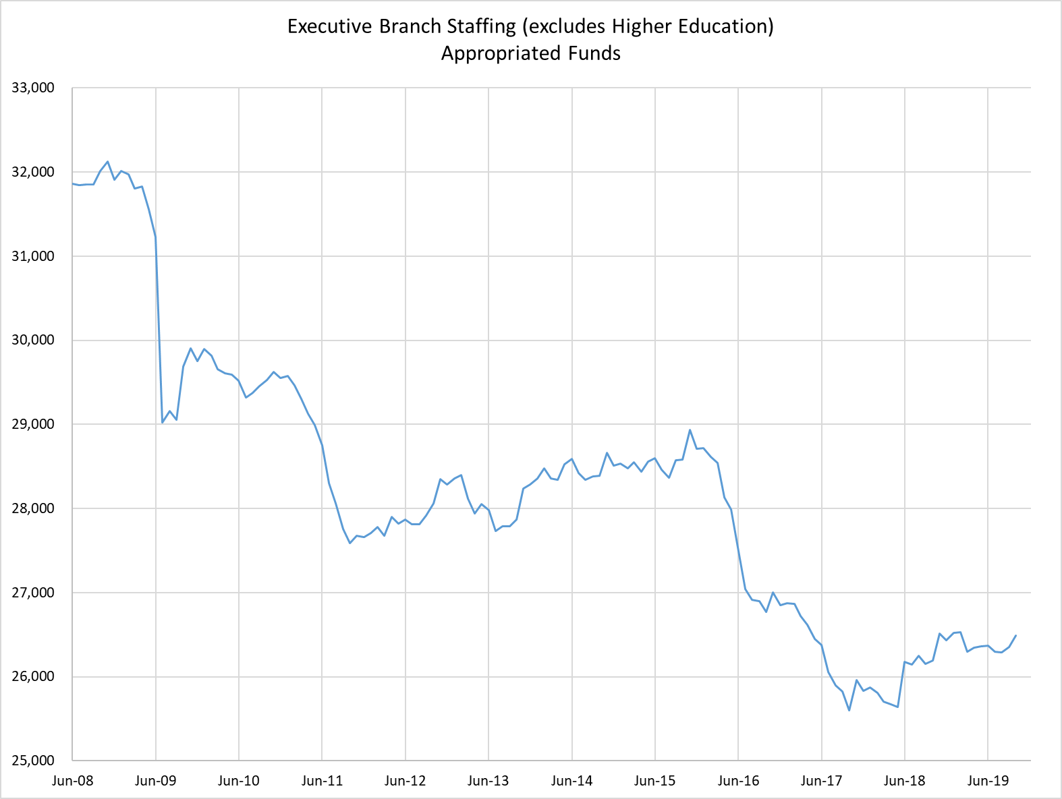
Executive Branch Staffing
All Appropriated Funds (excludes Higher Education)
5,370 employees, or 16.9%, lower than the number at the end of FY 2008
When adjusted for changes in state population, executive branch agencies have fewer staff than at any time since the 1950s
State employee wages and salaries now account for less than 1/8th of the General Fund budget
A substantial number of employees are expected to retire in 2022

Slide 42
Conclusion
A General Fund operating shortfall of $19.6 million is projected in FY 2020. Management actions are expected to mitigate this shortfall.
The Rainy Day Fund is expected to rise from $2.5 billion to $2.8 billion by the end of FY 2020 and could reach the 15% target by the end of FY 2021.
  Once the 15% target is attained, surpluses will be directed to reducing long-term liabilities (SERS, TRS, bonded indebtedness)
The nation is overdue for a recession. The state’s reserves are sufficient for a moderate recession scenario, but are insufficient for a severe economic downturn.

Slide 43
Conclusion
“Fixed” costs are rising faster than revenue growth from FY 2020 to FY 2024.
  Revenues: 2.4% year-over-year growth.
  Fixed costs: 4.8% year-over-year growth.
The spending cap will allow growth of 3.5% to 3.6% per year, but this exceeds the level of revenue growth and must accommodate growth in fixed costs subject to the cap.
Future budgetary choices will be impacted by the need to align:
  Revenue growth,
  Fixed cost growth, and
  Allowable growth in expenditures subject to the spending cap.

