Slide 1

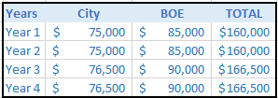
CITY OF HARTFORD
  Segal:
    Segal shall provide City with professional medical consultant services to assist the management of the City’s various insurance programs and other benefits offered.
    Prior contract with Segal was for $161,500 annually. Year one of the new contract reflects a 1% reduction.
    The Contract Commences May 1st, 2018 and ends April 30st, 2018. The City has the option to renew this agreement for up to three additional one year terms. The Compensation table for 4 years is listed below:

