Slide 1
The Corporate Practice of Medicine in Connecticut
Andrew M. Keller, M.D., Legal Extern, Office of Health Strategy
3L Quinnipiac University, School of Law

Slide 2
Disclaimer
This presentation is being provided at the request of the Physician Practice Workgroup, which was legislatively created under the Office of Health Strategy (OHS) to study physician practices within Connecticut. The information, content and material provided in this presentation is strictly for informational purposes. The presentation does not, nor is it intended to, constitute legal advice. In addition, any views or opinions expressed both within this document and at the scheduled presentation of this document are solely those of the author, and they do not represent the views of OHS, the Office of the Attorney General or the State.

Slide 3
Outline
Definition
Regulatory oversight
Legislated statutes
The corporate practice of medicine in neighboring states

Slide 4
Definition
The corporate practice of medicine doctrine (CPOM),
  Derives from American common law,
    Which has roots in English law and has been developed in the United States by our courts
    Where legal decisions are based on custom, morality, and precedent grounded in common sense
    (R. Satter, Under the Gold Dome 259 (2nd ed. 2009)).
  The CPOM doctrine is generally held to specify that:
    A corporation (or other corporate entity) may not be licensed to practice medicine
    All members/partners of a professional corporation (or limited liability corporation) formed to practice medicine, must be licensed in that field
    For-profit corporations cannot form or own any part of a professional corporation

Slide 5
Roles of Connecticut Agencies and Offices in CPOM
Department of Public Health (DPH)
  Licenses and regulates physicians, hospitals, and ambulatory facilities (among others)
  Conducts investigations into potential violations of standard of care, regulation, or law that may lead to discipline
Office of Health Strategy (OHS)
  Medical foundations must notify OHS when formed (C.G.S. § 33-132bb(f))
    Notifications include filing of the Certificate of Incorporation (and amendments)
  Receives annual reporting from all Medical Foundations (C.G.S. § 33-132bb(g))
Office of the Attorney General (OAG)
  Reviews transfers of ownership of certain medical practices, hospitals, and medical foundations (C.G.S. § 19a-486i)
  Receives and reviews notices of material change submitted by (among others) medical foundations (C.G.S. § 19a-486i)

Slide 6
Fundamental Statutes Defining the Practice of Medicine
C.G.S. § 20-9(a) – defines “[w]ho may practice medicine or surgery”
  “No person shall . . . diagnose, treat, operate for or prescribe for [any disease] nor practice surgery, until he has obtained . . . a license . . . only in the kind or branch of practice stated in such license.”
    Sub (b) provides a list of individuals to whom the medicine and surgery chapter of the general statutes does not apply
C.G.S. § 19a-19 – DPH is preempted from the direct regulation of the business practice and ownership of medicine
  “The Department shall not adopt any regulation concerning business practices . . . [including] ownership of a regulated practice . . . [and] practice in an association, partnership, corporation or other lawful entity.”

Slide 7
Fundamental Statutes Defining the Incorporation of Physicians
Two Connecticut statutes define the incorporation of physicians
  C.G.S. §§ 33-182a, et seq. – Professional Services Corporations (PC) (1969)
  C.G.S. §§ 34-243, et seq. – Uniform Limited Liability Company Act (LLC) (1993, revised 2017)
In the context of an organized entity for the practice of medicine, these statutes require that:
  Corporate entities are organized solely for delivery of professional services
  The professional services must be of the same license type
  The shareholders must be Connecticut licensed practitioners
These statutes effectively prohibit the CPOM in a PC or LLC. However . . .

Slide 8
Fundamental Statutes Defining Medical Foundations
In CT, Medical Foundations are a carveout to the prohibition against the CPOM
C.G.S. §§ 33-182aa, et seq. – Medical Foundations (“MF”) (2009)
  Sub (a) provides a mechanism for nonprofit health care entities to organize and become a member of a nonprofit MF
  Sub (b) allows IPAs, PCs, LLCs, registered in Connecticut to organize and form a (for-profit or nonprofit) MF, but
    At least 60% of ownership and control must be by that organizing corporate entity
    The MF must be formed to render professional medical services only
    Each shareholder of the MF must be a licensed physician
    No entity in sub (a) may own or control a sub (b) MF
  Sub (d) requires that no for-profit entity or employee may serve on the BOD of a MF
  Sub (d) also requires that no nonprofit entity or employee may be on the board of a sub (b) MF organized by a for-profit entity.
  In 2013, Public Act 13-278 passed the General Assembly and would have allowed for-profit or out-of-state entities to be members of MFs, but it was was vetoed by the Governor

Slide 9
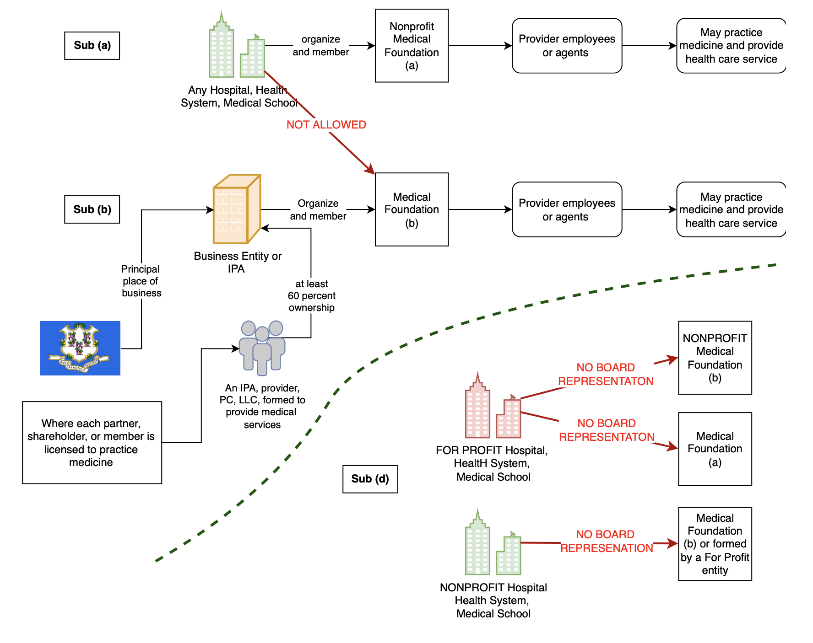
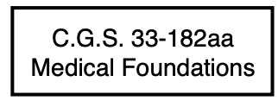
Notes:
Back up slide for MF under 33-182aa

Slide 10
CPOM in Neighboring States
Massachusetts: physician may practice in nonprofit service plan that may not restrict methods or treatments. (Mass. Gen. Laws ch. 176b, § 7)
New Jersey: May be a for-profit corporation employing or renumerating physicians. (N.J. Admin. Code § 13:35-6.16)
New York: Only nonprofit university faculty organization, indemnity corporations and hospital service corporations may employ a physician. (N.Y. Educ. Law § 6527(1) and N.Y. Not-for-Profit Corp. Law § 1412)
Rhode Island: A nonprofit entity controlled entirely by licensed physicians is legal even if a non-voting non-physician director is on the board as the control of the delivery of medical services remains with the physicians. RIH Med. Found., v. Nolan 723 A.2d 1123 (1999)

Slide 11
Conclusion
In Connecticut, the CPOM through Medical Foundations:
  Is a legislative carveout to the prohibition on the CPOM
  Is permitted pursuant to complex rules that depend on the for-profit or nonprofit status of the organizing entity
  Has restrictions on who may be on the board of directors of the foundation
  Is allowed, provided the practice of medicine remains with the providers and not the forming corporate entity

