Slide 1

Health Care Challenges for Individuals Served by the Department of Developmental Services (DDS)
Department of Developmental Services

Slide 2
Department of Developmental Services
The mission of the Department of Developmental Services is to partner with the individuals we support and their families, to support lifelong planning and to join with others to create and promote meaningful opportunities for individuals to fully participate as valued members of their communities.

Slide 3
History
Individuals with intellectual disability(ID)/developmental disability (DD) were institutionalized dating back to 1917. The transition from institutions to the community was initiated in the 1970s, with the development of Community Training Homes (CTH). In the 1980s the transition to the community included group homes referred to as Community Living Arrangements (CLA).
Focus has continued to promote community living, and has evolved to include:
Community Living Arrangements (CLA)
Continuous Residential Support (CRS)
Individualized Home Support (IHS)
Individual Family Support (IFS)
Community Companion Home (CCH formerly CTH)
Intermediate Care Facility (ICF) (Public Regional Centers and Private ICF residences)

Slide 4
Eligibility
CT residents who have an intellectual disability, autism OR a medical diagnosis of Prader-Willi Syndrome (a neurobehavioral genetic disorder).
Full Scale IQ score of 69 or below as indicated on intelligence/cognitive tests; and
significant limitations in adaptive functioning, that began during the developmental period before the age of 18.
Number of individuals served by DDS- 8,634 (17,199 eligible for services)

Slide 5
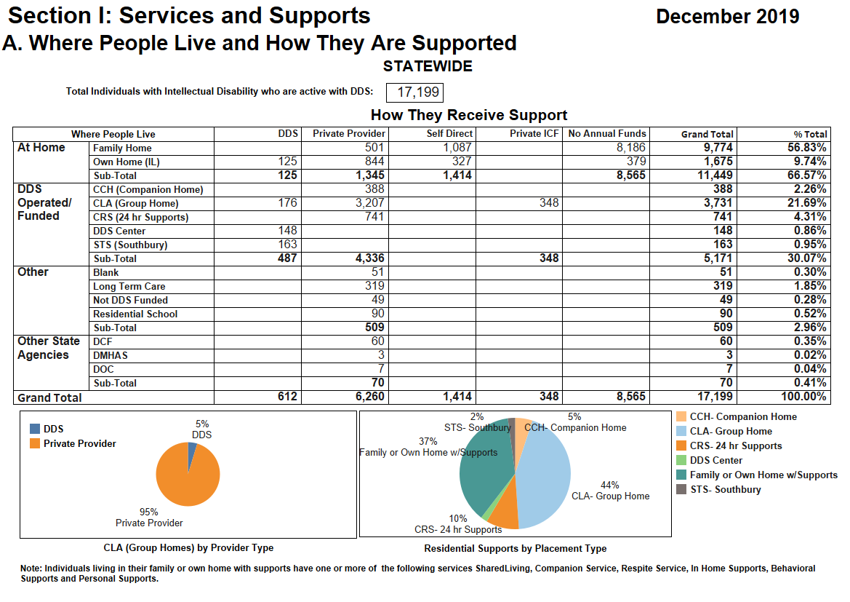
Individuals Served by Type of Residence

Slide 6
Health Care Goals
Improve the standard of health care for individuals with ID/DD to promote the same level of preventive care and medical treatment options that other members of the community are afforded.
These goals are accomplished by:
Person-Centered Planning
Multi-disciplinary Provider approach
Community access to health care
Minimum Preventive Care Guidelines for Persons with ID/DD
Lifelong planning with dignity and respect

Slide 7
Minimum Preventative Care Guidelines For Persons with IDD/DD

Slide 9

DENTAL RECOMMENDATIONS
PROCEDURE | 0-1 YEARS OLD | 1-18 YEARS OLD | 18+ with teeth | 18+ no teeth
Oral Exam | Clinical Discretion | Annually | Annually | Annually
Screening: x-rays | NA | Clinical Discretion/ 6-24 month intervals | Clinical Discretion/ 6-36 months | Clinical Discretion/ Not applicable
Dental Prophylaxis | Clinical Discretion | Annually 2 times per year if clinically indicated. | Annually 2 times per year if clinically indicated | NA
Professional Denture / Partial exam | NA | Annual if partials present | Annual if partials present | Annual if partials/ dentures present
Tooth brushing | 2 times a day | 2 times a day | 2 times a day | 2 times a day
Izabella Pulvermacher DDS Dental Coordinator Izabella.Pulvermacher@ct.gov

Slide 10
Challenges Accessing Healthcare
Difficulty securing community-based Primary Care Providers/Physicians (PCP) and Psychiatric Health Care Providers for individuals with ID/DD
DDS contracts for health care services (PCP and Psychiatric Providers)
Deferred, Limited or Declined Care - Identify best practice guidelines that are applied when healthcare providers, individuals, and/or guardians/family members defer, limit, or decline routine preventive health care. (Health Standard #09-2: Guidelines for Deferred, Limited, or Declined Health Care)
Guardian consent for treatment (Health Standard 19-1: Consent Required for Medical and Dental Procedures, Including Emergency Surgery)
DDS Manual https://portal.ct.gov/DDS/PoliciesProcedures/DDS-Manual/DDS-Manual (section I.H. Health Standards)

Slide 11
Opioid Epidemic
Individuals served by DDS generally do not engage in drug seeking behaviors
Prescribers often maintain or add to medication regimen without removing or reducing other medications
Risk of caregiver (residential or family)diversion
Summary of Opioids Prescribed to Individuals Served by DDS

Slide 12
End of Life Care
Advanced Directives and Living Wills put in place by the individual ONLY
DDS Do Not Resuscitate(DNR) Review Process (CGS17a-238g)
DDS does not review DNR orders when Advanced Directives or Living Wills in place
Mortality Review after death

Slide 13
Individual Reports Regarding Healthcare Services

Slide 14
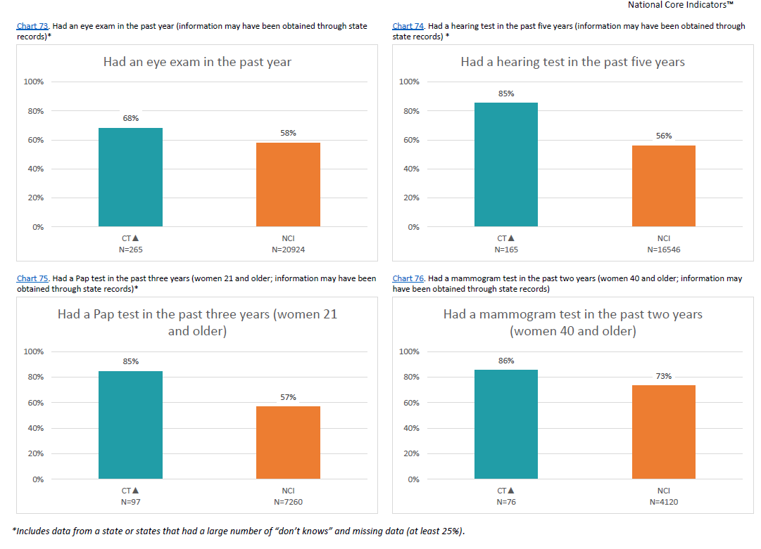
Individual Reports Regarding Healthcare Services

Slide 15
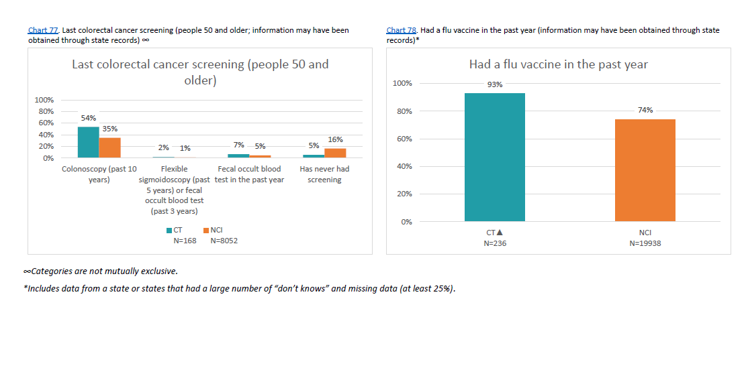
Individual Reports Regarding Healthcare Services

