Slide 1
A Presentation to the Health Care Cabinet
November 9, 2021
By: Olga Armah
CT LARGE MEDICAL GROUP PRACTICES
Dashboard Overview
CY 2016-2020

Slide 2
Overview
CT LARGE MEDICAL GROUP PRACTICES
Summary of what will be covered in this presentation
        Refresher
            Group Practices Statutory Requirements
            Purposes of the Requirements
            Sample of Filing
            Observations
        Dashboard Overview
        How to Access Large Medical Group Practice Information

Slide 3
Medical Group Practice Statutory Requirements
Connecticut General Statutes (C.G.S.) § 19a-486i (g) and (h), requires:
  each hospital, hospital system, non-hospital owned/affiliated group medical practices comprised of 30+ physicians to submit an annual report to the Attorney General and Office of Health Strategy ("OHS") by January 15th.
The filings include the following:
  Medical group practice and its affiliation to a hospital or health system
  A list of the practice’s physicians and their specialties
  Practice location, primary service area zip codes and specialty services provided at the location
Notes:
PSA is the smallest number of zip codes from which the practice draws at least 75% of its patients (P.A. 14-168(a)(11))

Slide 4
Purposes of the Requirements
For Certificate of Need purposes:
  To assess if the consolidation will adversely affect health care costs or accessibility to care
  To assess where the change will negatively impact the diversity of health care providers and patient choice in the geographic region
  To enable the CT Attorney General’s Office to review issues related to monopoly and their impact on consumers

Slide 5
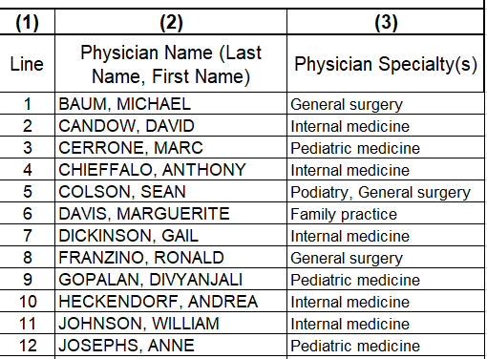
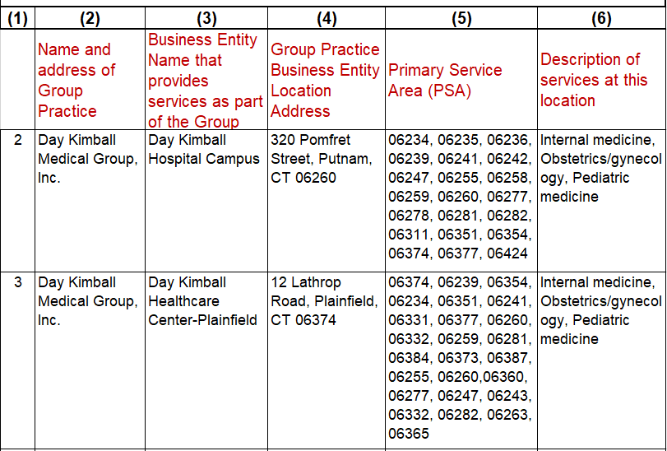
Sample CT Large Medical Group Practice Filing
Group Practice
(headquarter)
List of Practice Physicians & Specialty(s)
Practice Location, Primary Service Area and Specialty Services
Day Kimball Medical Group, Inc.

Slide 6
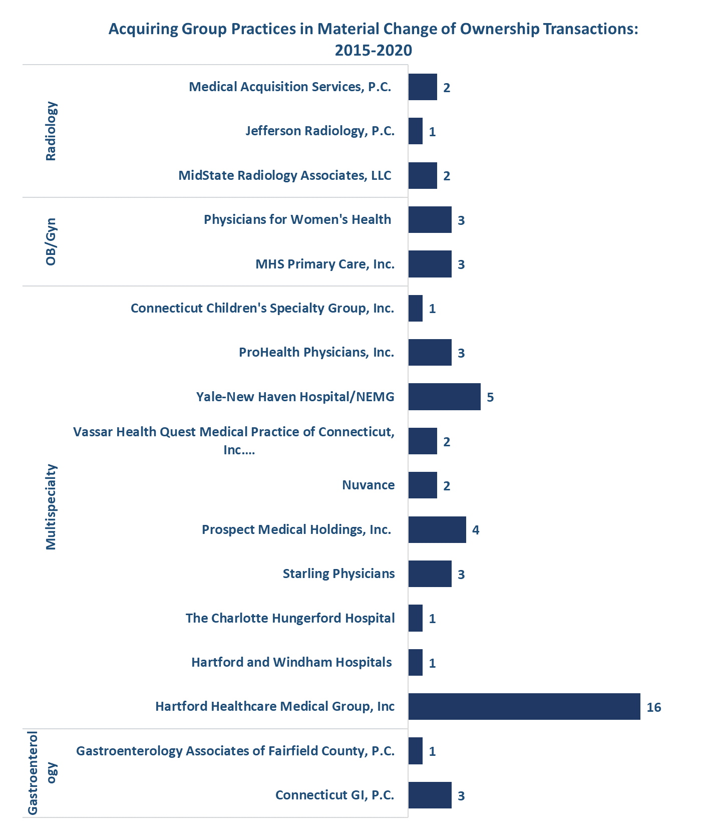
Material Change of Ownership Transactions 2015-2020
Source: CT OHS Group Practice Material Change of Ownership Filings https://ohsnotificationandfilings.ct.gov/Home/Index

Slide 7
OBSERVATIONS
Observations
    The group practice filings are not a comprehensive list of group practices in the state
      Limited to only group practices and providers that have 30+ physicians
    A group practice may have a wide primary service coverage area, but not all specialty services are provided at all the locations
    Most CT large medical group practices:
      are affiliated to a health system
      provide multispecialty services
      tend to acquire single specialty small group practices that offer relatively similar specialty services

Slide 8
CT Large Medical Group Practices
Dashboard Overview

Slide 9
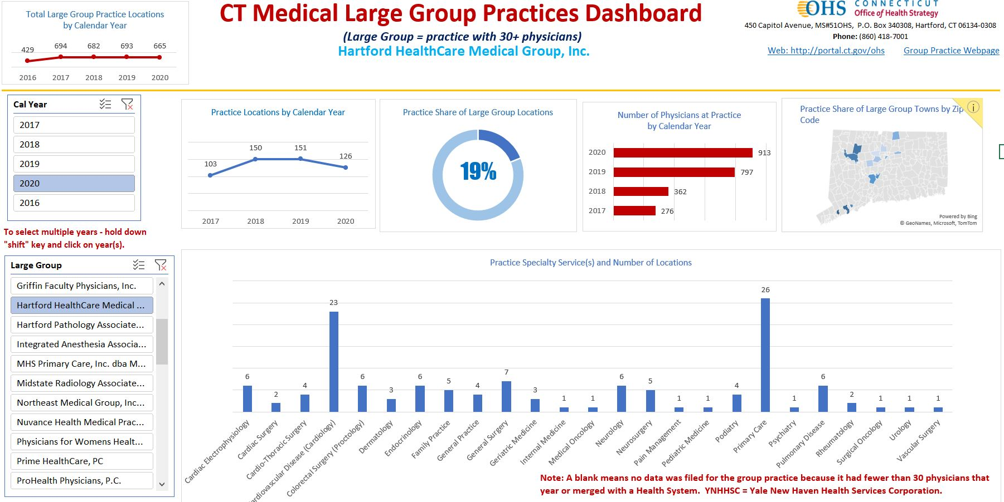

CT Large Medical Group Practices Dashboard

Slide 10
TO ACCESS LARGE MEDICAL GROUP PRACTICE
INFORMATION VISIT:
https://portal.ct.gov/OHS/Health-Systems-Planning/Notifications/Notifications-and-Filings
FOR MORE INFORMATION ABOUT OHS VISIT:
https://portal.ct.gov/OHS

Slide 11
Questions?

