Slide 1
Bed Need Methodology
Presented by Brian Carney & Hanna Nagy

Slide 2
History of CT’s Bed Need Methodology
Connecticut General Statutes Section 19a-638(a)(11) specifies that Certificate of Need authorization is required for an increase in the licensed bed capacity of a healthcare facility. Connecticut Hospitals seeking additional licensed beds are required to demonstrate that they satisfy Connecticut General Statutes Section19a-639 review criteria (e.g., clear public need, etc.).
In coordination with the development of the 2012 Facilities and Services Plan, the Acute Care and Ambulatory Surgery Subcommittee determined that a standardized methodology would enhance OHS’s (formerly OCHA’s) ability to evaluate the availability of acute care services, help identify areas with unmet need and provide an equitable measure to determine how acute care beds are distributed throughout the state.

Slide 3
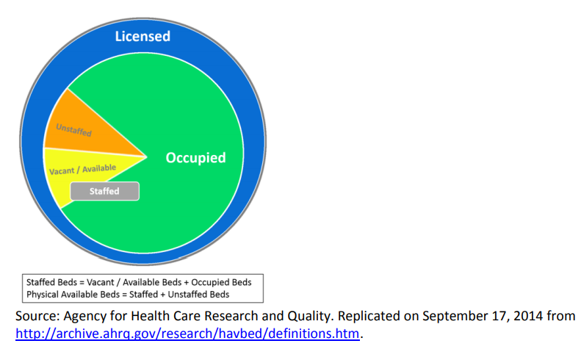
Conceptual Model of Licensed Hospital Beds, as Defined by AHRQ
The Agency for Healthcare Research and Quality (AHRQ) defines licensed beds as the maximum number of beds that a hospital is licensed to operate, though not all licensed beds need to be available or staffed.

Slide 5
CT Bed Need Calculation
Bed utilization is based on patient days and is calculated using data from three consecutive Federal Fiscal Years (FFYs). Patient days are broken down by county, hospital, service category (Medical/Surgical, Maternity, Psychiatric, Rehabilitation and Pediatric) and age group (0-14, 15-44, 45-64, 65+) – the Pediatric category uses different age groups (0-19, 20+) to better utilize population estimate age ranges.
Patient days are divided by 365 (days) to calculate Average Daily Census (ADC) for each year of the three years.
A Weighted ADC is calculated, giving the greatest weight to the most current year and the least weight to the oldest year. Weighted avg. daily census = (Year1 + Year2 x 2 + Year3 x 3)/6
The Weighted ADC is multiplied by a population growth/attrition factor for each county (based on projected population estimates for 2020 and 2025, provided by the Connecticut State Data Center) to produce the Projected Average Daily Census.

Slide 6
CT Bed Need Calculation
The Projected ADC is divided by the Target Occupancy factors provided by the Acute Care/Ambulatory Surgery Subcommittee to determine the number of beds needed.
“Beds Needed” is summed by service/age category and totaled by individual hospital.
The sum of “Beds Needed” is deducted from a hospital’s total number of licensed beds (excluding bassinets) to determine the number of excess or additional licensed beds that are required (Excess (-)/Deficit (+)).
Individual hospital utilization and licensed bed data can be summed by the region in which hospitals are located to produce regional results. Statewide capacity is calculated using data from all 28 acute care hospital.

Slide 7
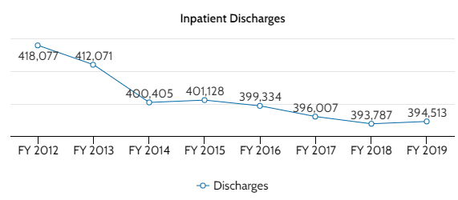
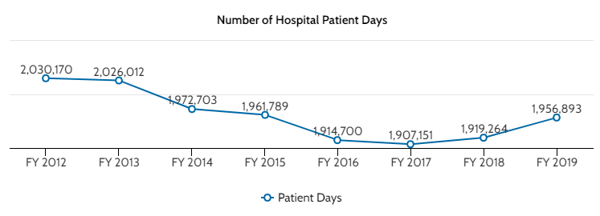
Inpatient Utilization Trends—FY 2012-FY 2019
In FY 2019, inpatient discharges were 23,564 less, and patient days were 73,277 less as compared to FY 2012.
Data Source: OHS Acute Care Hospital Discharge Database

Slide 8
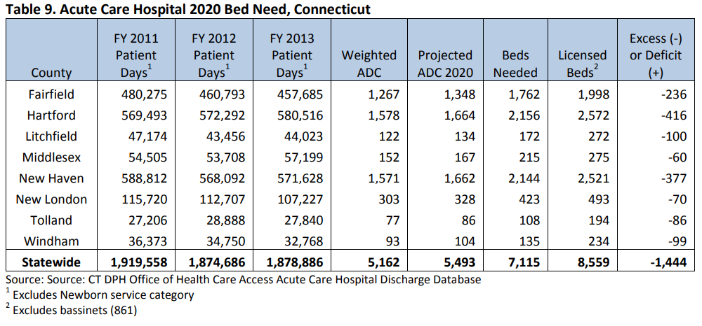
CT Hospital Bed Need Trends—2014
Source of Table: 2014 Facilities and Services Plan Supplement
In 2014, based on acute care bed need projections for 2020, CT had a statewide surplus of 1,444 inpatient beds which each county having excess capacity.

Slide 9
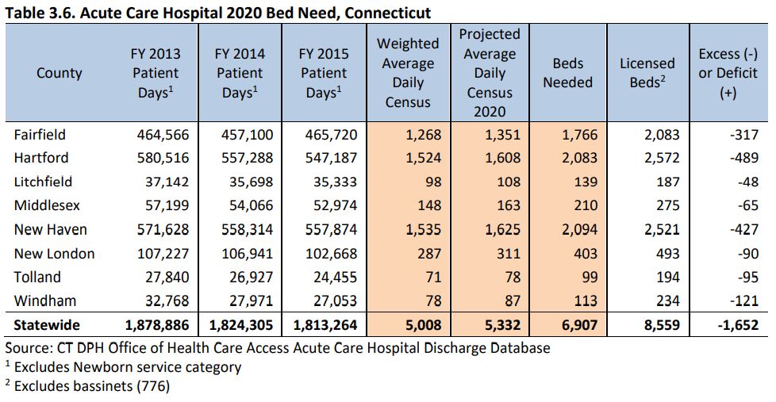
CT Hospital Bed Need Trends—2016
Source of Table: 2016 Facilities and Services Plan Supplement
In 2016, based on updated acute care bed need projections for 2020, Connecticut has a statewide surplus of 1,652 inpatient beds, 293 more than reported in the 2014 Supplement. Each county has a projected excess bed capacity.

Slide 10
2020 Bed Need Results
Based on the acute care bed need projections for 2025, Connecticut has a statewide surplus of 1,922 inpatient beds. Each of the five individual counties has excess capacity, ranging from a low of 84 surplus beds in Litchfield County to a high of 511 in Fairfield County.

Slide 11
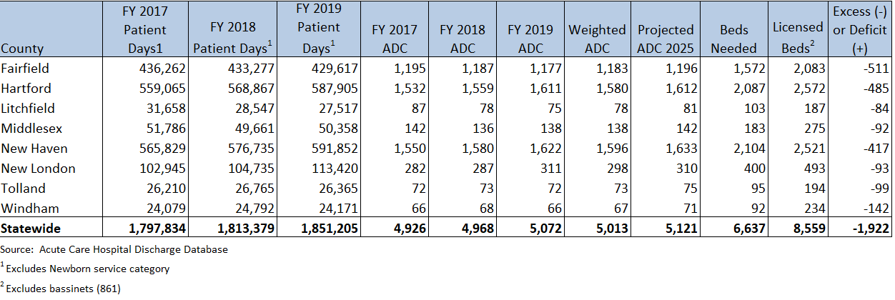
2025 Connecticut Acute Care Inpatient Bed Need by County

Slide 12
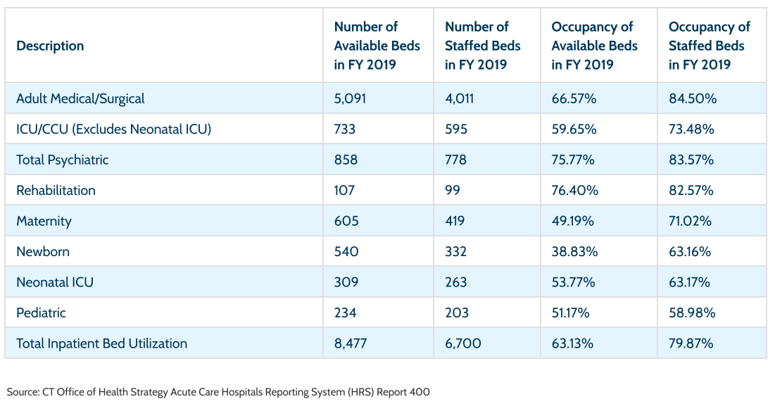
This table provides a slightly different measure of evaluating bed capacity – Available Beds. The occupancy rate for available beds was below the 80% target in Adult Medical/Surgical, Psychiatric, Rehabilitation and Pediatric, suggesting that there are more hospital beds available than necessary.

Slide 13
Range of Licensed Bed Excess/Deficit for 2025

Slide 14
Covid-19 Pandemic
Excess capacity:
Helped hospitals accommodate patient surge at critical times
Helped provide additional physical space to isolate Covid patients from the general patient population
Currently, less than 100 patients hospitalized in CT
Anomaly or do we need to maintain some level of excess capacity for future potential surges

Slide 15
Other Factors for Consideration:
The analysis is only for licensed inpatient beds (bassinets included) at acute care hospitals.
Observation days are not included in the analysis.
There is traditionally patient utilization ebb and flow throughout the year (e.g., flu season).
Inpatient days are declining as care is shifted to outpatient settings.

Slide 16
Questions for Discussion:
Does excess capacity add cost to the overall healthcare system?
As current statute does not allow OHS to reduce the number of licensed beds, how do we address the issue of excess capacity?
Can this excess capacity be transitioned/repurposed for other uses (e.g., geriatric specialty, rehab, psych, etc.)?

Slide 17
Appendix

Slide 18
2025 Population Projections
The factor applied to the weighted average daily census is an estimate of population change. It is calculated by age group and gender and is the division of future population by present population.
A factor equal to 1 represents no change in population;
A factor greater than 1 indicates a population increase; and
A factor less than 1 indicates a population decrease.
Source: Connecticut State Data Center, 2015-2040 Population Projections - State, County, and Regional Councils of Governments Level, June 29, 2018 edition. Retrieved from https://data.ct.gov/Government/2015-2040-Population-Projections-State-County-and-/pv2w-k7qu ; Also UConn link: https://ctsdc.uconn.edu/2015-to-2040-population-projections-state-level/#2015 to 2040 Population Projections--State Level July 31, 2017 Edition

Slide 19
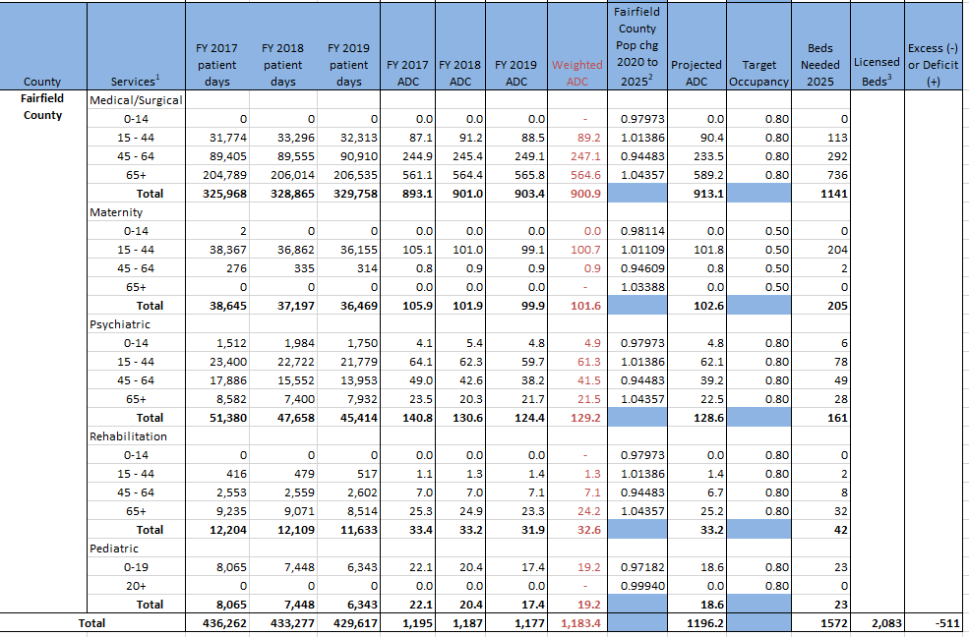
2025 Acute Care Inpatient Bed Need- Fairfield County

Slide 20
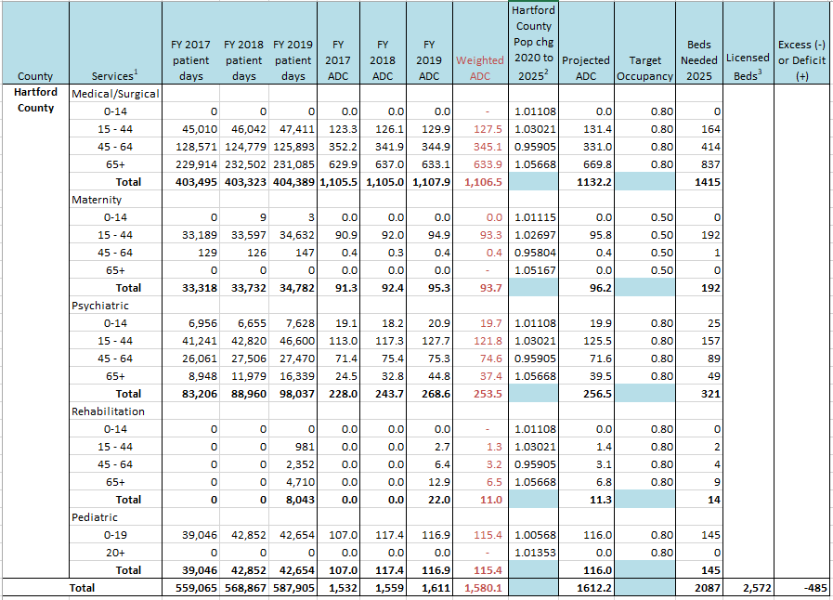
2025 Acute Care Inpatient Bed Need- Hartford County

Slide 21
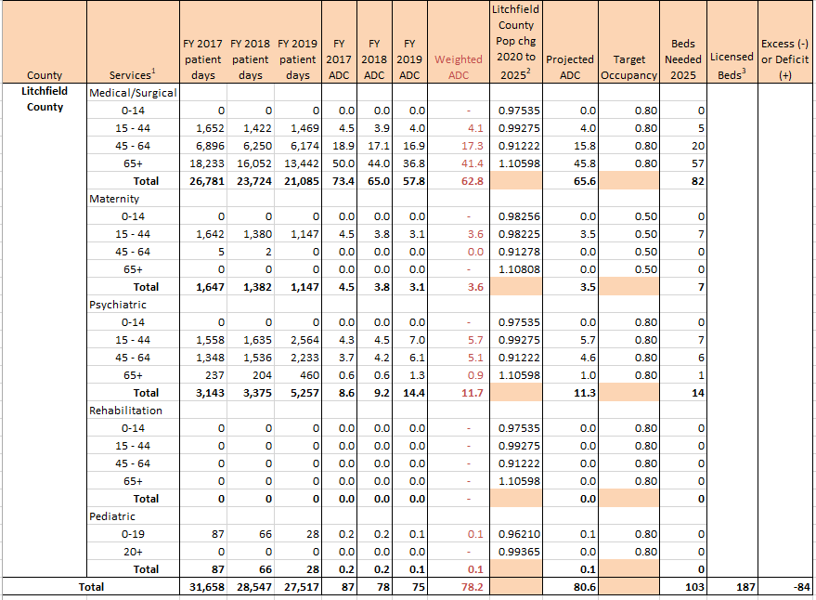
2025 Acute Care Inpatient Bed Need- Litchfield County

Slide 22
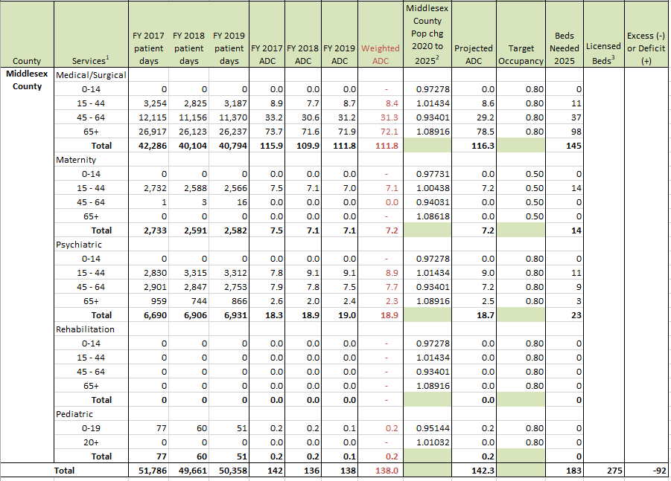
2025 Acute Care Inpatient Bed Need- Middlesex County

Slide 23
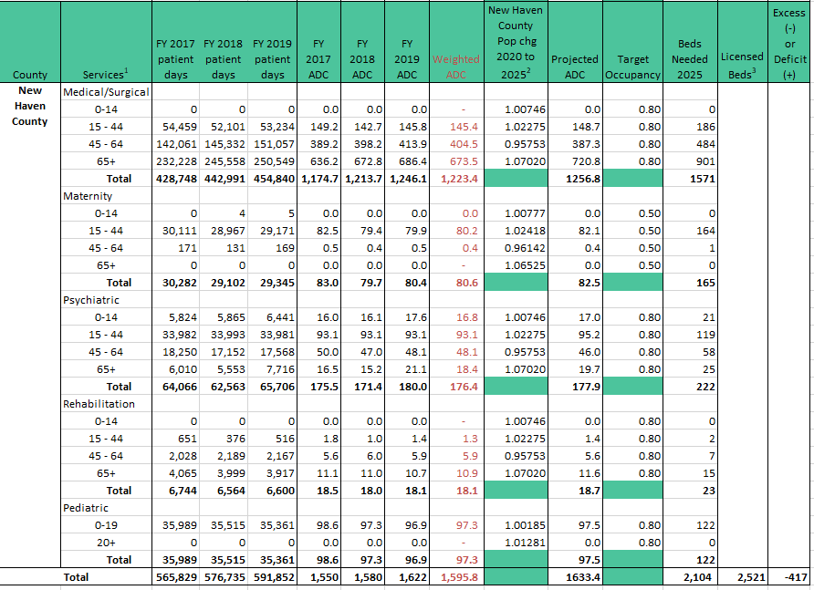
2025 Acute Care Inpatient Bed Need- New Haven County

Slide 24
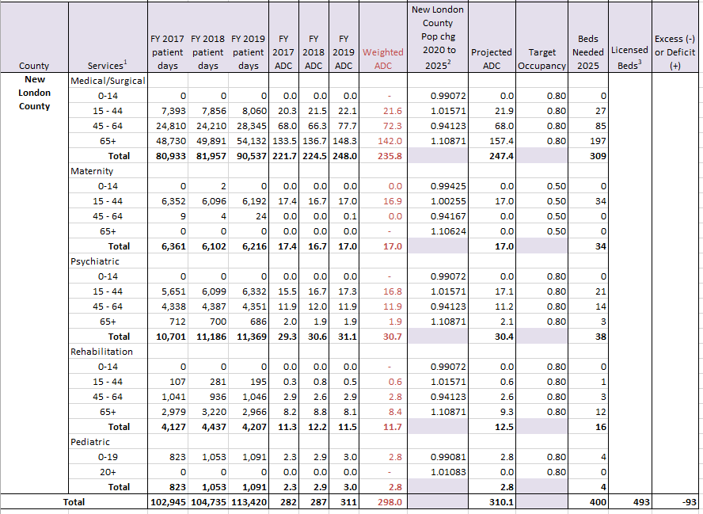
2025 Acute Care Inpatient Bed Need- New London County

Slide 25
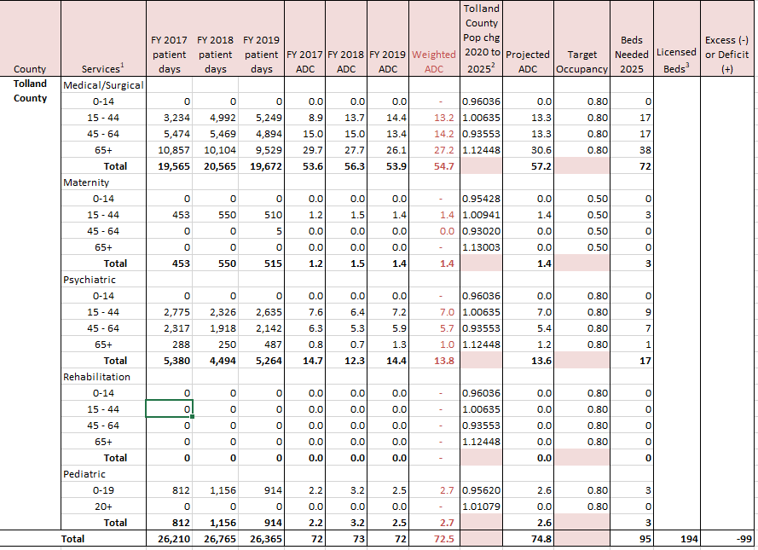
2025 Acute Care Inpatient Bed Need- Tolland County

Slide 26
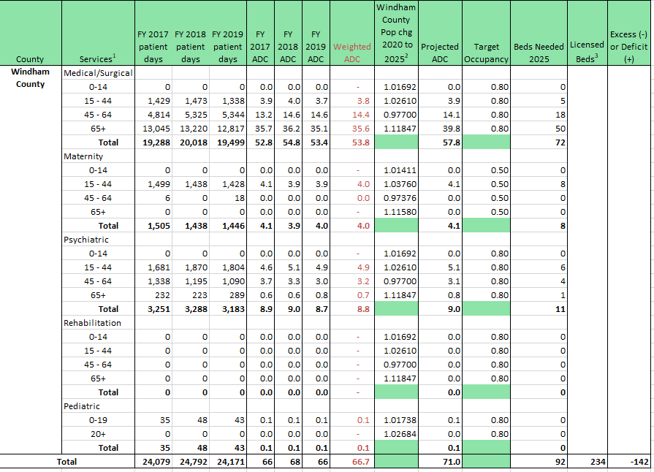
2025 Acute Care Inpatient Bed Need- Windham County

Slide 27
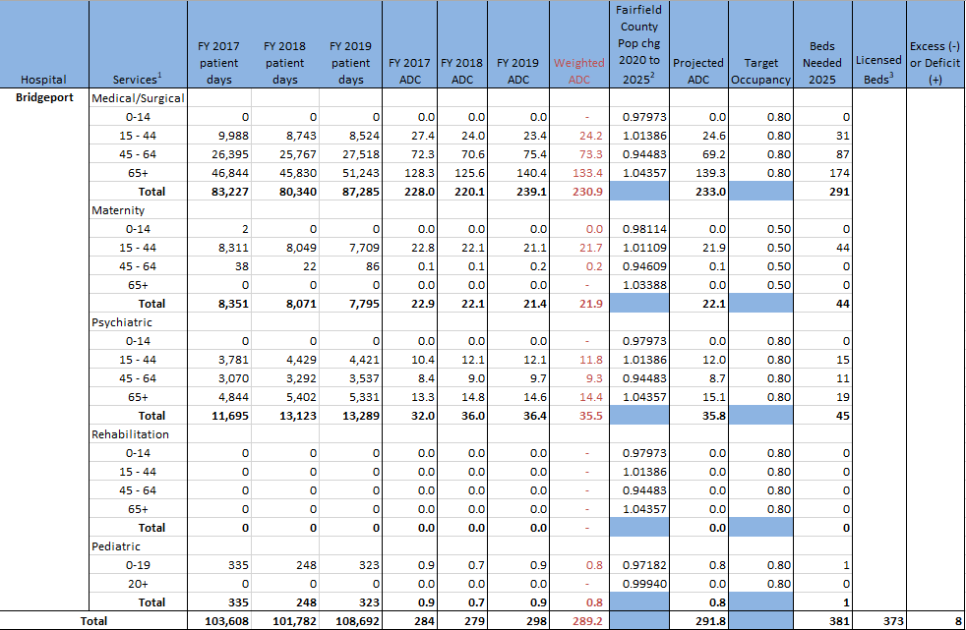
2025 Acute Care Inpatient Bed Need-Bridgeport Hospital

Slide 28
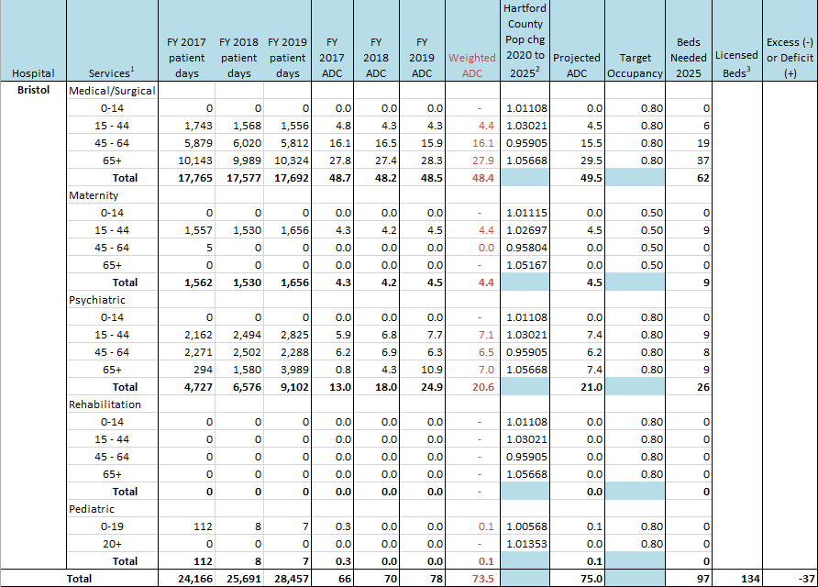
2025 Acute Care Inpatient Bed Need- Bristol Hospital

Slide 29
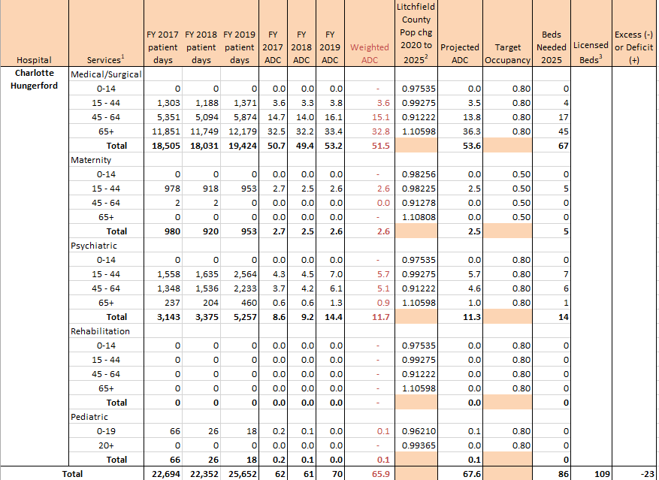
2025 Acute Care Inpatient Bed Need- Charlotte Hungerford Hospital

Slide 30
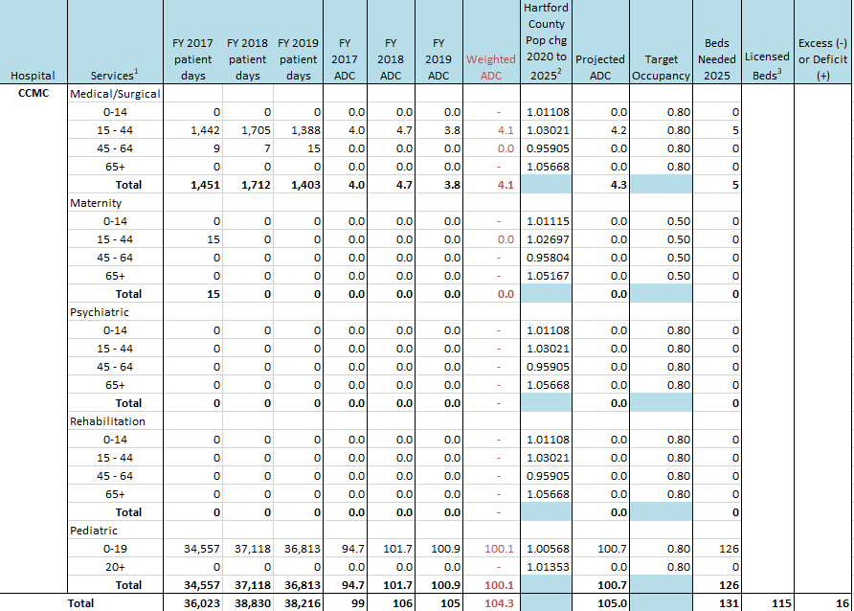
2025 Acute Care Inpatient Bed Need- CT Children's Medical Center

Slide 31
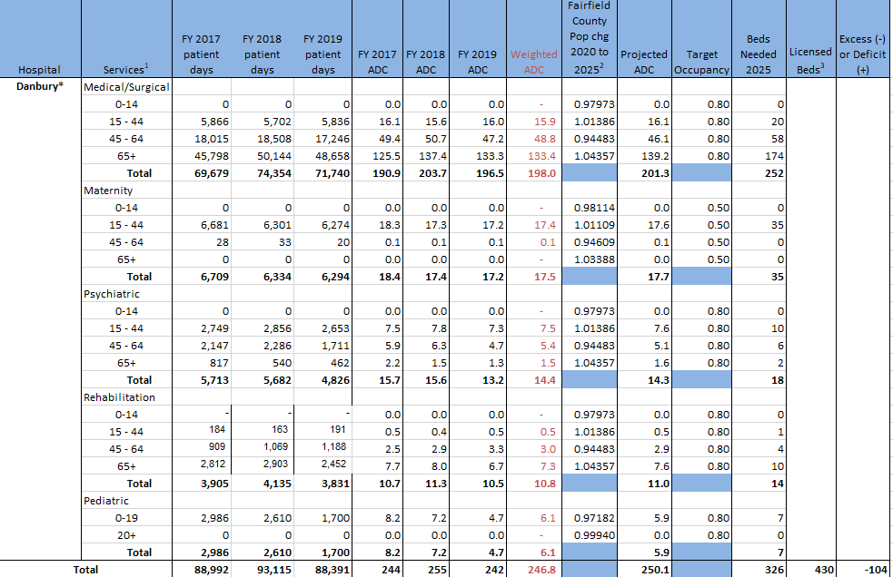
2025 Acute Care Inpatient Bed Need- Danbury Hospital

Slide 32
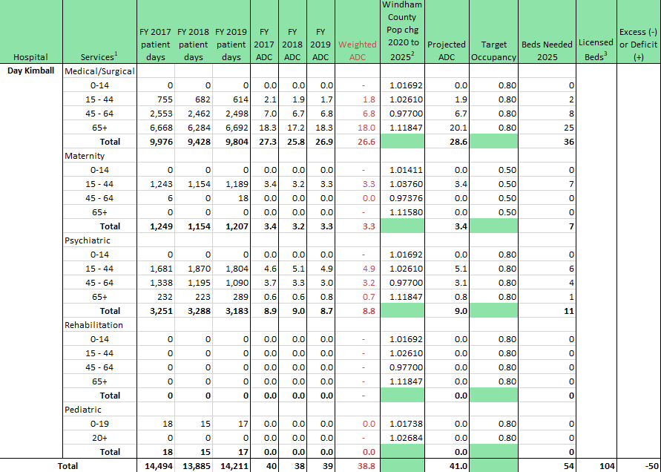
2025 Acute Care Inpatient Bed Need- Day Kimball Hospital

Slide 33
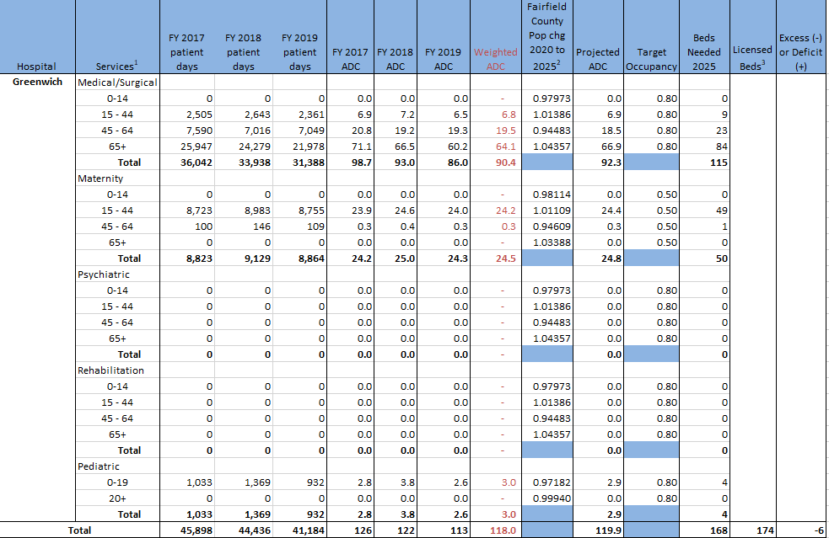
2025 Acute Care Inpatient Bed Need- Greenwich Hospital

Slide 34
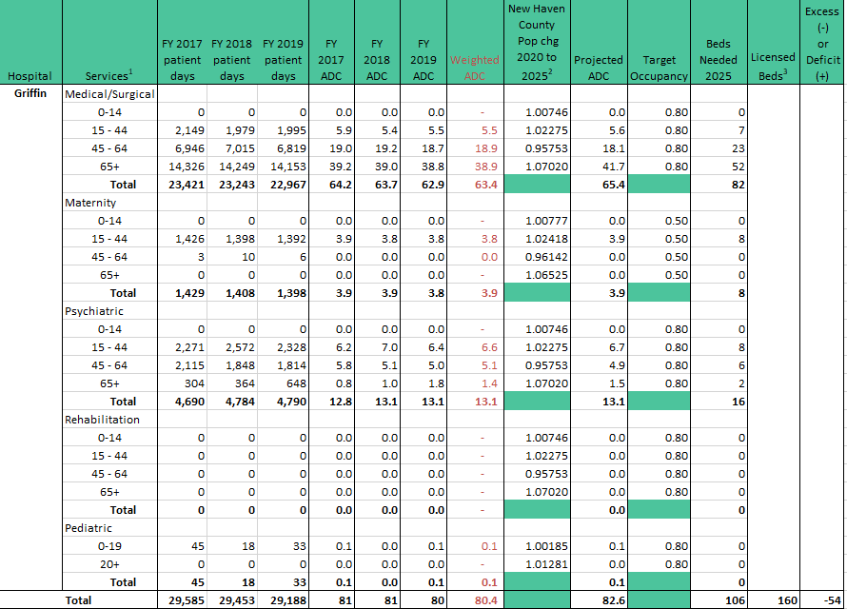
2025 Acute Care Inpatient Bed Need- Griffin Hospital

Slide 35
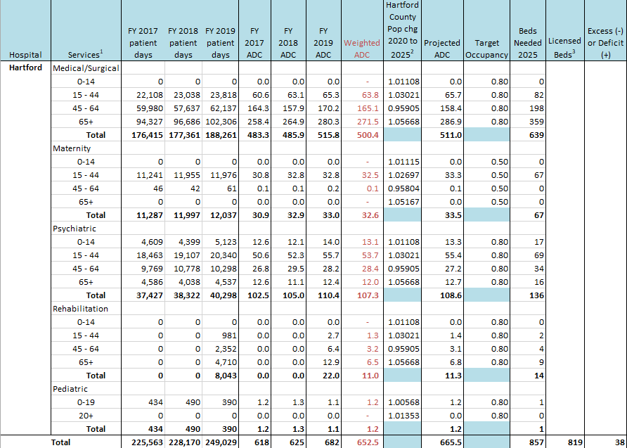
2025 Acute Care Inpatient Bed Need- Hartford Hospital

Slide 36
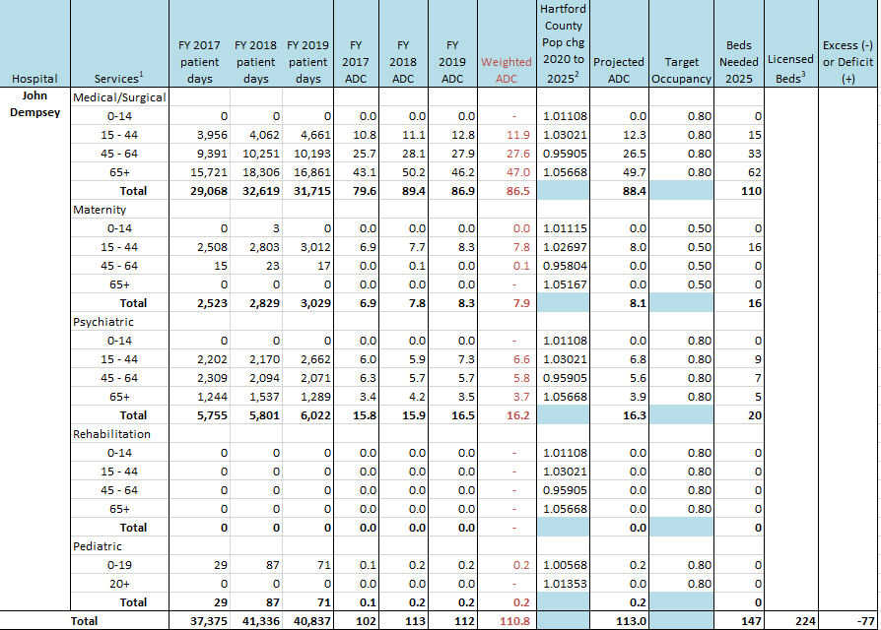
2025 Acute Care Inpatient Bed Need- John Dempsey Hospital

Slide 37
2025 Acute Care Inpatient Bed Need- Johnson Memorial Hospital

Slide 38
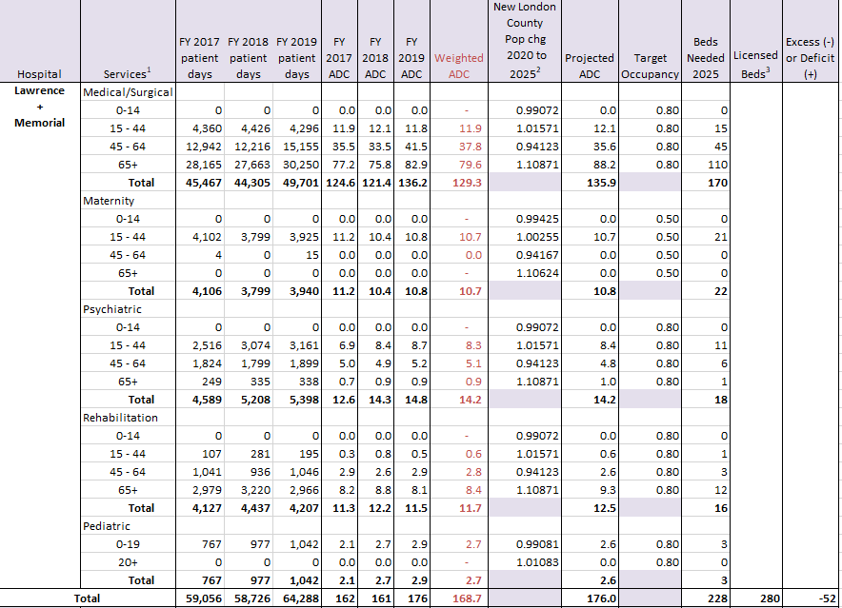
2025 Acute Care Inpatient Bed Need- Lawrence + Memorial Hospital

Slide 39
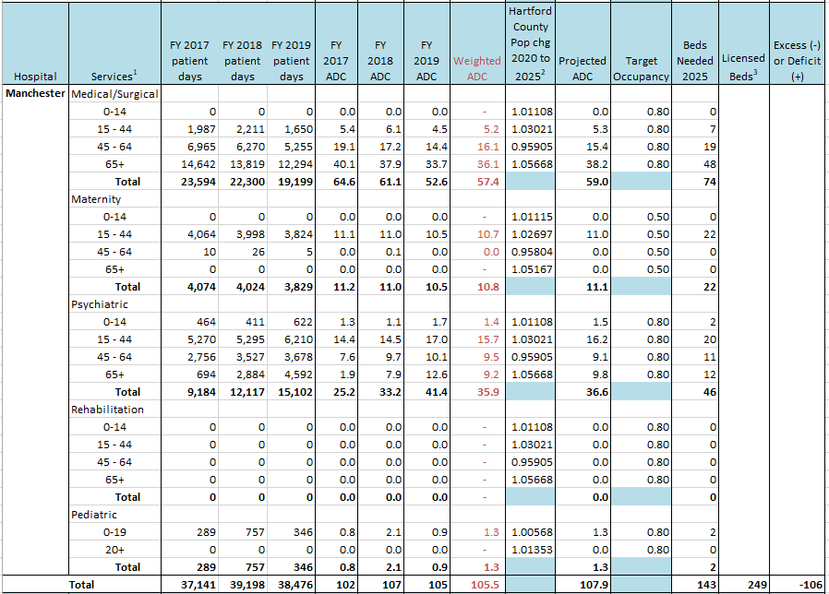
2025 Acute Care Inpatient Bed Need- Manchester Memorial Hospital

Slide 40
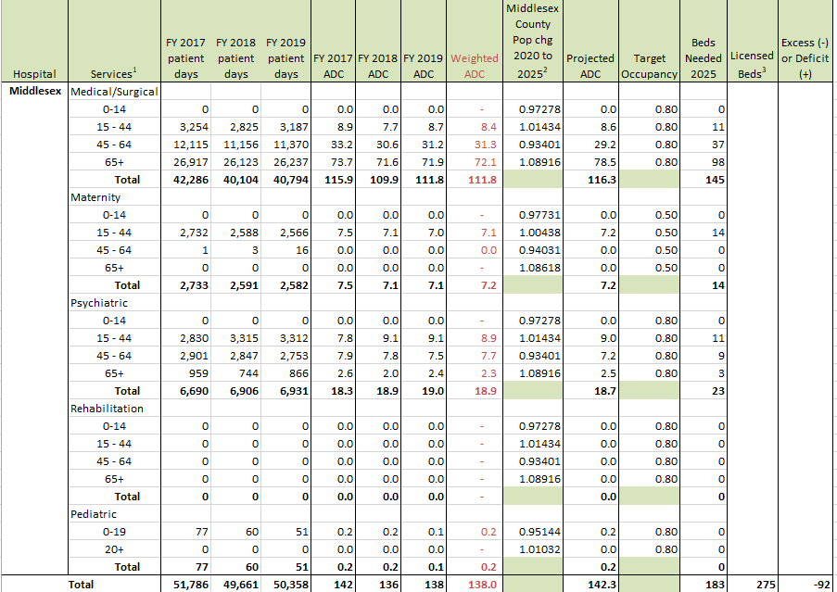
2025 Acute Care Inpatient Bed Need- Middlesex Hospital

Slide 41
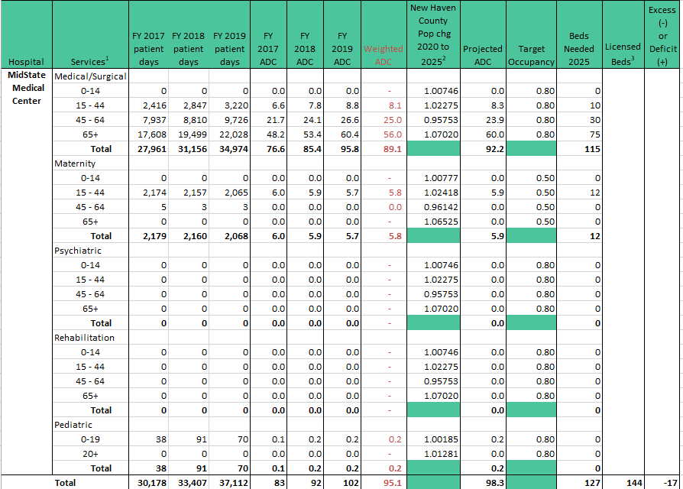
2025 Acute Care Inpatient Bed Need- MidState Medical Center

Slide 42
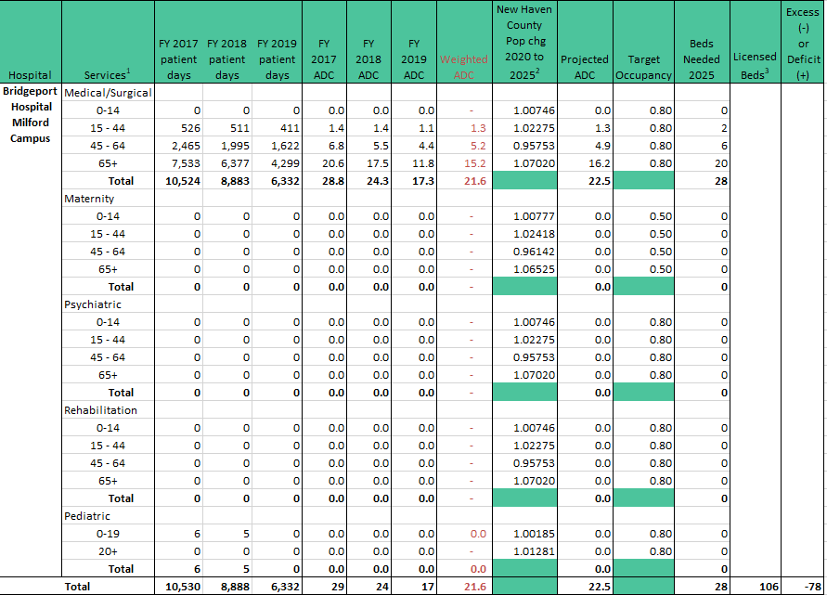
2025 Acute Care Inpatient Bed Need- Bridgeport Hospital Milford Campus

Slide 43
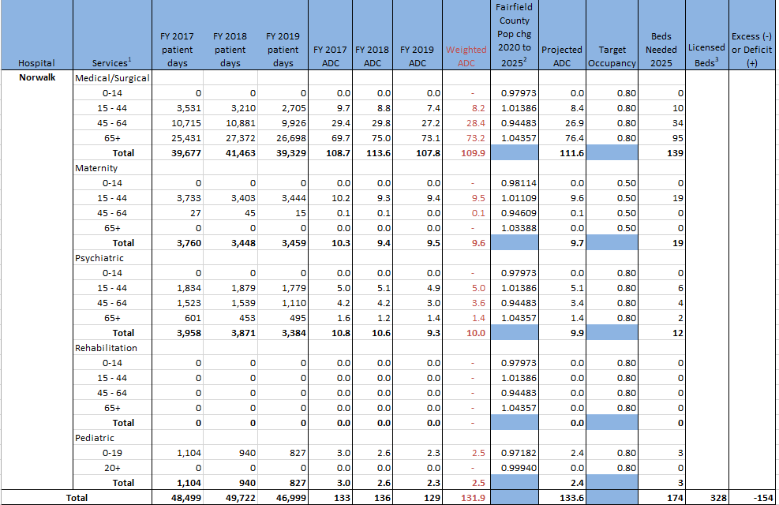
2025 Acute Care Inpatient Bed Need- Norwalk Hospital

Slide 44
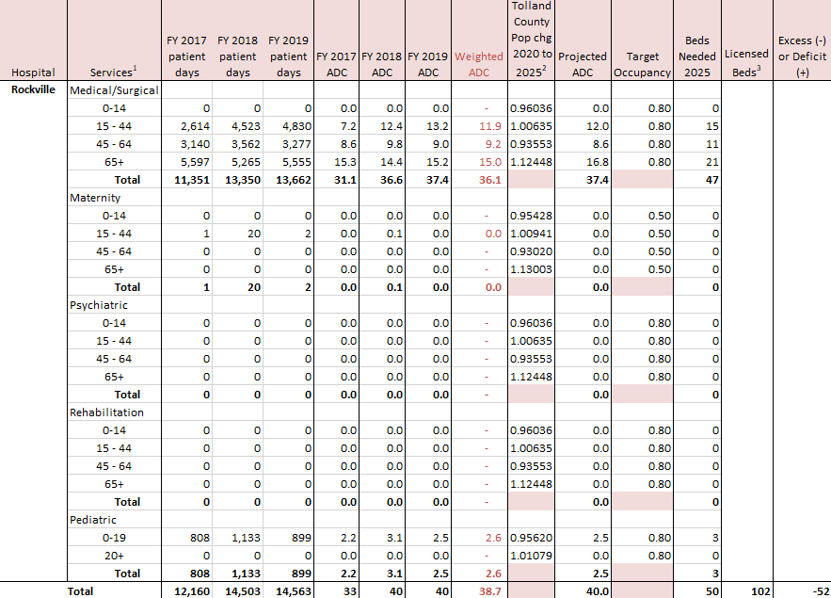
2025 Acute Care Inpatient Bed Need- Rockville General Hospital

Slide 45
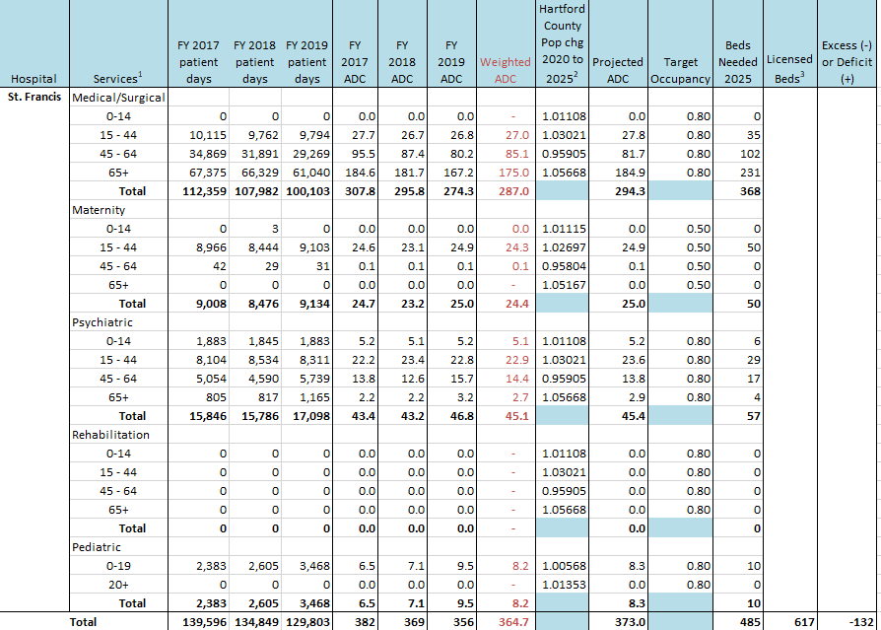
2025 Acute Care Inpatient Bed Need- Saint Francis Hospital and Medical Center

Slide 46
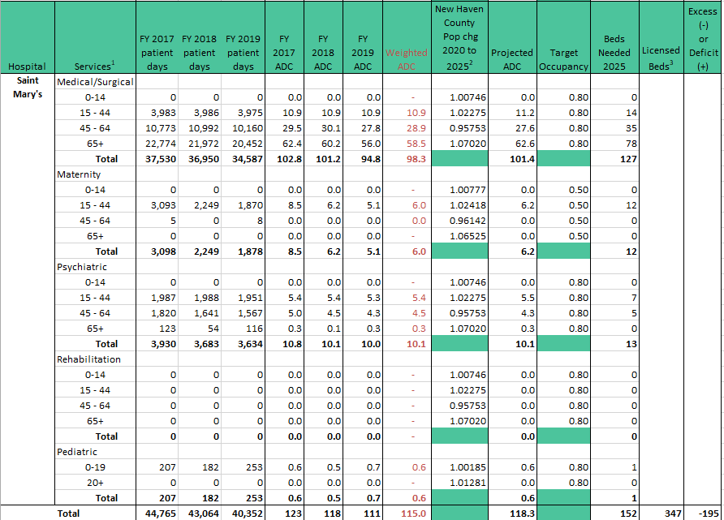
2025 Acute Care Inpatient Bed Need- Saint Mary's Hospital

Slide 47
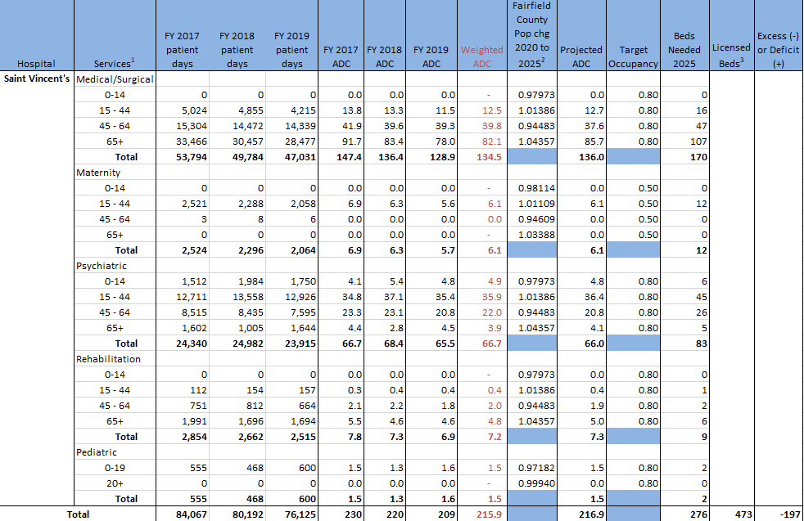
2025 Acute Care Inpatient Bed Need- Saint Vincent's Medical Center

Slide 48
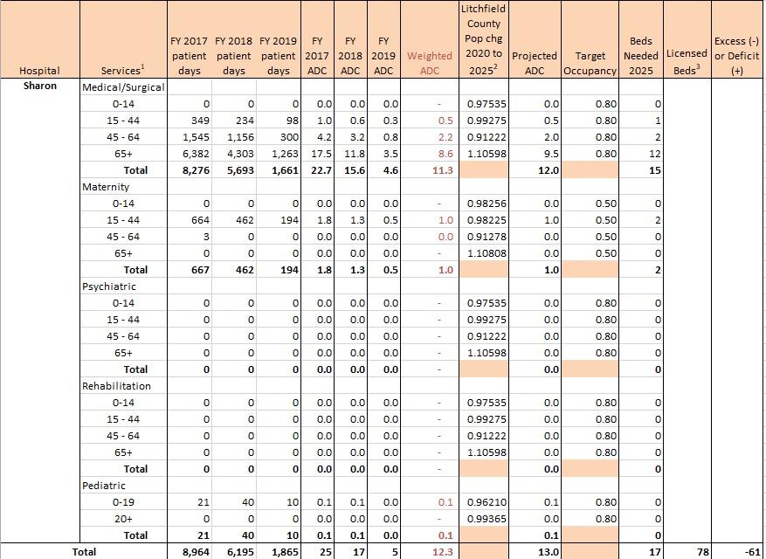
2025 Acute Care Inpatient Bed Need- Sharon Hospital

Slide 49
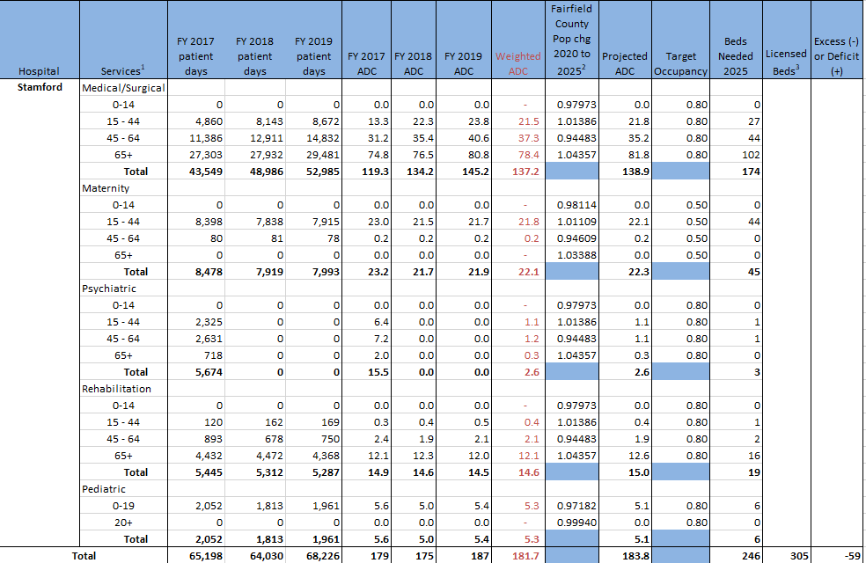
2025 Acute Care Inpatient Bed Need- Stamford Hospital

Slide 50
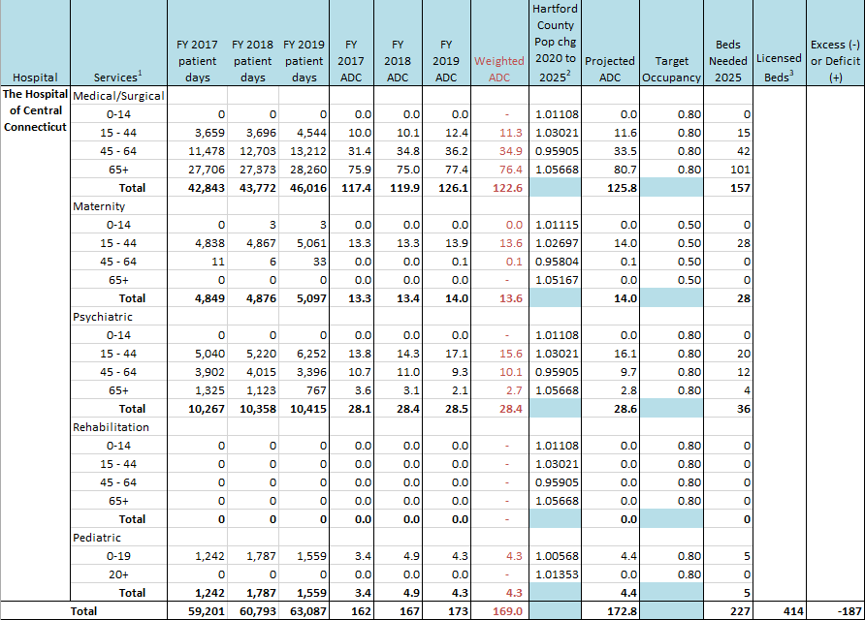
2025 Acute Care Inpatient Bed Need- The Hospital of Central Connecticut

Slide 51
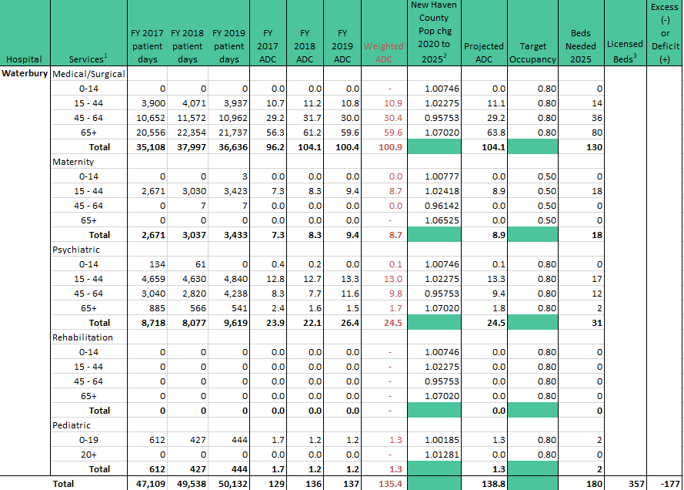
2025 Acute Care Inpatient Bed Need- Waterbury Hospital

Slide 52
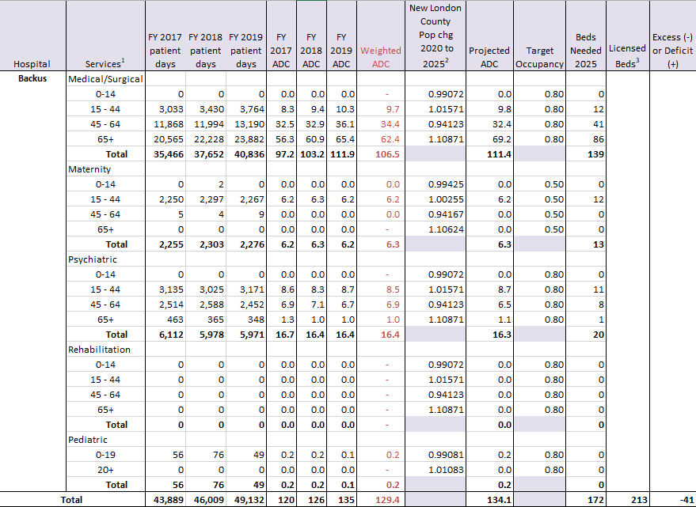
2025 Acute Care Inpatient Bed Need- William W. Backus Hospital

Slide 53
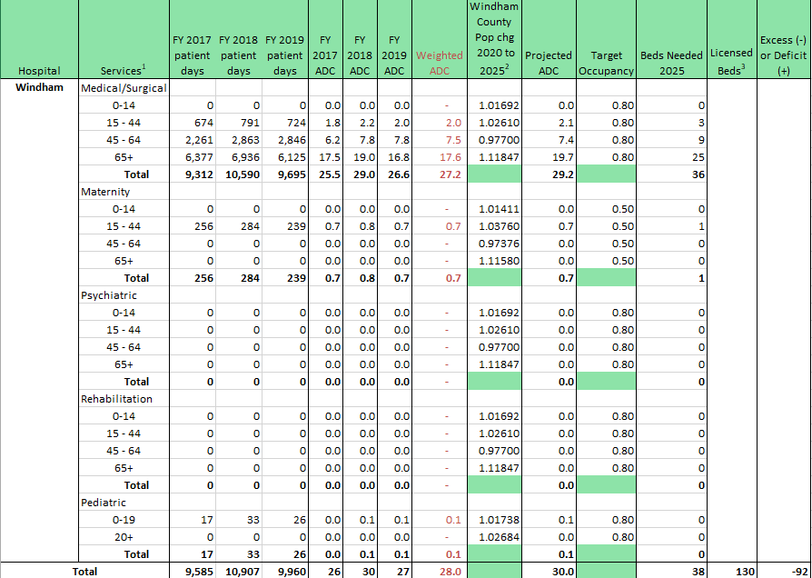
2025 Acute Care Inpatient Bed Need- Windham Community Memorial Hospital

Slide 54
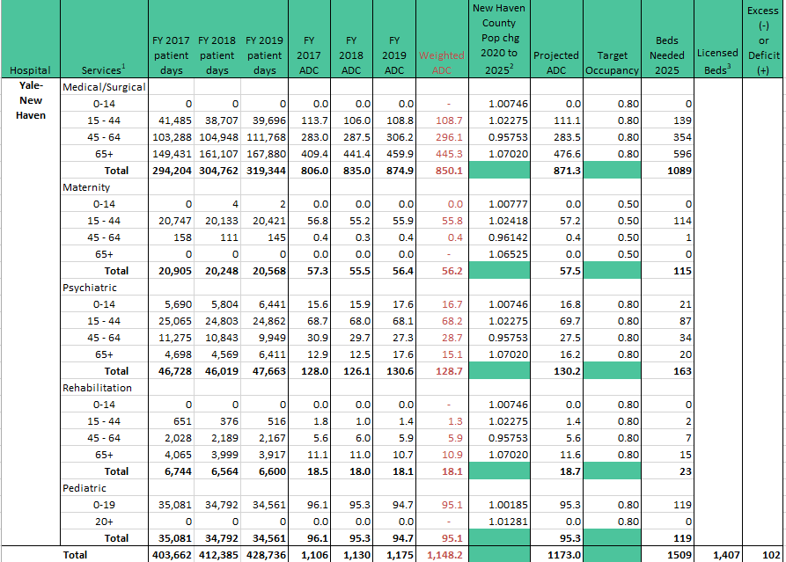
2025 Acute Care Inpatient Bed Need- Yale-New Haven Hospital

