Slide 1
FINANCIAL STATUS OF CONNECTICUT’S
SHORT-TERM ACUTE CARE HOSPITALS
Fiscal Year 2020 - Summary
December 14, 2021
Presented by: Ronald Ciesones

Slide 2
Report Mandate…
C.G.S. §19a-670 requires that OHS, by September first of each year, report the results of acute care hospitals Annual and Twelve-Month Filings.
The report shall include information concerning the financial stability of hospitals.

Slide 3
Statewide hospital operating expenses grew faster than operating revenues in FFY 2020
FY 2020
Operating Revenue - $13.69b
Operating Expense - $13.65b
Source: Office of Health Strategy’s Annual Report on Financial Status of Acute Care Hospitals for FY 2020.

Slide 4
FFY 2020 statewide hospital revenue decreased due
to lower activity and payments from the pandemic
Utilization
Patient days - (3.0%)
ED visits - (15.2%)
IP Surgeries - (9.8%)
OP Surgeries - (18.6%)

Slide 5
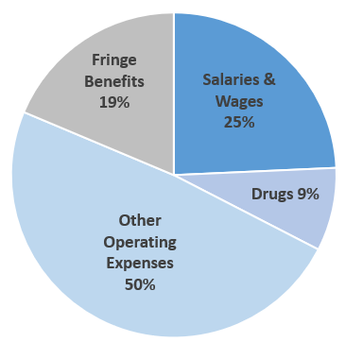
Statewide hospital expenses increase primarily due to rising salaries, fringe benefits and other operating expenses
% Share of $1.1b
Expense Increase
Supplies and Interest Expense both decreased slightly while interest expense rose slightly.
Other Operating expenses is composed of 40 different expense items such as contract labor, utilities, leases, maintenance, purchased services and corporate parent/system fees and general other operating expenses.

Slide 6
Statewide uncompensated care costs remain
approximately 2% of total hospital expenses
Uncompensated Care (UCC) = Charity Care + Bad Debt
UCC Cost = UCC Charges x Ratio of Cost to Charge (and excludes mark-ups for profits)

Slide 7
Statewide hospital operating gains from patient care and related activities decreased substantially in FY 2020
Operating Margin: Gain/Loss from Operations / Total Operating Revenue

Slide 8
Statewide hospital overall profitability
margins positive but declining
Total Margin: (Gain/Loss from Operations + Non-Operating Gain/Loss)/Total Revenue

Slide 9
Most hospitals were profitable in FFY 2020
Total Margin - 2020
18 hospitals were profitable vs. 20 in FY 2019.
9 Hospitals had a total margin of
< 0 vs. 8 in FY 2019.
The 9 hospitals were: Bristol, Bridgeport, Day Kimball, Dempsey, Hungerford, L+M, Rockville, St. Vincent’s and Sharon.
9 hospitals with a Total Margin < 0

Slide 10
Smaller hospitals show five-year average losses
5 hospitals with a Five Year Total Margin < 0
Source: Office of Health Strategy’s Annual Report on Financial Status of Acute Care Hospitals for FY 2020

Slide 11
Statewide total gains at hospitals were higher than
health systems in FFY 2020
*Gains were higher at hospitals than at the full health system.
Amounts include approximately $1 billion in CARES funding to hospitals and health systems and State and Capital appropriations for UCONN Health Center of $296 million.

Slide 12
Health System Grant Funding
amounts from CARES
Source: FY 2020 Audited Financial Statements Notes

Slide 13
Medical groups are loss leaders for health systems
but provide a source of referrals for hospital services
Source: Hospital & Health System AFS & HRS Reports

Slide 14
Three health systems were unprofitable in FFY 2020
9 systems were profitable,
vs. 8 in FY 2019.
3 Systems had a TM of < 0
vs. 7 in FY 2019.
The 3 were: Bristol, Day Kimball and Uconn.
3 systems with a Total Margin < 0

Slide 15
Questions?

Slide 16
Additional Hospital Data
For more information on the financial data or documents for a specific hospital visit the hospital financial data page of the OHS website.
    Annual Reporting & 12 Month Filings
    Audited Financial Statements
    Medicare Cost Reports
    IRS Form 990’s
    FY 2020 Financial Stability Report

Slide 17
The End

