Slide 1
Facility Fee Trends Calendar Year “CY” 2016-2020
December 14, 2021 Presented by: Bozena Piascik
Notes:
Laura

Slide 2
Facility Fee Filing Mandate
Effective July 1, 2016, C.G.S. §19a-508c(m)(1) requires hospitals/hospital health systems to report certain information on facility fees charged or billed for outpatient services provided at hospital-based off-campus locations to OHS, annually.
C.G.S. §19a-508c(l) also prohibits hospitals, hospital health systems and hospital-based facilities from charging facility fees for outpatient evaluation and management (E/M) services:
provided at a hospital-based off-campus location;
except for insurance contracts pre-dating 7/2/2016 that provide reimbursements for facility fees for E/M services, facility fees are banned on contract expiration; or
except for such services provided at a satellite emergency department
exceeding the Medicare rate for uninsured patients

Slide 3
Facility Fee Filing Mandate Intent
To analyze and monitor trends on hospital/hospital health system facility fees for Medicare, Medicaid, private insurers and other payers
To restrict facility fee charging for outpatient routine office visits
To provide transparency

Slide 4
Facility Fee Transparency
In its entirety, the mandate also requires hospital-based off-campus outpatient facilities to:
Give existing patients written notice that they may be charged a facility fee
Identify the fee as a facility fee in addition to, or separately from, any professional fee
Provide a general notice to patients through:
Prominently displayed written notices that the facility may charge a facility fee; and
Clearly displayed signage, marketing, website, etc., that the facility is hospital-based

Slide 5
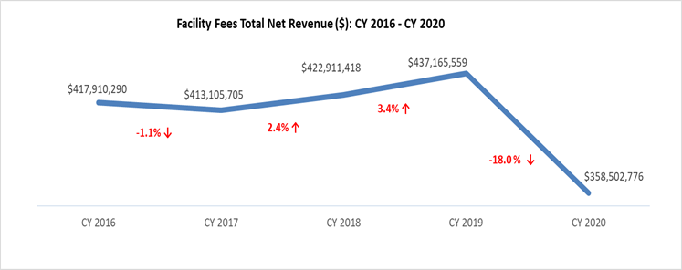
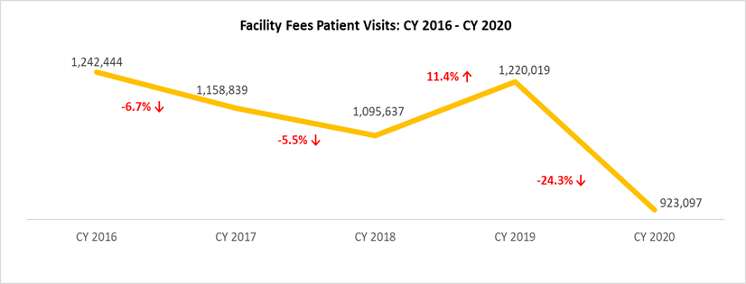
Statewide Facility Fee Revenue and Visits Declined in 2020
Source: OHS Facility Fee Filing Table 2

Slide 6
Majority of individual hospital facility fee revenues and visits decreased in 2020
Source: OHS Facility Fee Filing Table 2

Slide 7
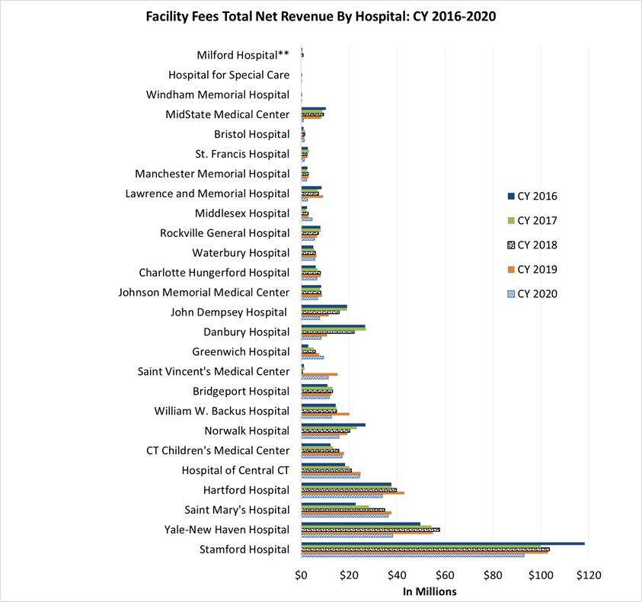
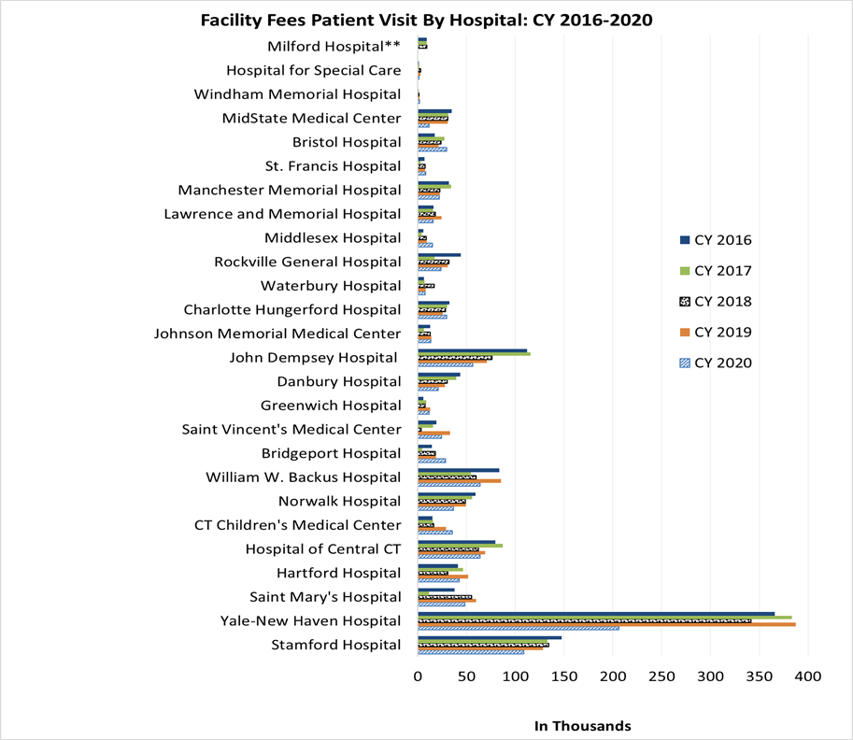
Stamford had highest revenue and Yale the most visits
Source: OHS Facility Fee Filing Table 2
.

Slide 8
Cardiovascular Procedures and Evaluation & Management generated the most facility fee revenue in 2020
Source: OHS Facility Fee Filing Table 1
*Services were determined by CPT/HCPCS categories..

Slide 9
E/M & A/M visits top facility fee volume in 2020
Source: OHS Facility Fee Filing Table 1

Slide 10
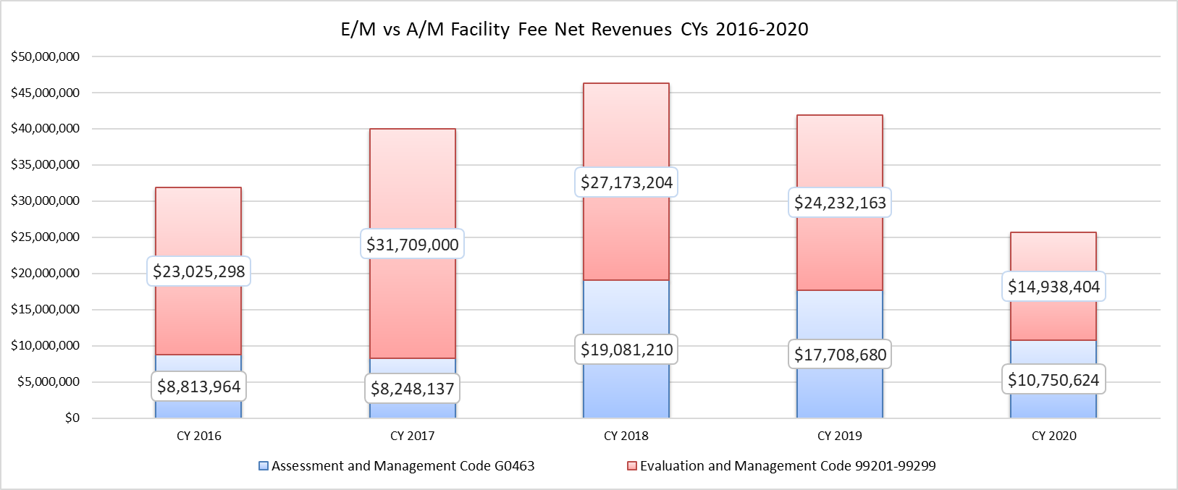
E/M and A/M revenue declined in 2020
In 2014, CMS collapsed E/M codes for clinic visits into HCPCS code G0463 Assessment and Mgmt. (A/M)
Source: OHS Facility Fee Filing Table 1

Slide 11
Top three individual locations that generated the most facility fee revenue in 2020
Stamford Hospital - Tully Health Center - $78,856,435
St Mary’s Hospital - Oncology Center - $15,754,902
Norwalk Hospital - Radiology & Mammography Center - $14,353,286
Source: OHS Facility Fee Filing Table 2

Slide 12
Top three revenue generating services by provider in 2020
Hartford Hospital- Eye and Ocular Surgical Procedures - $9,913,983
Yale-New Haven Hospital- Evaluation & Management Services- $8,703,397
Stamford Hospital - Colonoscopy with biopsy - $4,158,476
Source: OHS Facility Fee Filing Table 1

Slide 13
Top three services by visit volume and provider in 2020
Yale-New Haven Hospital – Evaluation & Management Services- 216,493
The William W. Backus Hospital – Assessment & Management OP Clinic Visit - 28,222
John Dempsey Hospital - Assessment & Management OP Clinic Visit - 25,086
Source: OHS Facility Fee Filing Table 1

Slide 14
Musculoskeletal Surgical, eye/ocular and nuclear medicine procedures had the highest per visit facility fee revenue in CY 2020
Source: OHS Facility Fee Filing Table 1

Slide 15
Top three procedures that generated the highest average facility fee per CPT code in 2020
CT Children’s Med. Ctr. - Anterior Cruciate Ligament (ACL) Repair- $15,130
CT Children’s Med. Ctr. - Ligamentous Reconstruction Knee Extra-Articular- $12,371
Greenwich Hospital - Large Breast Reduction- $10,419
Source: OHS Facility Fee Filing Table 1

Slide 16
Majority of fee revenue was from the privately insured
Source: OHS Facility Fee Filing Table 2

Slide 17
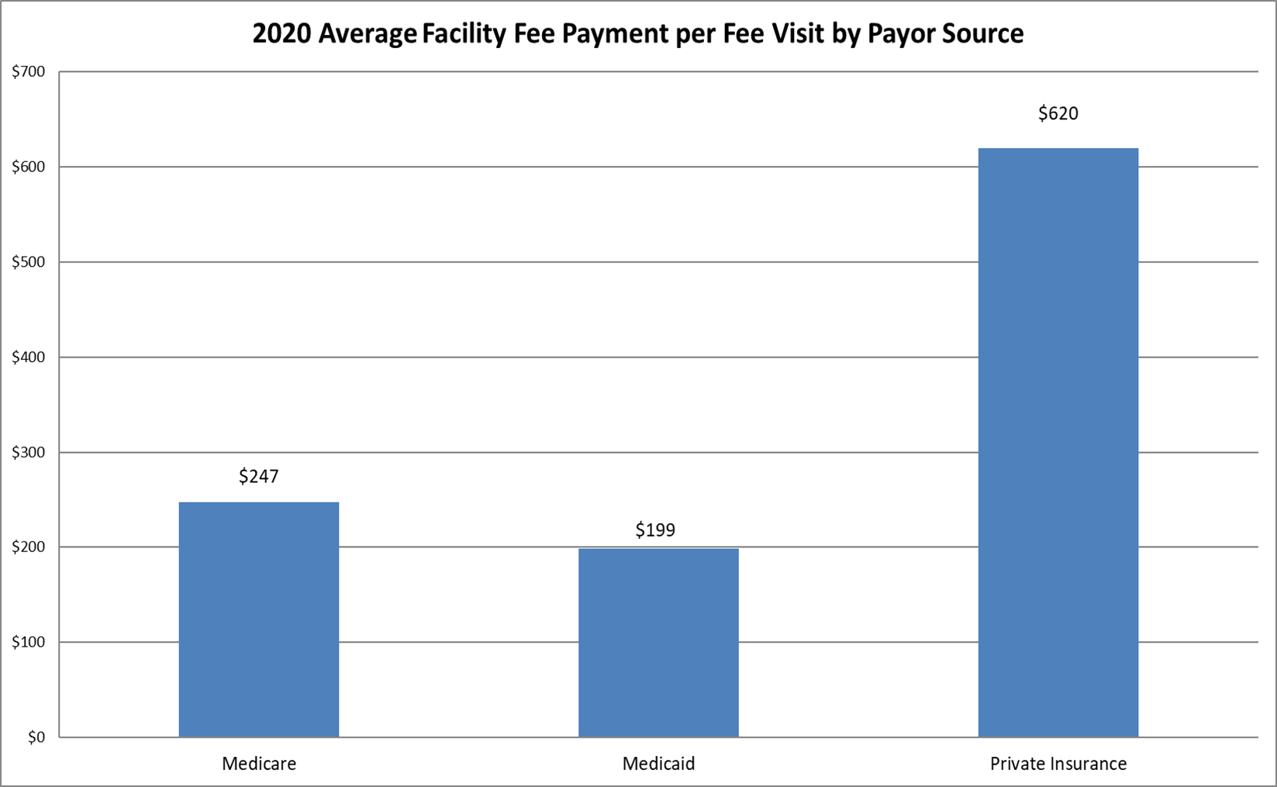
Privately insured paid the highest average facility fee payment per visit
Source: OHS Facility Fee Filing Table 2

Slide 18
Limitations of the current law
The exact facility fee(s) charged for specific services at each location cannot be determined through these filings.
The reported data provides information on the top ten revenue generating procedures/services at hospital-based off-campus outpatient centers, only
There is no way to determine if the facility fees charged uninsured patients exceed the Medicare rate

Slide 19
Facility Fee Filing Changes – Public Act 21-129
Requires a sample of a billing statement with information required by the law to be provided to OHS.
Requires facility fee charge notification in at least 15 languages, posted in appointment check-in areas, and sent to OHS.
Each hospital-based facility that was part of a transaction shall report to OHS the number of patients served by the facility in the preceding three years.

Slide 20
Facility Fee Changes continued…
No facility fee charges for A/M codes (or E&M codes) at hospital off campus locations.
Report total charges and revenues received by payer mix for the top ten services or procedures by CPT Code and by patient volume.
When a health care facility becomes hospital based and may charge a facility fee patients of the facility for the preceding three years to be notified.

Slide 21
Questions
?

Slide 22
For more information on facility fees visit
https://portal.ct.gov/OHS/Health-Systems-Planning/Notifications/Facility-Fees
To know more about OHS visit
https://portal.ct.gov/OHS

