Slide 1

Primary Care Modernization:
Unlocking the Potential of Primary Care to Improve Health and Affordability
Presentation to the Health Care Cabinet
April 9, 2019
1
DRAFT FOR DISCUSSION ONLY

Slide 2
OUR SHARED CHALLENGE
The highest performing health systems spend 10 to 12% of health care dollars on primary care. In Connecticut, primary care spending is 5% or less. The result is underuse of high value services, overuse of low value services, higher spending and worse outcomes.
Connecticut ranks…
32nd worst in the nation in avoidable hospital use and costs, largely driven by avoidable ED use¹
6th highest private health insurance spending per capita and 5th highest for Medicare²
43rd worst in the nation in health disparities³
44th worst in the nation in adults with diabetes without a hemoglobin A1c test²
33rd worst in the nation in adults with mental illness reporting unmet need²
39th worst in the nation in deaths from drug use³
The United States ranks last in primary care providers per 1,000 among developed countries⁴. Connecticut is projected to require a 15% increase in primary care physicians by 2030 to keep pace with current utilization⁵.
¹ Commonwealth Fund Scorecard on State Health System Performance, 2018, https://interactives.commonwealthfund.org/2018/state-scorecard/files/Connecticut.pdf
² Kaiser Family Foundation State Health Facts, 2017, https://www.kff.org/other/state-indicator/per-capita-state-spending/?currentTimeframe=0&sortModel=%7B%22colId%22:%22Location%22,%22sort%22:%22asc%22%7D
³ America’s Health Rankings 2018 Annual Report, https://www.americashealthrankings.org/
⁴ Organisation for Economic Cooperation and Development, https://stats.oecd.org/Index.aspx?QueryId=30173
⁵ Connecticut: Projecting Primary Care Physician Workforce, https://www.graham-center.org/content/dam/rgc/documents/maps-data-tools/state-collections/workforce-projections/Connecticut.pdf
3
DRAFT FOR DISCUSSION ONLY

Slide 3
TRANSFORM CARE ACROSS THE DELIVERY SYSTEM
PCM aligns Connecticut around proven capabilities and flexible payment model options that support patient-centered, convenient care delivered effectively and efficiently.
GOALS
INPUTS
ENABLERS
IMPACTS
FLEXIBLE PAYMENTS
REDUCED AVOIDABLE
HOSPITAL, ED, AND
SPECIALTY CARE
MORE USE OF HIGH VALUE SERVICES
BETTER ACCESS
PATIENTS AND FAMILIES
BETTER PATIENT EXPERIENCE
CARE TEAMS
COST ACCOUNTABLE
PAYMENT
PRIMARY CARE CAPABILITIES
CONSUMER
SAFEGAURDS
PREVENTIVE CARE AND
CHRONIC CONDITION OUTCOMES IMPROVE
BETTER QUALITY
QUALITY
MEASUREMENT
PROVIDER RECRUITMENT
AND RETENTION
IMPROVES
REVITALIZED PRIMARY CARE
HEALTH
NEIGHBORHOOD
POPULATION HEALTH MANAGEMENT
PEFORMANCE
ACCOUNTABILITY
AFFORDABILITY
IMPROVES
LOWER COST
4
DRAFT FOR DISCUSSION ONLY

Slide 4
IMPACT
HEALTH EQUITY
Through capabilities focused on identifying and addressing health disparities and payment model options that recognize social factors impact cost, PCM would improve health equity in Connecticut.
People from communities of color, non-English speakers, and other underserved populations have higher rates of disease, less access to quality care, and poorer health outcomes. Disparities are largely driven by systemic barriers.
By creating new systems and employing care teams that reflect the patients and communities they serve, PCM capabilities work together to address barriers such as:
Language differences
Culture
Lack of transportation, childcare, food security, housing stability
Difficulty taking time off work
Literacy
5
DRAFT FOR DISCUSSION ONLY

Slide 5
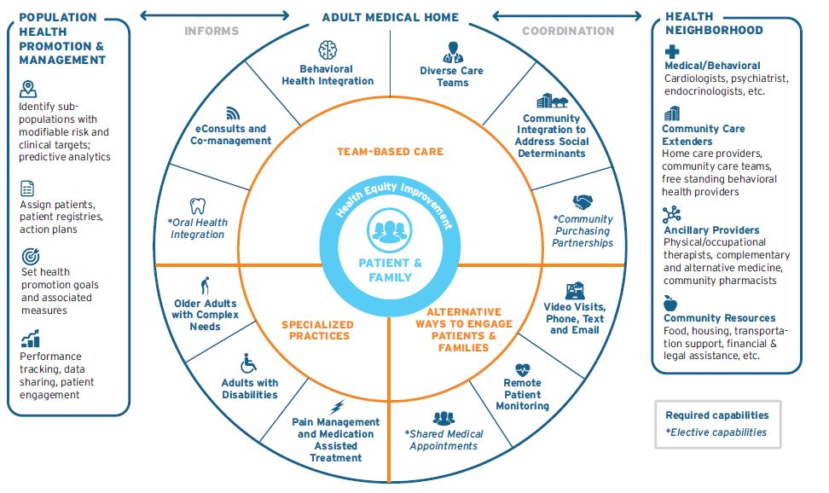
DRAW SHARED FOCUS TO PROVEN CAPABILITIES
Practices participating in PCM will develop care delivery capabilities that aim to make care more accessible, convenient and responsive to patients’ needs while improving health equity.
Adult Primary Care Capabilities
6
DRAFT FOR DISCUSSION ONLY

Slide 6
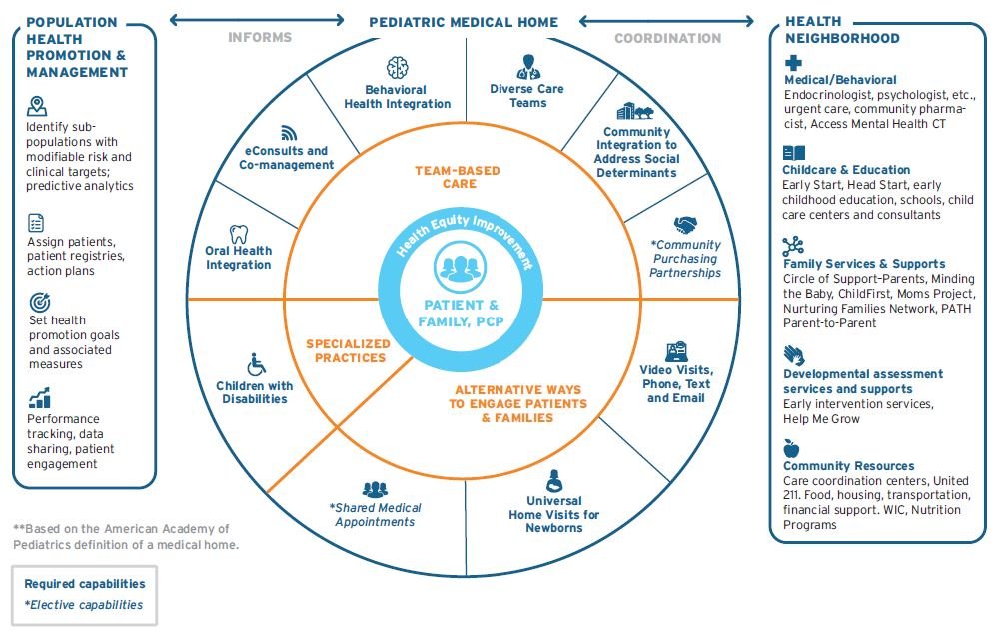
ADDRESS SPECIFIC
NEEDS OF PEDIATRICS
Pediatric practices participating in PCM will develop care delivery capabilities that aim to make care more accessible, continuous, comprehensive, family-centered, coordinated, compassionate, and culturally effective.
Pediatric Primary Care Capabilities
7
DRAFT FOR DISCUSSION ONLY

Slide 7
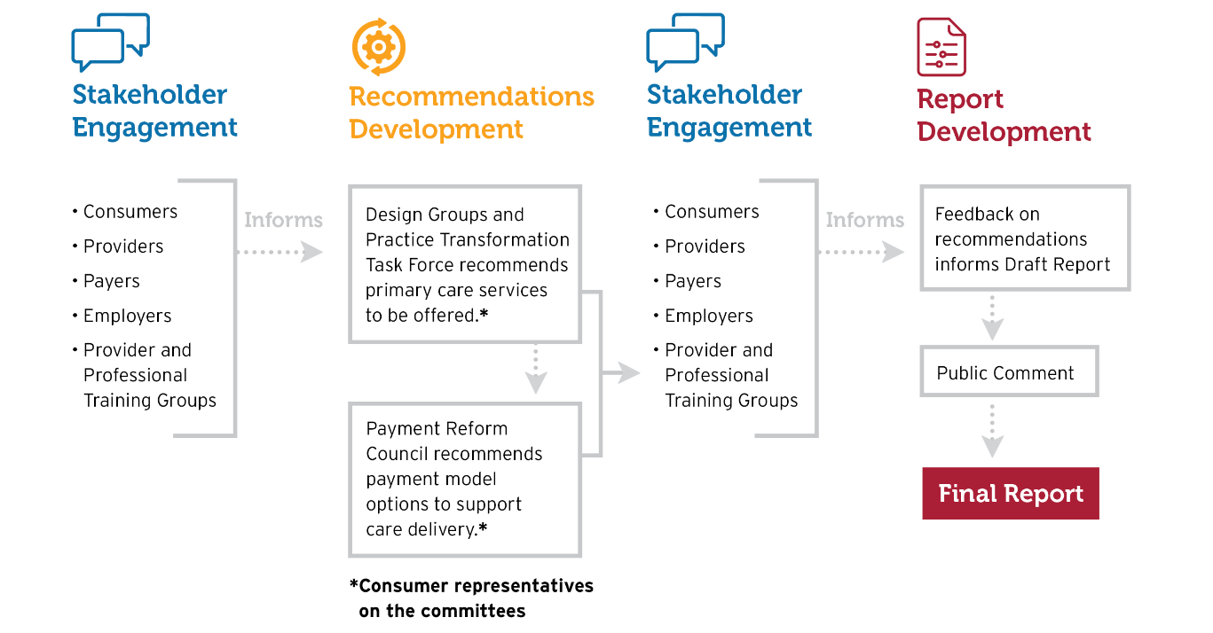
DESIGN SOLUTIONS WITH INPUT FROM ALL STAKEHOLDERS
More than 500 Connecticut stakeholders worked collaboratively to develop provisional recommendations that would drive immediate improvement and long-term transformation.
8
DRAFT FOR DISCUSSION ONLY

Slide 8

MEET
DR. NEIL
Dr. Neil is a primary care physician trying to provide good care. She feels overwhelmed by billing, coding and other administrative hassles. She wishes she had more clinical support too.
9
DRAFT FOR DISCUSSION ONLY

Slide 9

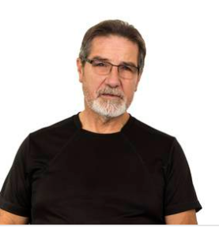
MEET DR. NEIL’S PATIENTS
Chris and Mr. Jones need more support than Dr. Neil can provide alone. They are frustrated and worried. They want to feel well again.
10
DRAFT FOR DISCUSSION ONLY
Notes:
Today, Dr. Neil is thinking about how PCM capabilities could change care delivery for her patients and how its payment model options could enable those changes. Following each story, we are going to highlight the patient’s needs and how the capabilities could support Dr. Neil in caring for patients.

Slide 10

CHRIS’ STORY
Chris was diagnosed with Crohn’s disease in her teens. Lately, her condition has been flaring up more often and its affecting her work and her mental health.
Chris’ Needs
Help managing her Crohn’s flare-ups
Support for her depression
More coordinated care to reduce the number of specialists she is seeing
Fewer days of missed work and fewer trips to the emergency room
Dr. Neil’s Practice Solutions
Part-time LCSW identifies behavioral health needs, makes referrals, and provides monthly support
Coordinated care between the gastroenterologist, PCP, and LCSW
eConsult addresses new skin problem
Nutritionist counsels Chris on changes to her diet such as limiting fiber and dairy
11
DRAFT FOR DISCUSSION ONLY
Notes:
Chris is 34. She’s recently married and was diagnosed with Crohn’s disease in her teens. Chris has worked full time for the same company for 10 years. However, lately, Chris’ Crohn’s disease has been flaring up more often and she’s been missing work.
Different specialists have different ideas about how to help and she doesn’t know whose advice to follow. Anxiety about her condition and missing work is making her feel anxious and depressed. Her husband encourages her to see her primary care doctor.
When Dr. Neil meets with Chris, she is immediately concerned about her mental health but often struggles getting patients’ access to a community clinician – limited capacity and patient reluctance to follow through. She also wonders when she’s going to have time to call Chris’ GI doctor. Dr. Neil has a full day of appointments and little help around the office.
With PCM, Chris could meet with her part-time LCSW. After conducting a screening and brief intervention, the LCSW could connects Chris with a therapist and peer support group. In addition, Dr. Neil could connect with Chris’s main GI specialist to develop a new medication strategy and then she could follow up by phone to see how things were going, without having to worry about lost revenue of a potential office visit. That would work much better for Chris who is already concerned about taking so much time off work.
About a month later, Chris begins noticing painful rashes on his arms. He makes an appointment with Dr. Neil but she doesn't know
who is able to connect to a dermatologist using an e-consult. Through coordination with his GI specialist, an adjustment to his medication reduces the rash. Chris begins using CBD oil to manage the pain associated with his condition and establishes a new dietary approach with help from the GI specialist and a nutritionist associated with Dr. Neil’s practice. He is not comfortable attending a support group, but the LCSW recommends a therapist that he sees monthly. With these adjustments, he is missing less work and needing fewer trips to the ED. He’s also enjoying fatherhood.

Slide 11
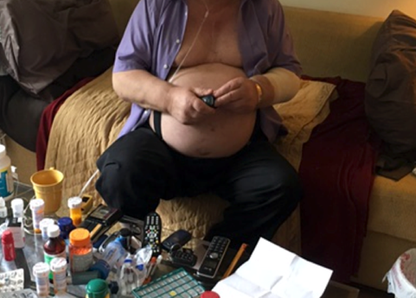
Mr. Jones has a complex medical history including heart failure, stroke, diabetes, and kidney disease. Recently, he began having serious complications.
MR. JONES’
STORY
Dr. Neil’s Practice Solutions
Home visit by part-time pharmacist
eConsult with cardiologist
Video check-ins with PCP and/or RN care manager
Remote patient monitoring for congestive heart failure
Frequent communication with care team through phone and email
Mr. Jones’ Needs
Help managing prescriptions for diabetes, congestive heart failure, kidney disease
More frequent and closer monitoring of changes in condition
Fewer avoidable trips to the doctor due to mobility challenges related to a stroke
DRAFT OR DISCUSSION ONLY
Notes:
Dr. Neil’s second patient, Mr. Jones , has a complex medical history including heart failure, stroke, diabetes, and kidney disease.
He has been having frequent heart failure complications that have been challenging Dr. Neil, his cardiologist, and the hospital team. He recently came in with a growth on his hand, but was also having severe breathing issues, his feet were swelling so badly that he could barely get into the office. He’s frustrated that after so many trips to the doctor, ED and hospital, he’s still not feeling better.
Dr. Neil is frustrated too. She’s had plenty of patients like Mr. Jones in the past and they just never seem to be able to manage their conditions or do what it takes to get better.
Dr. Neil knows her advanced network ABC HealthCare is considering implementing primary care modernization. She thinks about how she would treat Mr. Jones’ if she had access to PCM today.
She would have a part-time pharmacist visit Mr. Jones at home to go over his prescriptions. With another patient, she recently found duplicative, expired and even some unsafe over the counter medications. She finds patients and families often don’t understand their medications or how they should be taking them.
She remembers a patient like Mr. Jones who wasn’t taking his diuretic (water pill), furosemide, which caused frequent hospital admissions from HF exacerbation. Every time he was hospitalized for HF exacerbation, the doctors would increase his furosemide dose and then discharge him, but he was never taking his furosemide at home.
2) Next, Dr. Neil would arrange an eConsult with a dermatologist to look at the skin growth.
3) Finally, she would have her team offer him a device to monitor his CHF remotely. This would reduce his trips to the doctor, and give her team the information they need to make sure he was on track. She could also call or email him without worry about whether she was getting paid for the time.

Slide 12

DR. NEIL’S ADVANCED NETWORK
Dr. Neil’s practice is part of ABC Health Partners. Its adult internal medicine physicians and nurse practitioners serve about 50,000 patients a year.
Five Year Primary Care Modernization Implementation Plan
YEAR 1
YEAR 2
YEAR 3
YEAR 4
YEAR 5
CARE TEAM EXPANDS. Pilot practices include RN care managers, pharmacists, CHWs. Care transitions are a focus.
PCPs and care team receive technical assistance to support workflow redesign.
Phone, text, email upgraded for better patient experience.
eConsult, remote patient monitoring offered.
INTEGRATED BEHAVIORAL HEALTH PILOTED with hiring of LCSW.
Patients connected to community resources after analysis of social determinants data.
Care team expands to additional practices; new care team roles introduced. Technical assistance continues.
FORMAL PARTNERSHIP LAUNCHED with local housing referral service.
Integrated behavioral health expanded to all practice sites.
Care team expansion and technical assistance continues.
TWO SPECIALIZED PRACTICES DEVELOPED. One supports older adults with complex medical needs. Another focuses on chronic pain management.
Existing capabilities refined and expanded.
ALL PRACTICES ACHIEVE ALL CORE CAPABILITIES.
Technical assistance continues.
Two additional partnerships with community-placed resources launch.
13
DRAFT FOR DISCUSSION ONLY
Notes:
Care team expands in test practices or something like that or in pilot practices so that people

Slide 13


WHY DR. NEIL AND ABC HEALTHCARE NEED PCM
When ABC Health Partners began MSSP, it hired five community health workers. They immediately saved money. Patients loved the program. Then, ABC Health Partners abruptly ended the CHW pilot.
Why did ABC end the CHW pilot?
After training and overhead, the five employees cost about $300,000.
It estimated savings of $450,000 due to avoided ED visits, hospital stays and at least one skilled nursing facility stay. .
ABC had to split those savings with Medicare, 50/50. Its gain of $150,000 became a loss of -$75,000. For ABC, there is no reward for incremental improvements in efficiency.
Hiring CHWs highlighted other gaps too. ABC had insufficient data to identify high-needs patients; weak connections to community resources; and lacked certain care team members to address specific needs such as pharmacists to troubleshoot medication problems.
ABC realized it needed advance funding across its payers to redesign its systems and maximize the shared investment.
14
DRAFT FOR DISCUSSION ONLY
Notes:
For ABC, there is no reward for incremental investments in efficiency – add in the pathways examples

Slide 14
THE CASE FOR
ADVANCE FUNDING
Today, many care delivery investments are not made due to structure of some shared savings programs. With upfront investment, providers have greater incentive to transform care delivery and lower costs.
THE MATH TODAY
CHW Cost Paid by Provider | $300,000
CHW Savings | $450,000
Provider Share of Savings | $225,000
Provider Loss after Costs | $225,000 - $300,000 - $75,000
THE MATH WITH PCM
CHW Cost Paid with Advance Funding | $300,000
CHW Savings | $450,000
Savings Net of Investment | $150,000
Payer Share of Savings | +$75,000
Provider Share of Savings | +$75,000
No Win
Win-Win
15
DRAFT FOR DISCUSSION ONLY
Notes:
Advance funding enables incremental investments in value and efficiency

Slide 15
UPFRONT PAYMENTS
OFFER FLEXIBILITY
Clinical need and patient preference drives decision-making without the financial and administrative constraints of fee-for-service payments.
Advance Payments to Support Primary Care
Embedded within shared savings arrangement that rewards management of total cost of care
Supplemental Bundle
Fee for Service
Basic Bundle
Time of primary care providers
Other investments to achieve the capabilities.
Services not included in the bundle
16
DRAFT FOR DISCUSSION ONLY

Slide 16
UPFRONT PAYMENTS
OFFER FLEXIBILITY
Clinical need and patient preference drives decision-making without the financial and administrative constraints of fee-for-service payments.
Basic Bundle
Embedded within shared savings arrangement that rewards management of total cost of care
Attribution
Clinical risk
Changes in services and use
Unit cost trend
The same provider or tax ID number receiving today’s fee for service payments
Supplemental Bundle
BASED ON
ADJUSTED FOR
PAID TO
Time of primary care providers
Caring for patients
Leading care teams
Learning and peer support
Historical cost of primary care services included in the bundle
Prospective
Prioritize patient choice
Not standardized across payers
Clinical risk
Social risk
Conditions with intensive management needs (e.g., dementia)
Advanced Networks and FQHCs participating in shared savings programs with Medicare and other payers
Other investments to achieve the capabilities
Care team staff
Infrastructure and HIT
Patient incentives
Patient-specific expenses to address social needs
% Primary care spend targets applied consistently across providers
17
DRAFT FOR DISCUSSION ONLY

Slide 17
TRADE OFFS OF THE
BASIC BUNDLE
The basic bundle would allow primary care teams to treat patients based on clinical need and patient preference without the constraints of fee-for-service. However, as CMS adds codes and fees for additional services, some wonder if this would be a preferable approach for all payers.
BASIC BUNDLE TRADEOFFS
Benefits of Basic Bundle
Benefits of Additional Codes and Fees
Maximum flexibility
Lightened coding burden
Option to reduce consumer cost share*
Ease of administration for payers
Certainty regarding services provided
Familiarity and reliability for providers
Requirements of Both Approaches
Documentation to ensure patient access and capabilities achieved
Adaptation of billing systems
Changes in culture and workflow to maximize effectiveness
* For commercial only
18
DRAFT FOR DISCUSSION ONLY
Notes:
Add word examples

Slide 18
EVIDENCE SHOWS PCM CAPABILITIES SAVE MONEY
PMPM savings reflects the estimated per member, per month savings across the entire Medicare population. Therefore, this figure is smaller than the estimates for those benefiting from the capability.
Capability
Estimated Savings for Medicare Patients
Benefiting from the Capability
Savings Applied to Entire Population (PMPM)
Diverse Care Teams | Emergency department costs decrease 20%, inpatient costs decrease 10%. (PWC 2016) | $32.00
Behavioral Health Integration | Total medical expense decreases 10%. (Unützer 2008) | $4.03
Phone, Text, Email and Telemedicine | Avoidable specialist costs decrease 6%. (Strumpf, 2016; The Commonwealth Fund March 2012) | $2.70
Specialized Practices: Pain Management/MAT | Total medical expense decreases 45%. (Duke 2017) | $2.10
Specialized Practices: Older Adults with Complex Needs | Skilled nursing facility utilization decreases 16%. (Gross 2017) | $15.03
eConsult and Co-management | Based on 590 referrals by 36 primary care clinicians, eConsults replaced face-to-face specialty visits 69% of the time. (The Annals of Family Medicine, 2016) | $2.34
Remote Patient Monitoring | Avoidable readmission costs decrease 50%. (Broderick 2013) | $0.33
19
DRAFT FOR DISCUSSION ONLY
Notes:
MEDICARE version

Slide 19

EVIDENCE SHOWS PCM CAPABILITIES SAVE MONEY
PMPM savings reflects the estimated per member, per month savings across the entire Commercial population. Therefore, this figure is smaller than the estimates for those benefiting from the capability.
Capability
Estimated Savings for Commercial Patients
Benefiting from the Capability
Savings Applied to Entire Population (PMPM)
Diverse Care Teams | Emergency department costs decrease 20%; inpatient costs decrease 10%. (PWC 2016) Other outpatient facility costs decrease 12% (NEJM, 2014) | $19.00
Behavioral Health Integration | Total medical expense decreases 10%. (Unützer 2008) | $1.27
Phone, Text, Email and Telemedicine | Avoidable specialist costs decrease 3.6-6%. (Strumpf, 2016; The Commonwealth Fund March 2012) | $2.00
eConsult and Co-management | Based on 590 referrals by 36 primary care clinicians, eConsults replaced face-to-face specialty visits 69% of the time. (The Annals of Family Medicine, 2016) | $1.91
20
DRAFT FOR DISCUSSION ONLY
Notes:
Commercial version

Slide 20

SAVINGS INCREASE AS CAPABILITIES IMPROVE OUTCOMES
Based on an extensive review of the evidence, modeling shows PCM would drive immediate reductions in avoidable utilization and those savings would more than cover the cost of the program by year two.
PCM IMPROVES AFFORDABILITY
Immediate reductions in avoidable utilization
Return on investment in year 2 for commercial payers
Nearly 2 percent annual reduction in total cost of care by year 5
Less spending on low value services and more spending on high value services
Four percent of spend redeployed to primary care, similar to successful BCBS MA program (NEJM, 2016)
Aligned with value-based insurance design
Ability to reduce consumer cost share for commercial members, if desired
PCM Impact on Commercial Total Cost of Care
21
DRAFT FOR DISCUSSION ONLY
Notes:
Commercial version

Slide 21
SAVINGS INCREASE AS CAPABILITIES IMPROVE OUTCOMES
Based on an extensive review of the evidence, modeling shows PCM would drive immediate reductions in avoidable utilization and those savings would more than cover the cost of the program by year two.
PCM Impact on Medicare Total Cost of Care
PCM IMPROVES AFFORDABILITY
Immediate reductions in avoidable utilization
Return on investment in year 3 for Medicare
Nearly 2 percent annual reduction in total cost of care by year 5
Less spending on low value services and more spending on high value services
Approximately 4.7% spend redeployed to primary care
22
DRAFT FOR DISCUSSION ONLY
Notes:
Medicare version

Slide 22
GLIDEPATH, SHARED ACCOUNTABILITY, ENCOURAGES SMART INVESTMENT
Supplemental payments will increase gradually and “proof of performance” will be required to advance.
GLIDEPATH ENCOURAGES
SMART INVESTMENT
$13 - $17
Commercial supplemental bundle (PMPM) target for a typical AN
SAVINGS EXCEEDS SUPPLEMENTAL FUNDING
$9 - $13
QUALITY, ACCESS, EXPERIENCE IMPROVED
$6 - $9
Providers able to demonstrate readiness may have the ability to enter at a more advanced level
Inability to meet performance requirements may result in corrective action plan or termination
Medicare Shared Savings Program or similar program rewards management of total cost
$2 - $6
MORE ABOUT THE GLIDEPATH
DOLLARS SPENT ACCORDING TO PLAN
$2 - $6
PROVISIONAL PMPM ESTIMATES
23
DRAFT FOR DISCUSSION ONLY
Notes:
Commercial version

Slide 23
GLIDEPATH, SHARED ACCOUNTABILITY, ENCOURAGES SMART INVESTMENT
Supplemental payments will increase gradually and “proof of performance” will be required to advance.
GLIDEPATH ENCOURAGES
SMART INVESTMENT
Medicare FFS supplemental bundle (PMPM) target for a typical AN
$36 - $45
SAVINGS EXCEEDS SUPPLEMENTAL FUNDING
$27 - $36
QUALITY, ACCESS, EXPERIENCE IMPROVED
$18 - $27
Providers able to demonstrate readiness may have the ability to enter at a more advanced level
Inability to meet performance requirements may result in corrective action plan or termination
Medicare Shared Savings Program or similar program rewards management of total cost
$9 - $18
MORE ABOUT THE GLIDEPATH
DOLLARS SPENT ACCORDING TO PLAN
$9 - $18
PROVISIONAL PMPM ESTIMATES
24
DRAFT FOR DISCUSSION ONLY
Notes:
Medicare version

Slide 24
CAPTURING DATA ON PRIMARY CARE ACCESS
Using a standardized format, practices would document all patient touches by all practice-associated personnel.
25
DRAFT FOR DISCUSSION ONLY
Notes:
How would networks generate the report?
AN/FQHC configures EHR to capture all care team contacts, by patient and by type of contact
PCP and care team personnel record their patient contacts in the normal course of business similar to other visit types
AN/FQHC runs a quarterly contact summary report (de-identified) and uploads or transmits the report in a standard format to OHS and participating payers
Summary report includes contacts/patient by category of coverage (Medicare, Medicaid and commercial)

Slide 25
CAPTURING DATA ON PRIMARY CARE ACCESS
Types of encounters captured for all practice-associated personnel. This would provide greater insight into care delivery than available today.
AN/FQHC configures EHR to capture all care team contacts, by patient and by type of contact
PCP and care team personnel record their patient contacts in the normal course of business similar to other visit types
AN/FQHC runs a quarterly summary report (de-identified) and uploads or transmits the report in a standard format to OHS and participating payers.
Summary report includes contacts/patient by type of coverage (Medicare, Medicaid and commercial)
GENERATING THE REPORT
26
DRAFT FOR DISCUSSION ONLY
Notes:
Remove enrollee – number of patients during the reporting period, Add in graphic

Slide 26
SHARING DATA ON PRIMARY CARE ACCESS
As part of program monitoring, the state could report both practice and system performance over time. As an example, the total encounters for one group might appear as shown below, with the vertical line representing the start of bundled payments.
27
DRAFT FOR DISCUSSION ONLY
Notes:
Remove enrollee – number of patients during the reporting period, Add in graphic

Slide 27
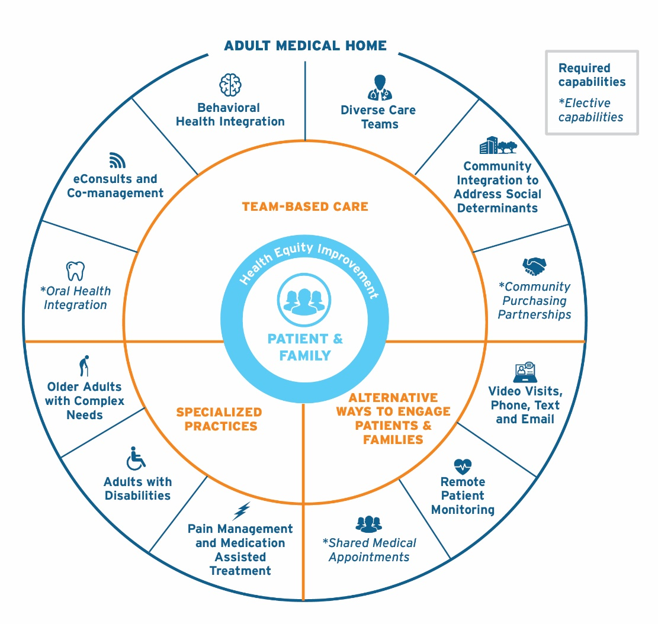
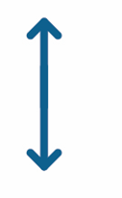
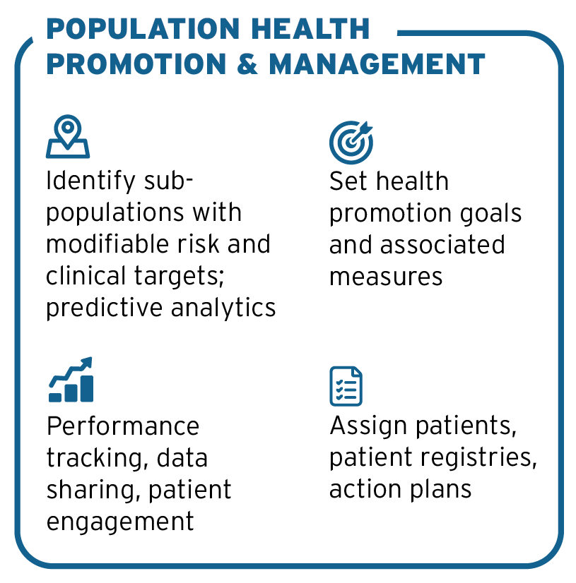
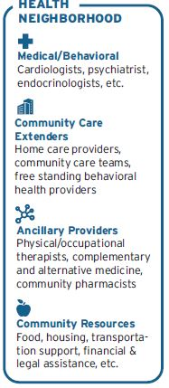
TRANSFORM CARE ACROSS THE DELIVERY SYSTEM
PCM aligns Connecticut around proven capabilities and flexible payment model options that support patient-centered, convenient care delivered effectively and efficiently.
GOALS
INPUTS
ENABLERS
IMPACT
BETTER ACCESS
Convenience
Timeliness
Flexibility
HEALTH OUTCOMES IMPROVE
ED costs reduced 20%; Hospital costs reduced 10%;
Medicare skilled nursing facility use reduced 16%;
Commercial outpatient costs reduced 6%
Spending on specialty care reduced 6% in Medicare and 3.6% in commercial
HbA1c and BP in control improved
Physician retention, satisfaction, recruitment increased (PCPs per 100,000)
CAHPS scores improved;
Health inequities reduced (e.g. race, ethnicity, income)
Health risk factors reduced (e.g. weight, tobacco)
AFFORDABILITY IMPROVES
2% net reduction in total cost;
4.7% of Medicare, 4% commercial spend redeployed to primary care
BASIC BUNDLE
Advance payment for primary care provider time
BETTER PATIENT EXPERIENCE
Courteous and welcoming
Listens and shares decision-making
Advises and informs
Coordinates and navigates
SUPPLEMENTAL BUNDLE
Advance payment for primary care team staff and infrastructure
FLEXIBLE PAYMENTS
Shared savings program rewards total cost of care management
BETTER QUALITY
Preventive care outcomes
Chronic care outcomes
Health equity
INFORMS
COORDINATION
CONSUMER SAFEGAURDS
Payments adjust for clinical and social risk
Reporting demonstrates higher level of patient service and support
REVITALIZE PRIMARY CARE
PCP and care team satisfaction
Make primary care a more rewarding profession
Incent incremental improvements in value
QUALITY MEASUREMENT
Quality and experience scorecard ties performance to shared savings rewards
LOWER COST GROWTH
Reduce cost growth
Improve affordability for consumers
ACCOUNTABILITY
“Proof of performance” required to qualify for supplemental payment increases
28
DRAFT FOR DISCUSSION ONLY
Notes:
Commercial and Medicare

Slide 28

QUESTIONS?
Contact: Mary Jo Condon
mcondon@freedmanhealthcare.com
29
DRAFT FOR DISCUSSION ONLY

