Slide 1
Health Care Cabinet Medication Reconciliation Work Group Update
Allan Hackney
April 9, 2019

Slide 2
Agenda
Agenda
Welcome and Call to Order | Sarju Shah | 2:00 PM
Public Comment | Attendees | 2:05 PM
Review and Approval of November 16, 2018 Meeting Minutes | Attendees | 2:10 PM
MRP Work Group Project Charter | Sean Jeffery | 2:15 PM
Funding Opportunity Update | Allan Hackney | 2:35 PM
Use Case Development | Sabina Sitaru | 2:50 PM
MRP Work Group Timeline and Structure | Michael Matthews | 3:20 PM
MRP Workshop & Hackathon | Tom Agresta | 3:45 PM
Next Steps and Adjournment | Sarju Shah | 3:55 PM

Slide 3
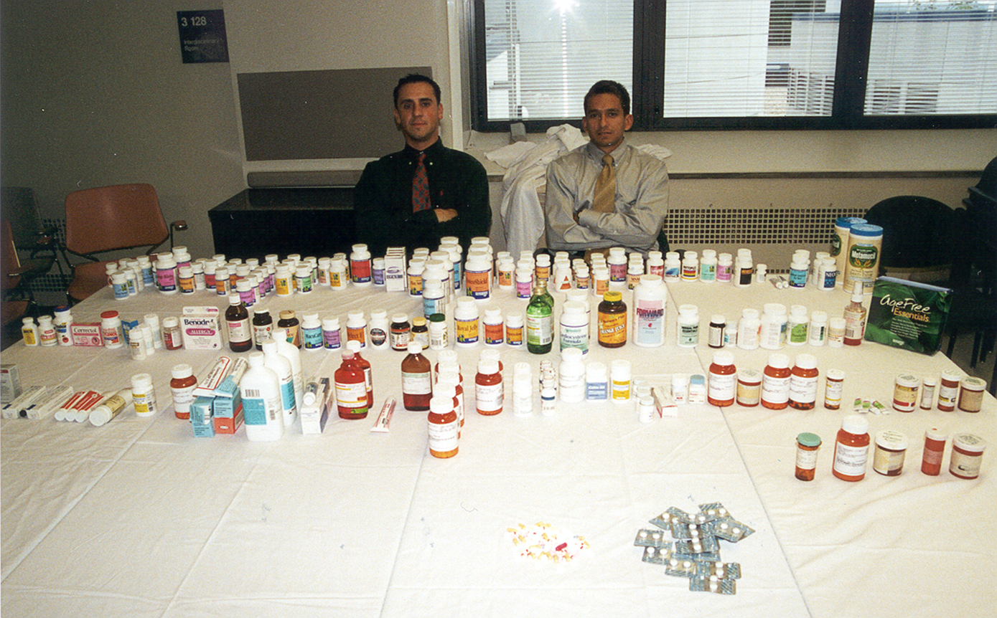
The Medication Reconciliation Issue…
Notes:
How presentation will benefit audience: Adult learners are more interested in a subject if they know how or why it is important to them.
Presenter’s level of expertise in the subject: Briefly state your credentials in this area, or explain why participants should listen to you.

Slide 5
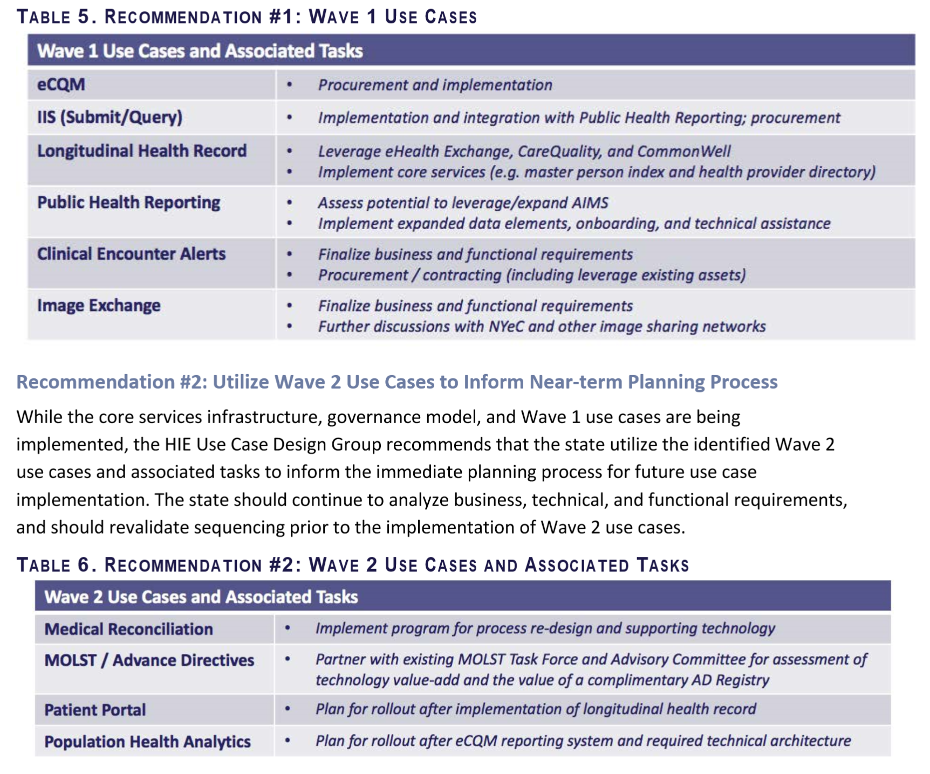
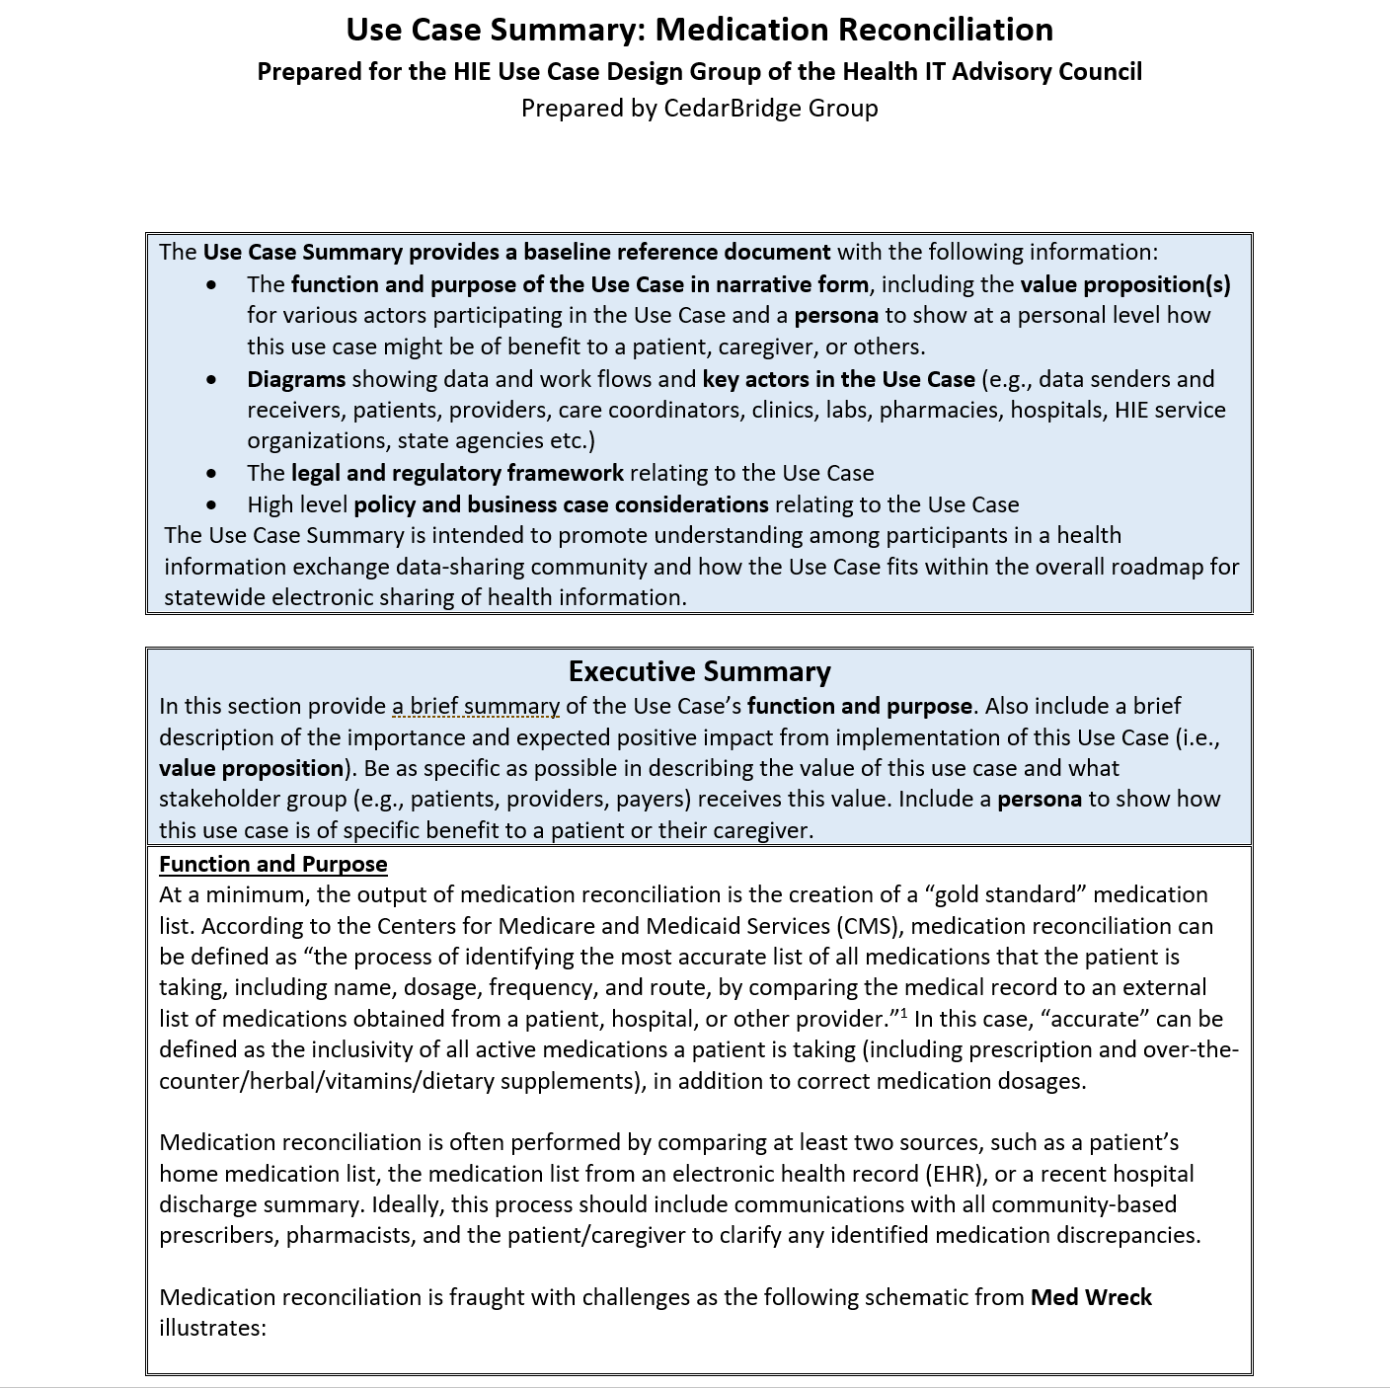
Med Rec Use Case*
*From HIE Use Case Design Group Findings and Recommendations

Slide 6
Med Rec Challenges
Source: Med Wr_{x}eck: Proposing a Solution for the Nightmare of Medication Reconciliation by Dr. Phil Smith, 2017, Applied Health IT Experts, LLC, First Edition, p. 26

Slide 7
MRP Work Group Project Charter
Developed by Sean Jeffery, Diana Mager, and Tom Agresta, with support from OHS and CedarBridge Group.
Table of Contents:
Project Overview
Project Milestones
Project Organization
Revision History
Project Goals and Objectives:
Develop, implement, and operate an effective organization structure and process
Establish foundational definitions for Work Group activities
Secure funding for planning, design, and development activities
Identify mechanisms to enhance efficiency and effectiveness of cancelling prescription medications
Develop strategies to operationalize deprescribing by defining responsibilities, communication, and training requirements for healthcare professionals
Develop strategies for communicating with and engaging key stakeholders
Support the implementation of priority solutions based on funding availability and design approval
Support the evaluation of any implemented standards and solutions

Slide 8
MRP Work Group Project Charter
Critical Success Factors
Engaged and active Work Group members
Effective support team
Focus on practical and impactful solutions
Secure funding to support the implementation of recommendations
Successful communication strategy for stakeholders
Major Project Milestones (with quarterly reports to the Health IT Advisory Council)
Adoption of definitions for Medication Reconciliation and Polypharmacy
Securing federal funding
Planning and design of SMMS
Work Group recommendations delivered to the HITO
Support the pilot implementation of SMMS
Support the evaluation of implemented standards and solutions

Slide 9
Strawman – MRP Work Group Structure
Health IT Advisory Council
MRP Work Group
Other Sub-groups / Design Groups
Technology & Innovation
Proposed Sub-groups
Opioid Reduction
Patient Engagement & Safety
Policy

Slide 10
Interest in Leadership & Sub-groups
Leadership
Sean Jeffery (co-chair)
Tom Agresta
Nate Rickles*
Marghie Giuliano*
Nitu Kashyap
Policy Sub-group
Peter Tolisano
Jameson Reuter
Sean Jeffery
Marghie Giuliano
Technology & Innovation
Bruce Metz**
Tom Agresta
Sean Jeffery
Jennifer Osowiecki
Nitu Kashyap
Jake Star (VNA / Council)
Stacy Ward Charlerie (Surescripts)
Marie Renauer (YNHH)
Opioid Reduction
Jameson Reuter
Nate Rickles
Sean Jeffery
Anne VanHaaren
Ece Tek
Marghie Giuliano
Nitu Kashyap
Ken Whittemore (Surescripts)
Patient Engagement & Safety
Nate Rickles
Sean Jeffery
Lesley Bennett
Anne VanHaaren
Kate Sacro
Marie Renauer (YNHH)
*Nominated
**Volunteered to Chair

Slide 11
CancelRx – gives us a start
Group of Clinical Leaders formed organically to solve a problem
CMIO’s meeting at AMIA in November and discussing how to get engaged with HIE efforts of the state – reviewing priority use cases
Discussed a major pain-point and patient safety risk
Able to cancel prescription electronically but rarely used in CT
Complex to implement in the EHR, pharmacies not participating (or unknown), Surescripts offered support but it wasn’t working
Formed a group - Medication Reconciliation planning
Supported by UConn Health but broad participation

Slide 12
Wins for CancelRx Work in CT!
Work Products
Pilot at Yale with surrounding pharmacies – leading towards lessons learned (Hartford Health and Trinity New England to start soon)
Paper accepted by J. American Medical Informatics Association (JAMIA)
NCPDP/HIMSS Pharmacy Town Hall Webinar Series, Part 1: Perfecting ePrescribing presentation
Presentation submitted for HIMSS 2019
CT CancelRx Workgroup Executive Summary (coming soon)
Notes:
J. American Medical Informatics Association
National Council for Prescription Drug Programs
Healthcare Information and Management Systems Society

Slide 13
MRP Work Group Proposed Timeline
Work Group Formation
Approval of Med Rec Definition
Approval of Project Charter and Designation of Leadership
Approval of IAPD Funding – Begin SMMS Planning & Design
Final Report due to Advisory Council
Finalization of Sub-groups
SMMS Planning and Design
Identify SUPPORT Act Opportunities
September 2018
November 2018
December 2018
January 2019
Feb – Sept 2019
April – June 2019
July 2019*
2019 - 2020
* Work Group can elect to extend the legislatively defined duration of the MRP Work Group

Slide 14
Med Rec Hackathon - Background
Medication errors are common and many are related to incorrect med lists
Getting a correct medication list is Complicated
Technology helps and hurts
ePrescribing –
No more handwritten prescriptions
Introduces unintended errors, difficulty with de-prescribing
Health Information Exchange
Tools to consolidate medication lists from several sources
Yet interoperability between systems is limited
Information & Cognitive Overload
National Coordinator is making interoperability standards core to national strategy
Pressing the use of FHIR standard (Fast Healthcare Interoperability Resources)
Connecticut is well-positioned introduce creative change

Slide 15
What is a Hackathon?
A hackathon is a competitive event in which a team of designers, developers, and subject matter experts collaborate to create solutions for a specific problem within a defined time frame. The goal is to build a working prototype, in the form of a website, an app, or a robot, to solve a given problem.
Source: Hackerearth

Slide 16
Hackathon’s Role on in HIE development
CT HIE Planning
Med Rec
Polypharmacy Workgroup
Hackathon
Cancel Rx Group
Plan HIE Med Management Services
Spring / Summer 2017
Fall / Winter 2018
Spring / Summer 2019

Slide 17
Who Participated?
Clinicians (MD, RN, APRN)
Pharmacist (PharmD)
Computer Scientists (MA, PhD)
EHR Analysts
State Agency (OHS, OSC, DPH, Consumer Protection)
CMIO, CIO, CEO
Patient Advocates
Entrepreneurs
Investors (CT Innovations)
Medical Students
Pharmacy Students
Engineering students (CSE, BME)
MBA students (UConn)
Industry Representatives
Surescripts, CVS
CT HIE entity
Planned Parenthood
Medical Informatics Experts
Faculty UConn, Yale, Temple, Johns Hopkins

Slide 18
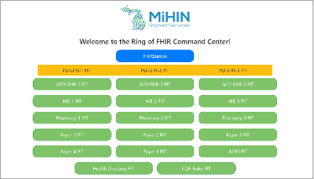
What did they do?
FHIR –
A global development standard for
Exchanging health information
Two groups were formed:
Clinicians formed teams to develop “pitches” for problems to be solved
Technicians were trained on the basics of FHIR
Clinicians “pitched” their ideas to technicians:
Technicians chose ideas that they felt they could solve
Joint teams formed around chosen ideas to do rapid development
Joint teams demonstrated their prototypes at end of event
MiHIN ”Ring of FHIR” –
Test bed for developers

Slide 19
Hackathon Event – April 5 & 6

Slide 20
Next Steps
Outputs from team efforts will be documented
Med Rec Work Group will consider the ideas for investment:
Will use outputs as the basis for business requirements for the HIE Medication Management use case

Slide 21
Contacts
Health Information Technology Office:
Allan Hackney, allan.hackney@ct.gov
Health IT Office Website:
https://portal.ct.gov/OHS/Services/Health-Information-Technology
CT Health and Information Services, Inc. (pending):
Sabina Sitaru, sabina.sitaru.CTHIE@gmail.com
CT Health Information Exchange Website:
Coming Soon!

