Slide 1
Medication Reconciliation & Polypharmacy Work Group
November 16, 2018

Slide 2
Agenda
Agenda
Welcome and Call to Order | Michael Matthews | 12:00 PM
Public Comment | Attendees | 12:05 PM
Review and Approval of October 15, 2018 Meeting Minutes | Attendees | 12:10 PM
Discussion: Med Rec Definitions (follow-up from small group) | Marghie, Diane, Janet, and Sean | 12:15 PM
Funding Opportunity: Discussion and Recommendation | Tom Agresta | 12:30 PM
Surescripts Presentation | Stacy Ward-Charlerie | 1:10 PM
Work Group Framework | Michael Matthews | 1:35 PM
Next Steps and Adjournment | Michael Matthews | 1:50 PM

Slide 3
Public Comment

Slide 4
Review & Approval of:
October 14, 2018 Meeting Minutes

Slide 5
Defining Medication Reconciliation
Discussion Topic

Slide 6
Discussion – Med Rec Definitions (Follow-up From Small Group)
All definitions analyzed contained similar language:
“The process of identifying the most accurate list of all medications that the patient is taking, including name, dosage, frequency, and route, by comparing the medical record to an external list of medications obtained from a patient, hospital, or other provider.” (CMS)
The process of creating the most accurate list possible of all medications a patient is taking – including drug name, dosage, frequency, and route – and comparing that list against the physician’s admission, transfer and/or discharge orders, with the goal of providing correct medications to the patient at all transition points.” (Institute for Healthcare Improvement)
“Medication reconciliation is a formal process for creating the most complete and accurate list possible of a patient’s current medications and comparing the list to those in the patient record or medication orders.” (Patient Safety and Quality: An Evidence-Based Handbook for Nurses – Chapter 38 – Jane Barnsteiner)
“Medication reconciliation is the process of comparing a patient’s medication orders to all of the medications that the patient has been taking... The process comprises five steps: (1) develop a list of current medications; (2) develop a list of medications to be prescribed; (3) compare the medications on the two lists; (4) make clinical decisions based on the comparison; and (5) communicate the new list to appropriate caregivers and to the patient.” (Joint Commission)
Structure (“the list”)
Process

Slide 7
Discussion – Med Rec Definitions Recommendation
Utilize the Joint Commission’s definition of Medication Reconciliation
“Medication reconciliation is the process of comparing a patient’s medication orders to all of the medications that the patient has been taking. This reconciliation is done to avoid medication errors such as omissions, duplications, dosing errors, or drug interactions. It should be done at every transition of care in which new medications are ordered or existing orders are rewritten. Transitions in care include changes in setting, service, practitioner, or level of care. The process comprises five steps:
Develop a list of current medications;
Develop a list of medications to be prescribed;
Compare the medications on the two lists;
Make clinical decisions based on the comparison; and
Communicate the new list to appropriate caregivers and to the patient.”
Considerations
Ensure the definition works effectively for all care settings
Questions from prior discussion are addressed: who, what, where and how
PCP should be the principal “owner” of medication reconciliation

Slide 8
Funding Opportunity: Statewide Medication Repository
Discussion & Recommendation

Slide 9
Funding Opportunity: Discussion
Funding Opportunity Background:
States may request 90/10 HITECH administrative funding for a wide range of HIE activities to support providers’ adoption and meaningful use of EHRs and the development of core HIE services, public health infrastructure, eCQM infrastructure, and provider onboarding.
Funding requests are submitted by the state’s Medicaid agency (DSS) through an Implementation Advanced Funding Document (IAPD) to CMS.
Funding is available until September 30, 2021
DSS is planning to submit the IAPD for Federal Fiscal Year 2019 & 2020 before the end of the year.

Slide 10
Funding Opportunity: Discussion
Background: Network of Networks model and OHS goals

Slide 11
Funding Opportunity: Discussion
OHS has the opportunity to receive funding to plan, design, and develop statewide medication reconciliation services through this Work Group
Support the development of infrastructure and health IT services to create accurate medication lists
Standards-based, modern architecture
Leverage current efforts of statewide HIE and existing infrastructure and systems used by organizations
Potential activities include:
Establish Statewide Medication Reconciliation Services Subgroup to support MRP workgroup regarding planning and design
Plan, design, and develop medication reconciliation services
Support eligible organization in piloting and implementing the medication reconciliation services
Work with onboarded providers and pharmacists to evaluate usability to create an action plan to implement changes based on evaluation

Slide 12
Funding Opportunity: Discussion
Initial funding (2019) ~ $1.2 million
Scope out the Med-Rec process / players in detail
Initial focus will be on single-source of truth for medication list
Develop a plan, design solutions, and begin build, testing, and piloting
Create onboarding plan with pharmacist and physicians
Explore integration with PDMP data
Leverage CancelRx work and implement via technical assistance dollars with the goal of >70% provider and 90% pharmacy adoption by 2020

Slide 13
Funding Opportunity: Discussion
Funding (2020) ~ $2.2 million
Onboarding of provider organizations, ambulatory pharmacies
Refinement of medication reconciliation services as needed
Addition of inpatient, skilled nursing facilities, and other settings
Development / integration of patient-facing API and testing
Development of additional “Use Cases”
Development of deployable tools at point of care
SMART on FHIR applications that use medication reconciliation services

Slide 14
Leverage Open Source Data

Slide 15
Medication Adherence SMART On FHIR

Slide 16
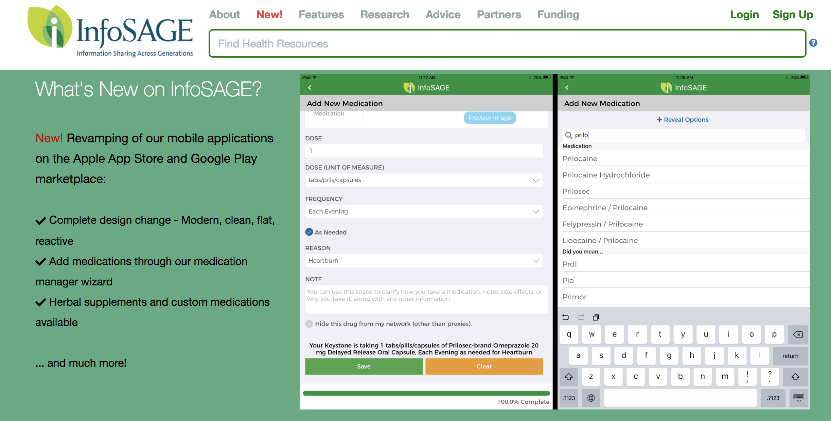
Example – Standards Based, Pt facing Med Rec tool

Slide 17
Proposal Request
The MRP Work Group requests that the OHS seeks IAPD funding in fiscal years 2019 and 2020 to:
1) Deploy the CancelRx standard via technical assistance support
2) Design, develop, test, pilot, deploy, and support onboarding of clinicians, hospitals, skilled nursing facilities, pharmacies, and other healthcare providers to medication reconciliation services, through the statewide HIE.

Slide 18
OHS Workshop on Medication Reconciliation Spring 2019
Coming soon!
UConn Health will be organizing a technology workshop on Med Rec on behalf of OHS, Spring 2019.
Topic: how technology can be utilized to support medication reconciliation solutions
Workshop is currently in the planning phase – all ideas are welcome

Slide 19
Work Group Framework
Leadership
Creation of subcommittees and task forces
Policy
Opioid Reduction
Patient Engagement and Safety
Technology and Innovation
Others?
Identify problems / key issues
Develop Project Charter (volunteers requested)

Slide 20
Interest in Leadership & Subcommittees
Opioid Reduction
Jameson Reuter
Nate Rickles
Sean Jeffrey
Anne VanHaaren
Ken Whittemore (Surescripts)
Patient Engagement & Safety
Nate Rickles
Sean Jeffrey
Lesley Bennett
Anne VanHaaren
Leadership
Sean Jeffrey (co-chair)
Nate Rickles
Tom Agresta
Policy Subcommittee
Peter Tolisano
Jameson Reuter
Sean Jeffrey
Technology & Innovation
Tom Agresta
Sen Jeffrey
Jake Star (VNA / Council)
Stacy Ward Charlerie (Surescripts)
Charter Development
Sean Jeffrey

Slide 21
Upcoming Meetings
Meeting #1 – September 24, 2018 (3pm – 5pm)
Meeting #2 – October 15, 2018 (3pm – 5pm)
Meeting #3 – November 16, 2018 (12pm – 2pm)
Meeting #4 – December 21, 2018 (2pm – 4pm)
2019 Meetings - TBD

Slide 22
Contact Information
Sarju Shah, HIT Program Manger, OHS - Sarju.Shah@ct.gov
Michael Matthews, Facilitator, CedarBridge Group– Michael@cedarbridgegroup.com
Chris Robinson, Project Manager, CedarBridge Group- chris@cedarbridgegroup.com

