Slide 1
Health IT Advisory Council
April 20, 2023

Slide 2
Agenda
Topics
Welcome & Call to Order
Public Comment
Council Action: Approval of Minutes: March 16, 2023
Community Based organizations and Social Services Initiation
Race, Ethnicity & Language Implementation Update
Connie Standing Update
Announcements & General Discussion
Council Action: Wrap Up & Meeting Adjournment

Slide 3
Welcome and Call to Order

Slide 4
Public Comment (2 minutes per commenter)

Slide 5
Approval of Meeting Minutes March 16, 2023

Slide 6
CBOs and Social Service Agencies Initiation
Community Information Exchange
of Social Services Data
Carol Robinson, CedarBridge Group

Slide 7
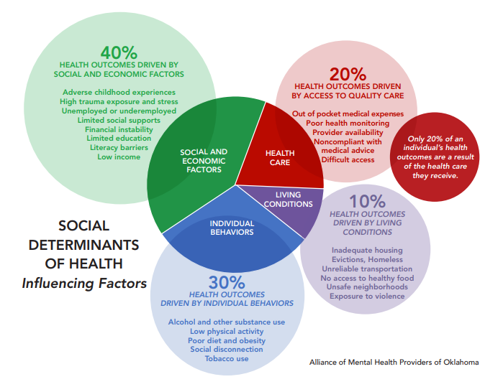
Background
Social context and conditions influence health outcomes
Addressing social determinants of health are critical for delivery of “whole-person” care
Referrals to Community Based Organizations (CBOs) who provide social services
Coordinated care teams must evaluate technology for closed loop referrals and information exchange
Notes:
For high needs populations, coordinated and integrated teams of care include health systems, independent practitioners, and CBOs providing transportation, housing support, food, and other supports, with payments tied to quality performance.

Slide 8
Community Information Exchange
Healthcare providers engage CBOs as coordinated care team members and address social needs to improve health outcomes.
Closed-loop referrals
Comprehensive & accurate directory of referral resources
Master person index (MPI) with person-matching
Analytics
Shared plan of care with health improvement goals
Consent management service to ensure client authorization for sharing sensitive data
Notes:
Verb - The use of care coordination tools by community-based organizations to collect and share social service data electronically.
Noun - An organized entity, often formed as a public/private collaboration with government participation, sanctioned to manage the use of care coordination tools and oversee the legal and business requirements related to the collection and sharing of individuals’ social service information between community-based organizations and social service agencies

Slide 9
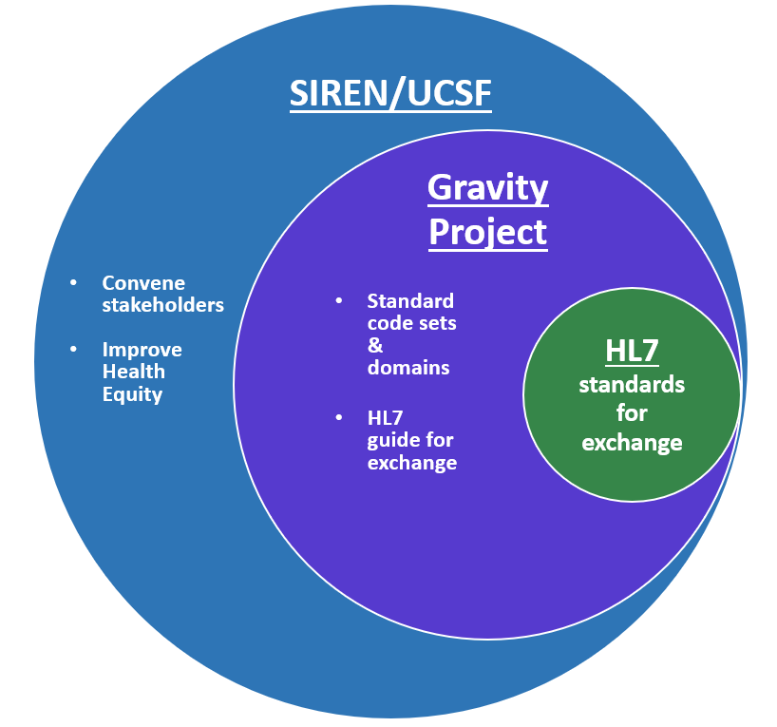
Developing National Standards
SIREN is a collaborative housed within the University of California, San Francisco (UCSF) focused on improving health equity and addressing SDoH; SIREN launched The Gravity Project.
The Gravity Project has focused on developing standard code sets for EHRs in 3 specific social risk domains:
food insecurity,
housing instability and quality
transportation access
Gravity Project partnered with the standards development organization HL7 to develop an SDoH Implementation Guide for

Slide 10
CIE Activities in Connecticut
Statewide Health Information Technology Plan
Published in February of 2022, the Plan recommends the following:
Chartering a Social Risk Data Design Group
Exploring support for CBOs and social service agencies to adopt IT systems
Convening stakeholders for consideration of statewide CIE shared services hub governance and management needs
Establishing a neutral CIE Feasibility Planning Committee to validate functional requirements and evaluate existing CIE infrastructure for shared services

Slide 11
CIE Activities in Connecticut
Connie
Collaborated with the Department of Social Services (DSS) on an Advanced Planning Document (APD) to support whole-person care through electronic closed-loop referrals for identified health-related social needs (HRSNs) initially focused on home-based care and identifying patient encounters with SDoH conditions.
The APD also includes funding for planning to prepare the enhancement of the existing eReferral use case service, to support SDoH assessment data collected by Connie participants within their EHR/HIE workflows for care coordination. Connie intends to request funding to move from the planning phase towards the development, design and implementation of this enhancement for FY 24.

Slide 12
CIE Activities in Connecticut
findhelp (formerly Aunt Bertha)
A national resource and referral platform with social needs screening, assessment tools, and analytics
Provides access to a comprehensive resource directory
Offers free and reduced cost programs to connect people to services in all 50 states and in all categories of social needs
More than 195,000 users in Connecticut and more than 743,000 searches since 2015
Top categories of searches include help paying for utilities and housing, food pantry, transportation, financial help, transportation for healthcare, and help finding housing

Slide 13
CIE Activities in Connecticut
Unite Us
Coordinated network of health and social service providers, connected through the Unite Us shared technology platform
Network supported by local Connecticut deployed Unite Us team
No cost to join for CBOs and safety net providers
Sponsored by Connecticut Hospital Association, Yale New Haven Health, Community Health Network of Connecticut, Connecticut Dental Health Partnership, and StayWell Health Center

Slide 14
CIE Activities in Connecticut
United Way of Central and Northeastern Connecticut
Member of first Learning and Action in Policies and Partnerships (LAPP) cohort a grant program sponsored by Robert Wood Johnson Foundation
9 Health Enhancement Communities, 2 Health Improvement Collaboratives, plus Trinity Health, New England/St. Francis Hospital, and the Connecticut Hospital Association
Priorities identified:
Real-time local data reflecting demographic groups and neighborhood, towns and communities
Pooled resources to link information, frequent publication of data
Centralized infrastructure for resourcing training support and analytics
Collecting stories and qualitative information to go with empirical data

Slide 15
CIE Activities in Connecticut
Eastern Connecticut Health Collaborative (ECHC)
A partnership to bring together a diverse cross-sector collaborative of executives from:
Health systems,
Human services,
Local public health,
Safety net providers, tribal health and social services, and municipalities to collaborate on community health and equity

Slide 16
CIE Activities in Connecticut
Connecticut Children’s Center for Care Coordination
Care Coordination Collaborative Model trains and provides technical support to community-based primary care partners
Includes care coordinators from various child services organizations
Empowers families to advocate for their children and connects families to appropriate medical, behavioral, educational, legal and social services
Advocates for policy level solutions to ensure families have access to beneficial services

Slide 17
CIE Activities in Connecticut
2-1-1 Connecticut
Front door for Connecticut Homelessness Prevention and Rapid Re-housing Program (HPRP)
Developed in 2010 with American Recovery and Reinvestment Act funding
Enables subgrantees to access the Homeless Management Information System (HMIS)

Slide 18
Barriers and Challenges
Stakeholders provided input:
Missed Connections
Responsibility for connecting the dots between CBOs and provide service documentation often lands on the client
System problems
CIE technology vendors aren’t connected with each other and are not connected to state agencies
Better options are needed
Notes:
when asked about the barriers and challenges to effective data exchange currently being experienced by CBOs and healthcare providers, stakeholder indicated:
Missed Connections
All responsibility lands on the client, who may not always have the resources to juggle CBO services documentation needs.
System Problems:
Healthcare providers will have a statewide solution for sharing clinical information with Connie, but the state agency systems are siloed without a master record for social service client data.
Unite Us and FindHelp are the most direct solutions to immediate referral tracking needs between CBOs exclusively, and also back with clinical providers. However,
Neither system cross-syncs with the other
Neither system communicates back with state agency systems (DMHAS and others)
Both systems are not connected to Connie
CBOs are not all on the same system, or at least a system that is capable of syncing
Better options are needed:
Because the system is so fragmented with little interconnectivity, the CBOs are discussing options to use paper forms, faxed documents, and shared online spreadsheets.
This is every sign of a broken system that is about to take a step backwards to the 1990’s to find solutions, and should not be the only option available to the hundreds of CBOs across the state
We desperately need support at the state level to synchronize these systems.

Slide 19
Other States’ Approaches
CIE San Diego
Regional CIE in California
Sustained and well supported
Collective approach to how CBO services fit into the whole delivery system
Comprehensive, longitudinal patient records integrating healthcare and social needs and services data
Coordinated with 2-1-1 program

Slide 20
Other States’ Approaches
Maryland CIE integration with HIE
State designated health utility
Technology and tools for collecting and sharing SDoH data
Supports coordinated care
Electronic closed-loop referrals
HIE healthcare and 2-1-1 social service provider directories
Referral history includes those made through other systems (findhelp, Unite Us, WellSky, etc.)

Slide 21
Other States’ Approaches
Washington Statewide CIE (in Planning)
Interoperability standards across all platforms at statewide scale
No platform expected to address every module
Existing investments connected and utilized, not replaced, and existing provider infrastructure connected and utilized where possible
State Health Care Authority to support common CIE platform
Modular implementation approach
Many options being considered for funding and governance

Slide 22
Other States’ Approaches
Texas (Regional CIE example)
Health Equity Collective led by University of Texas Health
400+ members from 140 organizations and 50 coalitions in Houston
Plans for a cloud-based Community Information Exchange
Federated model connects healthcare and CBOs regardless of their technology
Governance centered on provider and client needs
Adoption and sustainability models developed for continuity over time

Slide 23
Discussion

Slide 24
Race, Ethnicity & Language Implementation Update
Adrian Texidor, OHS

Slide 25
State Agency REL Implementation Updates

Slide 26
State Agency REL Implementation Updates
OHS continues to convene a forum for state agencies to discuss implementation, share progress, discuss challenges, and collaborate to solve challenges
10 state agencies are working to update systems to collect granular Race, Ethnicity and Language (REL) data
9 out of 10 are in the initiation-phase
Common Challenges: funding, staff resources, developing statistical methods in pre- and post data collection changes re: OMB Statistical Policy Directive No. 15 (SPD 15) revision and PA 21-35, and self-identification requirement vs. observed data collection

Slide 27
State Agency Implementation Update: OHS Progress
4 OHS data systems identified to update
All Payer Claims Database (APCD)
Inpatient
Outpatient Surgery
Emergency Department
Prioritized APCD
Initiation phase 100% complete
Design and Build phase will begin and be completed Q2

Slide 28
Yale/Equity Research and
Innovation Center (ERIC) Update

Slide 29
Yale/ERIC Convenings Phase 2: Toward Consensus and Action on Race, Ethnicity, and Language Data Collection in Connecticut!
Phase 2 of Yale/ERIC Convenings began in Dec 2022 with goal of “Guid[ing] action on a one-year collaborative action plan (Dec 2022 – Nov 2023) toward the standardization of REL data, including an overarching objective and five strategic priorities for continued collaborative action”
Objective: “By November 2023, providers across Connecticut will be ready to implement standardized, granular, self-reported REL data collection in alignment with PA 21-35, with tools to assist in doing so” (Yale, 2022, pg.2)
Three Working Groups
Clinical Integration/Information Technology Workgroup
Patient & Community Engagement Workgroup
Advocacy and Leadership Workgroup
Source: Yale University (November, 2022). Race, ethnicity, and language (REL) data collection in Connecticut: Collaborative Action Plan. New Haven, CT USA.

Slide 30
Overview: Initial Proposals for updating OMB’s Race and Ethnicity Statistical Standards

Slide 31
OMB SPD 15
What is OMB SPD 15?
OMB Statistical Policy Directive No. 15 is the directive enabling the collection and comparability of race and ethnicity data across federal datasets
SPD 15 provides a minimum set of categories that all federal agencies must use regardless of collection mechanism
Why it matters to CT:
Many state agencies and other organizations required to collect REL data according to PA 21-35 Sec. 11, must also collect this data according to the OMB standard. For the sake of efficiency, and utility of REL data, CT’s REL standards should align with SPD 15 as far as practicable
New directive slated for release Summer 2024
Source: Federal Register: https://www.federalregister.gov/documents/2023/01/27/2023-01635/initial-proposals-for-updating-ombs-race-and-ethnicity-statistical-standards

Slide 32
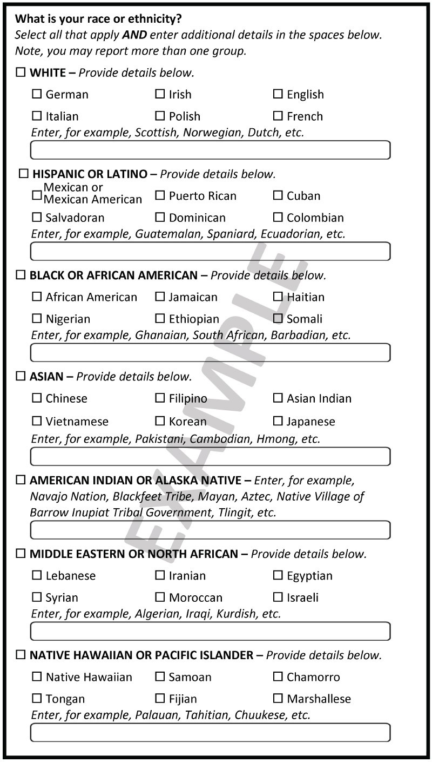
OMB Proposal: Collecting Race and Ethnicity data as one combined question with detailed categories
Source: https://www.federalregister.gov/documents/2023/01/27/2023-01635/initial-proposals-for-updating-ombs-race-and-ethnicity-statistical-standards

Slide 33
OMB Proposal: Collecting Race and Ethnicity data as one combined question
Source: https://www.federalregister.gov/documents/2023/01/27/2023-01635/initial-proposals-for-updating-ombs-race-and-ethnicity-statistical-standards

Slide 34
Additional OMB Proposals
Add:
Middle-Eastern or North African (MENA) as a summary category
“add terms related to descent from enslaved peoples originally from the African continent”
Remove:
other from Native Hawaiian and other Pacific Islander
other from Asian
MENA from the current “white” category
remove offensive language from SPD 15

Slide 35
REL Implementation Version 3.0

Slide 36
REL Implementation Plan Version 3.0
OHS plans to publish an Implementation Plan version 3.0
3.0 Updates
Update language coding
Possible timeline change
Updates will be duly noticed on the OHS website and communicated via email using OHS’ ListServs

Slide 37
Resources for Further Information
https://www.whitehouse.gov/omb/briefing-room/2022/06/15/reviewing-and-revising-standards-for-maintaining-collecting-and-presenting-federal-data-on-race-and-ethnicity/
https://www.federalregister.gov/documents/2023/01/27/2023-01635/initial-proposals-for-updating-ombs-race-and-ethnicity-statistical-standards
REL Webpage: https://portal.ct.gov/OHS/HIT-Work-Groups/Race-Ethnicity-and-Language

Slide 38
Connie Update Health IT Advisory Council April 20, 2023 Jenn Searls, Executive Director

Slide 39
Onboarding Updates

Slide 40
Onboarding & Outreach Progress
Onboarding Highlights:
Outreach Updates:
200+ Commitment to Connect forms (C2C) received weekly
327 additional organizations identified for outreach
729 organizations signed legal agreements (410 are BH orgs)
Prioritizing technical integrations based on EHR
Connecting with SmartLink and Tangible to facilitate integrations
Associated Pulmonologists of Western Connecticut (ADT)
Peter Licht MD and Jennifer Holloway MD (ADT)
Avon Convalescent Home, West Hartford Health Rehab Center (CCD)
Dr. Robert L. Ruxin (CCD)
Tolland Imaging Center (RAD)
Telemed at Home (CCD)
Child & Adolescent Health Care (CCD)
Children’s Medical Group (CCD)
Strong Women’s Health (CCD)
ECHN Hospitals (RAD)
THOfNE (Tentative: ADT April, ORU and CCD May)
Notes:
Continue to work with Behavioral Health providers – Connie and OHS have received letters requesting more information and a delay in the mandate date. To help answer some of the confusion and misinformation, Connie is scheduling some community forums with BH providers to help dive into questions they have and answer ongoing questions. The benefit of the mandate date means that Connie gets better data and information to then help prioritize onboarding by EHR – information we wouldn’t have had otherwise. Also allows us to connect with EMR vendors as we get groups of participating orgs on one system – hope is that we can help reduce costs incurred by POs by working with EHR vendors directly. Concerns from provider orgs have largely focused on the costs they will incur either in participation fees or integration fees from vendors. Focus has been on moving forward with organizations that are ready to move forward – given the timelines and the sheer volume of provider organizations we don’t spend a lot of time arguing with provider orgs.

Slide 43
Use Case Updates
Provider Directory
Enhancing the directory to be a more robust relationship management tool for:
Patients to have a one-stop shop for provider information including services, locations, networks, and insurance accepted.
Providers to have a more robust tool to support electronic referrals
Future use cases to support reporting and population health
Patient Access
Three workstreams:
Patient identification and validation
API Gateway for apps, including working with EMR vendors to connect to existing portals
Roadmap: Patient portal

Slide 44
Use Case Updates
Advanced Directives
Currently configuring the system to display advance directives available within 3rd party vendors (e.g. AD Vault/My Directives)
Emergent Imaging
Ready to onboard. Discussing timing with receiving hospitals.
Provider Mediated Affirmative Consent
The tool is planned for release at the beginning of May. NOTE: utility is limited until participating providers submit SUD data to the sensitive data repository.

Slide 45
Other Updates

Slide 46
Other Updates
BH Community Forums
90-min sessions
Small groups to allow for dialog
Focus on answers to questions that organizations still have
Data sharing
Privacy & security
Legal agreements
Connecting to Connie
Two groups of invitees identified initially
PR & Communications
New State Agency focused newsletter
Innsena engagement

Slide 47
Innsena Engagement
Purpose:
Highlight Connie as the state designated HIE and an asset for the state and its citizens
Build positive market perception
Refine value propositions and marketing messages
 | Mar ‘23 |  | Apr ‘23 |  |  |  | May ‘23
 | 3/20 | 3/27 | 4/3 | 4/10 | 4/17 | 4/24 | 5/1 | 5/8 | 5/15 | 5/22 | 5/29
Kick off
Media & communications audit
Learning interviews
Draft media plan
Board update (May 3)
Finalize plan
Launch
Notes:
What is Innsena’s expertise? Consulting firm with experience in healthcare technology and digital health. Experience and clients include PointClickCare, CyncHealth, CRISP, HealtheConnect.
Project:
-strategy and planning
-media relations
-visibility
-content
-positioning and audits

Slide 48
Patient Access Roadmap

Slide 49
Connie’s Patient Access Requirements
Complies with the ONC Interoperability/Info Blocking Rules
Connie is required to enable patients to access their data through a third-party apps using secure APIs, built using FHIR standards. (Medicare, Medicaid, and CHIP health plans have a similar rule under CMS.)
Working to attain the Patient Access goals for Connie described in Connecticut State Statute Sec. 17b-59d:
Allow real-time, secure access to patient health information and complete medical records across all health care provider settings.
Provide patients with secure electronic access to their health information.
Allow voluntary participation by patients to access their health information at no cost.

Slide 50
What Consumers Want…
Helping people understand their health records.
Easy access to their data on their phone, even when abroad
One-stop-shop for their records
Patient-facing information written in plain language with a health literacy lens.
Provided in multiple languages.
Electronic AND printed.
Live support without long wait times.
Feedback from 4 consumer groups
60+ participants
Notes:
Key take-aways from the consumer feedback meetings
4 different groups:
2 Hartford Healthcare patient and family groups
The CHNCT Member Advisory Group
And OHS Consumer Advisory Council
Over 60 participants, including staff of these groups as well as group members (about 50-50 split).
In terms of patient access feedback itself, here are some highlights
Interest in whether Connie has thought about helping people understand their health records.
Interested in the ability to access records on a mobile device/phone
Whether the patients will be able to access their data when they are traveling outside of the country in case of a medical issue while overseas.
Concerned about limitation that Connie only has data that is shared with Connie (not a complete record yet). They would like to have a one-stop-shop for their records, rather than having to go to different places (and having to remember different log ins, portals, and passwords).
Ensuring patient-facing information shared will be written in plain language with a health literacy lens.
Whether Connie will address issues of language barriers.
Concern that the data would just be available electronically (not printable).
Liked having live support, but cautioned not to have people waiting on the phone on hold to access that support.

Slide 51
Three Phases
FY23
Go Live September 30, 2023
Patients to access data shared with Connie through apps of their choice
FY24
Go Live TBD (Targeting September 30, 2024 for piloting)
Patients can access a patient portal that displays their data
FY25
Go Live TBD (Targeting September 30, 2025)
First features for patients to submit information through an interactive patient portal. Initially, this will be patient mediated affirmative consent.
Patients can request a PDF of their data electronically

Slide 52
3rd Party Apps
Applications use secure (API) connections either directly with Connie, and/or indirectly through Carequality.
A consumer downloads an application from an app store that is either registered with Connie or Carequality
The consumer approves the app to get their Connie/Carequality data during the app set up process
The app requires the consumer to verify their ID
Once the consumer’s ID is verified, the app makes a call to Connie/Carequality for the patient’s data.
Strengths:
Consumer has a choice of apps to access their protected health information.
Carequality provides a level of security as apps must comply with the Carequality requirements before registering.
Weaknesses:
Apps may not be HIPAA-compliant
Connie does not have a say in what data is available through the apps, nor which apps choose to register with Connie or Carequality for this use case.

Slide 53
Request a PDF
For consumers who are not comfortable usings apps, they can make a request for their data to Connie.
A consumer submits an online form to Connie requesting a copy of their medical record
Consumer verifies their identity, so Connie knows the requester is who they say they are
Connie creates the on-demand PDF of consumer’s record and sends it to a secure website
Connie sends the patient a link to the website, with a separate email with the passcode for the patient to download the information.
Strengths:
Consumer receives a free copy to a secure, HIPAA-compliant website.
Weaknesses:
For patients with complex issues, a PDF could be very long

Slide 54
Patient Portal (Initial phase)
A website where patients have secure, 2FA access to different categories of the information sent to Connie. Could include:
Care Team with contact information
Inpatient/outpatient/emergency encounters
Medication list
Lab reports
Referrals
Directory of all providers in the state
Problems/allergies on file
Immunization record
Images and associated reports
Strengths:
Consumers can provide input to Connie on what information they want displayed and how, so that it is user friendly.
Images, provider directories, and other tools can be included that may not be available in a 3rd party app.
Weaknesses:
It will take time for Connie to build a portal that is secure and meets consumer needs. We need to prepare for an iterative process, building more components each year.

Slide 55
Timeline
Phase 1 Go Live
September 30, 2023
Phase 2 Go Live
September 30, 2024
Phase 3 Go Live
September 30, 2024
Apr -Jun 2023
July-Sep 2023
Oct-Dec 2023
Jan-Mar 2024
Apr-Jun 2024
July-Sep 2024
Oct-Dec 2023
Jan-Mar 2024
Apr-Jun 2024
July-Sep 2024
Standing up 3rd party app connections and PDF request workflow
Patient Portal requirements gathering and vendor selection
Design and test the patient portal, limited to view only features
Refine requirements for phase 3
Design and test first interactive features of the patient portal
Continue to develop requirements to improve the portal form, function and accessibility
Continue to technically onboard providers to support a patient’s complete medical record

Slide 56
Announcements & General Discussion
Dr. Joe Quaranta & Council Members

Slide 57
Wrap Up and Meeting Adjournment Upcoming Meeting May 18, 2023

Slide 58
Contact Information
OHS Contact for April 2023 HITAC Meeting
Amy Tibor
Amy.Tibor@ct.gov
OHS General Email
OHS@ct.gov
Health IT Advisory Council Website
https://portal.ct.gov/OHS/HIT-Work-Groups/Health-IT-Advisory-Council

