Slide 1
Healthcare Cost Growth Benchmark Steering Committee Meeting
July 22, 2024
"We collaborate, out of a shared concern and responsibility for all Connecticut residents, to develop consensus models that advance equity and consumer affordability of healthcare in our state.”​

Slide 2
Meeting Agenda
Time | Topic
3:00 p.m. | I. Welcome and Roll Call
3:05 p.m. | II. Approval of May Meeting Minutes – Vote
3:10 p.m. | III. Connecticut AHEAD
3:30 p.m. | IV. 2022 Alternative Payment Model Adoption
4:15 p.m. | V. Steering Committee Recommendations for 2025 Policy Action
4:45 p.m. | VI. Forthcoming OHS Reports
4:50 p.m. | VII. Public Comment
4:55 p.m. | VIII. Wrap-Up and Next Steps
5:00 p.m. | IX. Adjournment

Slide 3
Welcome and Roll Call

Slide 4
Approval of May 20th Meeting Minutes - Vote

Slide 5
Connecticut AHEAD

Slide 6
Office of Health Strategy
Department of Social Services
AHEAD Model

Slide 7
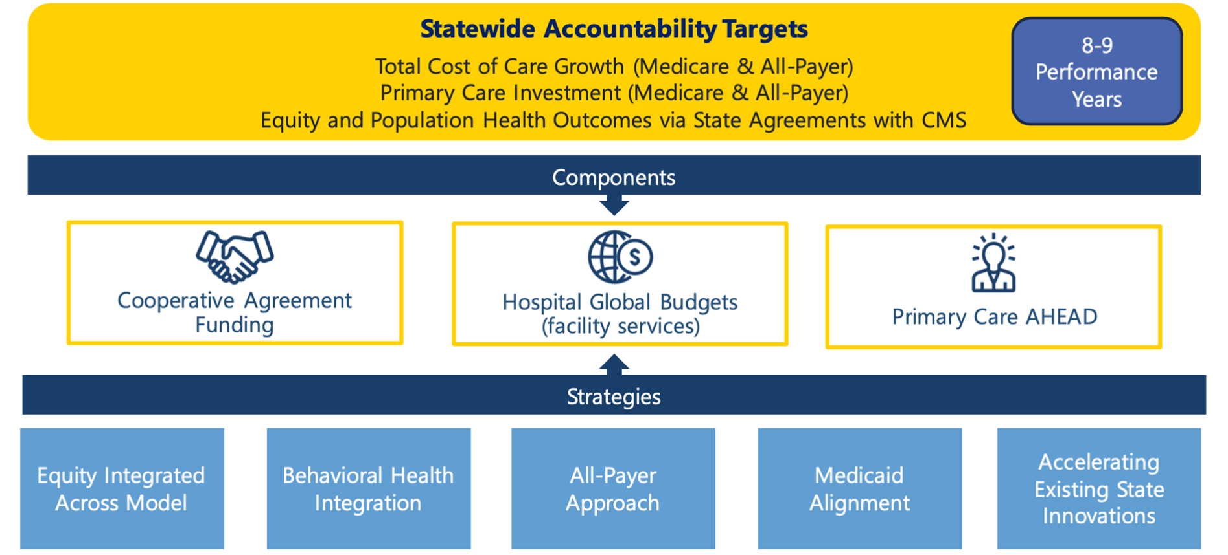
AHEAD Model At-A-Glance
Flexible Framework designed to improve health outcomes
AHEAD At-A-Glance

Slide 8
AHEAD Model Elements

Slide 9
AHEAD Benefits
States will benefit from a variety of tools as part of AHEAD
Benefits

Slide 10
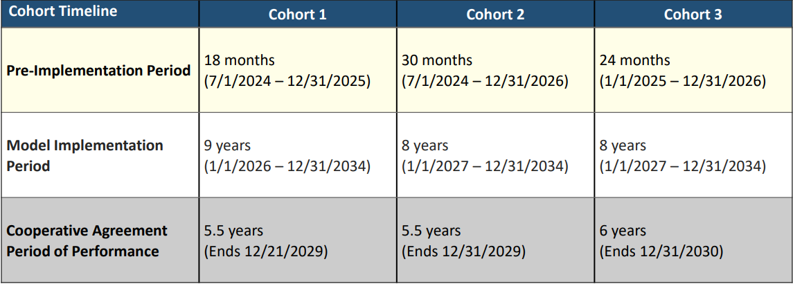
AHEAD Timeline
CT Award
Timeline

Slide 11
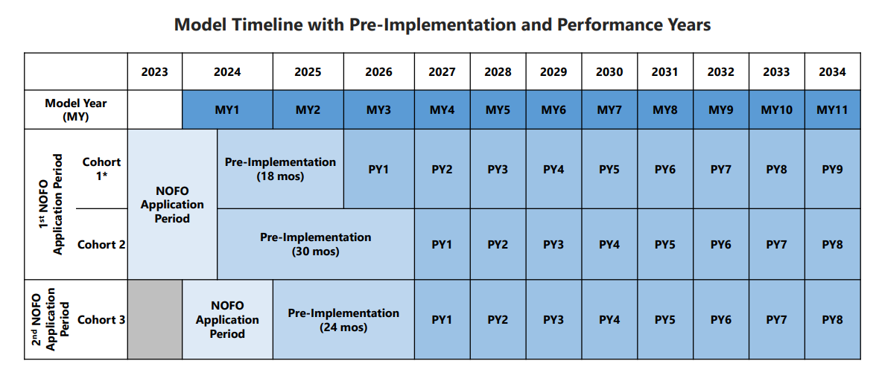
AHEAD Model Timeline
Model Timeline

Slide 12
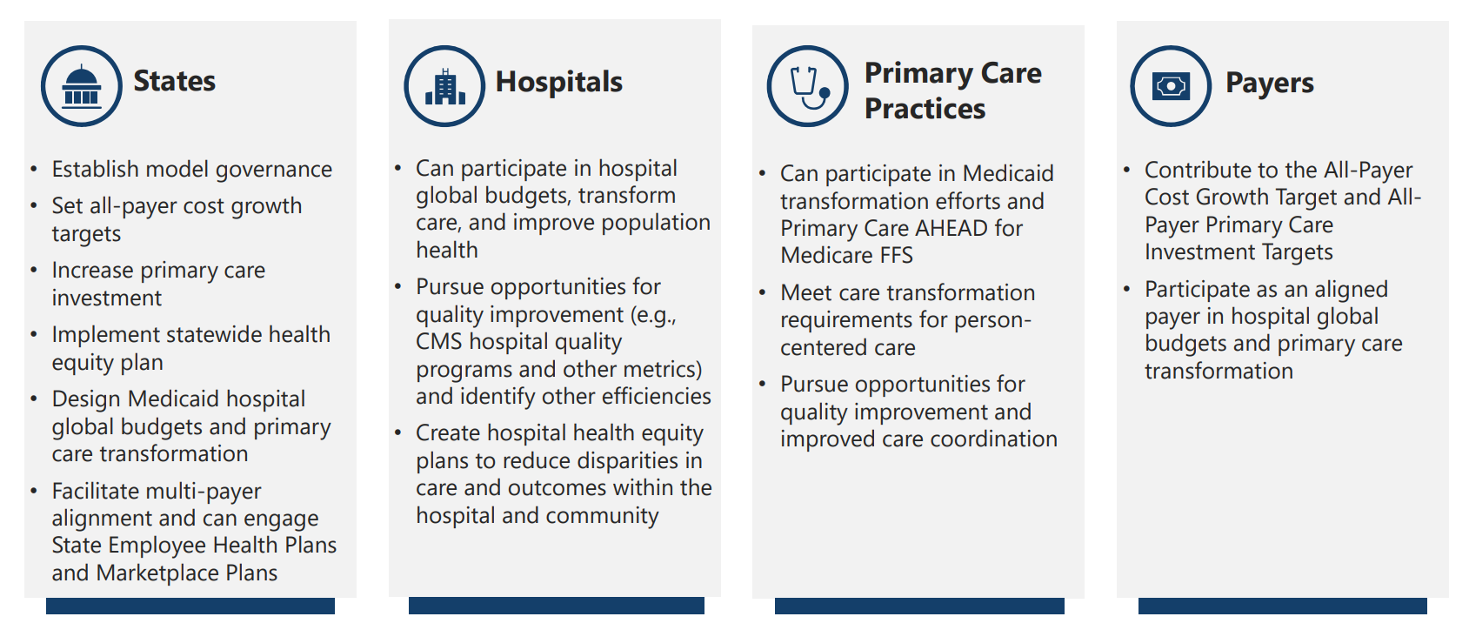
AHEAD Stakeholders
Roles of Stakeholders

Slide 13
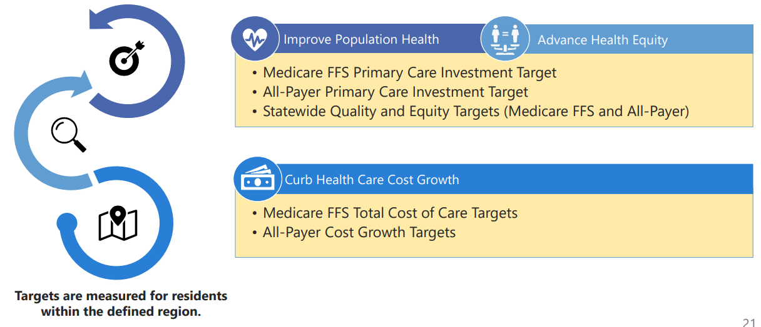
AHEAD Statewide Targets At-A-Glance
Targets are part of the State Agreement with CMS
Targets At-A-Glance

Slide 14
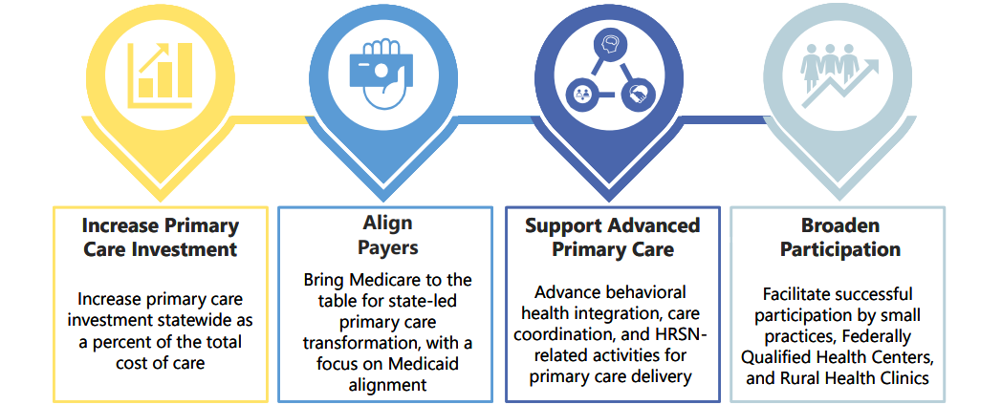
AHEAD Primary Care
Primary Care Goals
Primary Care Goals

Slide 15
AHEAD Global Budgets
Hospital Global Budgets Incentives
Hospital Global Budget

Slide 17
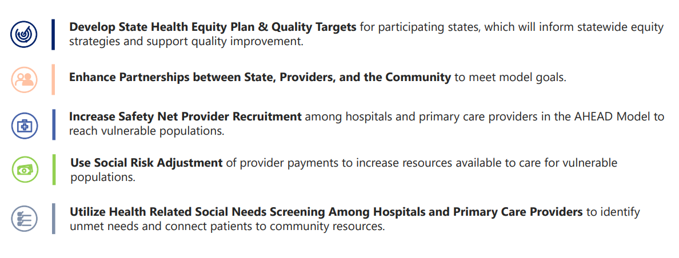
AHEAD Health Equity
Strategy to advance health equity
Health Equity Strategy

Slide 18
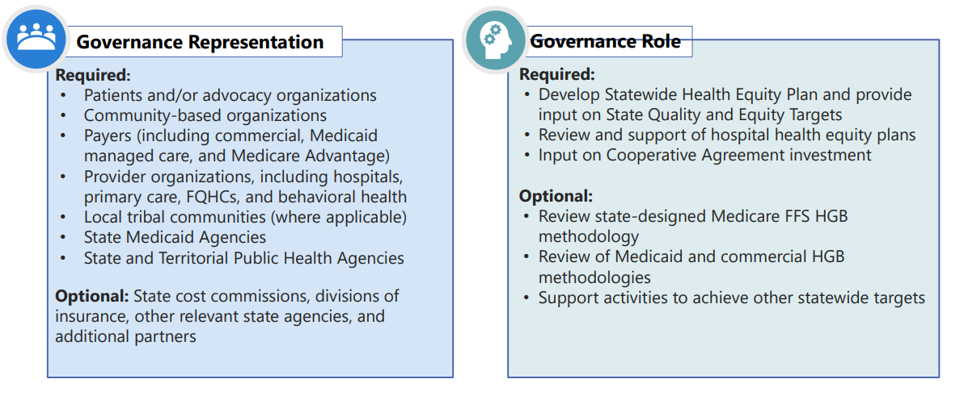
AHEAD Model Governance Structure
AHEAD states will establish multi-sector model governance structure
Model Governance Structure

Slide 19
Questions?

Slide 20
2022 Alternative Payment Model Adoption

Slide 21
Alternative Payment Model Monitoring Background
Connecticut General Statutes (CGS) 19a-754g et seq. charges OHS with monitoring the adoption of alternative payment methodologies (APMs) in the state.
The primary goal of tracking total dollars paid through APMs is to monitor the progress of healthcare organizations in shifting from traditional fee-for-service payment models to value-based approaches.
In 2023, OHS collected data from insurers regarding all 2022 commercial and Medicare Advantage payments (categorized by HCP-LAN category) and all covered lives (categorized based on whether or not the member was attributed to a provider participating in an APM).
Alternative Payment Model Monitoring Background

Slide 22
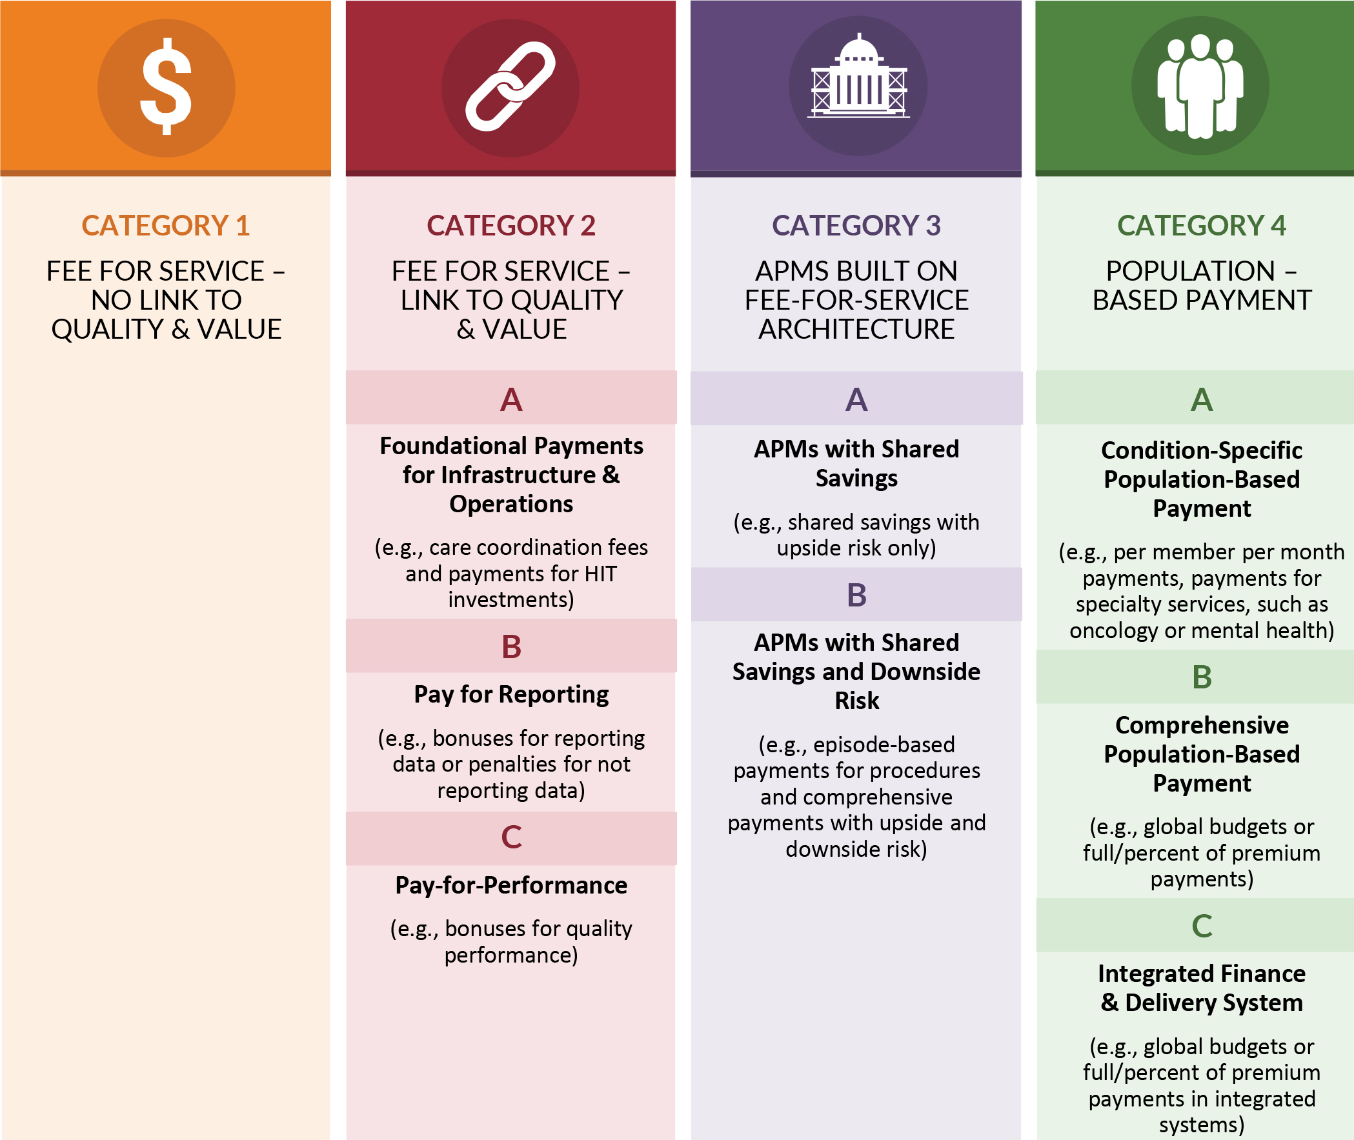
APM Categories
OHS uses the Health Care Payment Learning Action Network (HCP-LAN) Framework for categorizing APMs.
The Framework groups payment models into four major categories based on the degree of financial risk.
APM Categories

Slide 23
2022 Commercial Payments
Source for national data: Health Care Payment Learning & Action Network
Notes:
In the commercial market, Connecticut had the same percentage of payments made through Category 2 APMs as the HCP-LAN reported in its national survey (10.8% in both Connecticut and nationally). Connecticut had a higher percentage of payments made through Category 3 APMs (42.5% in Connecticut compared to 30.6% nationally). Connecticut had a similarly small percentage of payments made through Category 4 APMs as HCP-LAN reported in its national survey (1.5% in Connecticut compared to 4.1% nationally)

Slide 24
2022 Commercial Payments: Advanced APMs
Source for national data: Health Care Payment Learning & Action Network
Notes:
Connecticut had a higher percentage of commercial payments made though advanced APMs (i.e., Categories 3B and 4) than HCP-LAN reported in its national survey, but this was driven by Connecticut’s higher percentage of Category 3B payments (i.e., the national survey reported a higher percentage of more advanced population-based payments in Category 4).

Slide 25
2022 Medicare Advantage Payments
Source for national data: Health Care Payment Learning & Action Network
Notes:
In the Medicare Advantage market, Connecticut had a markedly higher percentage of payments made through Category 2 APMs than what HCP-LAN reported in its national survey (25.2% in Connecticut compared to 4.6% nationally). Connecticut had a lower percentage of payments made through Category 3 (16.3% in Connecticut compared to 32.5% nationally) and Category 4 APMs (15.9% in Connecticut compared to 24.6% nationally).

Slide 26
2022 Medicare Advantage Payments: Advanced APMs
Source for national data: Health Care Payment Learning & Action Network
Notes:
Connecticut had a significantly lower percentage of Medicare Advantages payments made through advanced APMs (Categories 3B and 4) than HCP-LAN reported in its national survey, particularly for Categories 4B (comprehensive population-based payment) and 4C (integrated finance and delivery systems).

Slide 27
2022 Connecticut Commercial and Medicare Advantage Covered Lives
The covered lives data represent plan members attributed or assigned to a Connecticut primary care physician (PCP), primary care group, or a non-PCP (i.e., specialist) participating in an accountable care APM of six months or longer in the calendar year.
Category | Commercial & Medicare Advantage | Commercial | Medicare Advantage
Percent of Covered Lives in APMs (Categories 3 and 4) | 39.7% | 41.0% | 33.9%
Percent of Covered Lives in Advanced APMs (Categories 3B and 4) | 14.3% | 14.0% | 15.6%
Category 3 = APMs Built on FFS Architecture
Category 3B = APMs with upside gain sharing and downside risk
Category 4 = Population-based payments
2022 Connecticut Commercial and Medicare Advantage Covered Lives
Notes:
The covered lives data represent plan members attributed or assigned to a Connecticut primary care physician (PCP), primary care group (PCG), or a non-PCP (i.e., specialist) participating in an accountable care APM of six months or longer in the calendar year.
41% of commercial lives in Connecticut were under accountable care arrangements (Categories 3 and 4). For Medicare Advantage, the percentage was slightly lower at 33.9%. Overall, 39.7% of commercial and Medicare Advantage covered lives in Connecticut were included in APMs, indicating substantial engagement in value-based care models.
Only 14% of commercial lives in Connecticut were attributed to a PCP or PCG participating in a Category 3B or Category 4 APM. For Medicare Advantage, the percentage was slightly higher at 15.6%. Overall, 14.3% of commercial and Medicare Advantage covered lives were attributed to a PCP or PCG participating in a Category 3B or Category 4 APM.

Slide 28
Key Takeaways from 2022 APM Monitoring
A large percentage of payments in Connecticut are still traditional FFS.
There is little adoption of advanced APMs (Models 3B and 4) in both the commercial and Medicare Advantage markets.
Connecticut is behind national rates of APM adoption for Category 4 prospective payment models.
Key Takeaways from 2022 APM Monitoring

Slide 29
Steering Committee Recommendations for 2025 Policy Action

Slide 30
Steering Committee Recommendations for 2025 Policy Action (1 of 4)
Based on the data we have shared this year, what policy strategies does the Steering Committee recommend OHS include in its October report to the legislature that support the Benchmark Initiative’s stated goals of (1) Affordability, (2) Quality, (3) Equity, and (4) Primary Care?
For example…
Steering Committee Recommendations for 2025 Policy Action (1 of 4)

Slide 31
Steering Committee Recommendations for 2025 Policy Action (2 of 4)
Identified Policy Problem | Benchmark Goal | Potential Solutions
Prescription Drug Costs: According to aggregate spending data submitted by payers for the cost growth benchmark program, retail pharmacy was the #1 driver of cost growth across markets in 2022. This trend was attributed primarily to growth in payment per unit for brand name drugs. | Affordability | Prescription Drug Affordability Board (PDAB): Over the past five years, 11 states have created prescription drug affordability boards. This past year, at least 14 more states proposed similar legislation. OHS Pharmacy Cost Mitigation Work Group Fall 2023 recommendations: Reference-based payment limits Penalties for excessive payment increases Expand drug rebate reporting to capture more accurate PBM information Prohibit spread pricing by PBMs
Steering Committee Recommendations for 2025 Policy Action (2 of 4)

Slide 32
Steering Committee Recommendations for 2025 Policy Action (3 of 4)
Identified Policy Problem | Benchmark Goal | Potential Solutions
APMs: There is currently little adoption of advanced alternative payment models in both the CT commercial and Medicare Advantage markets. “Advanced APMs” involve adoption of meaningful downside risk by contracting provider organizations to motivate slowed spending and improved access, equity and quality. | Affordability and Quality | Facilitate adoption of aligned multi-payer models to reduce administrative complexity for providers. (Oregon) Require insurer adoption of qualifying APMs. (Rhode Island) Incentivize advanced APM adoption by providers
Quality Benchmark challenges: Insurers are not using Quality Benchmark measures in all contracts with Advanced Networks, impeding their ability to report on Advanced Network performance for these measures. | Quality | Require commercial payer adoption of the aligned measure set in law. (Rhode Island) Massachusetts has considered this policy, but not adopted it, in part, because of high voluntary insurer measure set fidelity
Steering Committee Recommendations for 2025 Policy Action (3 of 4)

Slide 33
Steering Committee Recommendations for 2025 Policy Action (4 of 4)
Identified Policy Problem | Benchmark Goal | Potential Solutions
Cost Growth Benchmark Challenges: In 2024 pharmaceutical manufacturers again did not comply with OHS’ request to participate in its June Healthcare Benchmark Initiatives public hearing. | Affordability | Clarify in statute the requirement for “in-person” participation. Apply enforcement penalties for entities that fail to appear when asked to do so.
Primary Care Spending Target: Connecticut fell short of the 2022 primary care spending target; payers in the commercial and Medicare markets will need to make significant strides for Connecticut to meet the 10% target in 2025 | Primary Care | Create statutory requirements for primary care investment (Delaware, Oregon, Rhode Island) Note: Data shows projected shortages, and that increasing PCP workforce will help increase access and spend (see here for nationwide PCP data, and here for CT specific data)
Steering Committee Recommendations for 2025 Policy Action (4 of 4)

Slide 34
Forthcoming OHS Reports

Slide 35
Forthcoming OHS Reports
For your awareness, OHS will be releasing the following reports in the coming months:
OHS’ first annual report on the status of alternative payment model adoption in the state (for CY 2022)
OHS’ second annual report to the General Assembly describing health care spending trends, monitoring for unintended consequences of the benchmark program, and recommendations for strategies to improve the state’s health care system.
A report on the impact of the carrier requirements regarding prescription drug formulary changes in Sec. 38a-477jj
Forthcoming OHS Reports

Slide 36
Public Comment

Slide 37
Wrap-Up and Next Steps

Slide 38
Wrap-Up and Next Steps
The next meeting is scheduled for August 26th from 3-5pm.
Wrap-Up and Next Steps

