Slide 1
Cost Growth Benchmark
Stakeholder Advisory Board
Meeting #1
May 14, 2020

Slide 2
Agenda
Time | Topic
4:00 p.m. | Call to Order and Introductions
4:05 p.m. | Public Comment
4:15 p.m. | Governor Lamont’s Charge
4:25 p.m. | Charter and Bylaws
4:55 p.m. | Role of Stakeholder Advisory Board in the Development of Connecticut’s Program
5:05 p.m. | Health Care Cost Growth Benchmark: Key Concepts and Context for Connecticut
5:25 p.m. | Wrap-up & Next Steps
5:30 p.m. | Adjourn

Slide 3
Call to Order and Introductions

Slide 4
Stakeholder Advisory Board Members
Vicki Veltri
Reginald Eadie
Kathleen Silard
Janice Henry
Robert Kosior
Richard Searles
Ken Lalime
Margaret Flinter
Karen Gee
Marie Smith
Tekisha Everette
Pareesa Charmchi Goodwin
Howard Forman
Nancy Yedlin
Fiona Mohring
Lori Pasqualini
Sal Luciano
Kathy Flaherty
Hector Glynn
Rick Melita
Office of Health Strategy (Chair)
Trinity Health of New England
Stamford Health
Anthem Blue Cross and Blue Shield of CT
ConnectiCare
Merritt Healthcare Solutions
Community Health Center Association of Connecticut
Community Health Center, Inc.
OptumCare Network of Connecticut
UConn School of Pharmacy
Health Equity Solutions
Connecticut Oral Health Initiative
Yale University
Donaghue Foundation
Stanley Black & Decker
Ability Beyond
Connecticut AFL-CIO
Connecticut Legal Rights Project
The Village for Families and Children
SEIU Connecticut State Council

Slide 5
Process for Facilitating Discussion via WebEx
We are using the WebEx platform for today’s meeting.
Please mute your line to reduce background noise.
We invite members of the Stakeholder Advisory Board to use the “raise your hand” feature if you wish to be called upon.
  Click on the Raise Hand button, which will place a small hand icon next to your name in the participant list. This will alert us that you wish to be called upon.
Please unmute your line when you wish to speak.
If you have a question or request, please enter it into the Q&A box in the top right-hand panel.
  Indicate if your request is for everyone, or for the Bailit Health moderator.

Slide 6
Process for Facilitating Discussion via WebEx
Because the Stakeholder Advisory Board is a large body, it is possible that during the meeting we will not be able to address all of the questions and requests entered into the chat box. Those questions and requests that we cannot get to will receive a response in writing and posted with the meeting summary.

Slide 7
Public Comment

Slide 8
Governor Lamont’s Charge
Notes:
Why are we here?

Slide 9
Executive Order #5 Directs OHS to:
Develop annual health care cost growth benchmarks by December 2020 for CY 2021-2025.
Set targets for increased primary care spending as a percentage of total health care spending to reach 10% by 2025.
Develop quality benchmarks across all public and private payers beginning in 2022, including clinical quality measures, over/under utilization measures, and patient safety measures.
Monitor and report annually on health care spending growth across public and private payers.
Monitor accountable care organizations and the adoption of alternative payment models.

Slide 10
Connecticut is one of the states that spends the most on health care…
Personal health care spending, per capita, by state, 2009 and 2014
Source: Centers for Medicare and Medicaid Services, State Health Expenditure Accounts, 2009 and 2014
Notes:
Why did the Governor establish these benchmarks and targets?

Slide 11
Yet health care remains unaffordable to many
Since 2000, Connecticut employer-sponsored insurance premiums have grown two and half times faster than personal income
Source: Medical Expenditure Survey, Tables D.1 and D.2 for various years
Notes:
Why did the Governor establish these benchmarks and targets?

Slide 12
Connecticut employer-sponsored insurance per capita spending grew 17% in five years
ESI Annual Spending Per Person by Service Category
Payer & Patient Out of Pocket included
Source: Health Care Cost Institute 2017 Annual Report Interactive Tables – available at https://healthcostinstitute.org/research/hccur/2017-health-care-cost-and-utilization-report
Notes:
Why did the Governor establish these benchmarks and targets?

Slide 13
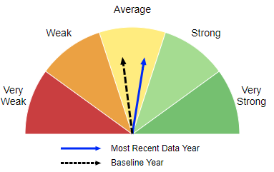
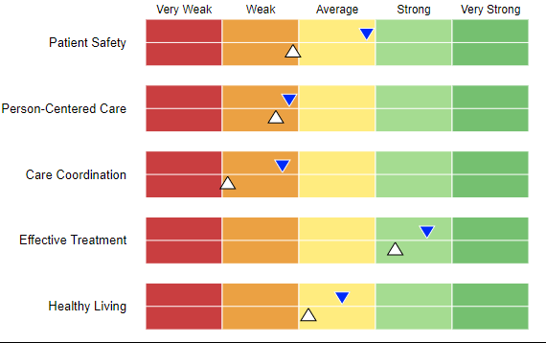
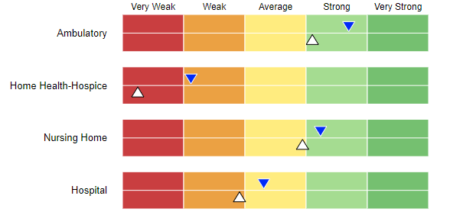
National Healthcare Quality and Disparities Report
Overall, Connecticut’s quality is in the “average” range compared to other states and has opportunity for improvement in several key categories of quality measurement.
Source: AHRQ. Measurement time period varies by measure. Blue arrows indicate performance most often between 2015-2017 and white arrows indicate performance from 2000-2012. https://nhqrnet.ahrq.gov/inhqrdr/Connecticut/dashboard
Notes:
The National Healthcare Quality and Disparities Report reports over 120 health care quality measures organized into six priority areas: (1) patient safety; (2) person-centered care; (3) care coordination; (4) effective treatment; (5) healthy living; and (6) care affordability). (No care affordability measures were reported on for CT in this report).
Solid white triangle describes results for baseline year and blue triangle describes results for the most recent data year. (Direction of triangle has no significance).
In general, quality performance has improved, but in some cases it has not improved to be within the average range compared to other states.
https://nhqrnet.ahrq.gov/inhqrdr/Connecticut/dashboard

Slide 14
Connecticut’s Cost Growth and Quality Benchmarks, and Primary Care Target Program
Role of the Stakeholder Advisory Board
Notes:
What is the role of the SAB?

Slide 15
Connecticut Benchmarks and Target Program
  1
Cost Growth
Benchmark
The SAB is to advise the Technical Team as it develops recommendations for a cost growth benchmark that covers all payers and all populations for 2021-2025.
  2
Primary Care
Target
The SAB is advise the Technical Team to develop recommendations for getting to a 10% primary care target that applies to all payers and populations as a share of total health care expenditures for CY 2021-2025.
  3
Data Use
Strategy
This is a complementary strategy that leverages the state’s APCD to analyze cost and cost growth drivers. The SAB will provide the Technical Team with input into this strategy.
  4
Quality
Benchmarks
Beginning in CY 2022, quality benchmarks are to be applied to all public and private payers. This work will be coordinated through OHS, DSS and the OHS Quality Council, with input from the SAB.

Slide 16
Connecticut Benchmark Program:
Key Deliberating Bodies
The Connecticut Benchmark Program will be established with the support of key deliberating bodies; the primary body is the Technical Team.
The Stakeholder Advisory Board is charged with providing input to the Technical Team on the development of the cost growth target and primary care target.
The Quality Council will be charged with developing the Quality Benchmarks with support from OHS and DSS.
Other bodies, such as the OHS Consumer Advisory Council, Health Care Cabinet, Practice Transformation Task Force, MAPOC, and other stakeholders will be consulted and will feed into the Stakeholder Advisory Board.

Slide 17
Technical Team Members
Vicki Veltri
Rebecca Andrews
Angela Harris
Luis Pérez
Paul Grady
Patricia Baker
Zack Cooper
Melissa McCaw
Deidre Gifford
Paul Lombardo
Rae-Ellen Roy
Office of Health Strategy (Chair)
American College of Physicians, Connecticut Chapter (Appointed)
Phillips Metropolitan CME Church (Appointed)
Mental Health Connecticut, Inc. (Appointed)
Connecticut Business Group on Health (Appointed)
Connecticut Health Foundation (Appointed)
Yale University (Appointed)
Office of Policy and Management (Designated)
Department of Social Services (Designated)
Connecticut Insurance Department (Designated)
Office of the State Comptroller (Designated)

Slide 18
  1
The SAB is to advise the Technical Team as it develops recommendations for a cost growth benchmark that covers all payers and all populations for 2021-2025.
Cost Growth
Benchmark
To develop recommendations for a cost growth benchmark the SAB will provide the Technical Team with input on responses to two questions:
  What health care spending is to be measured?
    The SAB will weigh in on specific questions related to the measurement of health care spending.
  How will the cost growth benchmark be set?
    The SAB will weigh in on the methodology and value of the benchmark.
Notes:
We’ll take note of definitions contained in the Governor’s bill when considering some of these options.

Slide 19
  1
The SAB is to advise the Technical Team as it develops recommendations for a cost growth benchmark that covers all payers and all populations for 2021-2025.
Cost Growth
Benchmark
We will review key questions pertaining to the cost growth benchmark with you and will relay your perspective back to the Technical Team prior to it finalizing any recommendation.
We will provide you with a synopsis of the preliminary discussions had by the Technical Team to help inform your understanding of the topics and the Technical Team’s rationale for preliminary recommendations.

Slide 20
  2
Primary Care
Target
The SAB is advise the Technical Team to develop recommendations for getting to a 10% primary care target that applies to all payers and populations as a share of total health care expenditures for CY 2021-2025.
The SAB will need to weigh in on two aspects of the primary care target:
  How is primary care defined and how will spending on primary care be measured?
    The SAB will weigh in on key questions related to defining what services should be considered primary care.
  What incremental primary care spend targets should lead up to 10% by 2025, and how should they be determined?
    The SAB will review preliminary recommendations made by the Technical Team and weigh in on incremental targets.

Slide 21
  2
Primary Care
Target
The SAB is advise the Technical Team to develop recommendations for getting to a 10% primary care target that applies to all payers and populations as a share of total health care expenditures for CY 2021-2025.
Currently, work to understand Connecticut’s primary care spending by payer type is being performed by the New England States Consortium Systems Organization (NESCSO). We will share information on studies to help inform your feedback.

Slide 22
  3
Data Use
Strategy
This is a complementary strategy that leverages the state’s APCD to analyze cost and cost growth drivers. The SAB will provide the Technical Team with input into this strategy.
The Data Use Strategy is a complementary strategy that will be moving forward parallel to the establishment of the Cost Growth Benchmark and Primary Care Targets.
Bailit Health’s partner, Mathematica, will be developing recommendations and will work with UConn AIMS and OHS on how to utilize the APCD to analyze cost and cost growth drivers so that performance against the cost growth benchmarks, primary care targets and eventual quality benchmarks can be understood.
The SAB will review preliminary recommendations for the types of analyses that could be routinely produced, and how those analyses might support insurers, providers, consumers, purchasers and policymakers to take action before the Technical Team finalizes its recommendations.

Slide 23
  4
Quality
Benchmarks
Beginning in CY 2022, quality benchmarks are to be applied to all public and private payers. This work will be coordinated through OHS, DSS and the OHS Quality Council.
Bailit Health will coordinate with the Quality Council to convey the SAB’s input into the development of annual health care quality benchmarks for health care entities and payers that:
  Report on a standard set;
  Include measures concerning clinical health outcomes, over- and under-utilization and patient safety, and
  Consider subpopulations
This work will also be coordinated with the work under EO #6 to develop a public transparency strategy for Medicaid cost and quality reporting.
The Technical Team will separately provide input on what core measures to include for primary care, specialty care, and hospital performance, and key considerations for setting the benchmarks.

Slide 24
Review of Proposed Charter and Bylaws
Notes:
What should our Charter and Bylaws be?

Slide 25
Objectives of Stakeholder Advisory Board
The Stakeholder Advisory Board will ensure that additional stakeholders from across the healthcare landscape, from consumers to providers, employers and the healthcare industry have input and feedback into the development of:
  Annual cost growth benchmark across all payers and populations for CYs 2021-2025, including ensuring that the cost growth benchmark does not cause any unintended consequences or exacerbate existing health inequities.
  Primary care spending targets across all payers and populations as a share of total health care expenditures for CYs 2021-2025 to reach a target of 10% by 2025.
  A strategy to use the state’s APCD to analyze cost and cost growth drivers.
  Annual quality benchmarks effective for CY22, and analysis of the impact of cost growth benchmarks and primary care targets on quality and equity.

Slide 26
Achieving the Objectives
The SAB will provide input to inform OHS, the Cost Growth Benchmark Technical Team and the Quality Council. Further, it will:
  Convene four times between May and September.
  Provide input relating to the Benchmarks and Targets.
  Identify unintended consequences of the Cost Growth Benchmark and relay potential solutions to unintended consequences to the Technical Team.
  Identify existing health inequities that could be exacerbated by the Cost Growth Benchmark and relay potential solutions to unintended consequences to the Technical Team.
  Provide input to the Technical Team on the State’s strategy to utilize the APCD to analyze cost and cost growth drivers.

Slide 27
Next Steps for Charter and Bylaws
We will incorporate feedback given during today’s meeting into a final draft of the Charter and Bylaws.
We will share an edited draft prior to the next meeting and then vote upon it when we next meet.

Slide 28
Health Care Cost Growth Benchmark
Key Concepts and Experience to Date
Notes:
The first topic we will discuss is the Health Care Cost Growth Benchmark

Slide 29

What Is a Cost Growth Benchmark?
January to add “bullseye” slide.
A health care cost growth benchmark is a per annum rate-of-growth benchmark for health care spending in the state.
When implemented, Connecticut will one of five states to have a statewide cost growth benchmark.

Slide 30
What Other States Have a Cost Growth Benchmark?
Connecticut’s health care cost growth benchmark needs to be designed by and for the people of Connecticut.
It is, however, informative to understand how other states have established (or are establishing) cost growth benchmarks.
2014
2015
2016
2017
2018
2019
2020
2021
2013
Massachusetts
Rhode Island
Oregon*
Delaware
Connecticut
*Due to the COVID-19 pandemic, Oregon may start its program in 2022.

Slide 31
Logic Model for Cost Growth Benchmarks
Plans, providers and the State will take action to ensure the target is not exceeded, motivated, in part, by the planned performance transparency and potential Performance Improvement Plans, and supported by improved cost and utilization information from OHS.
  OHS will annually report on state-level performance against the target, but also on performance at the health insurance market, insurer and large provider levels.
  OHS will provide better public information on costs and cost drivers through the strategy, using Connecticut’s All-Payer Claims Database (APCD) to inform and align policy efforts and stakeholder action.

Slide 32
What Does a Cost Growth Benchmark Measure?
In the states with benchmarks, the benchmark measures Total Health Care Expenditures (THCE) – which is a measure of spending by and for state residents from public and private sources.
THCE consists of:
  Total Medical Expense (TME) spending on all medical services for all state residents regardless of where care was provided, including non-claims-related payments to providers
  Patient cost sharing (e.g., copay, deductible, co-insurance)
  Net Cost of Private Health Insurance (NCHPI), a measure of the costs to state residents associated with the administration of private health insurance (including Medicare Advantage plans)

Slide 33
What Does a Cost Growth Benchmark Measure?
THCE does not include:
  Non-medical spending made by payers (e.g., gym membership)
  Vision or dental care not otherwise covered by a medical plan
  Costs incurred by providers, but not reimbursed by payers (e.g., costs for treating uninsured residents)
While this is how the other states have defined THCE, there are many nuances of health care spending measurement that will be discussed by the Technical Team and reviewed by the Stakeholder Advisory Board which may or may not result in a different definition of THCE for CT.

Slide 34
How Have Other States Implemented Cost Growth Benchmarks?
Massachusetts enacted its cost growth benchmark as part of a legislative package of health care reforms in 2012.
Delaware and Rhode Island enacted cost growth benchmarks through executive order in 2018 and 2019, respectively.
  In Rhode Island, prior to the executive order the major insurers and the largest providers signed a compact in 2018 agreeing to meet the target.
Oregon passed legislation calling for a committee of stakeholders to design a cost growth benchmark program and began meeting in late 2019.
  Washington passed similar legislation in 2020, but has yet to establish its stakeholder committee.

Slide 35
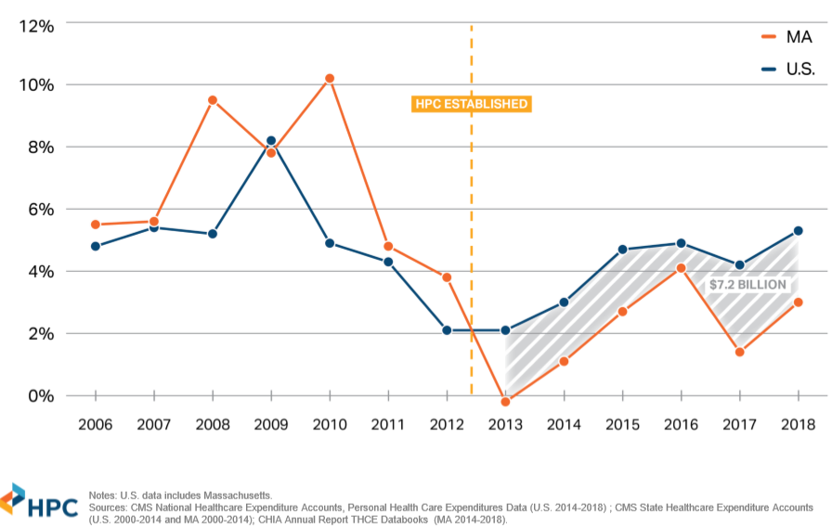
Massachusetts’ Cost Growth Benchmark Experience
From 2012 to 2018, annual health care spending growth averaged 3.38%, below the state benchmark.
Commercial spending growth in Massachusetts has been below the national rate every year since 2013.
Target established

Slide 36

Policy Experts’ Assessment of the Benchmark Program’s Impact
“Payer and provider rate negotiations are now conducted in light of the 3.6% target.”
  State Auditor study
“With an expected utilization increase of about 2%, payers and providers generally agree on annual price increases of about 1.5%.”
  David Cutler, HPC member
“The [cost growth benchmark] does mean something… It’s more than just a symbol, it becomes an operational component of how our health system works.”
  Stuart Altman, HPC Chair

Slide 37
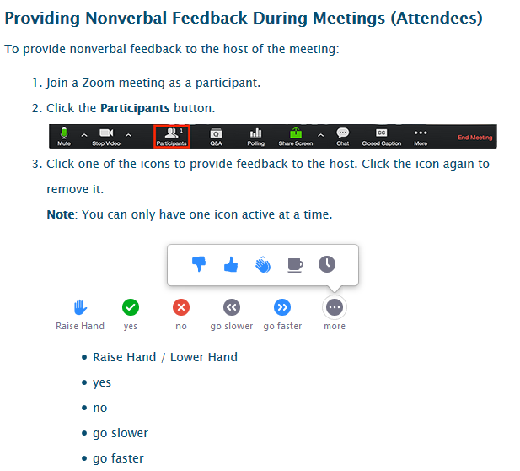
To Ask a Question...Raise your Hand!

Slide 38
Stakeholder Engagement Plan

Slide 39
Stakeholder Engagement Plan: Objectives
Gather input from key stakeholders, beyond Stakeholder Advisory Board members, to inform work of the Technical Team during its initial formative phase: May to September 2020.
Analyze stakeholder input to identify potential implementation concerns, challenges and unintended consequences.
After the annual cost growth benchmark and primary care targets are established, educate key stakeholders about what they mean and their impact.
Gather input from key stakeholders related to the development of quality benchmarks for CY 2022.

Slide 40
Stakeholder Engagement: Two Phases
Phase I
Outreach to engage stakeholders and solicit their input on the health care cost growth benchmark and primary care target during their formative stages from May to September 2020.
    …during this phase, we will also collect input from stakeholders on the State’s quality benchmarks development initiative.
Phase II
Starting in October 2020, focus on communication and education related to the state’s cost growth benchmark, primary care target, and quality benchmarks, while also gathering input on quality benchmarks

Slide 41
A Broad Range of Stakeholders
Phase I and Phase II activities will be aimed at a broad range of stakeholders:
Consumers and consumer advocates
Health care providers
Self-insured and fully-insured employers and employer associations
Health plans
Organized labor leaders
Benefit consultants
Legislators

Slide 42
Advisory Board Role with Stakeholder Engagement
OHS and the Stakeholder Advisory Board will help identify any additional stakeholders whose input is needed, and also the most efficient means of collecting that input.
  Please send your suggestions for additional stakeholders whose input is needed to Margaret Trinity at mtrinity@bailit-health.com
OHS and the Stakeholder Advisory Board will help determine the best means of soliciting input from each stakeholder group.
Each Stakeholder Advisory Board meeting will include updates on stakeholder engagement activities.

Slide 43
Plan of Meetings
Meeting # | Date | Meeting Goals
1 | May 14 | Orientation to Governor Lamont’s charge Review charter and governing bylaws Review role of Stakeholder Advisory Board Review detailed plan of meetings Review key concepts and context
2 | June, Date TBD | Review and adopt revised charter and governing bylaws Discuss the measurement of total health care expenditures and cost growth benchmark methodology, and gather feedback to share with the Technical Team
3 | July, Date TBD | Review cost growth benchmark values Review primary care spending target activity in other states Review data use strategy goals and possible analyses
4 | August, Date TBD | Discuss any unintended consequences of cost growth benchmark Discuss how to ensure cost growth benchmark does not exacerbate existing health inequities Provide input prior to last meeting of Technical Team

Slide 44
Wrap-Up & Next Steps

