Slide 1
New London Community CON Education Forum
October 24, 2019
Presenters:
Laura J. Morris, MPH, Director of Consumer Engagement
Steven W. Lazarus, Operations Manager
Leslie Greer, Community Outreach Coordinator
Ormand Clarke, Ph.D., MPH, OHS Compliance
Lindsey Donston, MPA, OHS Compliance Compliance
Notes:
Laura

Slide 2
The mission of Connecticut’s Office of Health Strategy is to implement comprehensive, data driven strategies that promote equal access to high-quality healthcare, control costs, and ensure better health outcomes for the people of Connecticut.
Notes:
Laura

Slide 3
Our Vision
We are looking to the future.
Working together, we can find the best solutions to the challenges we face in health and healthcare—cost, access, quality, equity—and present those options to our state policymakers and stakeholders.
Notes:
Laura

Slide 4
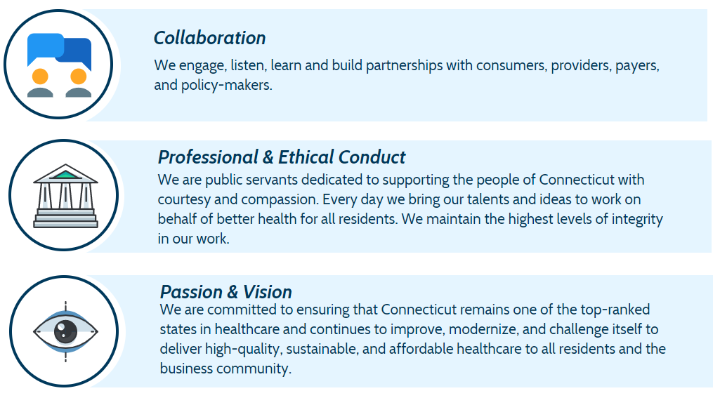
Our Values
Notes:
Laura

Slide 5
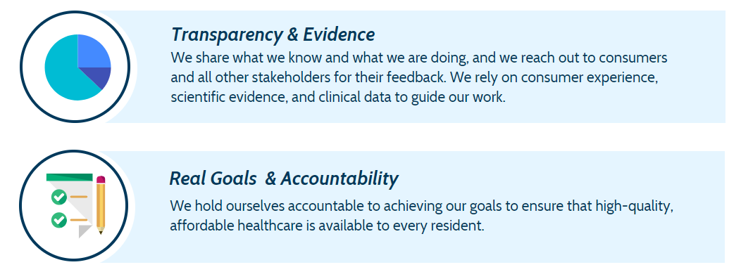
Our Values
Notes:
Laura

Slide 6
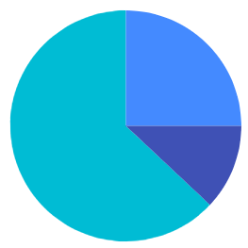
At OHS, we analyze healthcare systems and policies in the United States and in Connecticut, and we guide Connecticut to develop the best practices and best healthcare system for our state.
We do this through our Health Data & Analysis, Health Innovation & Strategy and Health Systems Planning teams.
Notes:
Laura

Slide 7
OHS History
Pursuant to CGS § 19a-754, as amended by Public Act 18-91, the Office of Health Strategy (OHS) was created in 2017 and established in 2018 by a strong bipartisan effort of the CT General Assembly to forward high-quality, affordable, and accessible healthcare for all residents.
The legislation re-organized existing state resources into one body, centralizing health policymaking and advancing healthcare reform initiatives that will drive down healthcare costs, close Connecticut’s deeply entrenched racial, economic, and gender health disparities, and undertake technology-driven modernization efforts throughout the system.
The work of the Office of Health Strategy is funded, in part, by federal grants secured through a competitive process, placing Connecticut among states leading the way in health care policy reform. No new positions were created in the establishment of OHS; existing state resources are being deployed in a new, more efficient and effective way.
Notes:
Laura

Slide 8
Three Teams Working Together
Notes:
Laura

Slide 9
Office Of Health Strategy
Office of Health Strategy
Health Data & Analysis
Health Innovation & Strategy
Health Systems Planning
Together we are the Office of Health Strategy in Connecticut.
Notes:
Laura

Slide 10
Health Innovation and Strategy
Notes:
Laura

Slide 11
Designing an innovative health system for CT
Establish a whole patient centered system.
Improve community health and eliminate obstacles that limit the highest quality care to everyone regardless of race, ethnicity, language or any other factor.
Ensure quality, access and a superior care experience.
Create payment models that help providers offer the most integrated holistic care.
Improve affordability by reducing healthcare costs.
Notes:
Laura

Slide 12
Health Innovation & Strategy
Develop state-led, multi-payer healthcare payment and service delivery reforms
Provide technical assistance to providers to support participation in model reforms
Develop and promote health insurance and coverage innovations that remove financial barriers to, or introduce rewards for healthy behavior, preventative care, medication adherence, chronic disease management, and use of high-value service and providers
Develop innovations for the management and financing of cross-sector community initiatives to improve health;
Promote healthcare workforce innovations – Community Health Worker Initiative
Notes:
Laura

Slide 13
Patients need to be empowered to participate in their own health and health care.
Notes:
Laura

Slide 14
Tracking the quality of health care
We all want to know where to find the highest quality care at the fairest price.
We provide a website where you can find information about the quality of care that health systems provide across Connecticut.
Visit www.healthscorect.com
Notes:
Laura

Slide 15
Health Data and Analysis
Notes:
Laura

Slide 16
We use data and policy ideas to improve health and contain the cost of health care for everyone in Connecticut.
Notes:
Laura

Slide 17
Medical Records and Information
Have you ever…
moved an elderly person to long term care and had to figure out all the medications they were taking?
had difficulty transferring your medical records to a new doctor?
had challenges ensuring your primary care doctor and specialists had the same up-to-date facts on your treatment?
been concerned that an emergency room doctor had access to critical medical information in case of an accident?
Notes:
Laura

Slide 18
Medical Records and Information
You need access to medical records and information and your health care provider needs them too.
Our Health Data & Analytics Team are working on a solution – we’re keeping a “map” of care that points to where medical records are created and stored so you and your providers can find and use them anywhere in CT.
Notes:
Laura

Slide 19
Using data to shape policies
We take the most up-to-date information about health and health care and analyze it in useful ways to deliver better health care in CT. The All Payers’ Claims Database (APCD), is an important source of Connecticut data that we use.
Our data contain facts and statistics about how people use hospitals and health care providers, what types of services are provided, how much health care costs and the quality of health care available.
We use these data to make evidence-based recommendations about improving our health care system in Connecticut.
Notes:
Laura

Slide 20
Health Data & Analysis
Create and administer a state Health Information Exchange
Establish and administer the Core Data Analytics Solution (CDAS) to enable in-depth data analytics, including electronic Clinical Quality Measures (eCQMs) to support payment and practice reforms.
Administer the All-Payer Claims Database (APCD) program for the purpose of collecting, assessing and reporting health care information.
Prepare the statewide Health Information Technology Plan (HIT Plan) to achieve the state's health information technology goals.
Medication Reconciliation and Polypharmacy work group is achieving stability and management solutions for patients who have many, multiple medications.
Notes:
Laura

Slide 21
Health Systems Planning
Notes:
Steve

Slide 22
Health Systems Planning Activities
Certificate of Need
Acute Care and Specialty Hospitals Annual Financial Data Filings, Audited Financial Statements, Organizational Charts, etc.
Utilization data collection (Inpatient, Outpatient and Emergency Department).
Inventory of health care services, facilities and imaging equipment (Bi-Annually)
Standard Publications:
Acute Care Hospitals Financial Stability Report, (Annually), and
Connecticut’s Health Care Facilities and Services Plan (Bi-Annually)
Notes:
Steve

Slide 23
What is a Certificate of Need and what does it do?
Certificate of Need (CON) process regulates, monitors and improves Connecticut’s health care system.
CON deliberations and public hearings are an Office of Health Strategy ‘s (OHS) regulatory responsibility that ensure that a health care facility and service development address the needs in our communities.
The CON process protects the accessibility of healthcare services for consumers while limiting duplication of excess capacity of facilities and services in any given geographical area. OHS holds public hearings and encourages residents to give input on every CON application.
Notes:
Steve

Slide 24
What Requires a CON? 19a-638 C.G.S.
Est. of a new health care facility (HCF)
Transfer ownership of a HCF
Transfer ownership of a large Group Practice
Est. of a Free Standing ED
Termination of a service (hospital)
Est. of an O/P Surgical Facility
Termination of a surgical services by an O/P (exemptions may apply)
Termination of an ED by a hospital
Est. of cardiac services
Acq. of CT, MRI, PET, PET-CT,
Acq. Of nonhospital LinAc
Increase in lic. bed capacity of a HCF
Acq. Of new tech. equip. (1st in State)
An increase of 2 or more ORs in 3 yrs
Termination of I/P, O/P services by any facility that is eligible for Medicare or Medicaid
Notes:
Steve

Slide 25
How many and what type of CON applications are filed each year?
Last year, 31 applications were filed with OHS:
10 for Termination of Service,
7 for Changes of Ownership (OSF/ASC, Group Practice),
5 for acquisition of imaging equipment,
5 for behavioral health.
Over the past 8 years, annual CON applications filings have averaged approx. 28-30 new filings per year.
Notes:
Steve

Slide 26
Who is part of the CON process?
Applicant(s)
Other providers (opposing or supporting the application/proposal)
Applicant(s) Employees
Public/Consumers/Community
Legislators
Media
Local Municipalities
Other States (Not directly but indirectly)
Notes:
Leslie

Slide 27
Opportunities for Engagement by Public/Consumers/Communities
Public comments are accepted anytime by OHS. (Once application is filed all public comments become part of the file)
Public has right to request a public hearing (Company representing 3 or more individuals or 5 or more individuals from public).
At a public hearing, general public can provide comment to OHS (written, oral or both).
Related statutory criteria, 19a-639 C.G.S.
Notes:
Leslie

Slide 28
OHS’ Current Efforts to Engage Public/Consumers/Community
Notice upcoming hearing in the region’s major newspaper(s).
Post public hearing information on our website.
Hearing information is disseminated via social media via (Twitter & Facebook).
OHS relay’s information to local town halls, public libraries and any public associations, that we may be aware of
Notes:
Leslie

Slide 29
OHS’ Current Efforts to Engage Public/Consumers/Community (Continued)
OHS’ Outreach Coordinator plays a pivotal role between OHS and public
Dedicated email for public comment (concomment@ct.gov )
Video recording of our public hearings on OHS YouTube Channel (Public Hearings recorded on and posted within 24 hours)
Notes:
Leslie

Slide 30
OHS’ Current Efforts to Engage Public/Consumers/Community (Continued)
A newly developed Public Hearings Page on our website (one-stop-shop)
OHS has a significant presence at its hearings. This provides public attending a direct person to ask questions regarding the application, hearing and process as well as submit information to OHS
If an issue is brought up by public that has not yet been addressed, OHS will have the Applicant(s) address it directly at the hearing, while the public is present in the audience
Notes:
Leslie

Slide 31
OHS’ Current Efforts to Engage Public/Consumers/Community (Continued)
Some examples of public engagement’s effects on CONs:
Development of Portals, since Sept 2017 (CON, HRS, Notifications/Filings)
Hearings starting later in the day and OHS hearing staff present at least
until 6 pm
Hearings being adjourned (not closed the day of) to provide ample time for comments on record
Notes:
Leslie

Slide 32
New London’s Community Concerns from Public Hearing
How will the affiliation between L+M and YNHHS help serve the greater New London community?
How was the community involved in the Community Health Needs Assessment?
Will members of the community be involved in decision making if essential services are no longer provided @ L+M?
How will L+M remain connected to its community as a resource for health care?
Termination of services @ L+M
Relocation of services routed to YNHHS leaving fewer specialist at L+M
Mistrust issues with hospital and decision makers
Transportation to outpatient appointments
Commitment to the Community Health Needs Assessment
Notes:
Leslie

Slide 33
Examples of OHS Conditions (Community Related)
In certain CON decisions, here are some examples of conditions included in an Agreed Settlements:
Public forums
Community member on local boards
Independent monitors
Cost and Market Impact Review
Requirement to develop and participate in local Community Health Needs Assessments/Reports, and
Requiring an increase in Hospital Community Benefits
Notes:
Steve

Slide 34
Conditions from L&M Change of Ownership (to Yale) CON Agreed Settlement
Conditions cover the follow areas:
Standard Conditions (submit Closing docs., legal agreements etc.)
Inclusion of Community Member
Joint Board Meetings & Public Forums
Independent Monitor
Data and Data Analysis (Related to Cost, Quality, Utilization, Financials)
Services and Strategic Planning
Community Benefits
Cost and Market Impact Review
Notes:
Steve

Slide 35
L & M Community Health Needs Assessment Priorities
L & M Hospital’s affiliation with Yale (Health System) began in September, 2016
2 Community Health Needs Assessment (CHNA) & Community Health Implementation Plans (CHIP)– Former (2016-2019) and Current (2019-2022)
L+M and Ledge Light Health District composed the CHNA
Click here for L & M’s 2016 & 2019 CHNA’s and Service Plans
Notes:
Ormand

Slide 36
Community Health Need
(Per 2016-2019 CHNA & CHIP)
Opioid Use
LatinX Mental Health
Healthy Lifestyles
Asthma
Maternal Child Health
Cancer
Access to Care
Social Determinants
Other Community Benefit Activities
Health Professions Education
Subsidized Health Services
Notes:
Ormand

Slide 37
Grand Total Community Benefits & Community Building
FY 2016: $38,686,420
*FY 2017: $48,408,718
FY 2018: Available November 2019
*Increase of $9,722,298 or 25% between FY 2016 & 2017
Note: The 2018 Community Benefits/Community Building Initiatives report is to be filed with OHS in the Nov., 2019 comprehensive report.
Notes:
Ormand

Slide 38
Community Health Need
(Per 2019-2022 CHNA & CHIP)
Chronic Diseases
Hypertension
Maternal Child Health
Injury and Violence
Environmental Risk Factors and health
Access to Care
Cancer
Mental Health & Substance Abuse
Infectious Diseases
Notes:
Ormand

Slide 39
Charity Care Policies
FY2016 | FY2017 | FY2018
$3,555,323 | $9,167,324 | $10,256,156
Notes:
Ormand

Slide 40
L+M Physicians Group
L+M Physicians are now New England Medical Group (NEMG) Physicians
No conversion of any L+M physician offices to hospital-based status
Notes:
Ormand

Slide 41
Community Input, During and Post Compliance
During compliance period (proposal specific):
Independent Monitor
OHS Outreach Coordinator (OHS’ Consumer Engagement)
OHS Compliance Unit
Post compliance period (over the hospital and health system):
Access via OHS’ Outreach Coordinator (OHS’ Consumer Engagement)
OHS, oversight through its statutory authority (19a-638 & 19a-639 C.G.S.)
Examples: CON Modifications, OHS Inquiries, CON Determinations and CON Application Process.
Notes:
Steve

Slide 42
New London Area Community Feedback
At this point, OHS would like to ask for your feedback
What has been your experience since the change of ownership has occurred?
Services been maintained, improved, deteriorate, reduced (provide specific examples)?
Access to healthcare? Physicians, Primary Care Services, etc. (examples)
Location of services? Same, relocated, changed names etc. (examples)
Other (Communication with community members, public forum, local board, etc.)
Notes:
Leslie to create survey

Slide 43
Leslie M. Greer
Community Outreach Coordinator
Mailing Address: 450 Capitol Avenue, MS#51OHS, P.O. Box 340308, Hartford, CT 06134-0308
Physical Address: 450 Capitol Avenue, 1st Floor, Hartford, CT 06106
Phone: 860-418-7013
leslie.greer@ct.gov(email)

