Slide 1

Community Health Worker Advisory Body (CHWAB)
May 2020
1

Slide 2
Purpose of Today’s Meeting

Slide 3
CHW Advisory Body
Meeting Agenda
Welcome & introductions
Public comment
Meeting summary approval
COVID-19: CHWs & Unmet needs
Review training requirements
Discuss training vendor application approval components and process
Certification update from DPH
General Questions
Next steps
Adjourn
3

Slide 4
Introductions

Slide 5
CHWAB Membership
CHWAB Chairs
Community Health Workers
Community-based CHW
training organization
Dr. Tekisha Dwan Everette
DeLita Rose-Daniels (CHW)
Mildred Landock
Bianca Noroñas
Jerry Smart
Nilda Paris
Derricia Parker
Michele Scott
CHWAB Support
Healthcare Employer
Vicki Veltri
Laura Morris
Dashni Sathasivam
Jeannina Thompson
Adriana Rojas
Healthcare Provider
CHW Association of CT
Milagrosa Seguinot
Jean K. Jacob, PharmD
DPH Appointee
Community College
CHW Employing Agency
Chris Andreson
Erika Lynch
Lee Carenza
5
Notes:
Leave space for Dr. Jacobs to introduce himself

Slide 6
Meeting Summary Approval

Slide 7
CHW Training Program Requirement Recommendations
Notes:
CHW Report to the Legislature 2018
This is what was recommended in the report and we are coming back with where all the

Slide 8
CHW Training Program Requirements
Changes Voted on 3/5
Added Attendance Policy To Assessment Requirement
8

Slide 9
Final CHW Training Program Requirements:
Areas For Recommendation | 2018 Legislative Report Recommendations | Gateway CC | Capitol CC | Housatonic CC | SW AHEC | Area Health Center
Content – Identify Core Competencies | The content of training CHWs should consist of the core skills and services utilizing the Community Health Worker Consensus Project (C3) Core Competencies. | Foundation of CHWs |  | Foundation of CHWs | Foundation of CHWs | Foundation of CHWs
Internship | Training programs should include 90 hours of training and an internship with a minimum of 50 hours. | 80-120 Hours | N/A | 36 Hours | Apprenticeship: 144 hours No formal required internship | 8 hour CHW practicum at Interprofessional Education Health Clinics – no formal internship
Training Modality/Methodology and Delivery | Training methodology should follow Adult Learning Principles, include role- playing, and be interactive. Training should be delivered in-person or utilize a hybrid approach that includes in person sessions and distance learning in “real-time.” | In-person | In-person | In-person | In-person | In-person
9

Slide 10
Final CHW Training Program Requirements:
Areas For Recommendation | 2018 Legislative Report Recommendations | Gateway CC | Capitol CC | Housatonic CC | SW AHEC | Area Health Center
Instructor Qualifications | Instructors for CHW training should be inclusive of CHWs with experience in the field, as well as non-CHWs who meet the requirements of the training vendor. | Practicing CHW & Public health practitioner (i.e. MPH) |  | Practicing CHW | If Not CHW: Experience in training the C3 minimum of 5 years If CHW: 2000+ hours training those who provide CHW Services in past 3 years | Faculty/instructors must co-teach at least 50% of the course with a CHW if they are not a CHW; If CHW may teach full course All must complete Train the Trainer
Number of Training Hours | Training programs should include 90 hours of training and an internship with a minimum of 50 hours. | 200 Hours |  | 108 Hours | 90 Hours | 90 Hours of In-Class Training
Type of Assessment | Assessments of successful training completion should utilize (1) pre- and post-tests, (2) skills assessment, and (3) include a capstone project or portfolio, or a combination of the two. (4) Attendance Policy | •Attendance 50% (Terminated after 2 absences) • Portfolio 50% |  |  | Task and Competency Verification Checklist evaluating field training, demonstrating fundamentals, proficiency
10

Slide 11
Recommendations CHW Training Program Requirements
Questions for Discussion:
How should the CHWAB handle Pathway 1 applicants prior to certified vendors being approved?
During the COVID-19 Pandemic, should the training modality in-person requirement be temporarily waived or altered?
11

Slide 12
CHW Training Program Approval
Notes:
CHW Report to the Legislature 2018
This is what was recommended in the report and we are coming back with where all the

Slide 13
Guidance from 2018 Report
Recommendation 18: The CHW Certification Advisory Body should review and approve CHW training vendors.
Key Considerations:
The Committee determined that programs should be required to obtain approval to provide CHW training that is recognized for CHW certification.
The Committee assessed who reviews and approves training vendors in other states and found that the Advisory Body often serves that role
Training vendors should not be limited to any particular type of organization, but should identify themselves, have a plan to screen and recruit participants, state the cost of training, and specify training frequency.
13

Slide 14
Training Program Approval Process
Topics for Discussion:
Application cost
Renewal period
Overview of Application review process
Training Program Approval Standards
Review Vendor Applications Other states
14

Slide 15
CHW Training Program Approval in other States
State | Entity Approving Training Programs/Curriculum | Application Cost | Renewal Period
Arizona | AZCHWA and CHW Workforce Coalition | $500 | 5 years
Florida | FL Certification Board | $300 initial review fee & $200 biennial approval fee | 2 years
New Mexico | The Office of Community Health Workers, NM DPH | $300 for first year of application, $200 for renewal | Annual
Texas | DSHS | None | 2 years
Oregon | Oregon Health Authority | None | 3 years*applications submitted at least 6 months prior to date of expiration
15

Slide 16
CHW Training Program Approval Process: Questions to Consider
What application cost, if any, should be required of training vendors?
How frequently should CHW training programs be required to be reapproved/certified/endorsed
Will applications be be accepted on a rolling basis, or is their a fixed period for submission each year?
If an organization is denied, how long do they have to address the gaps in their program/application.
Do they have to pay to resubmit within a certain time period?
16

Slide 17
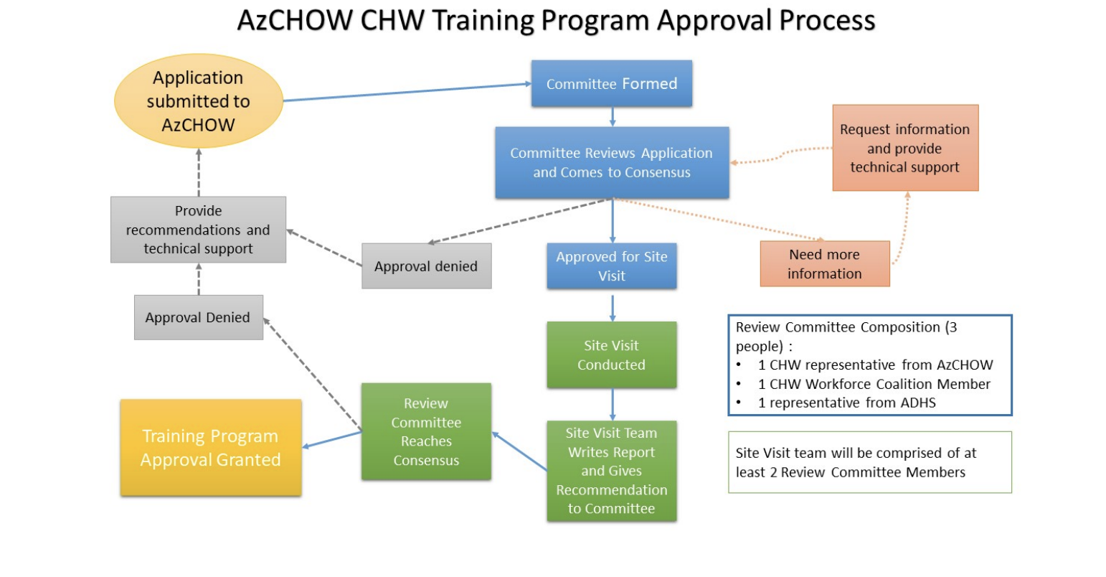
Application Review Process: Arizona
17

Slide 18
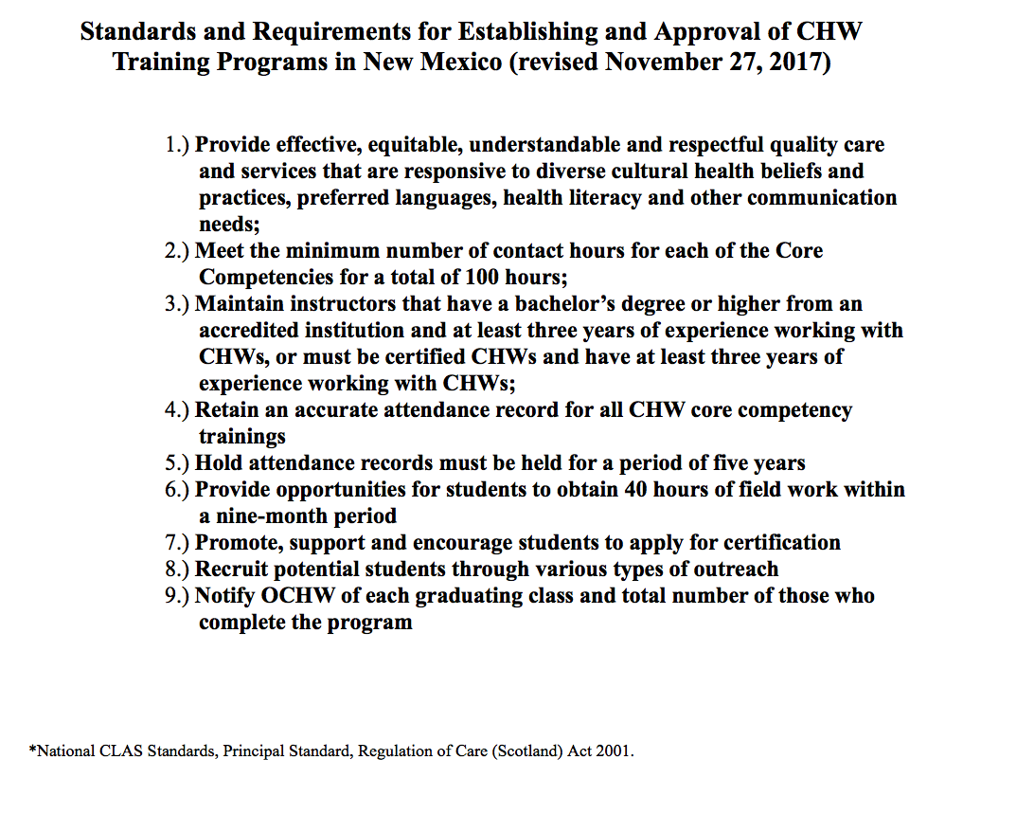
Training Program Approval Standards: New Mexico
18

Slide 19
Draft Vendor Training Application for CT
19

Slide 20
Training Program Approval Checklist: New Mexico
20

Slide 21
Training Program Application Components
General Information
Organizational overview
Prior training experience
Instructors and requirements
Training Program Details
Training location, delivery, development, instruction, modality, frequency, languages
Training cost and available support
Role of CHWs in delivery, quality
21

Slide 22
Training Program Application Components
Improvement and evaluation of curriculum
Evaluation
Collaboration with CBOs
Recruitment and enrollment
Community Need
Equivalency
Academic Credit
Training program feedback
Records and attendance
Training Curriculum and content
program syllabus and materials
Core curriculum
Specialty curriculum
Internships or apprenticeships
Demonstration of successful completion/assessment
Assessment methods and materials and
additional criteria
22

Slide 23
Marketing and Outreach
23

Slide 24
Update - OHS

Slide 25
Approval
Notes:
Request a motion for approval of the recommendations for CHW Internship programs either as is or with discussion.
Note, that again this does not preclude us from adding or changing in the future.

Slide 26
Certification Update - DPH

Slide 27
General Questions

Slide 28

Looking forward
Next meeting:
June 4th Webinar
Upcoming Training Program Requirements priorities:
Reviewing Training Program Applications
Application Rubric
Certification standards
Training Program Reporting Requirements
Continuing Education Units
Other updates:
Marketing & Outreach
28

Slide 29
Contact
Tekisha Dwan Everette: teverette@hesct.org
DeLita Rose-Daniels: Delita.Rose-Daniels@hartford.gov
Laura Morris: Laura.Morris@ct.gov
Dashni Sathasivam: dashni@hesct.org
29

Slide 30
Adjourn

