Slide 1
data.ct.gov

Slide 2
Executive Order 39:
Creates the Connecticut Open Data Portal
Establishes a Chief Data Officer (CDO) within OPM
Agencies shall identify an Agency Data Officer (ADO)
The ADO is required to develop a list of initial datasets for inclusion in the portal
Creates an Advisory Panel
Requires the CDO to develop an Open Data Policy

Slide 3
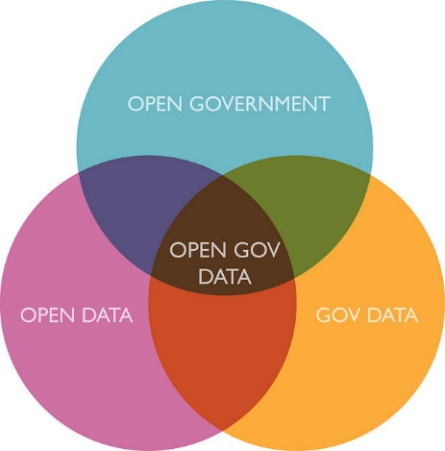
Source: Alex Howard

Slide 4
What Is Open Data?
Legally Open:
Not protected by law (e.g. FERPA, HIPAA, etc.)
Aggregate or de-identified “public” data
Not restricted by a license or terms of use.
Technically Open:
Machine readable.
NOT in PDF format!
Also, publically accessible, on the internet, without cost.

Slide 5
Why Open Data?
Transparency and democratic control
Participation
Self-empowerment
Improved or new private products and services
Innovation
Improved efficiency of government services
Improved effectiveness of government services
Impact measurement of policies
New knowledge from combined data sources and patterns in large data volumes

Slide 6
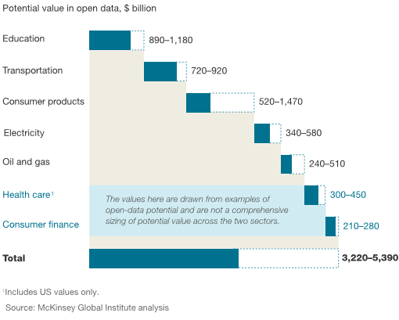
Open Data’s Value = $3 Trillion globally, and $1.1 in the U.S. alone
6 % of the Gross Domestic Product
$8,000 Per Household

Slide 8
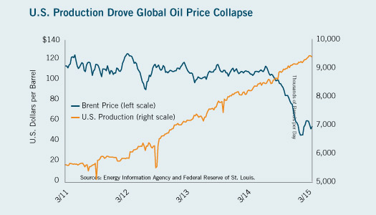
Typical Asset Valuation # 1 - Value per unit declines based on supply

Slide 9
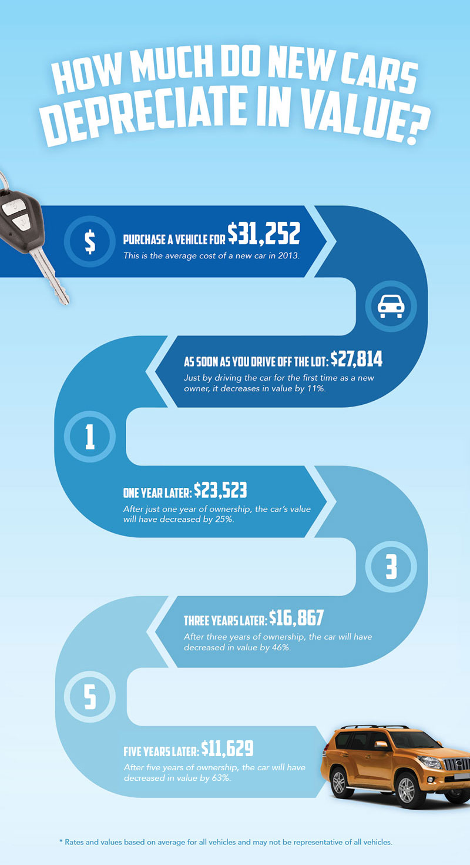
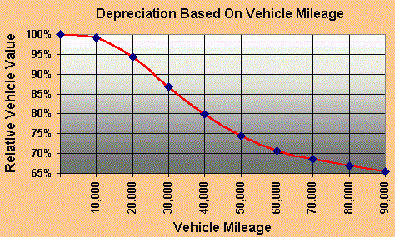
Typical Asset Valuation # 2 – Value declines as use increases

Slide 10
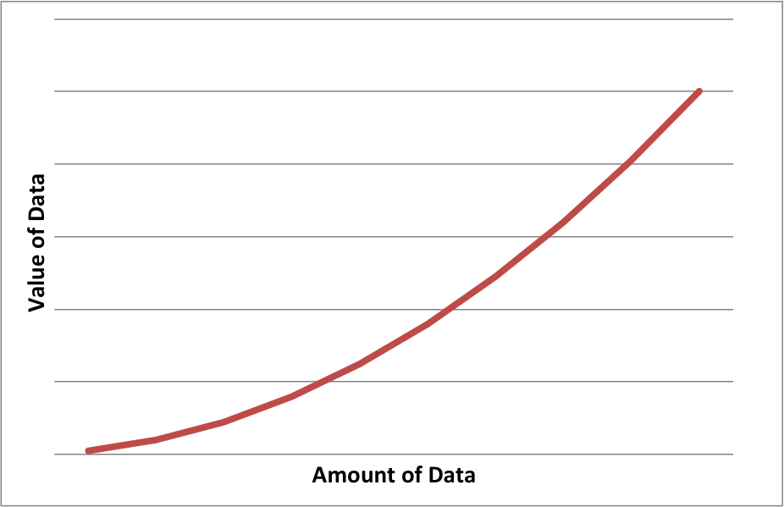
Data is an asset, just not a typical asset. It’s value increases with availability and use.
& Use of Data

Slide 11
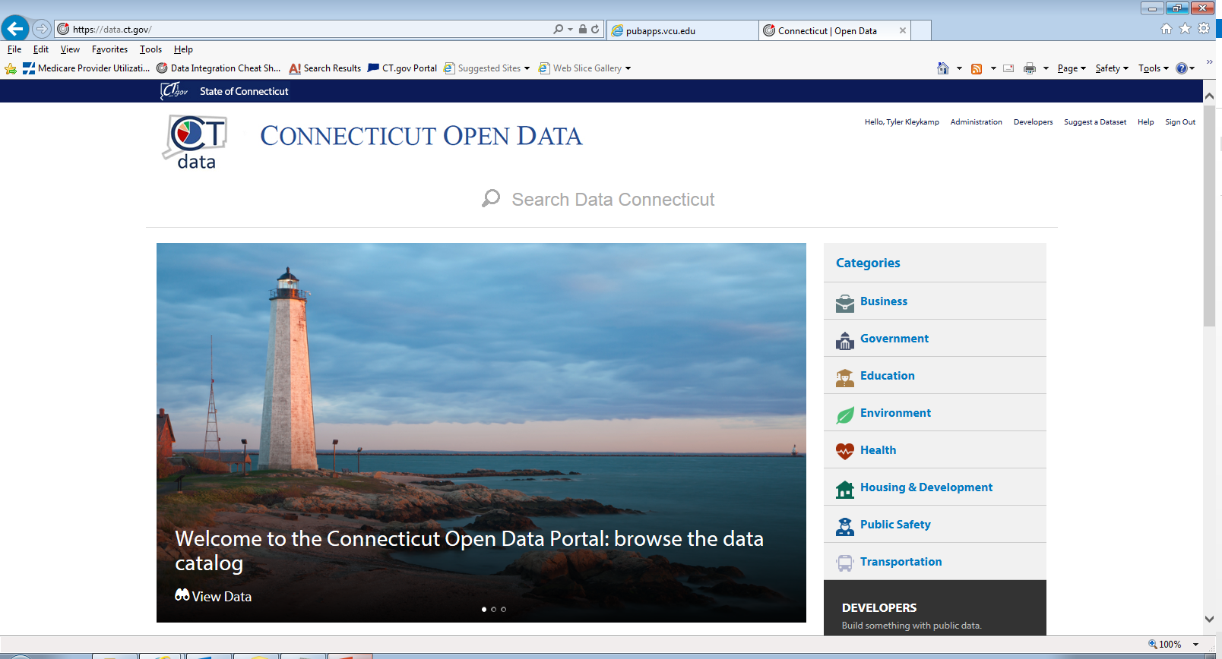

Slide 12
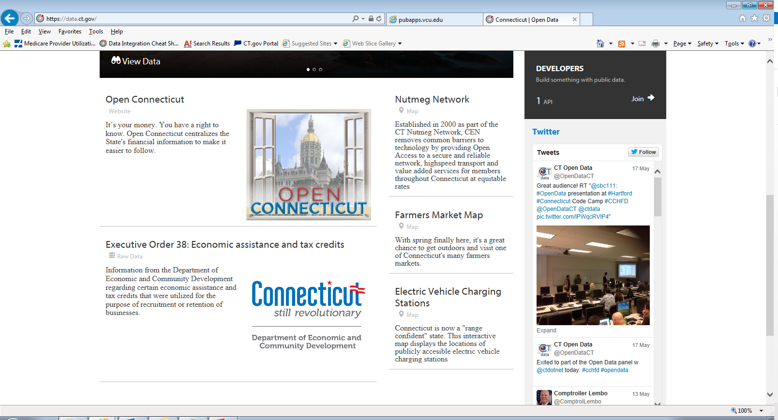

Slide 13
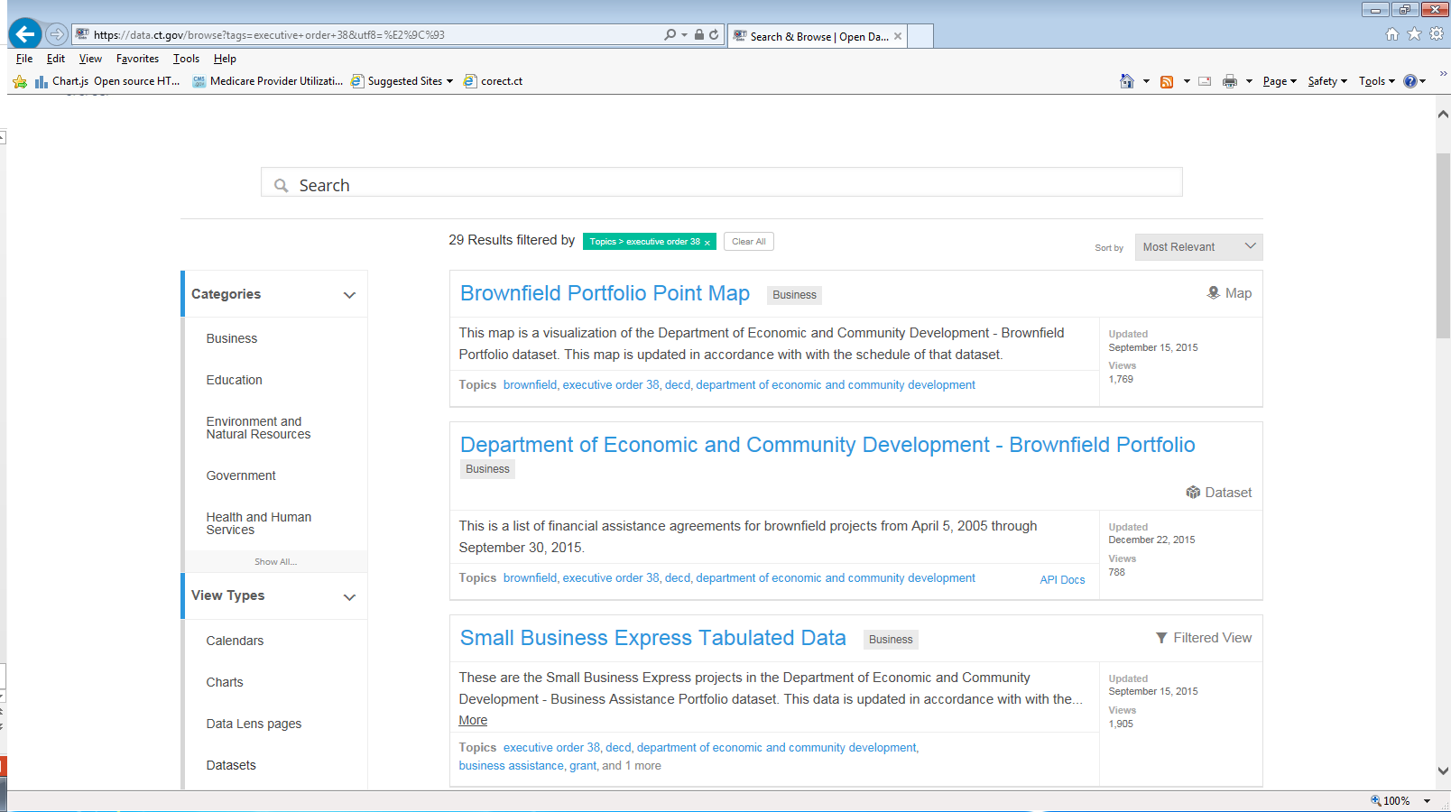

Slide 14
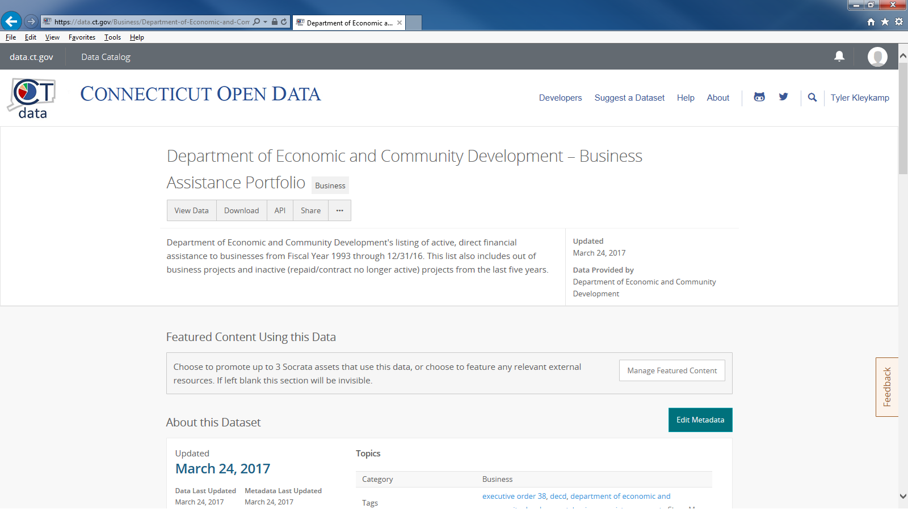

Slide 15
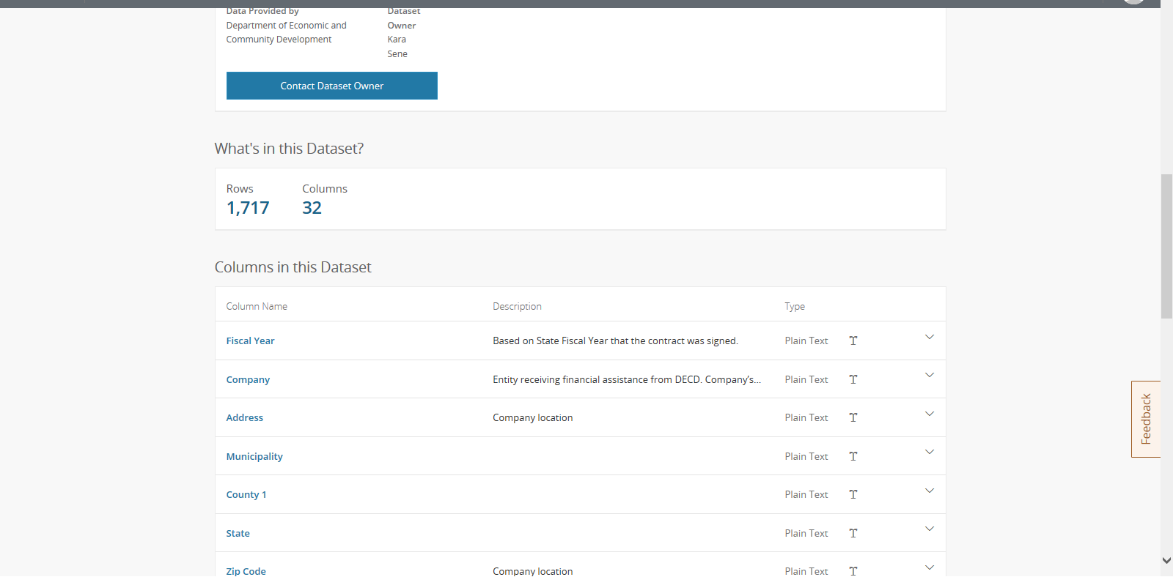

Slide 16
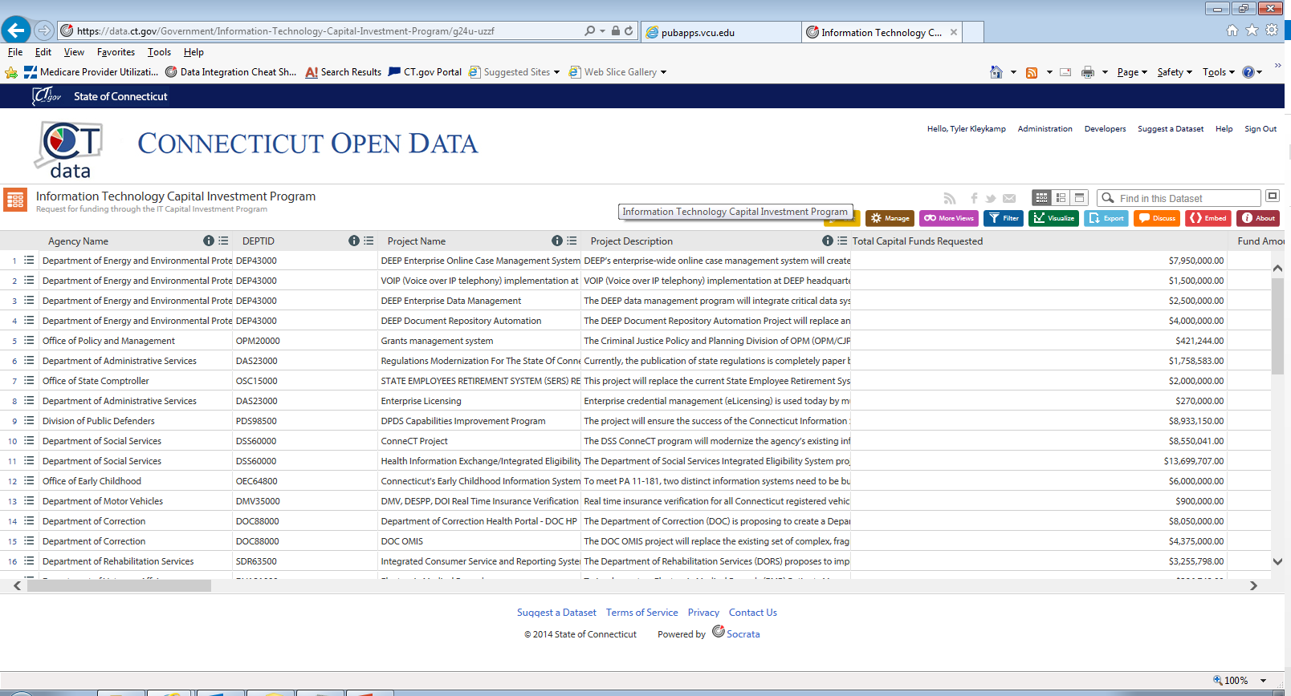

Slide 17
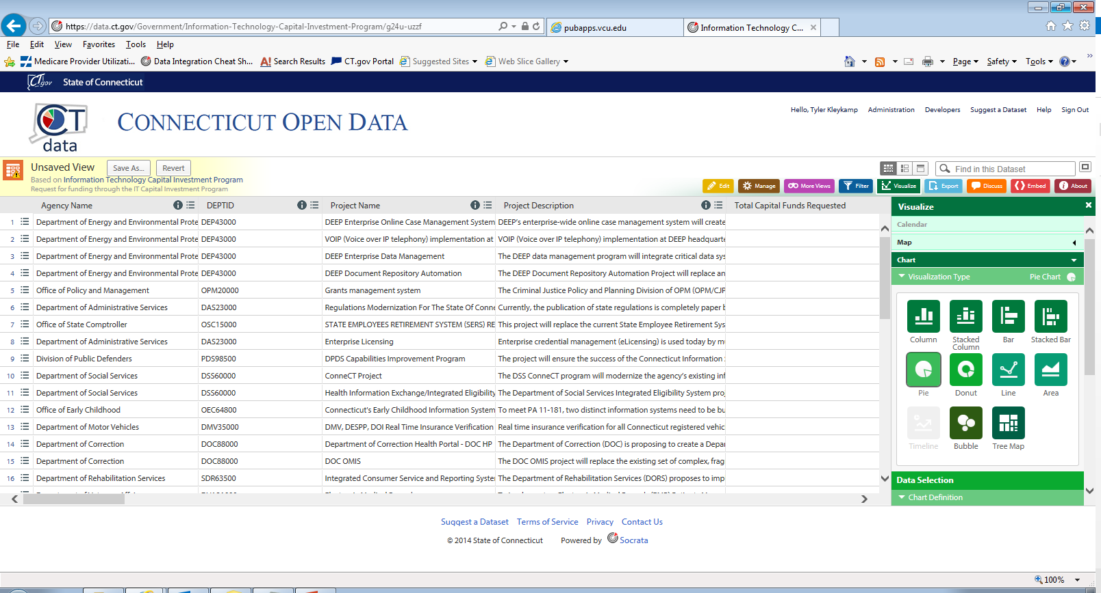

Slide 18
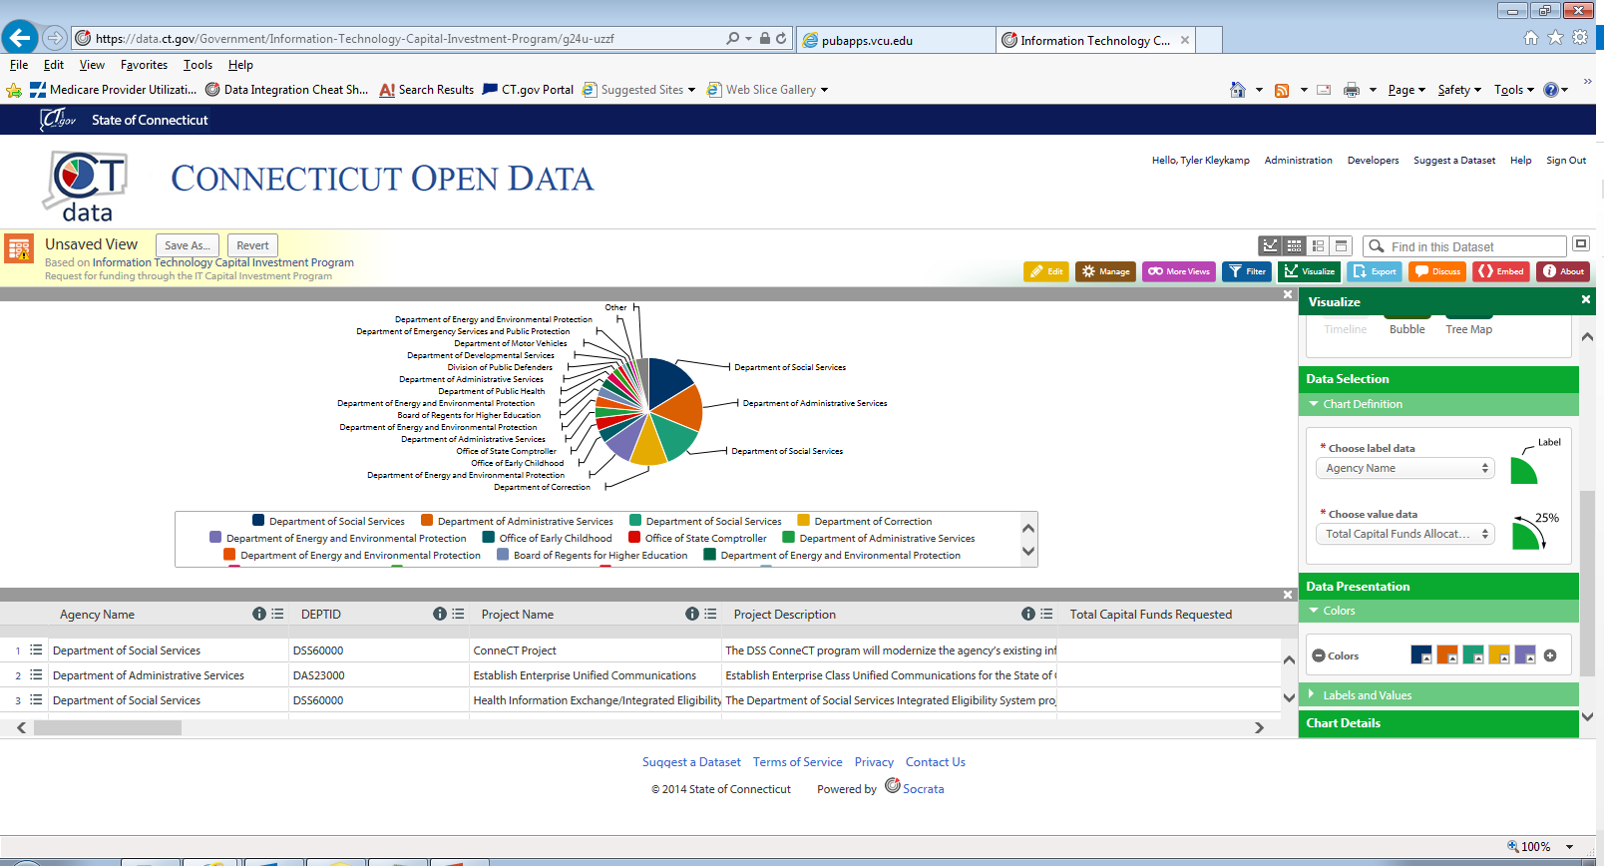

Slide 19
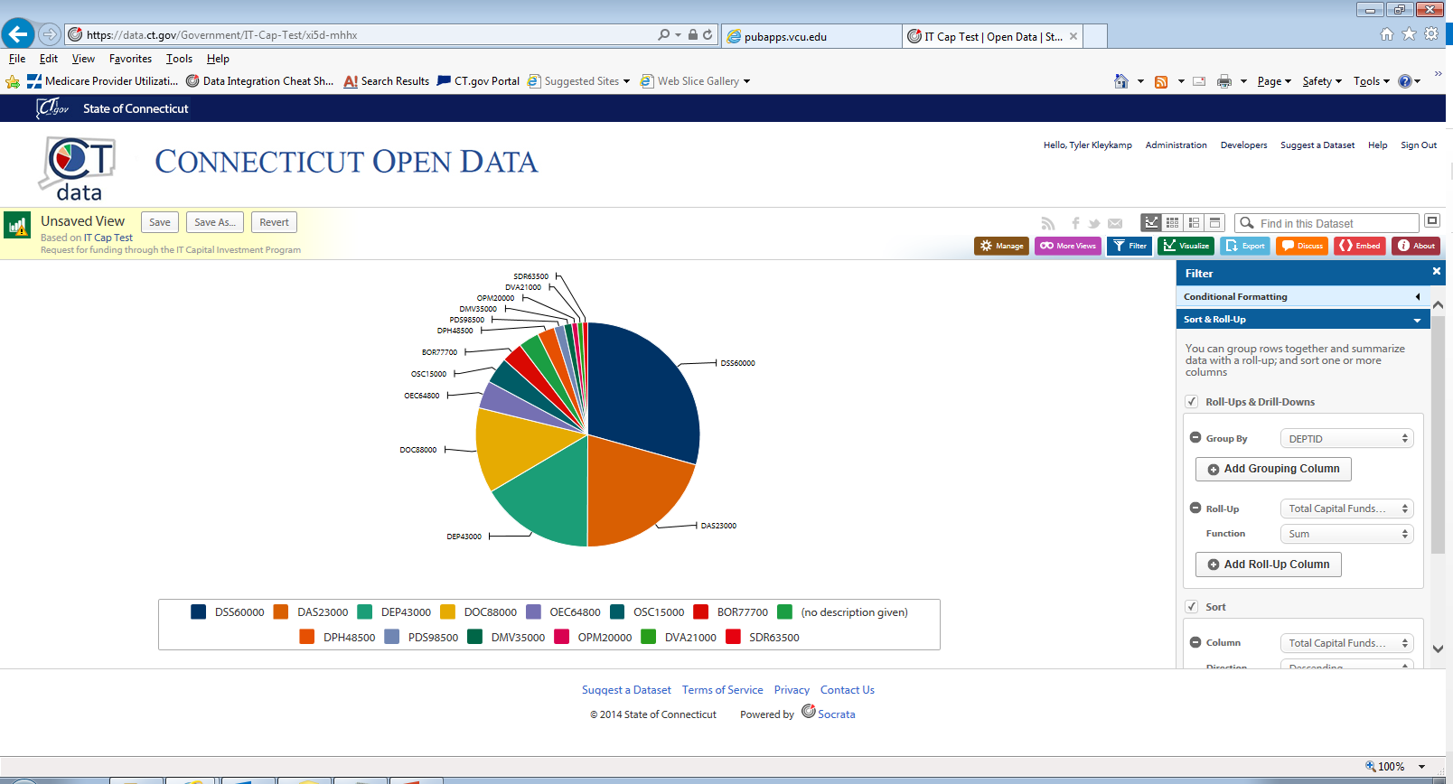

Slide 20
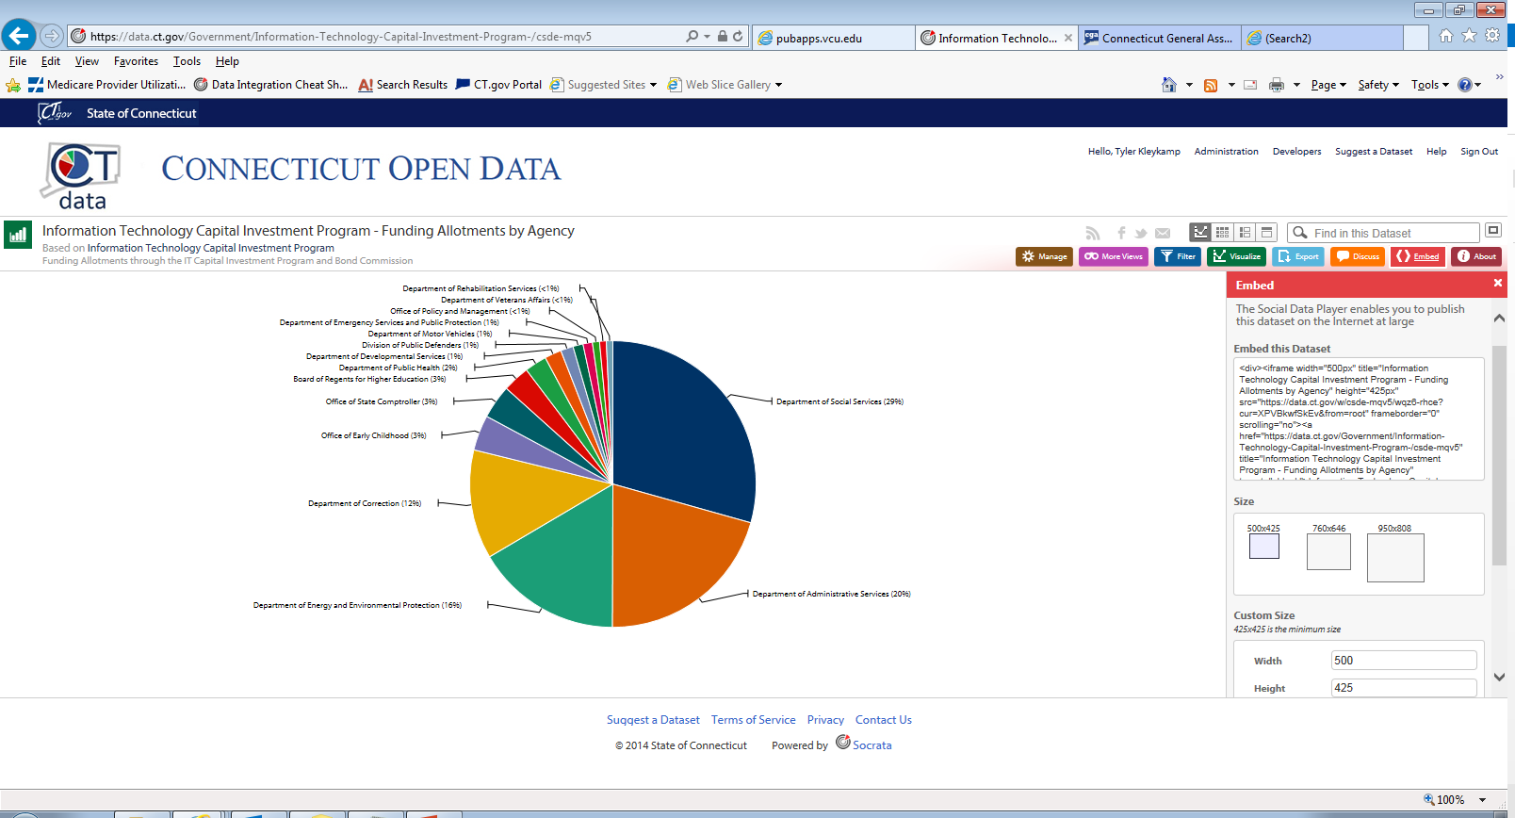

Slide 21
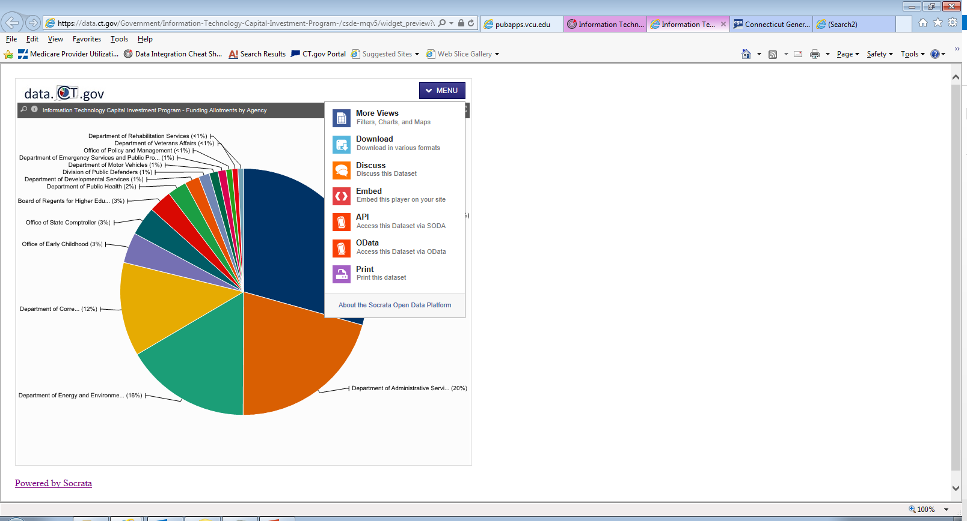

Slide 22
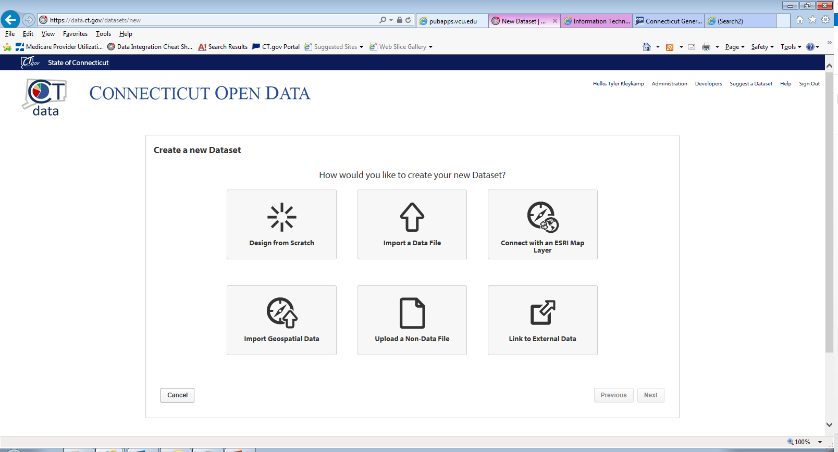

Slide 23
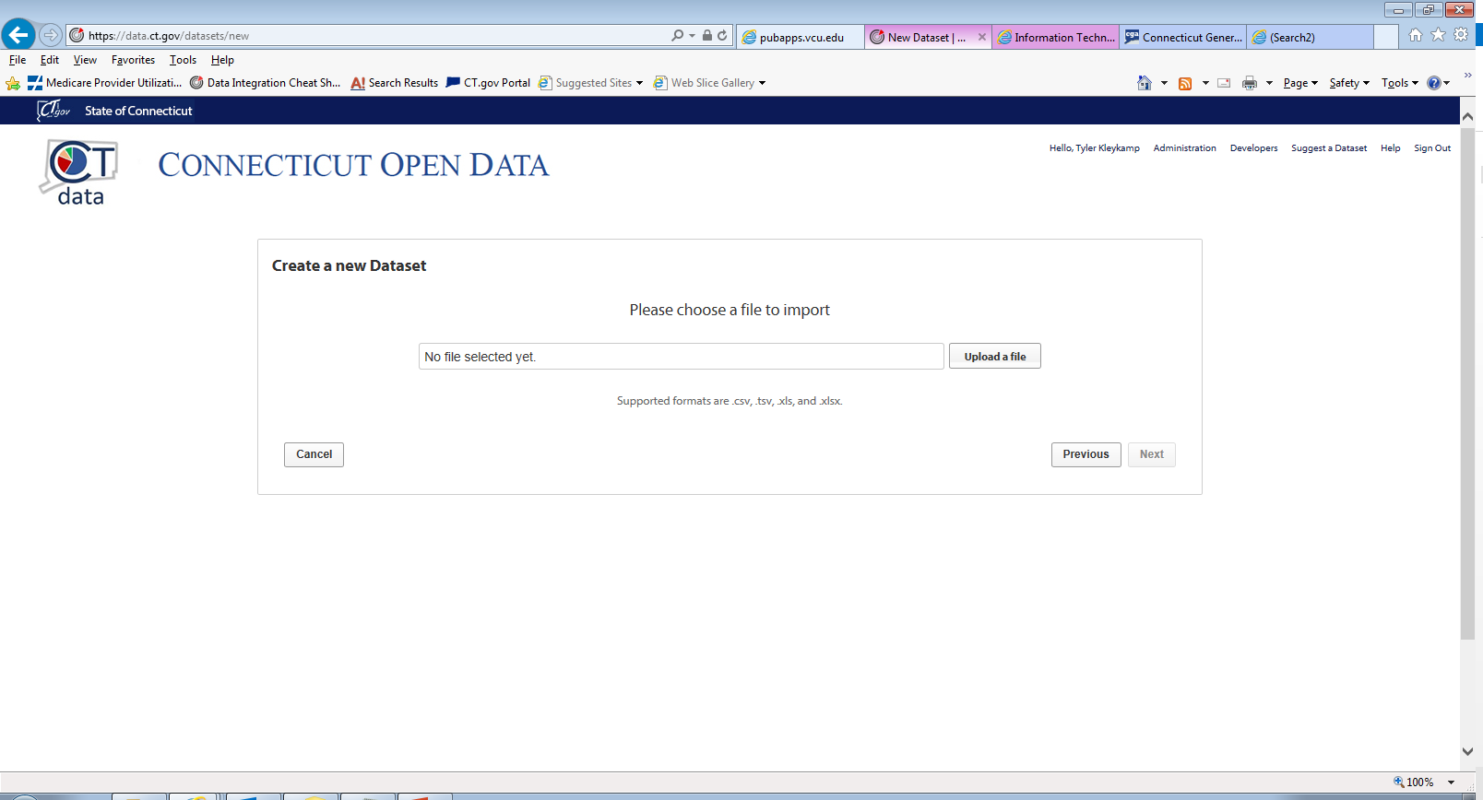

Slide 24
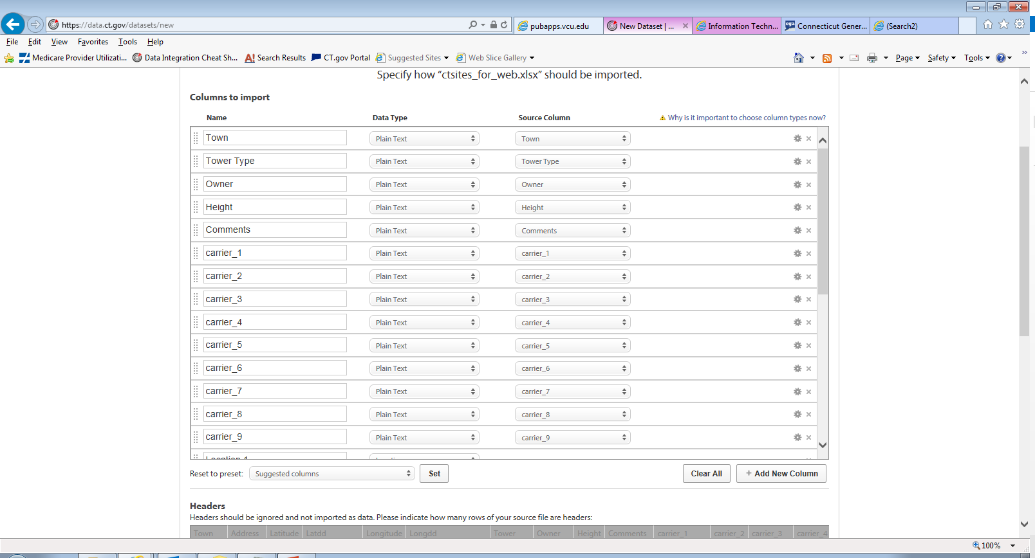

Slide 25
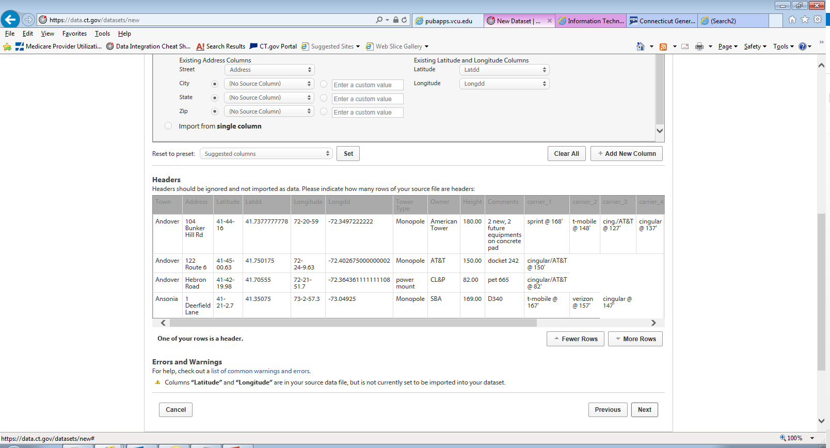

Slide 26
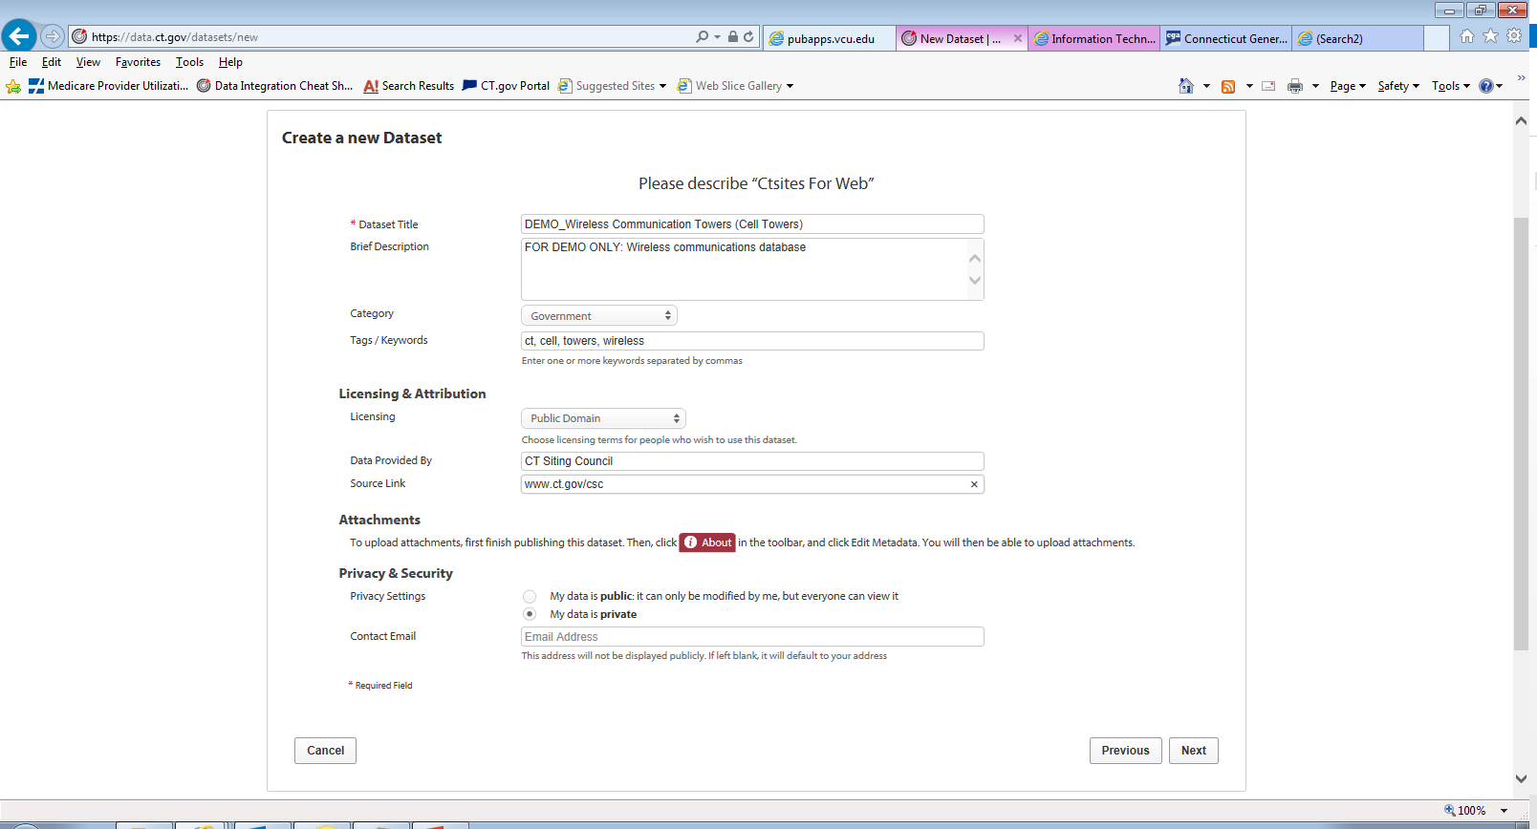

Slide 27
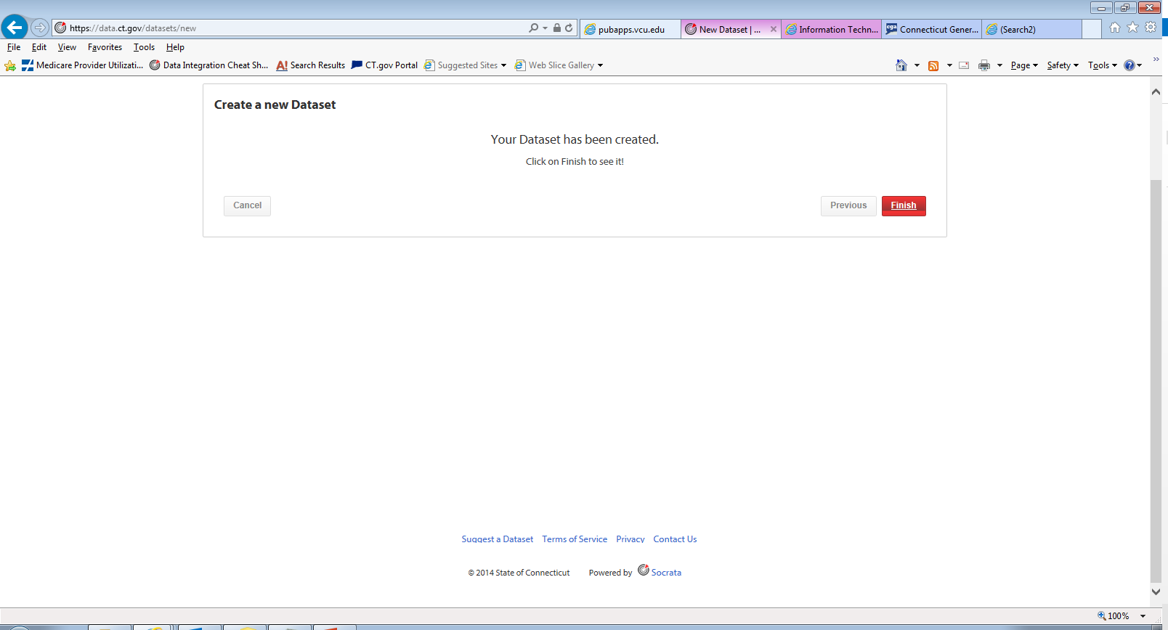

Slide 28
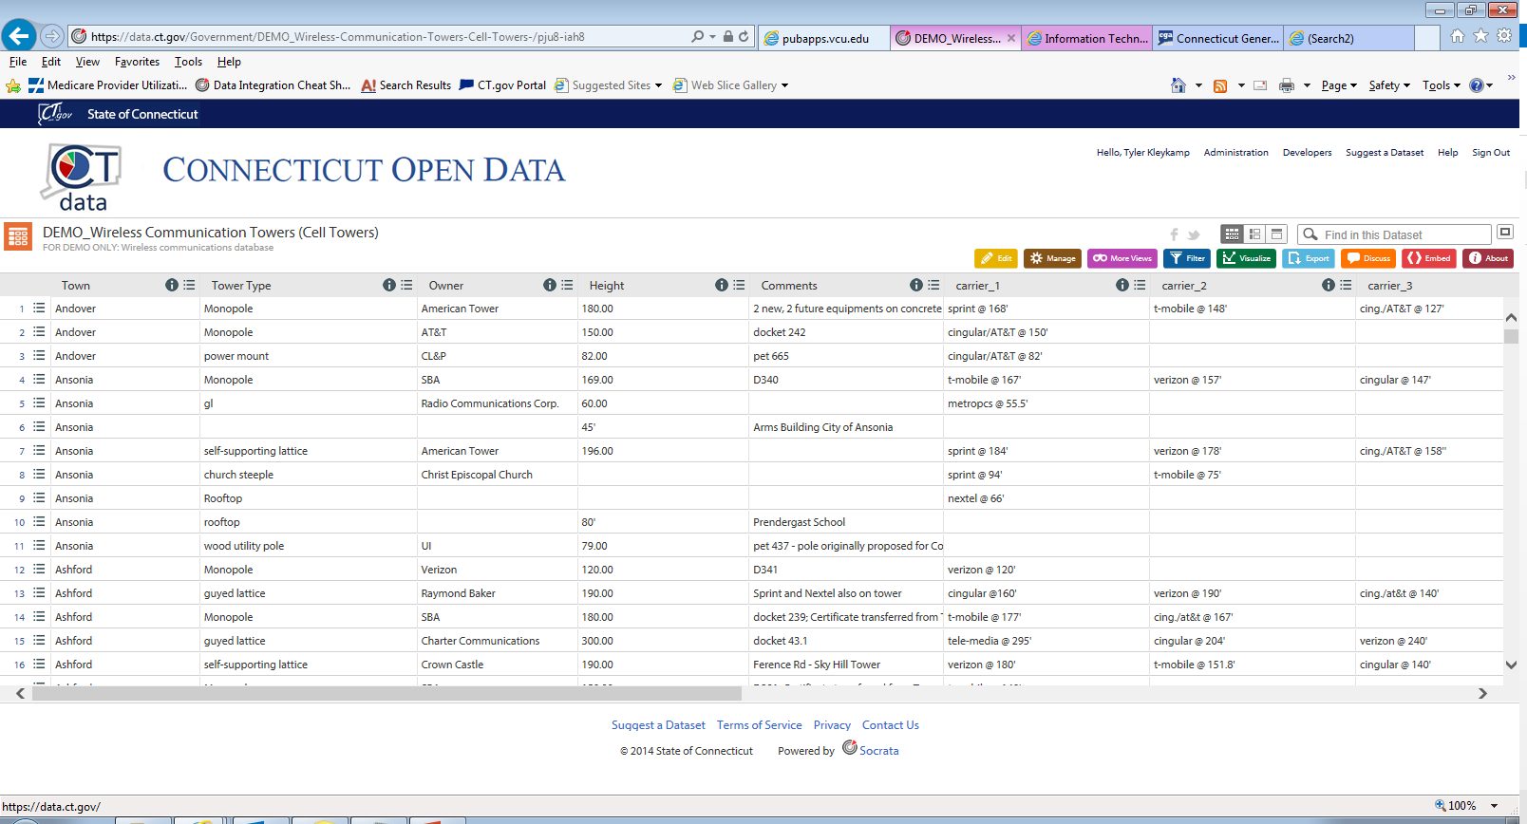

Slide 29
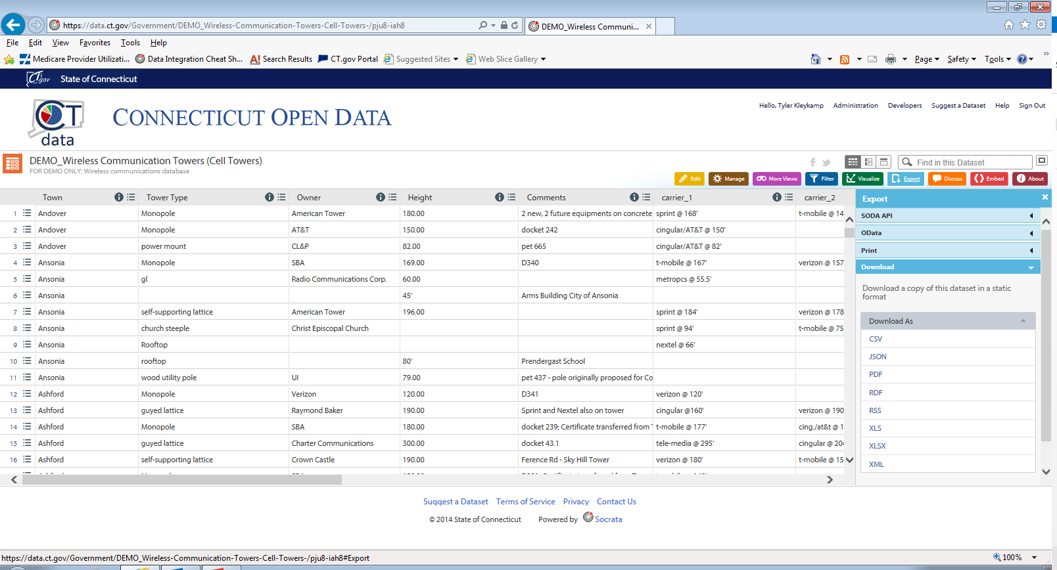

Slide 30
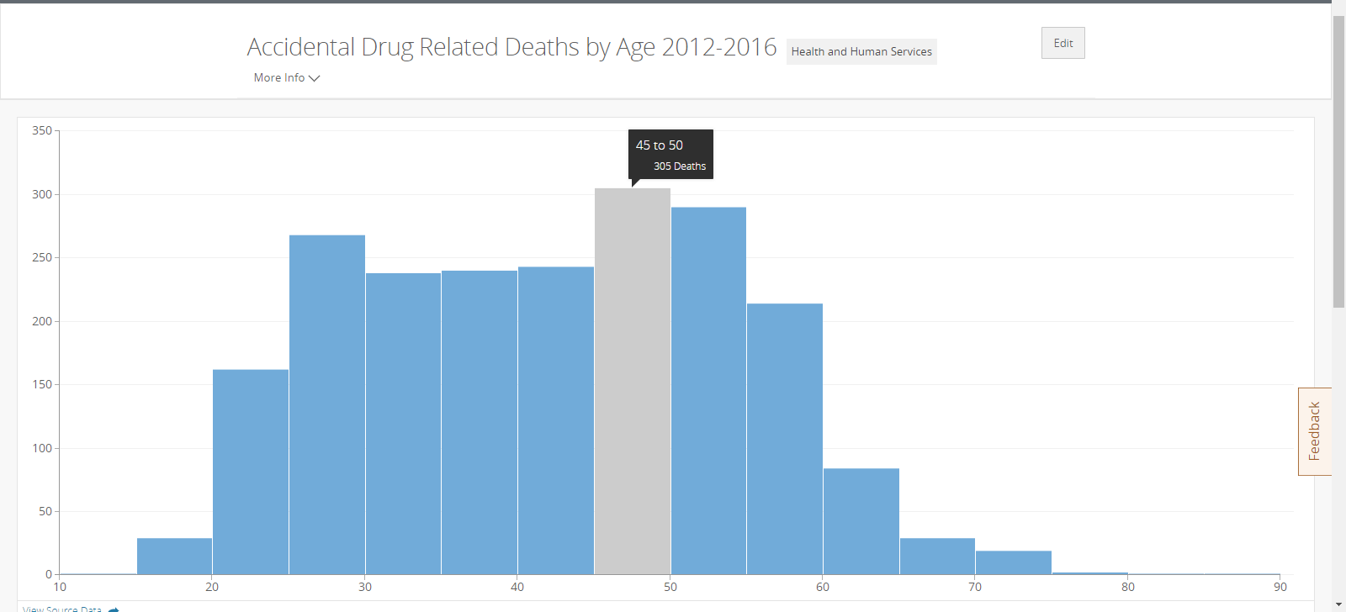
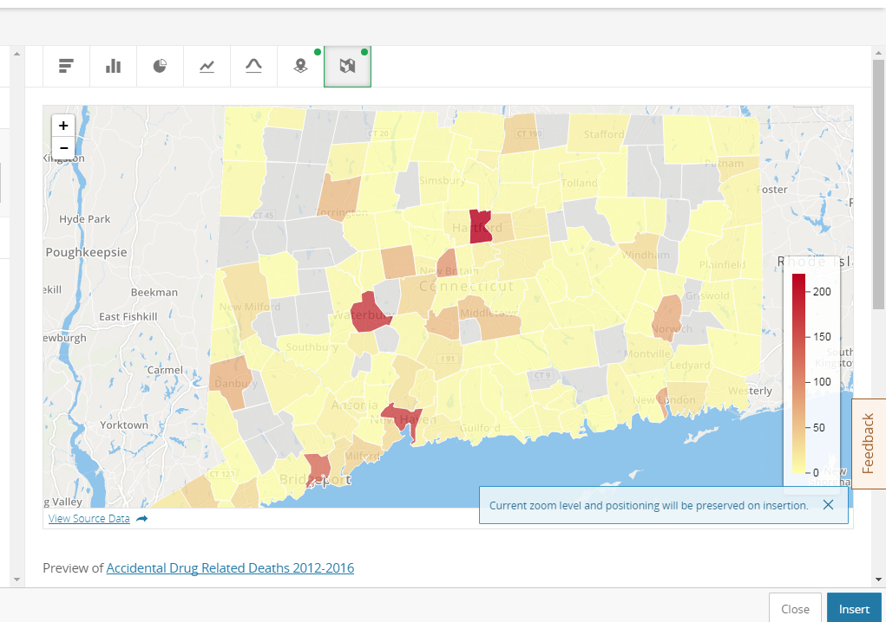
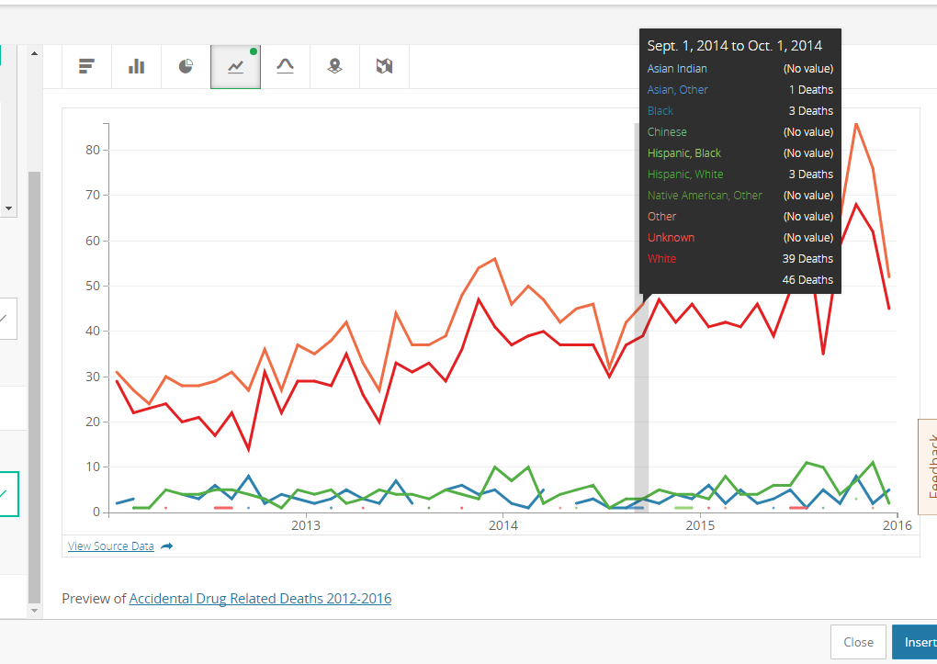

Slide 31
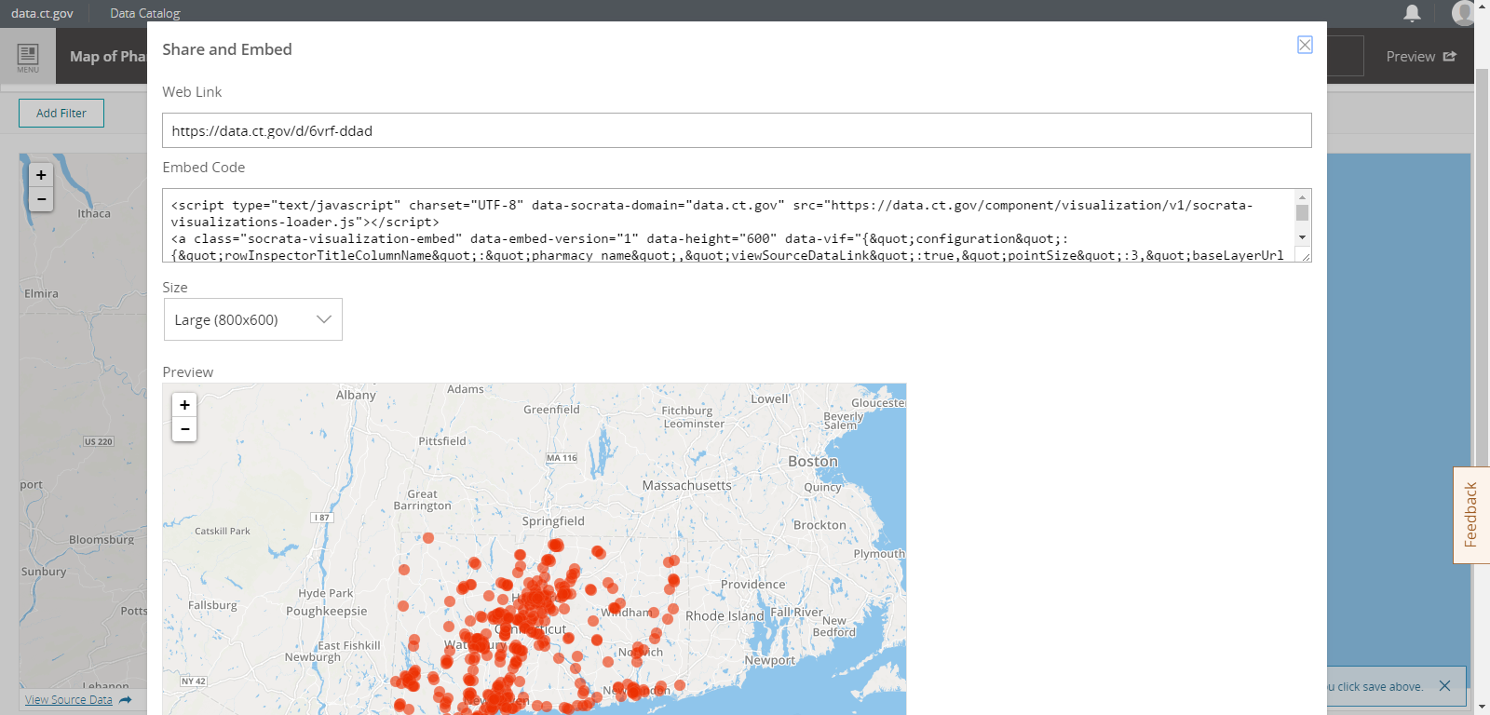

Slide 32
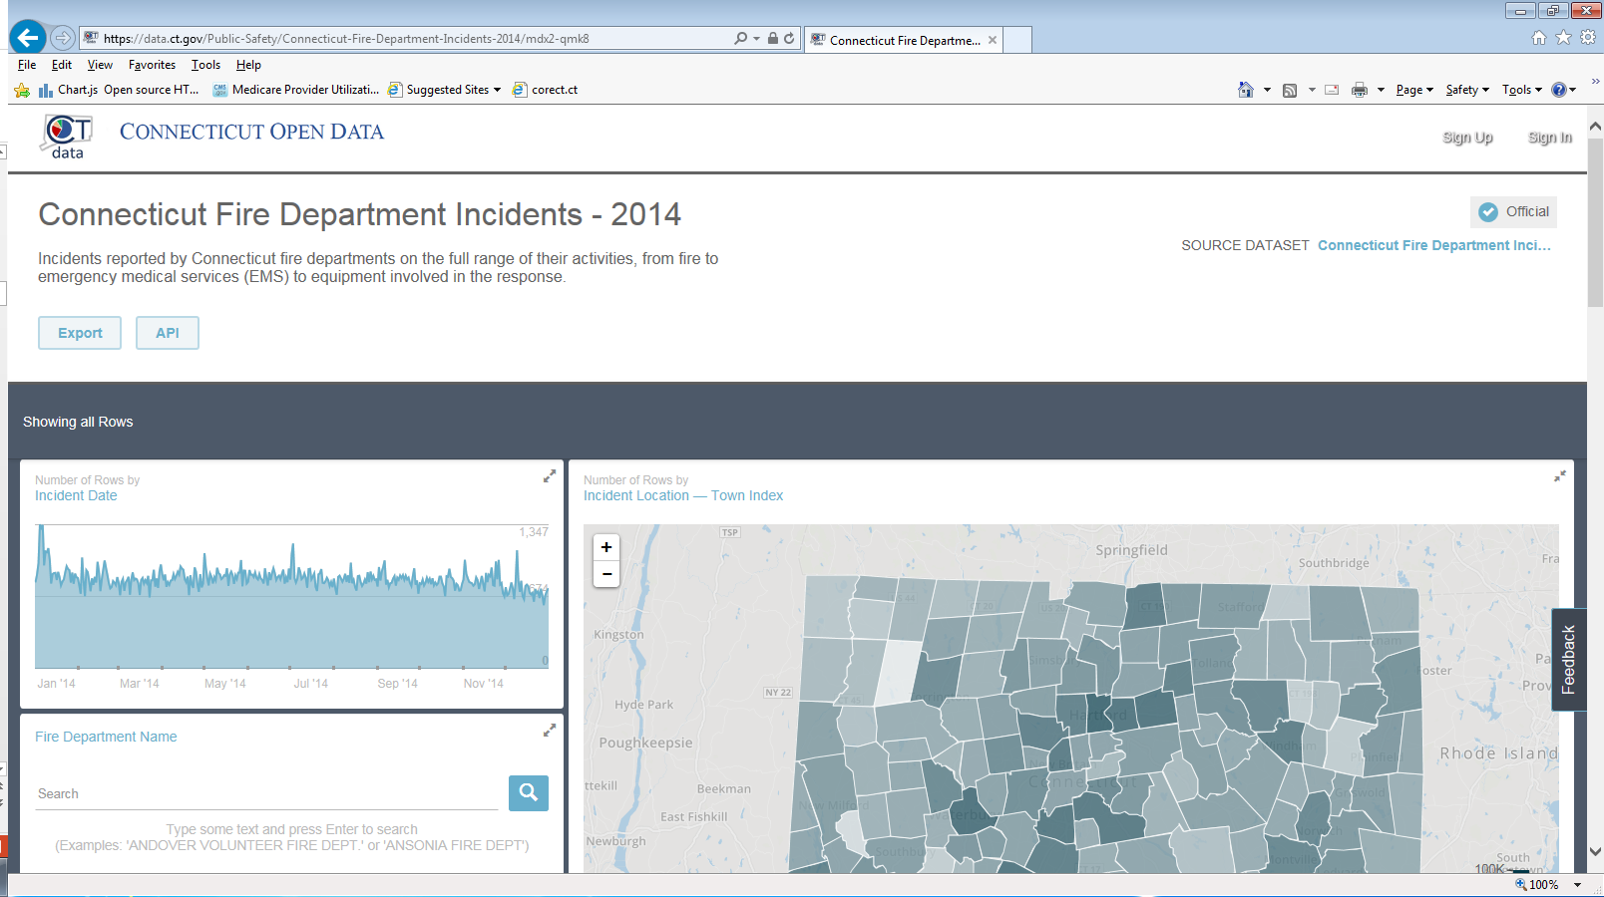

Slide 33
What Data Should I be Publishing?
Do people ask you for it? Either informally, or even through a FOIA request?
2. Is there a report that your agency submits to the legislature or the public that uses this data?
3. Are people required to provide it to you or your agency to obtain a license, credential, or certification?
4. Does it contain an address or a location, even if you’re not allowed to share it?
5. Is it or some version of it on the internet already?

Slide 34
Tyler Kleykamp
Chief Data Officer
(860) 418-6302
tyler.kleykamp@ct.gov

