Slide 1
CT Tech Act Project
Department of Aging and Disability Services
Arlene Lugo, ATP, Program Director
www.CTtechact.com

Slide 2
Connecticut Tech Act Project Mission
To increase independence and improve the lives of individuals with disabilities through increased access to Assistive Technology for work, school and community living.
Federally funded by the Assistive Technology Act legislation
Notes:
AT Act was just reauthorized as the 21st Century Assistive Technology Act of 2022.

Slide 3
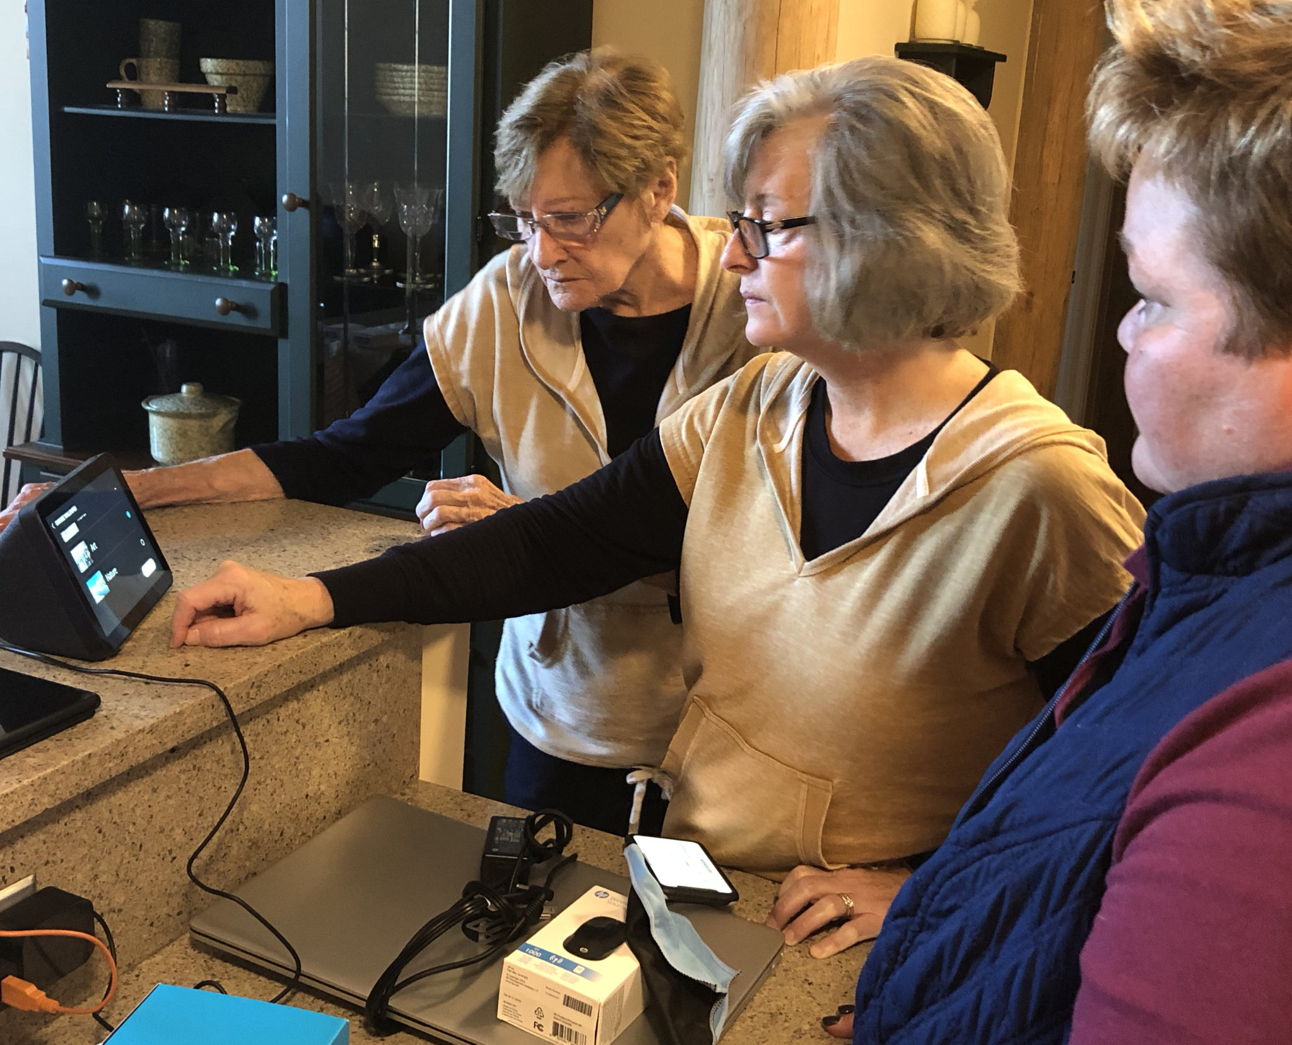
What is the Connecticut Tech Act Project?
Required to provide core services across the state:
AT Demonstration Centers
AT Lending
AT Recycling
AT Financial Loan
Training & Technical Assistance
Public Awareness
Information & Assistance
Notes:
Demos allow you to interact with device & make an informed decision
AT lending allows you to borrow and use device in your environment
Recycling allows you to get gently used equipment for less – cost savings
AT Financial Loan – allows you to borrow money to purchase AT you want or need at a lower rates with flexible paymetns

Slide 4
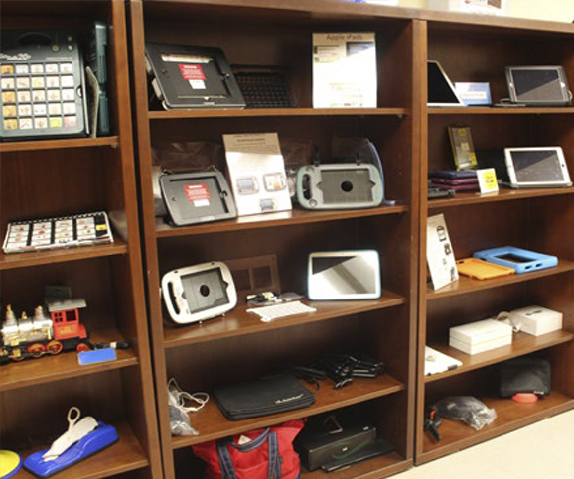
AT Community Partner Agencies
CREC
EASTCONN
Meriden ATECH
NEAT Center at Oak Hill
SERC
UCP of Eastern CT

Slide 5
Access Through Technology - FCC grant
Provides a range of telecommunication devices – computers, tablets, smartphones, amplified phones & more – to people with a combination of Deafness & Blindness at no cost.
Includes:
Assessment,
Free equipment,
Installation & Training
www.CTtech.com/att

Slide 6
Bridging the Digital Divide
Provide 1 on 1 or group training / technology supports to adults with disabilities and individuals 60 & older to help increase access to community, virtual programming & telehealth to reduce social isolation via mobile / tablet technology.
Training & supports to organizations & staff to help them support their clientele.
A collaboration between the Dept of Aging and Disability Services,
State Unit on Aging & CT Tech Act Project.

Slide 7
What is Assistive Technology (AT)?
“Assistive Technology (AT) device is any item, piece of equipment or product system, whether acquired commercially, modified or customized, that is used to increase, maintain, or improve the functional capabilities of individuals with disabilities.”
- AT Act of 2004
Notes:
Assistive Technology is defined as …any item, piece of equipment or product system, whether acquired commercially, modified or customized, that is used to increase, maintain, or improve the functional capabilities of individuals with disabilities.” – AT Act
I like to focus on the words “any item” …

Slide 8
“Holiday Shopping Just Got Smarter!”
“Smart home technology devices make awesome holiday gifts, especially for individuals with disabilities or aging adults who might be looking for ways to enhance access to their home, improve their functioning, and make a real difference in increasing their independence!”
https://cttechact.com/holiday-shopping-just-got-smarter
Notes:
Assistive Technology is defined as …any item, piece of equipment or product system, whether acquired commercially, modified or customized, that is used to increase, maintain, or improve the functional capabilities of individuals with disabilities.” – AT Act
I like to focus on the words “any item” …

Slide 9
What is AT Services?
Assistive Technology (AT) Services refers to “any service that directly assists an individual with a disability in the selection, acquisition or use of an assistive technology device.”
- AT Act of 2004
Notes:
Assistive Technology (AT) Services refers to “any service that directly assists an individual with a disability in the selection, acquisition or use of an assistive technology device.”
- AT Act of 1998, as amended

Slide 10
AT Services includes:
Evaluation of need
Device Trials
Designing, customizing, fitting, adapting the AT device
Training & Follow up
Maintenance or Repair
- AT Act of 2004
Notes:
AT Service includes:
Evaluation of need
Device Trials
Designing, customizing, fitting, adapting the AT device
Training & Follow up
Maintenance or Repair

Slide 11
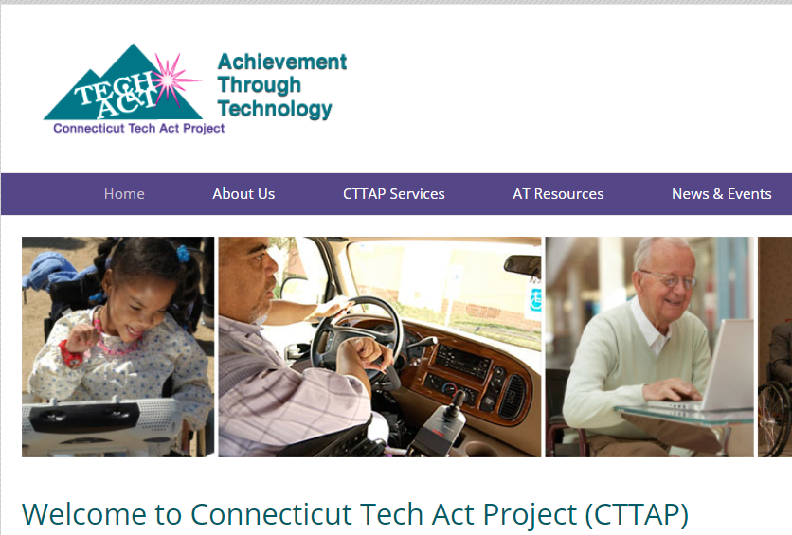
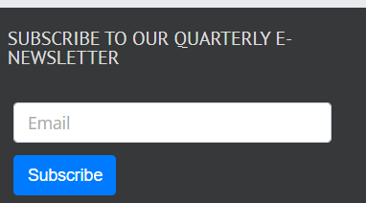
How can you learn more?
Visit our website: www.CTTechact.com
Sign up for our quarterly e-newsletter
Find contact info for our AT Partners
Sign up for AT Partners’ e-newsletters and follow on social media

Slide 12
Contact Information
Arlene.Lugo@ct.gov
860-803-0588 (call or text)
Follow us on:
Twitter, Instagram or Facebook
@CTtechact or ww.facebook.com/CTtechact/

