Slide 1
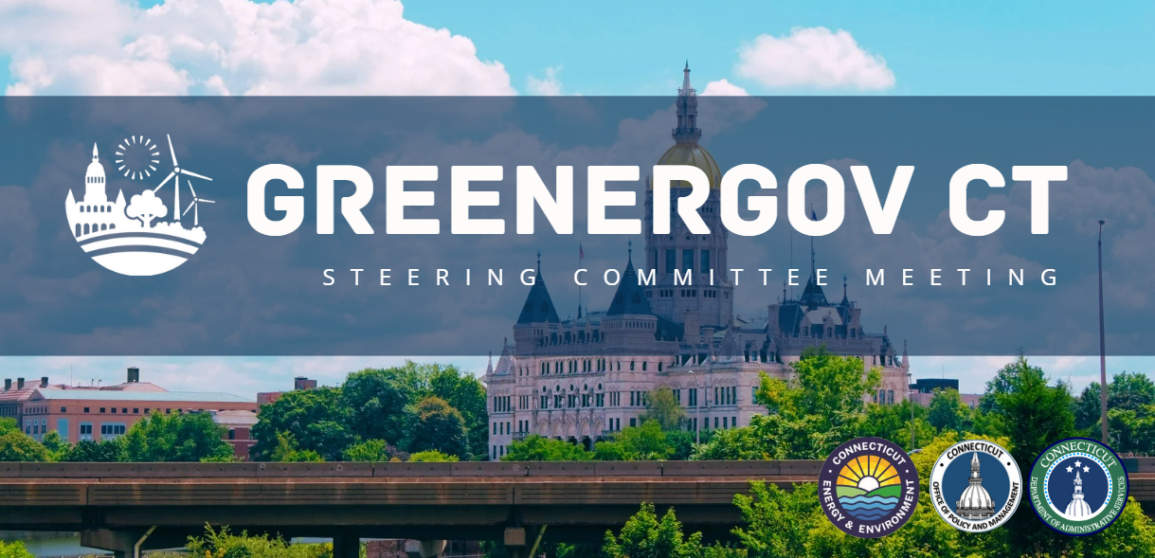
Friday 28, 2025 ​
79 Elm Street, Hartford, CT 06106
Gina McCarthy Auditorium

Slide 2

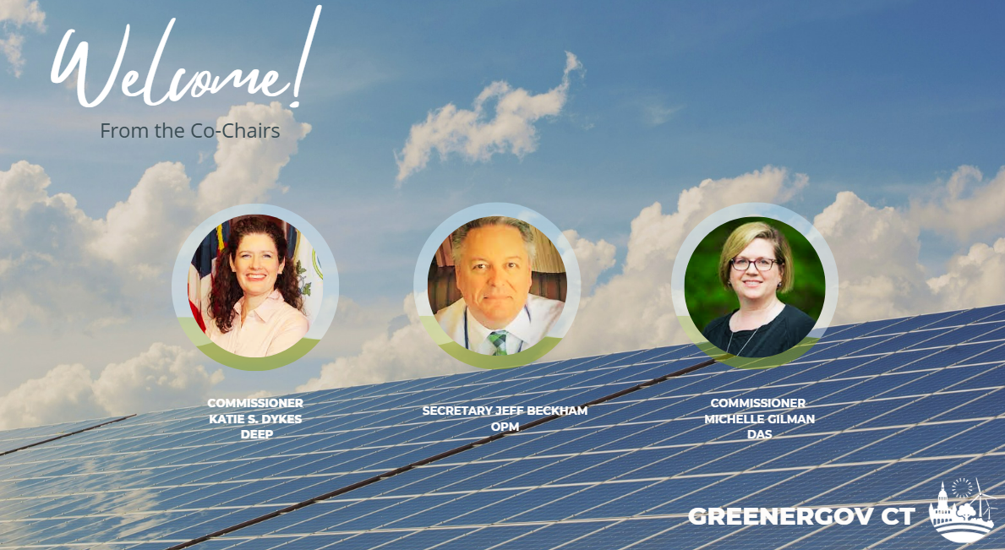
GReenergov

Slide 3

Agenda
Welcome and Introductions
GreenerGov Annual Report Presentation
Sustainability Efforts & Data Integration
Overview & Discussion of Resources for SSOs
Public Comment
Closing

Slide 4
Annual Report Presentation & key INITIATIVES

Slide 5



2. Greenergov E.O. 1 targets
E.O.1: Goals for State Sustainability
Reduce GHGs by 45% below 2001 levels by 2030
Reduce 25% of waste by 2030 from a 2020 baseline
Reduce 10% of water consumption by 2030 from a 2020 baseline
Targets

Slide 6






2. Greenergov e.O. 21-3 Targets
Strengthening interim targets by 2024
Organics & food waste program
Plan for zero GHGs for new construction & renovations
1% divestment of state building sq ft.
Strengthening interim targets by 2030
Electricity purchased 100% zero carbon
Leased state vehicles - zero emissions
Plan for zero emission heating & cooling systems
Solar capacity increase of 10,000kWDC

Slide 7
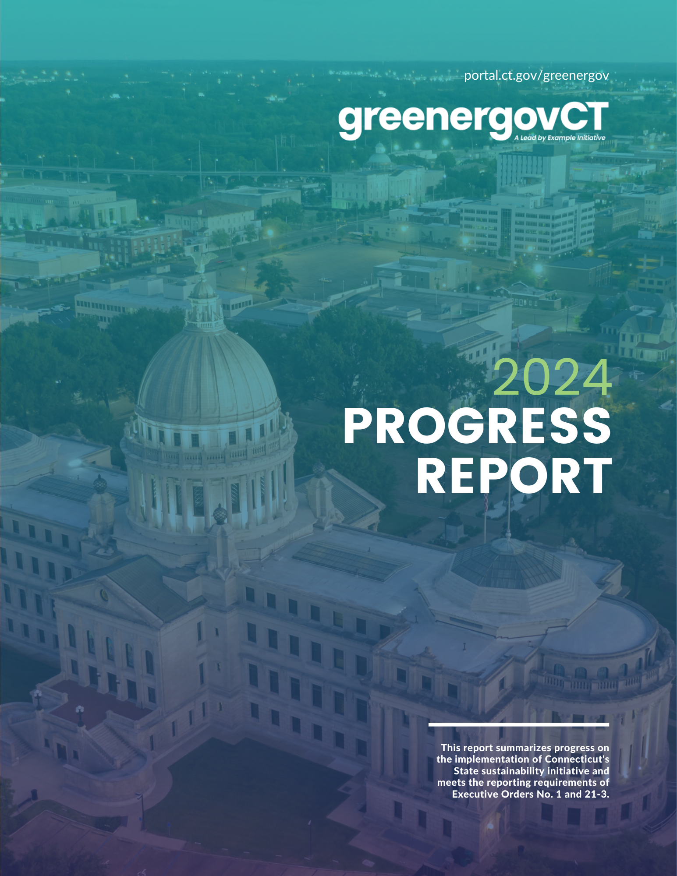
FY23 Annual report – key findings
Annual progress report includes updates on sustainability projects from agencies in 2024
Includes updated data on utility use and cost for FY19-FY23 and progress on sustainability goals
  Data was pulled on February 10, 2025
  Data is preliminary and subject to change as updates are made to the EnergyCAP database
In addition to the 2024 Progress Report, the GreenerGov CT Reporting Dashboard on the CT Open Data Portal has also been updated to reflect updated data from FY19-FY23.

Slide 8
FY23 Annual report – key findings – GHG Emissions
Executive Branch GHG emissions went down over 30% since FY 2019.
GHG emissions from building energy (electricity, natural gas, oil, propane, steam, chilled water, and hot water) decreased by 8% from FY22.
Much of this reduction can be attributed to a cleaner electricity mix and increased equipment efficiency.

Slide 9
FY23 Annual report – key findings – Water
Available water and sewer data show a decreased of more than 15% since FY 2019.
Some of this decrease can be attributed to incomplete data. More work is needed to ensure water usage data is complete going forward.

Slide 10
FY23 Annual report – key findings – waste
EO 1 requires Executive Branch agencies to reduce waste disposal by 25% from a FY19 baseline by 2030.
To measure progress towards this goal, we need consistent data on waste disposal at Executive Branch facilities, which we currently do not have.
  Facilities have a mix of metered and unmetered waste disposal, static and seasonal occupancy, varying levels of access to recycling and other diversion programs, and systemic restraints on waste management practices.
Our goal is to implement a consistent measurement methodology with the ability to incorporate facility-specific factors.

Slide 11
FY23 Annual report – key findings – EO 21-3 GOALS
Goal | Metric | FY22 | FY23
By 2024, all Executive Branch agency facilities, to the extent practicable, shall implement an organics and food waste diversion program | Number of Executive Branch facilities with contracted composting service | 2 (out of 29) | 6 (out of 29)
By 2030, all electricity purchased and generated by the Executive Branch will be 100% zero carbon | % of total electricity usage that is zero carbon | 76% | 63%
By 2030, all newly leased light duty state vehicles shall be zero emission vehicles | % of leased vehicles that are electric vehicles | 1.1% | 4.3%
By 2024, the State shall divest 1% of all Executive Branch building square footage, and an additional 2% by 2028 | Annual change in Executive Branch square footage | -2.7% | 8.6%
The State shall deploy an average of 10,000 KWDC of new solar capacity annually for the next 10 years | Total installed solar capacity (kWDC) since 2020 | 23,225 | 23,954
The State shall commit to reducing Executive Branch building GHG emissions by at least 1 % annually | Annual change in building GHG emissions (MTCO2e) | -3.8% | -8.2%

Slide 12
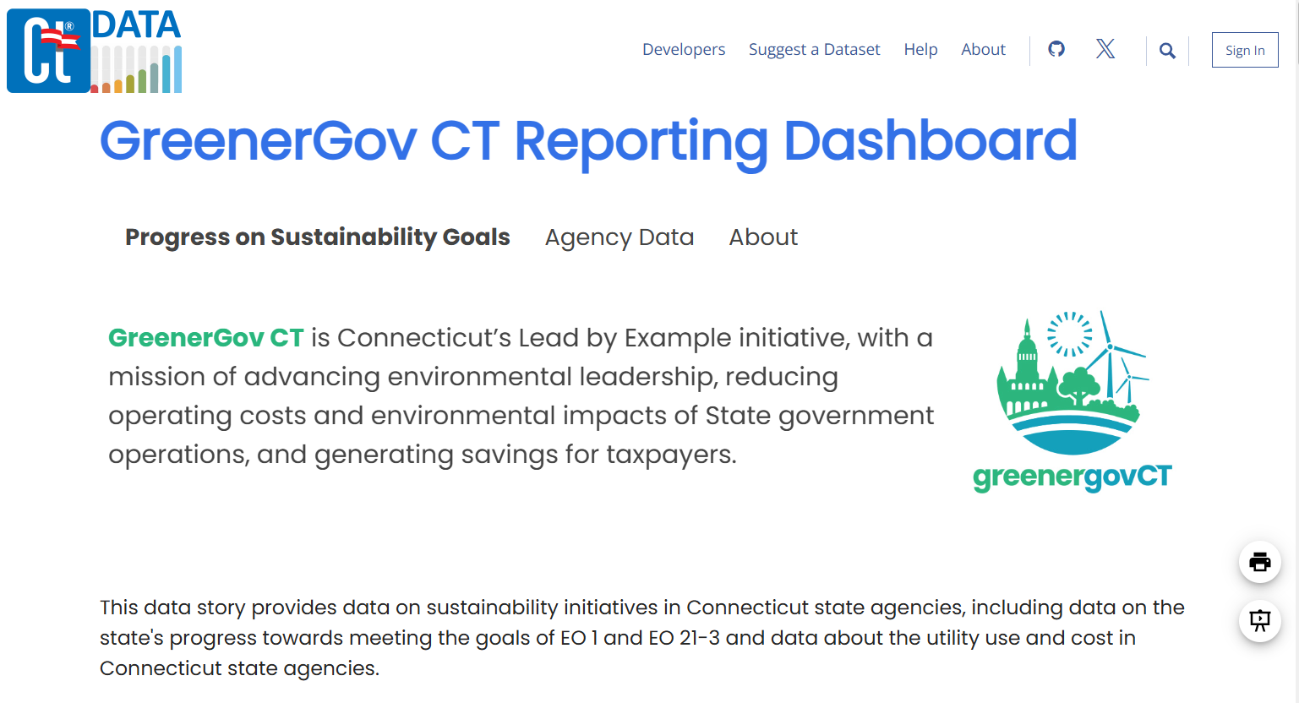
FY23 Annual report – key findings
Visit the GreenerGov CT Reporting Dashboard on the CT Open Data Portal to explore the metrics related to GreenerGov CT and see agency Sustainability Performance Plans.

Slide 13
Annual Report Presentation & key INITIATIVES
Net Zero Projects – DEEP & DOC
Transportation Electrification- DAS, DOT, MIL
  The Decarbonization Study - DAS
  Waste Initiative – UConn​

Slide 14
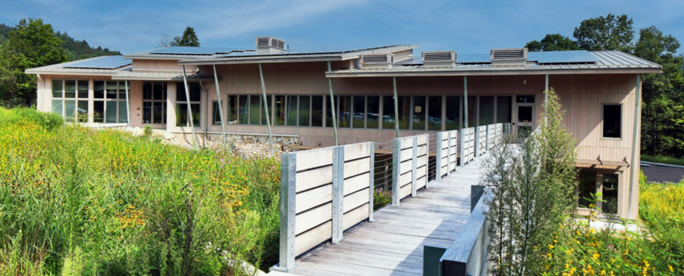
DEEP Western District headquarters

Slide 15
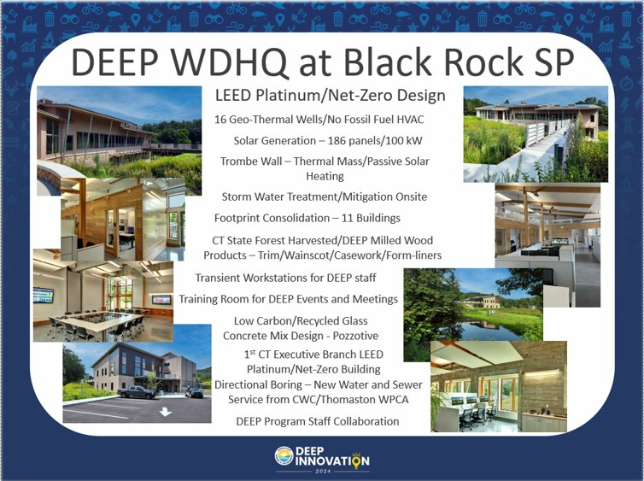

Slide 16
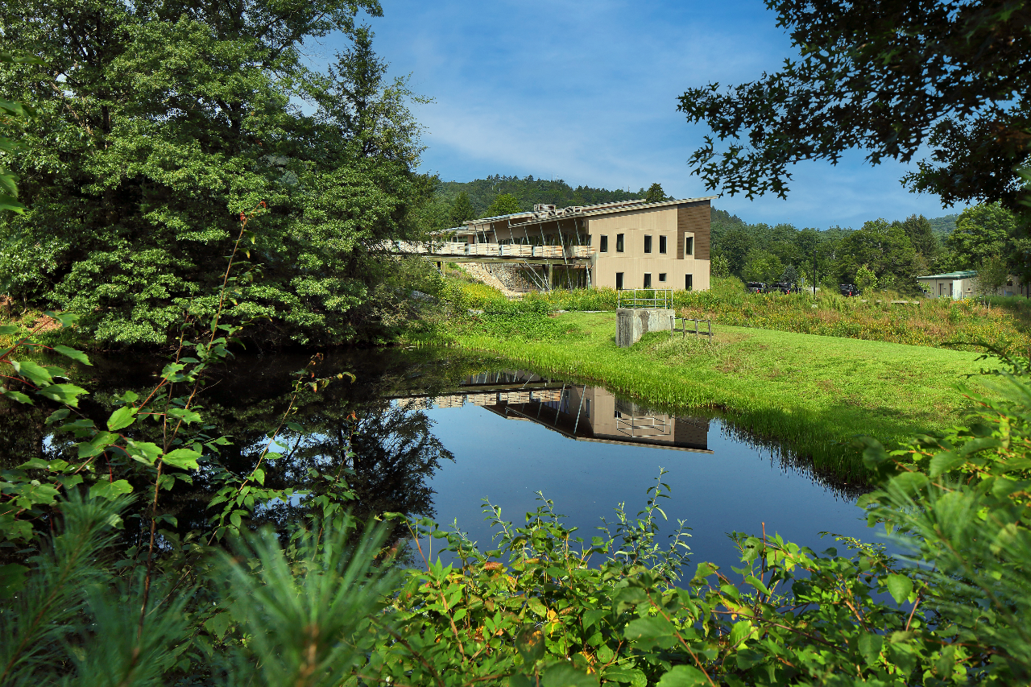

Slide 17
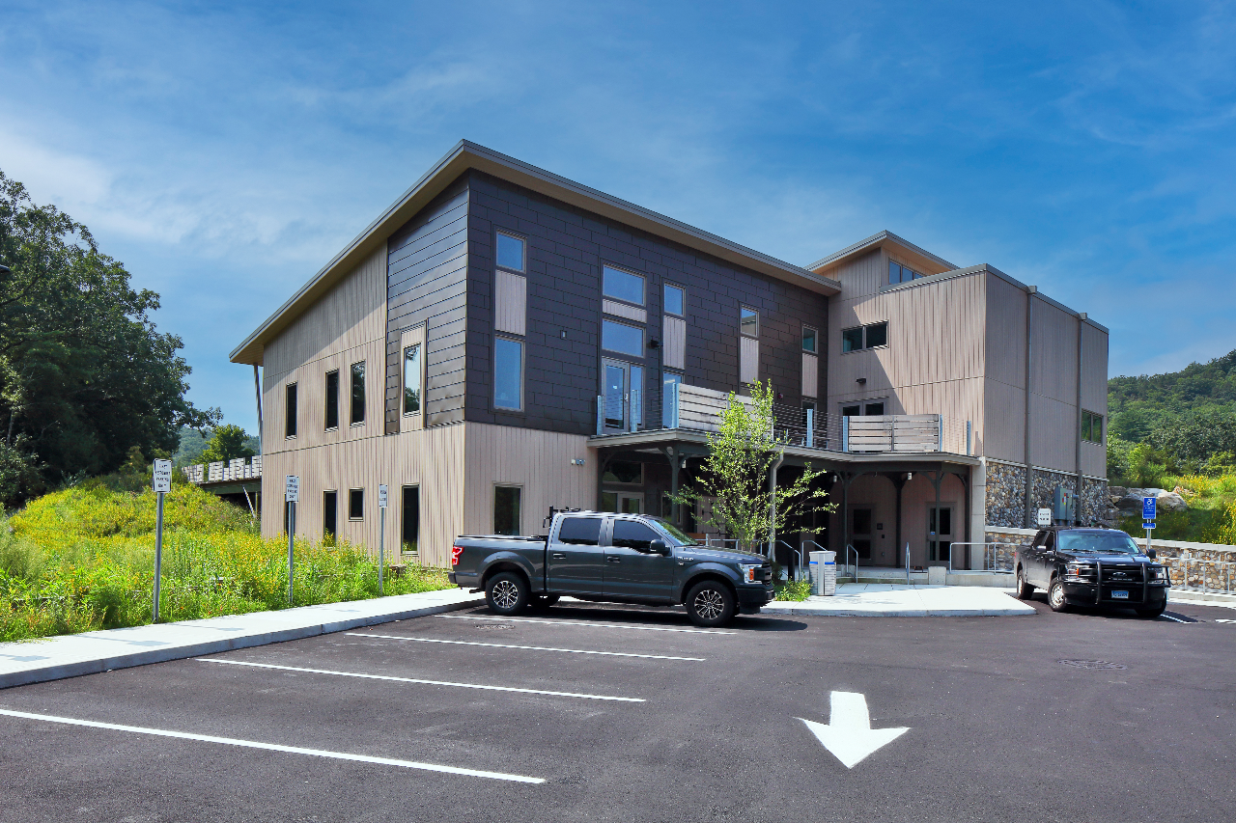

Slide 18
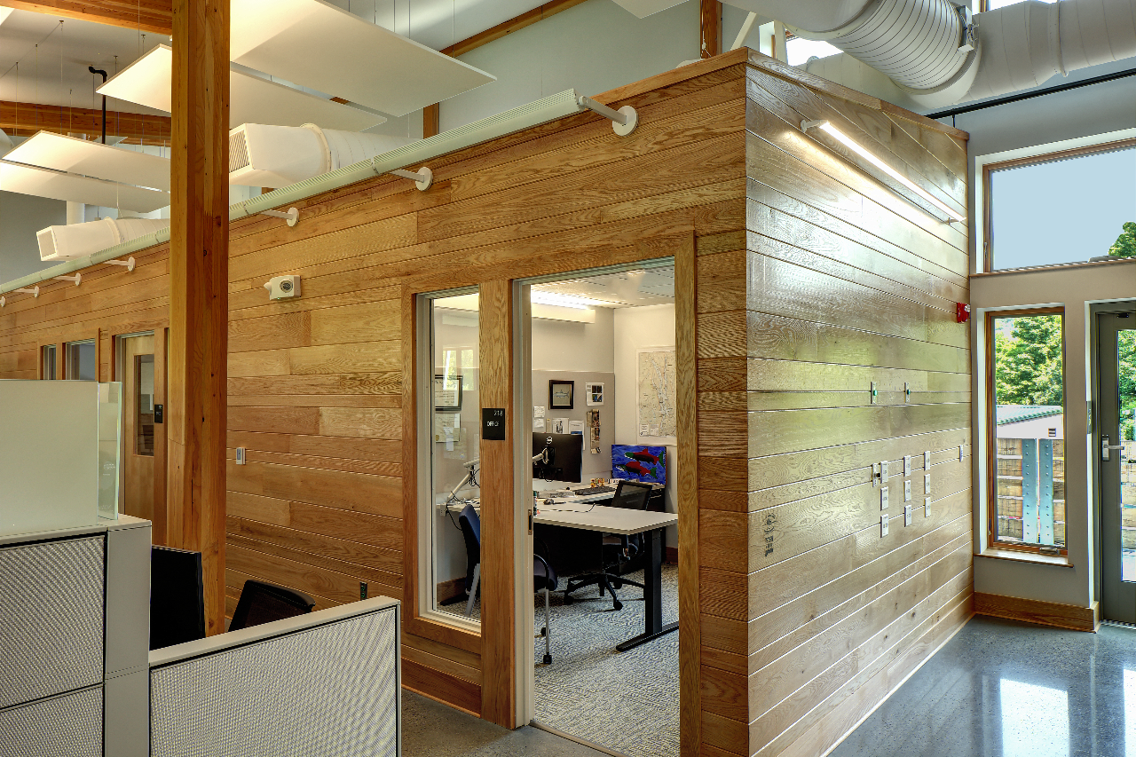

Slide 19


Slide 20
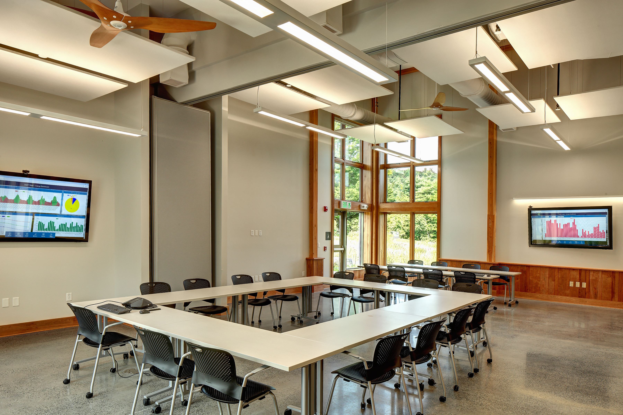

Slide 21
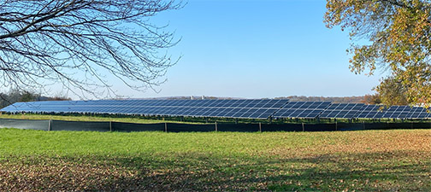
Reducing fossil fuel Dependency - DOC

Slide 22
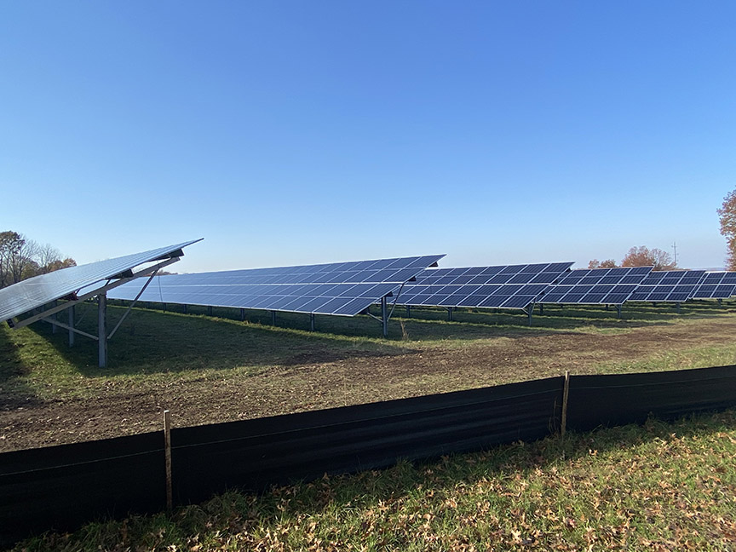
Reducing fossil fuel Dependency - DOC

Slide 23
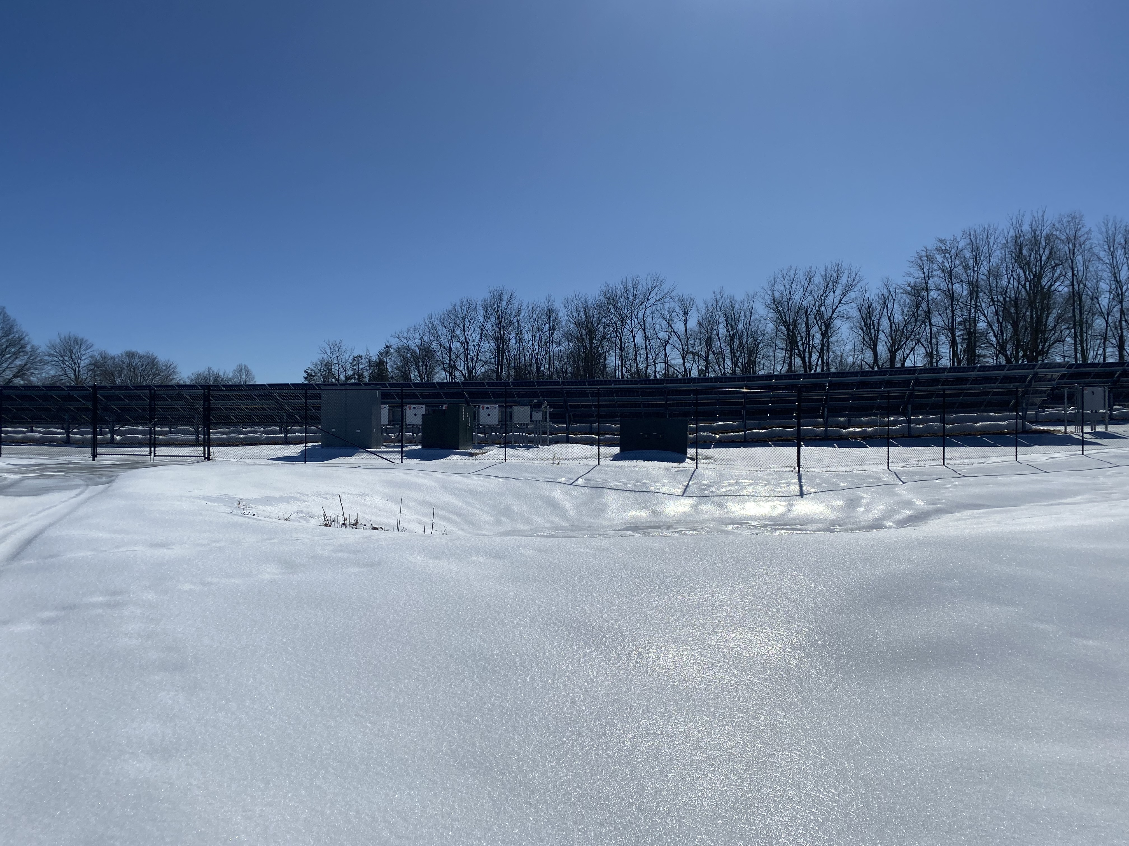
Reducing fossil fuel Dependency - DOC

Slide 24
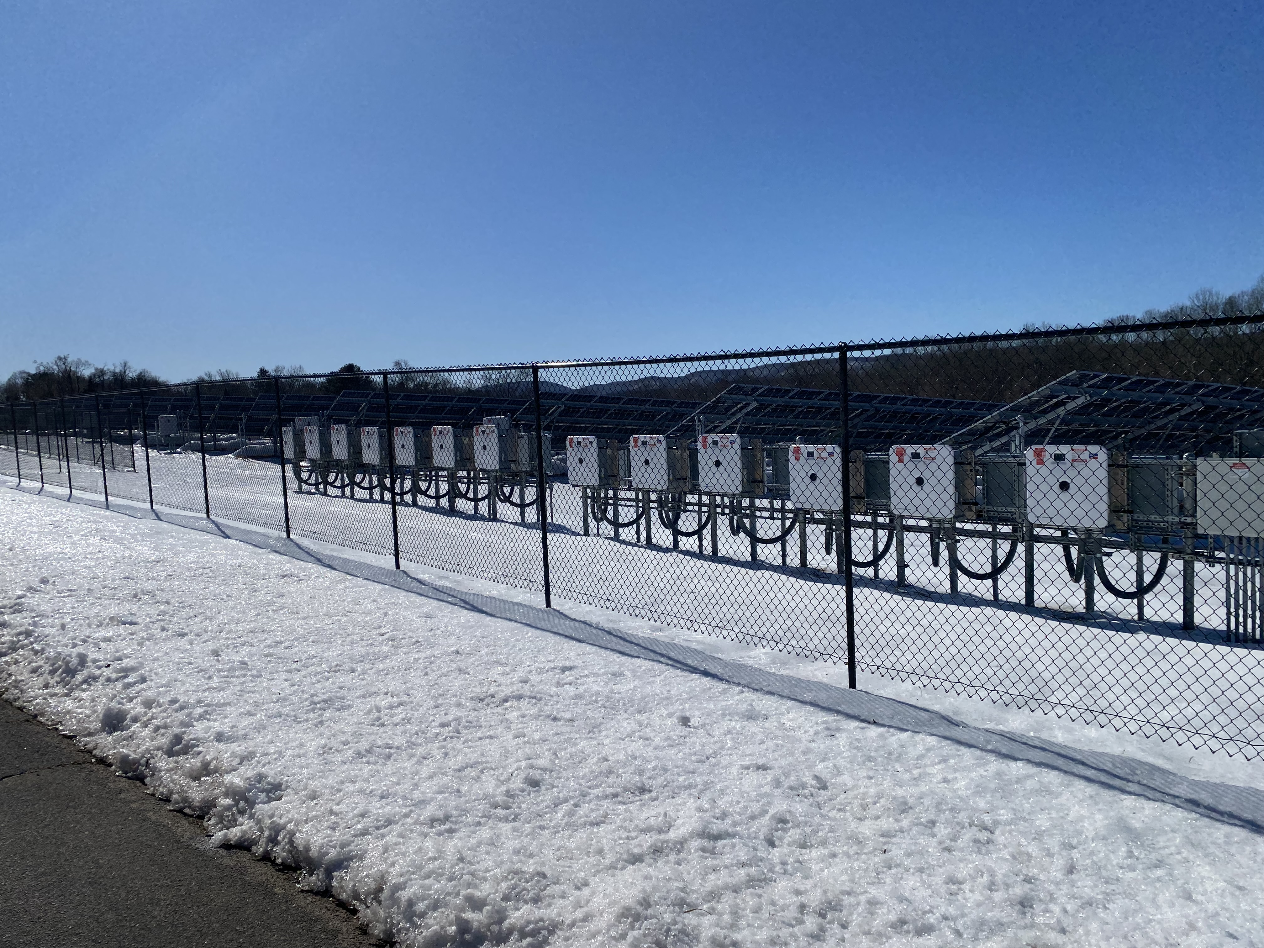
Reducing fossil fuel Dependency - DOC

Slide 25
Transportation Electrification - DAS
Mandated by statute to electrify state light-duty fleet vehicles
  Coordinating with state agencies to install electric vehicle (EV) chargers on state property where DAS leases light-duty fleet vehicles to
EVSE contracts:
  EVSE Software
  EVSE Hardware
  Maintenance/installation
Charging Fee implementation

Slide 26
Facility Electrification
Office of Transit and Ridesharing
Connecticut Department of Transportation
February 28, 2025

Slide 27
Legislative and Executive Language Related to Electrification
Connecticut General Statutes 4a-67d, excerpt:
State of Connecticut Executive Order No. 21-3 (dated 12/16/22), excerpt:
“Existing law requires that, starting January 1, 2030, at least 30% of state-purchased or –leased buses be zero-emission buses. Beginning January 1, 2024, the bill also prohibits the state from procuring, purchasing, or leasing diesel-fueled buses.”
“Statewide battery electric bus fleet by 2035. The DOT shall cease purchasing or providing state funding to third parties for the purchase of diesel buses by the end of 2023. DOT shall create an implementation plan which identifies any barriers to full bus fleet electrification.”

Slide 28
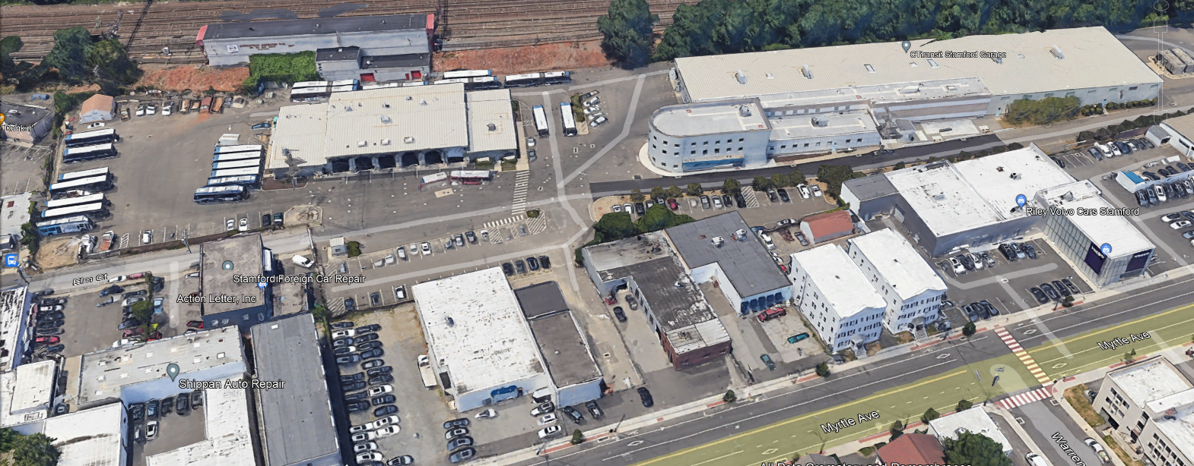
CTtransit Stamford
39
5
11
Current Fleet Breakdown: 55 Buses (42 Diesel, 13 Electric) - 100% Electrification by 2027
Phase 1 Electrification – 4 BEB Pilot Program
  5 new chargers installed and operational – 13 BEB’s in service
  Charge management software to monitor bus charging
Phase 2 - 100% Electrification Construction of Existing building
  Currently in construction – adds 39 chargers upon completion, by end of 2025
2. Phase 2 – 11 Bus Building

Slide 29
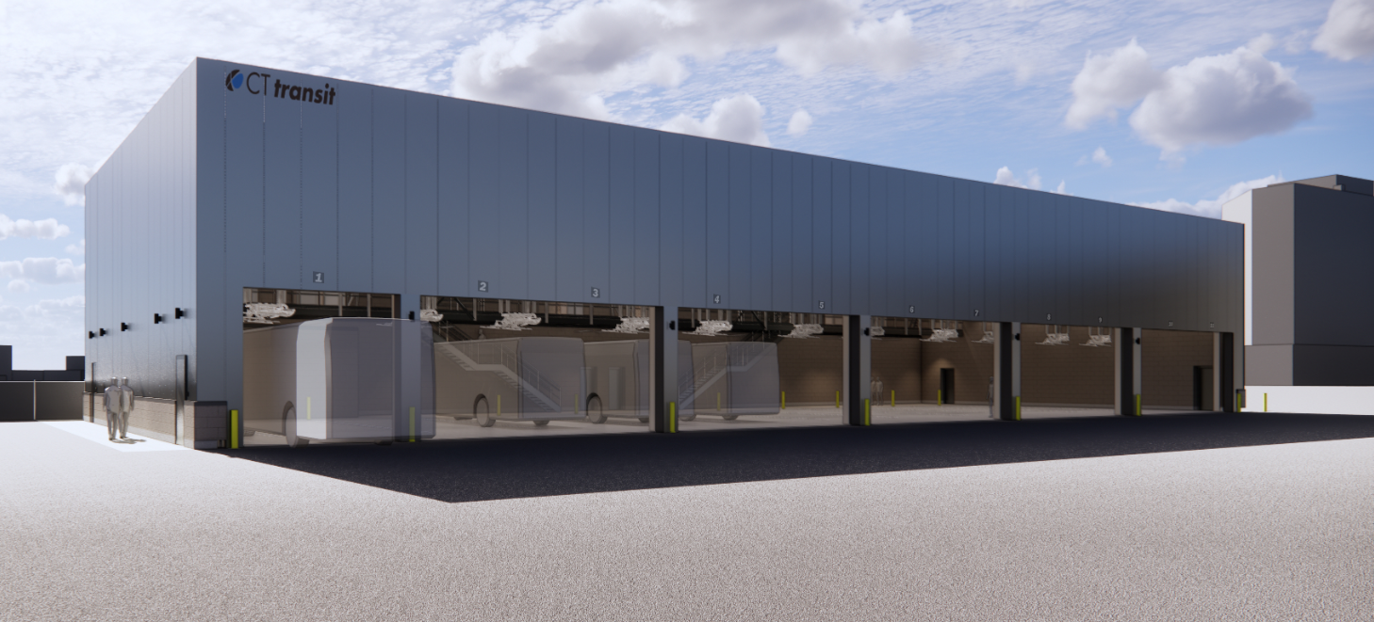
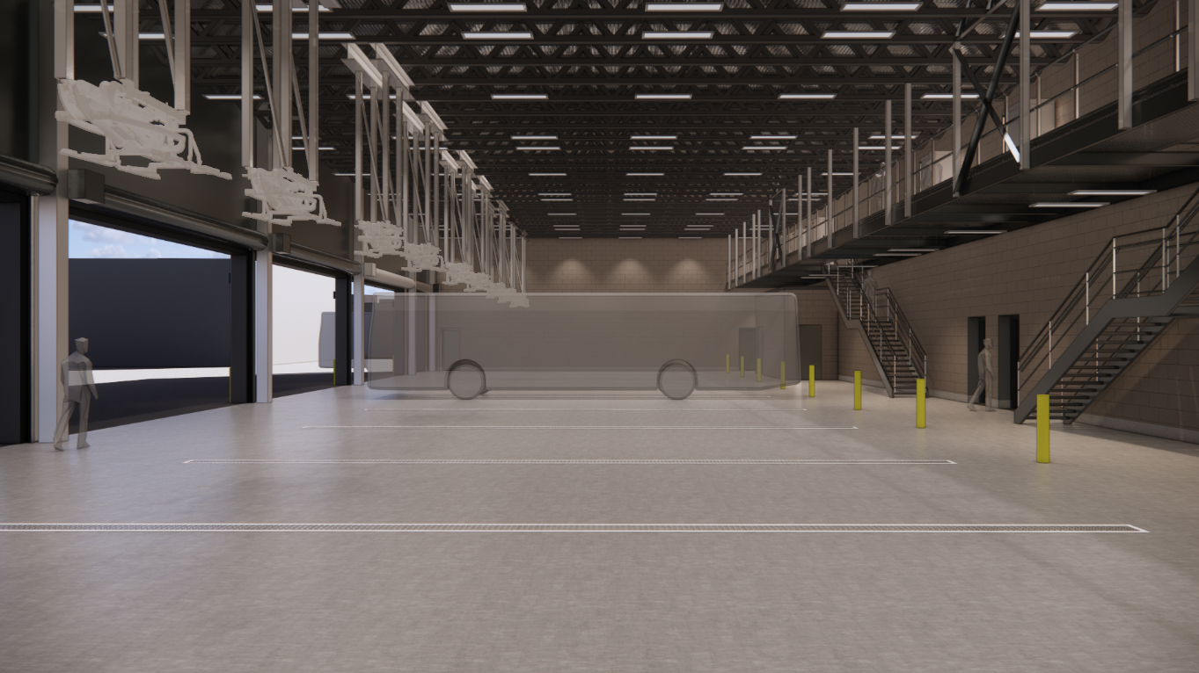
11 Bus Building
New 11 BEB storage & charging building – Phase 2 Electrification
11 pantographs to charge 11 buses
Mobilization February 2025
Construction Completion expected Q4 2026

Slide 30
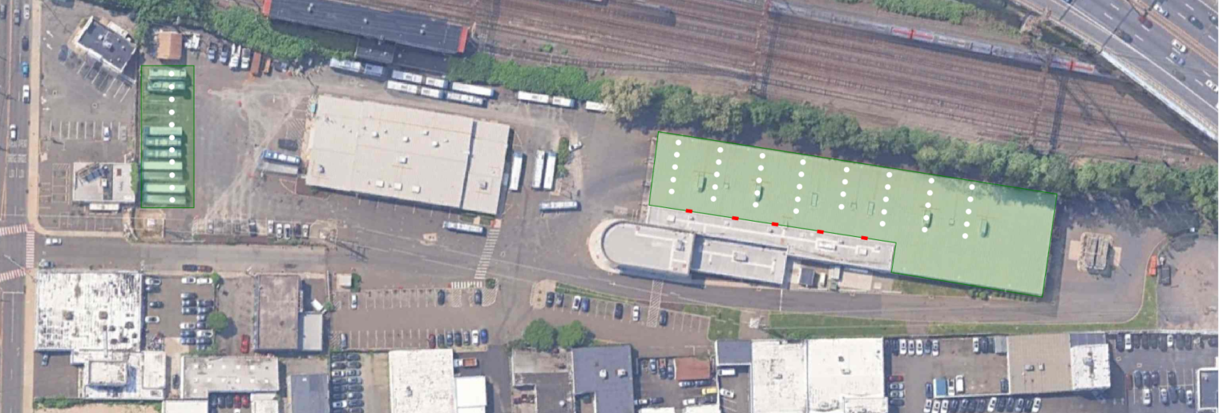
Charging Locations
Charger Type | Location | # of chargers
Pantograph | Bus Garage | 39
Plug-in | Bus Garage | 5 (10 dispensers)
Pantograph | 11-Bus Building | 11
 | Total: | 55

Slide 31
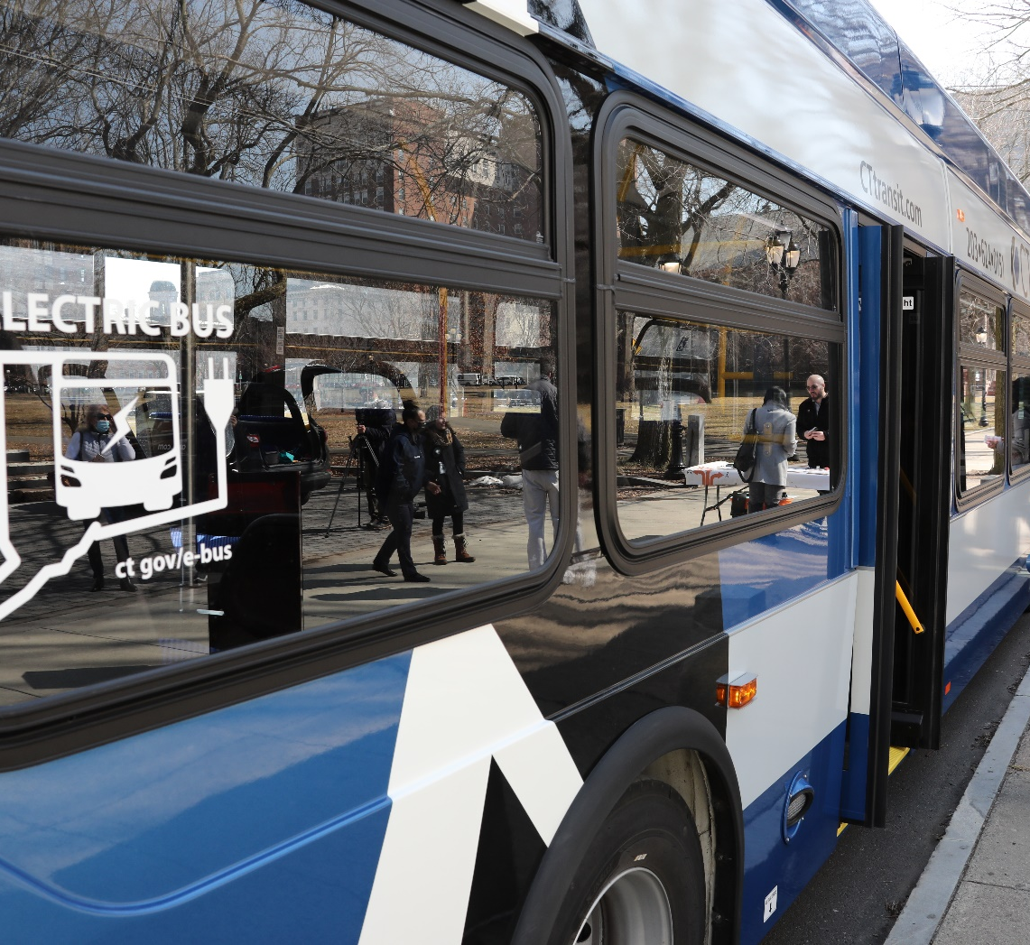
LONO Grant
The “Low Or No Emission” grant offered by FTA provides funding for the purchase or lease of low/zero-emission transit buses
Includes acquisition, construction and leasing of required supporting facilities
June FY2023 = $26,437,120
Funding to purchase and deploy BEBs to replace older diesel buses and modernize its CTtransit Stamford Division to support BEB service

Slide 32
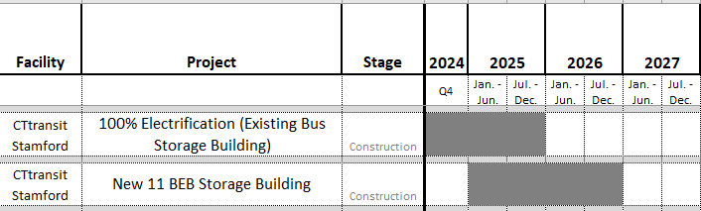
Schedule/Funding
100% Electrification
11 BEB Storage Building
Project Phase | Funding Source | Federal Amount | State Amount
Planning/Design | 100% State | - | $476,900
Construction | 80/20 FTA Low or No Emission Grant (CT-2024-006) | $6,849,120 | $1,712,280
(20) 40FT BEB’s | 1.) Low or No Emission (5339) 2.) Formula Funds (5307) | $15,200,000 $8,800,000 | $3,800,000 $2,200,000
Project Phase | Funding Source | Federal Amount | State Amount
Planning/Design | 100% State | - | $1,591,000
Construction | 80/20 5307 FTA Grant (CT-2023-022-01) | $8,419,488 | $2,104,872

Slide 33
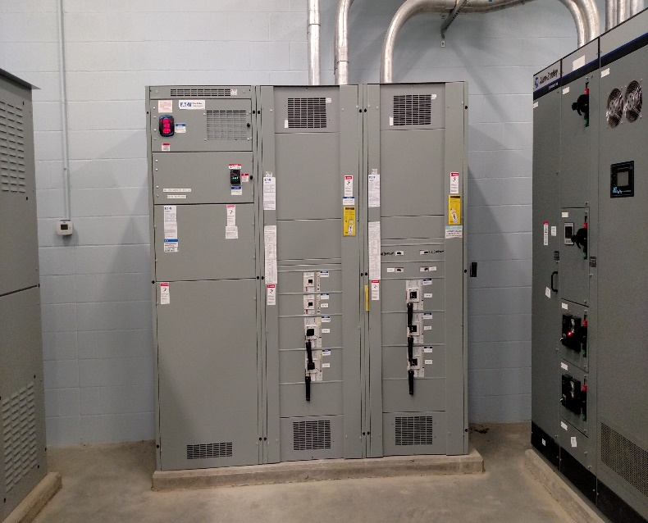
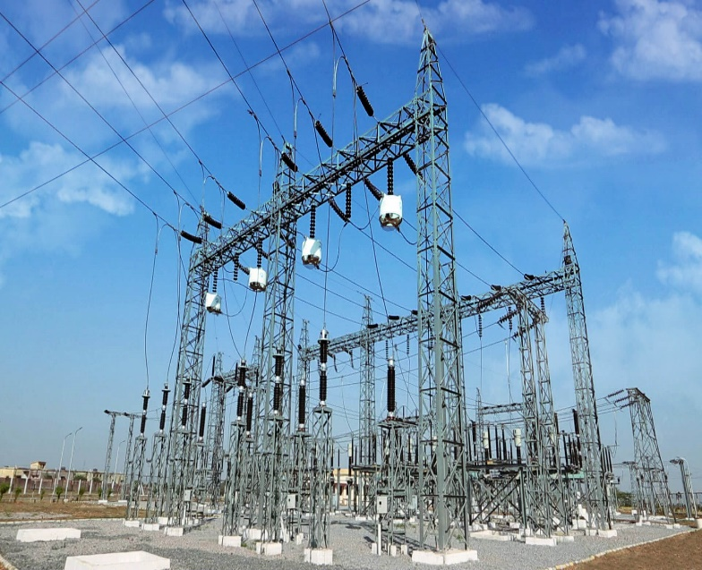
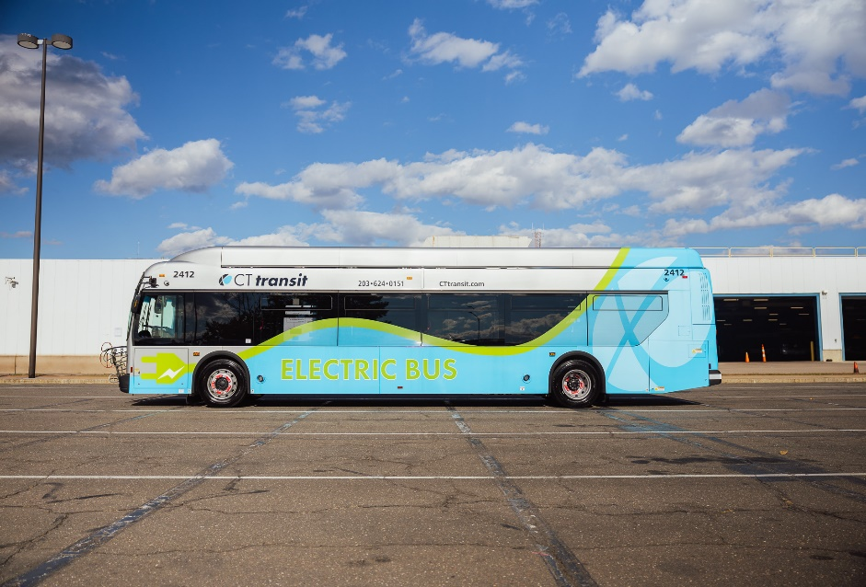
Electrification Challenges
Supply Chain
Long lead time on parts and materials
Grid Capacity
Not enough capacity in the area
Requires upgrades to the grid
Funding

Slide 34
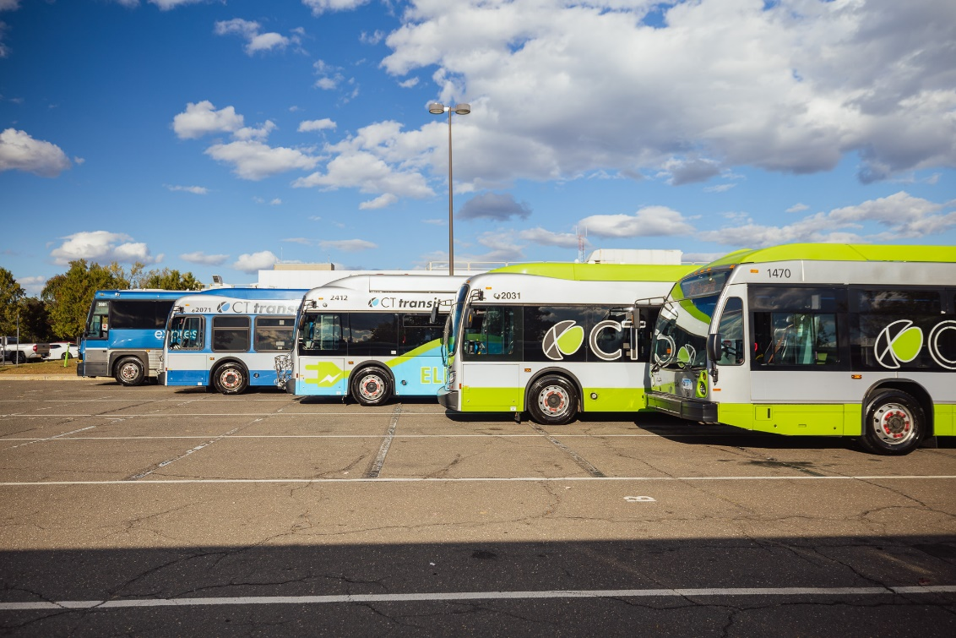
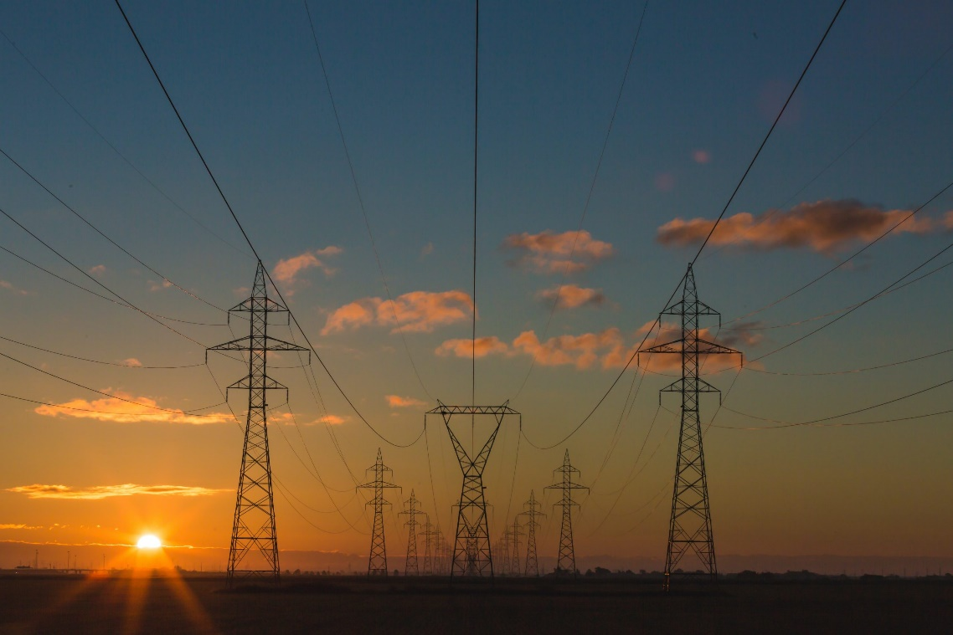
Electrification Priority
Age of Fleet
Grid Capacity
Cycling out old diesel & hybrid electric buses for fully electric buses one-by-one
BEB charging and building load require more capacity than what is available

Slide 35
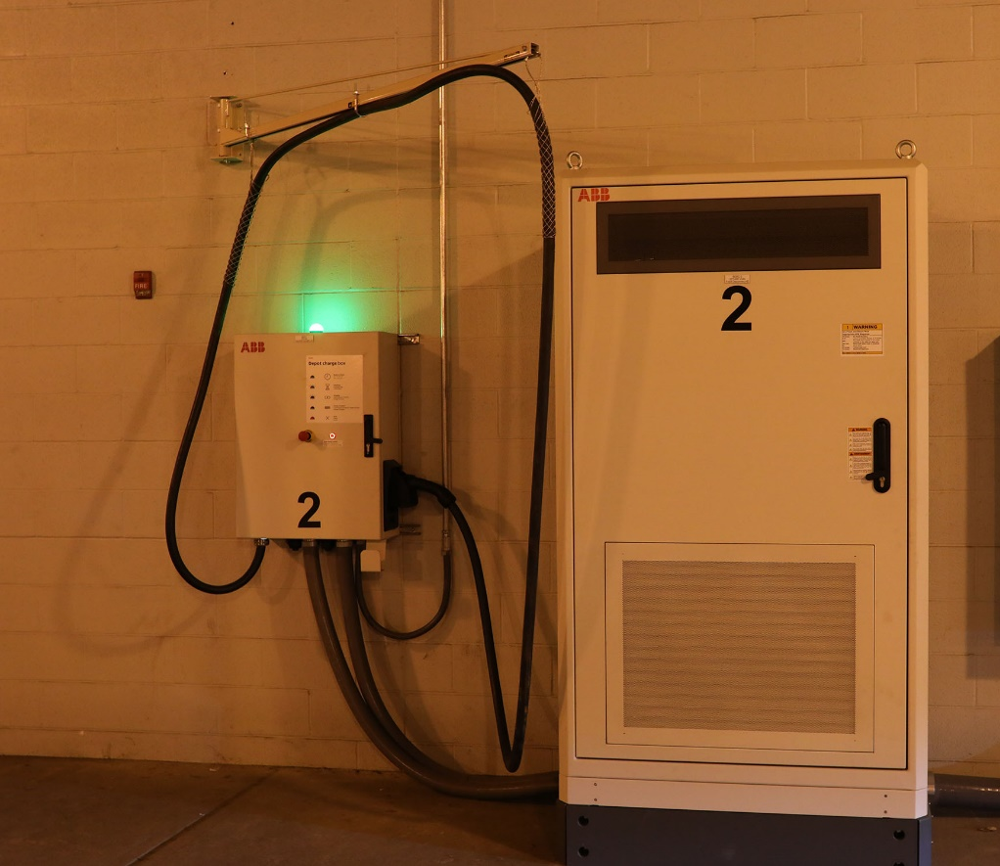
Statewide Totals Chargers
CTtransit Hartford – 8 chargers
CTtransit Hamden – 10 chargers
CTtransit Waterbury – 2 chargers
Greater Bridgeport Transit Authority – 7 chargers
River Valley Transit – 2 chargers
Milford Transit District – 2 chargers
Windham Regional Transit District – 2 chargers

Slide 36
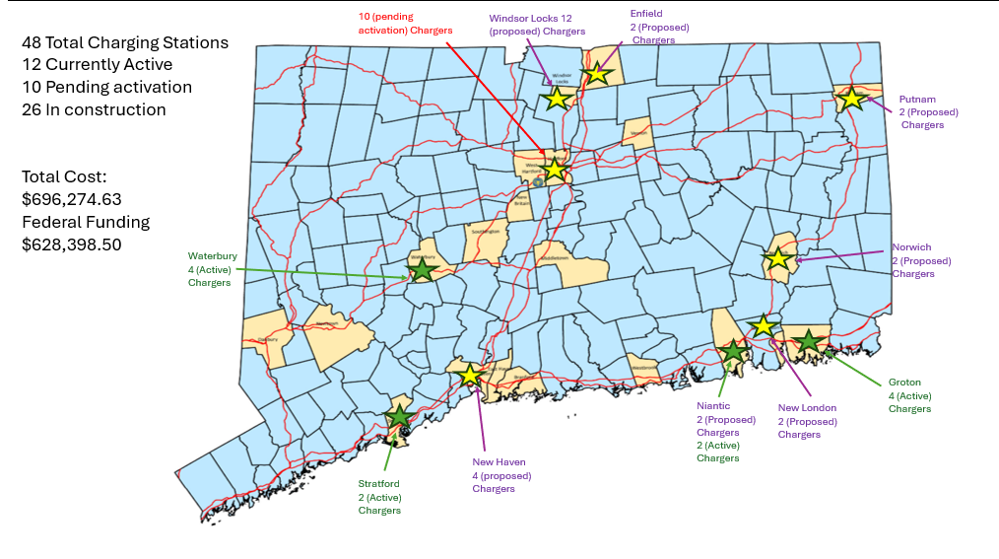
Transportation Electrification - the Military Department

Slide 37
Decarbonization Study – DAS
EO 21-3 HVAC Decarbonization Study - Purpose
Retrofit existing fossil-fuel based HVAC systems to those capable of operating without carbon emitting fuels.​
  Mandated by: EO #21-3, Part 3-D​
  Scope: Nearly 4000 Executive Branch facilities​
  Consultant: DAS & DEEP engaged Arup in 2024 ​

Slide 38
Decarbonization Study – DAS
Decarbonization Study Final Deliverables
Decarbonization Action Plan
  Prioritized steps
  Cost Analysis
  Procurement roadmap
Comprehensive Decarbonization Database Tool
  Existing and potential on-site electrical production (e.g., photovoltaic panels)
  Facility-specific decarbonization solutions
  Order of magnitude installation costs
  Utility/operating costs & energy usage versus current conditions

Slide 39
Decarbonization Study – DAS
Phase I – Discovery: Complete
26 State Agencies contributed to workshop sessions
Agencies provided valuable input on:
  Existing assets & energy usage
    Information management processes
    Level of detail available
  Starting point for decarbonization
  Decarbonization challenges

Slide 40
Decarbonization Study – DAS
Phases II-IV: Underway
Funding and contract amendment in-place
Kick-off with Arup team scheduled
Agencies notified of upcoming continued collaboration
18-month duration for study completion

Slide 41
Decarbonization Study – DAS
Phase II – Baselining and Digital Tool
Collect, review, and synthesize all 26 Agencies’ information
Baseline energy usage, cost, and equipment inventory
Develop decarbonization database tool
  Understand Agencies’ asset portfolios
  Identify Agencies’ prioritization criteria
  Digital decarbonization database tool high-level design and user testing

Slide 42
Decarbonization Study – DAS
Phase III – Identification, Prioritization, & Testing
Identify and test decarbonization strategies
Base strategies on short-list of building types
Determine decision-making and implementation priorities
Conduct site visits for each building type
Conduct energy modeling of proposed decarbonization strategies for impacts on (1) emissions and (2) cost

Slide 43
Decarbonization Study – DAS
Phase IV – Assessment & Completion
Final deliverables and warranty service
Agency-specific decarbonization solutions
Digital decarbonization database tool
  Conduct training
  Provide durational ongoing support to DAS/CS after study completion

Slide 44

Uconn Waste Initiative

Slide 45
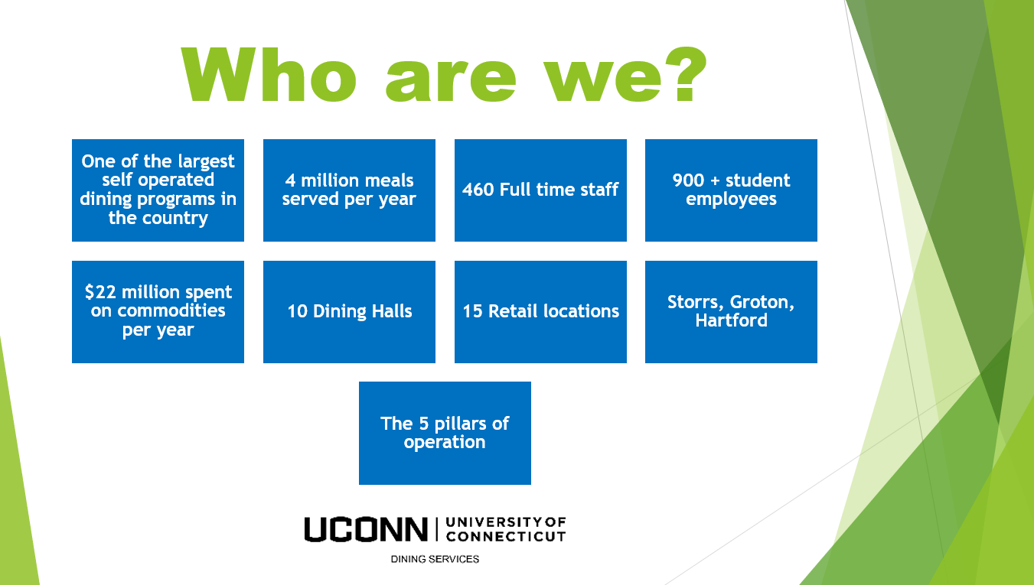

Slide 46
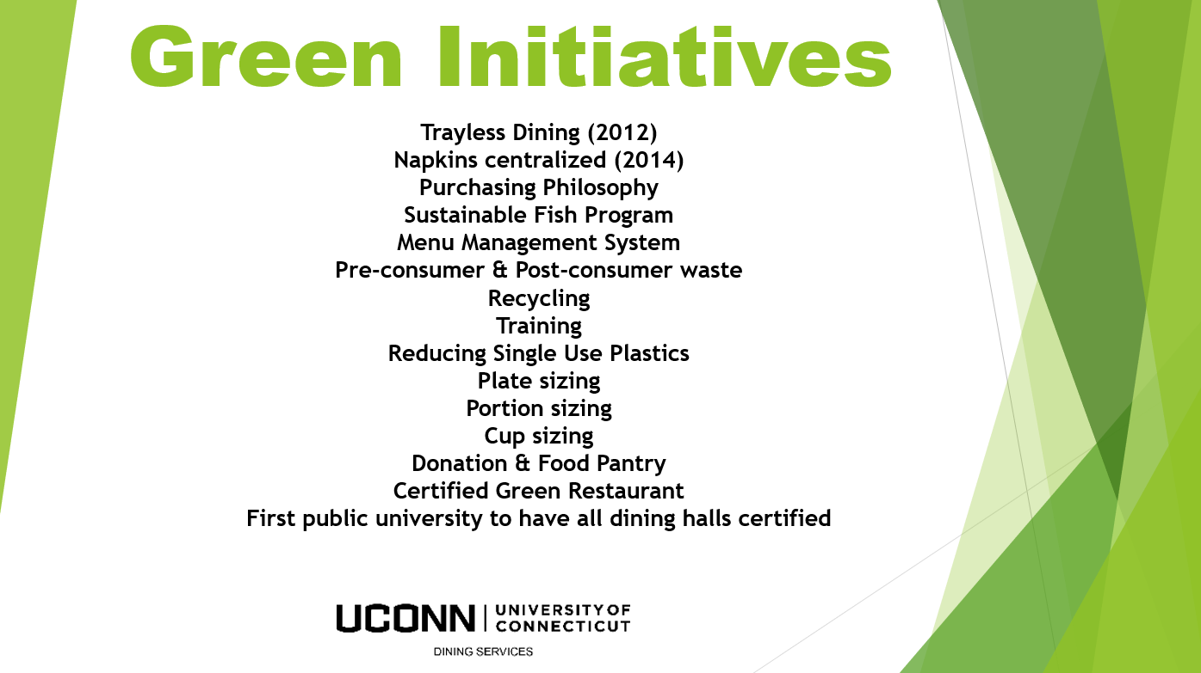

Slide 47
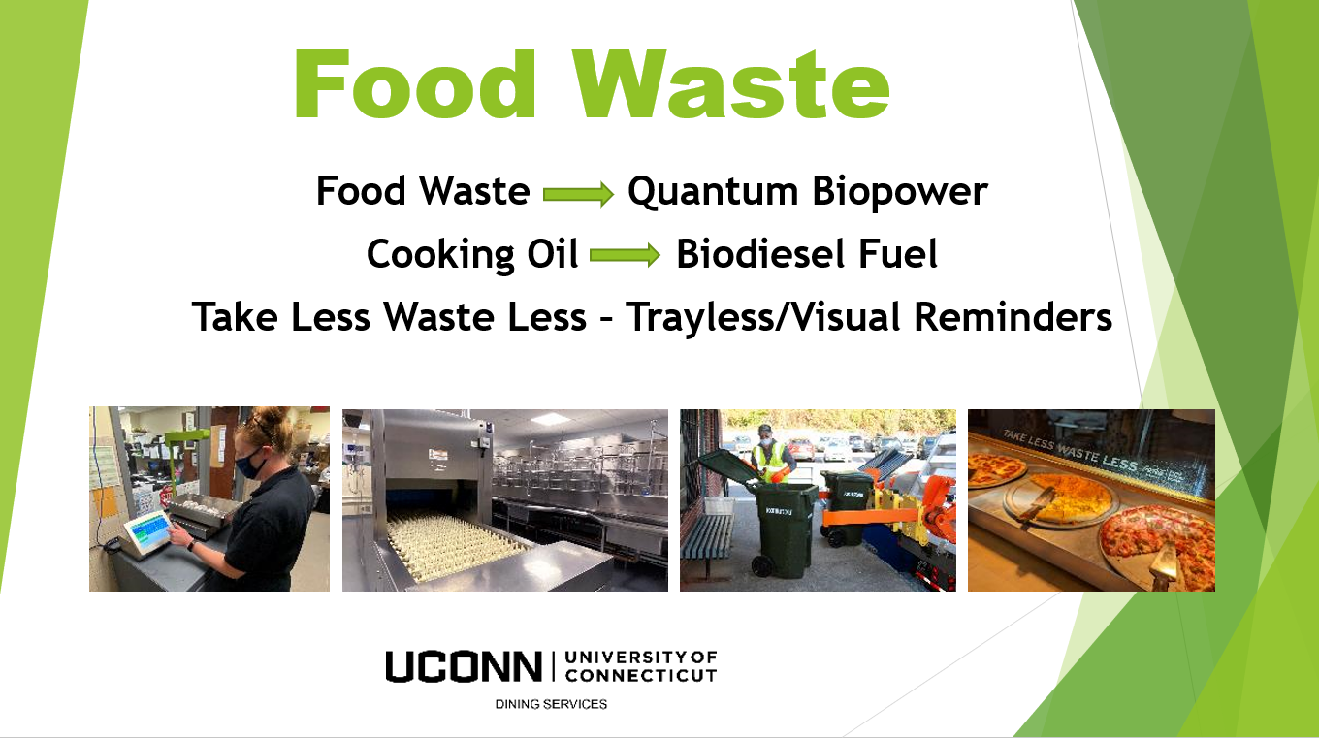

Slide 48


Slide 49


Slide 50
Sustainability efforts and data integration
The Interactive Map – DEEP & OPM
EnergyCAP - DEEP
Better Climate Challenge - DAS

Slide 51
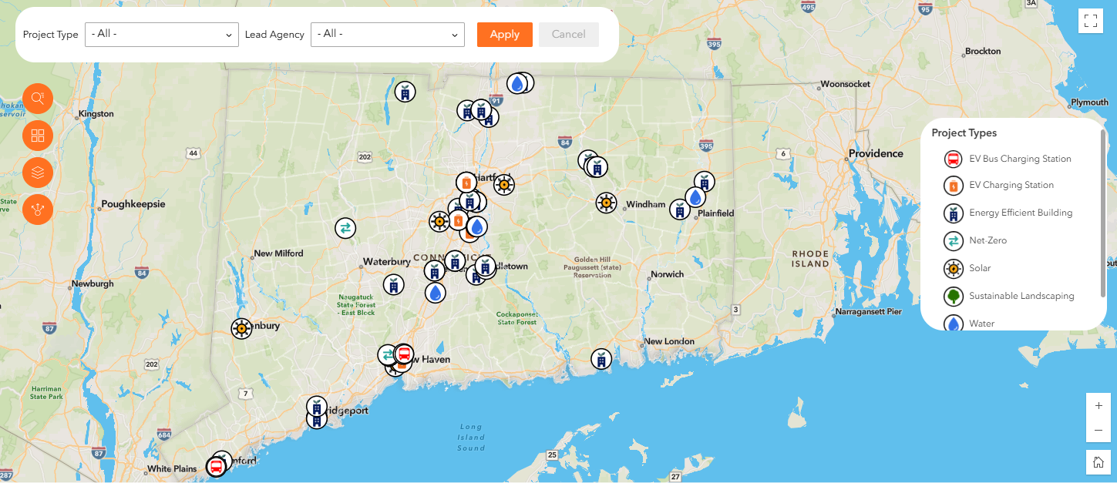
The interactive Map
Notes:
GreenerGov CT Dashboard - Projects Map | Connecticut Data

Slide 52
EnergyCAP Overview
Presented by: Wvarrda Saulat
Bureau of Energy and Technology Policy

Slide 53
What is EnergYCAP
EnergyCAP is an energy management software that is used for managing utility bill data for Connecticut’s Executive Branch agencies.
Agencies upload their utility bills into EnergyCAP and the software analyzes the bills to help us gain understanding into the state’s energy consumption patterns.
Used to:
  Track progress towards Executive Order 21-3 sustainability goals.

Slide 54
EnergyCAp tasks and Requirements
Billing Data To Upload
Other Agency Tasks
Electricity, Natural Gas
Gasoline, Diesel Fuel
Oil , Propane,
Waste, Recycling
Sewer, Steam, Water, Fire Protection
Manage Building Inventory
Ensure no Data gaps
Resolve Bill Flags

Slide 55
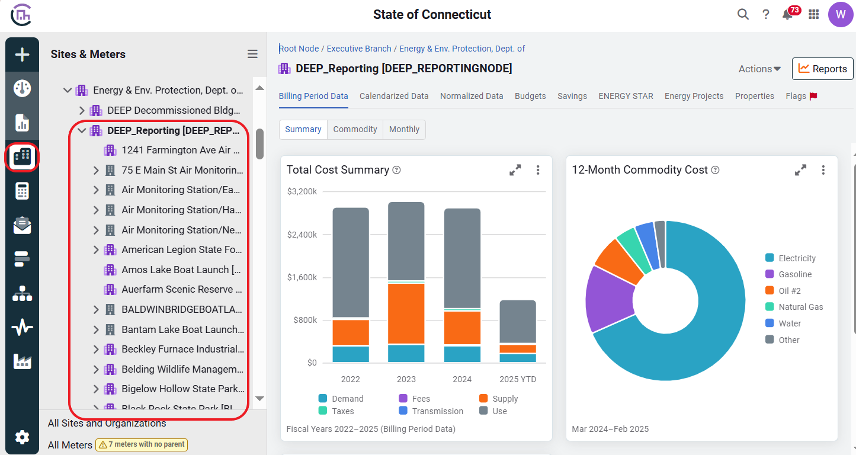
Managing Building Inventory Data

Slide 56
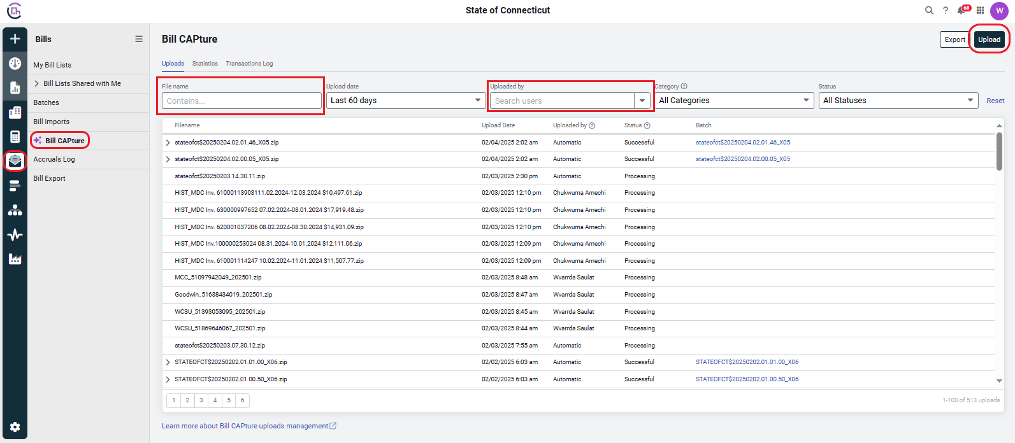
Ensuring No Data gaps

Slide 57
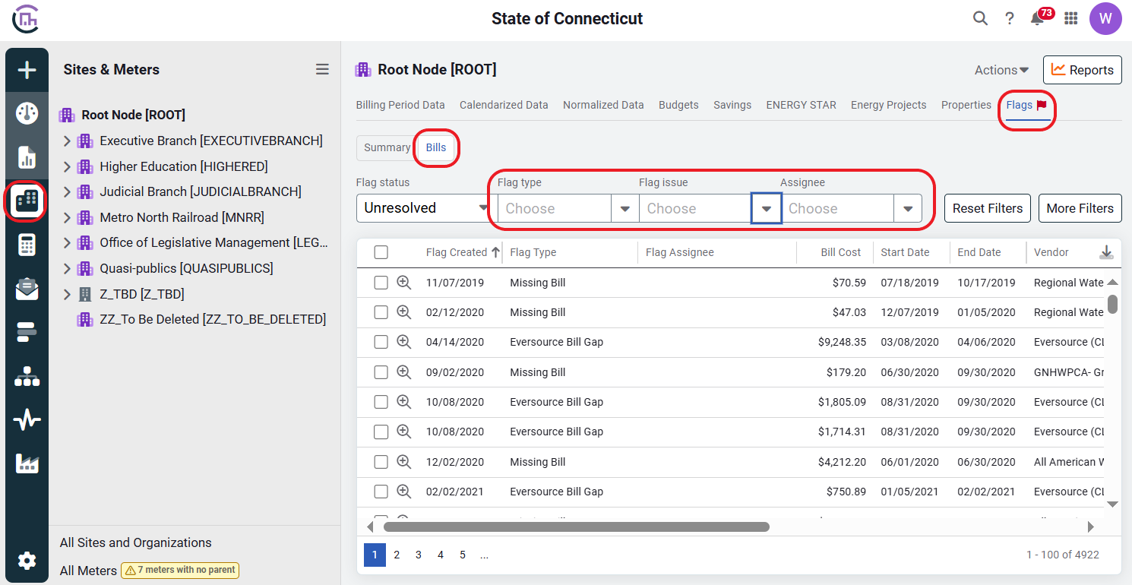
Monitoring Bill Flags

Slide 58
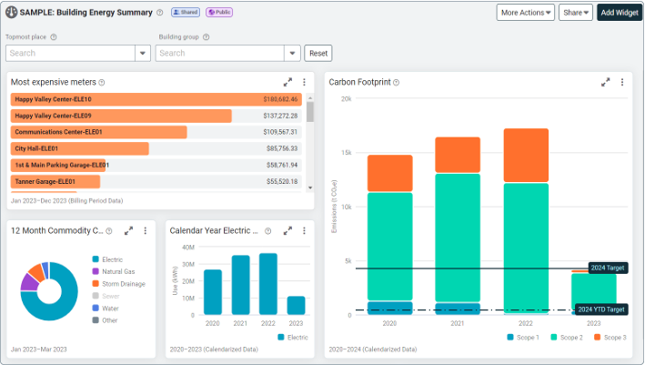
Dashboards
Provide visual insight into your utility bill data.
Useful features:
Utility costs and energy usage
Building or location comparisons
Emissions
Missing Bills & Bill Flags.

Slide 59
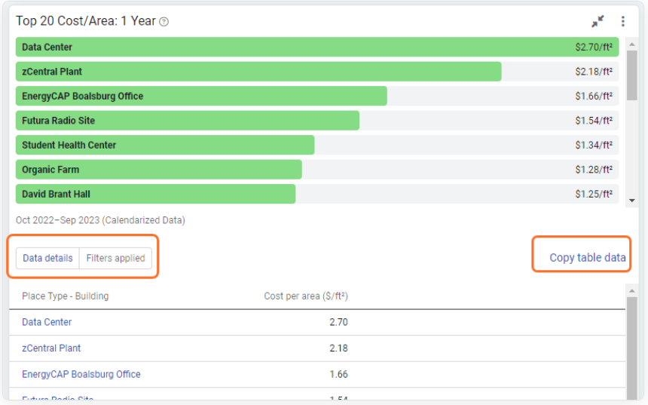
Dashboards

Slide 60
Contacts
EnergyCAP Customer Success Manager
  Josh Berkheimer
    josh.berkheimer@energycap.com
Managed Services Specialist
  Kim Fullum
    kim.fullam@energycap.com
DEEP EnergyCAP Team
  Wvarrda Saulat
    wvarrda.saulat@ct.gov
  Jimena Fernandez
    jimena.fernandez@ct.gov

Slide 61
Better climate challenge
State Commitment | DOE's Commitment
Publicly pledge to reduce GHG emissions by 50% or more across portfolio, pursue energy efficiency target as part of decarbonization strategy, assign a senior executive/primary POC to work with DOE. (EO1/EO21-3 outlines our goals and targets to achieve) | Provide technical assistance and implementation strategies.
Develop an organization wide plan with GHG reduction milestones, share GHG reduction strategies, and participate in working groups. (Currently developing a decarbonization plan for state executive branch agencies. Participating in US Climate Alliance working group meetings on various topics and share input) | Collaborate with partners on a regular basis.
Provide energy performance and GHG emission data, and report annually for 10 years. (GreenerGov Dashboard is public to show energy, water, and GHG data) | Collect/share best practices and facilitate peer-to-peer working groups.
 | Provide national recognition to partners.

Slide 62
Overview & Discussion of Resources for SSOs
Funding Options for Projects - DEEP
Brainstorm on the creation of Interagency Working

Slide 63
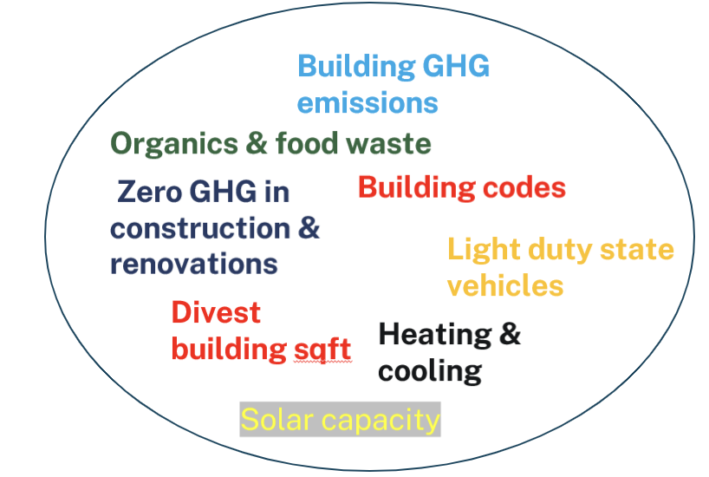


funding options for projects – LBE Project Evolution
Lead by Example 2011
E.O 1 –April 2019
E.O.21-3 – Dec. 2021
Water
Waste
GHG emissions

Slide 64
Funding options
On-bill financing with utility incentives
What is on-bill financing?
The first option for energy efficiency projects.
Reduces the total project cost through utility rebates/incentives
Allows the remaining project costs to be paid on-bill over time (up to $1 million in Eversource territory & up to $500K in United Illuminating territory)

Slide 65
Funding options
On-bill financing with utility incentives:
On-Bill Financing allows:
Project costs to be billed through the agencies’ regular monthly bills.
Payments made by agencies from their existing operating budget.
On-bill financing is provided at 0% interest and for up to four years (Eversource offers five-year loans as well).
Upfront financing comes from the utility or third-party financer.
The Utility Company will oversee the implementation of the project.

Slide 66
LBE Bond Funds
Bond funds are available for state agencies to help meet E.O. 1 and E.O 21-3 targets.
Application materials https://portal.ct.gov/greenergov/toolkits/agency-resources/funding-opportunities-for-agencies
TAC Review
Memorandum of Agreement
Send Application to leadbyexample@ct.gov
Important Note: Projects less than $1 million should go through utility on-bill financing before perusing Bond funds.

Slide 67
LBE Bond Funding options
Funding opportunities are available for projects that address any of the following topics:
Building upgrades that result in decreased environmental impacts and reduced greenhouse gas (GHG) emissions, which include heating and cooling upgrades, such as the installation of renewable thermal heating systems.
Electric vehicle charging infrastructure to support charging state-owned or leased electric vehicles.
Water use reduction initiatives.
Organic waste diversion (e.g., composting) and waste reduction projects.
Any renewable energy projects.
And other projects related to the Executive Order targets.

Slide 68
Other Funding options to Consider
Federal funding
Other agency funds

Slide 69
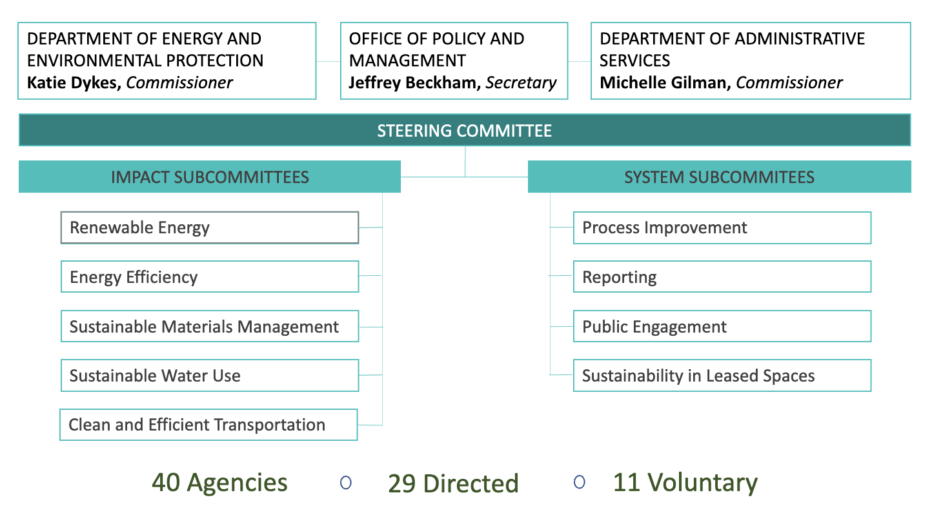

Brainstorm on interagency working Groups
Bi-weekly planning meetings between the co-chairs agencies (DAS, OPM & DEEP)
Monthly Technical Advisory (TAC) meetings for agencies to submit project proposals for LBE funding
Notes:
https://whiteboard.office.com/me/whiteboards/p/c3BvOmh0dHBzOi8vY3Rnb3ZleGVjLW15LnNoYXJlcG9pbnQuY29tL3BlcnNvbmFsL2ppbWVuYV9mZXJuYW5kZXpfY3RfZ292/b!XyRmgvmB1Ey_5XZy9PXHIsr_JqbgotxHhpX5OUhBBsPrnR_OsqnaSJ4gn3-XxV-p/01FB235VAC3YUCTVCXXVD2GWAYZMGSOAZ3?source=applauncher&auth_upn=jimena.fernandez%40ct.gov

Slide 70

Brainstorming session Report Outs

Slide 71
Public comment

Slide 72
Thank you for participating in the Steering committee meeting!

