Slide 1


GOVERNOR’S
INNOVATION LAB
GreenerGov Briefing 5/10/24

Slide 2
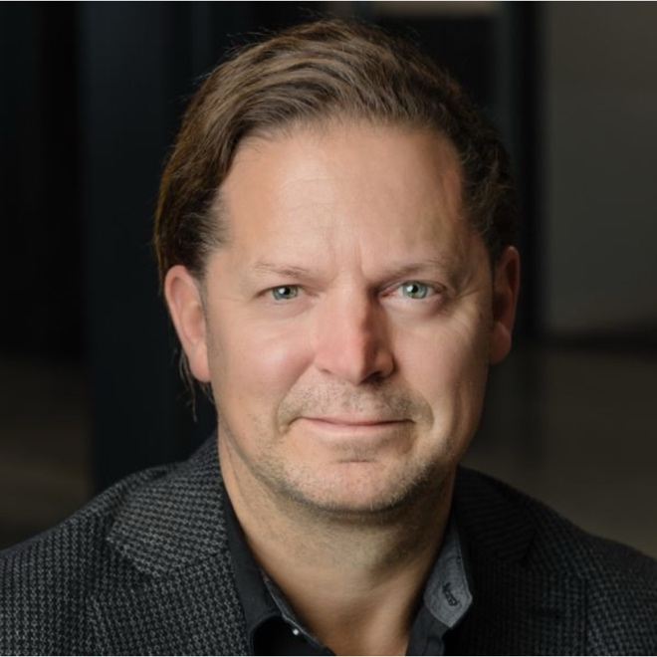
INTRODUCTIONS
David Bruno
Director, Innovation Lab

Slide 3
AGENDA
CT Innovation Lab
UCONN GreenerGov Challenge: Innovate
Budderfly’s Approach to a Greener Connecticut

Slide 4

DID YOU KNOW…?
CT HAS INVESTMENTS IN 220 COMPANIES
Connecticut is one of the few states that has a venture capital arm whose mission is to create new GDP and jobs:
Funds under management: $500M
Our companies have ~4,000 employees in CT
Focus areas: Climate, Health, Tech, Diverse Founders
We invest $40–$50 million a year in new companies
We generate positive returns overall (M&A activities)
We reinvest those returns in new CT companies
We are self-sustaining ie. at no-cost to the state
4
Notes:
Update

Slide 5
GOVERNORS INNOVATION LAB: ORIGINS
How do we make government more agile?
2022
Modernization Act
CGS § 32-39e creates Lab
2024
Six State Pilots
4 UCONN, 1 OSC, 1 DOH
2023
Operationalization
CI approves $2M budget
OPM & DAS mobilization

Slide 6
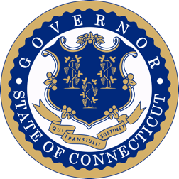
PILOT TO PROCUREMENT OPERATIONS¹
Ideation
Pilot
Procurement
Problem-Solution Fit
Agency needs
Solution scoping
Funding
Proposal
Socialization call
Engage BITS CSM / internal IT rep.
Economics review
Approval
OPM approval
Review template contract
Transmittal memo
Reviews
Data/cloud review
AI Impact analysis
Op-Sec review
Contract²
State T&Cs
Success metrics
Execution
User training
Project mgmt.
Metrics tracking
Completion³
Report results
Agency decision
Transmittal memo
Decisions
OPM (pilot success)
DAS (4a-58 evaluation)
CII
CII
OPM
DAS
DAS
Agency
Agency
OPM / DAS
Agency
Agency
Agency
Agency
Agency
Startup
OPM
Agency
Startup
OPM
CII
Startup
Startup
CII
DAS
CII
DAS
CII
¹ CGS § 32-39e applies to executive branch (line) agencies, constitutional offices & higher education.
² Approved pilots begin on date a pilot contract is signed and generally run for 12-months with an outcomes assessment around the 9-month mark.
³ Agency Commissioner & CII write a joint memo containing pilot outcomes and requesting consideration of standardized transaction procurement.

Slide 7









STATE MODERNIZATION: TOP PRIORITIES
Sustainable Infrastructure
Health & Human Services
Buildings Decarbonization
Grid resiliency
EV Charging
Population Health
Behavioral Health
Pharmacy Costs
Automation
Knowledge Management
Disbursements
Education Ops

Slide 8
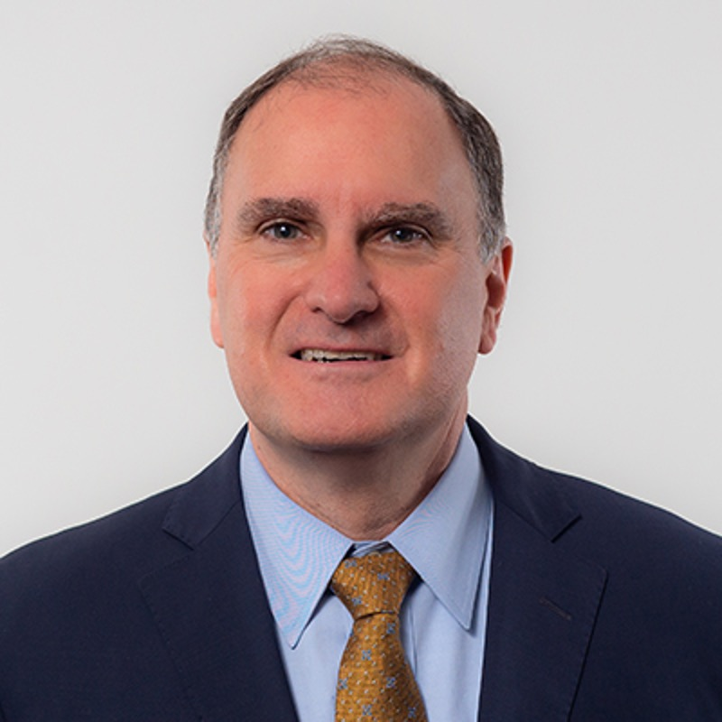
UCONN HEALTH
Eric Kruger
MBA | Vice President
Facilities Development & Operations

Slide 9
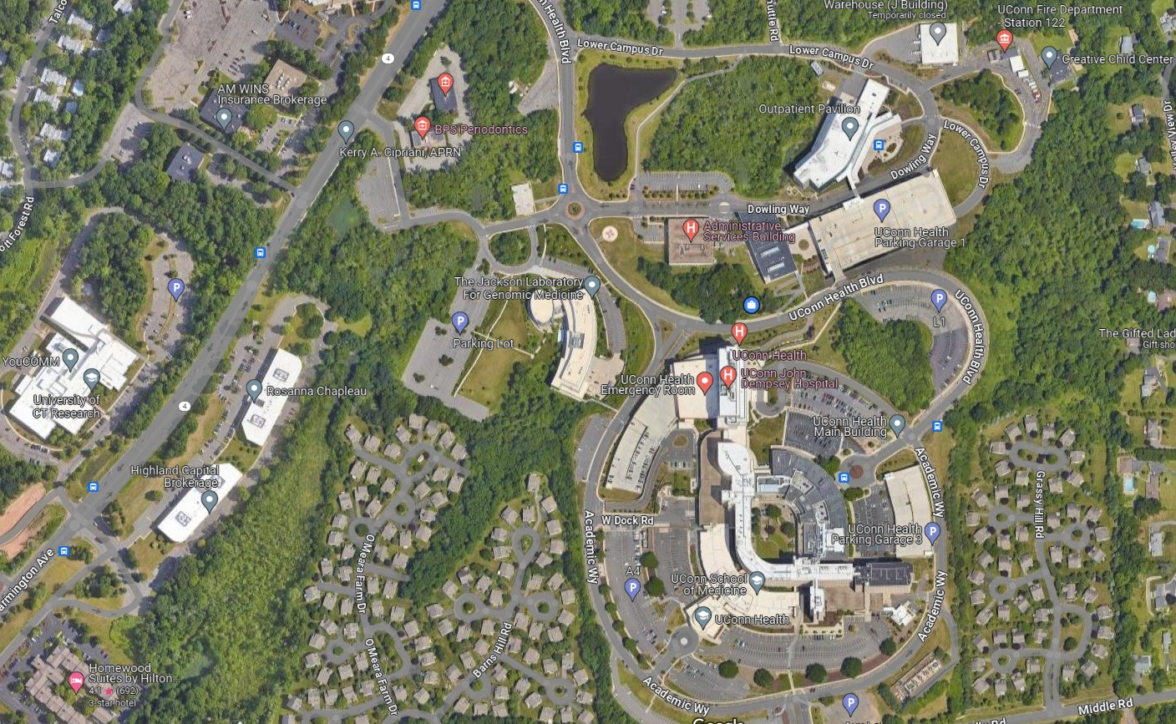

GreenerGov Challenge: Innovate
May 10, 2024

Slide 10
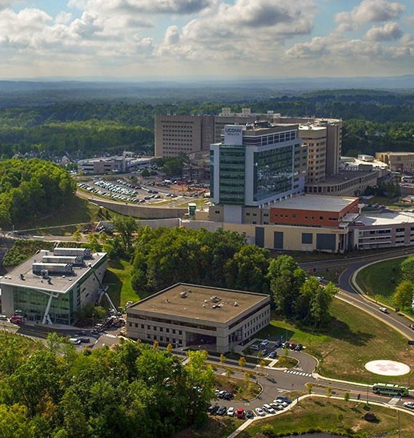
CONNECTICUT’S PUBLIC ACADEMIC MEDICAL CENTER
Opportunities to “Lead by Example”
Academics
School of Medicine
School of Dental Medicine
Graduate School
Patient Care
John Dempsey Hospital
UConn Medical Group
University Dentists
Biomedical Sciences and Research

Slide 11
UCONN HEALTH IN CONTEXT
UConn Health Main Campus in Farmington
3.8 Million Square Feet
68 Million kWh Electrical Usage
250 Thousand MMBtu Natural Gas Usage
592 Million kBtu Total Energy Usage across all locations
OPM approved a Pilot Project With Budderfly and Connecticut Innovations to bring the Creative Child Care Center to Carbon Neutrality
7,060 Gross SF
1990 Portable Building Structure
Current MEP:
Gas Fired RTUs that are oversized
Fluorescent Lighting Throughout
Heat Tapes under building and on Roof Edges
New Roof Being Installed this Summer/Fall

Slide 12
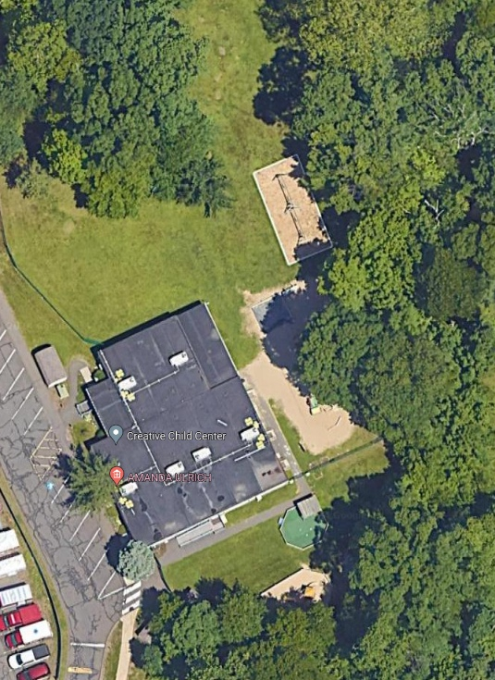
Creative Childcare Center
May 10, 2024

Slide 13
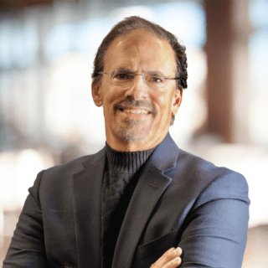
BUDDERFLY
Al Subbloie
Founder and CEO

Slide 14
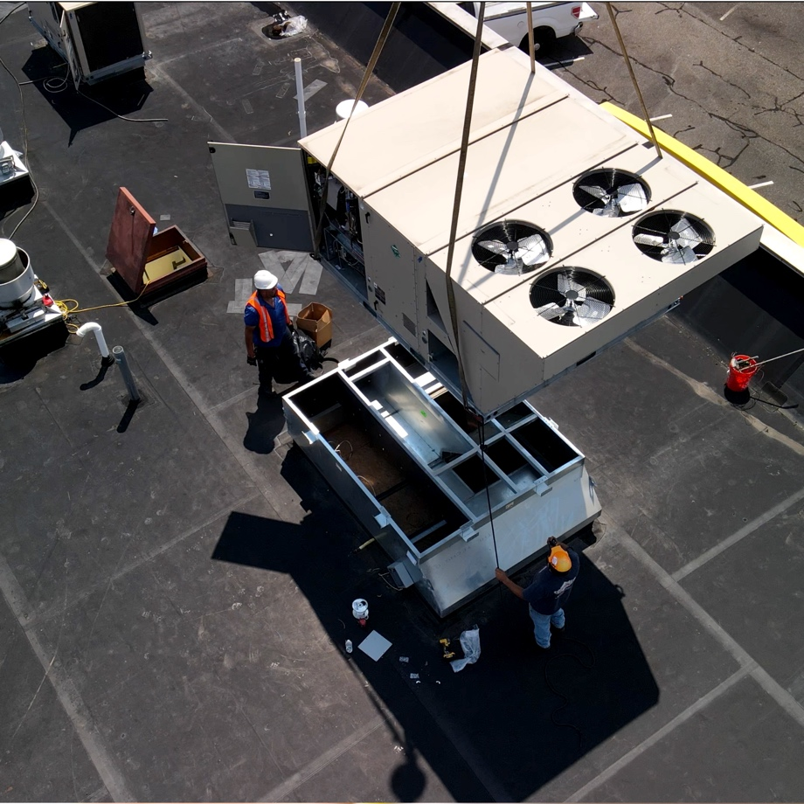
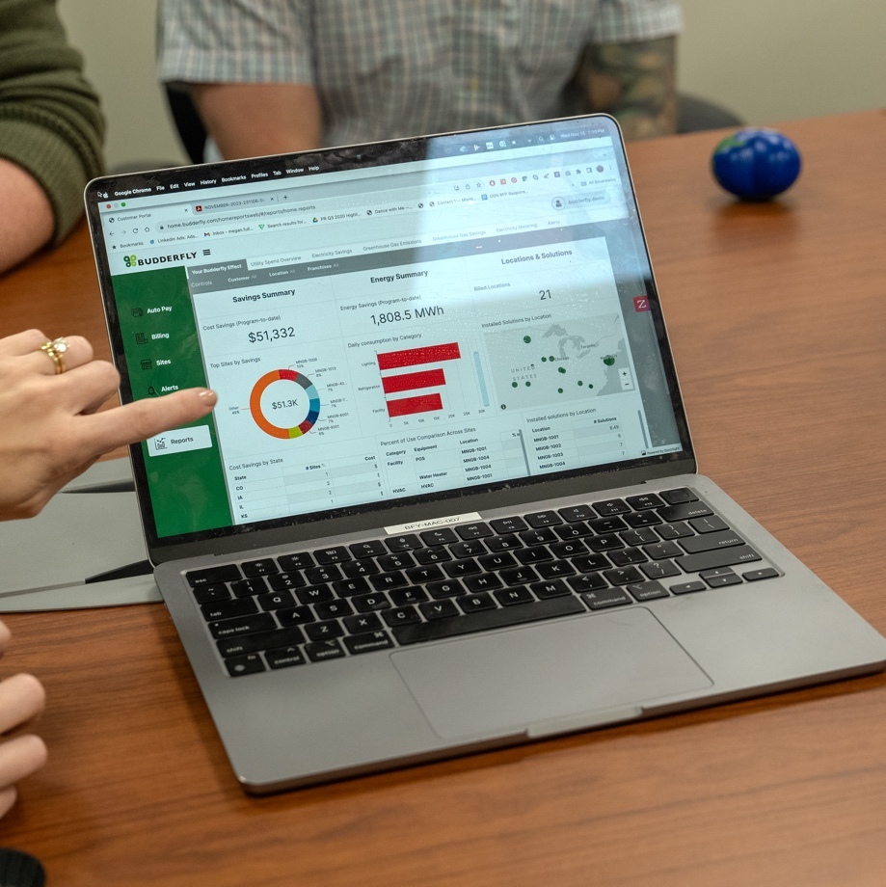
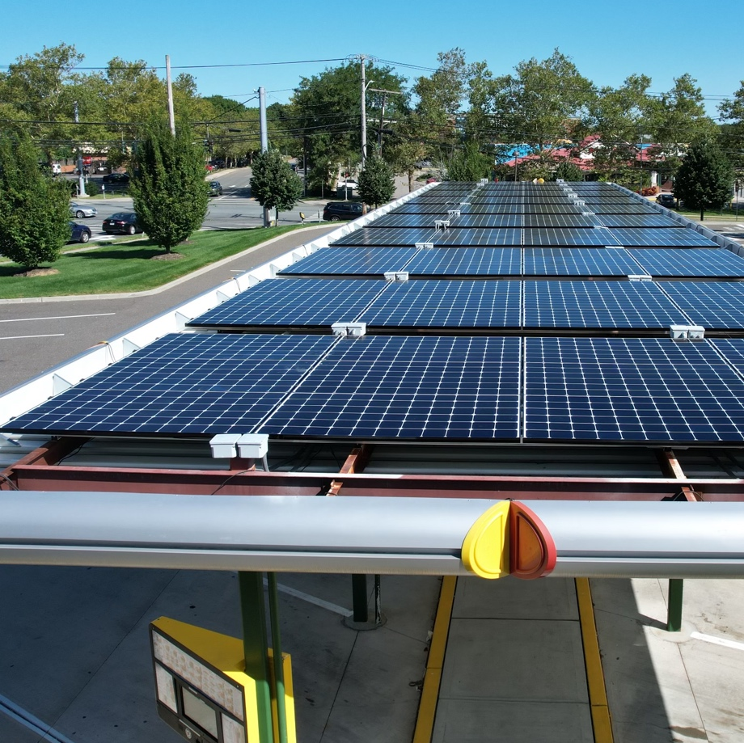
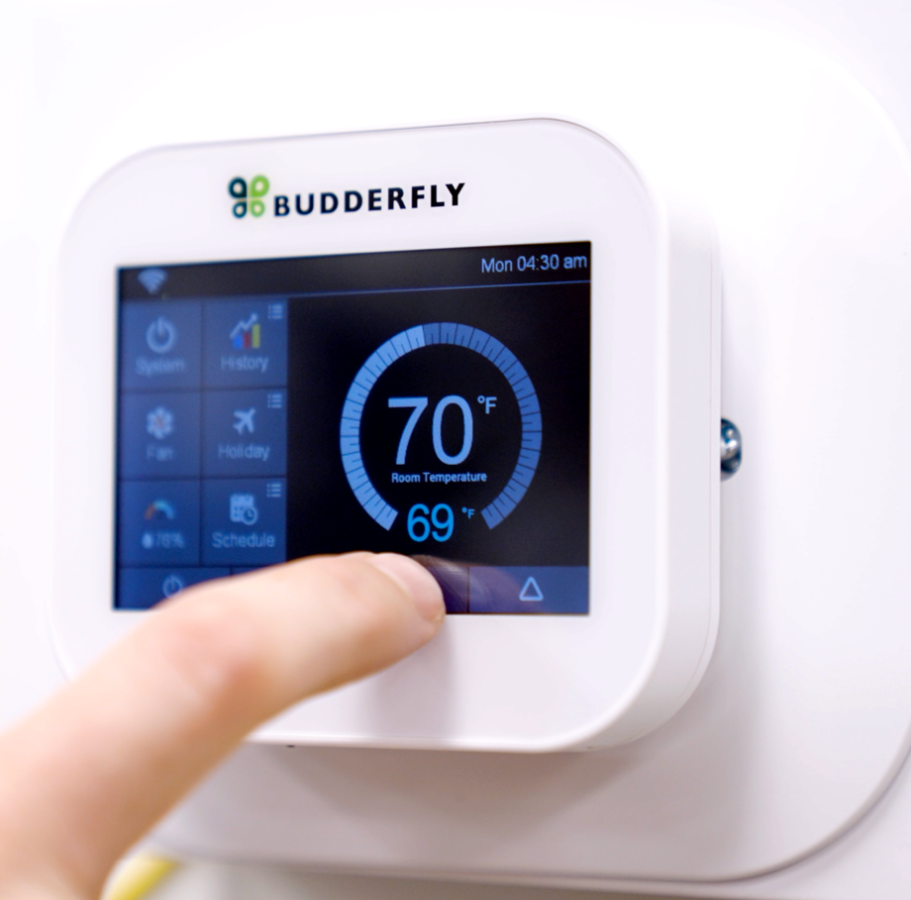
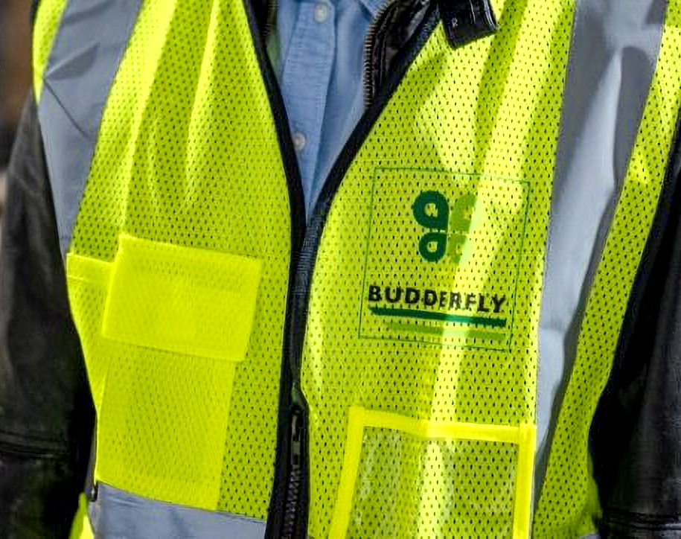
ABOUT BUDDERFLY
Budderfly is an Energy-as-a-Service company accelerating the adoption of sustainable technology solutions. Our holistic energy management platform supports the decarbonization of the built environment.
  Unique model
  We provide all capital
  Take on risk of performance
  Deliver predictable outcomes

Slide 15
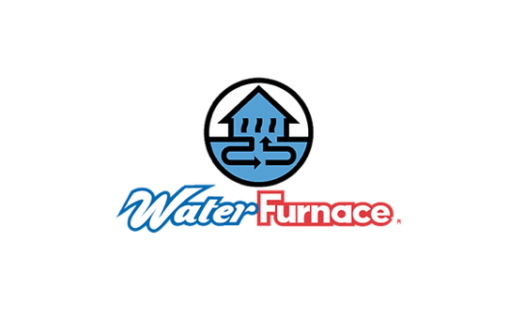

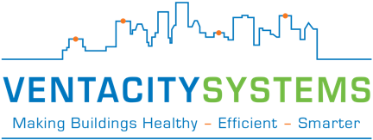



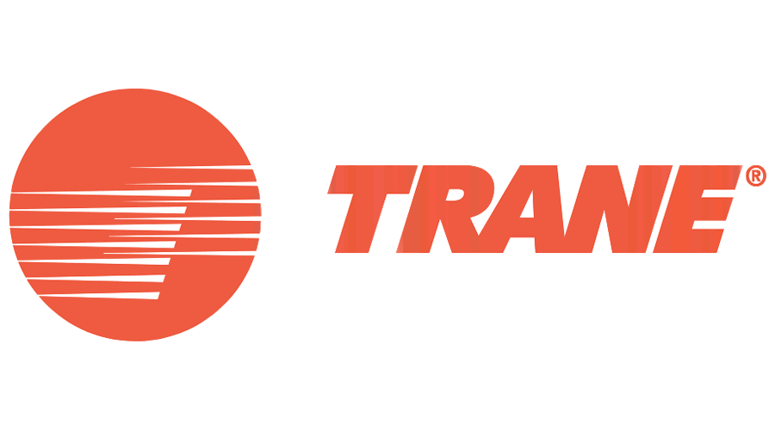
BUDDERFLY: BY THE NUMBERS
  By the Numbers:
  Growing 100%+ since inception
  Large customer base > 6,500+ locations
  Service deployed in 50 states
  15+ innovative patents
  224,169 MWh of energy saved
  Received over $1B in funding
Strategic National Partnerships:
  Leading HVAC manufactures – Carrier, Lenox, Trane
  Climate Master and Water Furnace – Top WSHP manufacturers
  Ventacity – A US ERV firm with a leading European manufacturer & tech partner
  NuWave – HVAC installation management firm coordinating local contractors

Slide 16
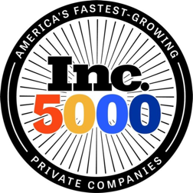



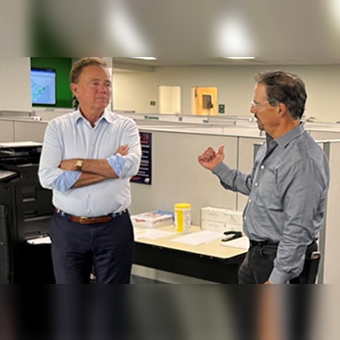


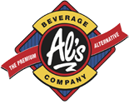
GROWTH IN CT
  Inc 5,000 Top 15 fastest growing CT company, consecutive 3 years
  CT Green Bank – financial and program support
  DECD – Loan support
  CT Innovations
  Partnered with trade schools - Lincoln Tech (New Britain and East Windsor) and Bristol Tech
Some of our CT clients:

Slide 17
AT A GLANCE: UCONN HEALTH CHILD CARE CENTER
Current State:
Location:
Farmington, CT
Timeline:
12-month pilot program
Funding:
  Connecticut Innovations Lab
  Budderfly provides all the capital
  Focused on a zero-carbon electric source by 2040
Ultimate Goal:
  Advance building sustainability
  A lower carbon footprint
34 years old
4,500 SF
~24 Tons of electric/natural gas packaged RTUs
Mostly original equipment
Some repairs, no maintenance

Slide 18
OUR GOAL
Help Connecticut buildings become more sustainable and efficient
Upgrade building insulation:
Enhance Efficiency:
Improve Air Quality:
We will install approximately 18 tons of water source heat pumps, utilizing existing ductwork
Our plan includes ERVs that will provide 1,000 CFM of ventilation / heat recovery
~ 200% R value increase

Slide 19
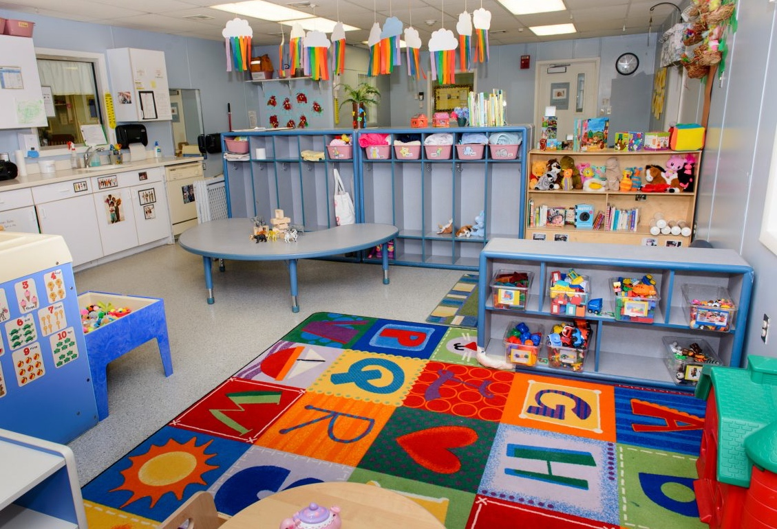
THE PLAN:
Replace traditional electric only hot water heater with heat pump hot water heater
Install individual climate controls for each room
Install new insulation to increase insulation on roof and under floor
Conduct structural analysis to confirm rooftop loading
Integrate Ultra-High Performance HVAC
Convert fluorescent lighting to LED to meet current CT dept. of health requirements for lighting levels in daycare centers

Slide 20
BUDDERFLY’S PORTFOLIO OF SOLUTIONS
Renewable Energy
Heat Pumps
Geothermal or Air Sourced
Battery Storage
Ultra High-Performance
HVAC
EV Charging
Water Solutions
Refrigeration Controls
Insulation

Slide 21
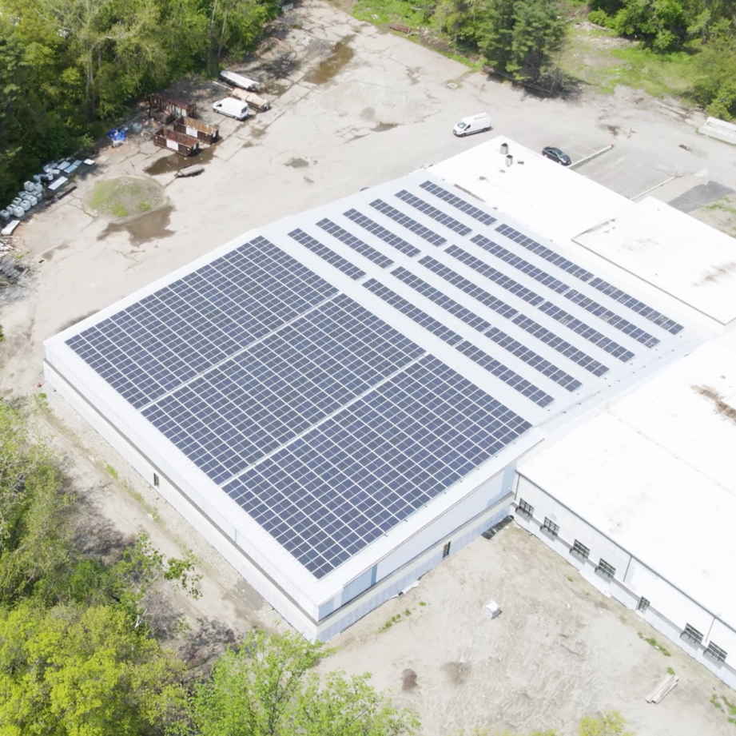
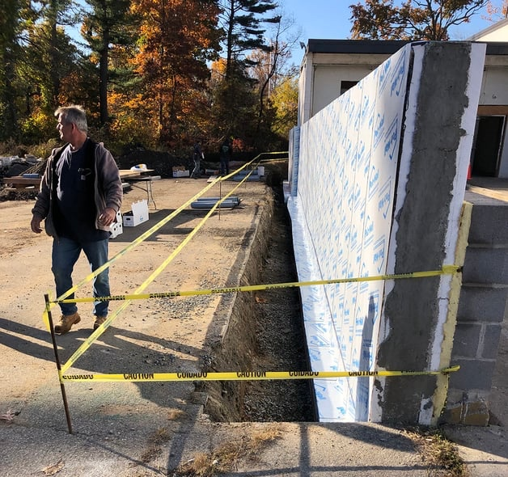
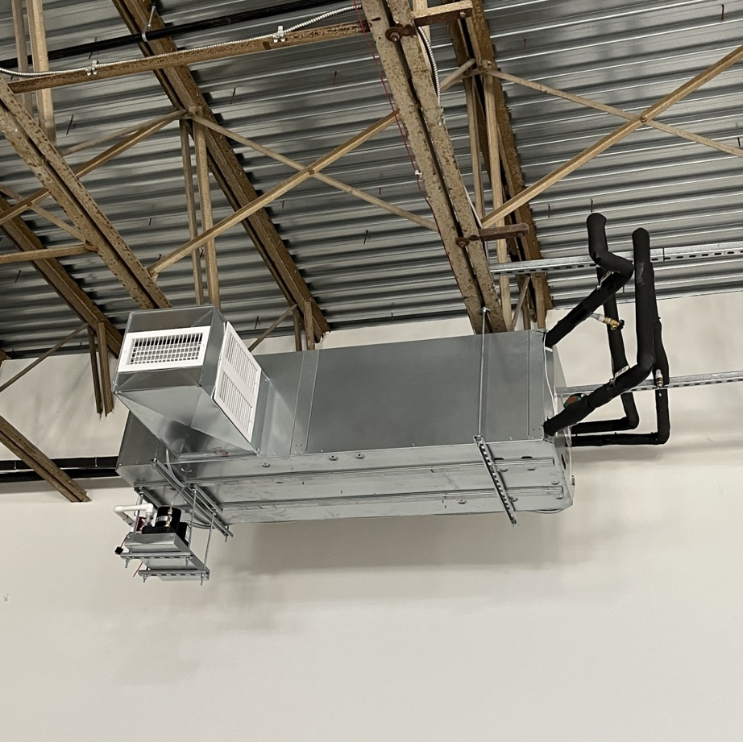
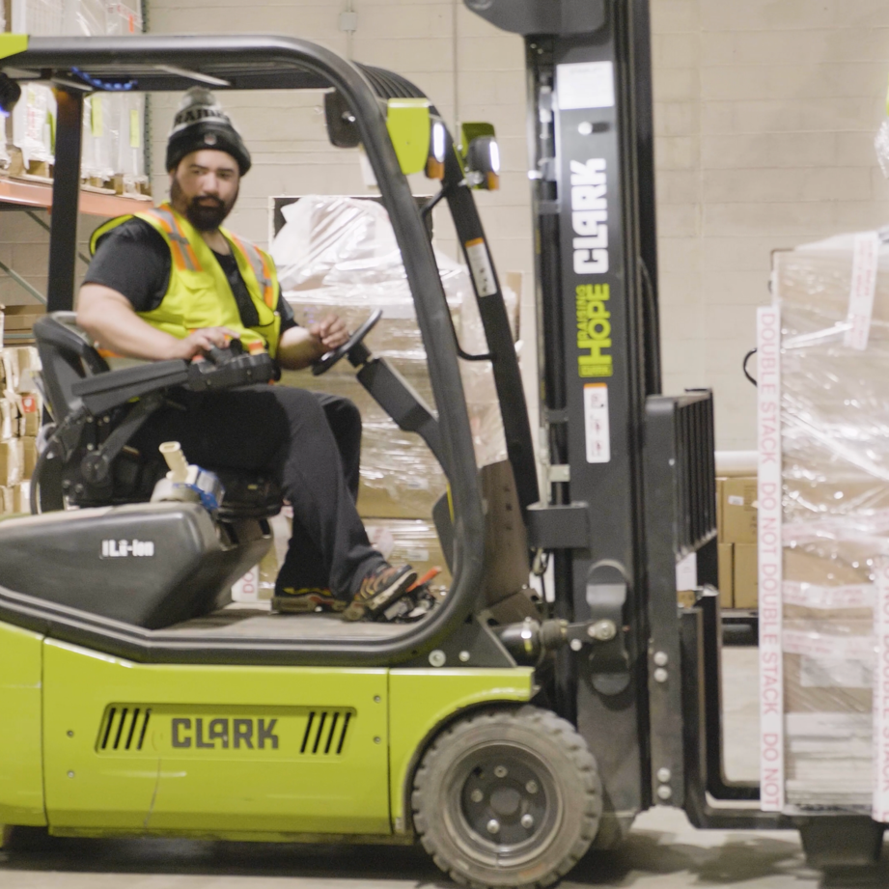
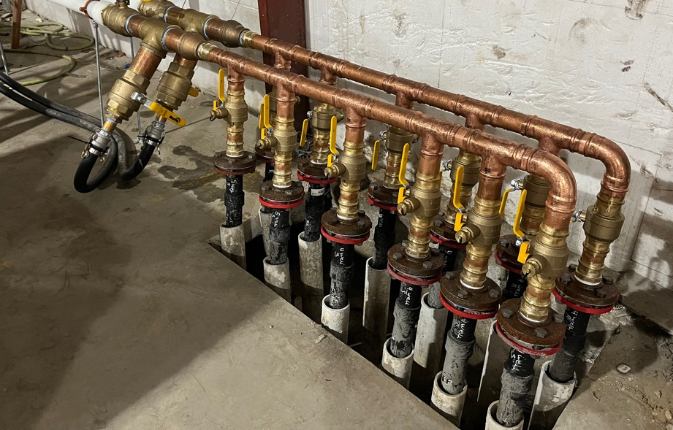
BUDDERFLY WAREHOUSE MODEL
Our Connecticut warehouse stores over 100 different types of energy savings equipment—including LED lights, HVAC units, custom client fixtures, and so much more.
We are on a path to net-zero.
  So far we have installed:
  Geothermal heating and cooling
  Solar panels
  New building insulation
  Electric Vehicles
  LED lighting
21

