Slide 1
GreenerGov Challenge: Transportation &
State Fleet
Notes:
Ryan

Slide 2
Speakers
DAS: Ryan Ensling, Sustainability Manager
DAS: Steve McGirr, Director of Fleet Operations
OPM: Joanna Wozniak-Brown, Climate & Infrastructure Policy Development Coordinator
Notes:
Ryan

Slide 3
Vehicle Policy Guidelines
Targets set via Governor Lamont Executive Orders & Legislation
Different targets for cars and light duty trucks and for buses
50% - Jan 1, 2026
75% - Jan 1, 2028
100% - Jan 1, 2030
CGS 4a-67d – Interim targets for cars or light duty trucks purchased by the state shall be battery electric vehicle
EO 21-3 - By 2030, all newly leased light duty state vehicles shall be zero emission vehicles.

Slide 4
Charging Policy Guidelines
  Executive Order did not specify a charger goal
  Legislation has goals re: state construction, agency regulations & plans, and local requirements
  CGS 4b-77 – With new construction of state facilities (>$100,000) install Level 2 EV chargers in at least 20% of parking spaces
  CGS Sec. 4b-13a – State agencies may:
    Set time limits on chargers
    Designate chargers for public or employee use
    Set a 'reasonable' fee per statute requirements
  Statutory requirements for charging infrastructure planning:
    DEEP Integrated Resources Plan (Sec. 16a-3e)
    DOT develop strategic plan for carbon reduction (Sec. 13b-23f)
    Electric Distribution Companies – load projections for distribution network (Sec. 16-19fff)

Slide 5
Interagency Coordination
Agencies work together formally & informally
  Grant Applications
  Working groups
  Specific umbrellas – GreenerGov (formerly LeadbyExample)
  Regular check ins on complex challenges
Agencies have different missions & responsibilities
  Energy transmission & generation
  Construction management & oversight; Capital planning
  Executive orders and legislation
  Interagency policy & budgeting coordination
  Provisioning for workforce and public

Slide 6
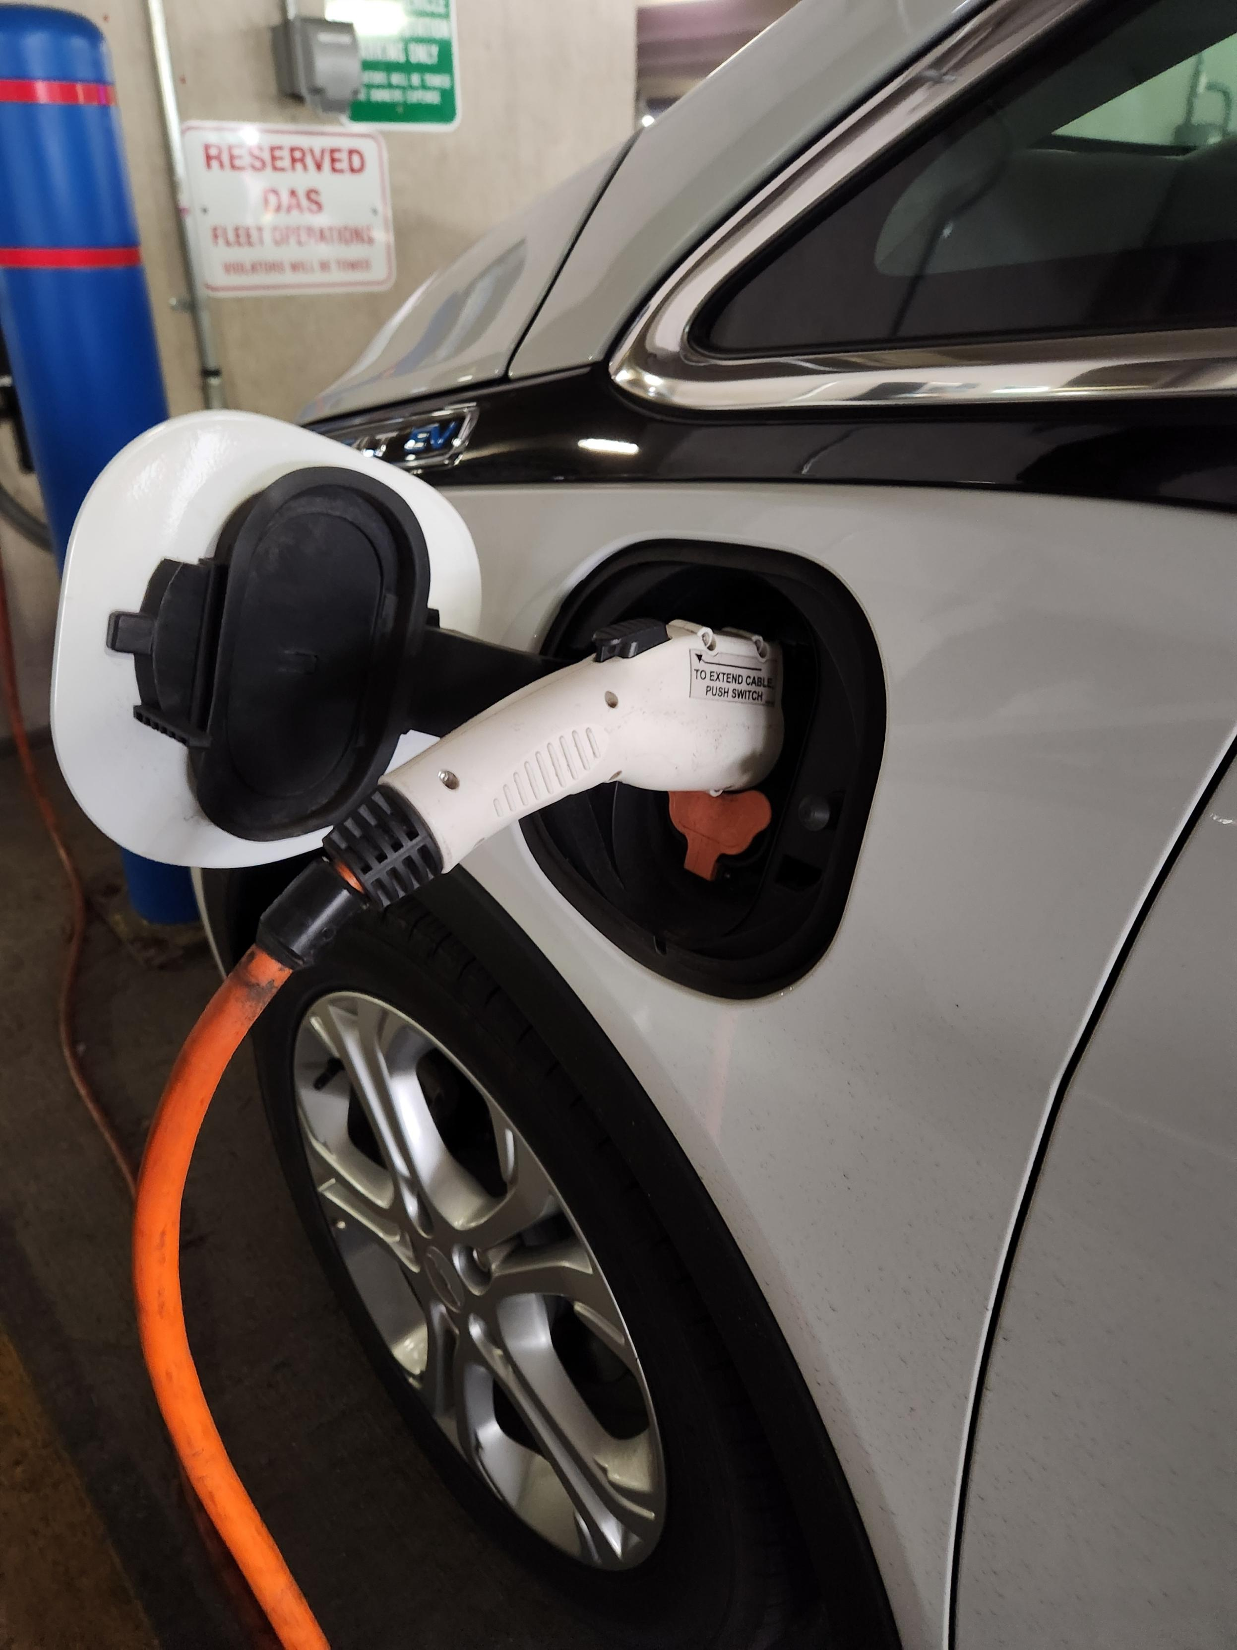
DAS Fleet Infrastructure
DAS, in consultation with Urban Engineers, is building out the roll out for EV charging infrastructure at our state properties that lease out fleet vehicles from DAS.
Notes:
DAS is building out the EV charging station infrastructure road map, with the assistance of our consultant, across state properties for the electrification of DAS’s Fleet Vehicles. We are finalizing our first 5 locations and roadmap and reviewing the recommendations for EV charging infrastructure. We are using telematics to provide better data on our fleet vehicles such as idling times, fuel economy and trip profiles to help inform decision-making on operational efficiency.

Slide 7
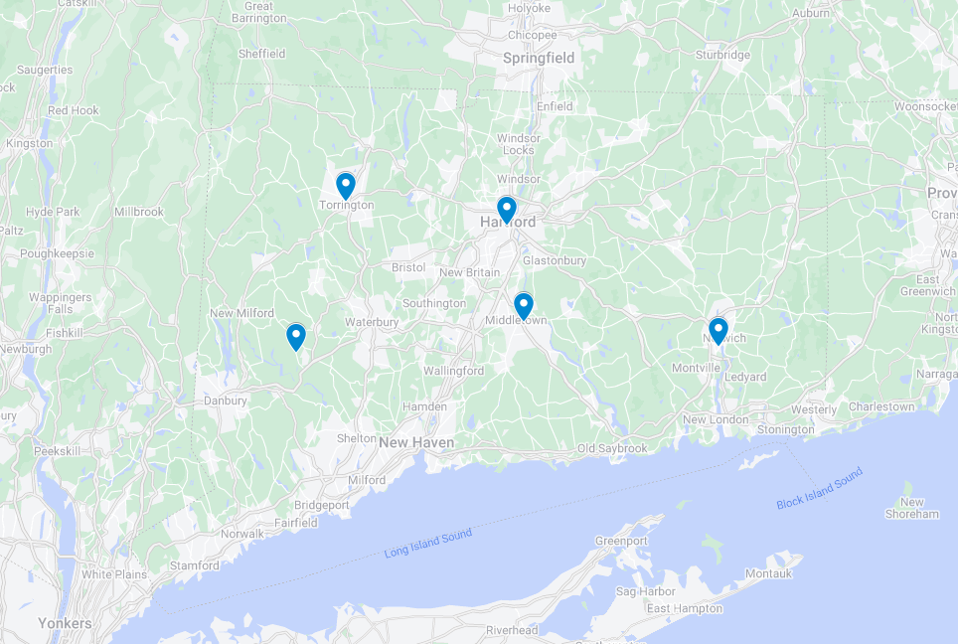
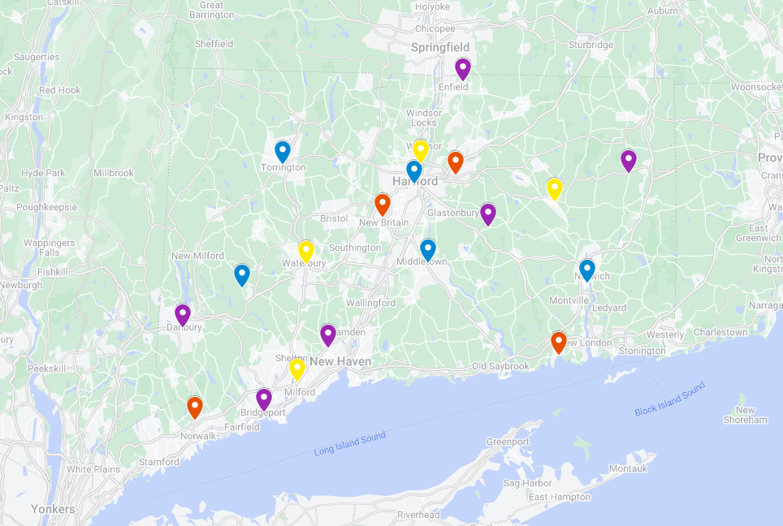
Site Groups 1-4
20-mile radius

Slide 8
EVSE Infrastructure Contract
Contract 21PSX0027; expires April 30,2028
9 firms to select on contract
Available for agencies to spearhead their own installation of EV charging infrastructure for public/employee use, outside of DAS scope.
Plans for new RFP are in discussions.

Slide 9
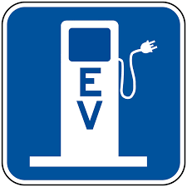
Fee Structure for public/employee use
Rate schedule established, $0.31/kWh, beginning October 1, 2022
CGA 4b-13a section (e)
A Memorandum of Understanding between OPM and Agency needed for credit/debit card transaction
Notes:
Fee is in statute and can be updated in the future.

Slide 10
Fleet Operations Endeavors
Vehicle Contract (19PSX0161 | Purchase of Cars and Light Duty Trucks) - in development
Available EV comparisons from those on contract
FY 2025 Replacement discussions

Slide 11
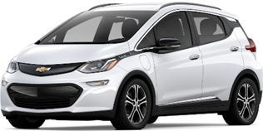
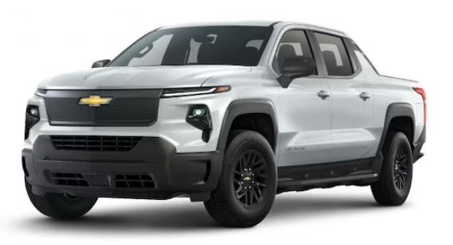
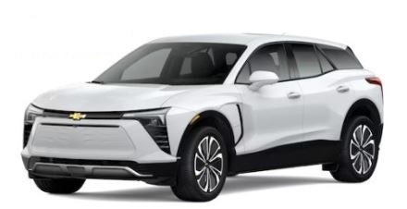
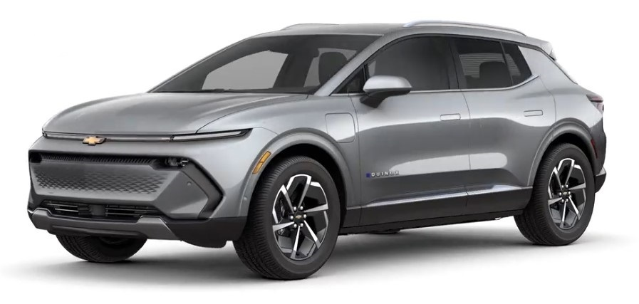
Vehicle Options
Vehicle Options are expanding
Range Assurance 230+
Bolt
Blazer
Silverado
Equinox

Slide 12
Agency Considerations
How many of the agencies DAS Fleet leased vehicles domicile overnight at state facilities?
Of the leased vehicles that domicile overnight at state facilities, how many have no special equipment?
The remaining vehicles will be counted towards the 50% 2026, 75% 2028, and 100% 2030 goals.
What charging infrastructure installations is the agency working on that are outside of the scope of DAS on going projects?

Slide 13
Inflation Reduction Act
45W Commercial Clean Vehicles Credit: for commercial clean vehicle purchases and government fleet purchases
  ≤$7,500 back for light-duty
  ≤$40,000 back for medium-heavy-duty vehicle.
30C Alternative Fuel Vehicle Refueling Property Credit:
  6% of the price of charging infrastructure installed in certain locations. Increase to 30% w/prevailing wage & apprenticeship requirements are met, ≤ $100,000.

Slide 14
Bipartisan Infrastructure Law
Focus on public-facing chargers, that state fleet could still access
Charging and Fueling Infrastructure Grant Program – CT awarded $14.6M for public chargers
CT DOT National Electric Vehicle Infrastructure Formula Program (NEVI)

Slide 15
Questions?
Contacts:
DAS – Ryan.Ensling@ct.gov
DAS – Stephen.McGirr@ct.gov
OPM – Joanna.Wozniak-Brown@ct.gov

