Slide 1


Solar MAP
Affordable Multifamily Housing Program
May 3, 2024
Greener Gov Challenge

Slide 2



Mission & Vision
Connecticut Green Bank is the nation’s first state level green bank. Established in 2011 as a quasi-public agency, the Green Bank uses limited public dollars to attract private capital investment and offers green solutions that help people, businesses and all of Connecticut thrive.
Our mission is to confront climate change by increasing and accelerating investment into Connecticut’s green economy to create more resilient, healthier, and equitable communities.
Our vision
Notes:
BG

Slide 3


Investing in Vulnerable Communities

Slide 4
Power Purchase Agreement

Slide 5
What is a Power Purchase Agreement?
Green Bank owns the Solar: Oversees development, construction, & asset management
Municipality is Buyer: Purchases electricity from solar installed on property
Contract between Green Bank and Municipality

Slide 6
What is a Power Purchase Agreement?
No upfront costs
Lock in energy savings
Positive cash flow
No operations & maintenance costs
Preserve capital & credit lines
Managed by a third-party solar system owner

Slide 7
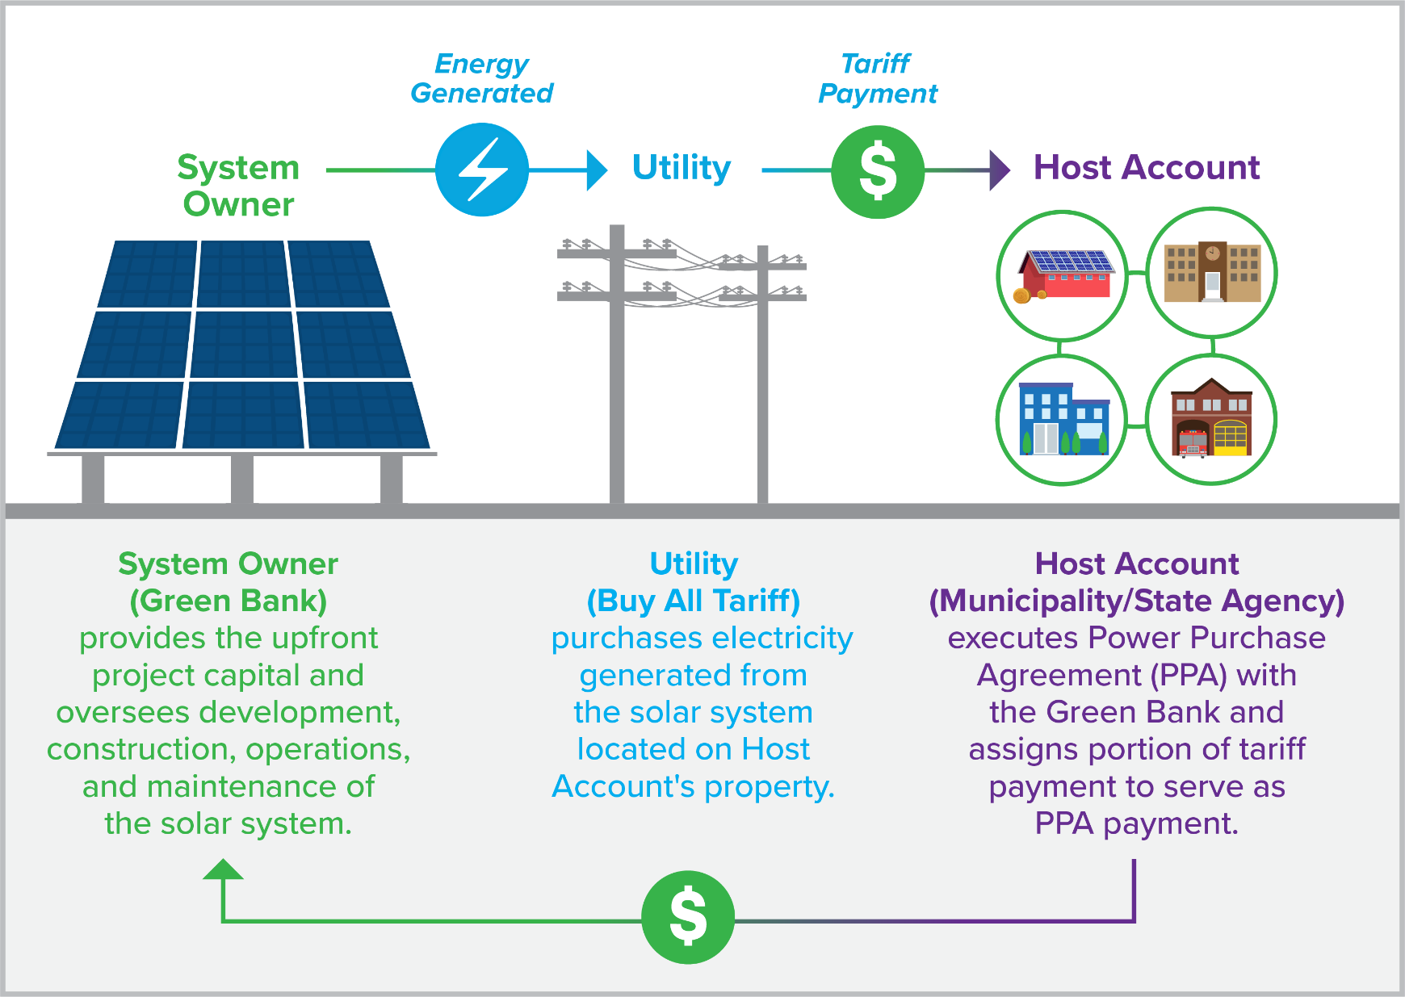
What is a Power Purchase Agreement?

Slide 8
Green Bank Assistance Program

Slide 9




Program Steps
Site Analysis. The Solar MAP team works with stakeholders to perform an analysis of all eligible locations to identify opportunities for solar projects​
Project Development. We conduct site visits, confirm project eligibility, and develop system designs for each project to determine project economics.
Execute. We present project specs and pricing to execute a project agreement.​
Trusted Partner. We solicit competitive proposals from solar contractors and select the best, bundling participating projects together to achieve economies of scale. After a qualified contractor is selected, the team manages all final steps of development, construction, and energization of the project. This process includes submittal for eligible state and federal incentives.

Slide 10
Federal Incentives
Inflation Reduction Act
  -Passed at the end of 2022​
  -Largest investment in climate and energy in American History ​
  -Creates the opportunity for projects to qualify for specific bonus investment tax credits ​
  -Goal: to accelerate the US green energy transition​
​
​
Base ITC​
The base investment tax credit (ITC) value is 30% ​
Potential Qualifying ITC Bonuses: ​
Energy Community Bonus – 10% ​
Low-Income Bonus – 10%​
Qualified Low-Income Residential Project – 20% ​
Domestic Content – 10%

Slide 11

Federal Funding
​The Connecticut Green Bank partnered with the Coalition for Green Capital for the National Clean Investment Fund (NCIF) application.
  There were 3 applicants selected.
  Coalition for Green Capital was awarded $5 billion.
  As a sub awardee, the Connecticut Green Bank will benefit from this funding.
Green Bank is a subrecipient of Connecticut’s Solar for All grant awarded through the Environmental Protection Agency’s Greenhouse Gas Reduction Fund (“GGRF”) to support solar and storage deployment through various existing and new programs and initiatives. Department of Energy and Environmental Protection (DEEP) is the primary recipient and leading the Connecticut Consortium of agencies participating in the grant. Green Bank intends to deploy a portion of these funds in existing programs such as Solar MAP.
Benefits:​
  Financial benefits to help cover eligible project costs
  OR make adding battery storage economically feasible ​
  Anticipated deployment of funds = 2025
​

Slide 12
Factors that impact project economics
Roof size
Building + Meter configuration
Exposure to the sun (and therefore how much energy your system produces)
How much energy is consumed across all units + common area meters
Potential Investment Tax Credit Bonuses
Building Type: high rise, garden style, etc.
# of units
Inclusion of battery storage
Required Upgrades:
  Interconnection Upgrades
  Structural Upgrades
  Roof Repair or Replacement Prior to Install

Slide 13
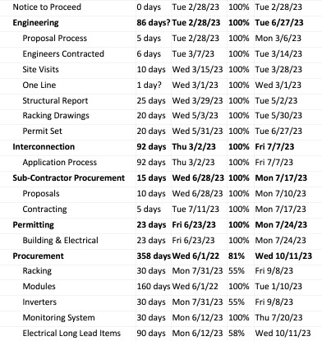
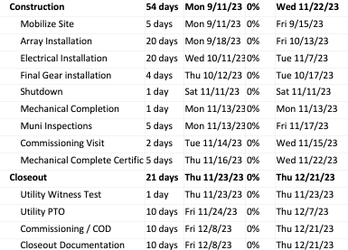
Sample Project Schedule

Slide 14
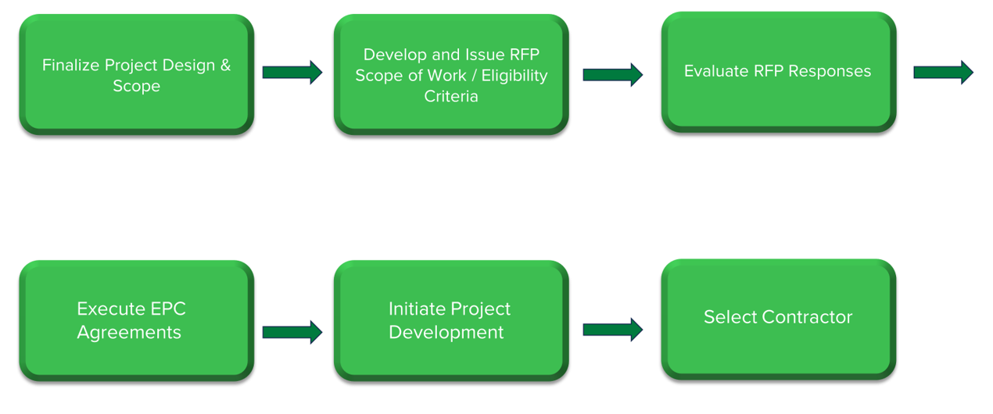
Competitive Solicitation With Our Contractor Network

Slide 15
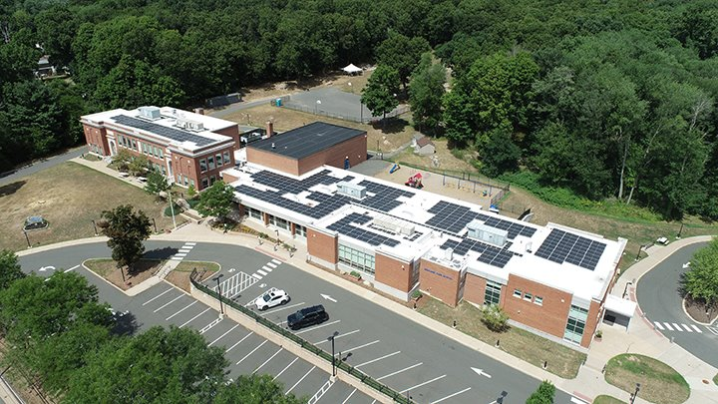
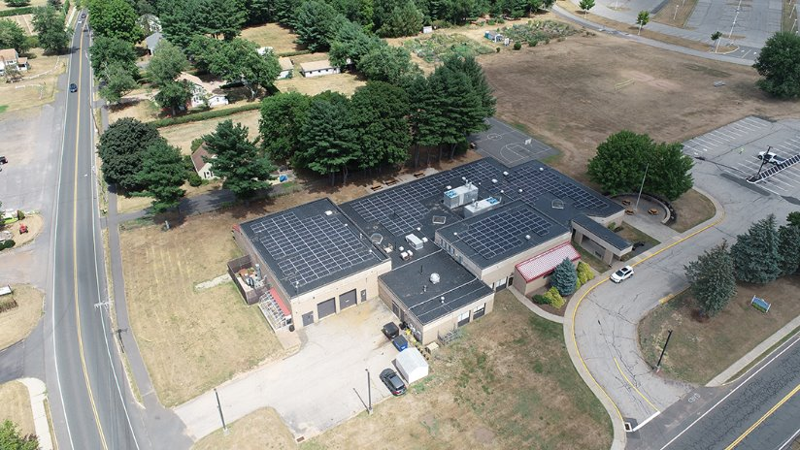
Program Spotlight: Town of Manchester
7 solar PV systems (over 2 MW) financed with the Green Bank Solar PPA​
Participated in Round 1 of Solar MAP along with 3 other towns​
Solar power provided an average 33% discount to utility power​
Average annual savings of $15,000 per building and a total savings over the term of $2.1 million​
Seven roof mounted solar PV systems on the municipal Water & Sewer Building and six Board of Education buildings

Slide 16


Questions & Answers
Contact:
Emily Basham, Associate Director, CT Green Bank
Emily.Basham@CTGreenbank.com
860-258-7839
Katie Shelton, Senior Manager, CT Green Bank
Katie.Shelton@ctgreenbank.com
860-785-9625
​Link to schedule a meeting:​
https://calendly.com/d/5j7-3jf-vyj/intro-call-solar-map-affordable-multifamily-solar

Slide 17


Thank you!

