Slide 1


Determining language needs for your agency using u.s. census data
Orlando Velazco, Director
Office of Health Equity
CT Department of Public Health
Created September 19, 2019

Slide 2
Slide deck notes
Hyperlinks to internet pages are underlined and red.
This entire analysis was completed using MS Excel, so if you have different spreadsheet software your methods may be different.

Slide 3
Presentation content
Introduction
Finding your census tracts
Finding U.S. Census language data
Finalizing your language needs assessment
Final Tips
Contact information

Slide 4
introduction
The purpose of this slide deck is to provide step-by-step instructions on how to find language needs in your service area for your Limited-English Proficient (LEP) population. LEP persons speak English less than “very well” and speak a language other than English.
Following this procedure will position your agency to better support the CLAS Standards (5 through 8) listed under the Communication and Language Assistance Enhanced Theme.
This language needs assessment is based on U.S. Census population estimates; both the American Community Survey and the U.S. Decennial Census are good data sources.
Repeating this process approximately every 3 years will allow your organization to better serve the changing diversity within your communities (CT is the most diverse state in New England).

Slide 5
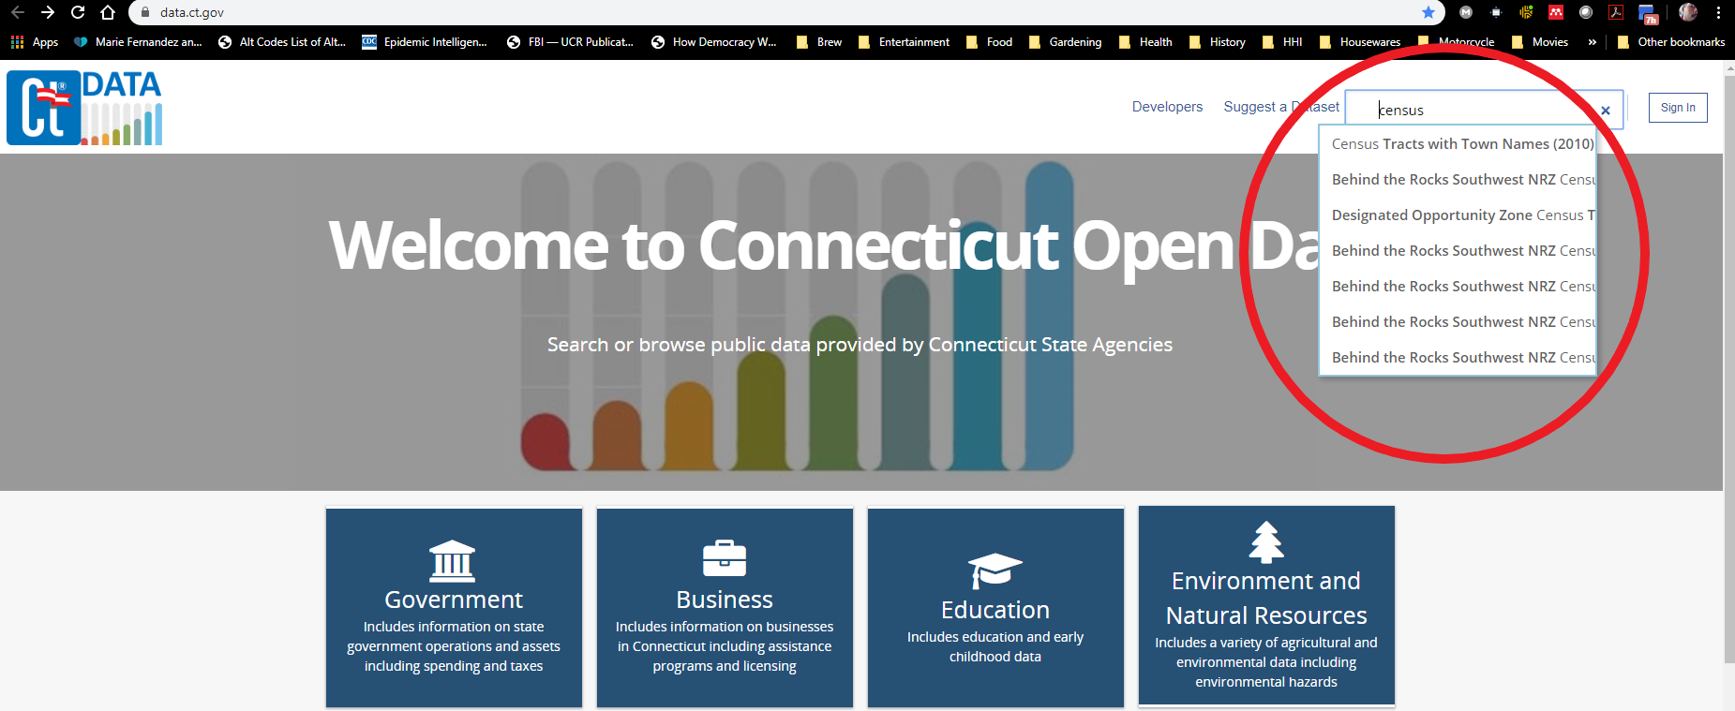
Finding your census tracts
1) Obtain census tracts from data.ct.gov by using search tool (i.e., the magnifying glass in the upper right) to find “Census Tracts with Town Names (2010).”

Slide 6
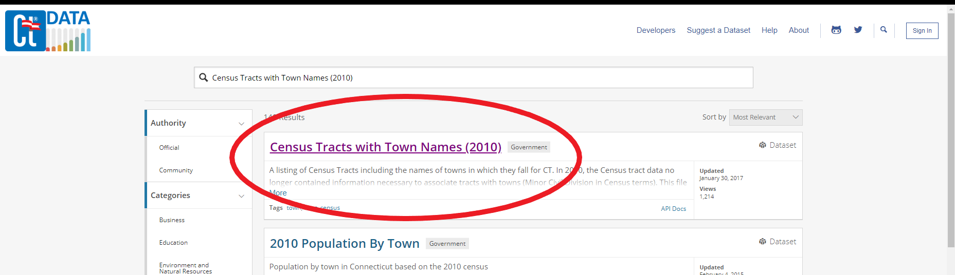
Finding your census tracts
2) Click on the link to get to the census tract data set.

Slide 7
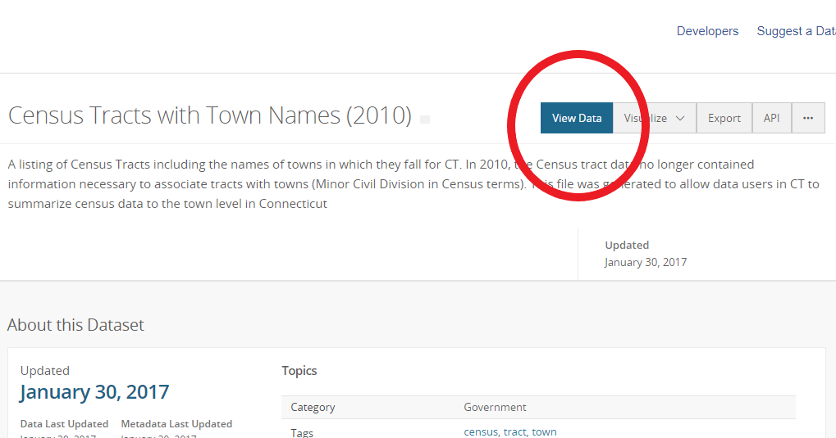
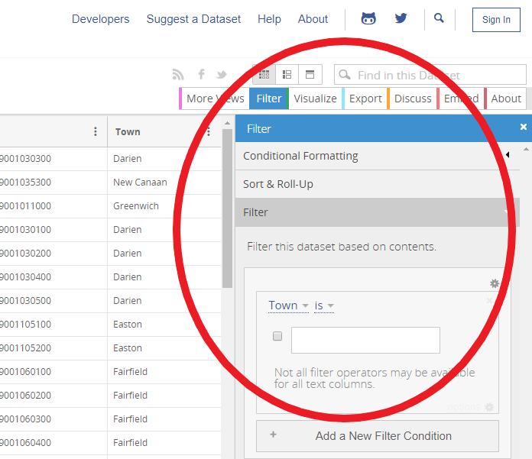
Finding your census tracts
3) Select “View Data,” then select “Filter” and enter each town of interest; make sure the selection boxes are checked. NOTE: the search field is case sensitive so you must capitalize the town’s name.

Slide 8
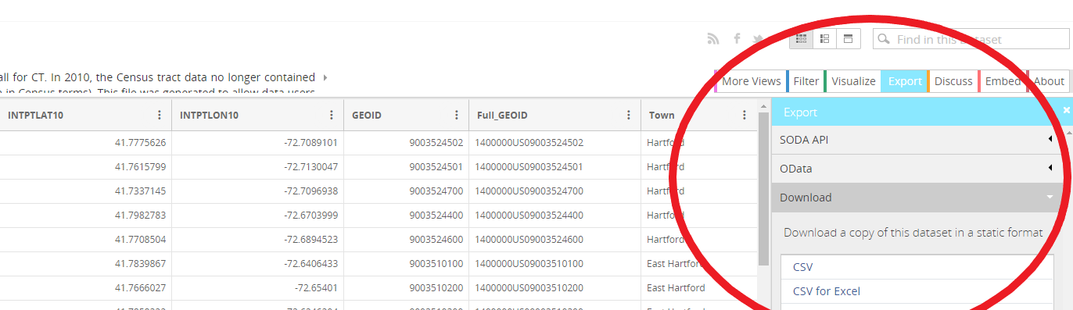
Finding your census tracts
4) Export results with “CSV for Excel” formatting for use with MS Excel; find and open file, and sort the exported table from A->Z by the census tract column (labeled “NAME10”); the census tracts are now listed in ascending order. Save your file.

Slide 9
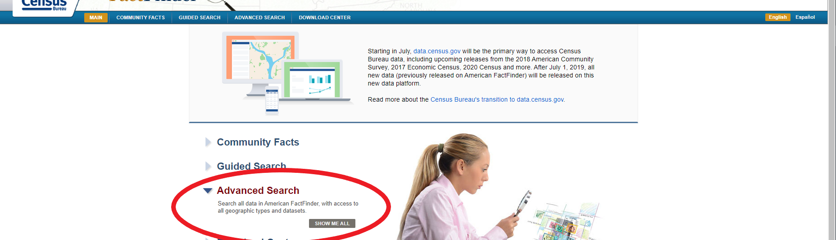
Finding u.s. census language data
5) Go to the U.S. Census Bureau’s American FactFinder and go to Advanced Search; select “Show Me All.”

Slide 10
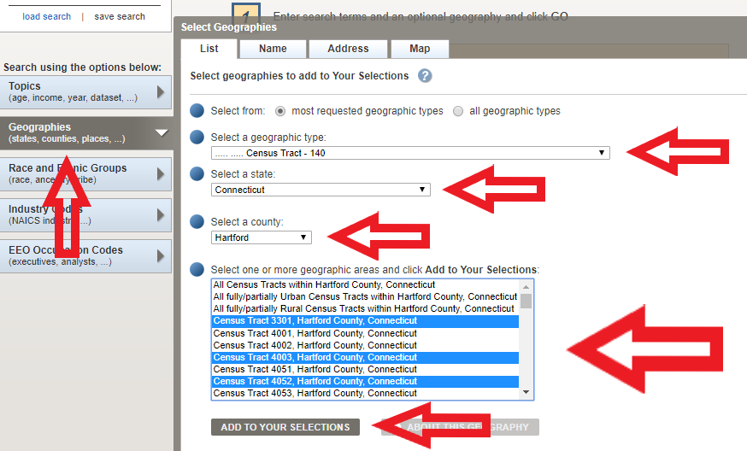
Finding u.s. census language data
6) On the left side, select “Geographies” and then select the geographic type “Census Tract – 140,” followed by “Connecticut, then the county in which the towns of interest are located; the census tracts will populate in ascending order. Using the spreadsheet obtained from data.ct.gov, select all the census tracts identified by holding the Control key while you make each selection (if you accidentally select a census tract that is not of interest, you can unselect by holding Control and clicking again on that same town. Your previous selections will remain highlighted). After making all of your selections, click “Add to Your Selections” and close the selection box on the upper right of the window.

Slide 11
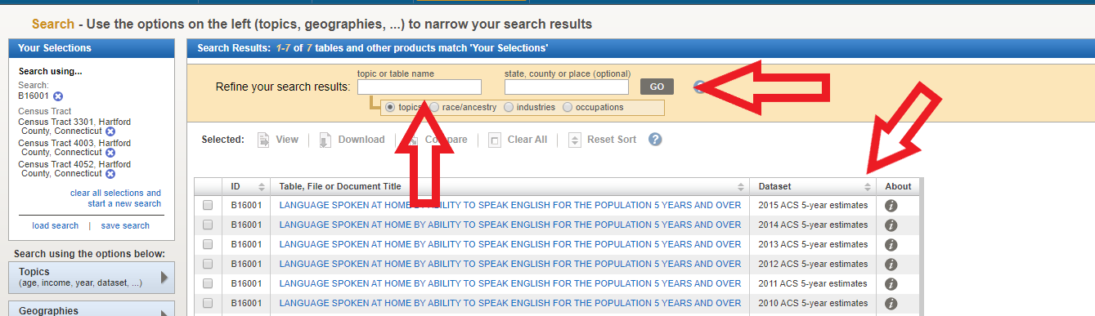
Finding u.s. census language data
7) In the yellow-ish bar up top, search for “B16001” (this is the table for language spoken at home by ability to speak English) under “Topic or Table Name,” and either click “Go.” Select the file with the most recent dataset (listed in the 4th column). NOTE: do not click on the pop-up window.

Slide 12
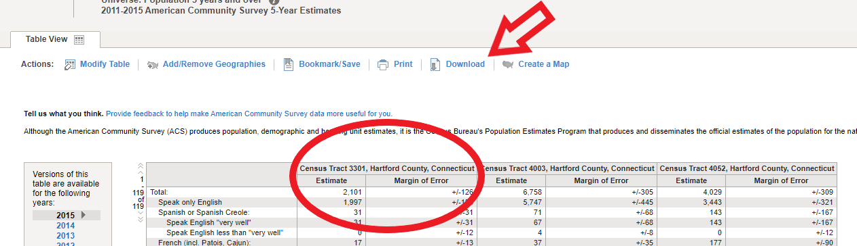
Finding u.s. census language data
8) After opening the table, headings will be labeled “Census Tract ‘X’” (depending on your selections) and include population estimates and margins of error for each census tract. Then select “Download.”

Slide 13
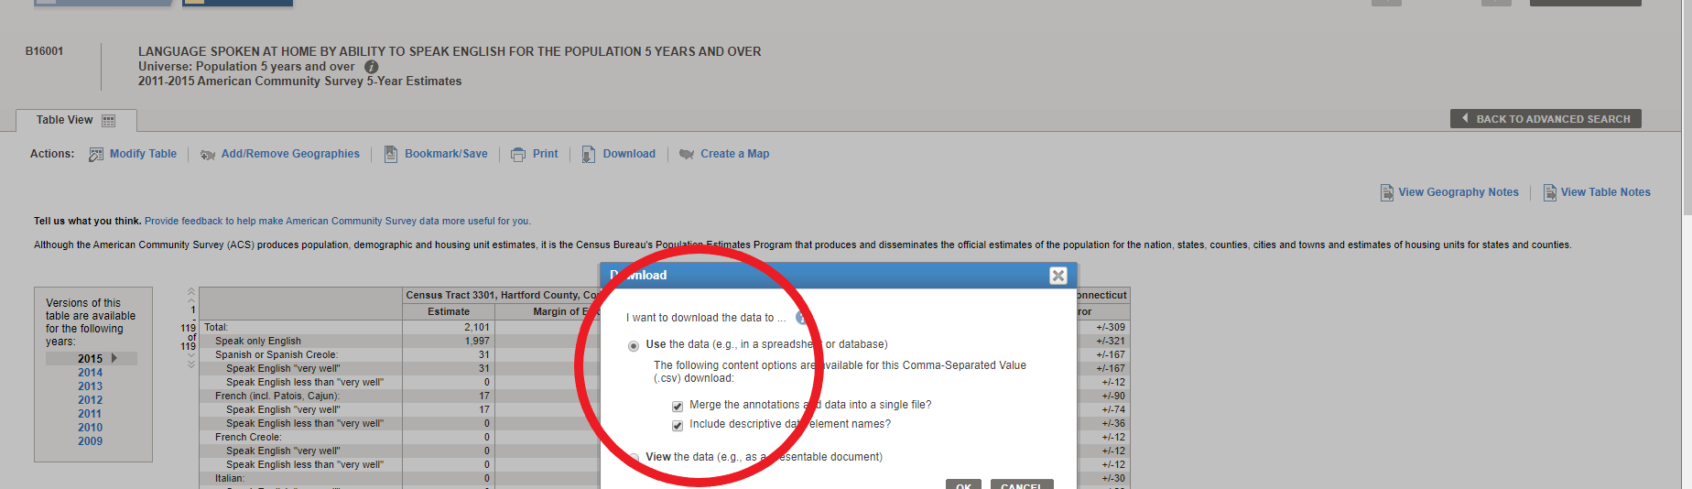
Finding u.s. census language data
9) A window will open up; select “Use the Data” option and select both options underneath, if not already selected.

Slide 14
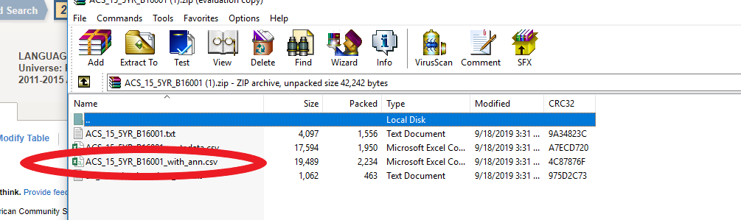
Finding u.s. census language data
10) After downloading the file, locate and open it (it will be zipped into a folder; the file of interest will be MS Excel and end with “_with_ann.csv”).

Slide 15
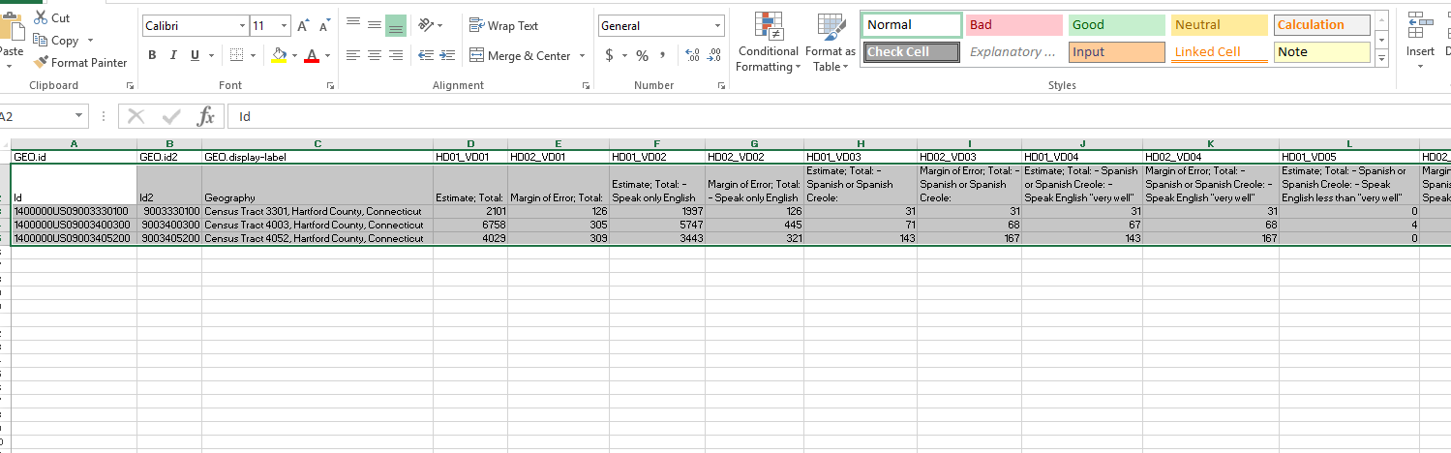
finalizing your Language needs Assessment
11) Create a pivot table by highlighting everything from the table except for the first row. For illustrative purposes, the columns in the image were adjusted to allow for viewing the labels in the second row; the table will not look the same upon opening. NOTE: the 2nd row has the descriptions needed and are the labels needed for the pivot table. If you need help on how to create a pivot table, please check out this video.

Slide 16
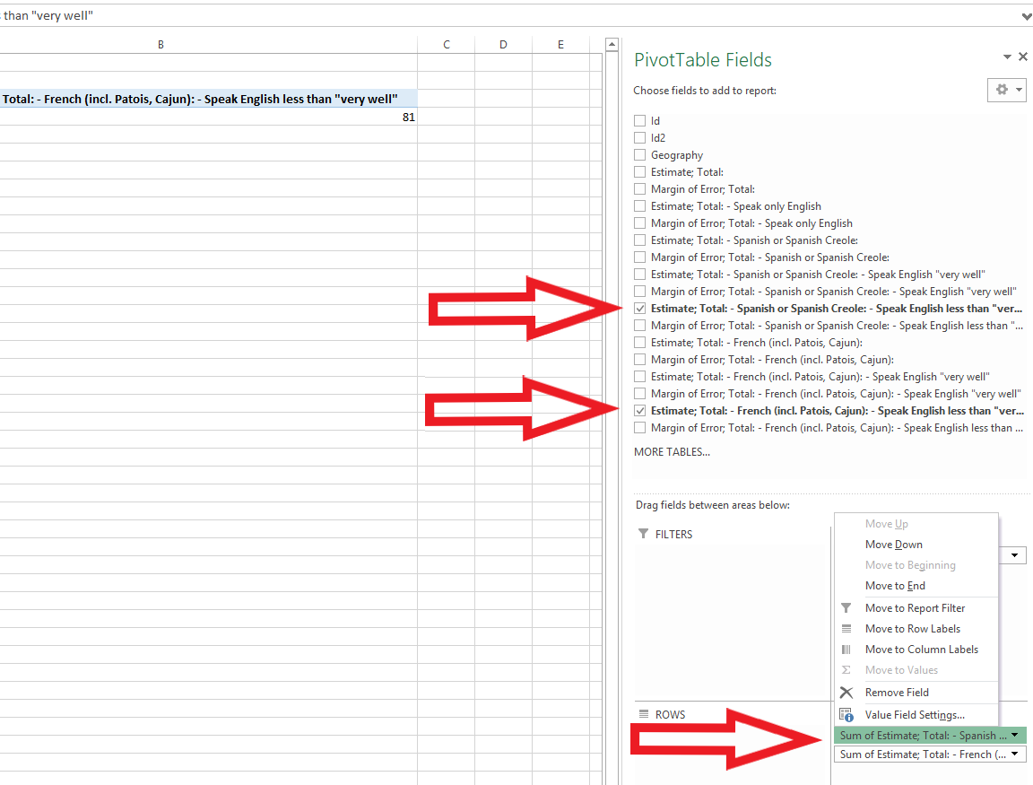
finalizing your Language needs Assessment
12) One-by-one add the estimate totals for each language where English is spoken less than “very well” by selecting them in the PivotTable Fields on the upper right and dragging each to the Values area, making sure that the Value Field Settings are set to sum (this is the default; if it is not, select the element you just dragged, click on “Value Field Settings…,” and change to “Sum” under “Summarize Values By”).

Slide 17
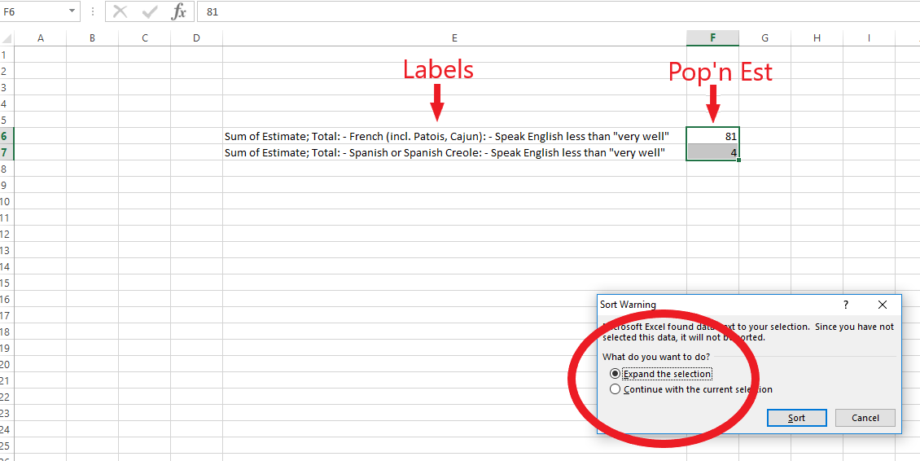
finalizing your Language needs Assessment
13) Copy the entire output of the pivot table and paste (preferably) on to a new sheet using the transpose paste option; your first column are the labels and the second column are the population estimates within your selected census tracts of residents who do not speak English “very well.” Select and sort the output by the second column (the population estimate) from Z->A; this list now approximates the number of residents who may need interpretation/translation services within your census tracts of interest, arranged from the greatest need to the least. NOTE: when sorting, make sure to select “Expand the selection” to ensure that the first column (i.e., the labels) re-orders with the second. If you do not, only the second column will re-order and the labels will not match the population estimates.

Slide 18
Final Tips
Certain language categories are labeled where it is impossible to identify a specific language (e.g., “Other West Germanic languages” or “Scandinavian languages”). If this is one of your top results, further investigation is required. You may want to reach out to social service agencies and area community-based organizations to make a more informed decision about client language needs.
If “French Creole” is one of your top results, it most likely can be substituted with Haitian Creole. Again, this requires some knowledge about your community and its culture.
CT DPH uses the count of the top 15 languages spoken by the state’s LEP population for agency-wide document translation and interpretation needs. Each agency must make its own determination for language needs, but any LEP population estimate that is greater than 3% of the total population should be seriously considered.
American Sign Language (ASL) will not appear anywhere in this analysis, but your organization should always consider adding resources to assist the speech- and hearing-disabled population.

Slide 19
Contact Info
Should you have any questions about this information, please contact the Office of Health Equity at DPH:
dphhealthequity@ct.gov
860.509.7140

