Slide 1
Mapping CT DOT’s Stormwater System & Interconnections
CT MS4 Mapping Workshop
Rocky Hill, CT
October 19, 2018

Slide 2
CTDOT MS4 Permit Background
CTDOT has been issued an MS4 Permit with an effective date of July 1, 2019.
Some differences exist between the municipal permit and the CTDOT permit
USGS Monitoring
Increased time to complete mapping
Mapping has been identified as the critical component of permit implementation moving forward
MS4 involves many Departments and Units within the DOT
Figuring out what parties are responsible for certain requirements within the permit will be an ongoing effort

Slide 3
Parties Responsible for MS4 Mapping
Mapping the drainage network is the responsibility of the Office of Environmental Planning
Maintaining the Drainage network is the responsibility of Maintenance
IDDE inspections and monitoring is the responsibility of Environmental Compliance
USGS monitoring and SELDM modeling is the responsibility of both Environmental Compliance and Environmental Planning

Slide 4
Mapping Initiation
Working Groups were formed in Winter 2016 to develop attribution for drainage assets
Discussions on what technology would be best to use
Spring 2017 a scaled back version of the MS4 program, was “piloted” that was to look at the condition of Corrugated Metal Pipes (CMP)
Winter 2017 each DOT District was tasked with performing the CMP inventory and inspection utilizing ESRI ARC Web Map and Collector App

Slide 5
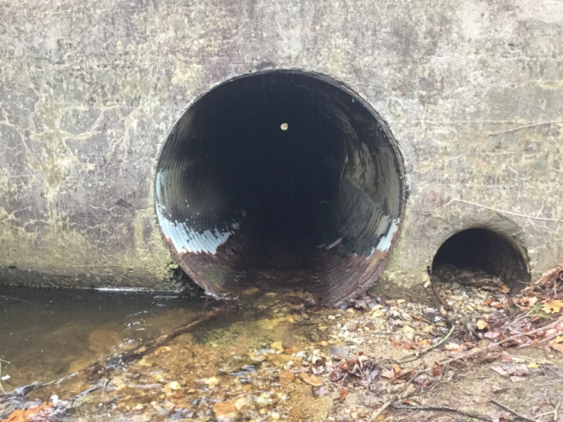
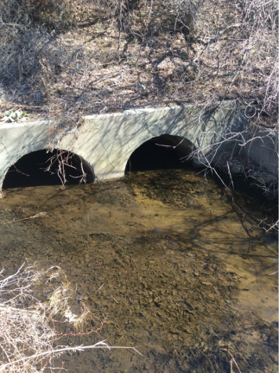
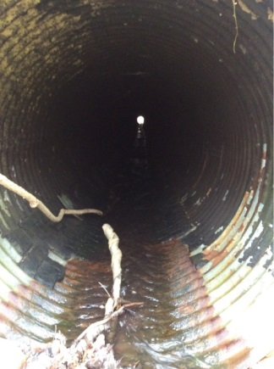
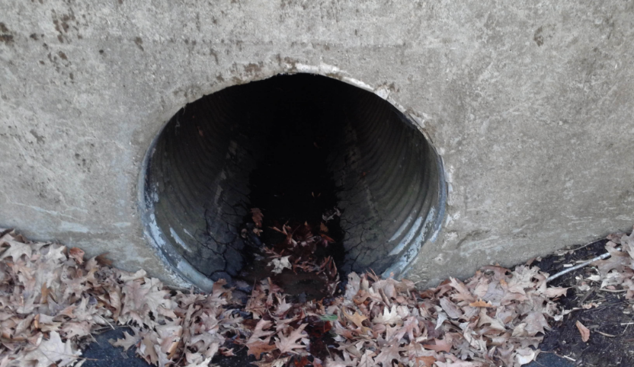
CMP Mapping Initiation
Spatially locate CMP’s in the Office utilizing georeferenced construction plans in ESRI ARC Web Map
Follow-up with field review of pipes to determine condition take photos and fill out other attribution in Collector App

Slide 6
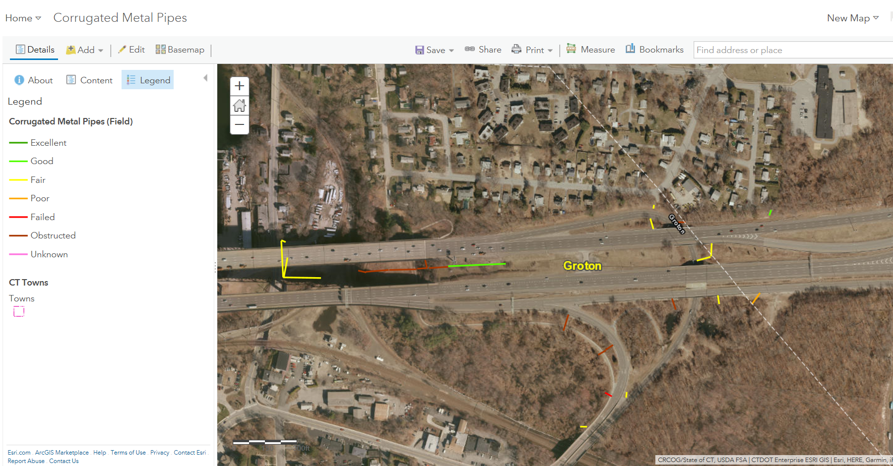

Slide 7
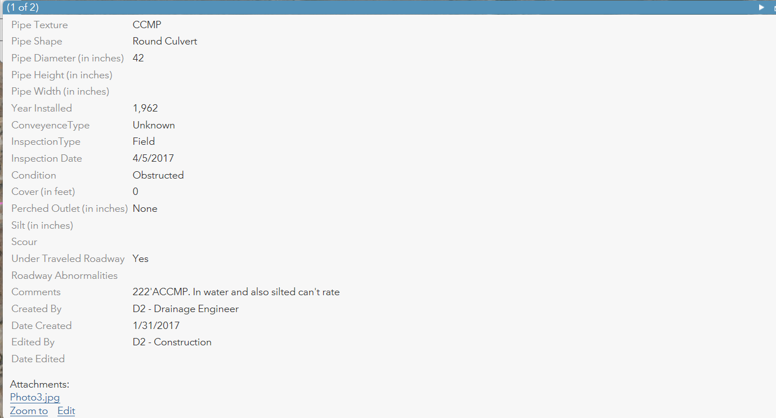

Slide 8
MS4 Mapping Initiation
The CMP pilot was successful and the technology used within the pilot is now being translated into MS4 Mapping.
DOT discussed and finalized attribution for all drainage structures
DOT IT developed program
Norwich and East Hartford determined as Pilot Location
Pilot is just beginning and is expected to be finalized by January
DOT is currently a member within the MS4 GIS standards working group that will hopefully allow for municipalities to mimic what DOT will have created for mapping.

Slide 9
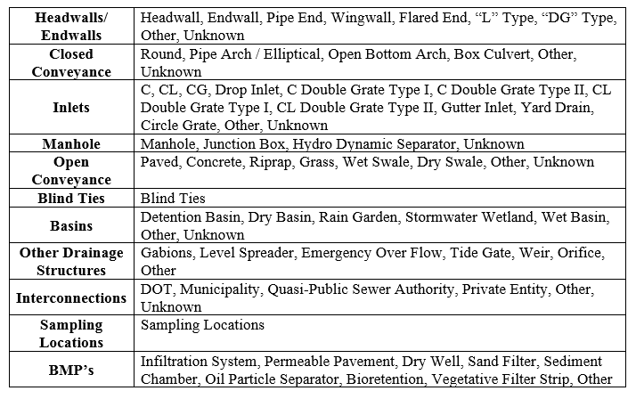
MS4 Mapping Schema: 11 Feature Classes

Slide 10
MS4 Mapping Schema
The 11 feature class will encompass all of the DOT drainage network
There are four fundamental ideas that were utilized when developing the schema and data model:
Attribution that does not change is tied to the asset (year built of a structure)
Attribution that is subject to change is captured in a maintenance reporting form connected to the asset (depth of sediment in a catch basin)
Sampling data (IDDE) is captured within set forms and is its own identifiable layer
Interconnections have their own identifiable layer

Slide 11
MS4 Mapping Schema
Interconnections
Put as individual points on a map to able to easily query and visualize them

Slide 12
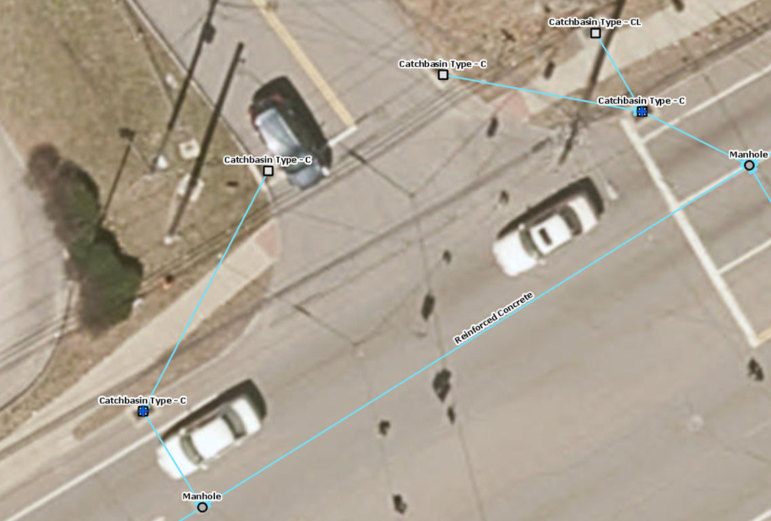
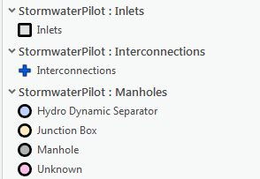
Interconnection from municipal system to DOT system

Slide 13
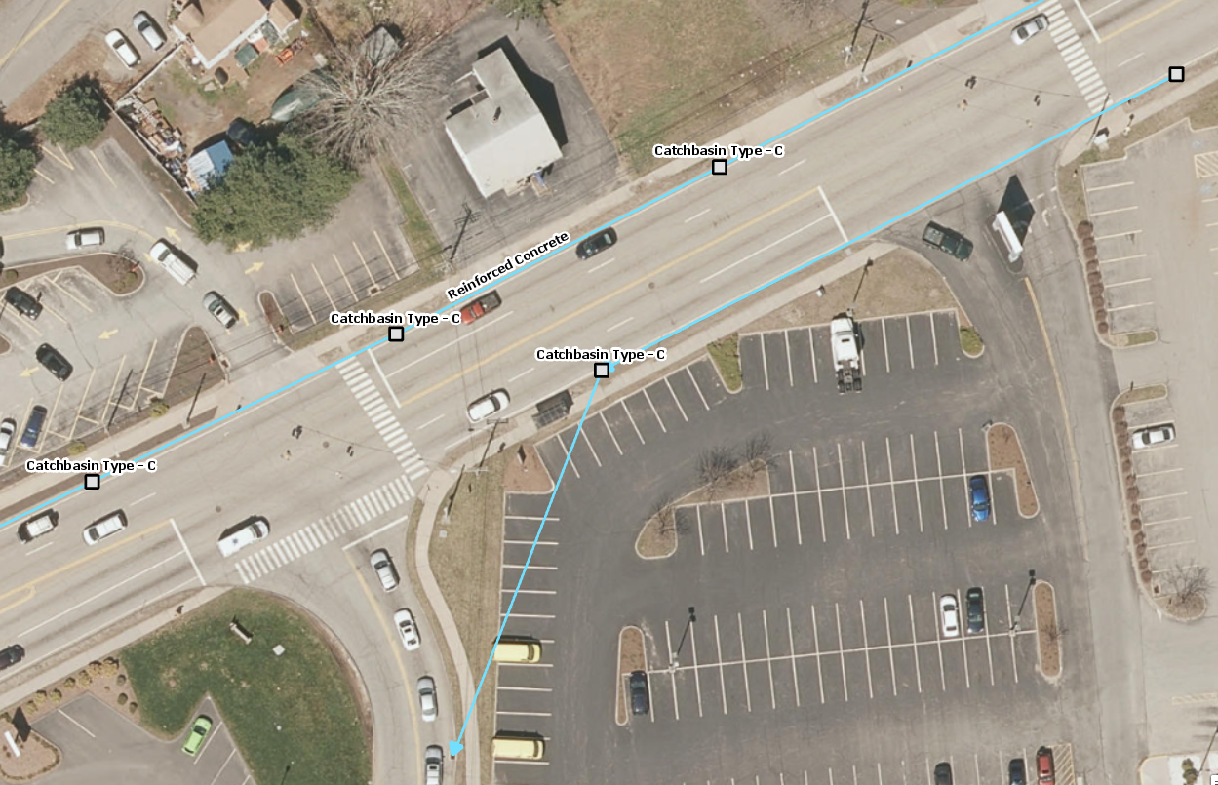
Interconnection from DOT system to municipal system

Slide 14
DOT MS4 Mapping Technology
Main Applications are the ESRI Arc Web Map and Collector App.
Also using ArcGIS Pro software to georeference construction plans and digitize drainage information to populate Arc Web Map.
ArcGIS Pro allows drainage structures and pipes to be “snapped” together to develop an “intelligent” utility system
Arc Collector App will be used to field verify asset information, add missing drainage features in the field and complete maintenance and IDDE reporting forms.

Slide 15
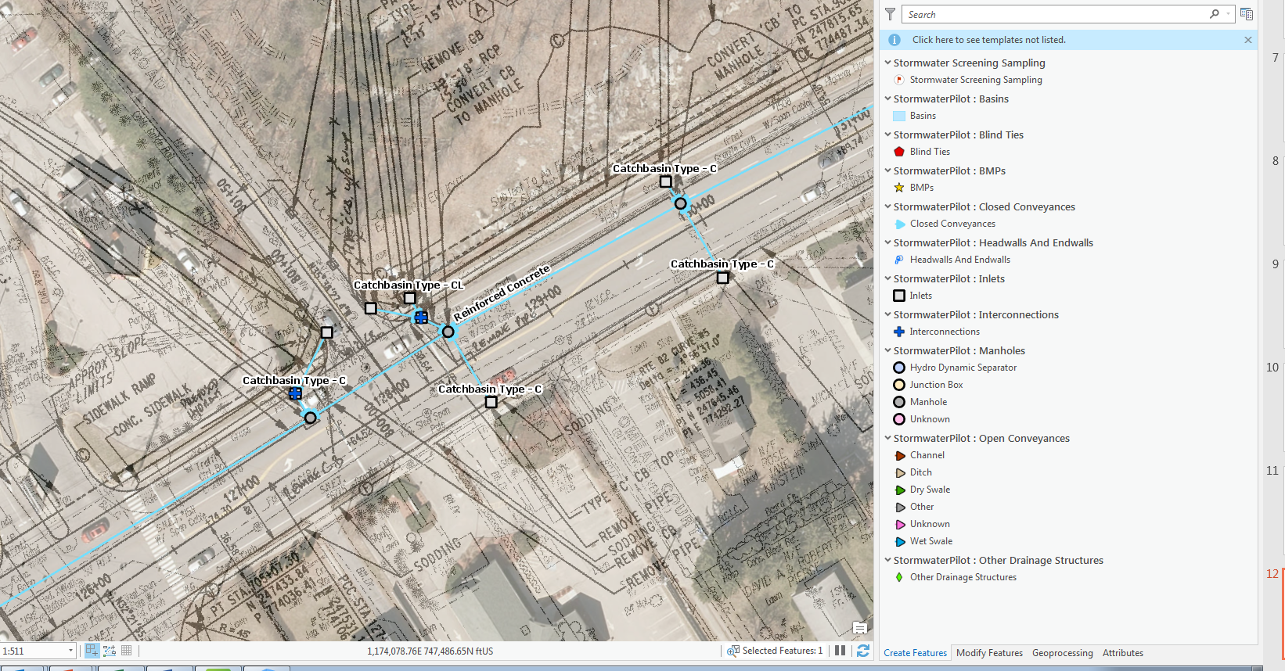
ESRI ArcPro with Georeferenced Construction Plan

Slide 16
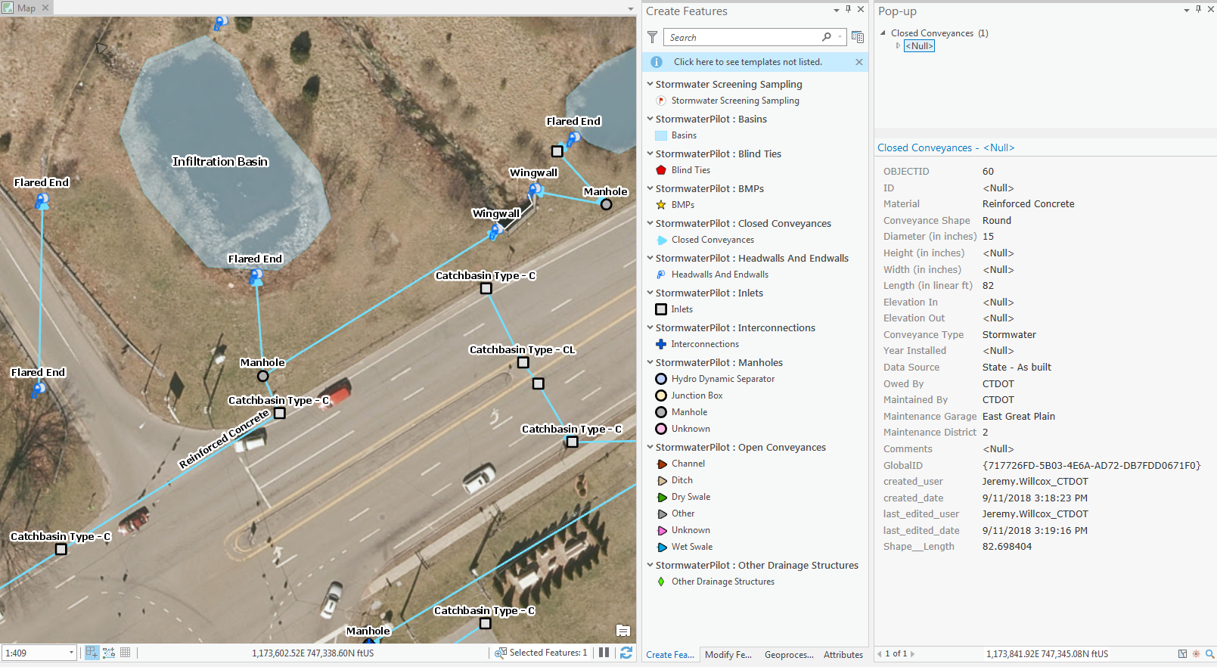
ESRI ArcPro with Attributes

Slide 17
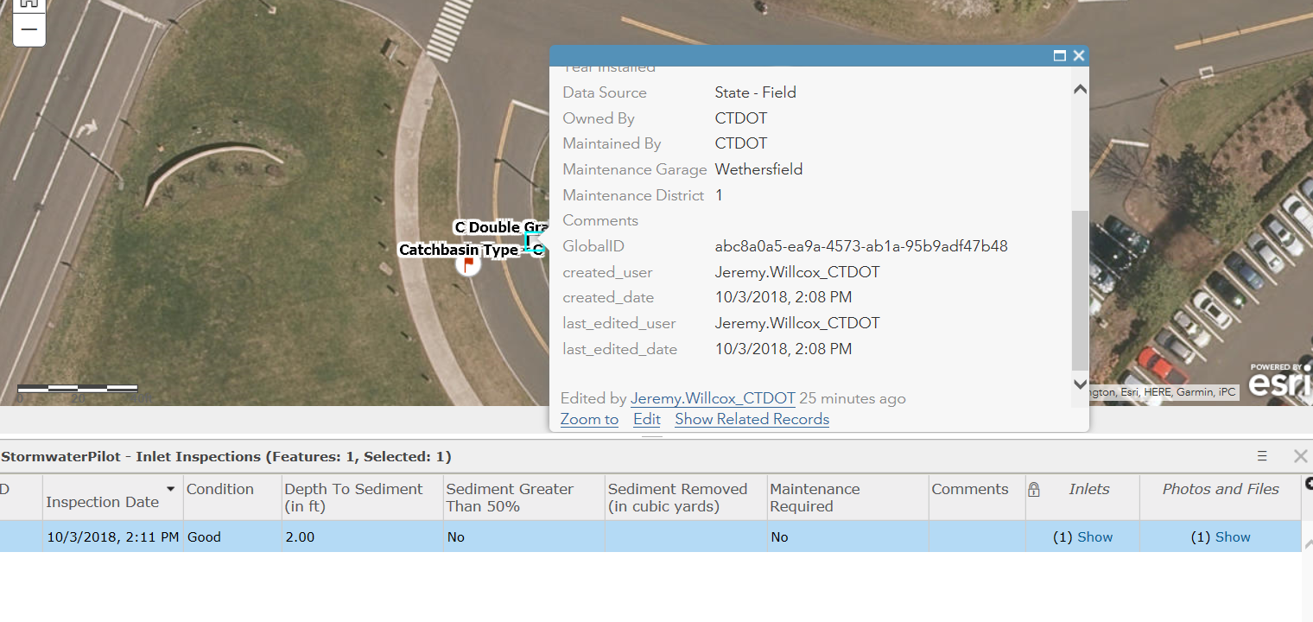
Inspection Forms were created for each asset that would require maintenance

Slide 18
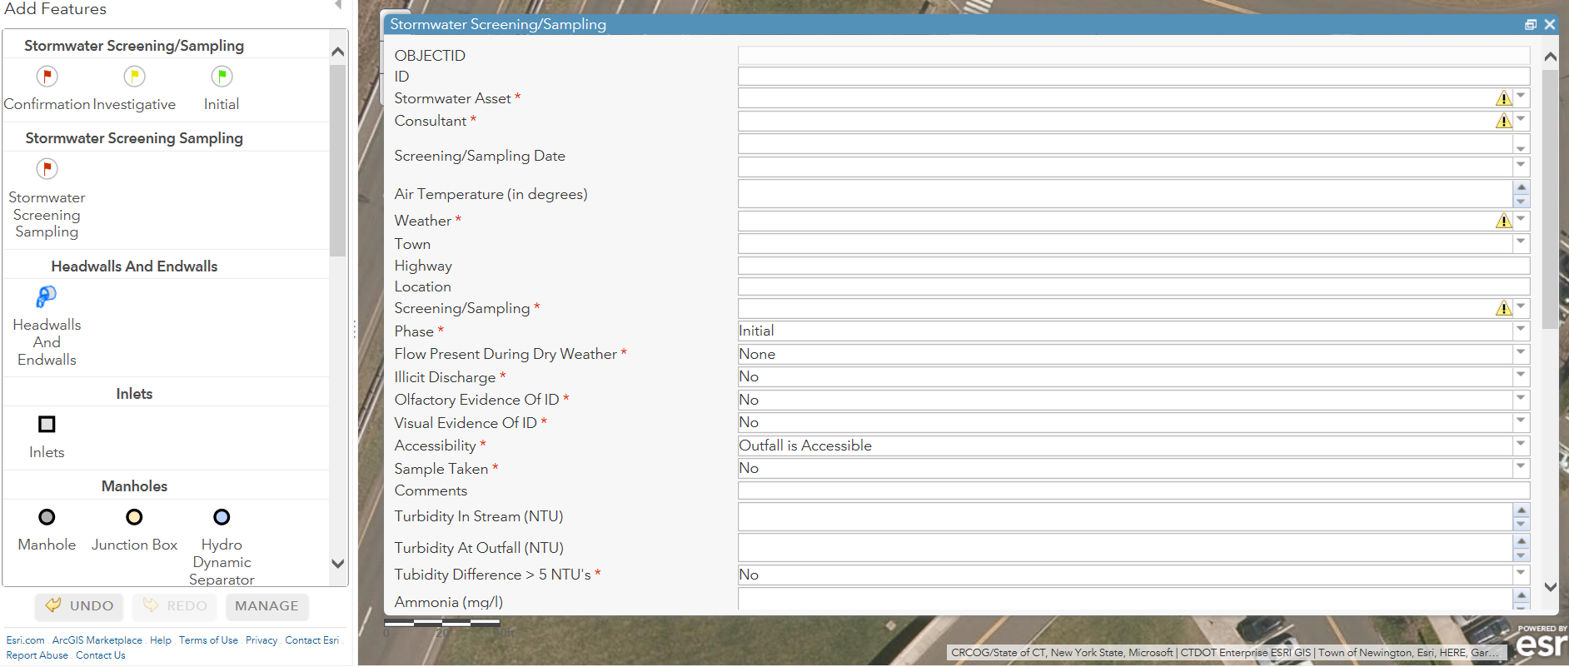
Sampling Forms were created for the Screening / IDDE component of the Permit

Slide 19
Moving Forward
Finalize attribution and standard operating procedures for conducting the mapping
Continue to work with GIS Standards Committee to try and provide a template that municipalities can utilize
Continue to develop the technology to provide a benefit to the Department as a whole for future asset collection projects
Incorporate design information into the MS4 mapper
Incorporate drainage agreements and encroachment permits (interconnections agreements) into program
Help create a platform where municipalities and DOT can easily exchange mapping data
Goal is to have a fully functioning program by July 1, 2019

Slide 20
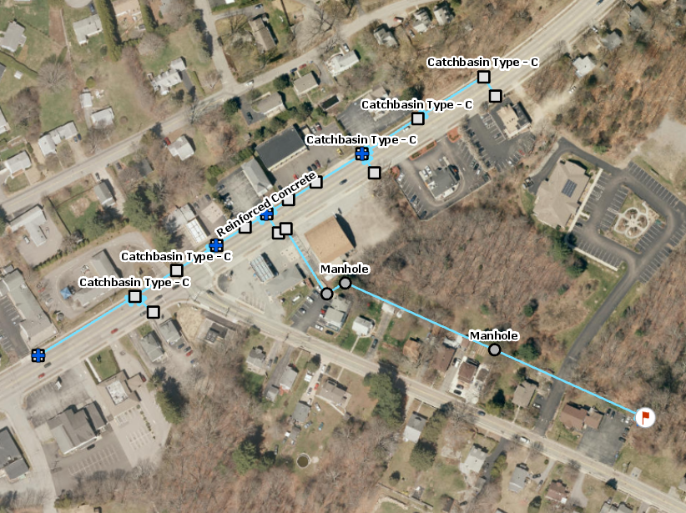
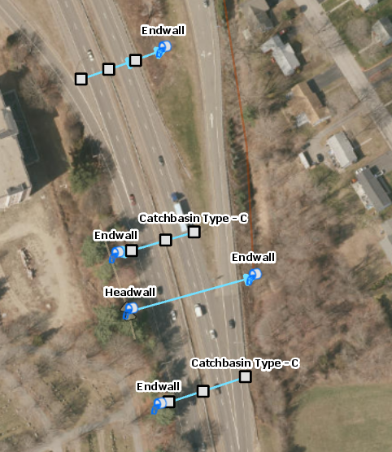
Thank you and if you have questions please contact:
Kevin Carifa, Office of Environmental Planning 860-594-2946
Jeremy Willcox, Office of Environmental Planning 860-594-2934

