Slide 1

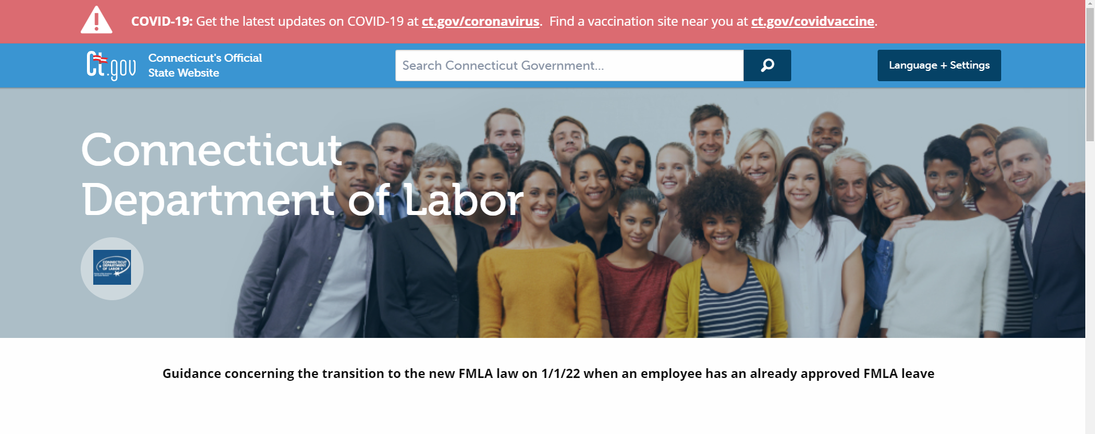
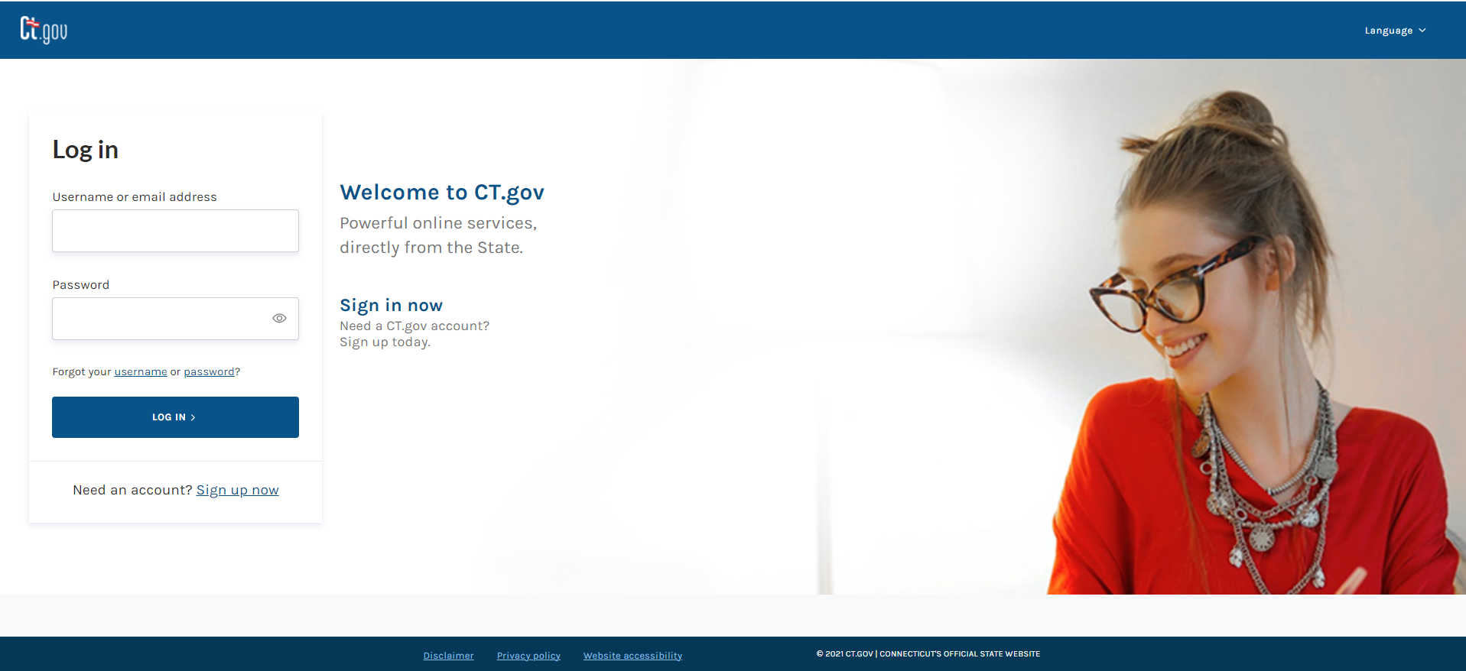
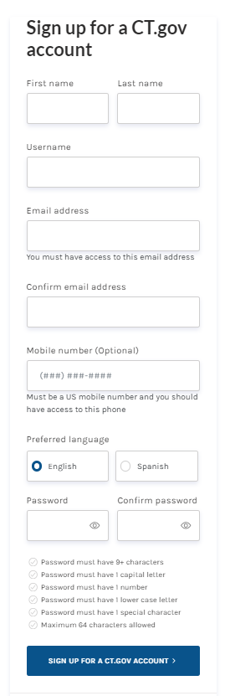
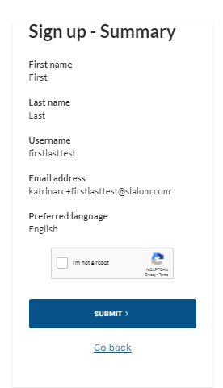
Employers Responding to a Connecticut Paid Leave Appeal
Disclaimer: All references within this document to the red box are solely for the use of this document and do not reference the website.
After you receive an email from CT DOL notifying you that an appeal has been filed, you will need to log into the Appeals portal to respond. Follow the steps in this job aid to log in and respond to an appeal.
Scroll to the bottom of the CT DOL website and select the link that allows you to file an appeal
Before proceeding with filing an appeal with CT Paid Leave, you MUST have a state identity with CT.gov. If you do not, click “Sign up now”, highlighted here with a red box to set one up
If you already have one, proceed to sign in using the “Log In” button
At the CT.gov site, complete the form to create an account
Click “SIGN UP FOR A CT.GOV ACCOUNT” button, highlighted here with a red box
Review the information on the summary screen, and if any changes need to be made, click on the “Go back” link and adjust.
If no changes need to be made, click in the CAPTCHA box to validate.
Click “SUBMIT”, highlighted here with a red box
Continue

Slide 2
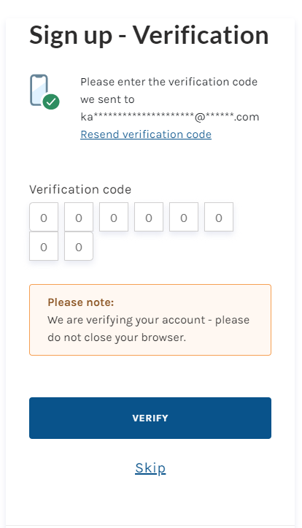
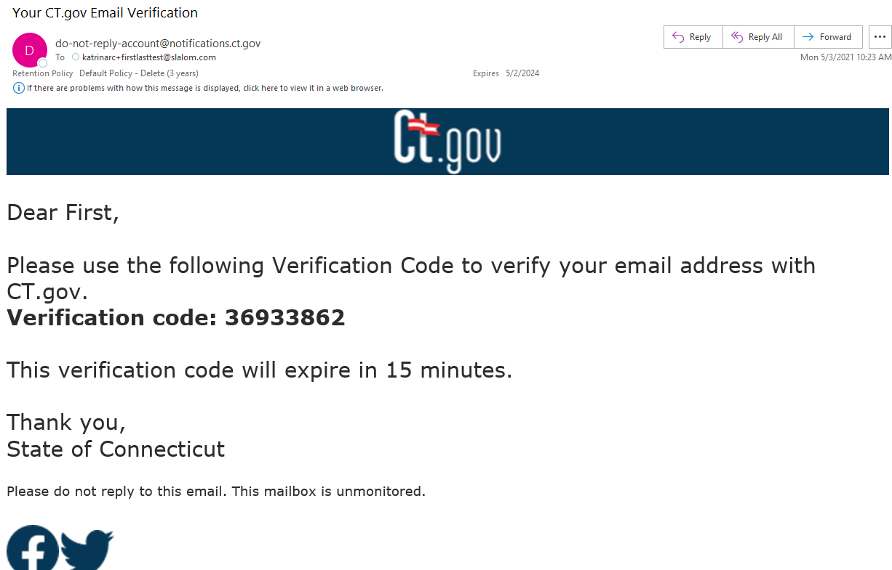
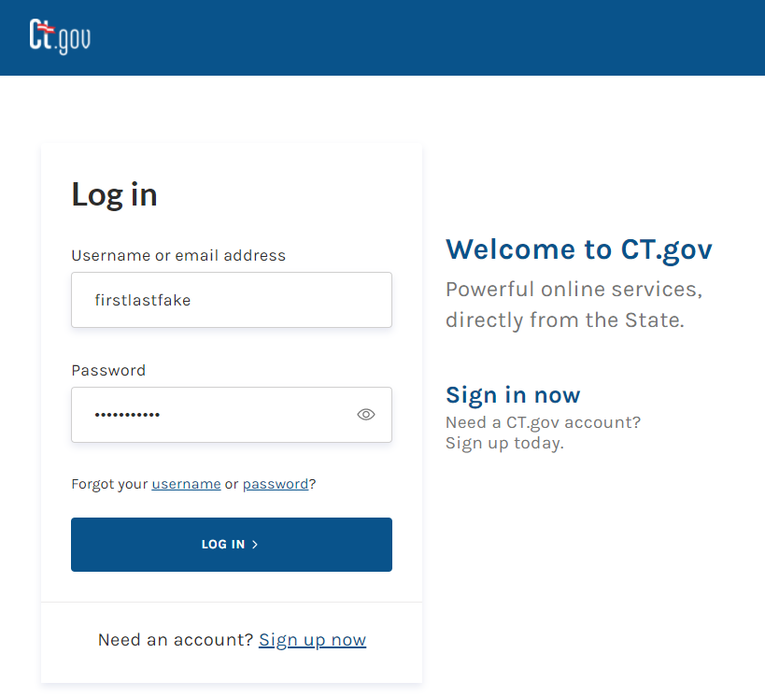
Employers Responding to a Connecticut Paid Leave Appeal
Disclaimer: All references within this document to the red box are solely for the use of this document and do not reference the website.
An eight-digit verification code will be sent to the email address used during the sign-up
You’ll need to toggle to the email account that you used to set up the CT.gov account with to acquire the code and then enter it here. The code is valid for 15 minutes
After you enter the code, click “VERIFY”, highlighted here with a red box
NOTE: You can use the “Skip” link to bypass the verification step as the system allows for 3 grace sign-in attempts before the system will force verification
Locate the email from do-not-reply-account@notification.ct.gov
Highlight the verification with your mouse or write down the code
Toggle back to the CT.gov verification screen and enter the code
Using the credentials, you just set up, enter your:
    Username OR email address, and
    Password
Click the “LOG IN” button, highlighted here with a red box
Continue

Slide 3
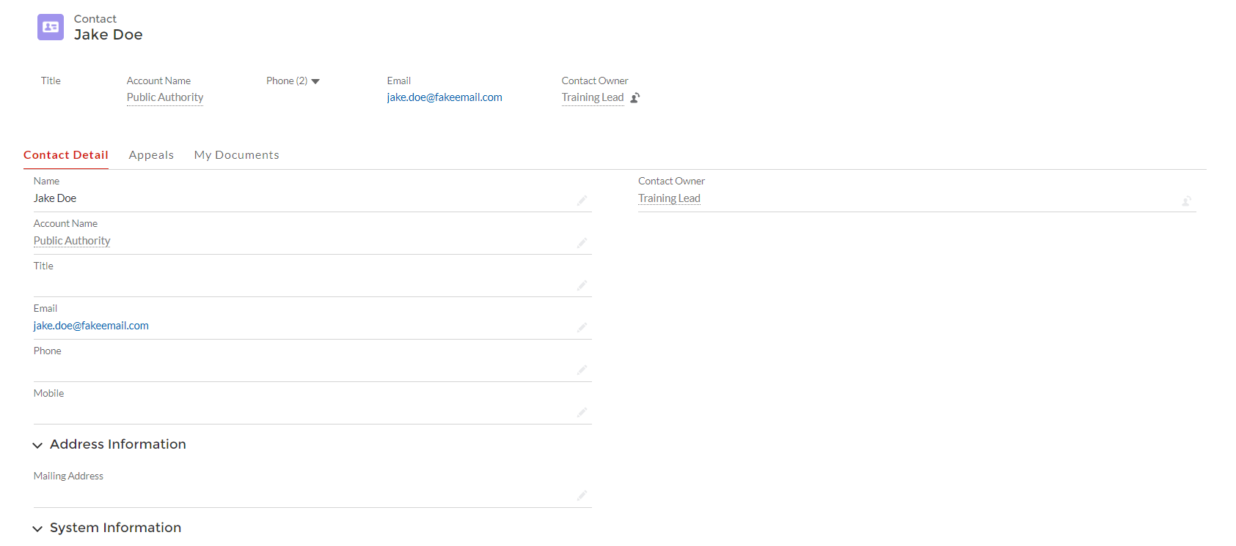
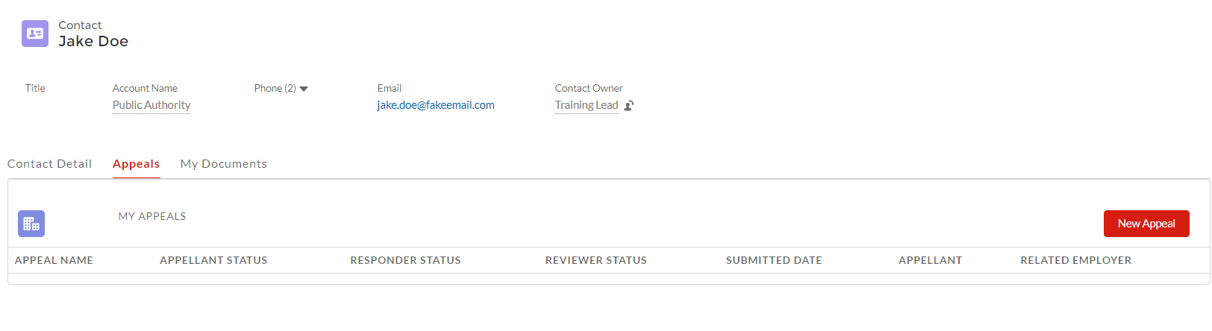

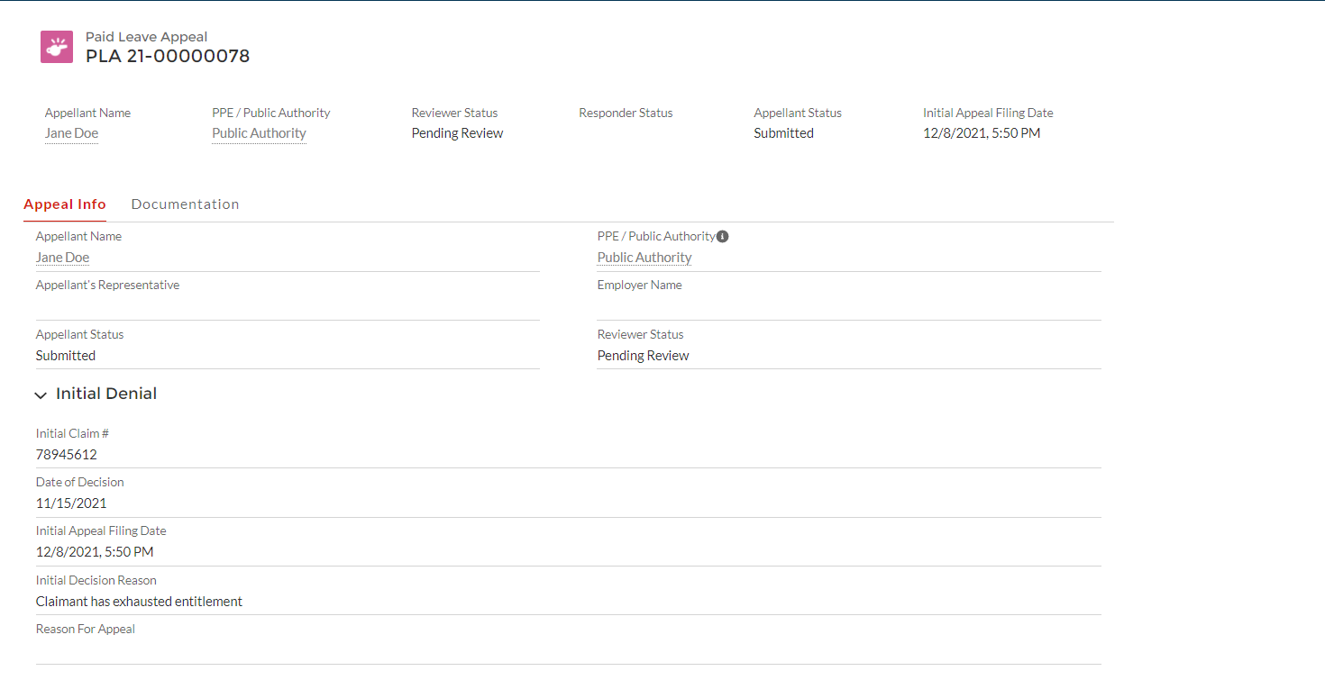

Employers Responding to a Connecticut Paid Leave Appeal
Disclaimer: All references within this document to the red box are solely for the use of this document and do not reference the website.
Once logged into ct.gov, Private Plan Employers (also known as Respondents), will be brought to your Appeal Account Dashboard. From here you will be able to view all appeals filed against the affiliated entity.
The landing screen is the “Contact Detail” tab, and from here you can view the information associated with your account. No editing will be allowed.
The “My Documents” tab displays all documents that were uploaded by the contact. In this example, all the documents that Jake Doe uploaded are displayed.
The “Appeals” tab is explained below.
From the “Appeals” tab, the Respondent can view the status of the appeal(s) filed against the affiliated entity.
To respond to an appeal by uploading documentation:
Begin by clicking once on the appeal name from the listing
Note : Functionality that will be added - If an employer needs to file their own appeal against the CTPL Authority, they can do so by clicking selecting “Submit an Appeal” from the User Profile dropdown menu.
Once within the appeal record,
Click on the “Documentation” tab

Slide 4
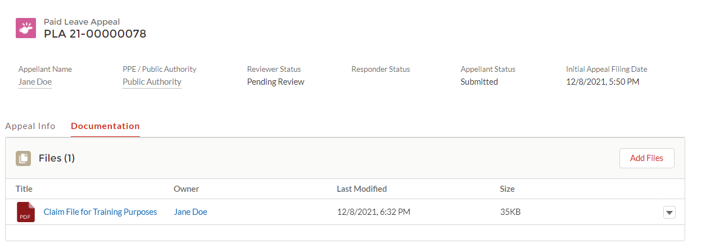

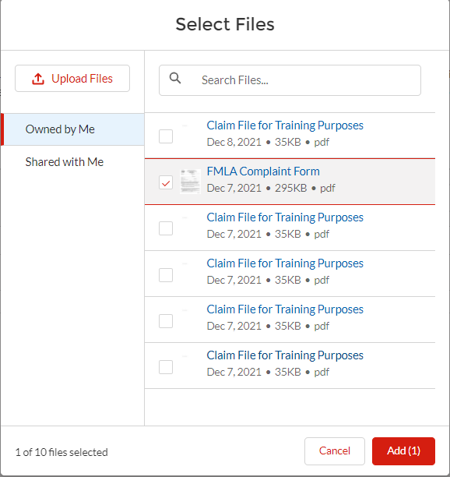

Employers Responding to a Connecticut Paid Leave Appeal
Disclaimer: All references within this document to the red box are solely for the use of this document and do not reference the website.
To upload new documents to the appeal record:
Click on the “Add Files” button
Note: Any documentation/records uploaded by the CT DOL Appeals Division Reviewer will display here as well.
Navigate to the file(s)
You can:
“Upload Files” from your pc
Select any of the documents from those listed in “Owned by Me” tab (any files that have been uploaded by the user will display here)
Select any of files from “Shared with Me” library
Once uploaded, files can be viewed by the internal CT DOL reviewer.
Please note: You can upload any additional documentation, including a written legal argument to the appeal filed by the appellant or appellant representative.

Slide 5
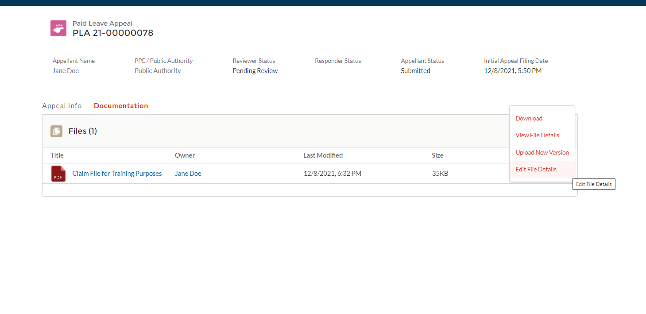



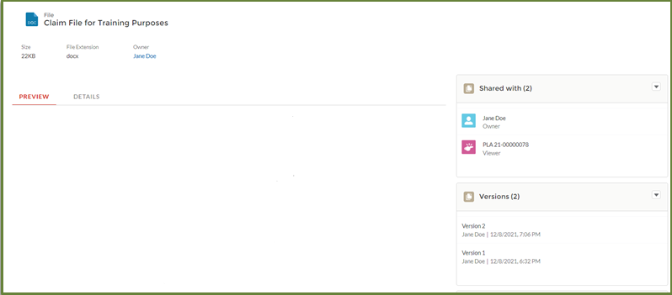
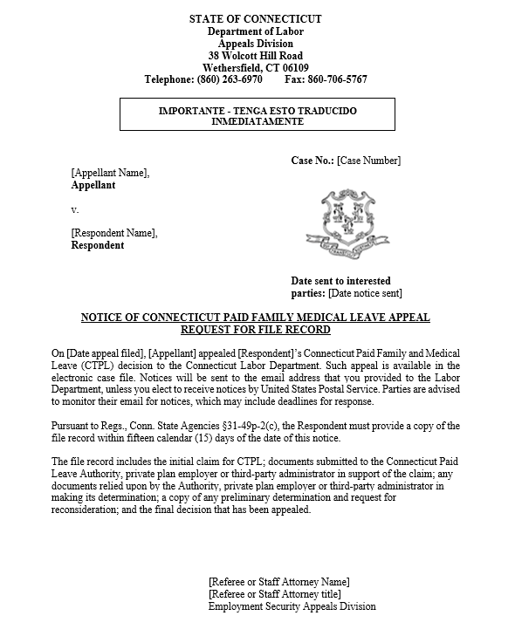
Employers Responding to a Connecticut Paid Leave Appeal
Disclaimer: All references within this document to the red box are solely for the use of this document and do not reference the website.
Click on the dropdown arrow for any individual file to access the menu displayed
Select:
Download (to save the file to your computer)
View the file details, (to preview the document) This will be especially useful as in the case of when the CT DOL Reviewer uploads a document/record for you to read

