Slide 1
Improvements at Gillespie Center
45 Jesup Street, Westport | 2026 CDBG Application Workshop

Slide 2
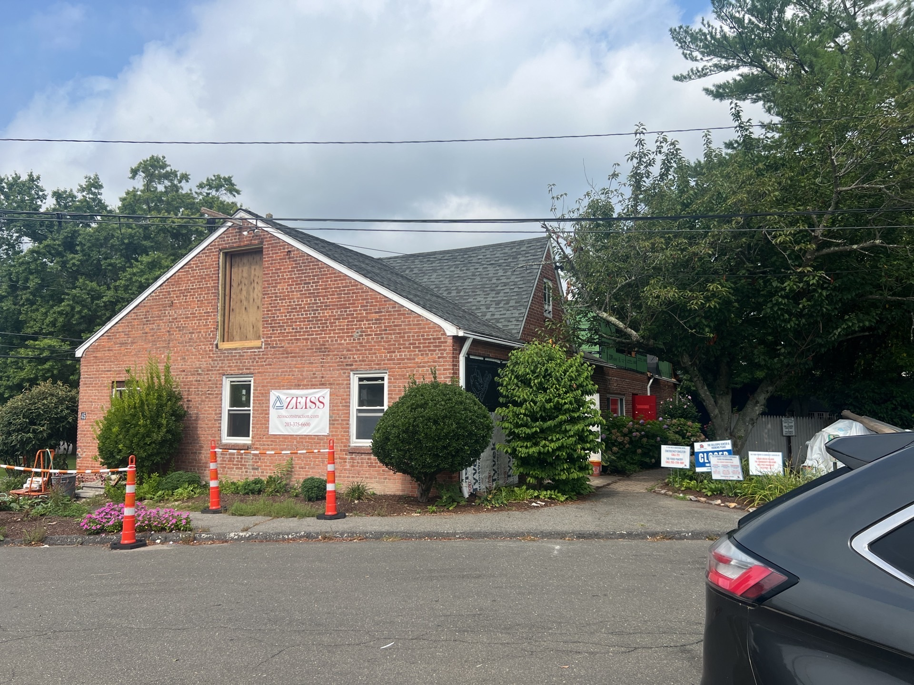
Gillespie Center – Shelter & Food Pantry
Staging Plan
Job Site 7/30/2024
Notes:
2,944 Square foot one-story
partially finished attic, Slab –on-grade
Constructed circa 1989

Slide 3
CARES Act Funding
Town of Westport applied in August 2020
CDBG-CV funds per CARES Act need to be used to
1. prevent
2. prepare
3. or respond to COVID 19 pandemic
National Objective
Directly for limited clientele category presumed to be Low-and Moderate-Income (LMI) persons. Homeless or at risk of becoming homeless in Fairfield County.
Building Improvements, including Public Facilities
Notes:
Total grant amount $ 1.7 million Original budget was $1.2 million

Slide 4

Town of Westport staff liasons
Town Attorney – grant and covenant review
Director of Human Services – grant writer and lead
Finance Manager of Human Services – prepared payment requests and reports
Director of Public Works – weekly meetings
Building Official – Building Department – some meetings
Public Site and Building Commission appointed officials - meetings
Notes:
Testing report is dated after the GC bidding process
Needed a change order for a radon mitigation system

Slide 5
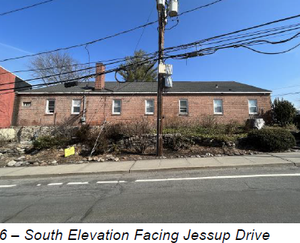
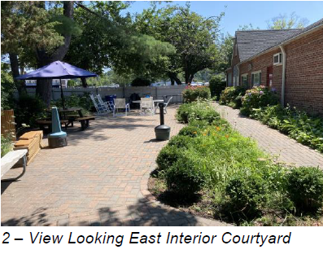
Project Site - Exterior
Jesup Street Site Line
Interior Courtyard

Slide 6
Environmental Review
Hazardous Building Materials Testing Report dated May 1, 2024
  Asbestos found on door and window caulk
  No lead paint testing done the building was built circa 1989
  Radon results above 4.0 pCi/L - Recommend Radon Mitigation
  Mitigation Measure Needed
Notes:
Testing report is dated after the GC bidding process
Needed a change order for a radon mitigation system

Slide 7
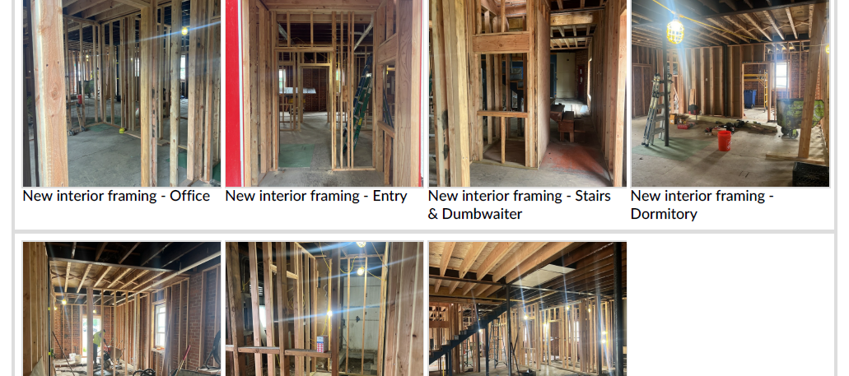
Work in Progress

Slide 8
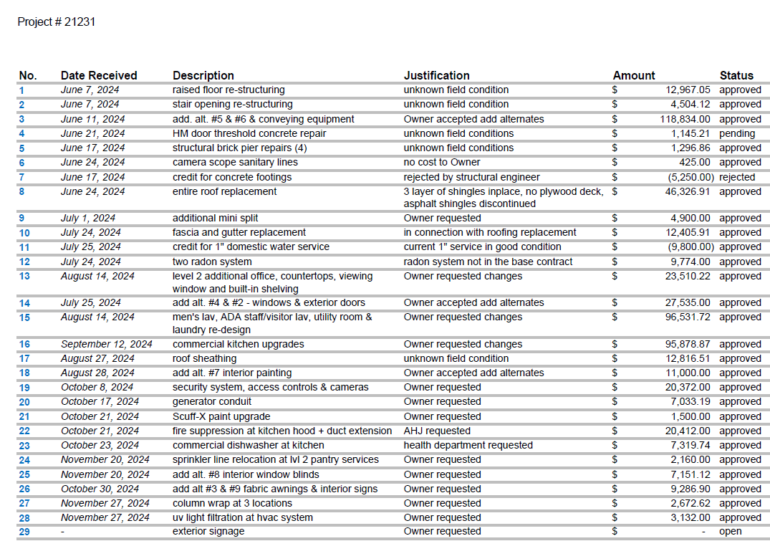
List of Change Orders
Notes:
The Change Orders were very high but this project had additional funds so change in scope to include kitchen upgrades. Reach in Freezer new range and Health Dept. required a commercial dishwasher. There were multiple concealed structural field conditions. ATS has policies on change order requirements, Change order reviews, change order Guide

Slide 9
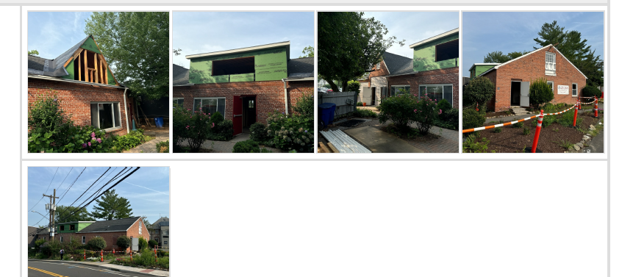
Two Dormers for Food Pantry

Slide 10
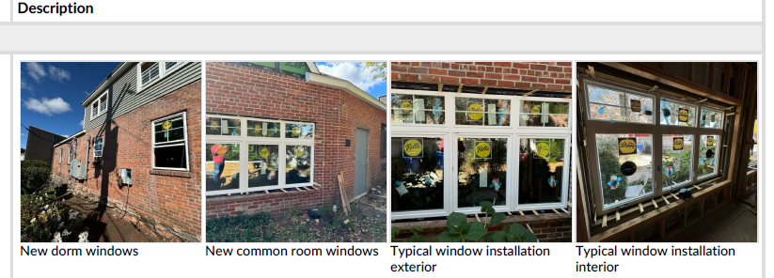
New Windows

Slide 11
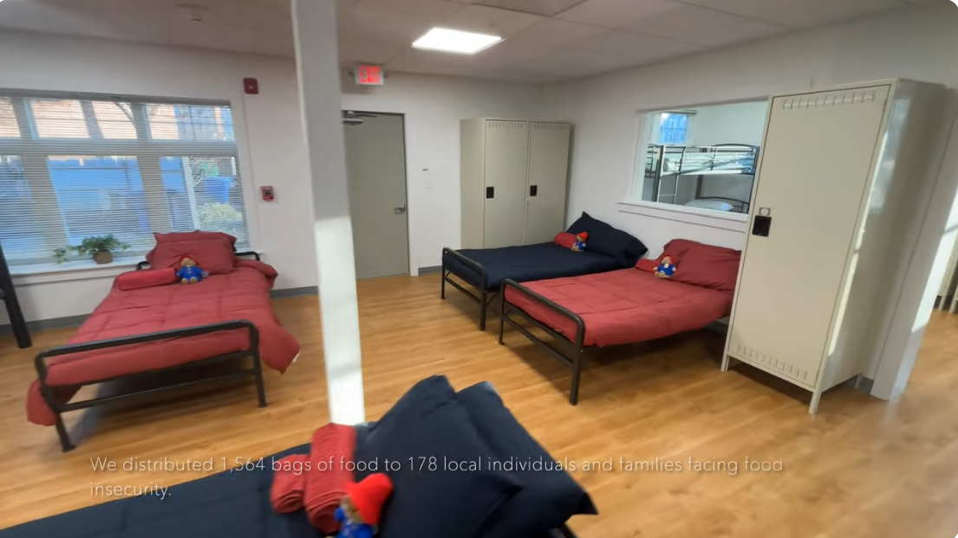
The Remodeled Gillespie Center - YouTube

Slide 12
Thank you to the Project Team
Town of Westport
Homes with Hope
O’Riordan and Migani Architects
Zeiss Construction

