Slide 1


CDBG Technical Compliance Overview
Environmental
Construction Documents
Project Development Budget
Accessibility
Procurement
Energy & Green Building

Slide 2







Mithila Chakraborty, Environmental Analyst 2
Department of Housing-
Architectural & Technical Services
Paul Jorgensen, Architectural & Technical Services Manager
Hermia (Mia) Delaire,
Disaster Recovery & Resiliency Program Manager
Stephen Dupre,
Building Construction Specialist 2
Simeon Stevens, Architectural Design Reviewer 1
Arlind Poro,
Building Construction Specialist 1
Eugene Choi,
Building Construction Specialist 1

Slide 3
CDBG Technical Compliance
4.4 Site & Building
Location Maps, Zoning, Flood Plain Maps
Environmental Site Assessments Phase I/II, Hazardous Materials Survey
State Historic Preservation Office Determination Letter
Capital Needs Assessment Report, Interior & Exterior Photos
Planning & Zoning & Related Approvals
4.5 Construction
90% Construction Drawings, Specifications (CSI format)
Completed Project Development Budget & Cost Estimate
Procurement Plans & Contracts
4.6 Energy Efficiency & Green Building
https://portal.ct.gov/DOH/DOH/Additional-program-pages/CDBG-SC-Grants-Management-Manual
Notes:
We are now asking for 90% construction documents for a more robust, complete review.

Slide 4
CDBG Technical Compliance, cont.
4.4 Site & Building
Location Maps, Zoning, Flood Plain Maps
Environmental Site Assessments Phase I/II, Hazardous Materials Survey
State Historic Preservation Office Determination Letter
Capital Needs Assessment Report, Interior & Exterior Photos
Planning & Zoning & Related Approvals
4.5 Construction
90% Construction Drawings & Specifications – Accessibility
Completed Project Development Budget & Cost Estimate
Procurement Plans & Contracts
4.6 Energy Efficiency & Green Building
https://portal.ct.gov/DOH/DOH/Additional-program-pages/CDBG-SC-Grants-Management-Manual

Slide 5
Environmental
Environmental Site Assessments Phase I/II
Records Review, Site Reconnaissance & Observations,
Summary of Findings, Areas of Concern, Recognized Environmental Conditions, Potential Release Areas
Hazardous Materials Survey
Lead-Based-Paint, Asbestos, Radon, Lead in Soil, Lead in Water, Polychlorinated Biphenyls (PCBs), Mercury, Universal Waste, Urea-Formaldehyde Foam Insulation (UFFI), Mold
findings may require Remedial Action Plans, Soil Management Plans, Remediation and Abatement Plans, Specifications, and Costs
CDBG Handbook. Basically CDBG State Chapter 13 Lead
CHFA Environmental & Hazardous Materials Review for joint funded projects

Slide 6
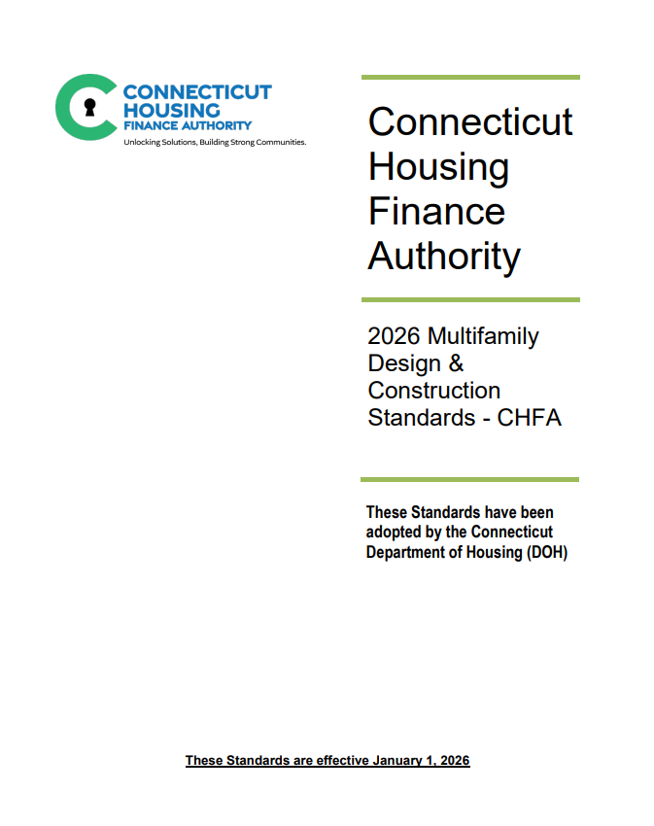
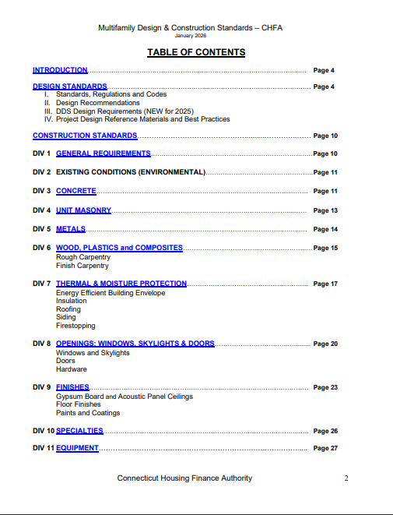
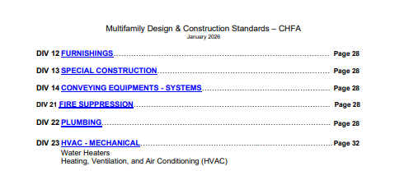
Construction Drawings & Specifications
https://portal.ct.gov/DOH/DOH/Additional-program-pages/CDBG-SC-Grants-Management-Manual

Slide 7
Accessibility/Adaptability
Requirements for Federally Assisted Housing
Section 504 Rehabilitation Act 1973
New construction - housing developments with 5 or more units must design and construct 5 percent of the dwelling units in accordance with the Uniform Federal Accessibility Standards (UFAS) or a stricter standard. An additional 2 percent of the dwelling units, or at least one unit, whichever is greater, must be accessible for persons with hearing or visual disabilities (HVI).
Substantial Renovation – If alterations are undertaken to a project .. that has 15 or more units and the cost of the alterations is 75 percent or more of the replacement cost of the completed facility, then the provisions of § 8.22 (new construction) shall apply.
Other Renovation - alterations to dwelling units in a multifamily housing project shall, to the maximum extent feasible, be made to be readily accessible to and usable by individuals with handicaps. If alterations of single elements or spaces of a dwelling unit, when considered together, amount to an alteration of a dwelling unit, the entire dwelling unit shall be made accessible…
www.hud.gov/program_offices/fair_housing_equal_opp/disabilities/accessibility
24 CFR Part 8.23 Alterations of existing housing
Also including CT State Building Code, IBC, IEBC Model Codes, and ANSI 2017 ICC A117 as amended.

Slide 8
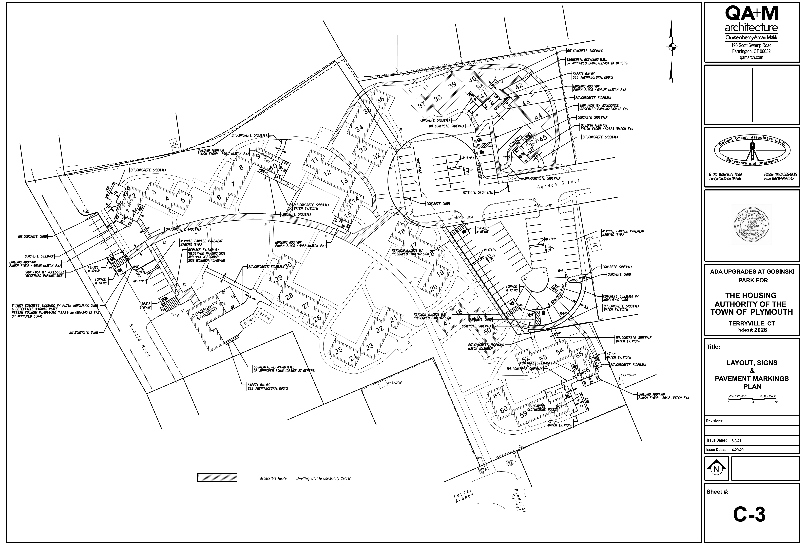
Accessible Routes
Thank you to QA+M Architecture

Slide 9
UFAS/TYPE A Adaptable Units
DOOR CLEARANCES
KITCHENS
BATHROOMS
UFAS (Section 504) Dwelling Units are similar to ANSI Chapter 11 - Type A – Adaptable Units

Slide 10
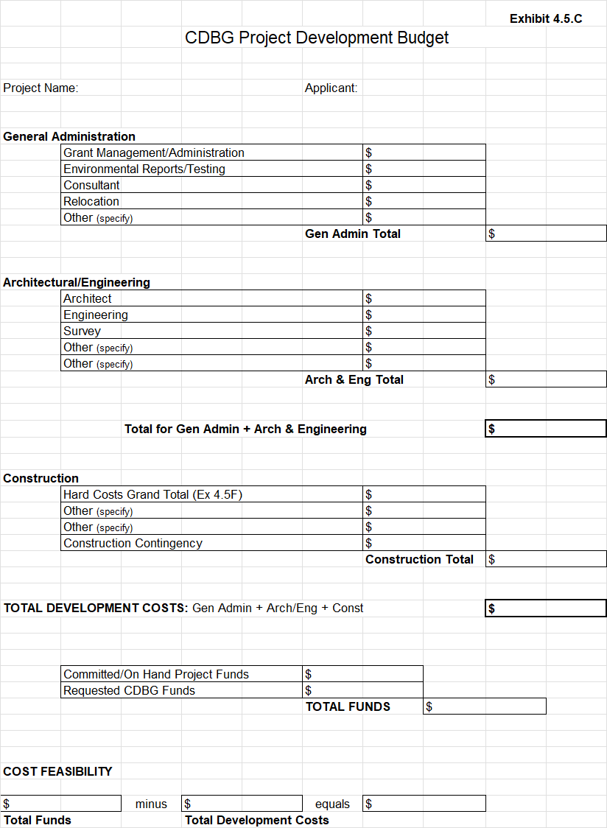
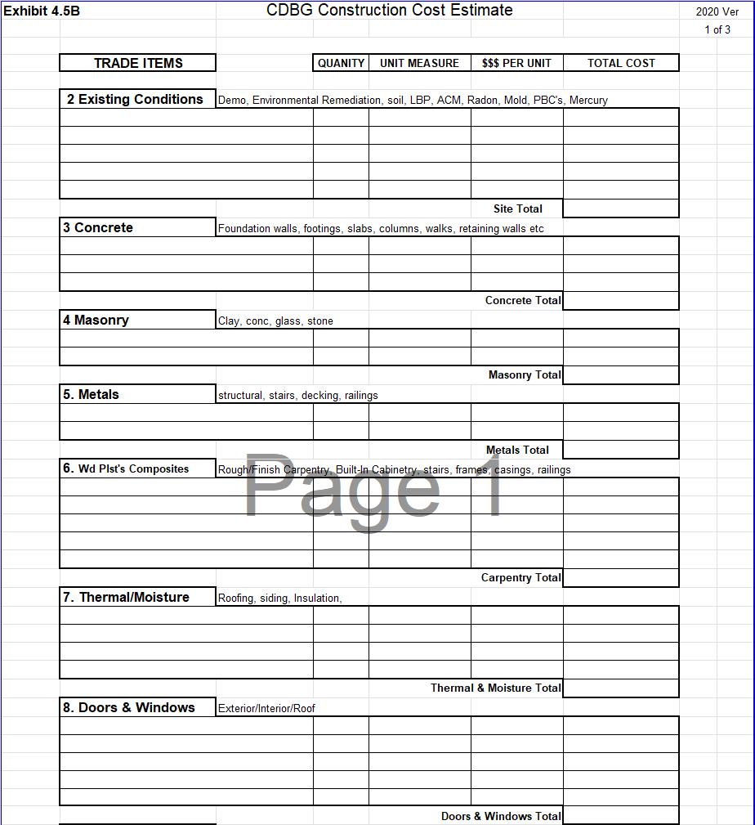
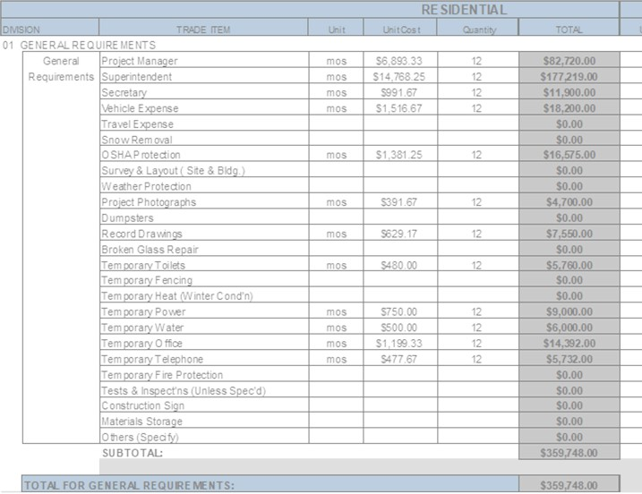
Project Development & Construction Cost
CDBG Exhibits 4.5C & 4.5B

Slide 11
Procurement
Consultants, Architectural, Engineering
Open – Publicly Advertised in Major Daily Newspaper
Competitive – Request for Qualifications or Request for Proposal
Complete – At least 2 bids, RFP is Fixed Fee or Hourly Not to Exceed
Outreach & Set-Asides - Section 3, MBE/WBE/SBE per CDBG Guidelines
Construction
Open – Invitation to Bid Publicly Advertised in Major Daily Newspaper
Competitive - Sealed Bid, At least 2 bids, 5% Bid Bond, Fixed Fee Contract
Provide Performance Specifications and at Least 3 Manufacturers
Outreach & Set-Asides - Section 3, MBE/WBE/SBE per CDBG Guidelines
Dept. of Housing – Procurement Req. & Guidelines – As of November 2021 (Currently in revision)
2 CFR Part 200 Methods of Procurement, CDBG Grants Management Manual Chapter 4
DOH CDBG website includes sample Invitation to Bids, RFP, RFQ, Evaluations, Bid Tabulation
Notes:
We are in the process of aligning our procurement guidelines to be consistent with other state departments. The updated version will be posted online within the upcoming months. Please continue to follow the 2021 version.

Slide 12
Procurement (2)
Build America, Buy America (BABA)
Enacted as part of the Infrastructure Investment and Jobs Act on November 15, 2021,
Established a domestic content procurement preference for all Federal financial assistance obligated for infrastructure projects after May 14, 2022.
Requires that all iron, steel, manufactured products, and construction materials used in covered infrastructure projects are produced in the United States (Buy America Preference).
HUD Construction Material Groups impacted
Iron & Steel – 2023 Awards and beyond
All Other Construction Materials
  • Glass
  • Drywall
  • Other construction materials
Specifically Listed – 2024 Awards and beyond
  • Metals other than iron or steel (nonferrous metals)
  • Lumber
  • Composite building materials
  • Plastic and polymer-based pipe and tube (e.g., PVC pipe)
Manufactured Products
  • A material or supply used in an infrastructure project that is not iron or steel or a construction material.
"Buy America Preference" (BAP), is detailed in the Infrastructure Investment and Jobs Act, Pub. L. 117-58 and 2 CFR 184.

Slide 13
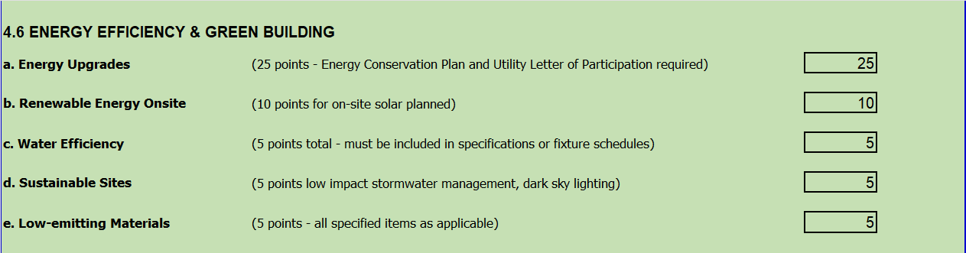
Energy & Green Building

Slide 14
THANK YOU FOR YOUR TIME!

