Slide 1
Radon Overview
June 2, 2026

Slide 2
2
What is radon?
How does radon enter a home?
What are the health effects?
Radon measurement & mitigation basics
Notes:
Over the next several slides we will discuss…

Slide 3
What is radon?

Slide 4
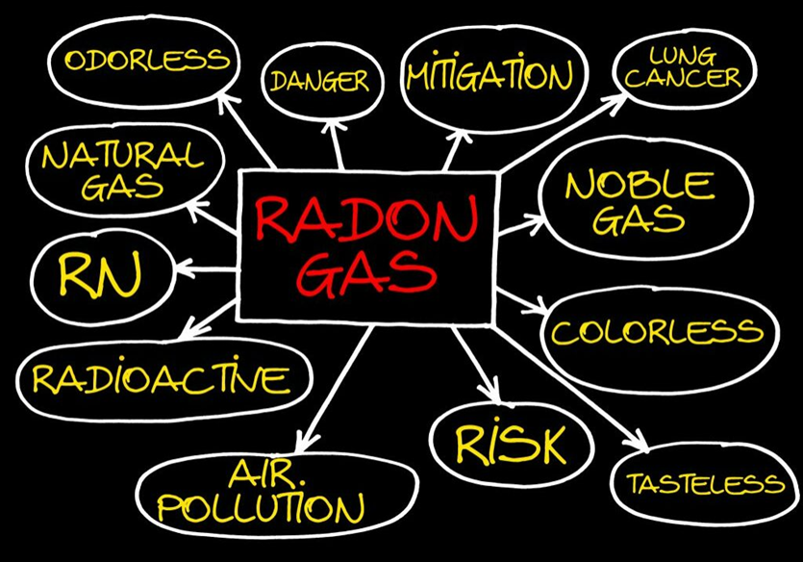
WHAT IS RADON?, cont.
Radon is a naturally-occurring, radioactive gas.
Radon is colorless, odorless, and tasteless.
Found all over the U.S. in all types of buildings:
Old and new
Drafty and well-sealed
With and without basements
Notes:
Radon is a naturally occurring, radioactive gas.
Radon cannot be detected by our senses. You can’t see, smell, or taste radon.
And it is found all over the country [READ SLIDE]…
Radon is one of the nation’s most important environmental threats – one that places people at risk in their own homes. Radon is the leading environmental cause of cancer; the leading cause of lung cancer in non-smokers, and the second leading cause of lung cancer overall, after smoking.

Slide 5
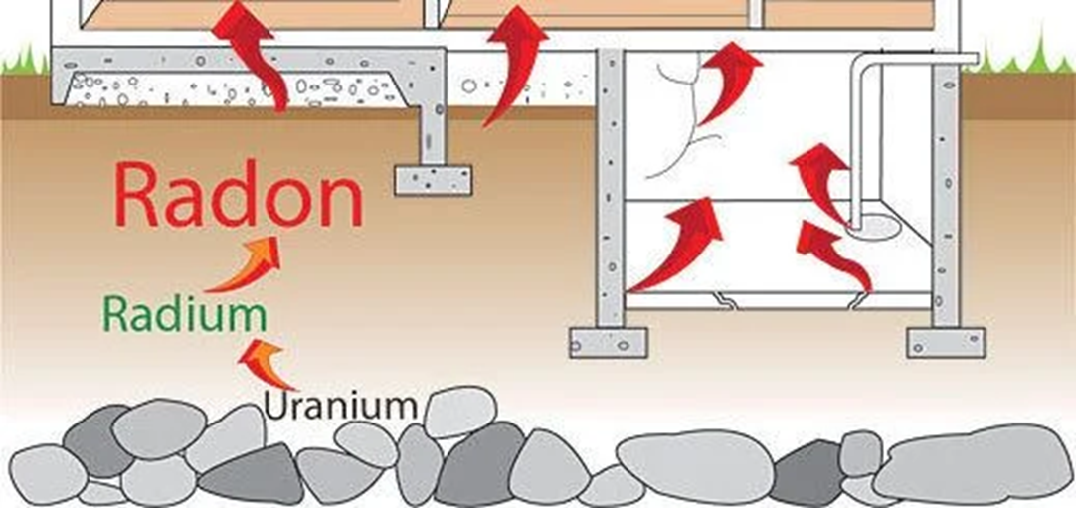
URANIUM DECAY CHART (simplified)
Notes:
As you now know, radon is naturally-occurring and is formed by the natural decay of radium which is a decay product of uranium. Both radium and uranium are very common, solid elements present in soil and rock. Radon gas is not directly harmful because of its 3.8-day half-life, but as it breaks down, it produces radioactive decay products that emit ionizing radiation. Outdoor radon is diluted quickly and poses little threat, but when it migrates into a building and becomes concentrated, it can become a health hazard.

Slide 6
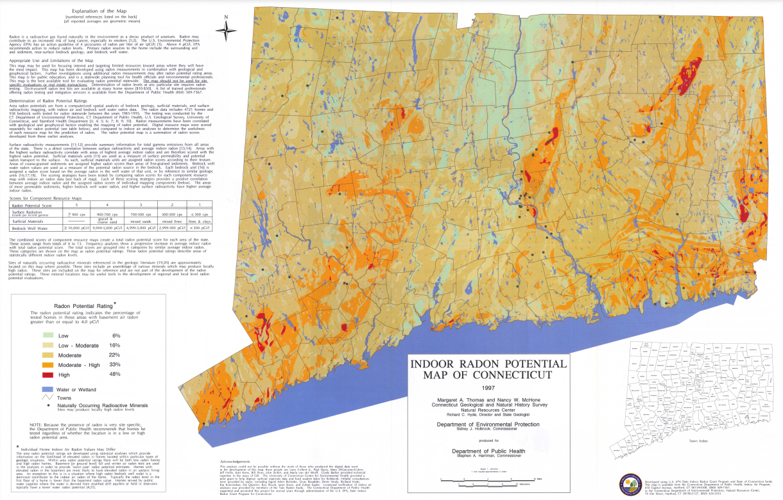
WHERE IS RADON FOUND GEOGRAPHICALLY?
Notes:
Radon levels vary for many reasons, including weather conditions, geology, and building construction. Changes in temperature and wind can affect the pressure differential between the soil and a building, which in turn can influence how much radon enters a home.
To help make sense of these variations across the state, a mapping project was completed in partnership with DEEP to estimate radon potential by geographic area. This map doesn’t predict the exact radon level in any individual home, but it does show where elevated results are more likely based on thousands of past test results and the underlying geology.
As you can see, most of Connecticut is shown in the dark yellow or tan color. That category represents areas where about 22% of homes tested had elevated radon levels, which is very close to the statewide average of about 26%, or roughly 1 in 4 homes.
The orange areas indicate a higher potential, where approximately 33% of homes tested high. The red areas show the highest potential, with about 48% of homes testing above the EPA action level.

Slide 7
How does radon enter a home?

Slide 8
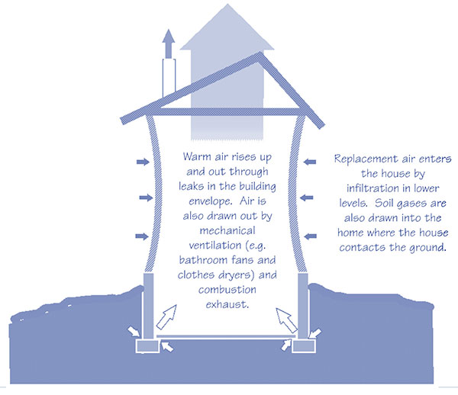
HOW RADON ENTERS A HOME
Source: USEPA https://www.epa.gov/sites/default/files/2014-08/documents/buildradonout.pdf
Notes:
This diagram shows why radon is able to move from the soil into buildings in the first place.
In most homes, the air pressure inside, especially at the basement and foundation level, is slightly lower than the pressure in the surrounding soil. That pressure difference is what drives soil gases, including radon, into the building.
The Stack Effect
As warm air inside the home rises and escapes through the upper parts of the building (like the attic, roof vents, or small leaks) it creates a need for replacement air. That replacement air often enters at the lowest points of the home: through cracks in the foundation, gaps around pipes, floor drains, and other openings that are in contact with the soil. This natural upward movement of air is known as the stack effect. In simple terms, the house acts a bit like a slow vacuum.
Other Contributors to Negative Pressure
Mechanical systems can increase this effect as well. Exhaust fans in bathrooms and kitchens, clothes dryers, and combustion appliances all push air out of the home. When air leaves, new air has to come in and some of that air can come from the soil.
Why Winter Matters
This process is typically strongest in colder months, when indoor–outdoor temperature differences are greater. That’s one reason radon levels are often highest in winter.
Takeaway
The key takeaway here is that radon entry is driven by negative pressure in the home. Because most buildings naturally operate at slightly lower pressure than the soil around them, radon can be continuously pulled indoors unless steps are taken to prevent it.

Slide 9
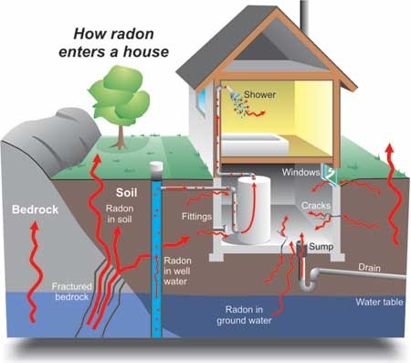
RADON ENTRANCE PATHWAYS
Cracks in solid floors
Construction joints
Cracks in walls
Gaps in suspended floors
Gaps around service pipes
Cavities inside walls
The water supply
Notes:
Radon can enter a home in many different ways. Because it is a soil gas, it will take advantage of any opening or pathway between the ground and the indoor living space.
Common entry points include:
Cracks in concrete floors or foundation walls
Construction joints where different building materials meet
Gaps around service pipes, drains, and utility penetrations
Openings around sump pits or floor drains
Cavities inside block walls
Gaps in suspended floors or crawlspaces
And, in some cases, through the water supply, especially from private wells
The important thing to understand is that these pathways exist in nearly every home to some degree. Even very new, well-built homes can have elevated radon levels if the underlying soil and geology allow radon to migrate upward.

Slide 10
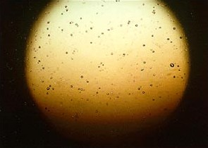
THE POWER OF ALPHA PARTICLES
Image Source: http://www.ilradon.com/what-is-radon/
Notes:
This image shows the plastic chip from an alpha track detector at 100x magnification. The detector was exposed to radon at a concentration of 4 pCi/L for three months. A picocurie per liter is a standard unit used to measure radiation.
The small dots on the chip are microscopic pits that formed when alpha particles collided with the plastic. These tracks provide a powerful visual reminder - if alpha radiation can scar a solid surface, it can also damage living lung tissue when inhaled.
Next, I will show you a short video to help you “see the unseeable”, and then we’ll take a closer look at what radon exposure means for human health and why understanding these effects is so important.

Slide 11
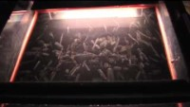
VISUALIZING RADON
Notes:
Click PLAY button on video (MUTE SELF to prevent feedback): https://www.youtube.com/watch?v=BGypyw66La4&list=PPSV&t=2s

Slide 12
What are the health effects?

Slide 13
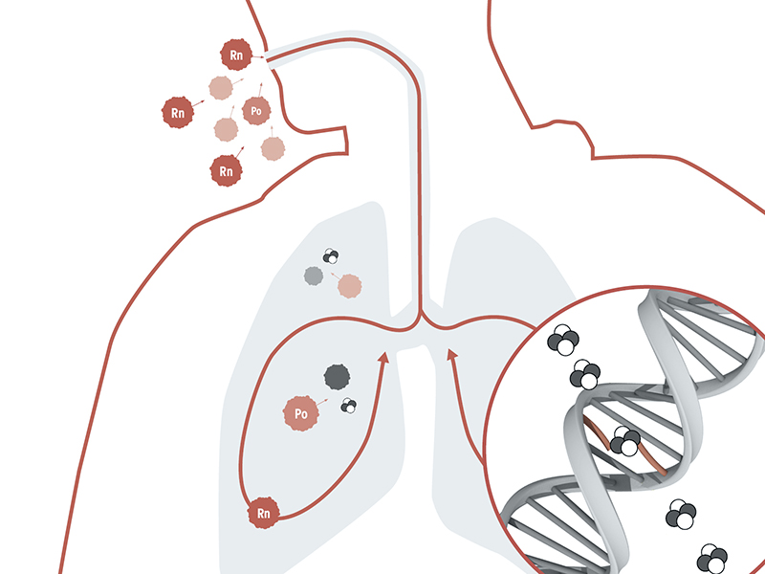
HEALTH EFFECTS OF RADON EXPOSURE
Prolonged exposure to elevated radon levels may increase a person’s risk of developing LUNG CANCER.
There are NO immediate health effects from exposure and radon gas itself does not cause any symptoms.
The radiation created by the natural decay process damages lung cells and DNA.
Image Source: https://www.bfs.de/EN/topics/ion/environment/radon/effects/effects_node.html
Notes:
Radon is classified as a Class A carcinogen, meaning it is known to cause cancer in humans. Prolonged exposure to elevated radon levels increases a person’s risk of developing lung cancer.
It’s important to understand that radon exposure does not cause any immediate health effects. Radon gas has no smell, no taste, and causes no short-term symptoms. People who are exposed won’t feel sick or notice any warning signs. Symptoms such as persistent cough, chest pain, shortness of breath, or wheezing typically appear only after lung cancer has already developed and progressed to more advanced stages.
The danger comes from the radiation produced as radon naturally decays. When radon and its decay products are inhaled, they can damage lung tissue at the cellular level, including DNA. Over time, this repeated damage can lead to mutations that increase the likelihood of lung cancer.
That’s why radon is considered such a serious public health concern, even though you can’t see it or feel it, the long-term effects can be significant.

Slide 14
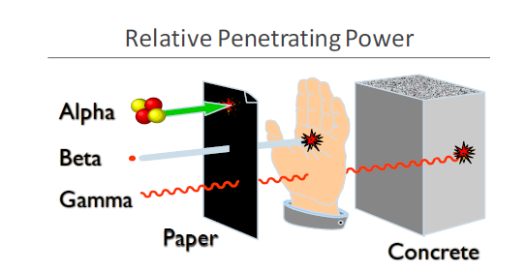
RADIATION TYPES
Image Source: https://aaaradontesting.com/where-does-radon-gas-come-from/
Notes:
On a previous slide, we talked about how radon exposure increases lung cancer risk because of the radiation released during radon decay. This slide helps explain why that happens by comparing the main types of radiation.
There are three basic types of ionizing radiation: alpha, beta, and gamma. Each type behaves very differently. As this diagram shows, gamma radiation has the greatest penetrating power: it can pass through paper, skin, and even dense materials like concrete. Because of that, gamma radiation is often what people think of first when they hear the word “radiation.” But with radon exposure, gamma radiation is not the primary concern.
The real health risk from radon comes from alpha particles. Alpha particles are relatively large and heavy, and they travel only a very short distance. From an external exposure standpoint, they’re not very dangerous - they can be stopped by something as thin as a sheet of paper or even the outer layer of your skin.
The situation changes completely, though, when alpha-emitting particles are inhaled. Radon decay products, especially polonium-218 and polonium-214, attach to tiny dust particles in the air. When those particles are breathed into the lungs, they can lodge in the bronchial passages. Because alpha particles deliver a large amount of energy over a very small distance, they can cause significant damage to the sensitive cells lining the lungs.
So even though alpha radiation can’t penetrate your skin, it becomes highly hazardous once it’s inside the body. This is why radon is considered primarily an inhalation hazard, and why controlling indoor radon levels is so important for protecting long-term health.

Slide 15
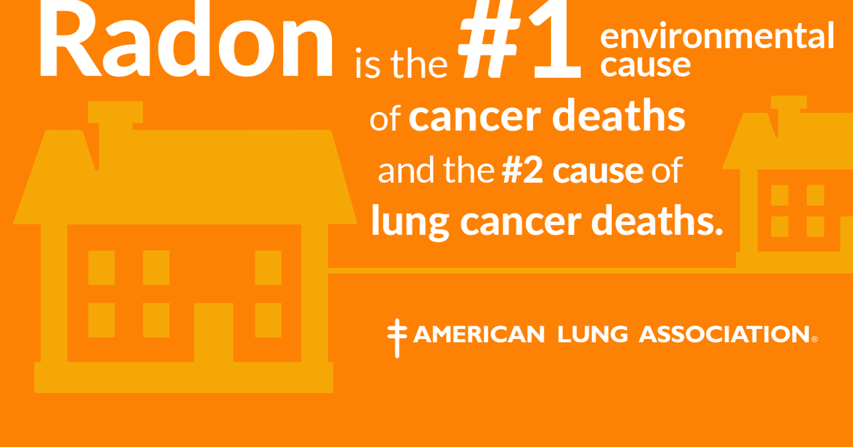
LUNG CANCER FACTS
Despite decreasing smoking rates, lung cancer remains the leading cause of cancer deaths*.
The Centers for Disease Control and Prevention (CDC) estimates that 80-90% of lung cancer deaths are linked to smoking, leaving 10-20% of lung cancers in those who have never smoked.
*2023 CDC data - https://gis.cdc.gov/Cancer/USCS/#/AtAGlance/
Notes:
Lung cancer continues to be the leading cause of cancer deaths in the United States, even as smoking rates have declined over time. According to 2023 CDC data (the most recent year for which data is available), the lung cancer mortality rate was 29 deaths per 100,000 people.
Although smoking remains the primary risk factor, an estimated 10 to 20 percent of lung cancers occur in people who have never smoked. That means a significant number of cases are caused by other factors, most notably, radon.
Major health organizations, including the World Health Organization and the American Lung Association, recognize radon as the number one environmental cause of cancer deaths and the leading cause of lung cancer among nonsmokers.
Current risk estimates from the EPA and the U.S. Surgeon General indicate that radon exposure contributes to approximately 21,000 lung cancer deaths each year in this country. That works out to roughly 58 people every day.
These numbers highlight why radon remains such an important public health issue and why testing and mitigation are critical tools for prevention.

Slide 16
Radon measurement & mitigation basics

Slide 17
ACTION LEVEL FOR RADON IN AIR
The Environmental Protection Agency’s (EPA) established action level for radon in air is:​
4.0 pCi/L*​
*This is NOT a health-based value.​
​
The World Health Organization (WHO) has a more conservative action level of 2.7 pCi/L​
​
​
At levels of 4.0 pCi/L or higher, the EPA recommends measures be taken to effectively reduce radon levels thereby decreasing the risk of developing lung cancer.
Notes:
Given everything we’ve discussed about radon risk, the next question is: how do we decide when action is needed?
In the United States, the Environmental Protection Agency established an action level of 4.0 pCi/L for radon in indoor air. It’s important to understand that this number is not a health-based threshold - it’s a policy and decision-making benchmark intended to balance risk reduction with feasibility.
The World Health Organization uses a more conservative reference level of 2.7 pCi/L, reflecting the fact that risk increases at even lower concentrations.
And the key message behind both of these values is the same: there is no truly safe level of radon. Any exposure carries some degree of risk.
For context, the average indoor radon level in U.S. homes is about 1.3 pCi/L, while the average outdoor level is about 0.4 pCi/L. So even typical indoor air already contains more radon than the natural outdoor environment.
The EPA recommends that:
Homes with radon levels at or above 4.0 pCi/L should be mitigated, and
Homes with levels between 2.0 and 3.9 pCi/L should consider additional testing and, if confirmed, mitigation as well.
The goal is simple: the lower the radon level, the lower the risk. Testing tells us where we stand, and mitigation gives us a proven way to bring those levels down and protect the health of the people who live there.

Slide 18

TESTING IS THE ONLY WAY TO KNOW
1.3 pCi/L
8.1 pCi/L
Notes:
First and foremost, it’s important to understand that testing is the only way to know a building’s radon level.
As you know, radon comes from the natural breakdown of uranium in rock and soil, and those geologic conditions vary widely from place to place. On top of that, every home is different; construction style, foundation type, ventilation, and even day-to-day occupancy patterns all influence how radon enters and accumulates indoors.
Because of that variability, you can’t predict radon levels based on where a home is located, how new it is, or how well it was built. As this image illustrates, two houses right next to each other can have very different radon levels; one may be relatively low, while the other may be well above the action level.
There are no visible warning signs, and radon can’t be detected by sight, smell, or taste. That’s why professional testing, or a properly conducted DIY test, is essential for every home, regardless of age, location, or design.
The key takeaway here is simple: without testing, you’re only guessing.

Slide 19

RADON MEASUREMENT
The DPH recommends using a Nationally Certified Measurement Provider to test for radon.
For a single building (single or multi-family), the DPH recommends testing the lowest occupied space.
A short-term testing device is placed for a minimum of 48 hours up to seven (7) days, depending on the device used – with 12 hour closed building conditions preceding the test.
Notes:
The current recommendations for percentage-based testing in multi-family housing likely do not comprehensively identify the risk for radon exposure in multi-family housing. Specifically, testing 10% or 25% of all ground-floor units results in a generally low probability of identifying units with radon levels at or above 4.0 pCi/L in structures with fewer than 30 ground-floor units.
To fully characterize radon risk in multi-family buildings, it is recommended to test 100% of ground-contact units.

Slide 20

RADON MITIGATION
The DPH recommends using a Nationally Certified Mitigation Professional to perform radon mitigation
Must be nationally certified through NRSB or NRPP (formally known as the National Environmental Health Association (NEHA)) and,
Must be a home improvement contractor registered with CT’s Department of Consumer Protection (DCP) (per CGS § 20-420)

Slide 21

RADON MITIGATION, cont.
Radon mitigation systems are:
effective
relatively inexpensive
easy to install
Average cost ~ $1,200-$1,500
Notes:
The good news about radon is that it’s a problem with a proven solution.
Radon mitigation systems are highly effective, relatively inexpensive, and typically straightforward to install. In most homes, a properly designed system can reduce radon levels by up to 99 percent, which often brings them well below the EPA action level.
The most common and reliable approach is called active sub-slab depressurization or SSD. This system uses a small fan and vent pipe to pull radon gas from beneath the foundation and safely discharge it above the roofline before it can enter the home.
For the average single-family home, installation costs generally range from about $1,200 to $1,500, depending on the size of the home, the foundation type, and labor rates. Compared to many other home improvements, mitigation is considered a very cost-effective way to reduce a significant health risk.
It’s important to have this work done by a nationally certified radon mitigation professional. Certified contractors have specialized training and follow established standards to ensure the system is installed correctly and performs as intended.
With proper design, installation, and follow-up testing, radon mitigation is a reliable, long-term solution that can greatly reduce exposure and protect the health of everyone in the home.
Next, we’ll look at what a typical mitigation system looks like and the key components involved.

Slide 22
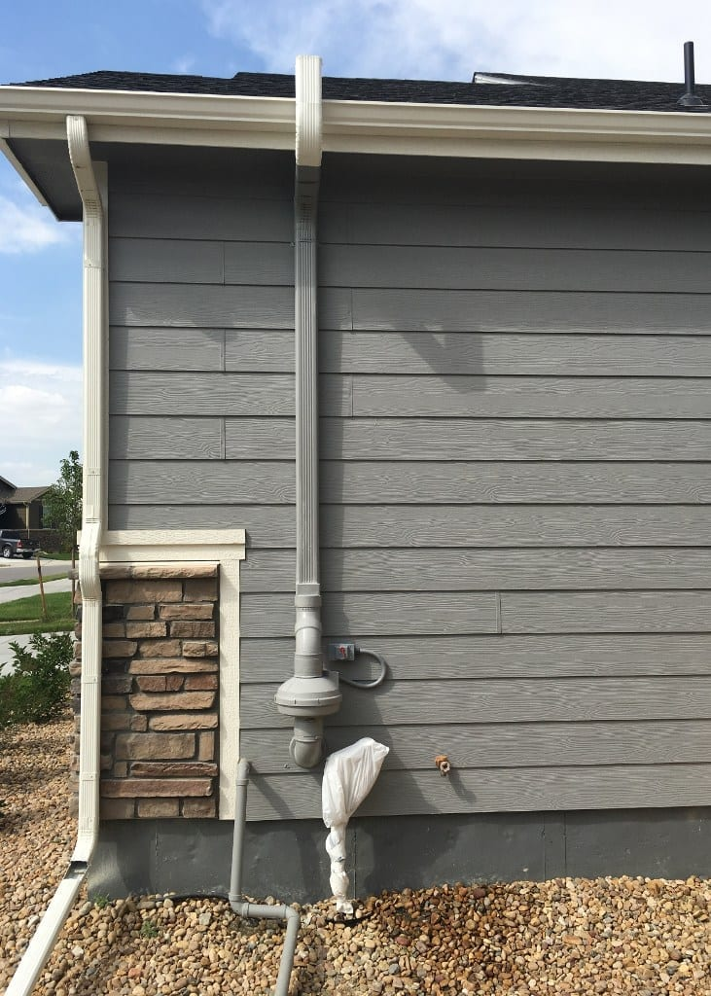
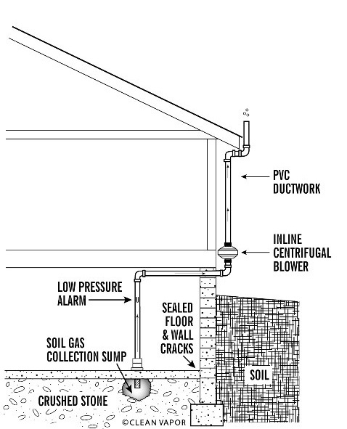
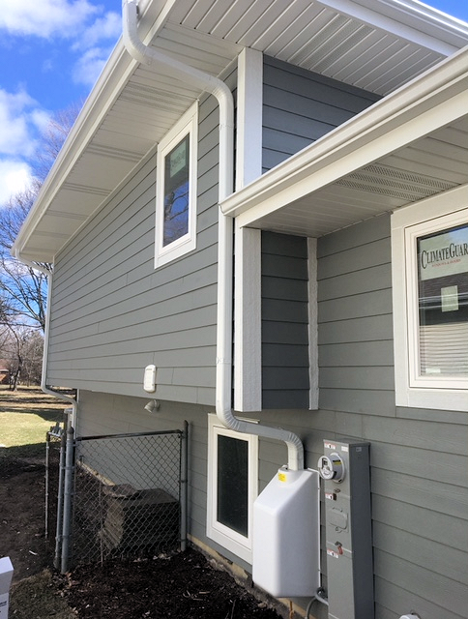
SUB-SLAB DEPRESSURIZATION (SSD) SYSTEM
Image Source: https://vim-1.itrcweb.org/sub-slab-depressurization-ssd-tech-sheet/
Notes:
This slide shows what a typical SSD system looks like in real homes.
As mentioned earlier, SSD is the most common and most effective method for reducing radon levels. The basic concept is simple: a small fan creates suction beneath the foundation, preventing radon gas from entering the home and instead venting it safely outdoors.
The center image provides a diagram of how the system works. A small hole (usually about four inches in diameter) is drilled through the basement floor, and a shallow collection pit is created beneath the slab. PVC piping is then installed from that point, routed to the exterior of the home, and connected to an inline fan that exhausts the radon gas above the roofline.
The photo on the left shows a real-world example of an installed system. You can see how the piping can be neatly routed along the exterior of the home and even painted to match the siding, so it blends in.
The image on the right shows another common feature, a fan cover box. These covers help protect the fan from weather, reduce noise, and make the system more visually appealing.
Together, these examples illustrate that radon mitigation systems are not only effective but can also be installed in a way that is practical, durable, and unobtrusive for homeowners.
After installation, it’s important to verify that the system is working properly, which is why follow-up testing and periodic verification of system operation are essential.

Slide 23
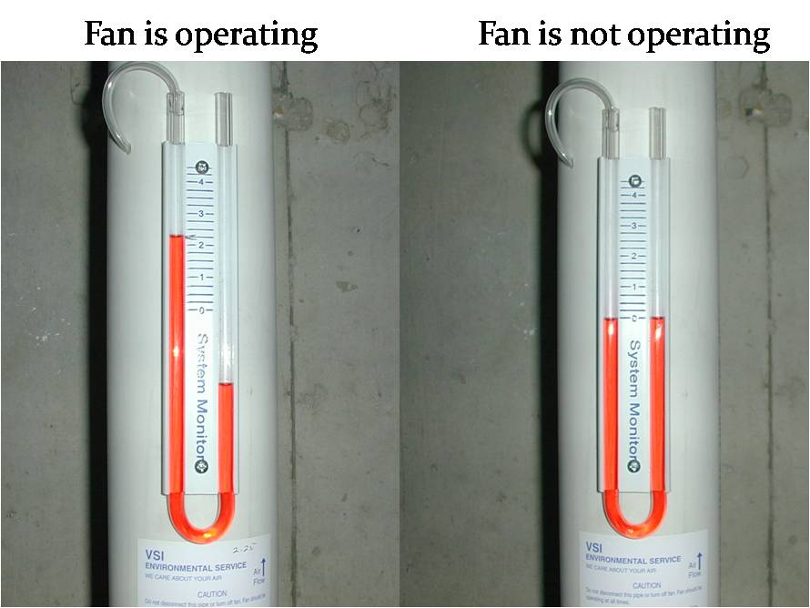
SUB-SLAB DEPRESSURIZATION (SSD) SYSTEM, cont.
Image Source: https://radongas.com/troubleshooting-your-system/
Notes:
Once a radon mitigation system is installed, it’s important to be able to confirm that it continues to operate properly. That’s why we rely, in part, on the system's manometer.
The manometer, shown in these photos, is a simple U-shaped gauge filled with colored fluid. It allows homeowners to visually monitor whether the fan is creating suction beneath the slab.
It’s important to understand what the manometer does and what it does not do.
The manometer does not measure radon levels. Instead, it measures the pressure difference between the indoor air and the air being pulled through the vent pipe.
In the photo on the left, the fluid levels are uneven, which indicates that the fan is running and the system is working as intended. In the photo on the right, the fluid is level on both sides, which means there is no pressure difference and that tells us the fan is not operating.
Checking the manometer regularly is an easy way for homeowners to make sure their system is still functioning.
However, even with a properly operating mitigation system, ongoing verification is important. That’s why it’s recommended that homes test for radon at least every two years after mitigation, or sooner if major renovations or changes to the home are made, like adding insulation, installing a new roof or energy efficient windows.
Together, regular visual checks and periodic retesting help ensure that the system continues to provide long-term protection.

Slide 24
Questions?
Amanda Parkins
Epidemiologist 3
Environmental Health Section
amanda.parkins@ct.gov
(860) 509-7370

