Slide 1
Key reminders for Community Development
Block Grant
Funded Projects Involving Lead
Kimberly Ploszaj
Supervising Environmental Analyst
Lead Hazard Reduction and Control Section
June 2, 2026

Slide 2
What is lead?
What is lead?
Lead is a metal found in our natural environment. Over time, it has been used in products such as paint, varnish, and gasoline. Due to its wide use, lead can be found in most of our communities.
What is lead poisoning?
Lead poisoning occurs when a detectable level of lead is found in the blood
Lead poisoning can cause brain damage, reduced IQ and attention span, learning disabilities, developmental delays, hearing loss
Most childhood lead poisoning occurs when children swallow lead dust or lead paint chips
Lead poisoning is the most preventable childhood disease

Slide 3
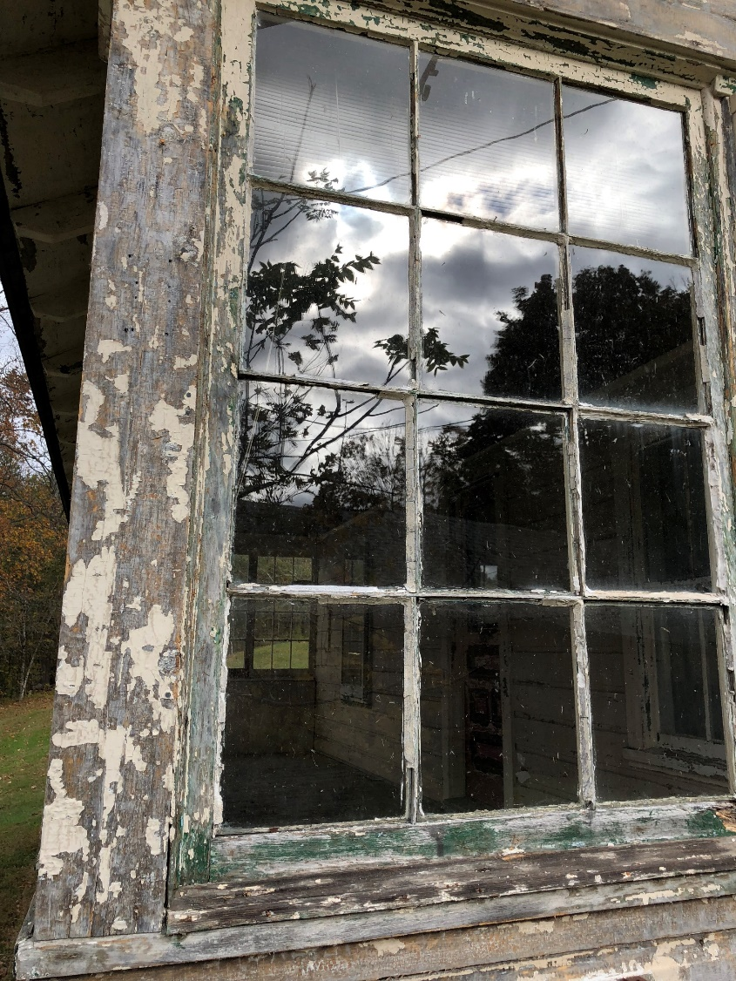
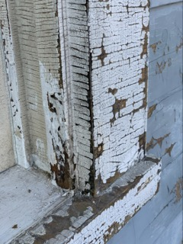
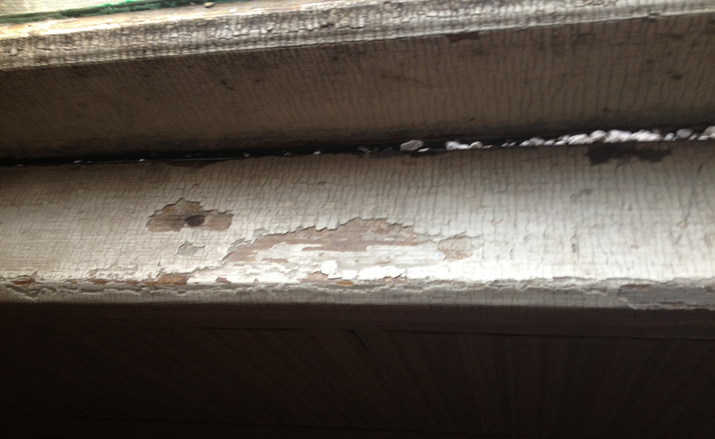
images

Slide 4
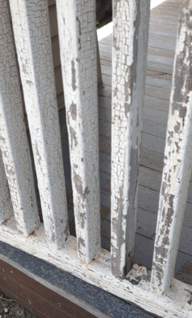
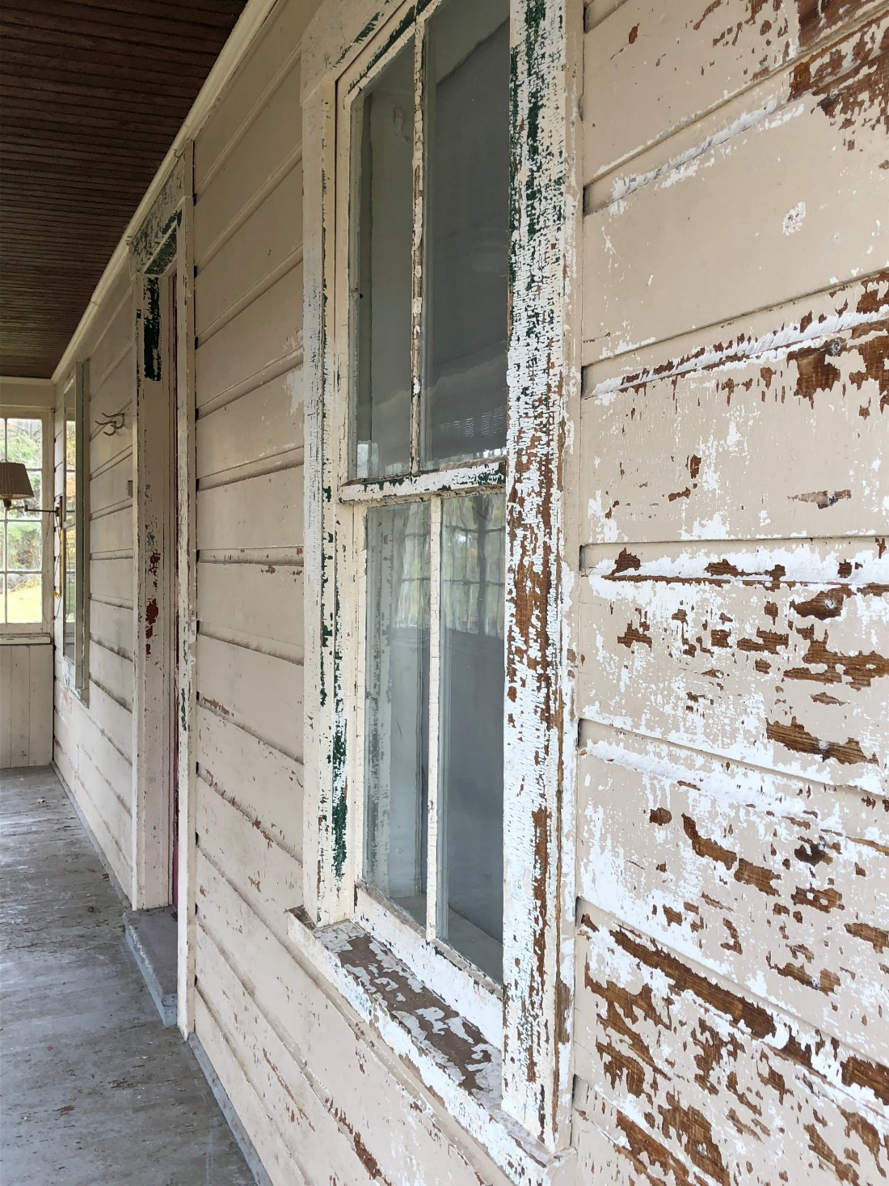
More Images

Slide 5
Lead Exposure
Environmental Sources
Paint
Dust
Soil
Water
Non-Environmental Sources
Occupational
Lead in products: toys, clothing, jewelry
Ayurvedics
Hobbies

Slide 6
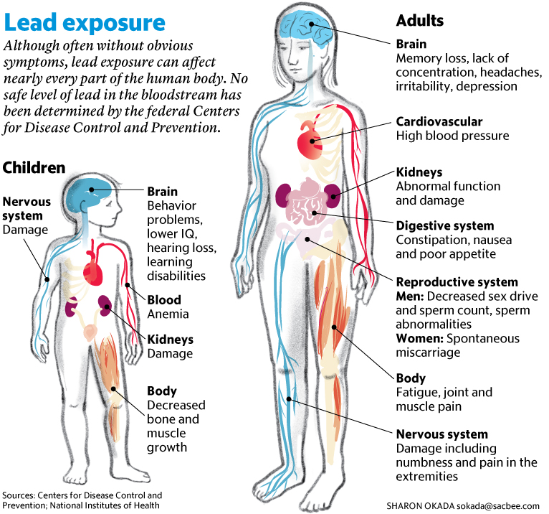
Images of lead exposure impact

Slide 7

CPH new header

Slide 8
Phase in actions at lower blood lead levels
Time effective | Epidemiological Investigation
January 1, 2025 | ≥ 5 µg/dL

Slide 9
Updated Lead Dust Hazard Levels & Lead Dust Clearance Levels
 | Floor | Sill | Well
Risk Assessment Dust Hazards Standards | any reportable level | any reportable level | any reportable level
Post-Abatement Clearance Dust Standards | < 5 µg/ft² | < 40 µg/ft² | < 100 µg/ft²

Slide 10
Lead remediation vs abatement
Lead Remediation
vs.
Lead Abatement

Slide 11
Lead Remediation vs. Lead Abatement
Lead Remediation is the process of reducing lead-related hazards by using methods such as paint stabilization. These activities do not trigger CT lead-related regulations. The work must be performed by an EPA Renovation, Repair and Painting (RRP) certified firm, employing staff trained in lead-safe work practices. Clearance dust wipes must be conducted at the completion of the job – per HUD.
Lead Abatement is the process of permanently removing lead hazards. These activities trigger CT lead-related regulations. The work must by performed by a CT DPH-licensed lead abatement contractor, employing certified supervisors/workers. The process for lead abatement includes: a lead inspection, submission and approval of a lead abatement plan and lead management plan to a local health department and clearance dust wipes at the completion of the job.

Slide 12
Lead remediation
Lead
Remediation

Slide 13
Reminders
Presence of defective paint
Testing of the painted surfaces is required
All defective surfaces shall be remediated by a certified EPA RRP firm
The EPA RRP firm shall employ workers or supervisors who have completed a HUD approved lead-safe work practice course or an EPA RRP certified renovator course (this credential is certified by EPA)
A lead remediation plan shall be developed
At the completion of the job, a DPH-licensed lead consultant contractor shall complete clearance dust wipes

Slide 14


Images from epa

Slide 15
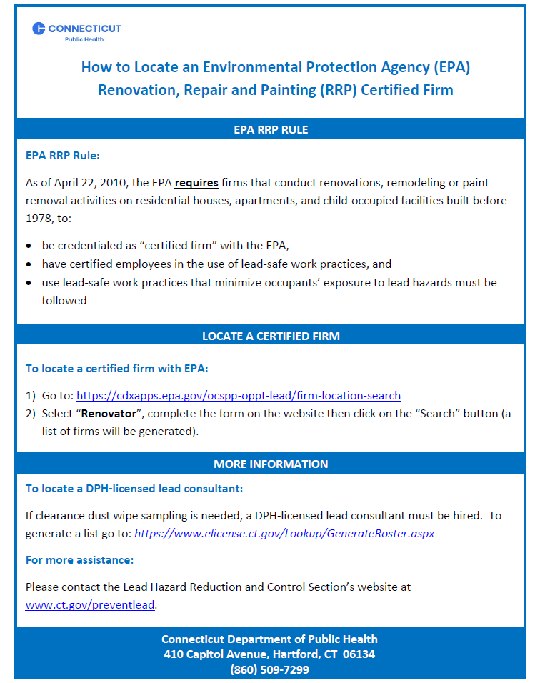
Locate epa rrp firm

Slide 16
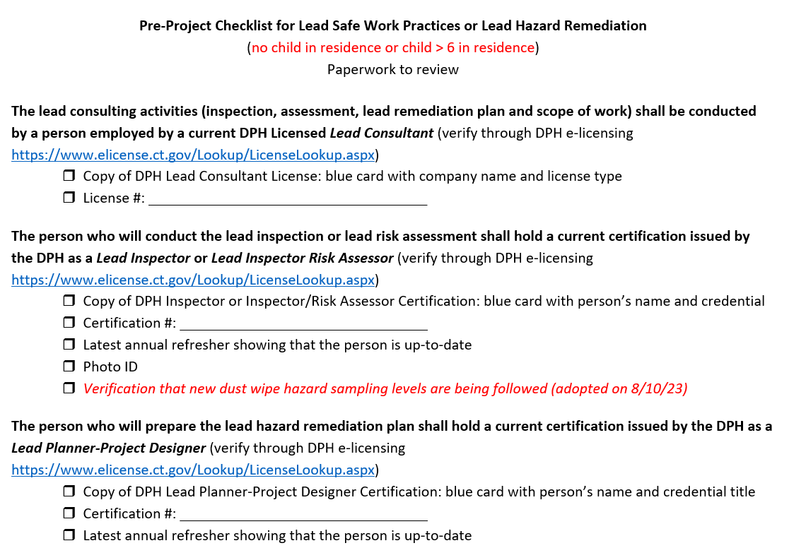
Pre-project checklist

Slide 17
Lead abatement
Lead
Abatement

Slide 18
More Reminders
A child < 6 years of age resides at the property and there is defective lead paint = a comprehensive lead inspection is required
The comprehensive lead inspection will identify all lead hazards in paint, dust, water and soil
All lead hazards shall be abated
All intact leaded surfaces shall be placed on a management plan
A lead abatement plan or a lead management plan shall be developed by a DPH-licensed lead consultant contractor

Slide 19
Reminders, cont.
A lead abatement plan shall be approved by the local health department before any work can begin
All abatement work shall be performed by a DPH-licensed lead abatement contractor that employs certified lead abatement supervisors and workers
At the completion of the job, a DPH-licensed lead consultant shall complete clearance dust wipes

Slide 20
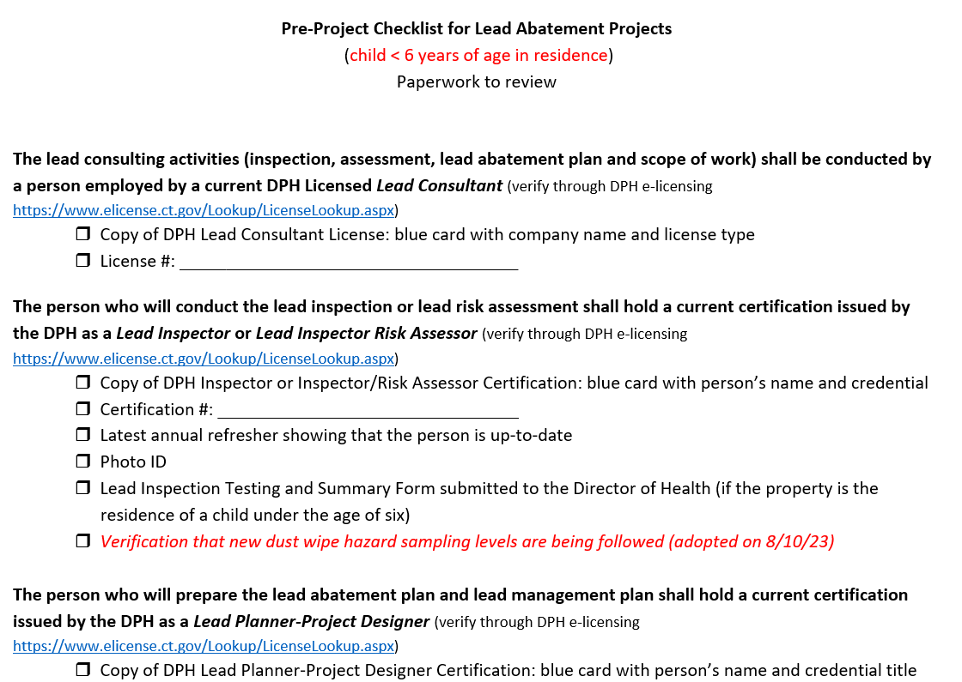
Pre-project checklist for lead

Slide 21
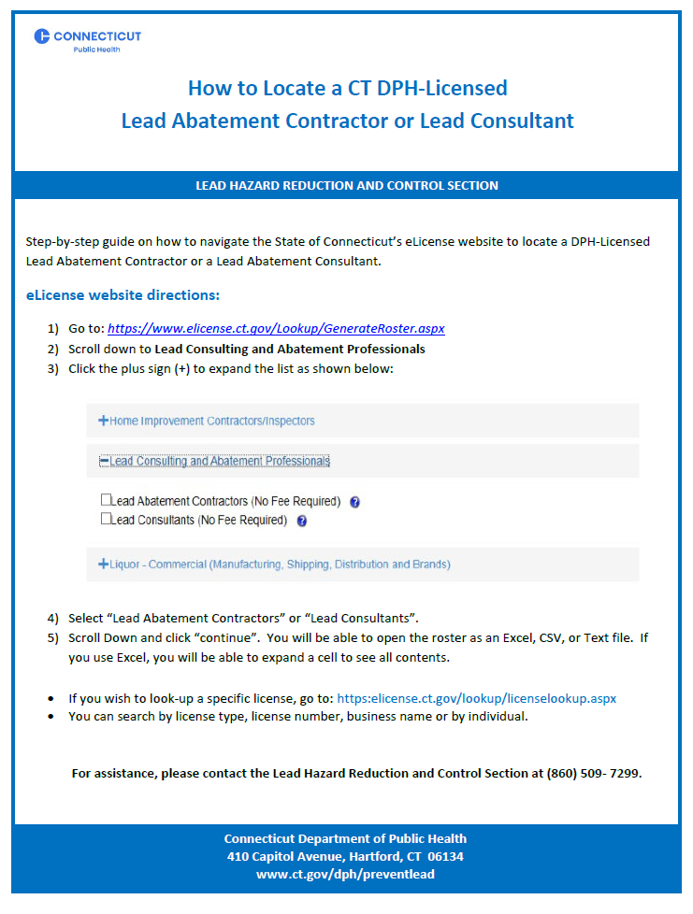
Locate CT DEP-licensed

Slide 22
Remember to…
Use the pre-checklists
Know the difference between lead remediation and lead abatement
Involved DPH-licensed practitioners and the local health department when lead abatement is required
Seek approval for work order changes, for lead abatement projects, from the local health department
Ensure clearance dust wipes are collected at the end of lead remediation and abatement work

Slide 23
When in doubt…
DPH has authority to take action for any lead abatement violations, 860-509-7299
EPA has authority to take action for any lead RRP violation, 617-918-1111

Slide 24

Questions

Slide 25

Lead Hazard Control and Reduction Section contact information:
For technical assistance please contact:
(860) 509-7299

