Slide 1

National
Objectives and
Eligible Activities
Notes:
CDBG Small Cities National Objectives and Eligible Activities
Lilia & Madison
Who is eligible towns and munciaplities that have 50,000 people or less

Slide 2

National Objectives
24 CFR 570.483
Notes:
The CDBG program is designed for states and local governments to develop viable communities, provide suitable living environments, and expand economic opportunities. These CDBG activities are required to meet on the three national objectives.
Developing a project that meets one of these national objectives is crucial and a key decision point in completing an application.

Slide 3
State of Connecticut - Department of Housing - Small Cities CDBG
National Objectives
Activities Benefiting Low to Moderate Income Persons
Prevention or Elimination of Slum/Blight
Urgent Needs
Area Benefit
Limited Clientele
Housing
Area Basis
Spot Basis
Serious & Immediate Threat
Recent Origin
Unable to Finance
No Other Sources of Funding
Notes:
Lilia: The National Objectives fall into 3 categories. Any project that CDBG funds are used for must be clearly attributable to one.
Madison: Lilia, there might be some applicants attending the workshop that are not familiar with CDBG, can you breakdown into further detail the 3 national objectives?
Lilia: Well sure Madison, ….First possible Objective is how the project Benefits Low to Mod Income Persons. According to the current HUD definition, “low income” captures individuals at 50% or below AMI (area median income). “Moderate income” captures residents that earn between 50 % and 80 % of AMI. This means that for CDBG, an LMI person has a total household income equal or less than 80 percent of the median family income for the county where they live. These amounts are updated annually and published by HUD.
Activities which benefit LMI Persons can be further broken down
A. Area benefit - this means the project takes place in an area where at least 51% of people are LMI.
B. Limited Clientele - means the project helps at least 51% as a direct benefit to the LMI persons.
C. Housing is a deep root for CDBG – that’s why we exist.
The second objective is that prevents or rehabilitates blighted buildings. It can be further defined as impacting an Area Basis or a Spot Basis. Projects that help whole neighborhood or possibly one blighted building
“Urgent Need” is the last objective and allows funding for serious emergencies where there is no other plausible funding source. DOH seldom funds Urgent Need projects.
Madison: When will a project actually be approved as meeting a national objective?
Lilia: Tank you for the question Madison ecen though a project is propsed, and the national objective is identified it does not meet that onjective till your project is done, completed and report to DOH.
Lilia : Good point , Madison!

Slide 4

Eligible Activities
24 CFR 570.482
Notes:
Madison: Thanks Lilia – so if we receive a project that clearly meets one of these objectives is that all that is needed?
Lilia: No, after your project is focused on the correct national objective, it still needs an eligible activity.

Slide 5
NATIONAL OBJECTIVE
+
ELIGIBLE ACTIVITY
=
VIABLE CDBG PROJECT
Notes:
Lilia: This slide show the overall equation.
National Objective + Eligible Activity = viable CDBG Project

Slide 6
Eligible
Activities
Acquisition & Disposition of Real Property
Relocation & Demolition
Rehabilitation of Residential & Non-residential Structures
Construction of Public Facilities & Improvements
Removal of Architectural Barriers
Activities relating to Energy Conservation and Renewable Energy Resources
Code Enforcement
Planning and Capacity Building
Program Administrative Costs
Activities carried out through Non-Profit Development Organizations
Public Services
Notes:
Madison: I see there are a lot of eligible activities. Can you breakdown the eligible activities that DOH is prioritizing for the upcoming 2026 application?
Lilia : well sure thing Madison……
Lilia: So with the right national objective a project can determine the proper eligible activities. (name just a few off list)
Lilia will offer a few project examples.

Slide 7
Eligible Activities
Infrastructure Improvements
Water & Sewer
Street paving
and sidewalks
Drainage, parking lots, rail spurs
Public
Facilities
Community Centers
Shelters
Parks and playgrounds
Direct
Benefit
Housing Rehab
Temporary relocation
Water or Sewer Hookups

Slide 8
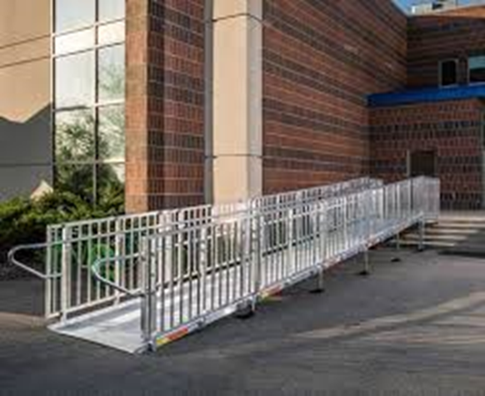
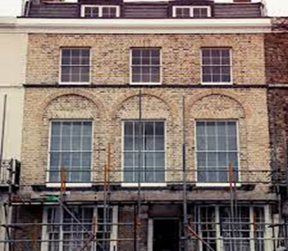
Public Facilities and Infrastructure Improvements
Infrastructure improvements (construction or installation) including, but not limited to streets, curbs, and water and sewer lines
Removal of Architectural Barriers
Items or obstructions that restrict the mobility and accessibility of elderly and/or people with disabilities

Slide 9

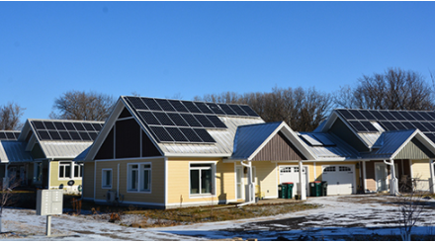
SSHP Focus – Public Housing Modernization
Notes:
Madison: What is a state sponsored housing portfolio project and why are why focusing on it?
Lilia: Well yes Madison, the DOH focus for this application round is SSHP projects. >>>>>
As mentioned earlier - this round of focus is the state sponsored housing portfolio and any other Public Housing Modernization project as well.

Slide 10
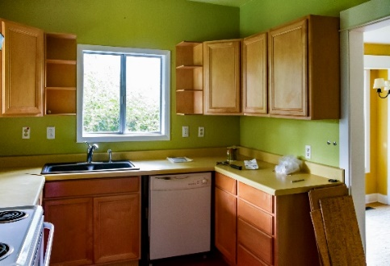
SSHP - PHASED PROJECTS
High dollar – Work with CHFA for extra Funding
**Submit ConApp *
CDBG Money goes first PHASED Indoor/Outdoor
Split the Units – only do some of them
Address certain issues (roof only, windows only,
generator only
Do community room only
LOTS OF SCENARIOS – BUT MAKE IT A COHESIVE PLAN
** NO NEW HOUSING CONSTRUCTION**
Notes:
Lilia: WILL GO OVER ABOVE
Madison: How does an organization apply for extra funding?
Lilia: Town would work will CHFA knowing the circumstance with an already existed relationship. money needs to be submitted money through the Con App

Slide 11

Ineligible Activities
Political Activities
If unsure ask!
Construction of New Housing
Buildings to Conduct General Government Business
Notes:
Madison: Lilia, can you remind the applicants what are the IN Eligible activities?

Slide 12
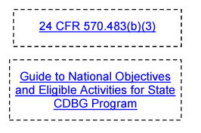
For a further breakdown on national objectives and all eligible activities, you can visit the DOH website and locate the CDBG Grants manual, the link will be available in Chapter 7 of the manual.
Notes:
Madison Wrap this up

