Slide 1
Multifamily Solutions
Technical assistance, programs and incentives for immediate solutions and long-term planning

Slide 2
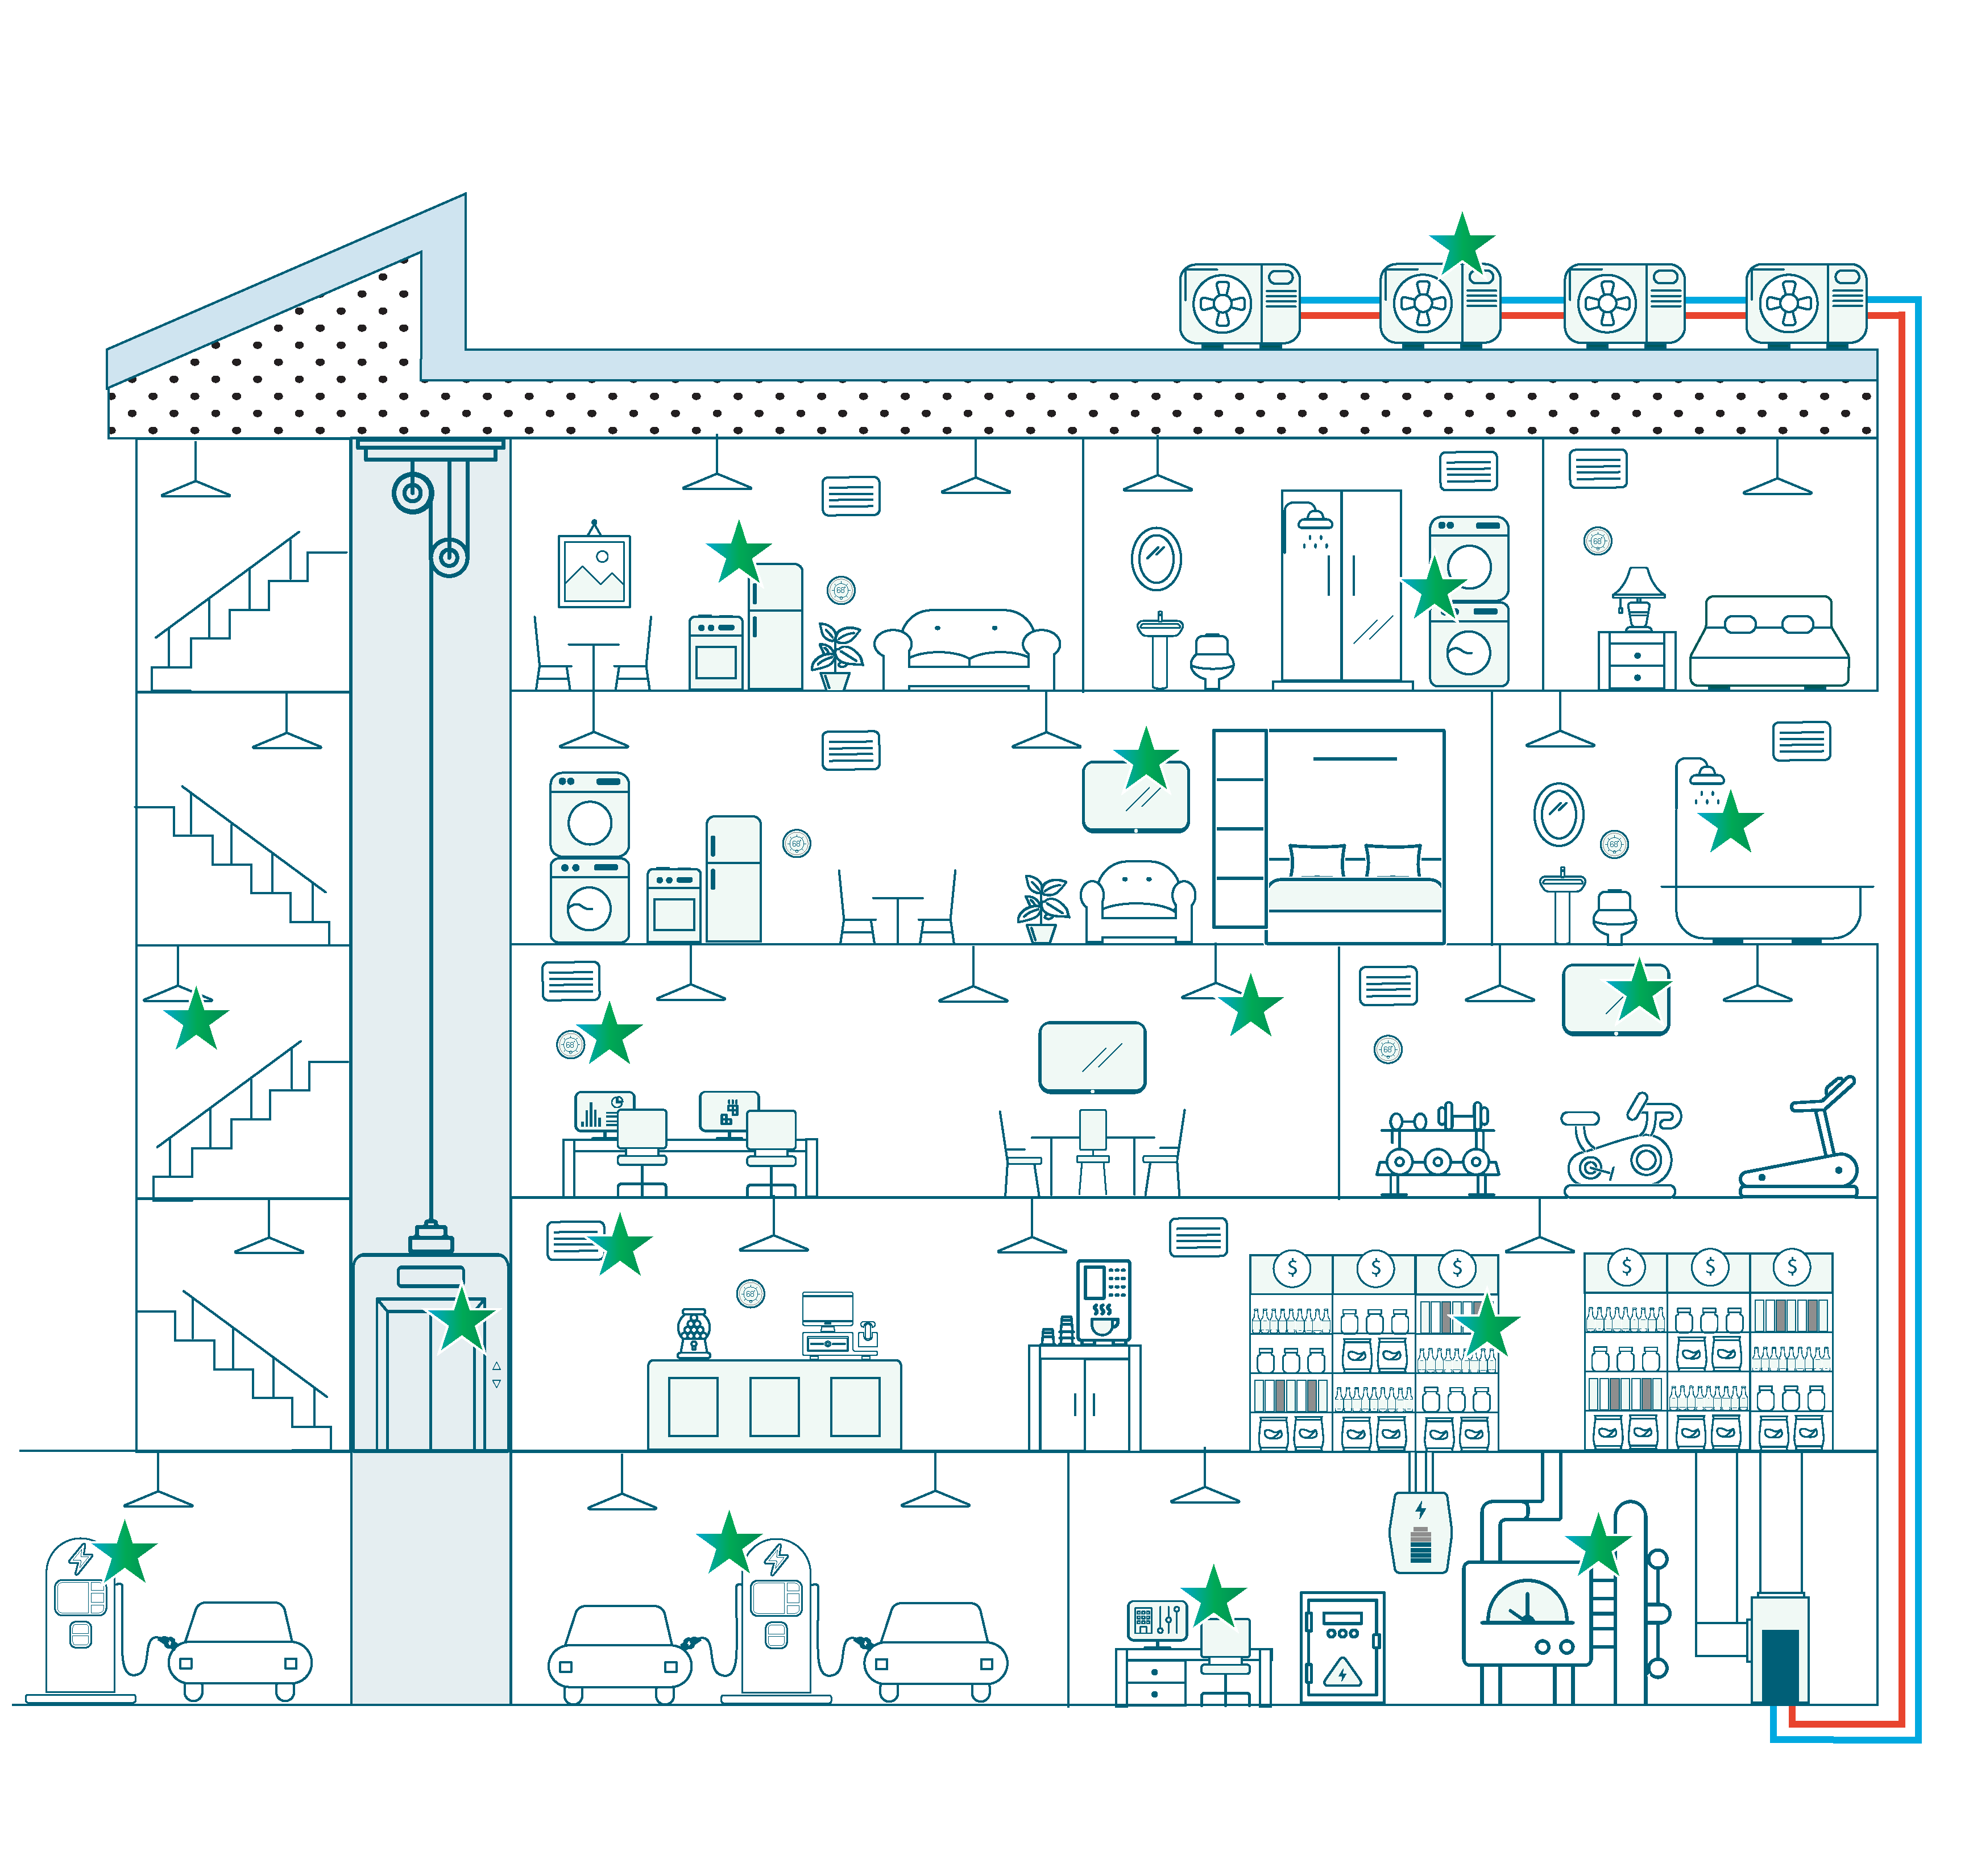
Investment Opportunity:
Properties of the Future

Slide 3
Incentive Caps
Comprehensive Projects | Single End Use | Direct Install Measures
Up to 65% of project cost | Up to 50% of measure cost | Up to 100% of installed cost
Up to 90% of project cost | Up to 75% of measure cost | Up to 100% of installed cost
Market Rate
Income Eligible

Slide 4
Funding Process
Project Initiation
Customer contacts Eversource
Project Review
Initial review of SOW
Eversource issues Letter of Participation to customer
Incentive Commitment
Notify Eversource of funding award
Construction
Completion
Project team submits final SOW
Eversource evaluates SOW and provides Letter of Agreement
Contractor(s) install measures
Notification of completion
Measurement & Verification
Communicate SOW changes
Incentive payment
Scope of work (SOW) submission to Eversource
Project team introduction

Slide 5
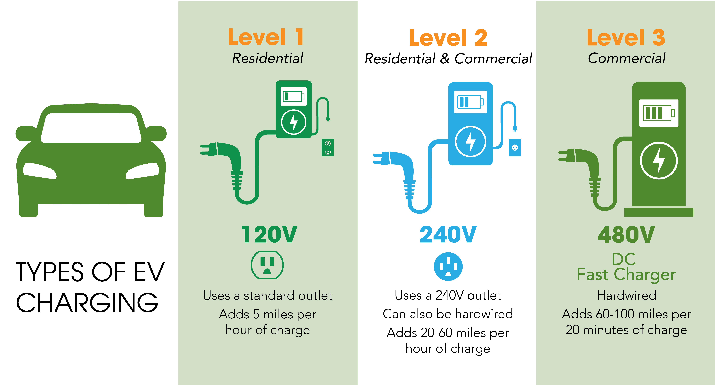
Types of EV Charging

Slide 6

Eligibility
Budget
The passing of Public Act 25-173 capped our program budget at $16M
2026 Application are now open
Eligible Costs
Rebate Capped At:
Chargers: up to 50%
Make-ready installation: up to 100%
Futureproofing costs: up to 100%
EV Charger
Qualified Vendor List (QVL)
Charger and Network Provider must be on list to qualify

Slide 7
Charging Incentive Levels
Location | EV Charger Type | Per Site Maximum Rebate Amounts | Property Type | Port Installation Requirements
Baseline | Level 2 | Up to $20,000 | Multifamily | 2
 |  |  | Public | 2
 |  |  | Workplace | 2
 | DCFC | Up to $150,000 | Public | 2
Underserved | Level 2 | Up to $40,000 | Multifamily | 2
 |  |  | Public | 2
 |  |  | Workplace | 2
 | DCFC | Up to $250,000 | Public | 2
Level 2:
Baseline: $20,000
Underserved: $40,000
DCFC:
Baseline: $150,000
Underserved: $250,000
Underserved Communities Map

Slide 8

Key Definitions
Multi-Unit Dwelling (MUD):
Site must have a minimum of five residential units. Multifamily located EV charging stations participating in the commercial EV Charging Program cannot be assigned to an individual tenant or deeded parking spaces. Individual tenant or deeded parking spaces can participate in the residential EV Charging Program
Program Guide page 6

Slide 9
What’s Covered
 | Covered by incentives |  | Paid for by the customer
 | Infrastructure | Electric vehicle supply equipment (EVSE) hardware | Other soft costs
Examples | Conduit & trenching Oversized panels Futureproofing Cost paid to Eversource or UI for new or upgraded electric service Pads Permitting, site design and engineering | Level 2 smart or DC fast charging stations | Signs Bollard Network fees Maintenance fees Charger warranty
Paid for by | Eversource and UI reimburse up to 100% | Eversource and UI reimburse up to 50% | Customer
 | Customer responsible for any remainder | Customer responsible for the remainder

Slide 10
Note: Rebates can be assigned to third party by applicant
EV Project process
2 – Submit application, sign Letter of Agreement & receive incentive reservation letter
1 – Plan a Project & Gather Proposals
3 – Install and activate your charger(s)
4 – Submit payment request & receive incentive check

Slide 11
Multifamily Initiative
Natalia Sudyka
multifamily@eversource.com
Natalia.Sudyka@eversouce.com
(877) 947-3873
(203) 352-5439
Connecticut EV Initiative
Jennifer Reilly
CTEVCharging@eversource.com​
Jennifer.Reilly@eversource.com
(203) 350-3555
(860) 665-5369

Slide 12
questions

