Slide 1


Solar MAP+
Affordable Multifamily Housing Program
June 2, 2026
2026 Small Cities CDGB Workshop

Slide 2



Mission & Vision
Connecticut Green Bank is the nation’s first state level green bank. Established in 2011 as a quasi-public agency, the Green Bank uses limited public dollars to attract private capital investment and offers green solutions that help people, businesses and all of Connecticut thrive.
Our mission is to confront climate change by increasing and accelerating investment into Connecticut’s green economy to create more resilient, healthier, and equitable communities.
Our vision
Notes:
BG

Slide 3

Solar MAP+ for Affordable Multifamily Housing​
Leverage the expertise of the Green Bank Team who has successfully developed over 60 solar and battery storage projects​ to date.
Benefit from no cost technical assistance and project development support that simplifies every step of the process​
Third party ownership structure allows for ease of adoption with zero investment required​
Benefit from immediate energy savings day 1​
Eliminates ongoing operations and maintenance responsibilities​
Ensure backup power in case of outages with integrated battery storage​
Competitive RFP process run by the Connecticut Green Bank for contractor selection.

Slide 4

Overview of CT’s
Affordable Multifamily Housing Program
Affordable multifamily properties will be allowed to access the Residential incentive program (RRES) ​
Residential Tariff is higher than the alternative commercial tariff​
  $0.3839/kWh (2026)
There is no cap on the number of Residential Tariff projects​

Slide 5
Financial Benefit Must Be Shared With Tenants
Housing with Tenant-paid utilities: Tenants receive portion of tariff via on-bill credits on their utility bill
  Requirement that a portion of the financial benefit be shared with the tenants of the facility = 20% of the tariff
Master metered sites: the net present value of 25% of the tariff must be set aside for an eligible upgrade to the facility.
Measures include:
  Immediate Measures
    Energy Efficiency Measures
    Energy Storage
    Energy Efficiency Barrier Remediation
    Operational Reserve (this is a measure of last resort)
    EV Charging Stations
    Green Spaces and Community Amenities
    Security Enhancements
    Balanced Ventilation Systems
  Ongoing Measures
    Broadband Internet Access
    Onsite Mental Health & Supportive Services
    Residential Service Coordinator
    Bill Credits on Electrical Bills Covered By Landlords

Slide 6
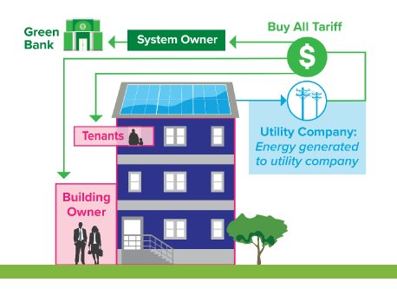
Multifamily Affordable Housing Solar Lease
No capital requirement from property owner​
Tenants receive credits on their electric bill from production (i.e., RRES)​
Green Bank owns and maintains asset, and bears risk​

Slide 7
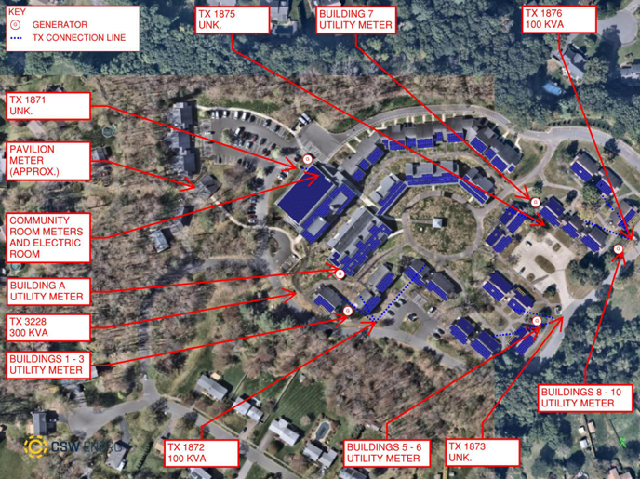
Sample Lease Modeling - 30% ITC Scenario
Sample Project
System Size (kW) | 1,073 kW DC
Year 1 Production (kWh) | 1,223,244 kWhs
ITC Assumption | 30% ITC
Cumulative Financial Benefit (Residents + Property Owner): $3,465,292 | Tenant $1,322,292 | Property Owner $2,143,000
Resident Share of Tariff | $1,322,292 (25% NPV of the tariff for eligible improvement)
Property Owner Share of Tariff | $113,714 (25.5% of the tariff)

Slide 8
Battery storage through Solar MAP+
Backup Power in Outages:
  Automatically islands from the grid to power critical loads.
No Emissions:
  Clean energy solution without pollutants.
Cost Savings:
  Can reduce electric bills for customers with demand charges
Works with Solar PV:
  Continues operation during outages if solar is available.
No Fuel Shortages:
  Stores energy directly, no reliance on fuel.
Service Continuity:
  Ensures reliable power for essential services.

Slide 9
Participating Sites
Round 1 – 8 Sites | Round 2 – 8 Sites | Round 3 – 7 Sites
Cheshire Housing Authority | Hamden Housing Authority | Glastonbury Housing Authority
Hamden Housing Authority | Glastonbury Housing Authority | Parish Court
Juniper Hill Village | Portland Housing Authority | Windsor Housing Authority
Simon Konover Group – Federation Square | Ferry Crossing | Windsor Locks Housing Authority
Access Housing – Parker Place | Enfield Housing Authority | Norwalk Housing Authority
 | Sarum Village | Oak Tree Village
 | St. Martins Townhouses
 | New Horizons Village

Slide 10
How can Solar MAP be paired with CDBG Funds?
Connecticut Green Bank Provides:​
No Cost technical assistance through the Solar MAP program​
Solar Lease, allows facilities to complete an energy related modernization project with zero capital outlay required​
CDBG Funds can be used to:​
Address barriers to completing a solar project which include:​
  Roof restoration or replacement prior to solar​
  Structural upgrades​
  Interconnection costs or electrical upgrades​
  Administrative burdens, such as legal expenses when contracting a project​
  ​
Alternatively, facilities may elect to submit for CDBG Funds to address other energy related upgrades to a facility (because there is an avenue to complete a solar project through solar MAP with zero capital outlay required). Projects may include: ​
Lighting Upgrades​
Energy Storage​
Insulation ​
Energy Efficient Windows or Doors

Slide 11
Timing Considerations
Preserve savings and economics by getting ahead of the accelerated phase out of the investment tax credit for solar in July 2026
2027 is the last year of the RRES program

Slide 12


Questions
Email us at info@ctgreenbank.com
Katie Shelton, Senior Manager, CT Green Bank
Katie.Shelton@ctgreenbank.com
860-785-9625
https://www.ctgreenbank.com​
​Link to schedule a meeting:​
https://calendly.com/d/5j7-3jf-vyj/intro-call-solar-map-affordable-multifamily-solar

Slide 13


Thank you for attending!

