Slide 1

Small Cities CDBG 2026
Virtual Application Workshop
Accessing Bonus Points to increase the scope of work

Slide 2
Bonus points-phased projects only
Phase I
Phase II
CDBG Funds- up to $2.5M
Energy Conservation improvements e.g. roofs, thermal envelope insulation/ siding, widows, doors, water heaters etc.
ADA upgrades to meet state 10% requirement
SSHiP Funds-Up to $5M- make property sustainable for 15-20 yrs.*
Community Room ADA improvements
Solar energy implementations
Notes:
If your application is for PHM, you’re in Luck. CT has been prioritizing this particular housing stock because the majority of them are in grave need of repair. Properties that fall under the SSHIP umbrella are in need of capital repairs….so guess what, you can get to the top of the line with Bonus Points
for straight CDBG, Phased, or even blended! You all can get bonus points

Slide 3

Bonus points-phased projects
Phase II
SSHiP Funds-Up to $5M Plus Town Match
the remaining items e.g., interior renovations/updates.
Generators, whole-campus refrigeration, heating, cooling w/ a min of 3 powered outlets
Life safety systems- e.g. call for Aid, Campus Security
Notes:
Taking a closer look…..with the phased approach

Slide 4


How
Town Match
Need and Impact
Capping at 151 points
Capacity
Capping at 172.5 points
Notes:
HOW??? Need Impact-go for the max bonus of up to 100 pts
Capacity go for the maximum bonus

Slide 5

Need & Impact

Slide 6

Get up to 100 Bonus pts
PHM-
Phased Projects
Section 1.1
1.1.1 A (earn 15 of those 100)
Or
1.1.1 B (earn 10 of those 100)
include some of the following in your 1000-word project description
View the distribution in the Rating & Ranking workbook
Notes:
1. CDBG/SSHP project demonstrating need with comprehensive plan noted clearly describing both Phase 1 and 2
1.1.1 A means that you are ready to submit both phases I & II with D&S at 90% on August 28
Option 2
1.1.1B means that you want to phase your project, clearly delineated, but you need a little extra time to cultivate the D&S to 90% by October 28.
In your narrative be sure to include the high ticket items In your SOW to earn those additional 85 points

Slide 7
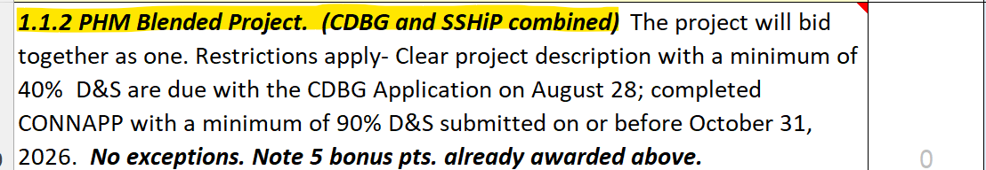
Get up to 90 Bonus pts
PHM-
Blended Projects
Section 1.1.2
include some of the following in your 1000-word project description
View the distribution in the Rating & Ranking workbook
Notes:
CDBG/SSHP project demonstrating need with a comprehensive plan that clearly describes what both major sources of funds will do together
1.1.2 Means that your team has decided to blend the funds (bid as one project) to meet the 40% 8/28/26 and 90% by 10/28/26 so you get 5 points and your responses to the remaining 12 or 13 questions would determine your total bonus for Need
3. Does the project include an update/increase in #of units to meet State 10% Type A units? *Type A begins at the parking lot ….
4. Does this project include Solar as an energy savings component for the entire campus e.g. the solar system selected should include (sub-metering), distribute cost savings to both Housing Authorities and residents?
5. Does the HA promote Sustainability and wellness: Raised garden beds, an opportunity for residents to grow food, pollinating gardens, composting, recycling etc.
6. How impactful is your HA? Does the Community Center offer adult learning of any kind e.g. classes, games, reading, programs to facilitate interactions with surrounding neighborhoods etc.

Slide 8
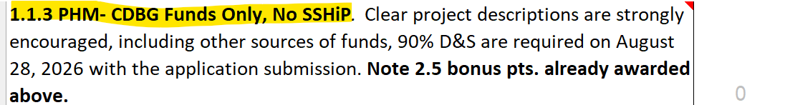
Get up to 87.5 Bonus pts
PHM-
CDBG Only No SSHiP
Section 1.1.3
include some of the following in your 1000-word project description
View the distribution in the Rating & Ranking workbook
Notes:
CDBG project demonstrating need with a comprehensive plan that clearly describes what the $2.5M funds will do
1.1.3 Means that your project is ready. The 90% D&S will be submitted by 8/28/2026. Can’t change your mind and go asking for SSHiP funds, so know your scope and know it well. Your SOW will mostly be covered with the base sum. Applicants are strongly encouraged to seek other sources of funds get the support of Town to waive the P&F, check out Eversource rebate program, maybe get DPW to kick in Dumpsters, paving, sidewalks etc,.. clean up (bid as one project) so you already got 2.5 points and your responses to the remaining 12 or 13 questions would determine your total bonus for Need
3. Does the project include an update/increase in #of units to meet State 10% Type A units? *Type A begins at the parking lot ….
4. Does this project include Solar as an energy savings component for the entire campus e.g. the solar system selected should include (sub-metering), distribute cost savings to both Housing Authorities and residents?
5. Does the HA promote Sustainability and wellness: Raised garden beds, an opportunity for residents to grow food, pollinating gardens, composting, recycling etc.
6. How impactful is your HA? Does the Community Center offer adult learning of any kind e.g. classes, games, reading, programs to facilitate interactions with surrounding neighborhoods etc.

Slide 9
Get 100 Bonus pts
Section 1.1
include some of the following in your 1000-word project description
View the distribution in the Rating & Ranking workbook
Notes:
1. CDBG/SSHP project demonstrating need with comprehensive plan noted clearly describing both Phase 1 and 2
2. Does this project include a whole campus generator(s) for all units? Refrigeration, heating and cooling, life safety systems with a minimum of three powered outlets per unit
3. Does the project include an update/increase in #of units to meet State 10% Type A units? *Type A begins at the parking lot ….
4. Does this project include Solar as an energy savings component for the entire campus e.g. the solar system selected should include (sub-metering) distributes cost savings to both Housing Authorities and residents?
5. Does the HA promote Sustainability and wellness: Raised garden beds, an opportunity for residents to grow food, pollinating gardens, composting, recycling etc.
6. How impactful is your HA? Does the Community Center offer adult learning of any kind e.g. classes, games, reading, programs to facilitate interactions with surrounding neighborhoods etc.

Slide 10

Capacity

Slide 11
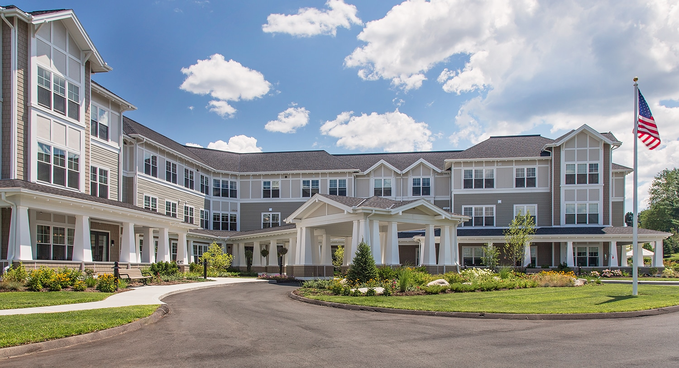
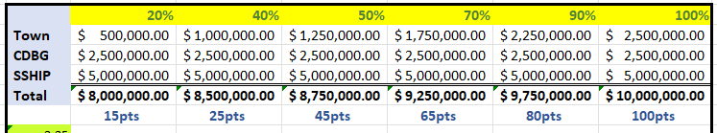
Town Match Funds-Get up to 100 Bonus points
Notes:
Nothing has changed here! Get your municipality to match CDBG funds.

Slide 12

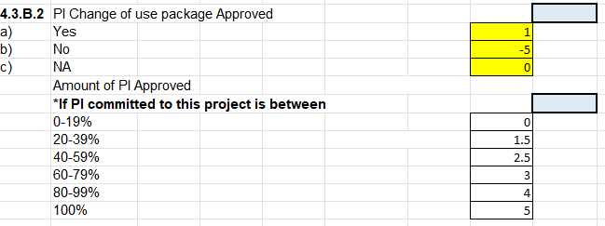
PI- Change of Use (approved and committed to this 2026 application)

Slide 13

Staff Capacity-Bonus Points
-15
+15
The members of the Applicant Team have experience with the CDBG program and have had excellent performance on open/closed grants (timely and accurate reporting, no citizen complaints, and effective and timely resolution with regards to any monitoring findings and/or concerns) in the last 5 years.
The members of the Applicant Team lack experience with the CDBG program OR are experienced but have had significant performance problems on open/closed grants untimely and inaccurate reporting, 4 or more citizen complaints, issues with complaint resolution, and repeated or prolonged monitoring findings and/or concerns in the last 5 years.
Notes:
Play your cards right. Stay compliant, trouble-free, and earn your 15 pts. Not so good can cost your application 15 pts….so those 15 extra points could easily go <<poof>> isn’t solid.

Slide 14

CGA Bonus-if you’ve followed along for the last 6 years
The members of the application administrative team are Certified Grant Administrators in good Standing. Teams must consist of municipal staff and consultants (both must be certified)- (3 pts.). One point for each additional member with a current CGA certificate in good standing (max of 3 additional points)
Notes:
Very straight forward

Slide 15
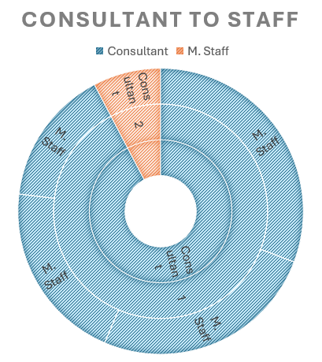
CGA-Bonus
One Consultant and 1 M. staff =3, (each additional certified staff 1pt up to 3 pts)
1 CGA Municipal staff w no Consultant =0; 1 consultant, 0 municipal CGA=-5; multiple Municipal staff with no consultant= 1.5

Slide 16
Bonus points for phase projects or even CDBG funds only.
August 28, 2026
For Phase projects, submit the CDBG (Phase I) application to DOH on August 28. In the project description Exhibit 1.1, fully describe both phases.
October 31, 2026
DOH will accept 40% D&S, but MUST complete the CONNAPP and submit to CHFA no later than Octoberber 31, 2026 with 90% D&S.
October 31, 2026
Failure to submit 90% D&S by October 31, automatically loose the bonus points earned and your application will be disqualified. Come back next year.
State of Connecticut - Department of Housing - Small Cities CDBG

Slide 17

CDBG Funds only -
CDBG Funds with no SSHiP
still encourage these including other sources but NO SSHIP funds (Town should plan on absorbing the permit and fees, PI conversion, Eversource, Sustainable CT, Green Bank). MUST be submitted by
August 28, 2026 with 90% D&S
State of Connecticut - Department of Housing - Small Cities CDBG
Notes:
Again this year, if you don’t complete this section accurately, your score will be negatively impacted.

Slide 18

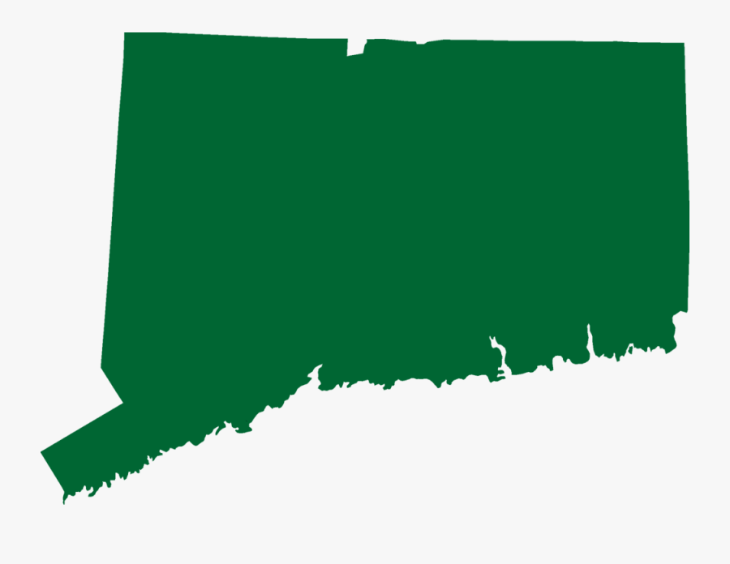
State of Connecticut - Department of Housing - Small Cities CDBG
Speaking of Sustainable CT opportunity- Eight Connecticut Communities Recognized for Sustainable CT Certification
Bloomfield, Branford, Clinton, Cromwell, and Westbrook earned Bronze Certificates
Preston, and Woodbridge earned Silver Certificates

Slide 19

Section 4
Project Feasibility & Merit
4.1 Budget Summary
4.2 Local leverage Funds
Tuesday, June 2, 2026
Notes:
4.2 local leverage. This is where we access your partnerships, your buying power and your level of firm/Conditional commitment at the time of application. We prefer to see firm commitments so put some skin in the game. Towns again this year are required to waive Permit & Fees
Our partners Eversource ,Sustainable CT and GreenBank this year will work again with applicants to prepare a firm commitment letter We are looking closely at your extra dollars in buying power.

Slide 20

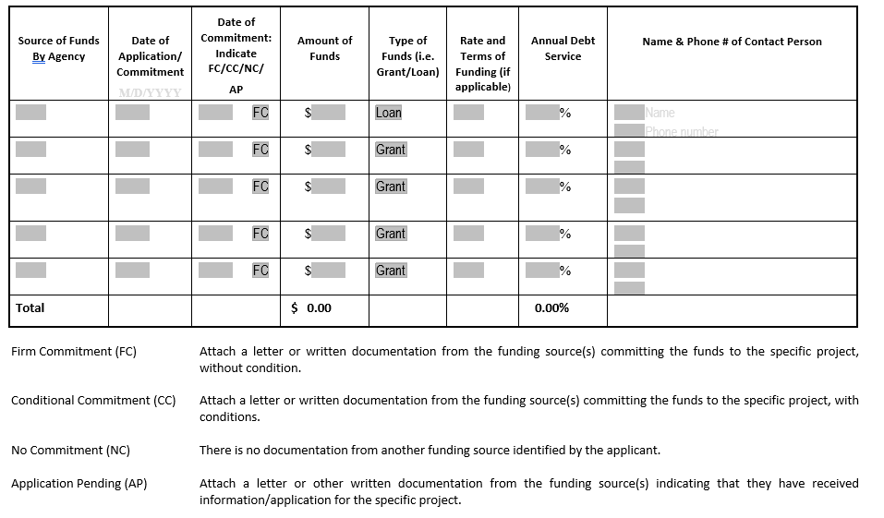
Section 4.2
Local Leverage/Other Sources
4.2 Local Leverage
List the sources of local match and leveraged funds. Amounts should be rounded to the nearest dollar.
Note. Sponsoring Municipalities are strongly encouraged to waive Permits and Fees applicable to this project (Firm Commitment).
Tuesday, June 2, 2026
State of Connecticut - Department of Housing - Small Cities CDBG

Slide 21

Tuesday, April 1, 2025

