Slide 1
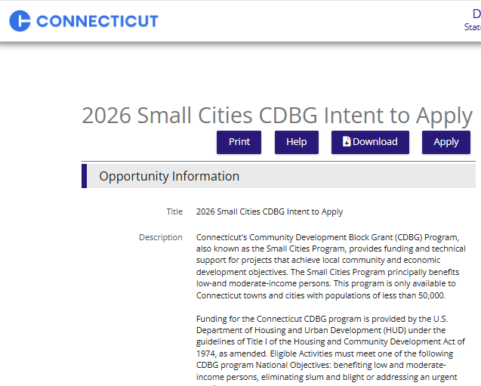
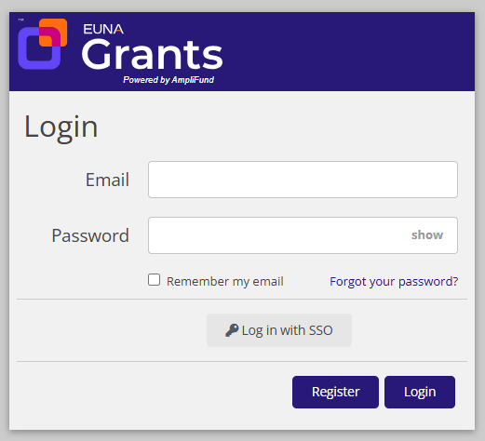
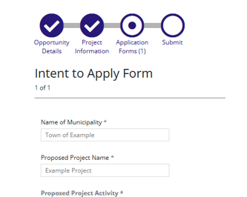
Register and Apply in the Euna Grants Portal
Photo and/or call out area
Photo and/or call out area
Click the Links to Access Intent to Apply and Full Application
Register in the Euna Grants Portal
Complete and Submit the Applications!
Review Funding Opportunity Information and Click ‘Apply’ to begin Registration/Log-In Process
Intent to Apply: Click HERE
Full Application: Click HERE
Applicants should only register ONCE for their Organization
Additional Users can be added into your Organization account
Complete all Forms and Sections of the Application. Required Fields marked with an *
All Application Forms and Sections must be ‘Marked as Complete’ to successfully Submit

Slide 2

Euna Grants Help and Support
Call the help desk:
(844) 407-3572
Submit a support ticket:
support@amplifund.zendesk.com or in product
Customer Support Hours:
8am – 8pm ET, Monday through Friday, excluding holidays
Phone is always available as a fully accessible alternative for applicants who cannot submit a written ticket

