Slide 1

2026 Small Cities Community Development Block Grant (CDBG)
Application Workshop
Program Overview
JUNE 2, 2026

Slide 2




2026 CDBG Funding
Funding Available for FY 2026-2027 approximately $11 million
The amount available to fund projects will be approximately $10.2 million
The above funding amounts will change based on the final HUD allocations

Slide 3
Application Requirements
Due Date: by August 28, 2026
Time: No Later than 11:59 pm
NEW Application is now web-based and will be completed via the EUNA Grants system
Link will be posted on ct.gov/DOH/SmallCities (more details to come later in the workshop)
Electronic submission will be made available after the Intent to Apply
DOH WILL NOT accept applications or additional information after August 28 at 11:59 pm
Notes:
The State of Connecticut has entered into a contract with the EUNA grants management system. We are pleased to announce that the Small Cities 2026 application will now be web‑based. Applicants will be able to access the 2026 application via CT.GOV/DOH/SmallCities. Additional details will be provided later today during a presentation from the EUNA grants team.

Slide 4
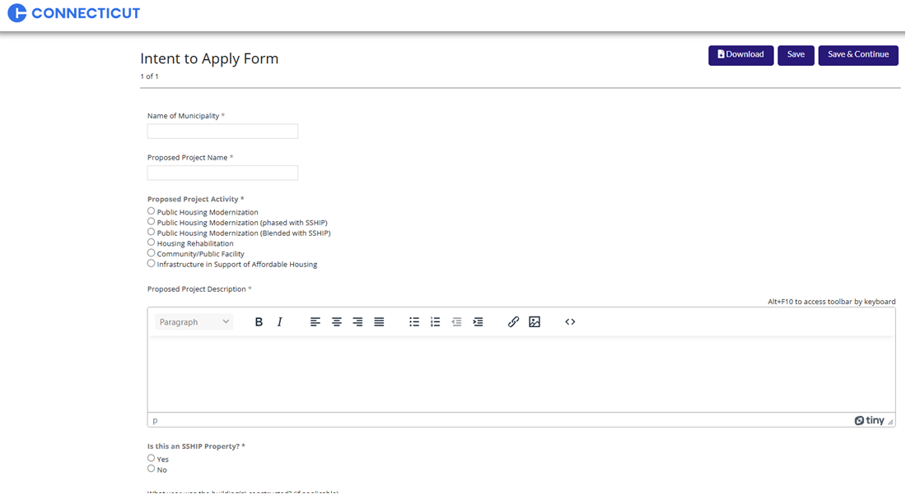
Intent to Apply
Web-based Intent to Apply Form. Please fill out and submit by Tuesday, July 7, 2026
Basic information required is the proposed project, project amount, and whether or not you have or plan to hire a consultant
Access form via link on the DOH Small Cities webpage

Slide 5
The Connecticut Housing Finance Authority (CHFA) in conjunction with the Connecticut Dept. of Housing (DOH) encourages municipalities and housing authorities to partner to address the needs of our
State-Sponsored Housing Portfolio

Slide 6
Spending Thresholds
2025 Grants – Blanket Program Waiver
2024 Grants – Blanket Program Waiver
2023 and older Grants – 100% expended and have a Pre-Closeout Certificate and Final Semi-Annual Progress Report by June 30, 2026
If you intend to apply for 2026 and a prior grant was identified for Express Closeout and you have not complied or your submission is incomplete after June 30, 2026, your application will not be scored
No more than 2 open grants allowed per applicant; closeouts?
Open and unresolved findings and concerns will impact the rating and ranking
Grantee will not be awarded funds if had a grant “terminated for cause” in the last 5 years

Slide 7
Program Guidelines & Requirements 1 of 3
Administration costs are restricted up to 8% of the grant or $33,000, whichever is lower
$3,000 maximum for Application development and $3,000 maximum for ERR development (admin. cost)
Program costs are restricted to up to 12% of grant funds for all activities except Public Service activities
Draws for non-hard costs should be kept to within a few percentage points of hard costs, cumulatively
Program Income (PI) threshold: Under CT CDBG program, any revenue generated from revolving loan funds is considered PI, regardless of the amount.
If no active PI Reuse Plan, you will be asked to utilize PI first for the project

Slide 8
Program Guidelines & Requirements 2 of 3
Program Income – up to 8% limit on admin costs, up to 12% limit on program costs per the amount of PI allocated toward a specific activity.
No more than $35,000 PI on hand (PI upcoming changes!!!)
Section 3 Final Rule – 24 CFR Part 75
Build America, Buy America (BABA) Act
  But what about tariffs?!
Notes:
New Section 3 Final Rule:
24 Part 75
$200K applicability threshold of total HUD assistance
Report on labor hours rather than new hires
Targeted Sec. 3 worker lives in neighborhood or service area of project (within 1 mile of project)
Transition period ends July 1, 2021 (have to update material by then)
Any contracts (even construction) signed after Nov. 30, 2020 are subject to 24 Part 75.
The Build America, Buy America Act (the Act), enacted as part of the Infrastructure Investment and Jobs Act on November 15, 2021, established a domestic content procurement preference for all Federal financial assistance obligated for infrastructure projects after May 14, 2022. The domestic content procurement preference requires that all iron, steel, manufactured products, and construction materials used in covered infrastructure projects are produced in the United States.

Slide 9
Program Guidelines & Requirements
3 of 3
Cash Management Methods
  Reimbursement Method
  To save time, Towns are strongly encouraged to pay invoices with local funds and get reimbursed with SC funds later
  Project Expenditures Account
The waiver of permits and fees as “leveraged” funds is strongly encouraged and will result in bonus points
Notes:
The waiver request must, at the very least, address the following items:
1. Source of funding: grant dollars (and grant year) or program income.
2. A reason as to why the Town would like to move forward with the case,
3. The proposed scope of work and itemized cost estimate of the work,
4. Identify the proposed scope of work as Life Threatening or Non-Life Threatening,
5. If the household(s) are receiving income and if bank statements have been checked to determine
that the homeowner cannot pay for some of the improvements to bring the LTV down,
6. If relocation will be necessary; and if so, how it will be handled,
7. Any upgrades or maintenance work done to the property in question in the last 10 years,
8. Any open home equity lines of credit, and
9. Any other information that the grantee deems will help the waiver request.

Slide 10
Reminders
If you plan to do a survey, you must get permission from DOH prior to doing the survey. All requests for approval must be submitted to DOH by June 16. Late submissions may be reviewed at the discretion of DOH
Survey Methodology Handbook that outlines the survey requirements is posted on the Web site in a booklet format for your review
Independent surveyor must conduct the surveys
The Certification dated July 31, 2026 will be used to determine your program income amounts. This amount is compared to the info in the application

Slide 11
Reminders (Cont.)
Threshold criteria must be met before the application is submitted:
Fair Housing Action Plan and Section 3 Plan, if applicable, MUST be submitted as part of the application
If you anticipate relocation, please submit a relocation plan for review
All payment requests must be at DOH for processing no later than July 31, 2026 to meet the spending threshold requirement.
Budget Extensions – Must demonstrate a need to extend the budget beyond the initial 2-year deadline. Extensions will not be granted without adequate reasons.
Request must be prior to the final quarter of the performance period.
The Town and/or its grant consultant and the subrecipient, if applicable, must attend the Certified Grant Administrator training and obtain certification if it intends to apply for a grant (more on that later)

Slide 12
Submittals
NEW CEPA Intake Form will now need to be submitted along with the application
Environmental Review Record
  Exempt
  Categorically Excluded Not Subject to Part 58.5
  Broad-level (Tier I) Review
But WHAT about CEST or EA?

Slide 13
Additional Information
https://portal.ct.gov/DOH/DOH/Programs/Small-Cities-Program
Application 2026
Handbook
Financing Plan & Budget
Application Exhibits Checklist
Application Exhibits
Cost Estimate Budget Forms
Survey Methodology
Environmental Review Guide

Slide 14
More to come ….
Training Opportunities
  2026 Certified Grant Administrator (CGA) Training and Recertification classes
    CDBG 101 (Part 1) – Sept. 15-18
    CDBG 102 (Part 2) – Sept. 29 - Oct. 1
Programmatic Bulletins

Slide 15

Good bye

