Slide 1
Radon Overview
Environmental Health & Drinking Water Branch
Environmental Health Section
Amanda Parkins, Epidemiologist
March 28, 2023

Slide 2
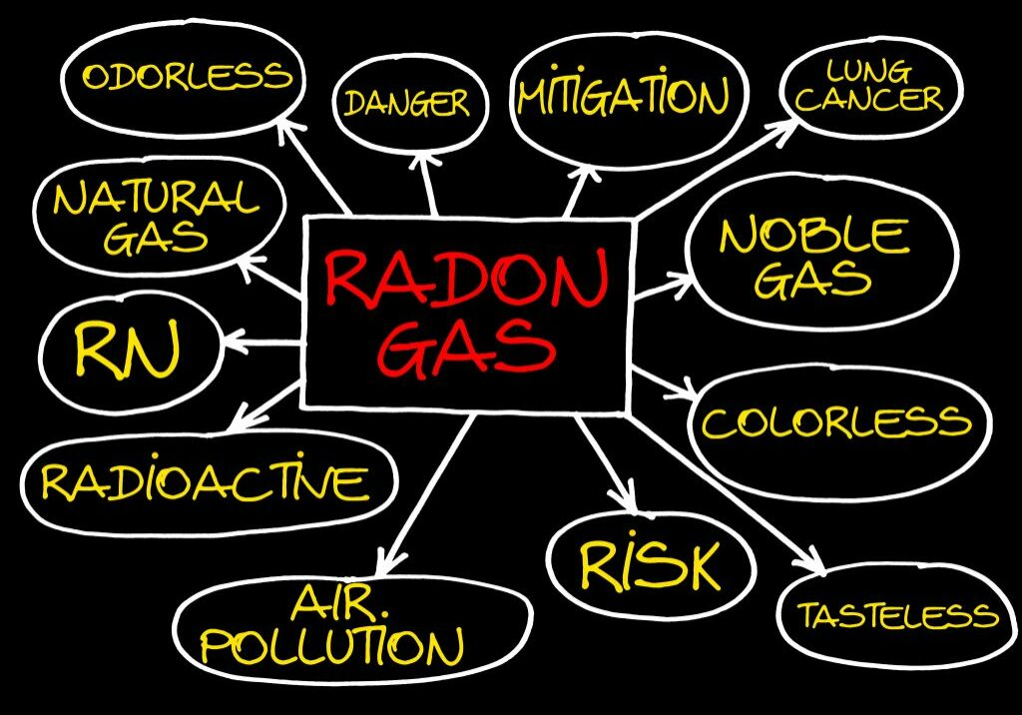
Overview
What is radon?
How does it enter a home?
What are the health effects?
Radon Measurement & Mitigation Basics
Notes:
Over the next several slides we will cover…

Slide 3
What is Radon?
Radon is a naturally-occurring, radioactive gas.
Radon is colorless, odorless, and tasteless.
Found all over the U.S. in all types of buildings:
Old and New
Drafty and Well-Sealed
With and Without Basements
Notes:
Radon is a naturally occurring, radioactive gas.
Radon cannot be detected by our senses. You can’t see, smell, or taste radon.
And it is found…
Radon is one of the nation’s most important environmental threats – one that places people at risk in their own homes. Radon is the leading environmental cause of cancer; the leading cause of lung cancer in non-smokers, and the second leading cause of lung cancer overall, after smoking.

Slide 4
Uranium Decay Chart
Radon
Radium
Uranium
Notes:
Radon gas is formed by the natural decay of radium which is a decay product of uranium. Both radium and uranium are very common, solid elements present in soil and rock. Radon itself is not dangerous, but as it decays, the gas produces radiation in the form of microscopic particles that can cling to house dust or other airborne particles. Outdoor radon is diluted quickly and poses little threat, but when it migrates into a building and accumulates, it can become a health hazard.

Slide 5
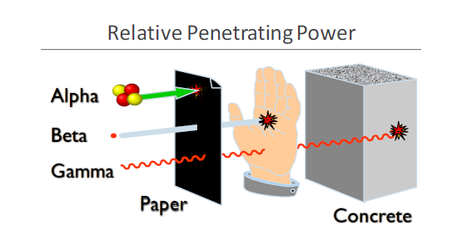
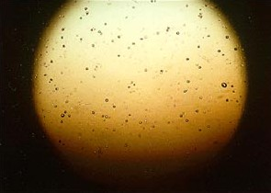
Radiation Types
Image Source: http://www.ilradon.com/what-is-radon/
Image Source: https://aaaradontesting.com/where-does-radon-gas-come-from/
Notes:
During radon decay, gamma and alpha radiation result. Gamma is not the greatest concern in this scenario but rather the slow moving, bulky, alpha particles which pack quite a punch to sensitive lung tissue. Alpha particles can’t pass through your skin, but can be inhaled and affect the bronchial cells in the upper airway of the lungs.
Bearing in mind that one picocurie per liter of radon creates a total of 6.66 alpha particles each minute…and to assist with the visualization of the damage radon decay can cause, I’ve included the image on the right which is from an alpha track detector (a radon measurement device). The spots you see are pits created by the alpha particles as they contact the plastic chip. Now, if they can do that kind of damage to a rigid plastic chip, imagine what happens to sensitive lung tissue…

Slide 6
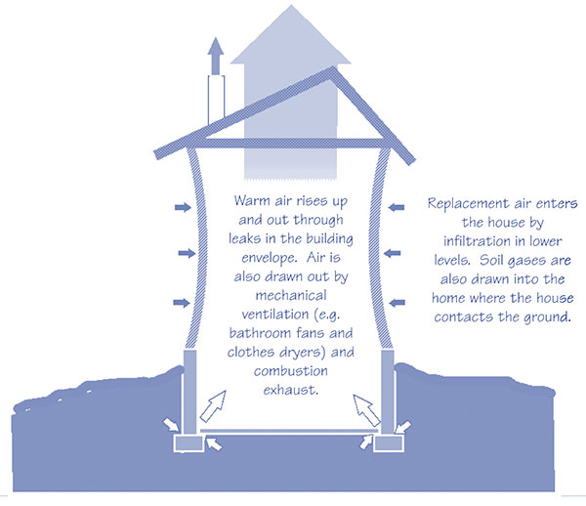
How Radon Enters a Home
Notes:
As warm air rises it creates the need for makeup air, wherein soil gases are drawn into the home. In this way, a home acts like a vacuum via what’s referred to as the stack effect. The driving force is from negative pressure.

Slide 7
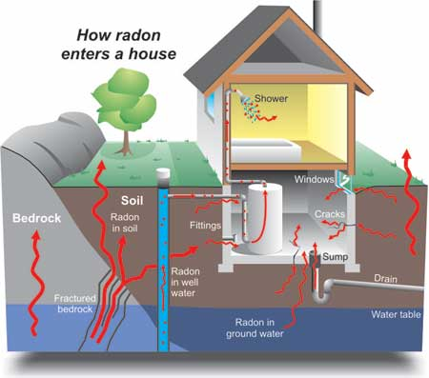
Cracks in solid floors
Construction joints
Cracks in walls
Gaps in suspended floors
Gaps around service pipes
Cavities inside walls
The water supply
Notes:
Routes for entry include:

Slide 8
Health Effects of Radon Exposure
Prolonged exposure to elevated radon levels increases a person’s risk of developing LUNG CANCER.
There are NO immediate health effects from exposure and radon gas itself does not cause any symptoms.
The radiation created by the natural decay process damages lung cells and DNA.
Image Source: https://www.bfs.de/EN/topics/ion/environment/radon/effects/effects_node.html

Slide 9
Action Level for Radon in Air
The Environmental Protection Agency’s (EPA) established action level for radon in air is:​
4.0 pCi/L*​
*This is NOT a health-based value.​
​
The World Health Organization (WHO) has a more conservative action level of 2.7 pCi/L​
​
There is NO SAFE level of radon!​
​
At levels of 4.0 pCi/L or higher, the EPA recommends measures be taken to effectively reduce radon levels thereby decreasing the risk of developing lung cancer.

Slide 10
Testing is the ONLY Way to Know
1.3 pCi/L
8.1 pCi/L
Notes:
Because radon originates from rock and soil and geologic formations are not uniform, and due to all the variables in house construction and occupancy patterns, one home can have elevated levels, while the house next door does not.
Note: it is not practical nor feasible to test the soil before constructing a home to predict what the radon level might be.

Slide 11
Radon Measurement
DPH recommends using a Nationally Certified Measurement Provider to test for radon
For a single building (single or multi-family), DPH recommends testing the lowest occupied space
A short-term testing device is placed for a minimum of 48 hours up to 7 days, depending on the device used

Slide 12
Radon Mitigation
DPH recommends using a Nationally Certified Mitigation Professional to perform radon mitigation
Must be nationally certified through NRSB or NRPP
Must be a home improvement contractor registered with CT’s Department of Consumer Protection (DCP)

Slide 13
Radon Mitigation
Radon mitigation systems are:
effective
relatively inexpensive
easy to install
Average Cost = $1,500

Slide 14
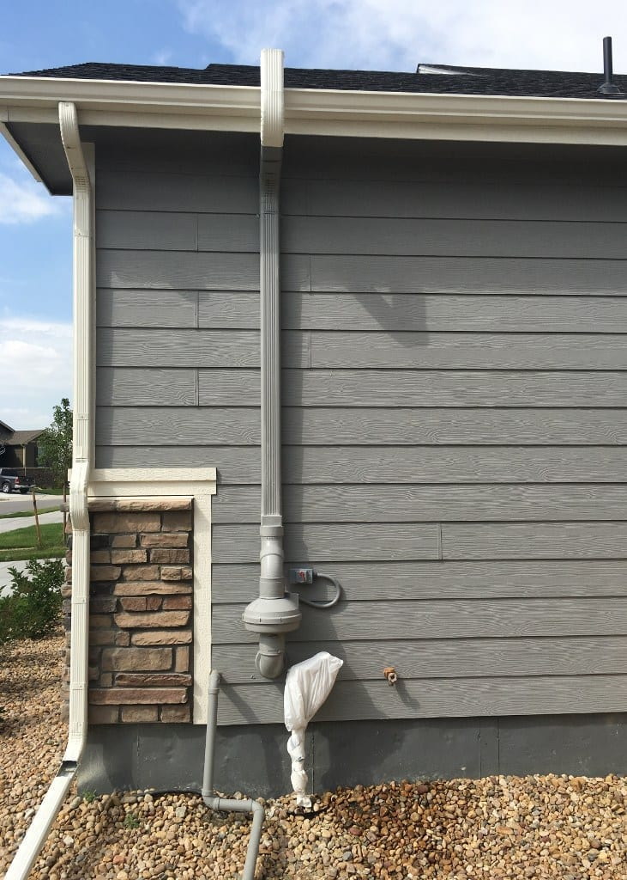
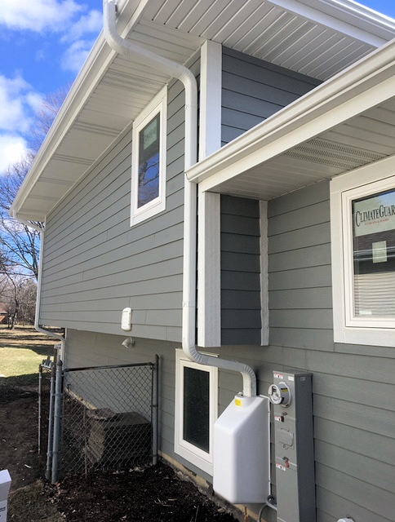
Sub-Slab Depressurization (SSD) System
Image Source: https://vim-1.itrcweb.org/sub-slab-depressurization-ssd-tech-sheet/
Notes:
A SSD is the most common type of system installed. The center image provides a diagram of such a system, where a small pit is excavated beneath the foundation, then piping is installed and run to the exterior of the home where a fan is mounted with an exhaust pipe above.
The image on the left shows how a system can be customized to the home via color-match painting. And the image on the right shows a fan cover box, which can make the system more visually appealing and less obvious.

Slide 15
Sub-Slab Depressurization (SSD) System
Image Source: https://radongas.com/troubleshooting-your-system/
Notes:
Even after a mitigation system is installed periodic testing for radon in air is recommended (EPA suggests every 2 years). The systems are easy to visually monitor with a manometer (pictured here).

Slide 16
Notes:
At this time I would like to open up the discussion for any questions.

Slide 17
Contact Information
Amanda Parkins
Epidemiologist 2
State of Connecticut
Department of Public Health
(860) 509-7370
amanda.parkins@ct.gov
Notes:
If you would like to discuss radon further, my contact information is provide here.

