Slide 1
Lead Overview
Kimberly Ploszaj, Supervising Environmental Analyst
Environmental Health and Drinking Water Branch
March 15, 2022

Slide 2
Does this look lead safe?
Let’s take a look…

Slide 3
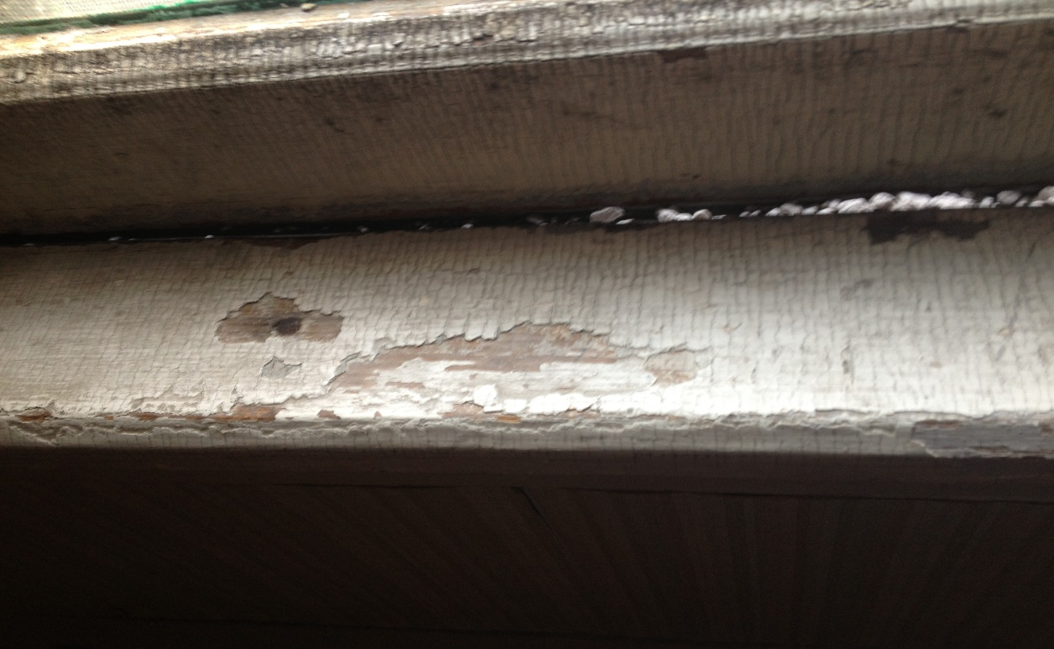
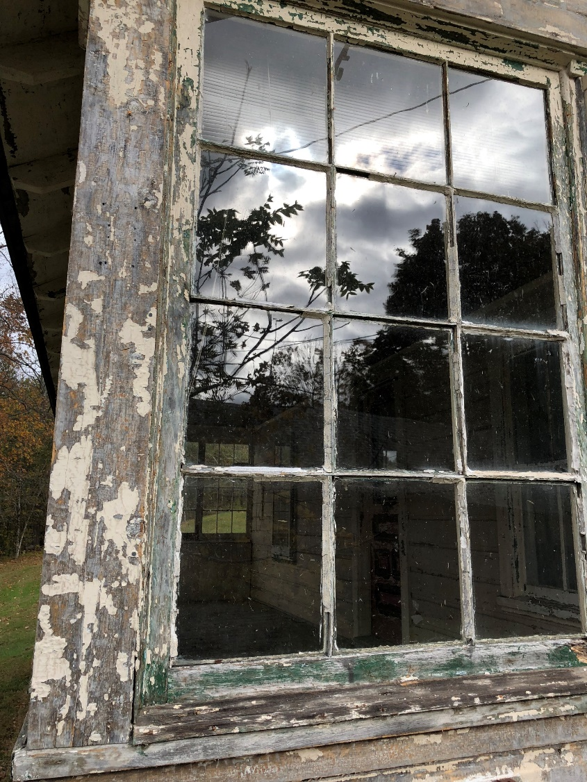
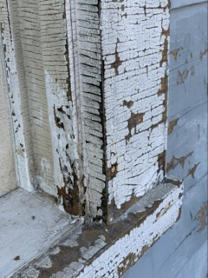

Slide 4
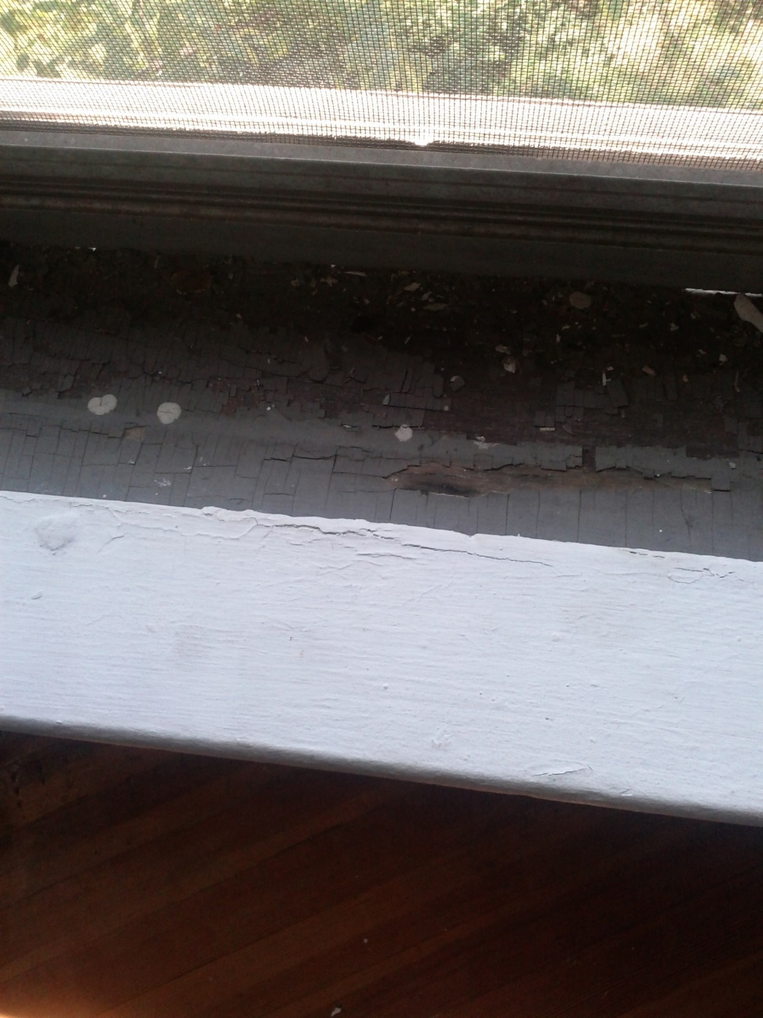
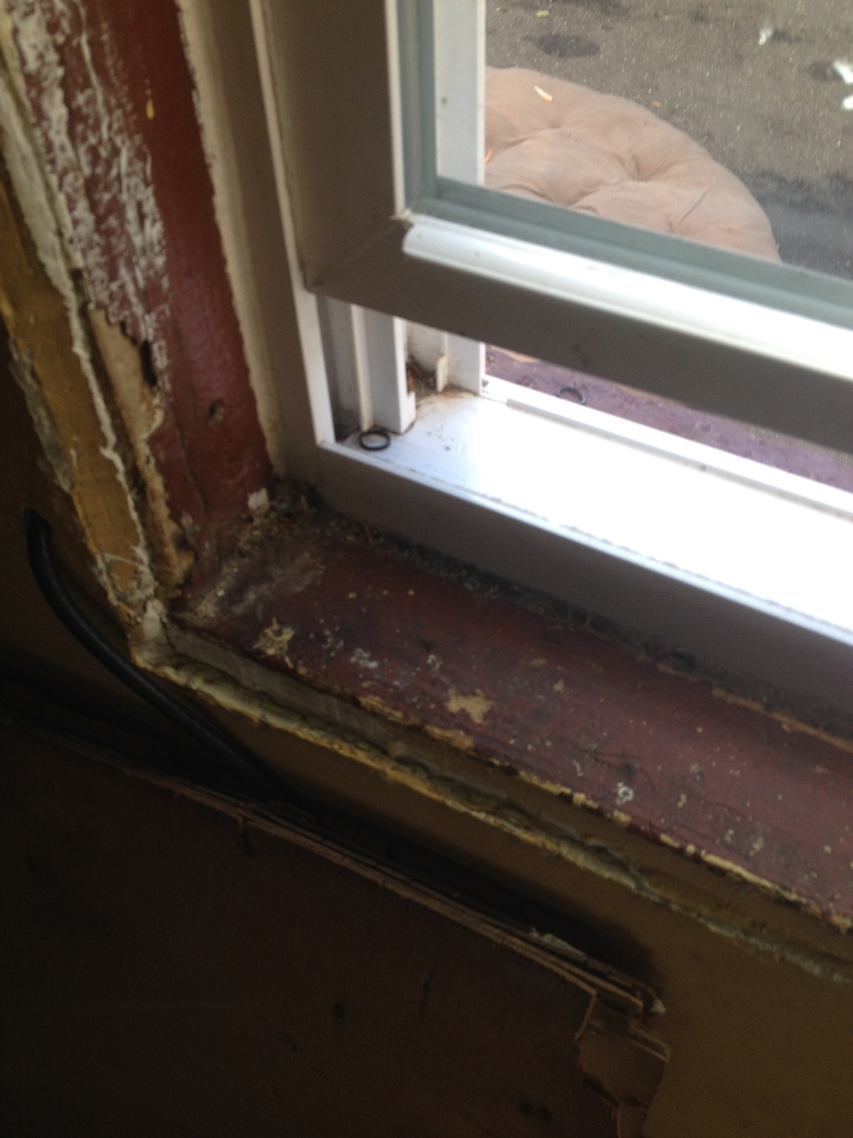

Slide 5
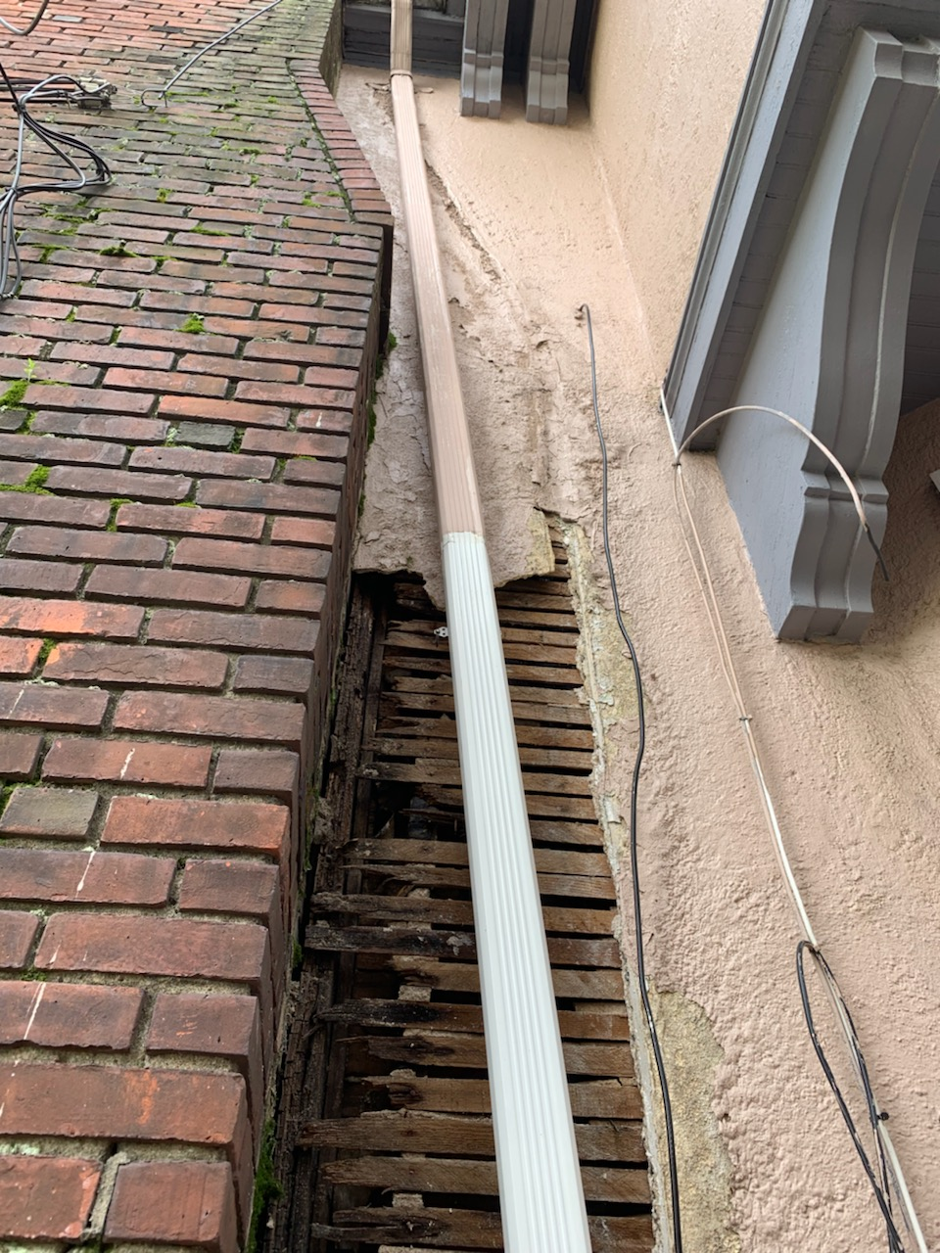
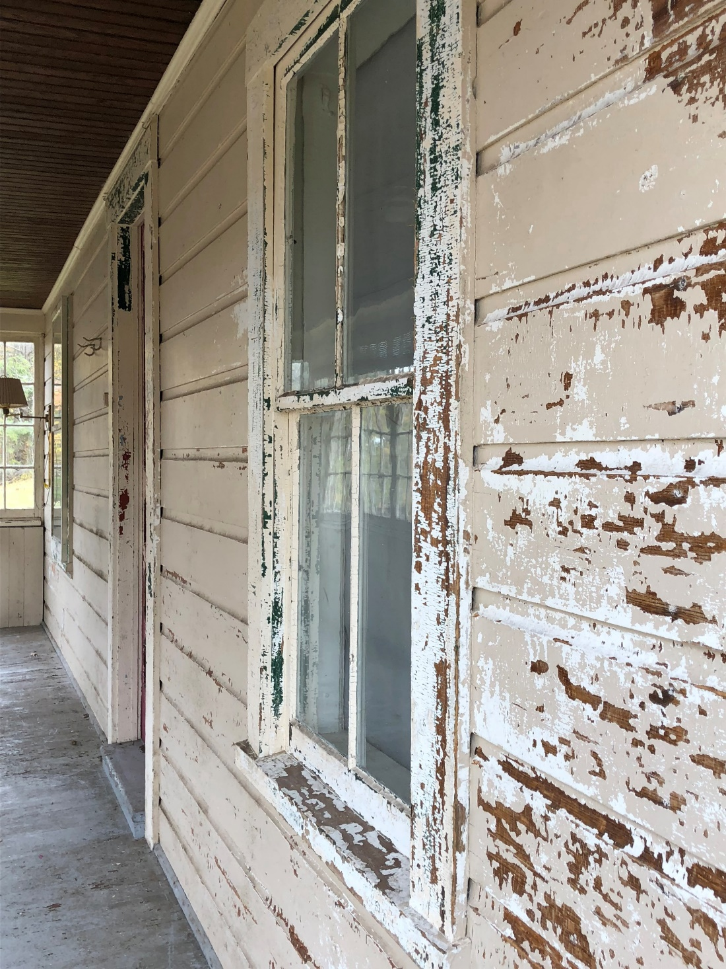

Slide 6
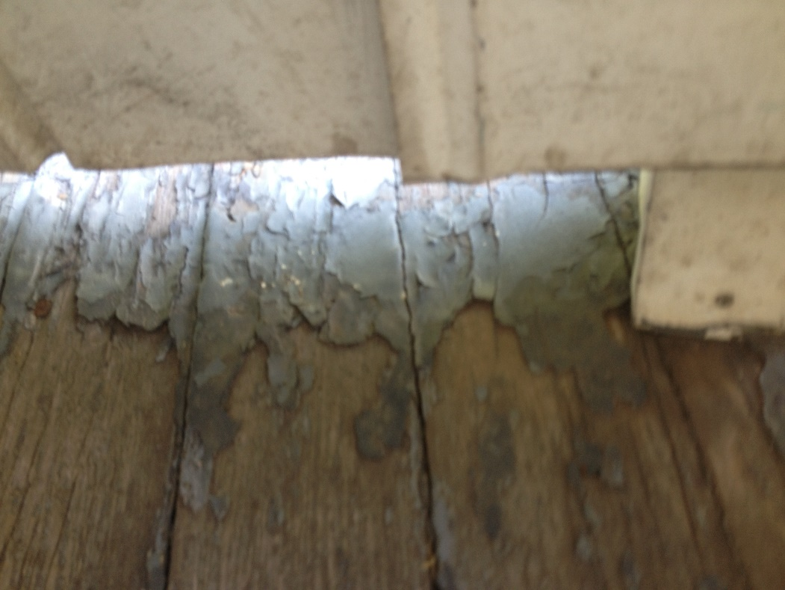
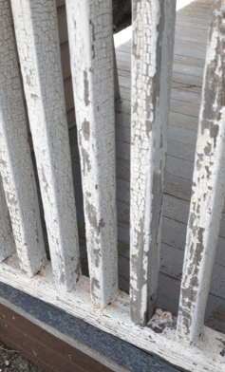
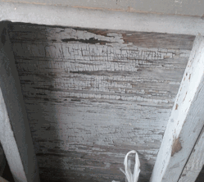

Slide 7
EPA Dust Wipe Updates

Slide 8
What’s New
EPA has changed the requirements for dust level hazard standards – adopted 1/6/22
EPA will be changing the requirements for dust level clearance standards – will adopt 3/8/23

Slide 9
What’s New
DPH is required to adopt the EPA standards (or more strict)
DPH is in the process of updating our regulations
This process takes about a year
DPH is targeting 9/1/23 for full adoption of both standards

Slide 10
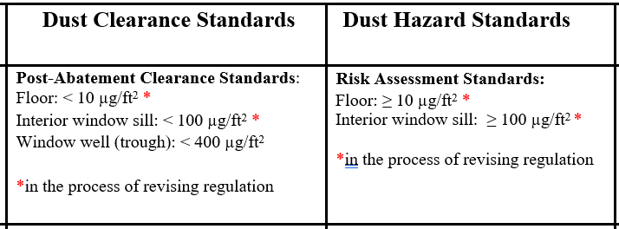
New Dust Levels

Slide 11
CDBG Small Cities Funding Chart

Slide 13
Scenario 1:
A project costs $17,500
There are three (3) children ages 11, 8 and 7 in residence
The property has not been tested for lead paint
Many areas at the property have defective paint
What are your next steps?

Slide 14
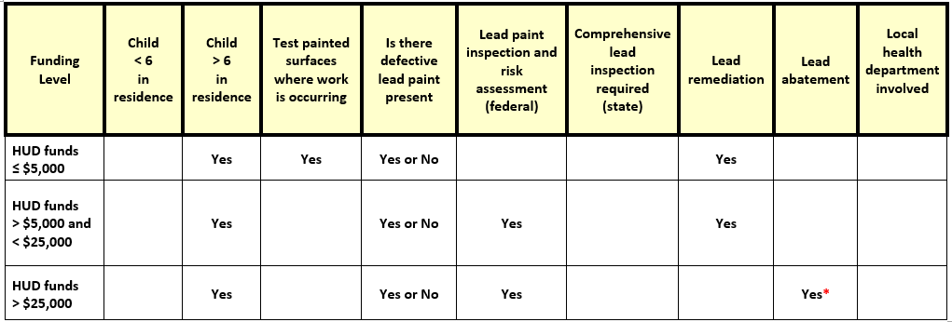
Child > 6 in residence

Slide 15
Answer:
Presence of defective paint
Testing of the painted surfaces for lead is required
All defective surfaces shall be remediated by a certified EPA RRP firm
The RRP firm shall employ workers/supervisors who have completed a HUD-approved lead-safe work practice course
A lead remediation plan shall be developed
At the completion of the job, a DPH-licensed lead consultant contractor must complete clearance dust wipes

Slide 16
Protect Your Family
EPA Renovate Right

Slide 17
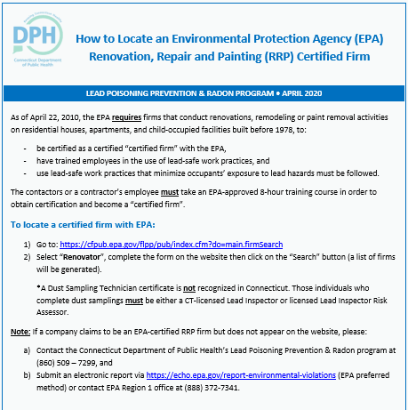

Slide 18
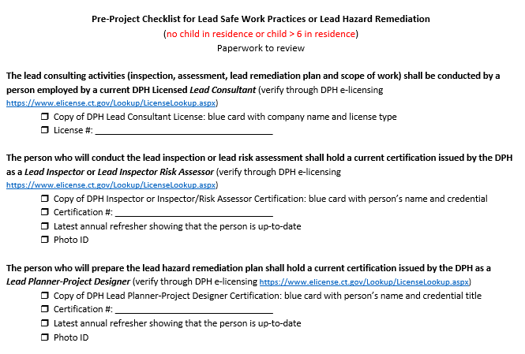

Slide 19
Scenario 2:
A project costs $33,000
There are two (2) children ages 5 and 2 in residence
The defective paint has been tested for lead and is positive
What are your next steps?

Slide 21
Answer:
A child < 6 years of age resides at the property and there is defective lead paint = a comprehensive lead inspection is required
The comprehensive lead inspection will identify all lead hazards in paint, dust, water and soil
All lead hazards shall be abated
All intact leaded surfaces shall be places on a management plan
A lead abatement plan or a lead management plan shall be developed by a licensed lead consultant contractor

Slide 22
Answer:
A lead abatement plan shall be approved by the local health department BEFORE any work can begin
All abatement work shall be performed by a DPH-licensed lead abatement contractor that employs certified supervisors and workers
At the completion of the job, a DPH-licensed lead consultant shall complete clearance dust wipes

Slide 23
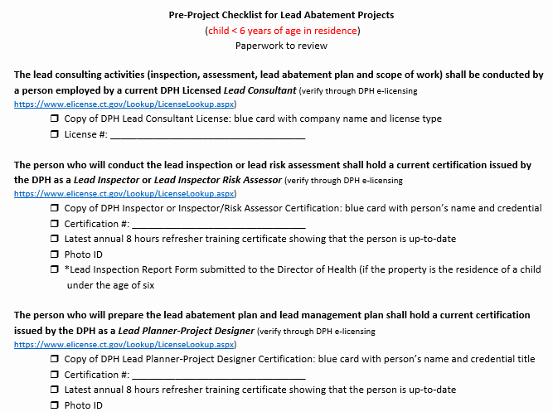

Slide 24
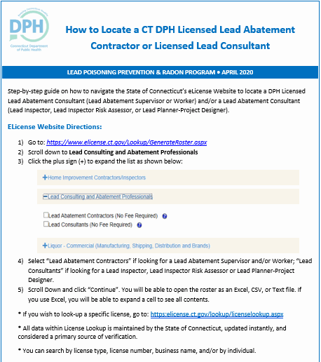

Slide 25
Challenges
Programs not…..
using the pre-checklists
knowing the differences between lead remediation and lead abatement
involving licensed lead practitioners and the local health department when lead abatement is required
seeking approval for work order changes, for lead abatement projects, from the local health department
ensuring clearance dust wipes are required at the end of lead remediation and abatement work

Slide 26
When in doubt…
CALL DPH
DPH has authority to take action for any lead abatement violations
EPA has authority to take action for any lead remediation violations

Slide 27
Questions?

